Slide 1
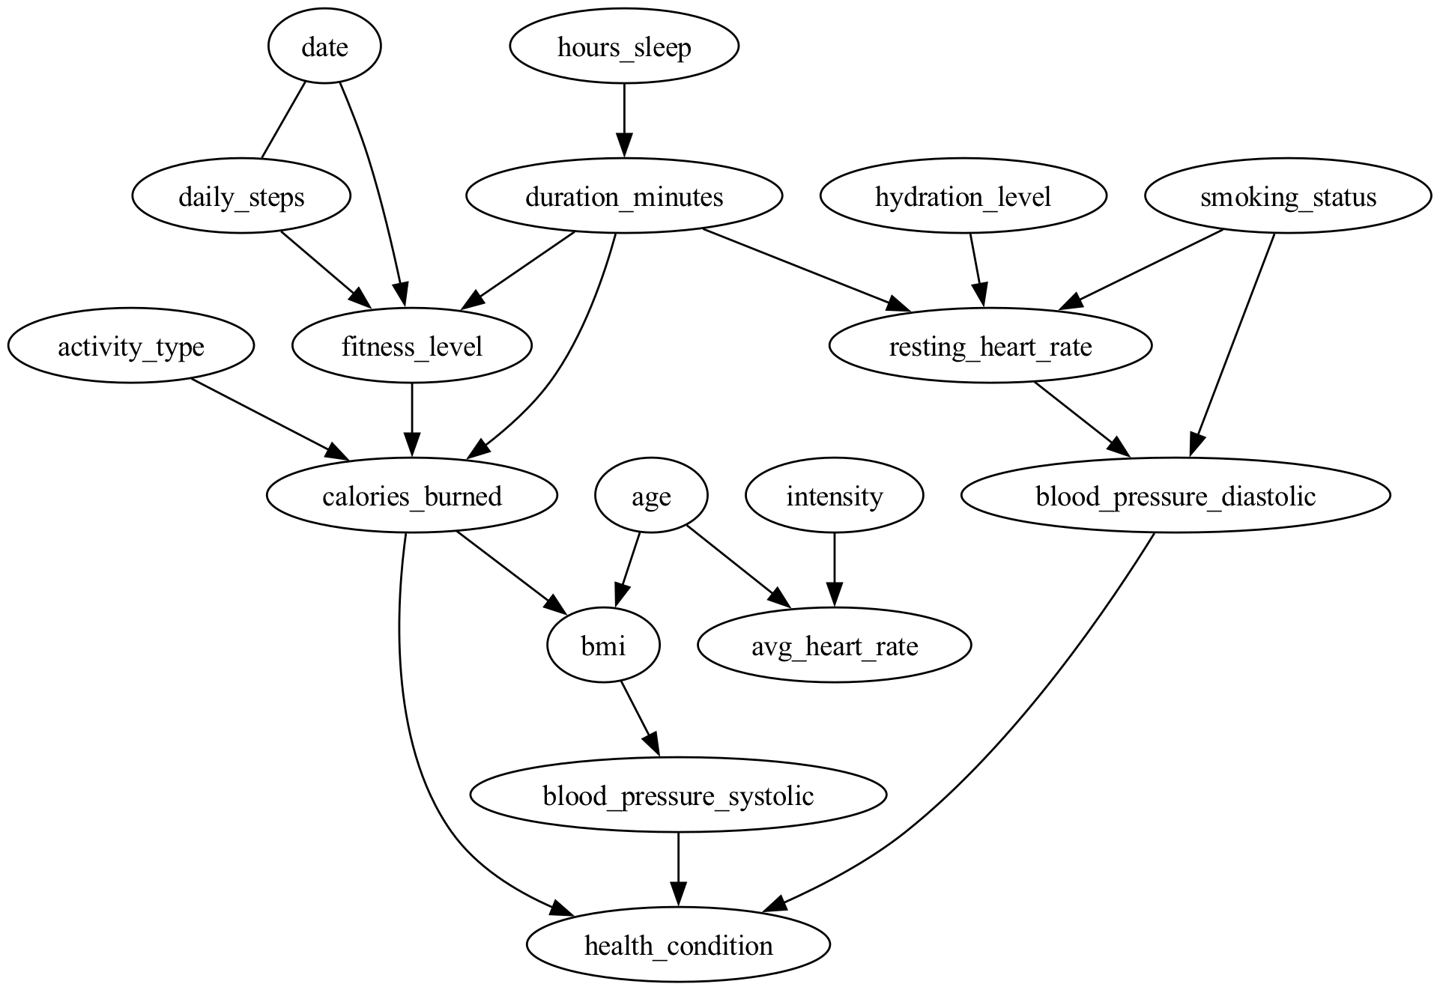

Slide 2

Name (p_id): (30)
Sex: Female
Age: 50
BMI: 21.2
Resting Heart Rate: 73 bpm
Blood Pressure: 88/122 mm Hg
Smoking Status : Current
Health Condition: Hypertension
 | FITNESS |  |  | LIFESTYLE |  |  |  | HEALTH | RESULTS
 | Activity | Duration | Intensity | Daily Steps | Sleep Hours | Stress Level | Hydration Level | Average Heart Rate | Calories Burned (*1000) | Fitness Level
January | Running | 76 | High | 9168 | 7.09 | 4.79 | 2.42 | 126 | 12 | 0.85
February | Basketball | 81 | Medium | 9477 | 6.92 | 3.91 | 2.6 | 128 | 12 | 2.87
March | Weight Training | 68 | High | 10156 | 7 | 5.2 | 2.62 | 126 | 8 | 5.11
April | Weight Training | 72 | Medium | 10747 | 7.07 | 5.09 | 2.59 | 128 | 12 | 7.07
May | Cycling | 58 | Medium | 10058 | 7.06 | 4.33 | 2.26 | 125 | 9 | 8.91
June | Basketball | 75 | Medium | 9207 | 7.05 | 5.17 | 2.56 | 127 | 17 | 10.61
July | Swimming | 74 | High | 8286 | 6.65 | 4.62 | 2.53 | 124 | 13 | 12.29
August | HIIT | 74 | Low | 7325 | 6.95 | 6 | 2.24 | 127 | 26 | 13.77
September | Running | 80 | Medium | 6673 | 7.37 | 4.36 | 2.38 | 120 | 16 | 14.88
October | Weight Training | 69 | Medium | 7610 | 6.71 | 7.17 | 2.37 | 123 | 15 | 15.91
November | Cycling | 64 | Medium | 7479 | 7.17 | 4.07 | 2.28 | 123 | 13 | 16.88
December | HIIT | 72 | High | 8269 | 7.13 | 4.54 | 2.48 | 130 | 21 | 18.08
Causal question: “Does the type of activity I do have an impact on the calories I burn?”
activity_type ==> calories_burned

Slide 3
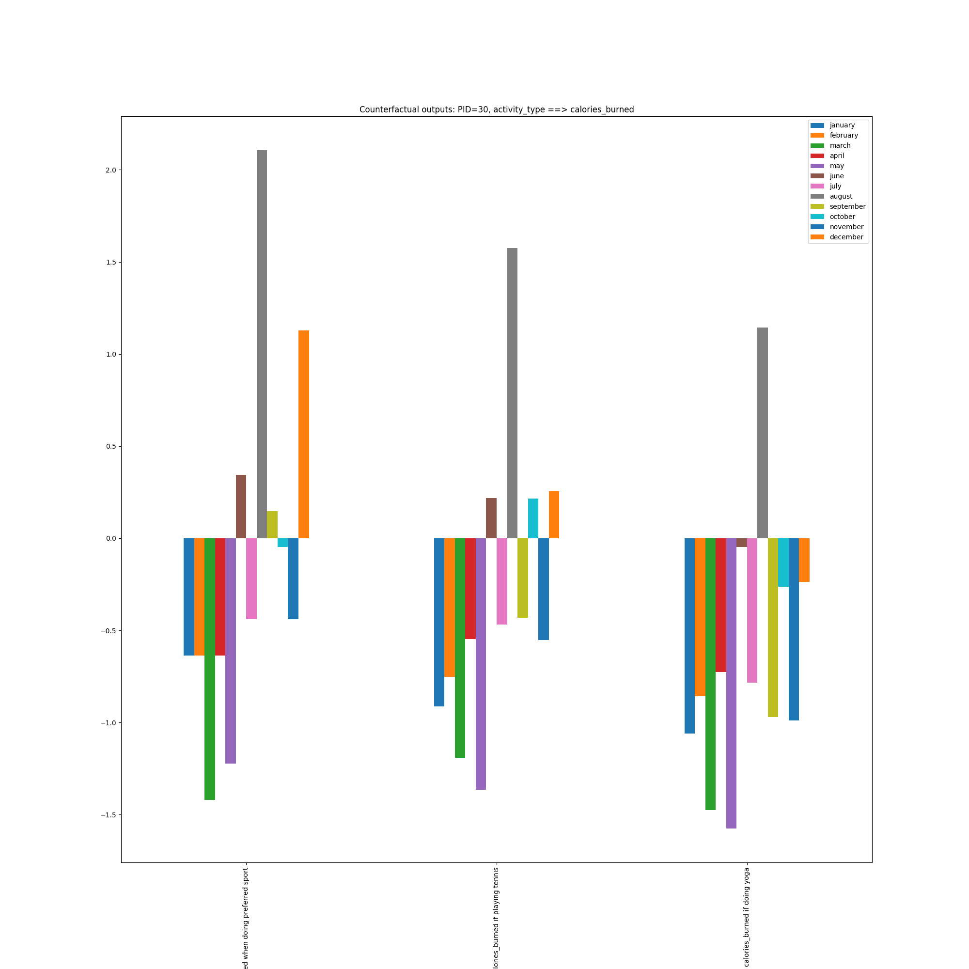
Causal question: “Does the type of activity I do have an impact on the calories I burn?”
activity_type ==> calories_burned

Slide 4

Name (p_id): (8)
Sex: Male
Age: 54
BMI: 28.7
Resting Heart Rate: 72 bpm
Blood Pressure: 89/129 mm Hg
Smoking Status : Former
Health Condition: Hypertension
 | FITNESS |  |  | LIFESTYLE |  |  |  | HEALTH | RESULTS
 | Activity | Duration | Intensity | Daily Steps | Sleep Hours | Stress Level | Hydration Level | Average Heart Rate | Calories Burned (*1000) | Fitness Level
January | Yoga | 73 | Medium | 8628 | 7.02 | 5.76 | 2.33 | 121 | 9 | 0.83
February | Tennis | 66 | Low | 9462 | 7.12 | 4.61 | 2.48 | 121 | 18 | 2.27
March | Basketball | 66 | Low | 10396 | 7.1 | 5.62 | 2.35 | 120 | 15 | 3.87
April | HIIT | 76 | High | 10478 | 6.93 | 5.86 | 2.32 | 122 | 18 | 5.79
May | Yoga | 72 | Medium | 9784 | 7.26 | 5.05 | 2.78 | 128 | 15 | 7.58
June | Weight Training | 69 | Low | 9484 | 6.89 | 6.07 | 2.33 | 121 | 26 | 9.07
July | Cycling | 69 | Low | 7930 | 7.11 | 6.16 | 2.74 | 127 | 23 | 10.53
August | Basketball | 68 | Medium | 7741 | 7.17 | 5.71 | 2.64 | 119 | 19 | 11.82
September | Tennis | 79 | Medium | 7220 | 6.82 | 5.1 | 2.46 | 122 | 32 | 12.88
October | Tennis | 72 | Low | 6568 | 7.14 | 6.62 | 2.36 | 125 | 26 | 14.11
November | Tennis | 70 | High | 7433 | 7.15 | 3.17 | 2.51 | 123 | 30 | 15.3
December | Tennis | 66 | Medium | 7967 | 6.65 | 4.38 | 2.31 | 122 | 23 | 16.43
Causal question: “I am going to train more! What effects will I notice?”
increase duration_minutes

Slide 5
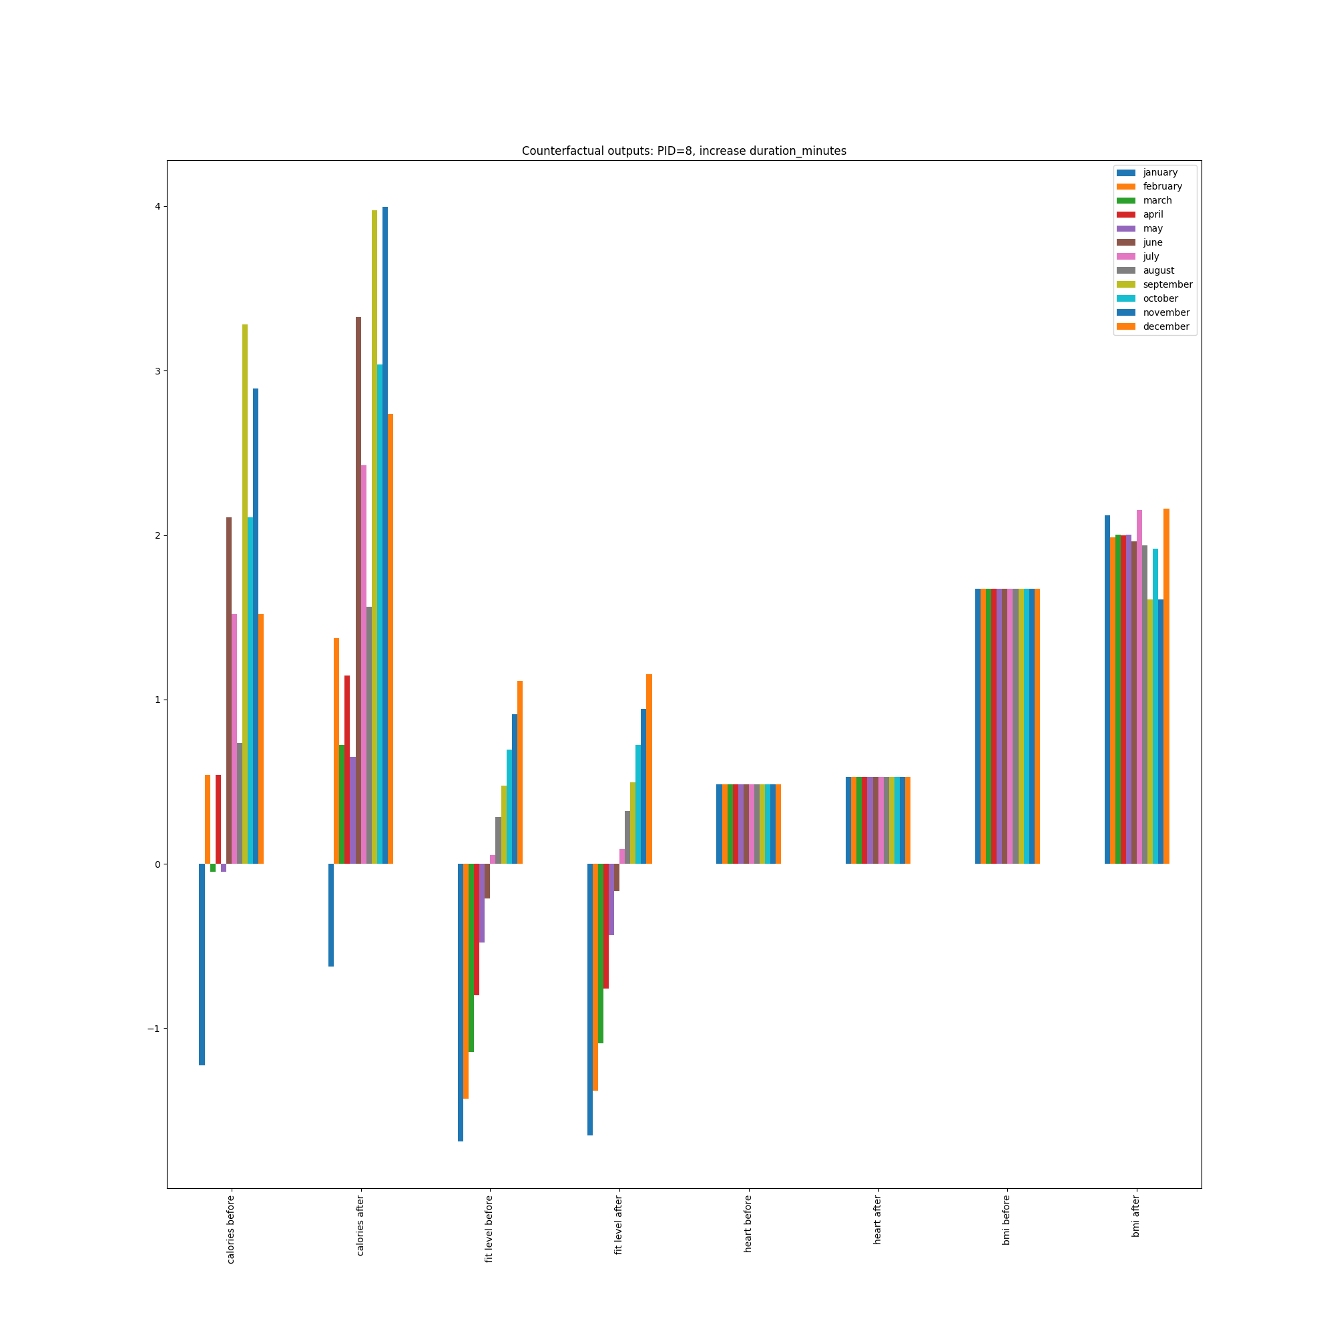
Causal question: “I am going to train more! What effects will I notice?”
increase duration_minutes

Slide 6

Name (p_id): (165)
Sex: Female
Age: 39
BMI: 18.7
Resting Heart Rate: 74 bpm
Blood Pressure: 81/105 mm Hg
Smoking Status : Former
Health Condition: Diabetes
 | FITNESS |  |  | LIFESTYLE |  |  |  | HEALTH | RESULTS
 | Activity | Duration | Intensity | Daily Steps | Sleep Hours | Stress Level | Hydration Level | Average Heart Rate | Calories Burned (*1000) | Fitness Level
January | Swimming | 67 | High | 8351 | 7.06 | 5.91 | 2.37 | 134 | 10 | 1.07
February | Swimming | 71 | Medium | 9921 | 6.94 | 5.55 | 2.38 | 135 | 10 | 2.82
March | Weight Training | 69 | Medium | 9885 | 7.03 | 5.09 | 2.48 | 135 | 6 | 4.6
April | Walking | 69 | Medium | 9167 | 6.93 | 4.46 | 2.55 | 138 | 7 | 6.31
May | Walking | 79 | High | 10069 | 7.18 | 5.26 | 2.65 | 133 | 11 | 8.49
June | Weight Training | 60 | Low | 8584 | 7.16 | 4.56 | 2.54 | 132 | 12 | 9.96
July | Yoga | 70 | Medium | 7986 | 6.82 | 5.16 | 2.52 | 131 | 16 | 11.34
August | Swimming | 73 | Medium | 7191 | 6.91 | 4.57 | 2.58 | 135 | 13 | 12.76
September | Swimming | 62 | Medium | 6970 | 6.98 | 6.39 | 2.44 | 131 | 16 | 13.96
October | Cycling | 68 | Medium | 6406 | 7.2 | 4.26 | 2.28 | 136 | 22 | 15.42
November | Swimming | 73 | Low | 7426 | 6.63 | 5.24 | 2.54 | 128 | 17 | 17.07
December | Swimming | 76 | Low | 8402 | 7 | 4.62 | 2.32 | 131 | 17 | 18.39
Causal question: “Had I increased the amount of exercise I did, would I be in better shape?”
duration_minutes ==> fitness_level + duration_minutes ==> bmi

Slide 7
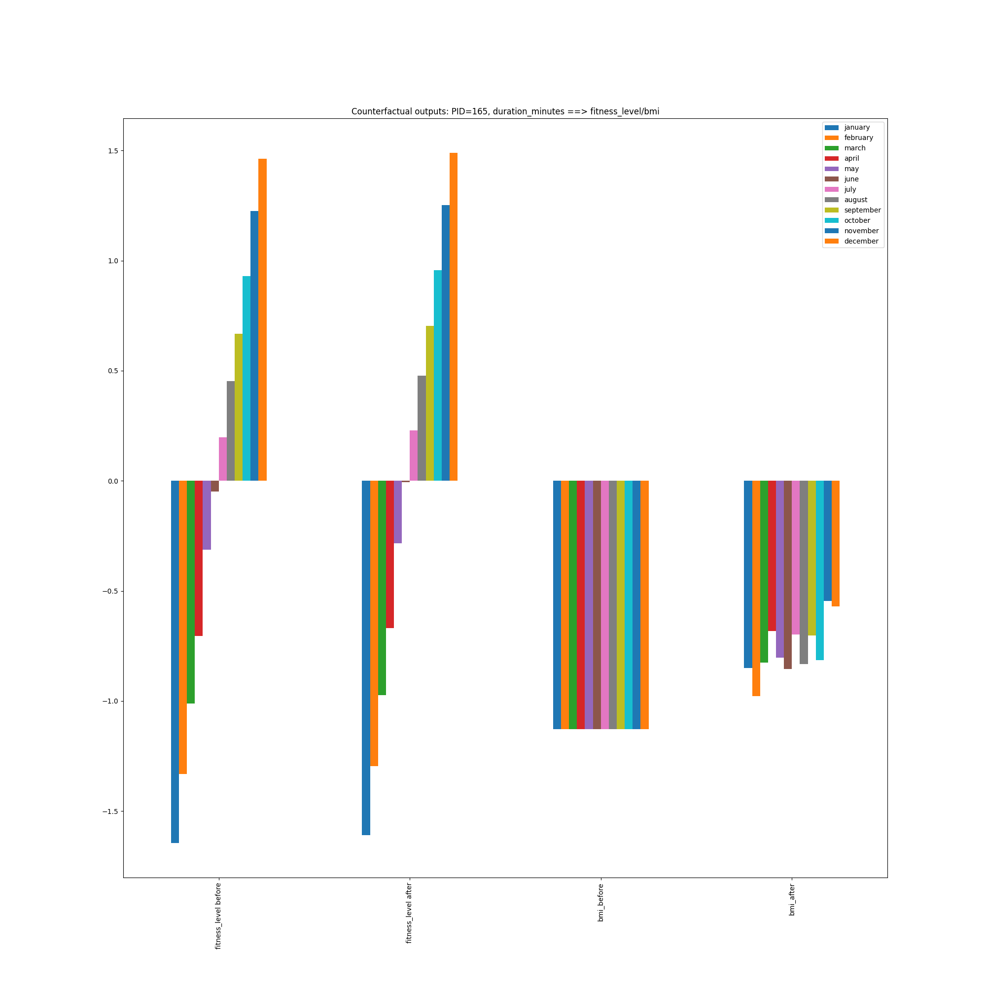
Causal question: “If I increased the amount of exercise I do, would I be in better shape?”
duration_minutes ==> fitness_level + duration_minutes ==> bmi

Slide 8

Name (p_id): (262)
Sex: Male
Age: 40
BMI: 21.2
Resting Heart Rate: 76 bpm
Blood Pressure: 81/144 mm Hg
Smoking Status : Current
Health Condition: Diabetes
 | FITNESS |  |  | LIFESTYLE |  |  |  | HEALTH | RESULTS
 | Activity | Duration | Intensity | Daily Steps | Sleep Hours | Stress Level | Hydration Level | Average Heart Rate | Calories Burned (*1000) | Fitness Level
January | Dancing | 56 | Medium | 8656 | 7.29 | 5.39 | 2.51 | 132 | 9 | 0.6
February | HIIT | 75 | Medium | 9742 | 7 | 5.75 | 2.57 | 128 | 11 | 2.09
March | Running | 81 | Medium | 9656 | 7.34 | 5.22 | 2.62 | 130 | 15 | 4
April | Weight Training | 65 | Medium | 9759 | 7.27 | 5.6 | 2.69 | 130 | 12 | 6.1
May | Tennis | 76 | Medium | 9844 | 6.99 | 5.22 | 2.41 | 135 | 17 | 8.11
June | Swimming | 61 | Low | 8824 | 7.25 | 4.91 | 2.37 | 132 | 13 | 10.06
July | Yoga | 70 | High | 8091 | 7.15 | 5.58 | 2.39 | 132 | 16 | 11.54
August | Weight Training | 77 | Medium | 6934 | 7.4 | 5.11 | 2.41 | 127 | 17 | 13.28
September | Walking | 64 | Medium | 6758 | 6.91 | 4.8 | 2.61 | 125 | 15 | 14.72
October | HIIT | 64 | High | 6476 | 7.12 | 4.35 | 2.56 | 137 | 17 | 15.93
November | Running | 61 | Medium | 7220 | 7.12 | 5.06 | 2.66 | 131 | 21 | 17.18
December | Weight Training | 73 | Medium | 8363 | 6.87 | 5.11 | 2.46 | 132 | 18 | 18.54
Causal question: “Is it better to walk more or to train harder to get in better shape?”
daily_steps ==> fitness_level + duration_minutes ==> fitness_level

Slide 9
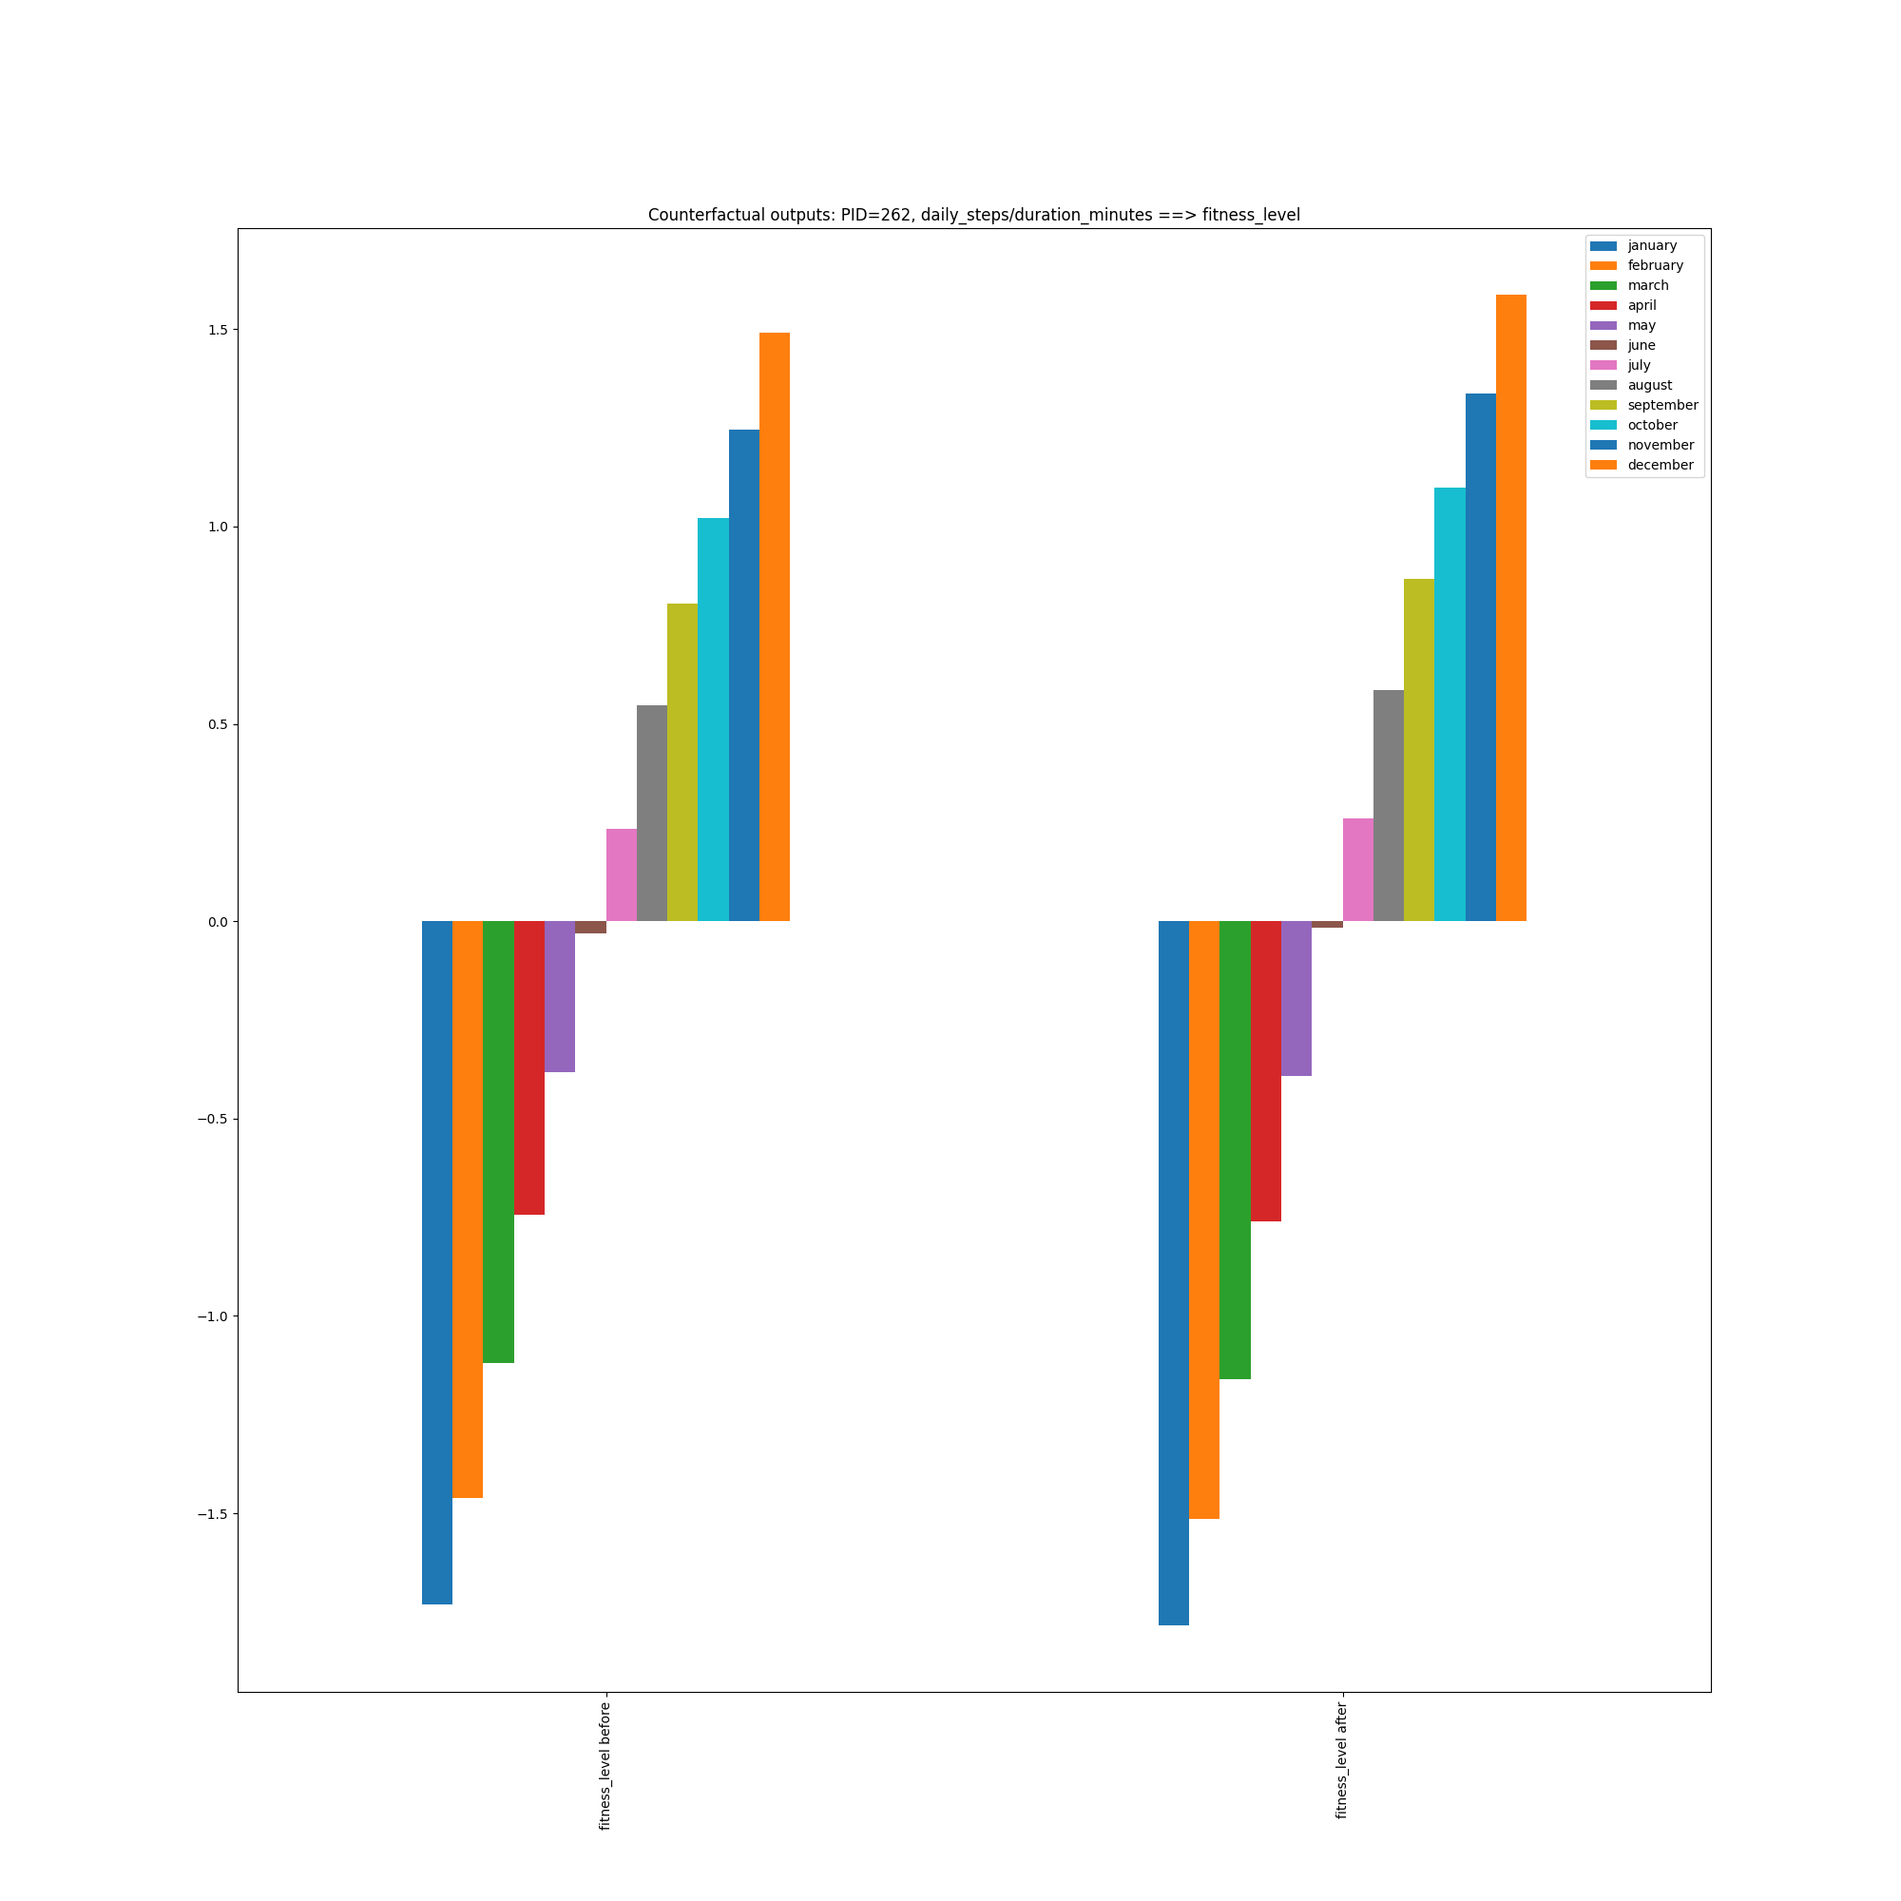
Causal question: “How beneficial is it to walk more and train harder to get in better shape?”
daily_steps ==> fitness_level + duration_minutes ==> fitness_level

Slide 10
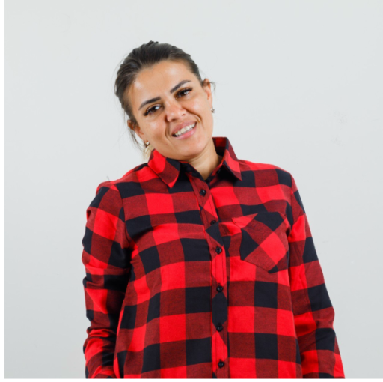
Name (p_id): (108)
Sex: Female
Age: 39
BMI: 23.8
Resting Heart Rate: 70 bpm
Blood Pressure: 74/98 mm Hg
Smoking Status : Current
Health Condition: Asthma
 | FITNESS |  |  | LIFESTYLE |  |  |  | HEALTH | RESULTS
 | Activity | Duration | Intensity | Daily Steps | Sleep Hours | Stress Level | Hydration Level | Average Heart Rate | Calories Burned (*1000) | Fitness Level
January | Cycling | 82 | Medium | 8802 | 7.11 | 5 | 2.68 | 137 | 11 | 0.88
February | Tennis | 77 | Medium | 9261 | 6.62 | 5.31 | 2.49 | 131 | 13 | 2.96
March | HIIT | 68 | Medium | 9973 | 7.14 | 5.21 | 2.51 | 132 | 13 | 5.17
April | Basketball | 74 | Low | 9519 | 6.72 | 5.39 | 2.21 | 131 | 15 | 7.06
May | HIIT | 67 | Medium | 8744 | 7.28 | 5.74 | 2.54 | 132 | 16 | 8.89
June | Basketball | 65 | Medium | 9105 | 7.13 | 5 | 2.5 | 136 | 13 | 10.92
July | Swimming | 64 | Medium | 7768 | 7.19 | 5.22 | 2.62 | 134 | 12 | 12.47
August | Walking | 56 | Low | 7384 | 7.27 | 5.6 | 2.25 | 126 | 12 | 13.59
September | Basketball | 65 | Medium | 7226 | 6.75 | 6 | 2.59 | 131 | 17 | 14.62
October | Cycling | 71 | Low | 7167 | 7.03 | 4.9 | 2.39 | 131 | 18 | 15.91
November | Cycling | 56 | Medium | 8043 | 7.21 | 4.88 | 2.76 | 131 | 15 | 17.25
December | Cycling | 66 | Medium | 7685 | 7.25 | 5.62 | 2.74 | 134 | 12 | 18.32
Causal question: “If I train more, will it be good for my heart?”
duration_minutes ==> blood_pressure_systolic/blood_pressure_diastolic/average_heart_rate

Slide 11
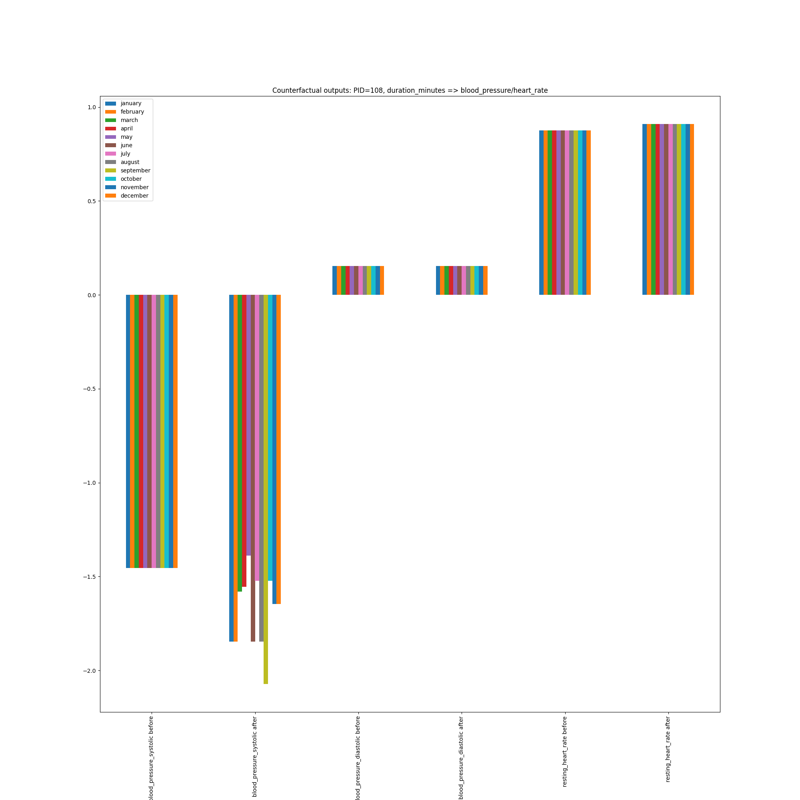
Causal question: “If I train more, will it be good for my heart?”
duration_minutes ==> blood_pressure_systolic/blood_pressure_diastolic/average_heart_rate

Slide 12

Name (p_id): (6)
Sex: Male
Age: 61
BMI: 15.7
Resting Heart Rate: 68 bpm
Blood Pressure: 78/123 mm Hg
Smoking Status : Never
Health Condition: Diabetes
 | FITNESS |  |  | LIFESTYLE |  |  |  | HEALTH | RESULTS
 | Activity | Duration | Intensity | Daily Steps | Sleep Hours | Stress Level | Hydration Level | Average Heart Rate | Calories Burned (*1000) | Fitness Level
January | Swimming | 63 | Medium | 8949 | 7.16 | 6.67 | 2.41 | 114 | 8 | 0.88
February | Cycling | 56 | Low | 9585 | 7.22 | 5.52 | 2.51 | 115 | 9 | 2.34
March | HIIT | 75 | Low | 10386 | 7.17 | 5.25 | 2.47 | 115 | 10 | 4
April | Weight Training | 73 | High | 9534 | 6.97 | 4.71 | 2.4 | 121 | 17 | 6.08
May | Walking | 73 | Medium | 9244 | 7.1 | 5.8 | 2.5 | 114 | 9 | 7.91
June | Swimming | 67 | Low | 9002 | 6.7 | 6.39 | 2.6 | 115 | 12 | 9.67
July | Weight Training | 74 | Low | 7949 | 7.15 | 4.82 | 2.51 | 112 | 15 | 11.28
August | Cycling | 79 | High | 7786 | 7.12 | 5 | 2.64 | 113 | 17 | 12.68
September | Cycling | 58 | High | 7067 | 7.34 | 5.19 | 2.64 | 114 | 11 | 13.87
October | Dancing | 66 | Medium | 6655 | 6.97 | 4.5 | 2.51 | 117 | 16 | 14.99
November | Tennis | 59 | Medium | 7652 | 7.12 | 5.25 | 2.13 | 109 | 13 | 15.93
December | Dancing | 67 | Low | 7609 | 6.94 | 6.19 | 2.51 | 113 | 15 | 16.98
Causal question: “Now I am retired and have more time for sports. Will I lose weight?”
duration_minutes ==> calories_burned

Slide 13
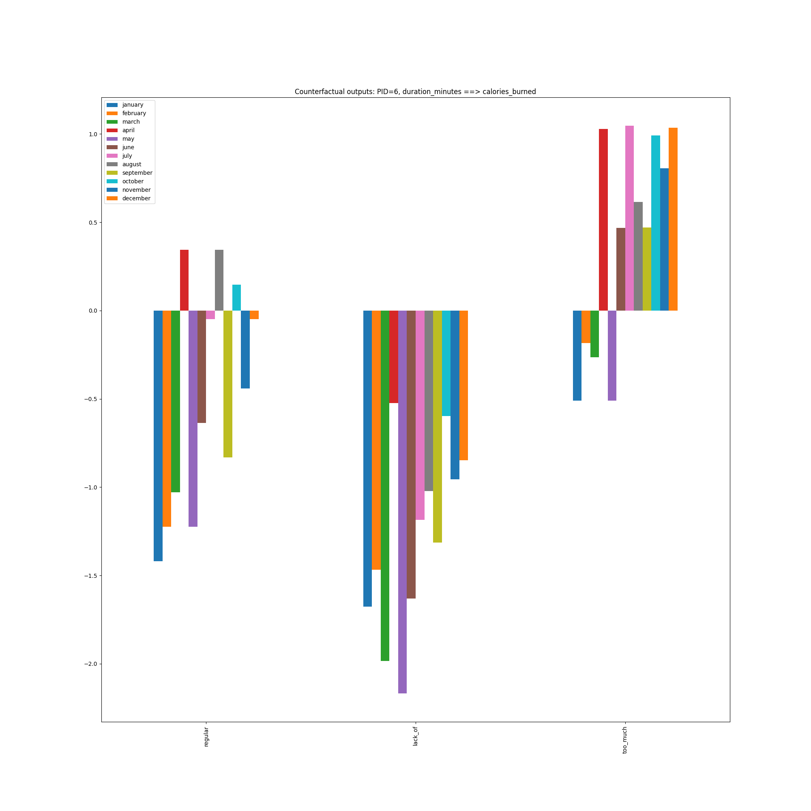
Causal question: “Now I am retired and have more time for sports. Will I lose weight?”
duration_minutes ==> calories_burned

Slide 14

Name (p_id): (41)
Sex: Female
Age: 52
BMI: 22.5
Resting Heart Rate: 78 bpm
Blood Pressure: 79/124 mm Hg
Smoking Status : Never
Health Condition: Asthma
 | FITNESS |  |  | LIFESTYLE |  |  |  | HEALTH | RESULTS
 | Activity | Duration | Intensity | Daily Steps | Sleep Hours | Stress Level | Hydration Level | Average Heart Rate | Calories Burned (*1000) | Fitness Level
January | Running | 82 | Low | 9037 | 6.55 | 5.62 | 2.4 | 123 | 13 | 1.22
February | Dancing | 68 | Medium | 9827 | 6.82 | 5.39 | 2.46 | 125 | 8 | 3.24
March | Weight Training | 68 | Medium | 9877 | 7.43 | 5.54 | 2.38 | 123 | 12 | 5.33
April | Tennis | 58 | High | 10161 | 7.02 | 5.46 | 2.51 | 124 | 10 | 7.18
May | HIIT | 64 | Low | 9881 | 6.68 | 5 | 2.53 | 121 | 14 | 8.78
June | Tennis | 69 | Low | 8115 | 7.13 | 4.53 | 2.61 | 124 | 16 | 10.11
July | Swimming | 70 | Medium | 8077 | 7.32 | 4.71 | 2.53 | 128 | 16 | 11.64
August | Walking | 65 | Low | 7315 | 6.94 | 5 | 2.31 | 123 | 13 | 13.13
September | Dancing | 89 | Medium | 6920 | 7.24 | 5.73 | 2.45 | 122 | 13 | 14.68
October | Dancing | 74 | Low | 7025 | 7.05 | 5.6 | 2.42 | 123 | 15 | 16.3
November | Weight Training | 62 | Low | 7145 | 6.73 | 5.1 | 2.3 | 123 | 15 | 17.93
December | Basketball | 76 | Medium | 7767 | 6.87 | 4.54 | 2.36 | 120 | 16 | 19.33
Causal question: “I know I’ll eat a lot and train less on vacation; will it be bad for my weight?”
calories_burned ==> bmi

Slide 15
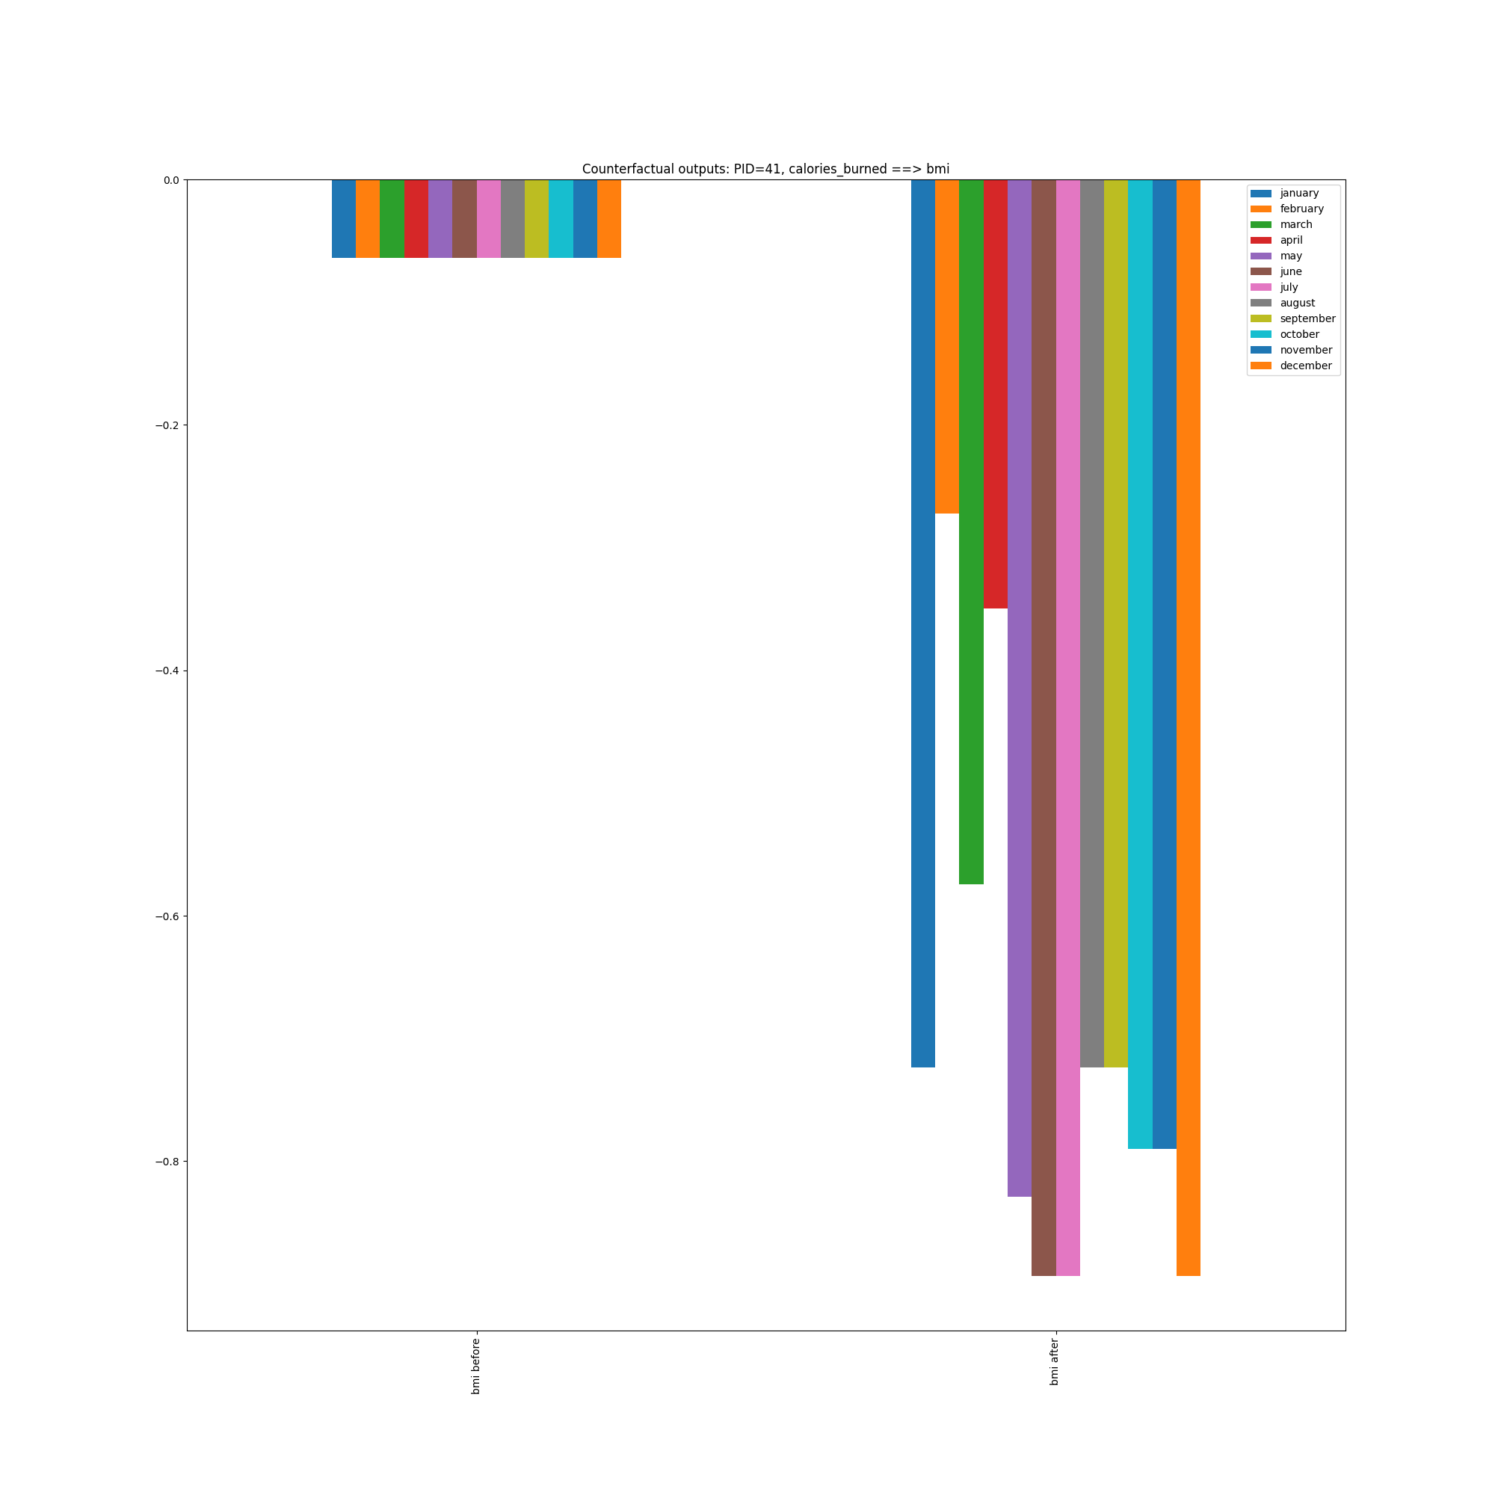
Causal question: “I know I’ll eat a lot and train less on vacation; will it be bad for my weight?”
calories_burned ==> bmi

Slide 16

Name (p_id): (2)
Sex: Male
Age: 40
BMI: 23.7
Resting Heart Rate: 82 bpm
Blood Pressure: 78/128 mm Hg
Smoking Status : Never
Health Condition: None
 | FITNESS |  |  | LIFESTYLE |  |  |  | HEALTH | RESULTS
 | Activity | Duration | Intensity | Daily Steps | Sleep Hours | Stress Level | Hydration Level | Average Heart Rate | Calories Burned (*1000) | Fitness Level
January | Cycling | 63 | Low | 8503 | 6.92 | 5.67 | 2.68 | 133 | 12 | 0.73
February | HIIT | 73 | Low | 9120 | 7.09 | 4.9 | 2.51 | 131 | 12 | 2.23
March | Swimming | 74 | Medium | 9978 | 7.18 | 6 | 2.57 | 138 | 16 | 4.44
April | Tennis | 69 | Medium | 10489 | 6.76 | 5.29 | 2.45 | 134 | 17 | 6.54
May | HIIT | 70 | Low | 9990 | 7.01 | 5.38 | 2.62 | 131 | 17 | 8.35
June | Weight Training | 66 | Medium | 9336 | 7.05 | 5 | 2.47 | 130 | 17 | 10.37
July | Tennis | 76 | Low | 8133 | 6.97 | 5.16 | 2.49 | 127 | 21 | 12.16
August | Dancing | 77 | High | 7452 | 6.98 | 6.62 | 2.45 | 131 | 25 | 13.69
September | Running | 73 | Low | 6385 | 6.99 | 5.3 | 2.42 | 132 | 16 | 15.18
October | Walking | 74 | Medium | 6726 | 6.82 | 4.39 | 2.53 | 134 | 20 | 16.84
November | Cycling | 72 | Low | 7372 | 7.02 | 5.26 | 2.58 | 128 | 22 | 18.33
December | Dancing | 69 | Low | 8123 | 6.93 | 4.13 | 2.63 | 133 | 16 | 19.71
Causal question: “I don’t feel like walking a lot after work anymore… Will this be bad for me?”
decrease daily_steps

Slide 17
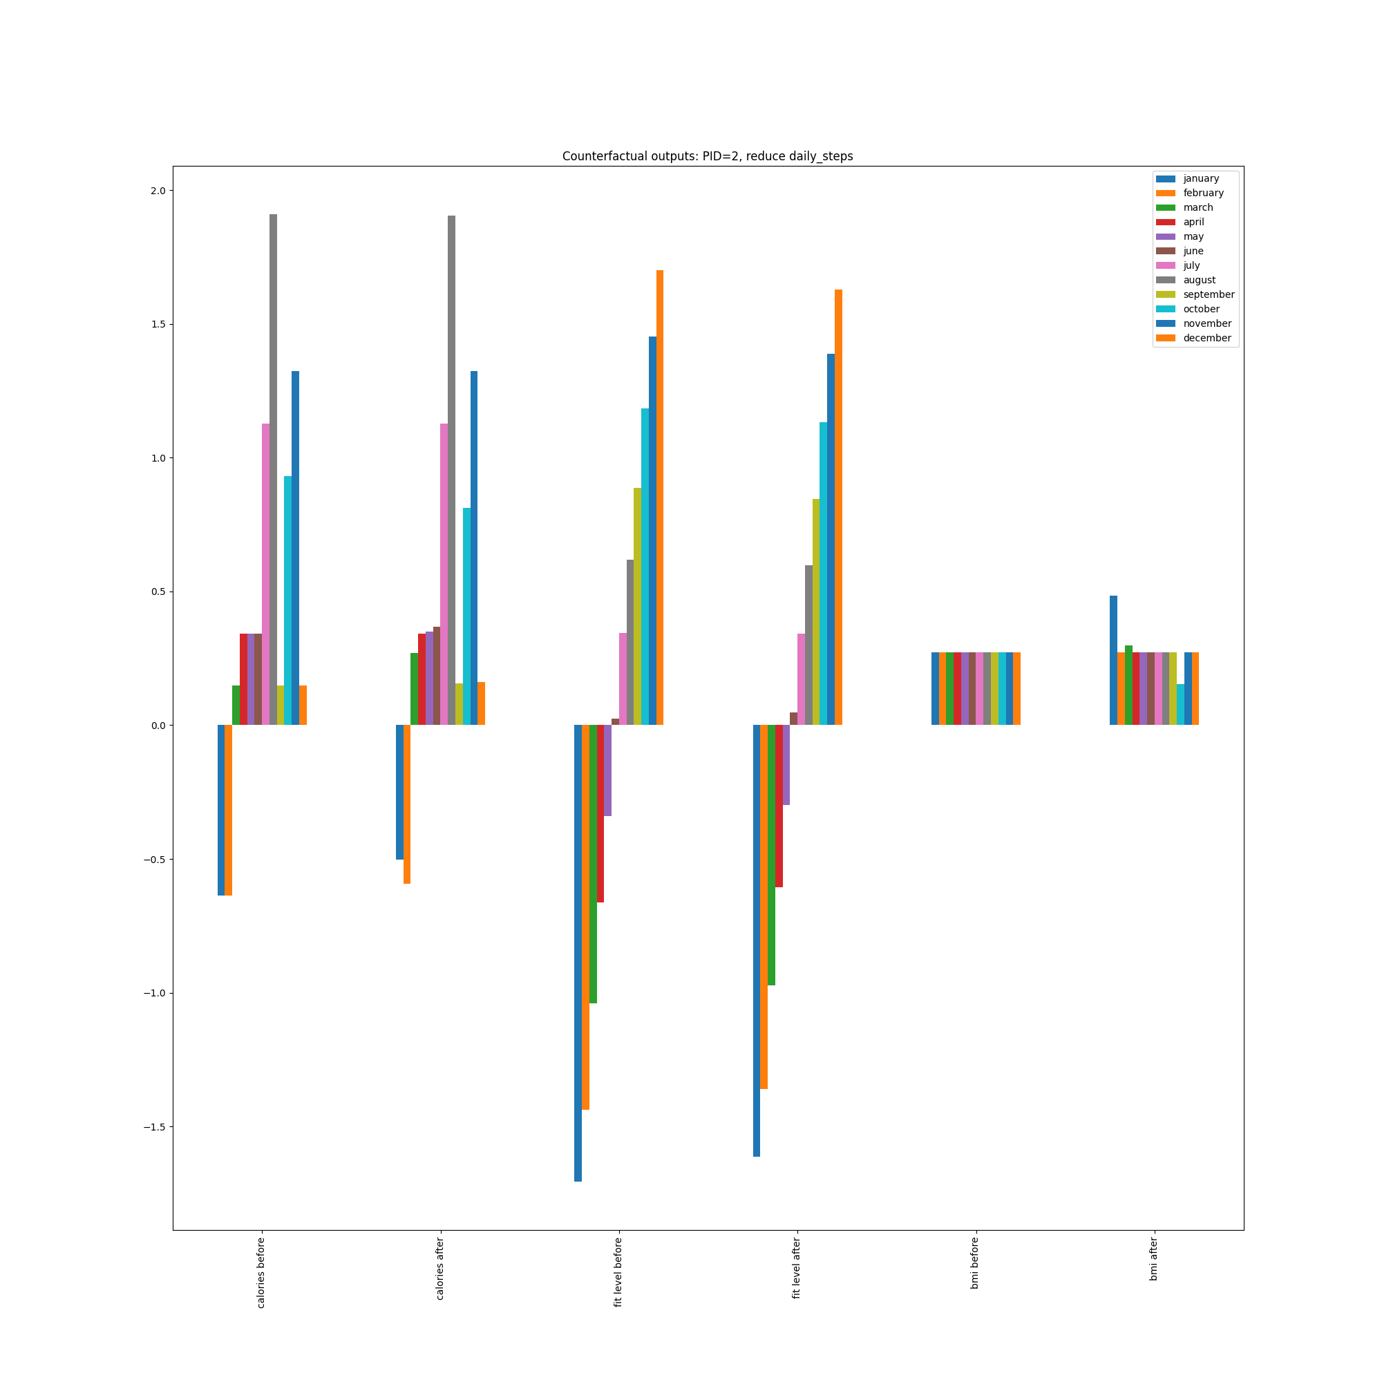
Causal question: “I don’t feel like walking a lot after work anymore… Will this be bad for me?”
decrease daily_steps

Slide 18

Name (p_id): (26)
Sex: Female
Age: 26
BMI: 18.4
Resting Heart Rate: 75 bpm
Blood Pressure: 89/115 mm Hg
Smoking Status : Never
Health Condition: Hypertension
 | FITNESS |  |  | LIFESTYLE |  |  |  | HEALTH | RESULTS
 | Activity | Duration | Intensity | Daily Steps | Sleep Hours | Stress Level | Hydration Level | Average Heart Rate | Calories Burned (*1000) | Fitness Level
January | Basketball | 71 | High | 8693 | 7.48 | 5.71 | 2.49 | 152 | 6 | 0.73
February | Tennis | 73 | Medium | 9420 | 7.21 | 4.95 | 2.47 | 142 | 11 | 2.48
March | Dancing | 70 | Low | 10522 | 7.07 | 5.04 | 2.44 | 146 | 10 | 4.37
April | Weight Training | 67 | Low | 10271 | 6.68 | 5.26 | 2.47 | 135 | 9 | 6.12
May | Dancing | 68 | Medium | 9319 | 6.92 | 5.42 | 2.42 | 141 | 10 | 7.77
June | Weight Training | 62 | Low | 8379 | 7.12 | 5.3 | 2.36 | 136 | 9 | 9.32
July | Tennis | 78 | Medium | 8475 | 7.2 | 4.32 | 2.54 | 147 | 18 | 11.07
August | Basketball | 73 | Low | 7037 | 6.99 | 3.82 | 2.79 | 144 | 15 | 12.65
September | Cycling | 62 | Medium | 6813 | 6.82 | 4.12 | 2.28 | 145 | 9 | 14.02
October | Dancing | 61 | High | 7679 | 6.73 | 4.35 | 2.33 | 145 | 17 | 15.25
November | Running | 64 | Medium | 7010 | 6.99 | 4.47 | 2.62 | 142 | 19 | 16.52
December | Dancing | 75 | High | 8176 | 7.17 | 4.28 | 2.41 | 141 | 20 | 18
Causal question: “What impact does my fitness level have on the calories I burn?”
Fitness_level ==> calories_burned

Slide 19
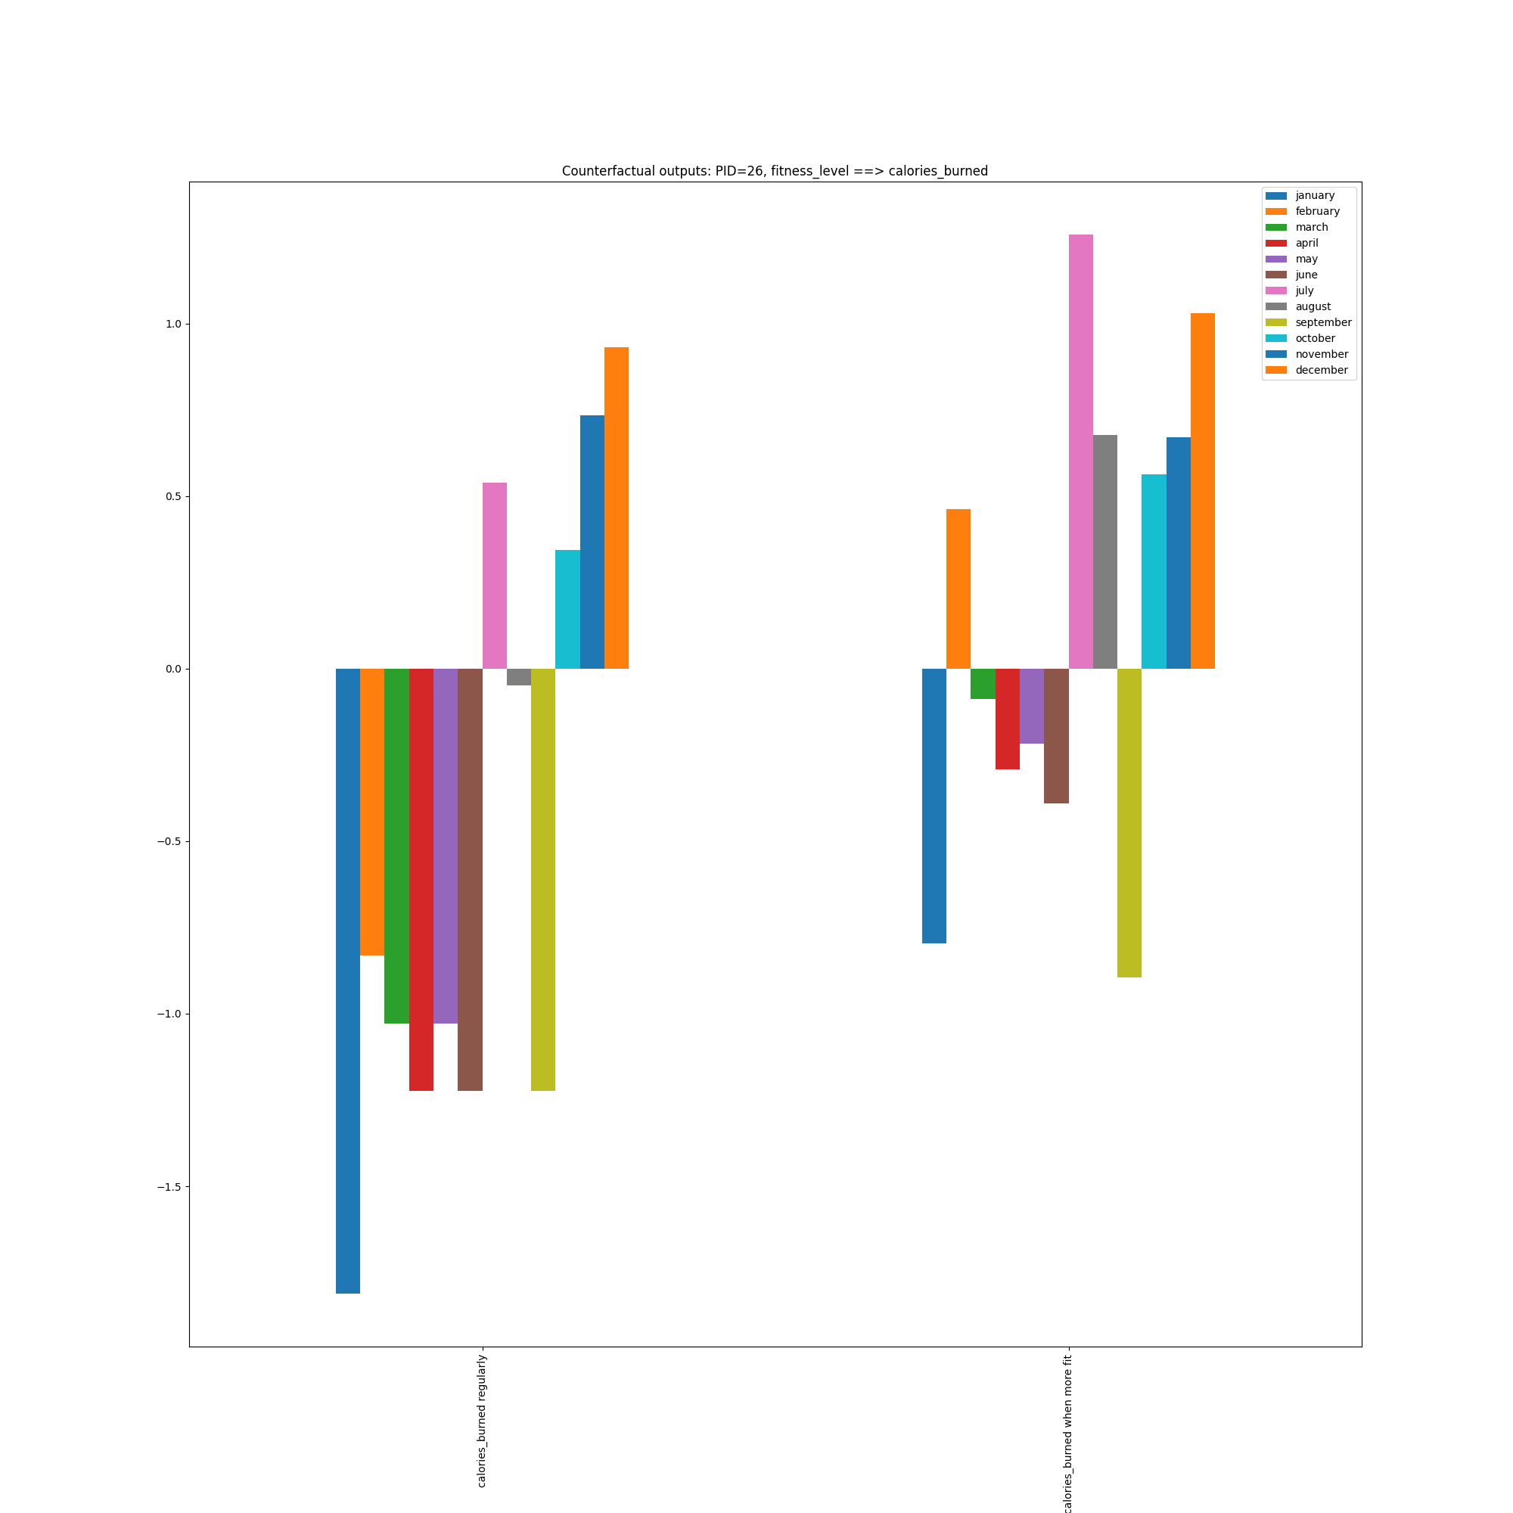
Causal question: “What impact does my fitness level have on the calories I burn?”
Fitness_level ==> calories_burned

Slide 20

Name (p_id): (5)
Sex: Male
Age: 50
BMI: 29.1
Resting Heart Rate: 70 bpm
Blood Pressure: 80/139 mm Hg
Smoking Status : Current
Health Condition: None
 | FITNESS |  |  | LIFESTYLE |  |  |  | HEALTH | RESULTS
 | Activity | Duration | Intensity | Daily Steps | Sleep Hours | Stress Level | Hydration Level | Average Heart Rate | Calories Burned (*1000) | Fitness Level
January | Cycling | 66 | Medium | 9165 | 7.23 | 4.61 | 2.73 | 125 | 13 | 0.72
February | HIIT | 75 | Medium | 10041 | 7.17 | 4.52 | 2.57 | 128 | 25 | 2.39
March | Running | 67 | Low | 9932 | 7.09 | 5.25 | 2.59 | 127 | 12 | 4.45
April | Tennis | 74 | Medium | 9997 | 6.93 | 6.3 | 2.45 | 120 | 17 | 6.45
May | Cycling | 72 | High | 9473 | 7.15 | 5.31 | 2.51 | 127 | 20 | 8.69
June | HIIT | 73 | Medium | 8599 | 7.04 | 4.89 | 2.55 | 129 | 27 | 10.67
July | Cycling | 71 | Medium | 7779 | 7.09 | 4.5 | 2.47 | 123 | 17 | 12.27
August | Running | 73 | Medium | 6930 | 7.05 | 4.82 | 2.44 | 123 | 18 | 14.02
September | Swimming | 71 | Low | 6423 | 6.88 | 4.62 | 2.35 | 125 | 18 | 15.37
October | Walking | 63 | Low | 6700 | 7.31 | 6.18 | 2.78 | 120 | 15 | 16.38
November | Running | 59 | Medium | 6908 | 7.42 | 5.17 | 2.52 | 120 | 19 | 17.18
December | Tennis | 68 | Medium | 7756 | 6.96 | 4.43 | 2.63 | 128 | 26 | 18.21
Causal question: “Does my sleep schedule influence how long I can train for?”
hours_sleep ==> duration_minutes

Slide 21
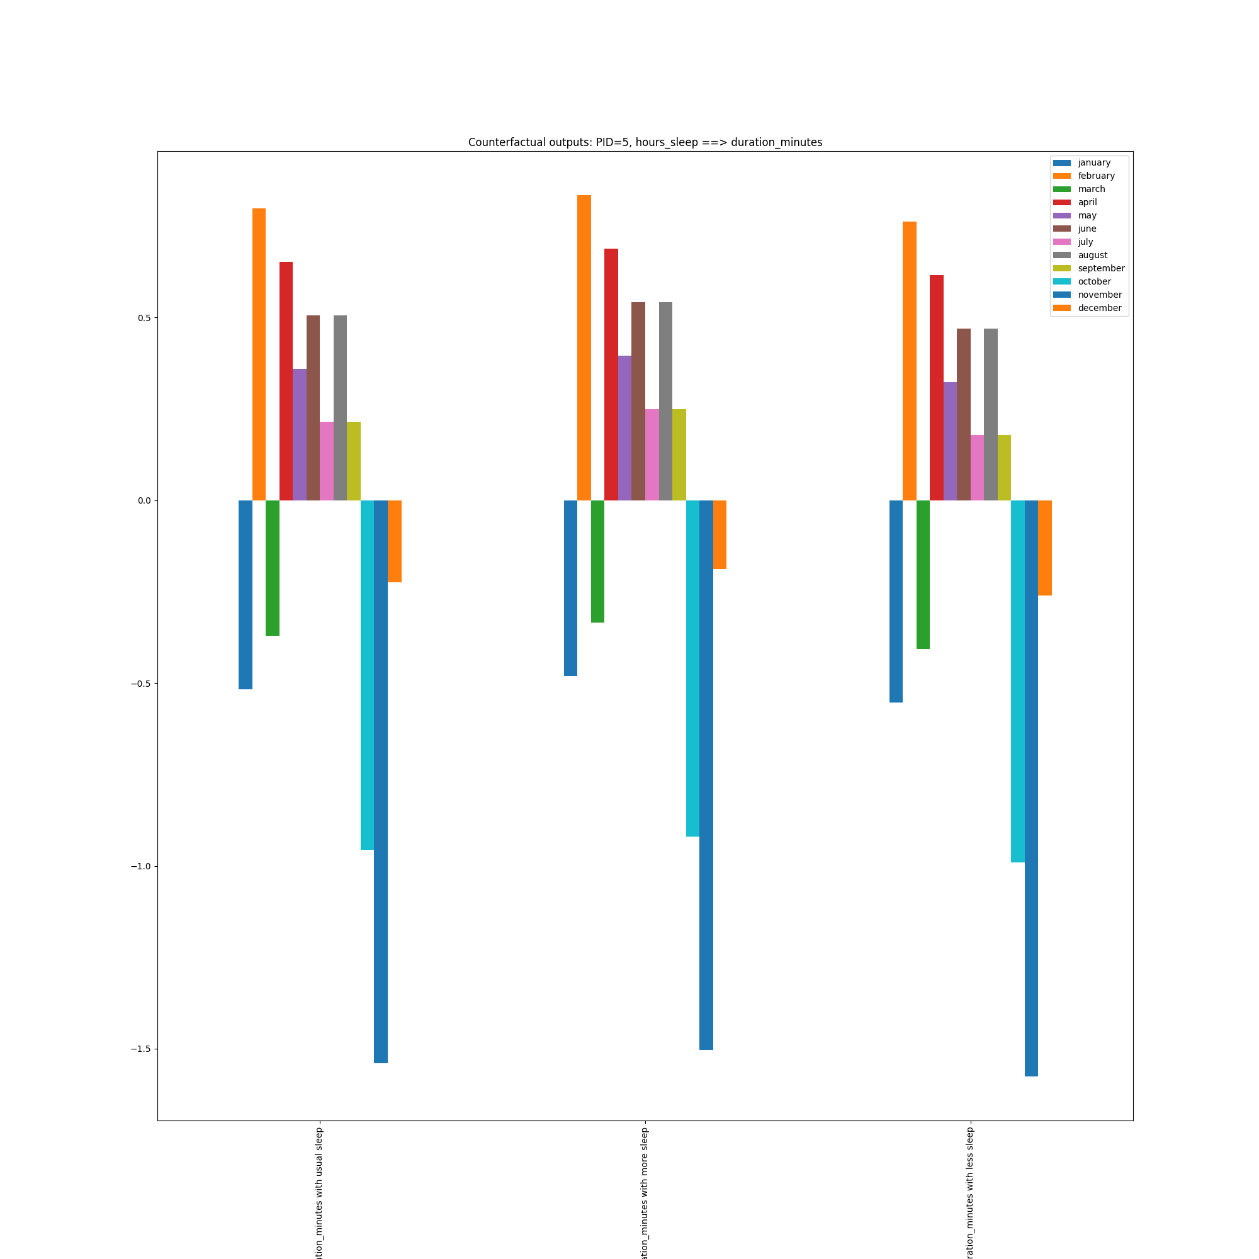
Causal question: “Does my sleep schedule influence how long I can train for?”
hours_sleep ==> duration_minutes

Slide 22

Name (p_id): (11)
Sex: Female
Age: 43
BMI: 22.2
Resting Heart Rate: 69 bpm
Blood Pressure: 67/120 mm Hg
Smoking Status : Former
Health Condition: None
 | FITNESS |  |  | LIFESTYLE |  |  |  | HEALTH | RESULTS
 | Activity | Duration | Intensity | Daily Steps | Sleep Hours | Stress Level | Hydration Level | Average Heart Rate | Calories Burned (*1000) | Fitness Level
January | Cycling | 76 | Medium | 8714 | 7.14 | 4.64 | 2.3 | 131 | 12 | 1.1
February | Tennis | 83 | Medium | 9542 | 7.28 | 4.96 | 2.6 | 134 | 17 | 3.25
March | Basketball | 77 | Medium | 10241 | 7.23 | 5.14 | 2.39 | 126 | 14 | 5.65
April | Walking | 72 | Medium | 10026 | 6.97 | 5.88 | 2.52 | 130 | 16 | 7.63
May | Cycling | 75 | Low | 10047 | 7.03 | 5.72 | 2.38 | 129 | 14 | 9.84
June | Dancing | 67 | Medium | 9823 | 7.09 | 5.45 | 2.55 | 134 | 20 | 11.84
July | Cycling | 59 | Low | 7823 | 7.03 | 5.74 | 2.61 | 130 | 12 | 13.36
August | Weight Training | 65 | Medium | 6947 | 7.4 | 5.94 | 2.63 | 131 | 14 | 14.71
September | Swimming | 72 | Medium | 6940 | 7.41 | 6.27 | 2.59 | 125 | 18 | 15.94
October | Yoga | 75 | Low | 5883 | 7.25 | 4.12 | 2.79 | 122 | 12 | 16.86
November | Tennis | 67 | Low | 7338 | 7.1 | 4.52 | 2.61 | 123 | 14 | 18.01
December | Weight Training | 72 | Low | 7682 | 7.39 | 5.1 | 2.02 | 123 | 19 | 19.15
Causal questions: “I’ve been told that I need to walk and train more. What effects will this have on my physique?”
duration_minutes/daily_steps => calories_burned

Slide 23
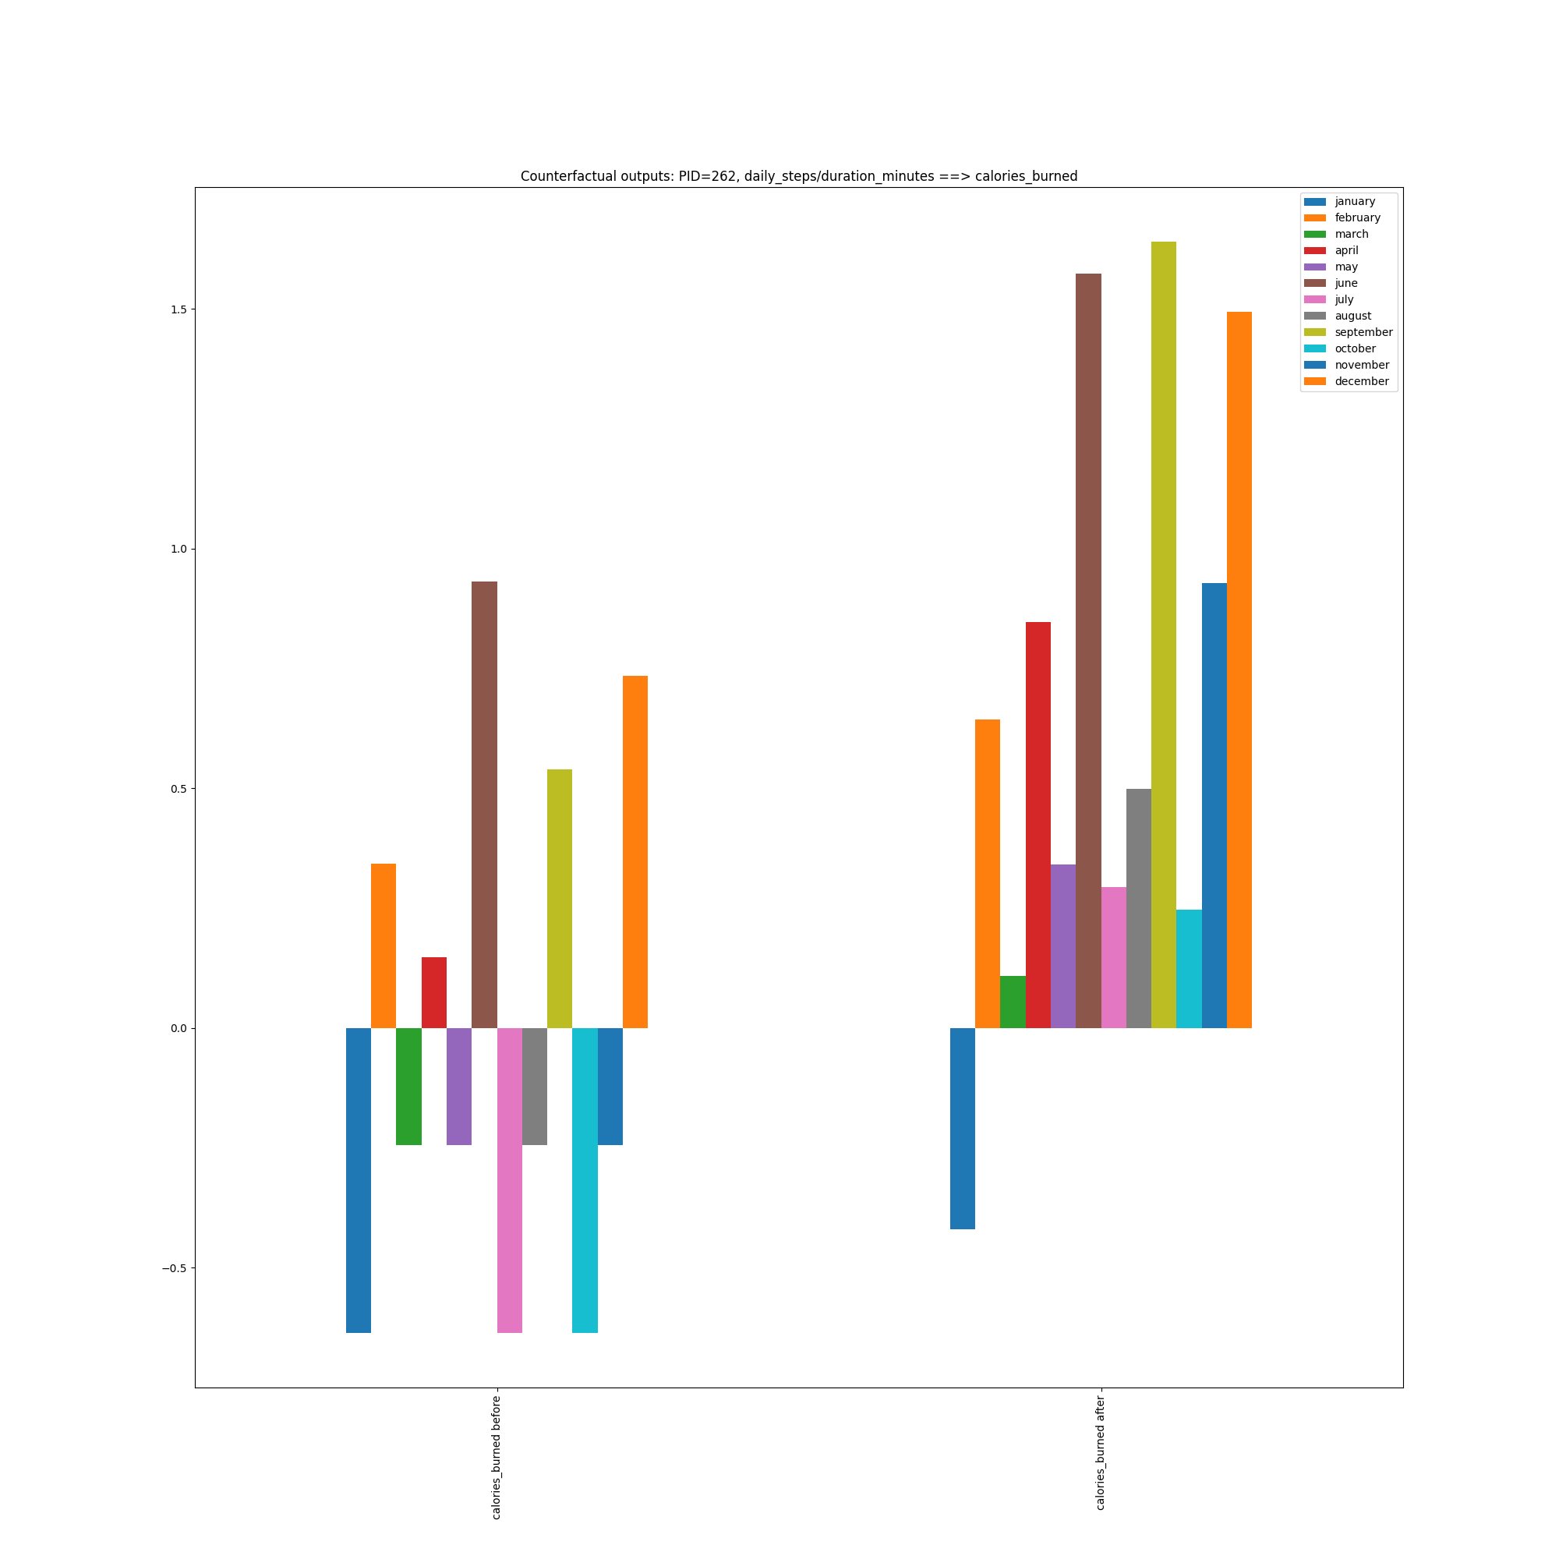
Causal questions: “I’ve been told that I need to walk and train more.
What effects will this have on my physique?”
duration_minutes/daily_steps => calories_burned

Slide 24

Name (p_id): (172)
Sex: Male
Age: 59
BMI: 25.2
Resting Heart Rate: 69 bpm
Blood Pressure: 76/129 mm Hg
Smoking Status : Former
Health Condition: Asthma
 | FITNESS |  |  | LIFESTYLE |  |  |  | HEALTH | RESULTS
 | Activity | Duration | Intensity | Daily Steps | Sleep Hours | Stress Level | Hydration Level | Average Heart Rate | Calories Burned (*1000) | Fitness Level
January | Basketball | 78 | Medium | 8604 | 7.02 | 4.96 | 2.69 | 116 | 13 | 1.16
February | Basketball | 66 | High | 9522 | 6.96 | 4.95 | 2.54 | 123 | 13 | 3.13
March | Weight Training | 72 | Low | 10037 | 6.96 | 4.5 | 2.45 | 117 | 17 | 4.81
April | Walking | 66 | Low | 10265 | 7.13 | 5.24 | 2.54 | 114 | 12 | 6.53
May | Running | 61 | Low | 10611 | 6.66 | 3.9 | 2.56 | 114 | 15 | 8.11
June | Weight Training | 68 | High | 8835 | 6.95 | 5.11 | 2.69 | 116 | 18 | 9.62
July | Yoga | 82 | Low | 7938 | 7.35 | 5.45 | 2.58 | 116 | 8 | 11.37
August | Basketball | 65 | Low | 7705 | 7.26 | 4.29 | 2.63 | 118 | 15 | 13.07
September | Dancing | 66 | High | 6230 | 7.27 | 6.2 | 2.52 | 115 | 16 | 14.38
October | Cycling | 64 | Low | 7305 | 7.25 | 5.36 | 2.49 | 119 | 12 | 15.45
November | Running | 69 | Low | 7482 | 6.45 | 5.23 | 2.33 | 116 | 22 | 16.51
December | Walking | 77 | Low | 7820 | 6.94 | 5.36 | 2.62 | 113 | 11 | 17.69
Causal question: “Does training for longer have a good effect on my resting heart rate?”
duration_minutes ==> resting_heart_rate

Slide 25
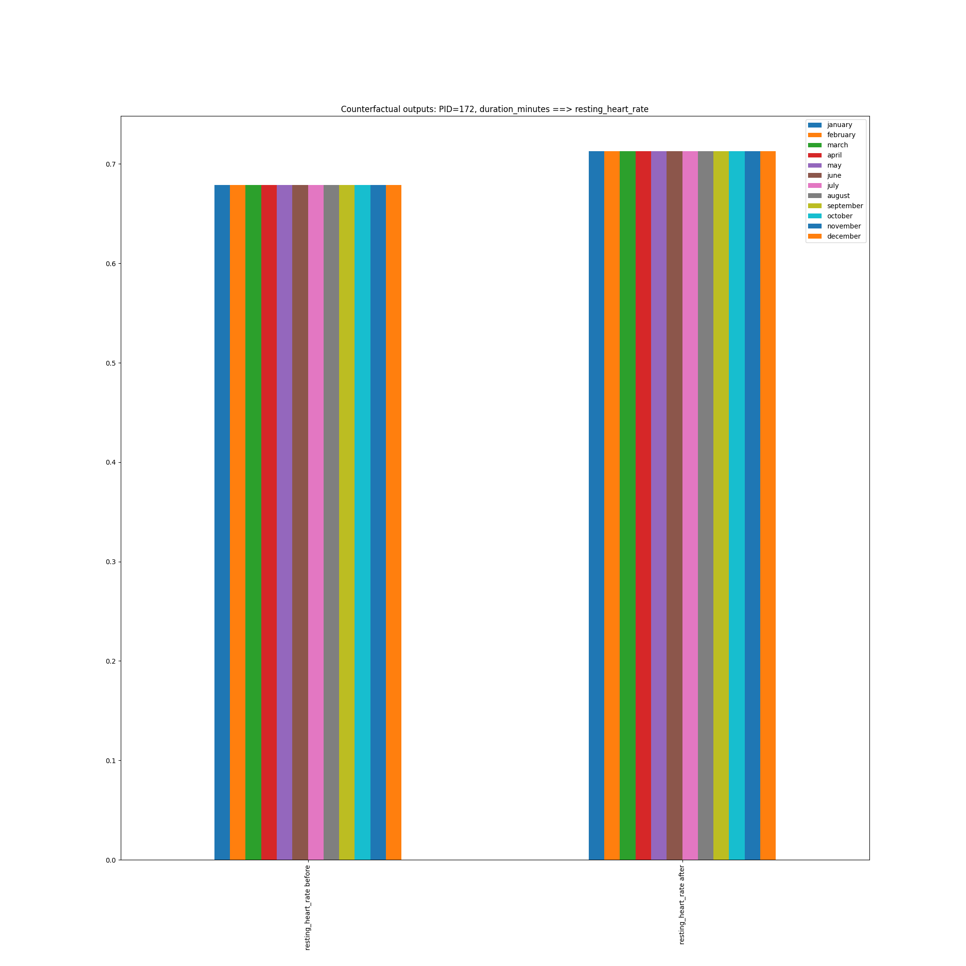
Causal question: “Does training for longer have a good effect on my resting heart rate?”
duration_minutes ==> resting_heart_rate

