Slide 1
Bayesian Statistics for
Reliability Assessment
QPR Meeting #123 - June 2026 Luca Lizza

Slide 2
Outline
Predictions vs. in-orbit reality
The Bayesian idea
The Gamma–Poisson update
A worked example: one component, start to finish
Open questions: priors, propagation, scale
Applicability of Bayes – and recommendations
Where this fits: REX and the thesis

Slide 3
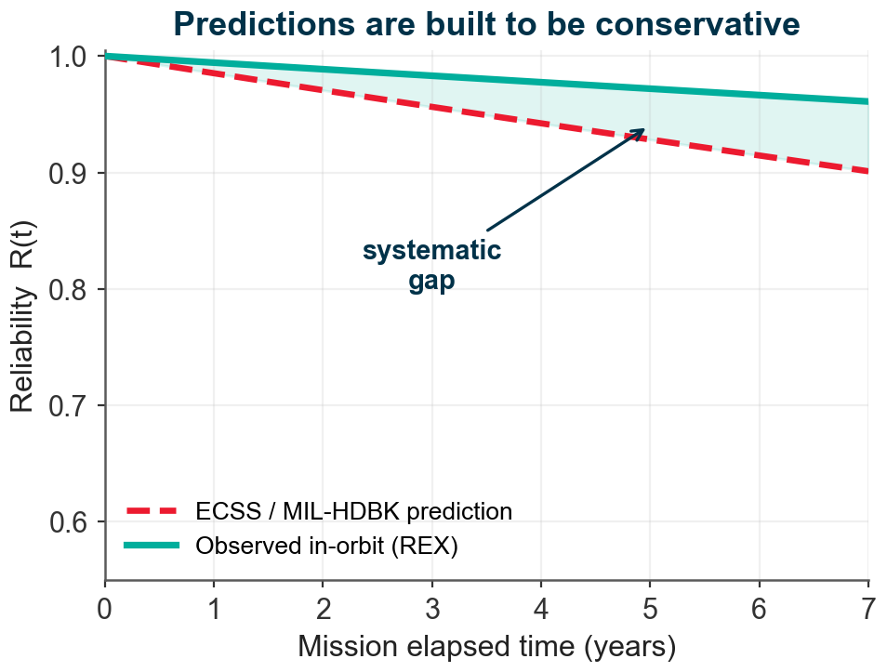
Problem Statement
Reliability predictions (ECSS-Q-ST-30, MIL-HDBK-217) are built on ground-test data, empirical formulas, and deliberately conservative assumptions.
They are often poorly representative of real in-orbit conditions: predicted and observed reliability drift apart over a mission.
ESA’s REX initiative now collects in-orbit operational data across past and current missions.
So, the real question is: how do we combine a prior prediction with real evidence, rigorously?

Slide 4
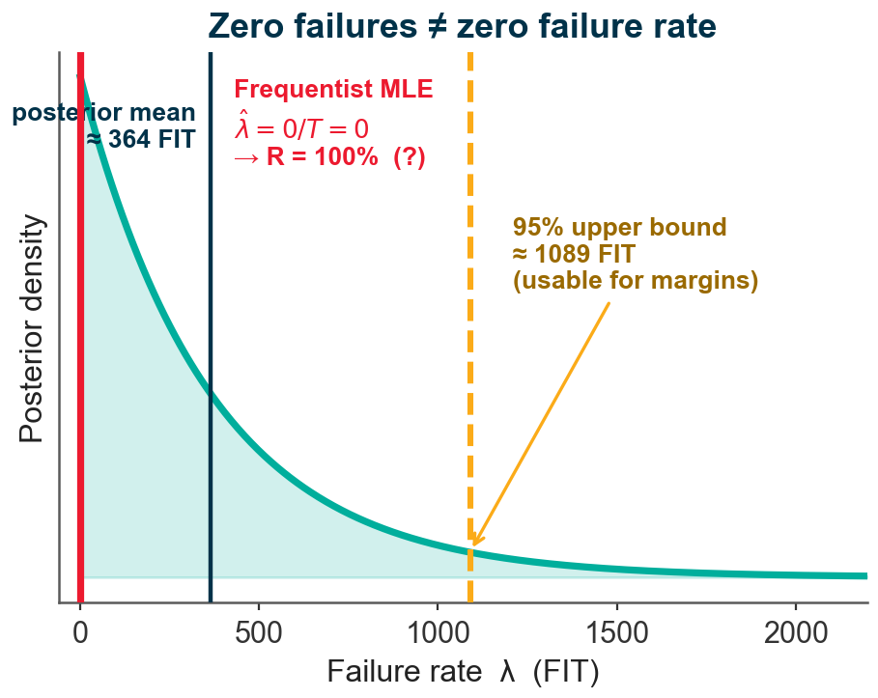
Why classical estimates break on sparse data
A unit runs for T operating hours with zero failures (the in-orbit norm, not the exception).
Classical estimate: λ = 0 → “infinitely reliable”. Useless for margins.
Bayesian estimate: a bounded posterior — a best guess ≈ 364 FIT and a 95% upper bound ≈ 1089 FIT you can design to.
Same data, a usable answer — because we started from a prior.

Slide 5
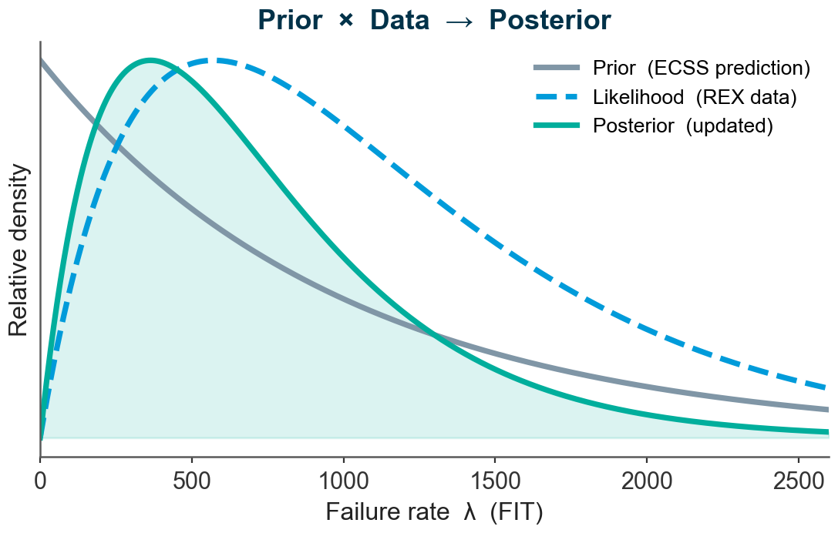
The Bayesian idea, in our terms
Prior — what the handbook predicts before flight.
Likelihood — what the REX data says.
Posterior — the updated belief: prior × data, normalised.
The prior is not an arbitrary guess — it is our existing ECSS prediction, written as a distribution instead of a single number.

Slide 6
Two ways to say what we know
Classical (frequentist)
λ is a fixed unknown number
Data is random; estimates carry confidence intervals
A “95% CI” is a statement about the procedure, not this component
Bayesian
λ has a probability distribution
We update it as evidence arrives
Credible interval: “90% probability λ is in [129, 1725] FIT” — what engineers actually want to say
Same data — but the Bayesian statement is the one you can defend in a margin review.

Slide 7
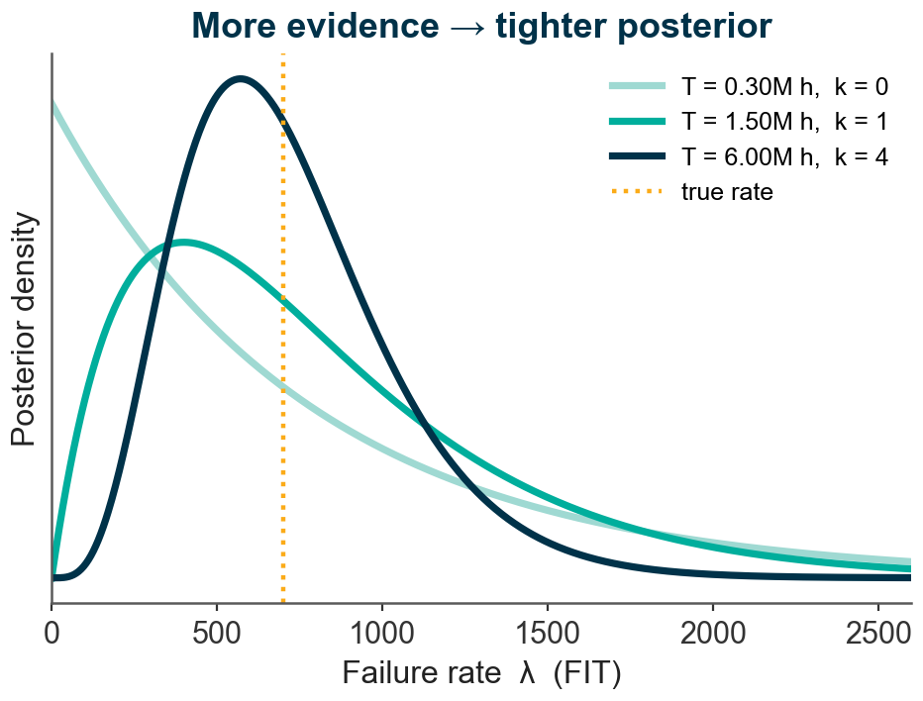
The workhorse: a conjugate update
Failures in time → Poisson(λT); constant rate → exponential life. The natural model for FIT.
Conjugate prior on the failure rate: λ ~ Gamma(α₀, β₀).
Gamma(α₀, β₀) → Gamma(α₀ + k, β₀ + T)
for k failures observed in T hours
α₀ = “equivalent prior failures” — prior strength in data units; β₀ anchors the prior mean to the handbook FIT.
Closed-form: no MCMC — cheap, transparent, auditable.

Slide 8
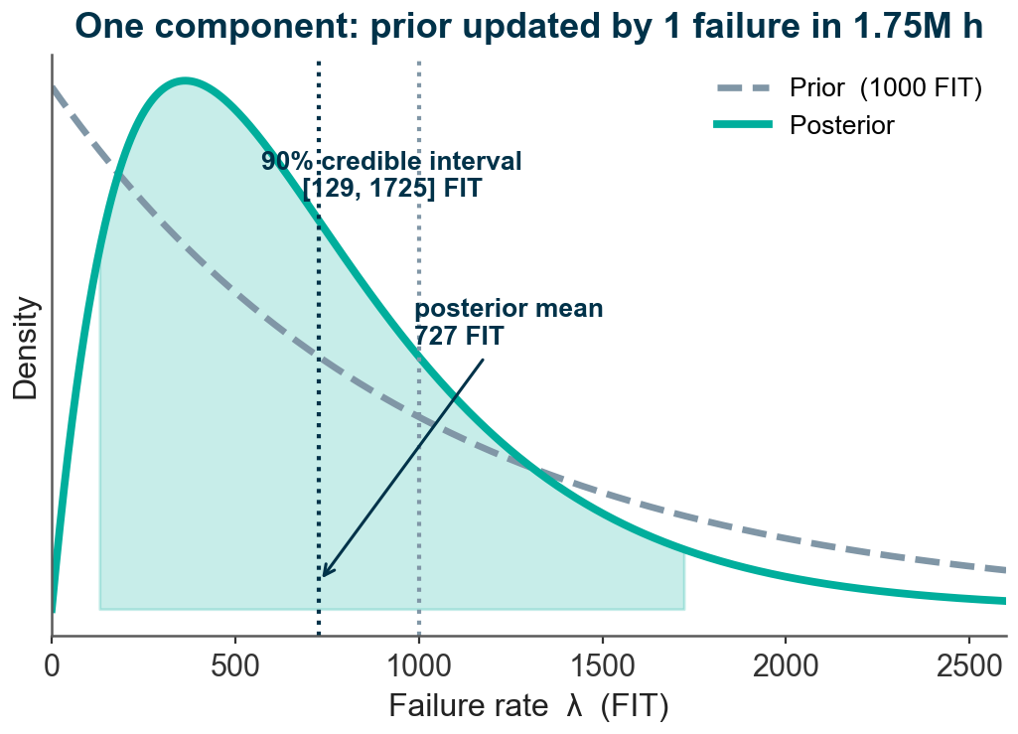
One component, start to finish
Illustrative unit, prior 1000 FIT from ECSS → Gamma(1, 10⁶ h).
REX shows 1 failure in 1.75 million operating hours.
Posterior: mean 727 FIT, 90% credible interval [129, 1725] FIT.
Predicted 7-year reliability: 0.940 → 0.956 — the unit runs a little better than the conservative prior, and we can quantify how sure we are.

Slide 9
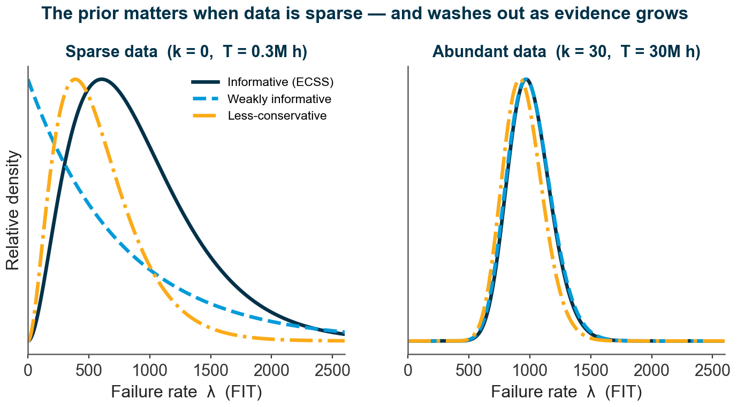
Open question 1 — how much does the prior matter?
With sparse data, the prior can dominate — different defensible priors give different answers.
With enough data, the prior washes out and the evidence speaks for itself.
So: choose priors principledly, and always report how sensitive the result is — the less-conservative ECSS prediction is one reference point.

Slide 10
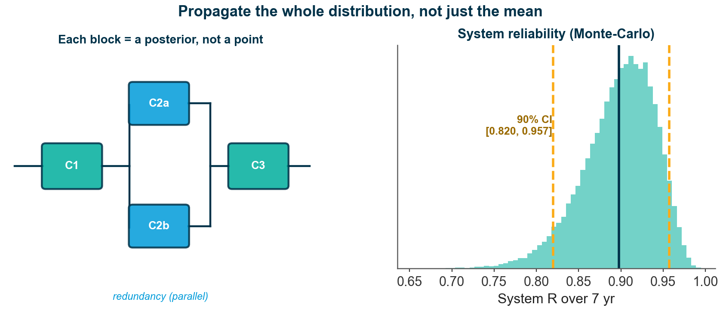
Open question 2 — from components to systems
We don’t want component numbers only — we want subsystem and satellite reliability.
The hard part: propagate the full posterior uncertainty through RBDs / fault trees, with redundancy and common-cause — not just point estimates.
Monte-Carlo over component posteriors yields a system distribution with its own credible interval.

Slide 11
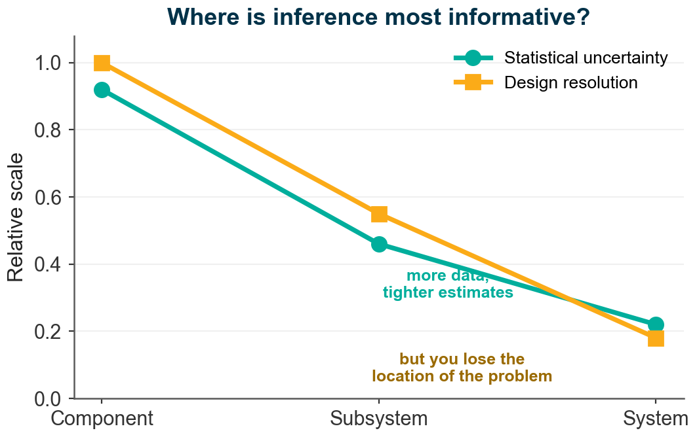
Open question 3 — at what scale is inference most robust?
Components: many, but each fails rarely → sparse data, wide posteriors, high design resolution.
Systems: fewer, but accumulate failures → tighter estimates, lower resolution.
Aggregating buys statistical certainty but loses the location of the weak spot.
Which level should inform which decision?

Slide 12
When to reach for Bayes — and when to be careful
Strengths
Principled fusion of prediction + data
Honest uncertainty (credible intervals)
Handles sparse / zero-failure data
Sequential — update as REX grows
Watch out for
Results depend on the prior — be explicit
Garbage in, garbage out — data quality is everything
Beyond conjugate cases → computational cost
A cultural shift: a distribution, not one number

Slide 13
Where this sits in our work
REX, operationally
Bayes is the engine that turns in-orbit data into updated predictions and EOL inputs — the quantitative side of the REX initiative.
My thesis
A multi-scale Bayesian framework: prior sensitivity (SQ1), propagation (SQ2), scale of aggregation (SQ3), and validation against observed in-orbit behaviour (SQ4).
Status
Component-level Gamma–Poisson update working on a synthetic mission; next steps are real REX priors and hierarchical propagation.

Slide 14
Discussion
A few questions I’d genuinely like your read on:
Where in your projects would an uncertainty-aware, updated estimate change a decision?
Where would you not trust it?
What would make a prior credible enough to use?
Thank you — Luca Lizza, RAMS Section, ESTEC

