Slide 1
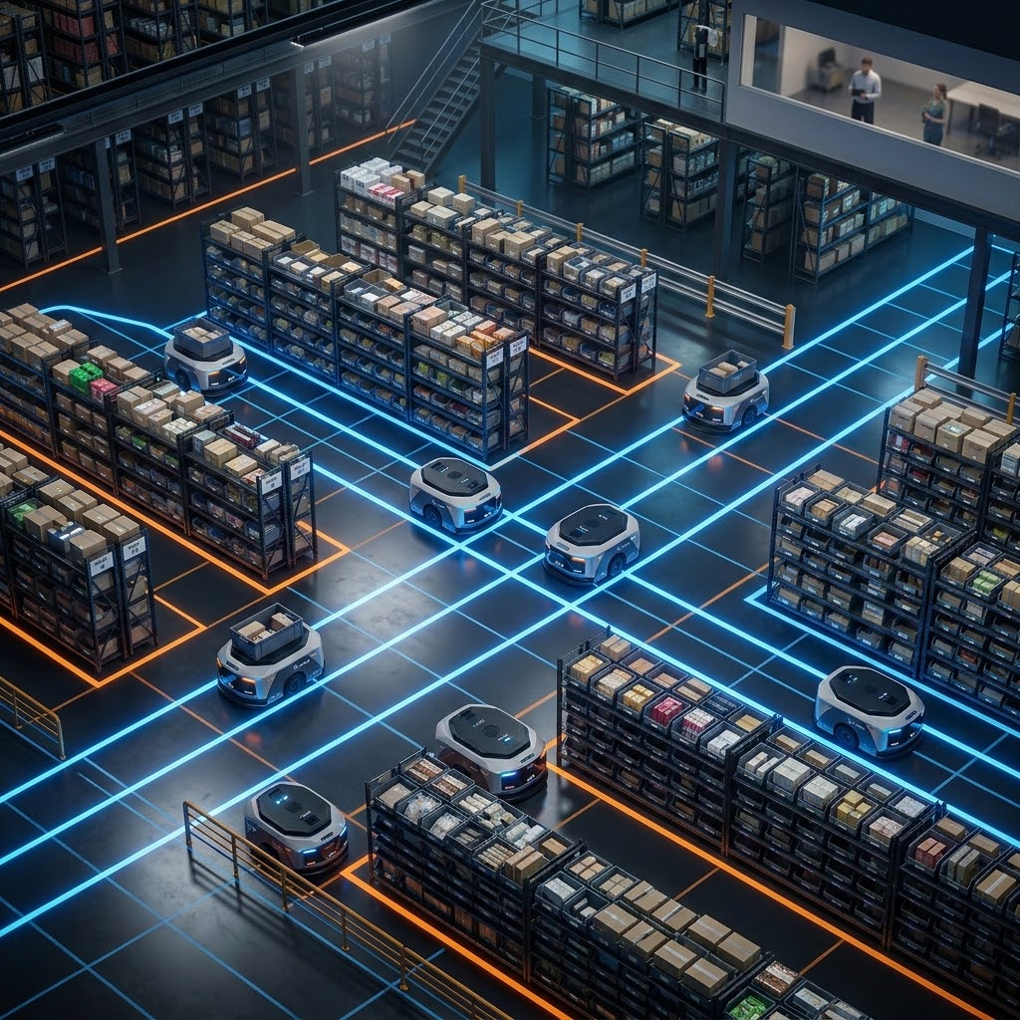
Warehouse Robotics: Multi-Robot Coordination
Core Problem
Resource Contention
Robots must efficiently navigate and deliver packages while ensuring no two units ever occupy the same physical location simultaneously.
Strategic Approach
No Implicit Coordination: Strict avoidance of hardcoded "if-then" waiting rules between robots.
Emergent Behavior: Cooperation and collision avoidance arise naturally from defined spatial physics.
Physical Constraints: Focus on defining the environment's rules rather than individual robot scripts.

Slide 2
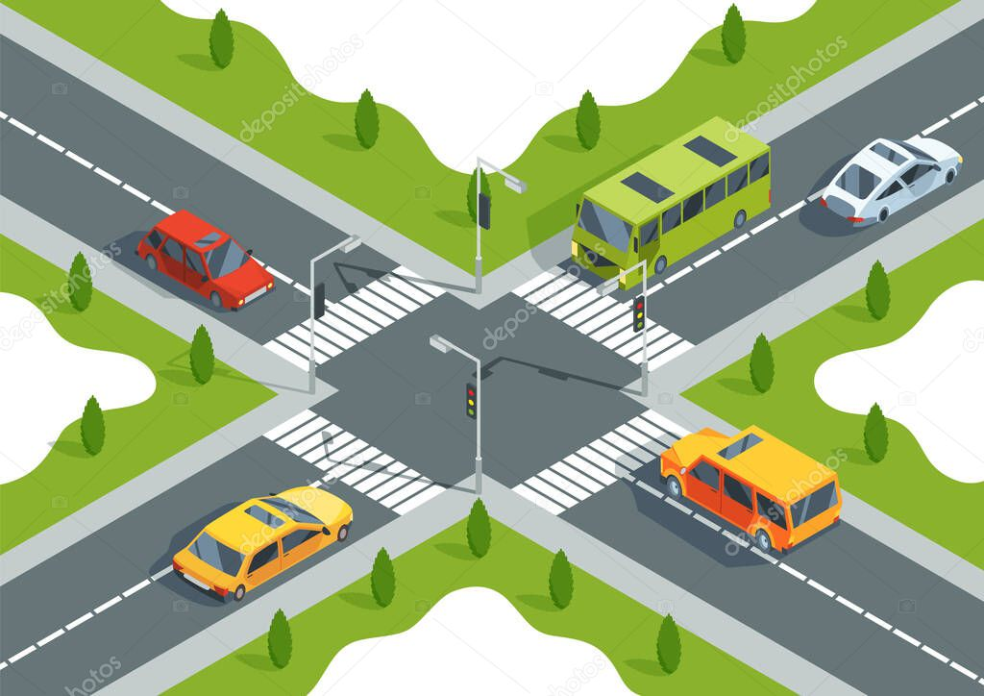
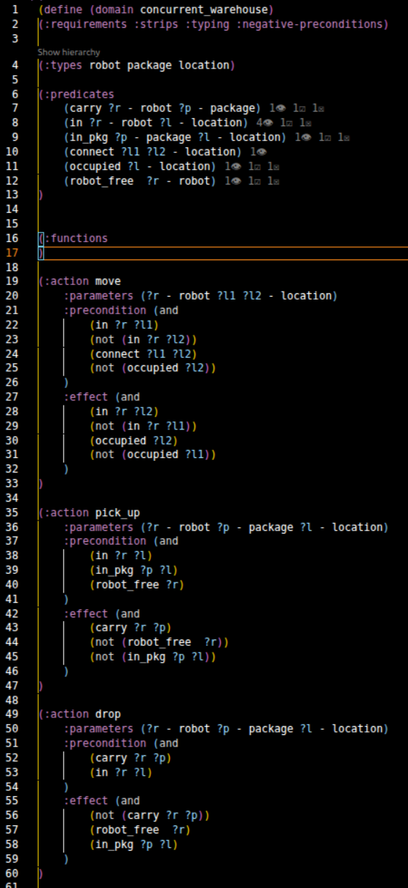
PDDL Modeling
In the PDDL model, collision avoidance works but the planner act like a discrete traffic controller.
In PDDL planning safety is achieved through rigid synchronization rather than fluid coordination.

Slide 3
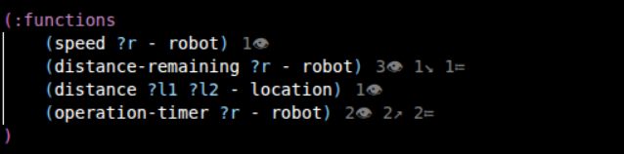

Fluents
Numeric Variable Tracking
In PDDL+, numeric fluents represent the internal state of robot activities that change over time.
Action Initialization: Instantaneous actions act as triggers, explicitly initializing the numeric fluents (e.g., assigning operation timers to zero or setting the required distance).
Continuous Change: Fluents represent quantities like distance or picking_up time that increment/decrement linearly.
Process Integration: Tied directly to the active duration of "moving," "picking," or "dropping" processes.
Threshold Gates: Final state transitions occur only when a fluent reaches a predefined numeric limit.

Slide 4
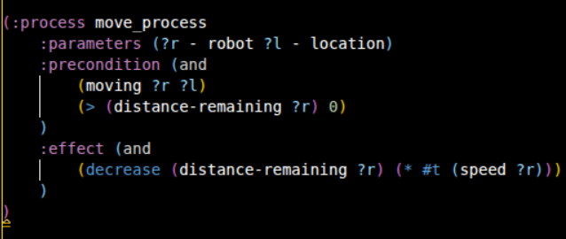
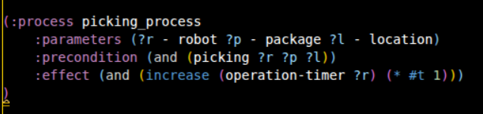
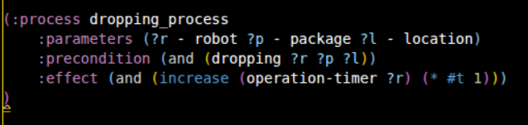
Processes
Continuous Execution: Unlike instantaneous PDDL actions, the PDDL+ domain models robot activities using three continuous processes (moving, picking up, and dropping off).
Numeric Fluents: Each process operates by continuously incrementing or decrementing a tracked numeric variable over time.
Threshold-Triggered Events: Autonomous events automatically trigger to finalize the action the moment the modified variable reaches its specific threshold.

Slide 5
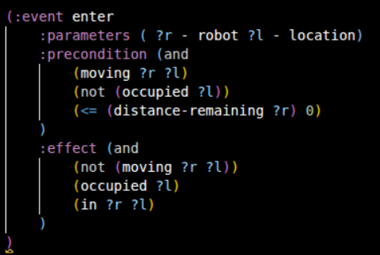
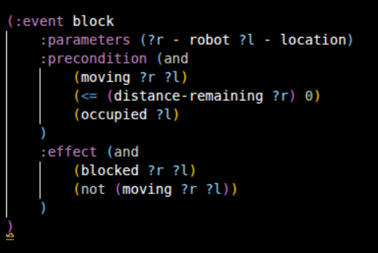
Autonomous Events
Threshold Triggers
Events are instantaneous state transitions that occur automatically when numeric conditions are met.
No Duration: Unlike processes, events happen at a single point in time to finalize a change.
Autonomous: They do not require a planner to schedule them; they are triggered by the environment's physics or when a fluent reaches its threshold.

Slide 6
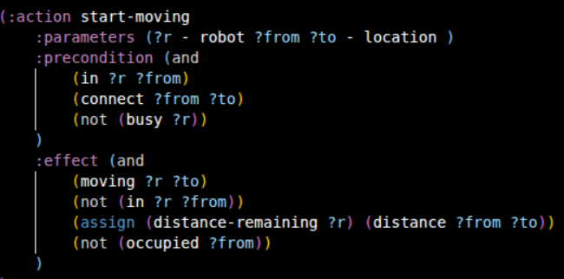
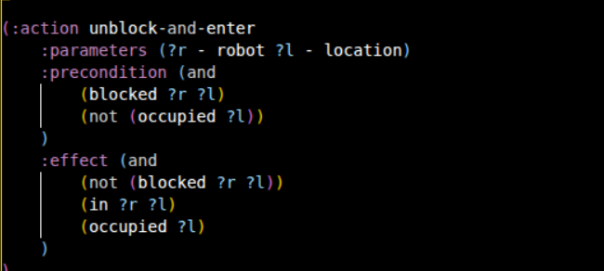
Actions
Instantaneous Triggers
Actions act as entry points for continuous processes, and they also function as standalone, immediate logical state transitions that do not trigger processes (such as the unblock-and-enter action).
State Initialization: Set initial values for numeric variables like distance-remaining or operation-timer.
Process Activation: Actions toggle the logical predicates that allow processes (like moving) to begin execution.
Discrete Change: Unlike events, actions are scheduled by the planner to achieve specific goal states.
Actions represent the "decisions" made by the robot to initiate physical changes in the environment.

Slide 7
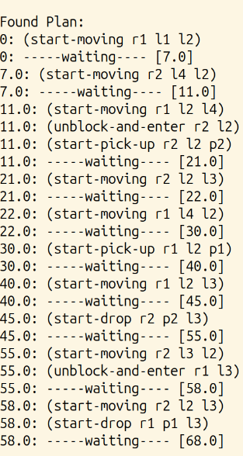
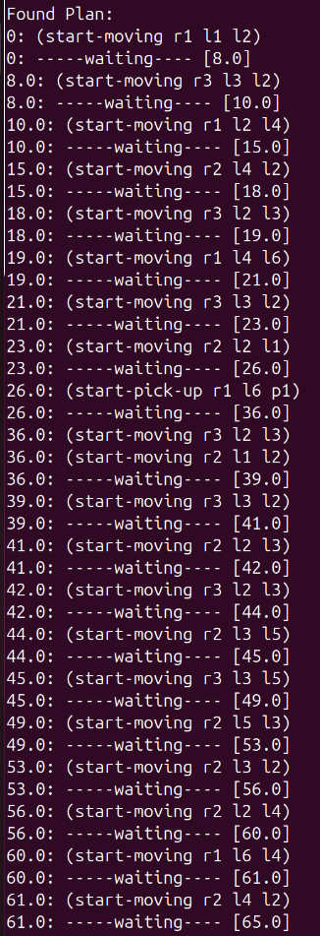
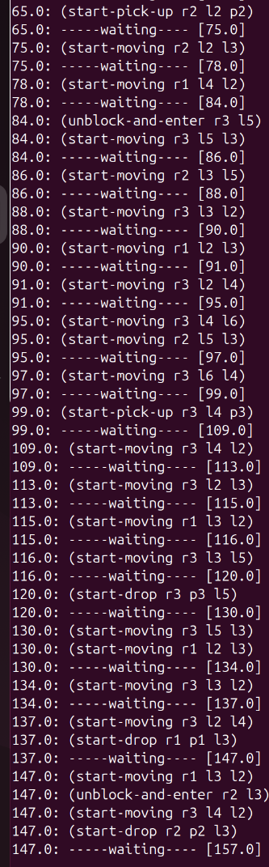
Plan Output
←2 robots problem
3 robots problem →

Slide 8
Reflections
Main Challenges
Current Limitations
Future Improvements
Avoiding Implicit Coordination: Resisting hardcoded traffic rules to let coordination emerge from spatial constraints.
Event-Driven Enforcement: Converting "blocking" from a planner choice (which could be bypassed) into an inevitable environment event triggered when target rooms are occupied.
Computational Overhead: ENHSP solver experiences long execution times due to state space explosion.
Heuristic Plateaus: Lack of movement cost makes "waiting 20s" and "wandering 20s" mathematically identical.
This results in the planner exploring thousands of useless, non-productive roaming branches.
Resource-Based Metrics: Introduce a "battery level" or "energy" fluent that drains during movement.
Search Tree Pruning: Assigning cost to movement forces robots to remain still while waiting.
This simple change would eliminate chaotic movement and significantly speed up computation times.

