Slide 1

Homework 1 – Group 1
Luca Manzini
Luigi Pampanin
Lucia Menna
Helen Wolf
Francesco Izzi
Imaging for Neuroscience a.a. 2023/2024

Slide 2

AIM OF THIS HOMEWORK AND DATASET
The goal of this homework is to investigate the relationship between brain states of two different groups of individuals as defined by dynamic functional connectivity obtained from resting state functional MRI data.
old = folder containing data of 10 old healthy controls
young = folder containing data of 10 young healthy controls
For both old and young controls, each subfolder contains:
preproc_rs_fMRI.nii.gz = preprocessed fMRI data (2x2x2 mm3, TR=1 s, 400 volumes) mapped into the MNI152 symmetric atlas
brain_mask.nii.gz = individual fMRI brain mask mapped into the MNI152 symmetric atlas
Schaefer_segmentation.nii.gz = Schaefer segmentation (100 parcels - 7 RSNs) of the MNI152 symmetric atlas
Schaefer2018_100Parcels_7Networks_order.txt = file containing the labels of the parcels
labels.mat = vector with the labels of the parcels
MNI_WM_mask.nii.gz = white matter mask of the MNI152 symmetric atlas
Vernikos and Schneider, Gerontology, 2009 Mhatre et al., Neuroscience and Biobehavioral Reviews, 2022

Slide 3
METHODS: Summary of performed analysis
Extracting fMRI data for each parcel for each group: old and young
🡪 excluding voxels outside the individual mask and within the one for the white matter
Computing static functional connectivity (matrix)
🡪 Fisher’s z-transformation: zFC
Computing dynamic functional connectivity: sliding window (length = 30 t.p. , step size (TR) = 2)
4. 🡪 Fisher’s z-transformation: zFC
5. + 6. Characterization of both populations (HC = old and young) by analysing functional states using the dynamic functional
connectivity results
  Clustering analysis: hierarchical method (tree) and Euclidean distance metric
  🡪 Optimal number of clusters: K_Old + K_Young between 2 and 10 🡪 shilouette approach
  Fractional occupancy = nr. windows for one state/ total nr. windows)
  Graph theoretical analysis on centroids of each of K_old and K_young clusters
    Adjacent matrix A_Old + A_Young: sparse matrix, one dim for each cluster
    (density reduced to 1 and 0, threshold = 75% highest positive values)
    Calculate Laplacian matrix = D – A
    Calculate Gradient = principal eigenvector corr. lowest eigenvalue: Gradient_Old + Gradient_Young
Comparison of functional states between old and young HC
  K_Old == K_Young ?
  Matrix Dist_all : Spearson corr. between Gradient_Old and Gradient_Young
  Which is the state of the old population that least resembles the youth states?
Vernikos and Schneider, Gerontology, 2009 Mhatre et al., Neuroscience and Biobehavioral Reviews, 2022

Slide 4
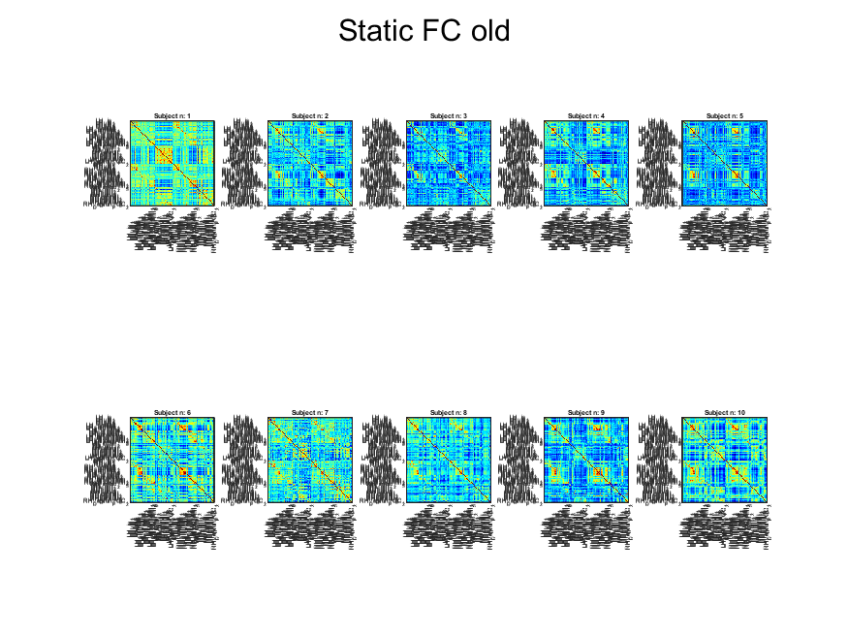
RESULTS Static FC 🡪 Old HC
Vernikos and Schneider, Gerontology, 2009 Mhatre et al., Neuroscience and Biobehavioral Reviews, 2022
Notes:
Here: FC matrices for HC = old after Fisher’s z-transformation: zFC 🡪 for normalisation
Labels: Parcels’ names: indicating brain networks
Matrices computed by pearson correlation of each voxels’ time courses
Red color: High correlation, yellow/green: in between , light/ normal blue low/no correlation, dark blue/black: inverse correlation
Subjects show different overall correlation between networks when comparing between the subjects but for all of them high correlation seen between the
LH Somato motor- LH somato motor,
LH Somato motor- RH somato motor,
RH Somato motor- RH somato motor
Also seen that correlation is in general higher within the networks (e.g LH vis x – LH vis y ) and between same networks but in the different hemisshpheres (e.g LH Somato motor- RH somato motor)
🡪 Makes sense as networks and hemispeheres are connected
- By the lighter ‘squares’ in the FCs, it is also visible which overall networks are more connected together ( e.g. LH visual – LH dorsalAttention)
Subject 1: higher correlation between networks in general,
especially in LH default 4-0, LH cont – LH default, LH_limbic –LH default, RH dorsal attention – RH salventral attention, LH cont – RH default, LH default – RH default
In general lower correlation values for subject 5 and 6

Slide 5
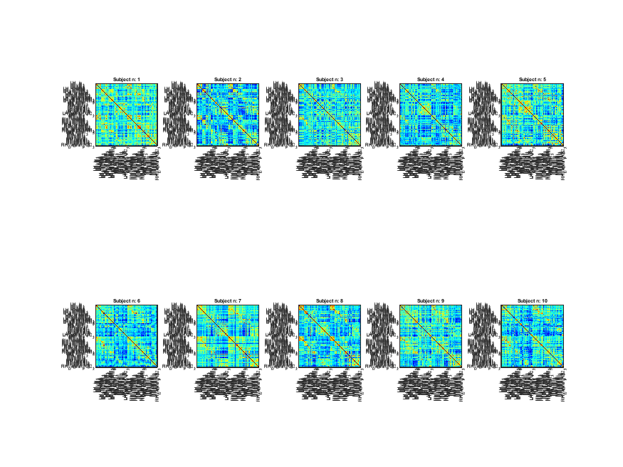
RESULTS Static FC 🡪 Young HC
Vernikos and Schneider, Gerontology, 2009 Mhatre et al., Neuroscience and Biobehavioral Reviews, 2022
Notes:
Here: FC matrices for HC = young after Fisher’s z-transformation: zFC 🡪 for normalisation!!! The Pearson correlation coefficient has a distribution that can be highly non-normal, especially for extreme values close to -1 or 1. The Fisher Z transformation makes the distribution of correlation coefficients more similar to a normal distribution, facilitating the application of statistical techniques that assume normality.
Labels: Parcels’ names: indicating brain networks
Matrices computed by pearson correlation of each voxels’ time courses
Also here higher correlation for subject 1
In general, same results seen as for old HC but higher overall correlation, especially between default networks
🡪 makes sense as old and young HC have probably different brain age: 🡪 differences in amount of gray matter (brain cells)
🡪 therefore also subjects in general different connectivity matrices

Slide 6
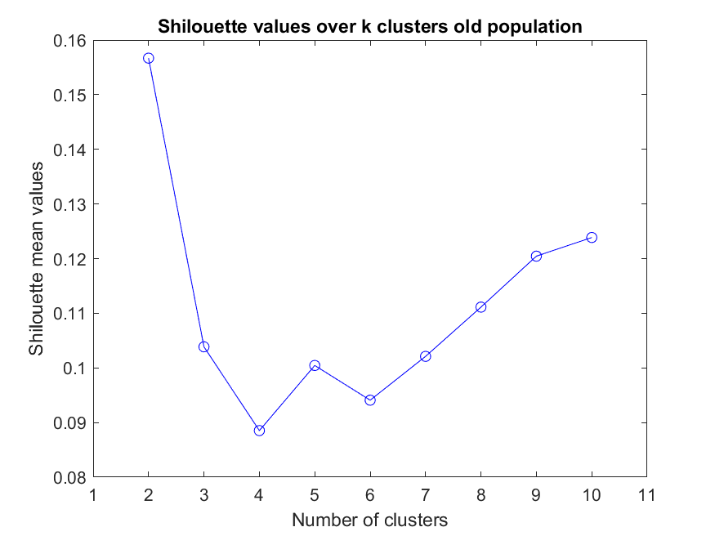
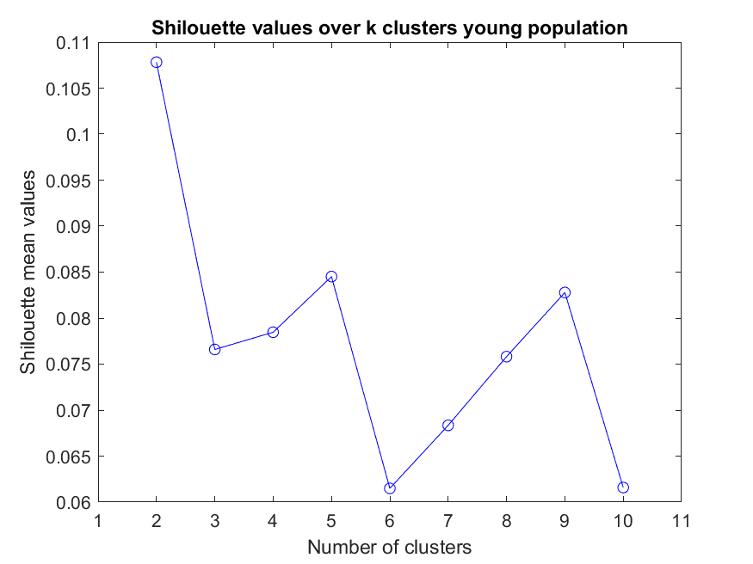
RESULTS: Dynamic functional connectivity – Clustering
Hierarchical method (tree) and Euclidean distance metric: ‘ward’ method
Nr. optimum clusters: shilouette approach used
K_Old = 5
K_Young = 5
Vernikos and Schneider, Gerontology, 2009 Mhatre et al., Neuroscience and Biobehavioral Reviews, 2022
Notes:
hierarchical method: clustering tree
Euclidean distance metric: ward method 🡪 use minimum variance as cluster criterion: only this method gave monotonous tree
Nr. optimum clusters: shilouette approach used: mean of all values 🡪 how close is one point to points in same cluster and how far to points in other clusters
Optimum nr.: K_Old = 5, K_Young = 5 🡪 local maximum (between rise and fall of shilouette value)
-

Slide 7
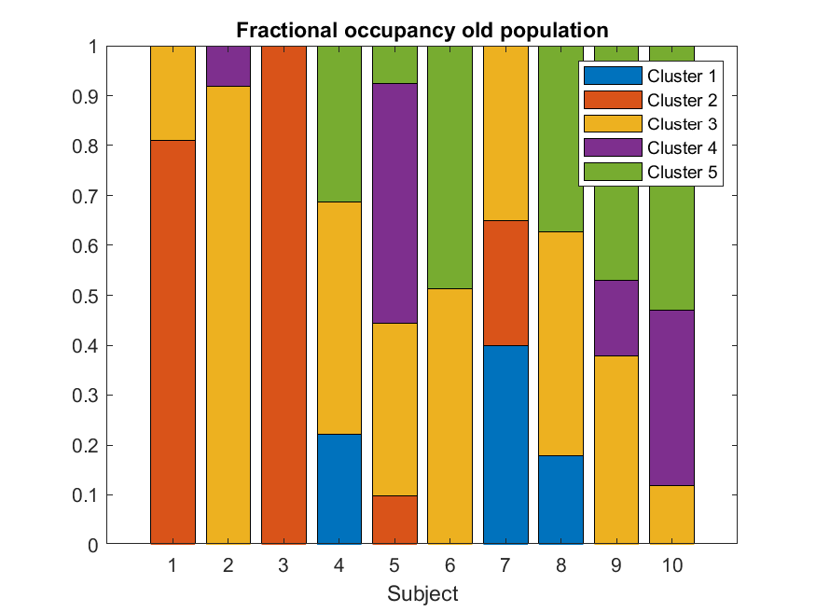
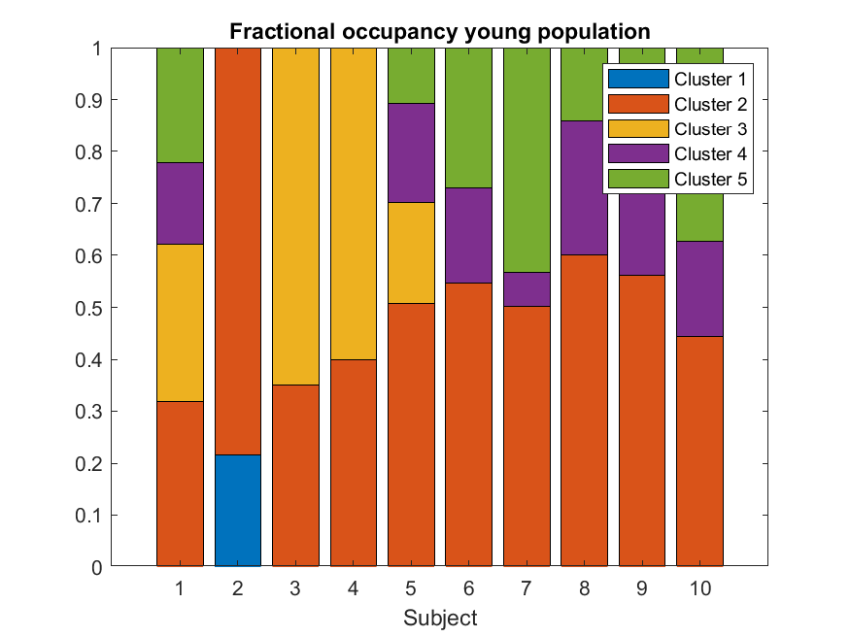
RESULTS Dynamic FC: Fractional occupancy
Fractional occupancy = nr. windows for one state/ total nr. windows)
Vernikos and Schneider, Gerontology, 2009 Mhatre et al., Neuroscience and Biobehavioral Reviews, 2022
Notes:
Plot shows how much time participants spent in the different stages (represented by the clusters)
It is seen that for the young HC, cluster = stage 2 is present to a quite high amount in all subjects and also stage 4 and 5 are present often. In the old population it is more mixed.
🡪 might show that young subjects e.g have kinda more of the the same networks connected over the time period as which is fitting to the higher correlation values of the static FC analysis
Old HC group more unstable in network connections: maybe some connections between brain areas not possible anymore?

Slide 8
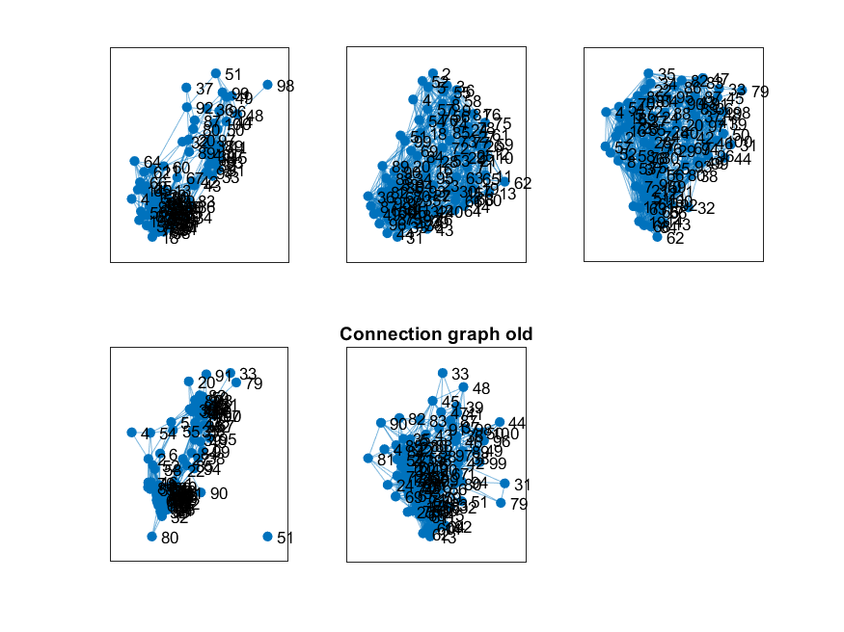
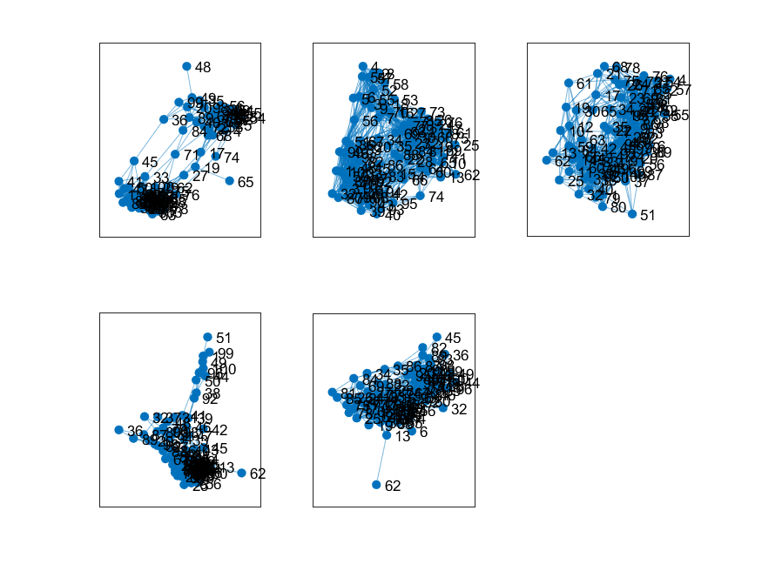
RESULTS Dynamic FC: Graph theoretical analysis
1. Adjacent matrix: sparse matrices, showing edge connection in graph🡪 illustrate connectivity graphs
Old
Young
2. Laplacian matrix: D-A
🡪 combining degree of a node and egde connections to get necessary information about networks’ connections structure
3. Gradient matrix: principal eigenvectors corr. lowest eigenvalue 🡪 how nodes can be grouped toegether
Vernikos and Schneider, Gerontology, 2009 Mhatre et al., Neuroscience and Biobehavioral Reviews, 2022
Notes:
- Adjacent matrix A_Old + A_Young: sparse matrix, one dim for each cluster (density reduced to 1 and 0, threshold = 75% highest positive values): indicating edges between nodes
Saw differences in sparse connectivity matrix
Can be seen also by looking at graphs: which nodes (parcel areas/networks) are connected to which others: differences between HC are seen in network connections
- Compare gradients to see differences between HC in grouping of the nodes 🡪 networks

Slide 9
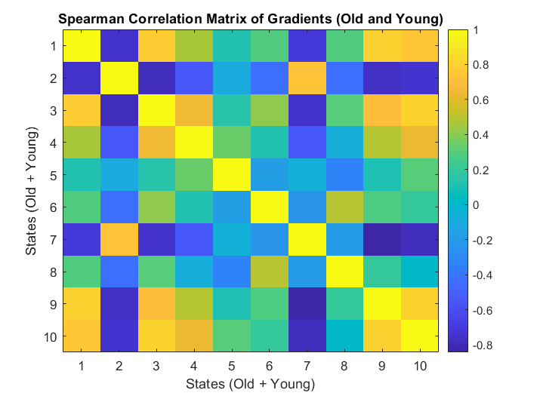
RESULTS Dynamic FC: Comparison between old and young HC
K_Old equal to K_Young
State 2 of old HC resembles youngs states the least
Vernikos and Schneider, Gerontology, 2009 Mhatre et al., Neuroscience and Biobehavioral Reviews, 2022
Notes:
Plot shows Dist_all : Spearson corr. between Gradient_Old and Gradient_Young (first 5 entries old HC, last 5 young HC)
Correlation between stages of old and young HC
Use to measure whether stages resemble the stages in the other HC :
1 = yellow: high correlation yes, resembles correlated state good, green/blue : low = 0: does not resemble other state , lower : -1dark blue: anti correlation
Anti correlation shows the opposite behvaiour of a stae 🡪 so the lower the correlation value, the less resembles a state a correlated one
🡪 finding minimum correlation value (anti correlation shows that stae is doing the opposite)

Slide 10
CONCLUSION
Differences in FCs bewteen subjects and HC:
Differences in amount brain cells and connections likely, especially between the groups (higher age 🡪 less brain cells)
Differences in fractional occupancy
Node connections differently
K_Old equal to K_Young
State 2 of old HC resembles youngs states the least
Vernikos and Schneider, Gerontology, 2009 Mhatre et al., Neuroscience and Biobehavioral Reviews, 2022

