Slide 2
VIS4AI – TheFinalGroup
Intermediate results
Luca Dal Bosco, Christian Kühberger, Adrian Lehrner, Nikesh Bhattarai
Notes:
Einleitung BA / MA und kurze Vorstellung der Person!

Slide 3
Summary
The task
  ...
Visualizations without AI
Visualizations with AI

Slide 4
The task
We study how a reasoning (DeepSeek-R1-Distill-Qwen-1.5B) and a similar non-reasoning model (Qwen2.5-Math-1.5B) solve school math problems (dataset GSM8K).
We ran our Notebooks in Google colab with a T4 GPU.
Example question:
Janet’s ducks lay 16 eggs per day. She eats three for breakfast every morning and bakes muffins for her friends every day with four. She sells the remainder at the farmers' market daily for $2 per fresh duck egg. How much in dollars does she make every day at the farmers' market?

Slide 5
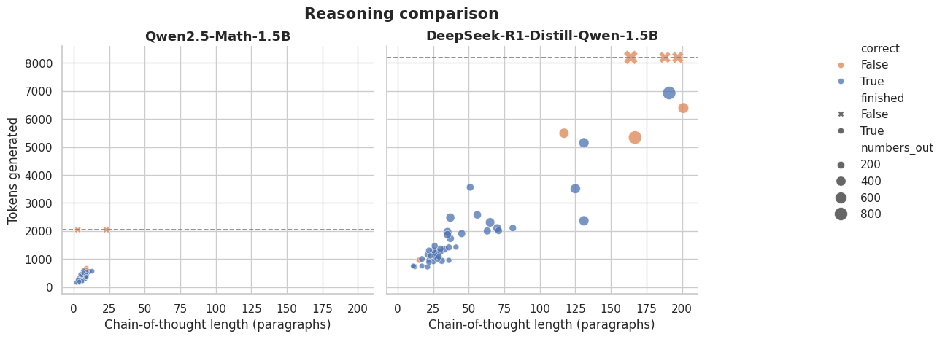
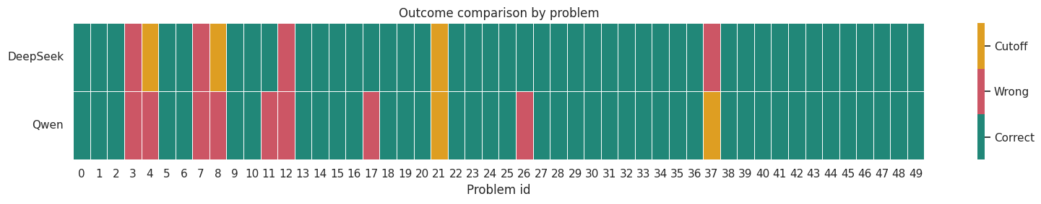
Visualizations without AI

Slide 6
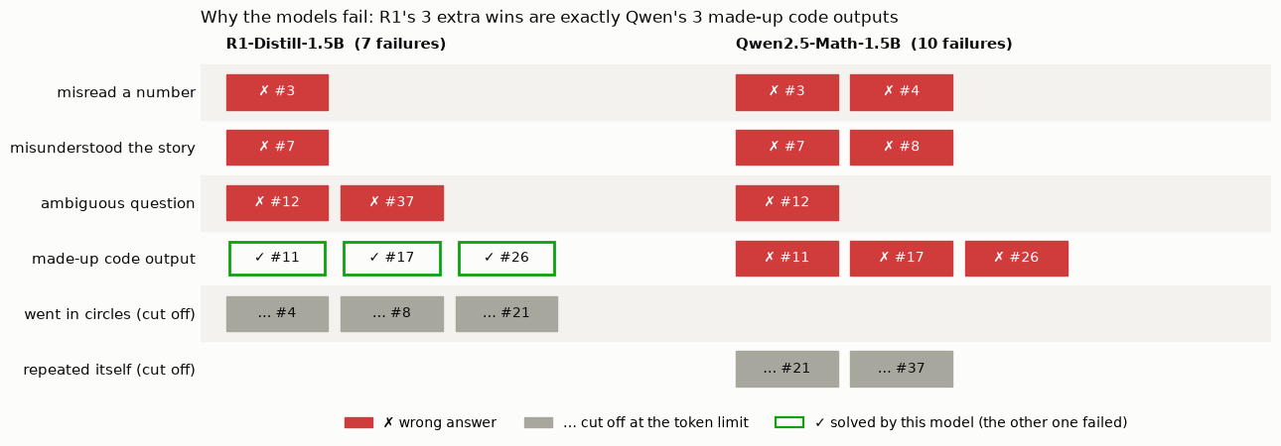
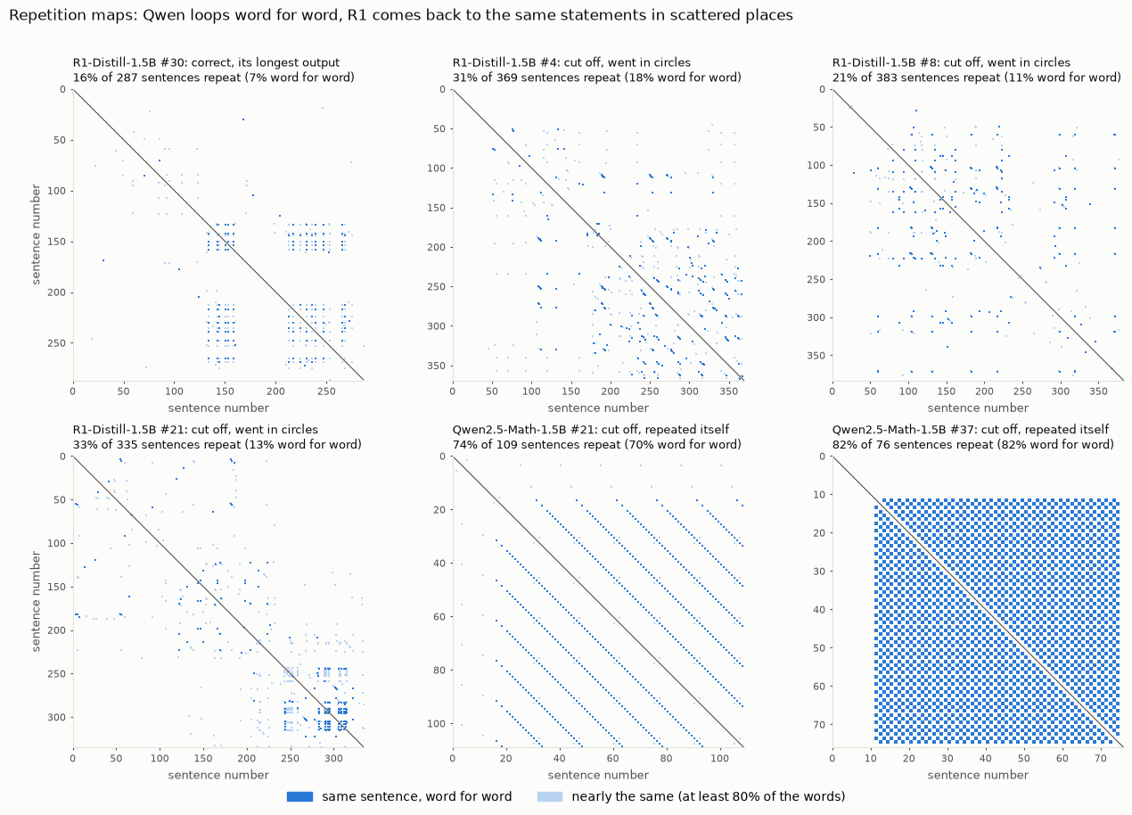
Visualizations with AI

Slide 7
Thank you!

