Slide 1

Secure Pass
Project and laboratory on communication systemS
Final presentation

Slide 2

Outline
Introduction
System Architecture
Server
Client
Web Application

Slide 3
Outline
Introduction
Team
Concept
System Architecture
Server
Client
Web Application

Slide 4
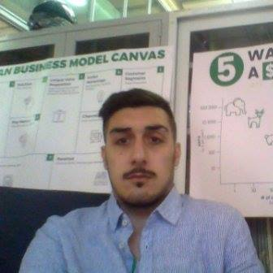


Development Team
Luca Mocerino
Edoardo Mazzella
Ramon Messinetti

Slide 5
Secure Pass - Concept
Where can it be used?
Secure Pass can be used in every work environment and private area.
Thanks to Secure Pass your company can:
control accesses for security reasons;
control employees working hours
It is the best alternative to the usual badge systems because it really allows to control accesses with maximum reliability and security avoiding unauthorized people to have an access in and employee fake entrances or exits.

Slide 6
Secure Pass - Concept
SecurePass is a system developed for improving security of any access control system.
The user can:
Access to the system using a double key validation throught face recognition system and univoque identifier;
The admin can:
Insert user/employee credetials;
Check the timetable of each employee;
Receive an email when the system spots an anomaly in the access procedures
Notes:
Highlight the fact that the firs ID is important as second key of validation since the only the face can be hacked using a printed photo

Slide 7
Outline
Introduction
System Architecture
Server
Client
Web Application

Slide 8

System Architecture
Web Application
Users
Network
Server
Client
FEZ Spider
Server Application
Ethernet
Database
Peripherals

Slide 9
Outline
Introduction
System Architecture
Server
Overview
Microsoft Cognitive Services
Execution Steps
Client
Web Application

Slide 10



Mail Service
ID
Image
Client
Server
Application
Credential
Confidence score
Microsoft
Cognitive Service
MySQL Database
Notes:
Highline the fact that we use client library from microsoft (oxford project) for face recognition, face and all the flo

Slide 11
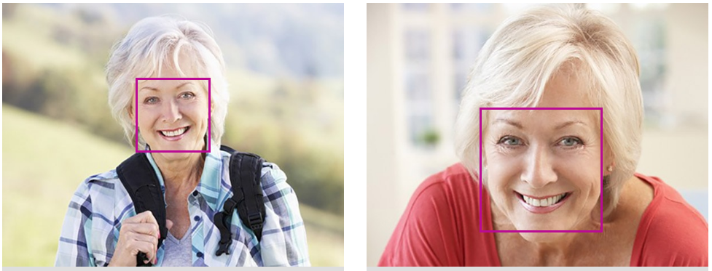
MS Cognitive Services – Face Recognition
Face Recognition is one of the cognitive services powered by Microsoft. It checks and returns the probability that two faces are of the same person.

Slide 12

Step 1 - Connection
Server creates a socket and wait for the client connection;
If the network is up, the Client opens the socket and connects to the Server
TCP/IP Socket
Client

Slide 13
Step 2 – ID Check
Client sends the unique ID as a first security layer;
Server accesses the database and check if the ID is in the database;
Send the acknowledge to the client
ID
Client
ACKNOLEDGE

Slide 14
Step 3 - Image Check
User pushes the button and sends the image to the server;
Server requests to Microsoft Cognitive Service for matching the image from camera with the one in the database;
Server sends an EN/EX/NACK message to the client;
In case of NACK the user can retry at most two more times, after those an email is sent to the admin;
IMAGE
Client
EN / EX / NACK

Slide 15
Outline
Introduction
System Architecture
Server
Client
Overview
Hardware Configuration
Glide
Web Application

Slide 16

Client - Overview
The Client Side is a .Net Gadgeteer application.
Microsoft .NET Gadgeteer is an open-source toolkit for building small electronic devices using the .
NET Micro Framework. It combines the advantages of object-oriented programming, solderless assembly of electronics, and support for customizable physical design.

Slide 17



TO SERVER
Ethernet
FEZ Spider
Ethernet
Analog
Button
Touch screen
Camera

Slide 18
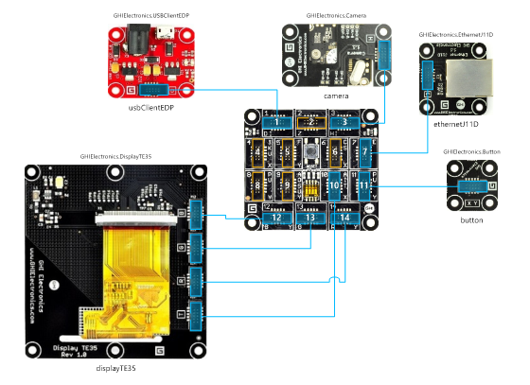
Client - HW Configuration
The hardware components utilized for the client application are:
A FEZ Spider II Mainboard
Display TE35
Camera
USB Client EDP
Ethernet J11D
Button

Slide 19

Client - Glide
Glide is a graphical library for .NET Micro Framework.
Through the Glide Designer Tool you can easily design a graphical screen made of buttons, text boxes and text blocks and generate an XML file that is loaded as a string resource in the Visual C# project.
Finally using the functions of the Glide library you can show the generated windows on the screen and associate events to the button pressure.

Slide 20
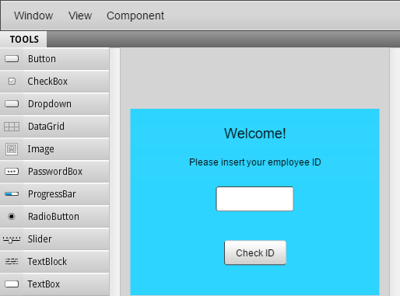

Client - Glide

Slide 21
Outline
Introduction
System Architecture
Server
Client
Web Application
Overview
Database Management

Slide 22
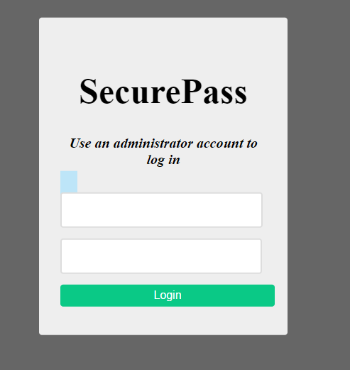
Web Application - Overview
A Web Application has been developed to allow the admin to manage the database and read the tables contents.
For security reason obviously the admin has to login before acting on the database.

Slide 23
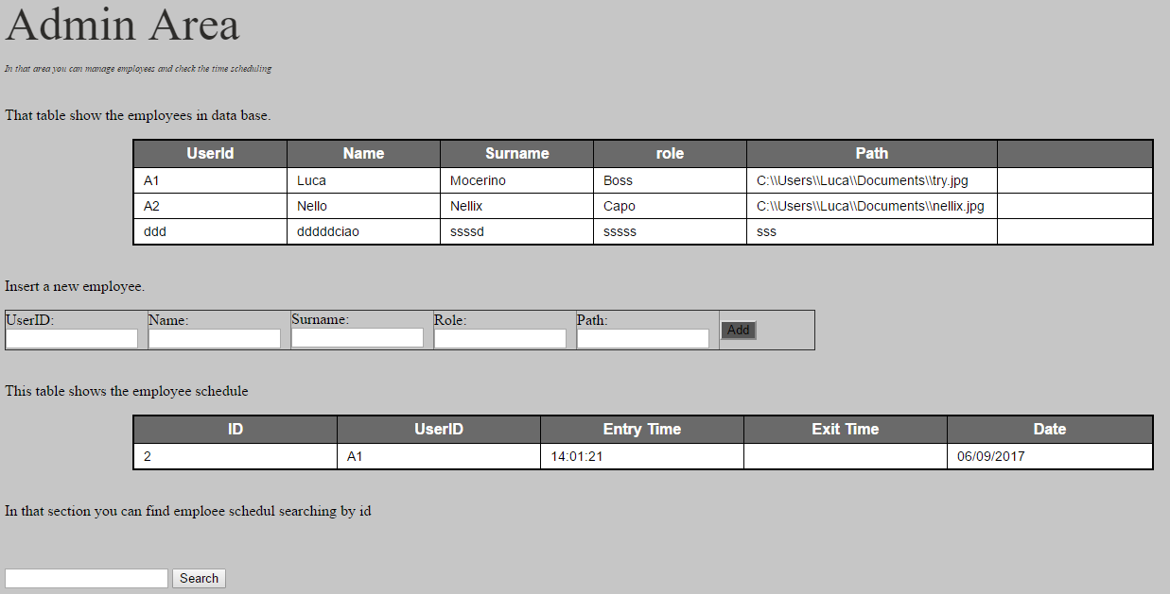
Web Application - Database Management
Through the Web Application the admin can create, read, update and delete users and can check the timetable to verify the employees’ working hours.

Slide 24
Thank You !
Any questions?
…
It is time for the demo

