Slide 1
Final Presentation
Stream Processing for Spatially-Distributed IoT Systems
Wolkowitsch Manuel
Riegler Maximilian
Bulatovic Djordje
Moroldo Luca
Milasus Edzus
Stream Processing for Spatially-Distributed IoT Systems

Slide 2
Real-Time Data Stream Processing
“Real-time data streaming is the process by which big volumes of data are processed quickly such that a firm extracting the info from that data can react to changing conditions in real time.”
https://www.techopedia.com/definition/31747/real-time-data-streaming

Slide 3
General Overview
Many applications today require real time data streaming and analysis
Examples:
Car sharing
Performance monitoring of airplanes
Monitoring manufacturing equipment status
Where sensors and cameras are used, data streaming can be utilized
Real world example:
Uber
Our objective:
implement real time taxi monitoring application

Slide 4
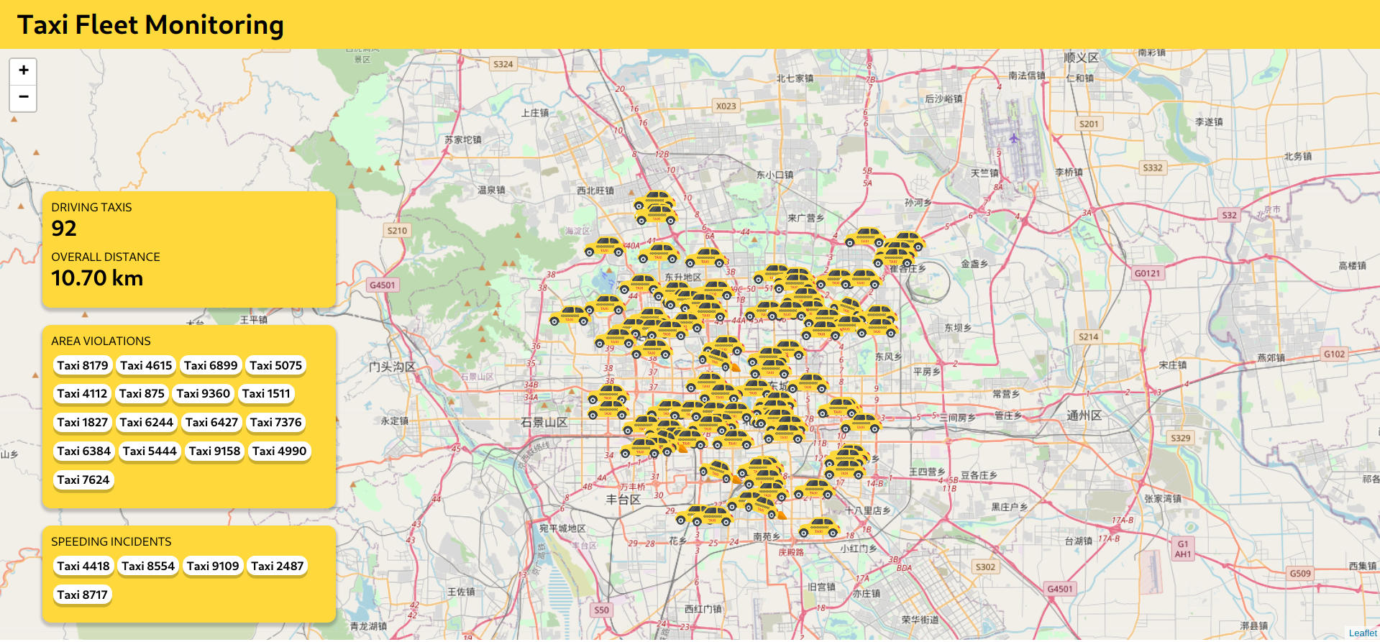

Slide 5
Motivation
We just care about the most recent data, which has to be processed
Process high volumes of data
Performance
Scalability

Slide 6
Tech used
Zookeeper: configuration management, naming, synchronization, etc.
Kafka: message broker
Storm: stream processing
Redis: in-memory database
Websockets: communication between notification bolts and dashboard
NodeJS: dashboard-backend
React: dashboard (user-interface)

Slide 7
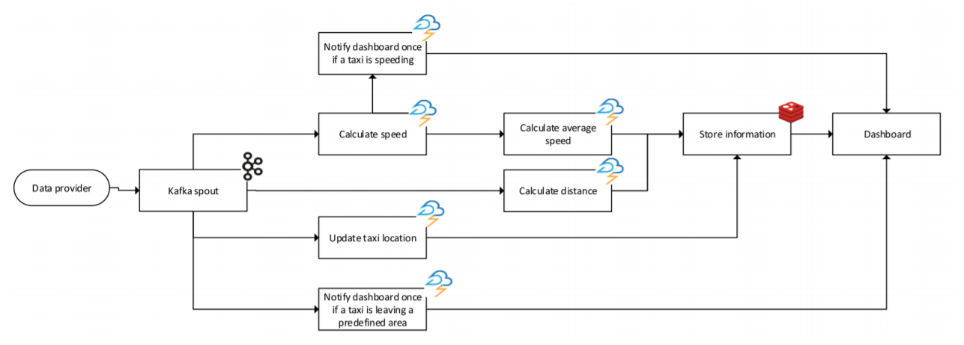
Topology Overview

Slide 8
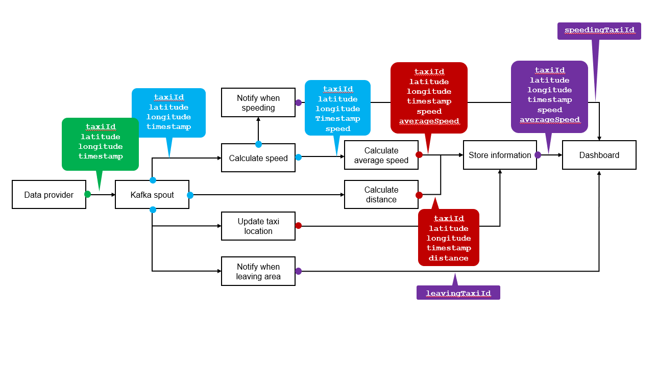
Data Flow Overview

Slide 9
Notify when speeding
Calculate speed
Calculate average speed
Store information
Dashboard
Data provider
Kafka spout
Calculate distance
Update taxi location
Notify when leaving area

Slide 10
Notify when speeding
taxiId
latitude
longitude
timestamp
Calculate speed
Calculate average speed
Store information
Dashboard
Data provider
Kafka spout
Calculate distance
Update taxi location
Notify when leaving area

Slide 11
taxiId
latitude
longitude
timestamp
Notify when speeding
Calculate speed
Calculate average speed
Store information
Dashboard
Data provider
Kafka spout
Calculate distance
Update taxi location
Notify when leaving area

Slide 12
taxiId
latitude
longitude
Timestamp
speed
taxiId
latitude
longitude
timestamp
Notify when speeding
Calculate speed
Calculate average speed
Store information
Dashboard
Data provider
Kafka spout
Calculate distance
Update taxi location
Notify when leaving area

Slide 13
Notify when speeding
Calculate speed
Calculate average speed
Store information
Dashboard
Data provider
Kafka spout
Calculate distance
Update taxi location
taxiId
latitude
longitude
timestamp
distance
Notify when leaving area

Slide 14
taxiId
latitude
longitude
timestamp
speed averageSpeed
Notify when speeding
Calculate speed
Calculate average speed
Store information
Dashboard
Data provider
Kafka spout
Calculate distance
Update taxi location
Notify when leaving area

Slide 15
speedingTaxiId
taxiId
latitude
longitude
timestamp
speed averageSpeed
Notify when speeding
Calculate speed
Calculate average speed
Store information
Dashboard
Data provider
Kafka spout
Calculate distance
Update taxi location
Notify when leaving area
leavingTaxiId

Slide 16
Technical Demo

