Slide 1

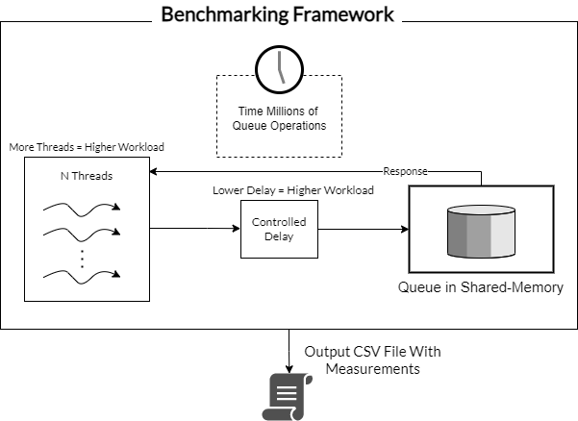
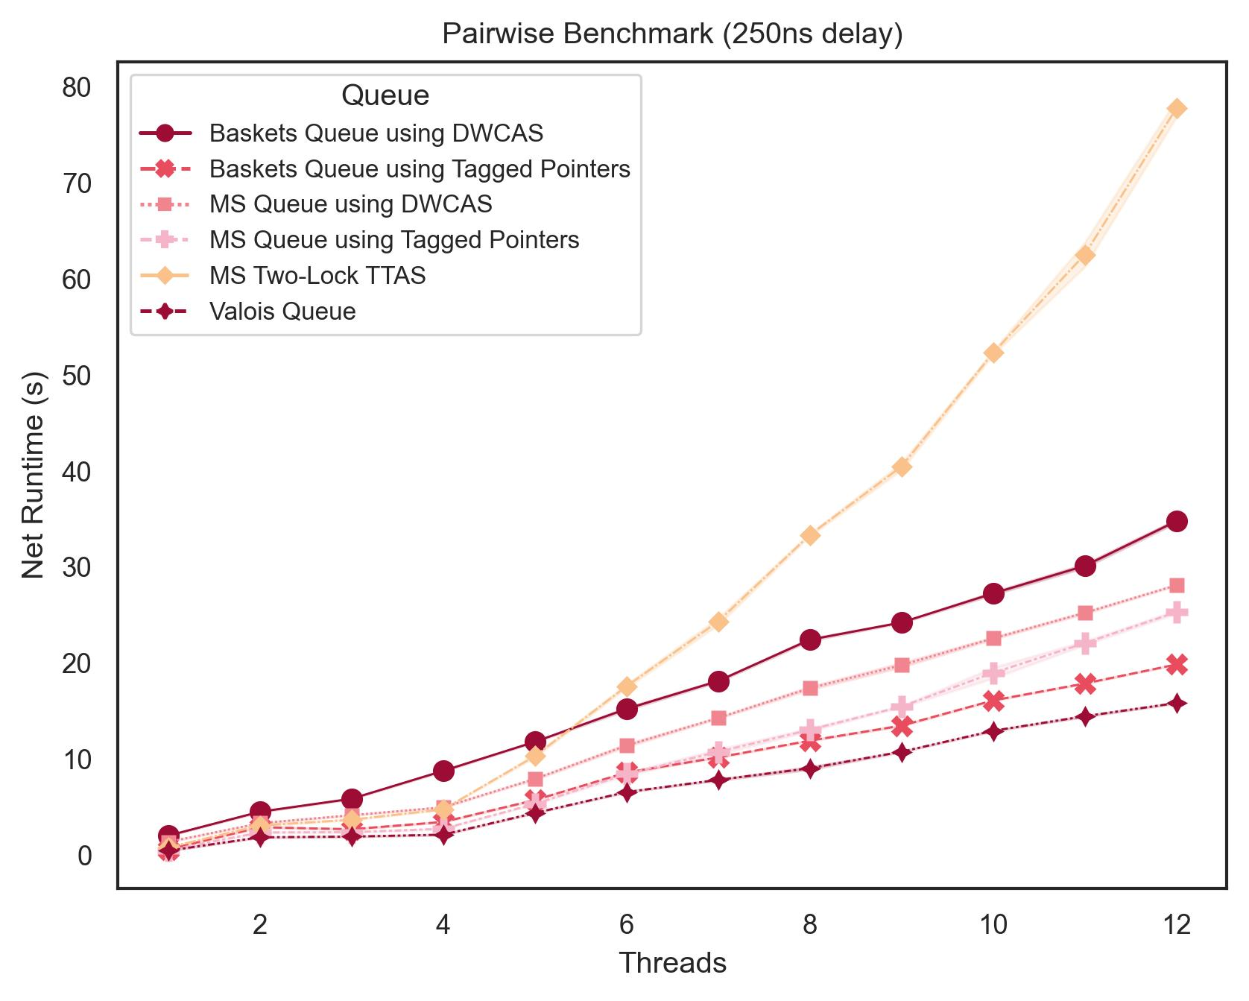
B.Sc. (Hons.)
Computing Science
A Comparative Study of Concurrent Queueing Algorithms & Their Performance
Luca Muscat
Supervisor: Prof Kevin Vella
INTRODUCTION
Queues are one of the most ubiquitous data structures in the field of Computing Science. With the advent of multiprocessor programming, concurrent queues are at the core of many concurrent and distributed algorithms. The act of writing and testing multiprocessor programs is often humorously referred to as an art [1], due to the sheer difficulty of ensuring the code’s correctness. Intimate knowledge of the CPU’s architecture and memory is a must, due to the plethora of ways one may unknowingly incur performance penalties.
BENCHMARKING FRAMEWORK DESIGN
AIM
Several concurrent queuing algorithms, together with a benchmarking framework capable of producing artificial workloads of varying intensities, are implemented following methodologies based on prior art. A statistically rigorous approach is taken to quantify the reproducibility of each experiment, making the results of the framework more veracious. All measurements taken are compared amongst each other and their seminal works. For these reasons, this study’s research objectives are the following: Implement a benchmarking framework for concurrent queueing algorithms; Reasonably validate results through metrics and experiments; Implement a variety of concurrent queueing algorithms, with the aim of replicating their original results; Critically evaluate the performance of each concurrent queueing algorithm under a variety of synthetic benchmarks;
METHODOLOGY
Mitigate Operating System Related Sources of Error;
Implement a Variety of Concurrent Queueing Algorithms;
Take Several Measurements For Each Queue, Enabling Valid Inferences To Be Made.
Create Benchmarks Resistant to Instrumentation Errors;
RESULTS & CONCLUSIONS
Concurrent queues with the ‘Blocking’ algorithmic property were found to be competitive with concurrent queues possessing the ‘Non-Blocking’ Property at small numbers of threads. During intense workloads, ‘Blocking’ queues were several magnitudes slower than their ‘Non-Blocking’, demonstrating the superiority of ‘Non-Blocking’ queues, and their resistance to delays attributed to busy systems. A benchmarking framework for concurrent queues, together with several implementations of existing concurrent queueing algorithms are contributed. Several findings of researchers (such as resilience to delay in ‘Non-Blocking’ queues [2]) and claims of specific queues outperforming other queues are replicated [3, 4].
REFERENCES
Herlihy, M., Shavit, N., Luchangco, V., and Spear, M. The Art of Multiprocessor Programming. Newnes, 2020. Valois, J. D. Implementing lock-free queues. In Proceedings of the seventh international conference on Parallel and Distributed Computing Systems, pages 64–69, 1994. Hoffman, M., Shalev, O., and Shavit, N. The baskets queue. In International Conference On Principles Of Distributed Systems, pages 401–414. Springer, 2007. Michael, M. M. and Scott, M. L. Simple, fast, and practical non-blocking and blocking concurrent queue algorithms. In Proceedings of the fifteenth annual ACM symposium on Principles of distributed computing, pages 267–275, 1996.

