Slide 1

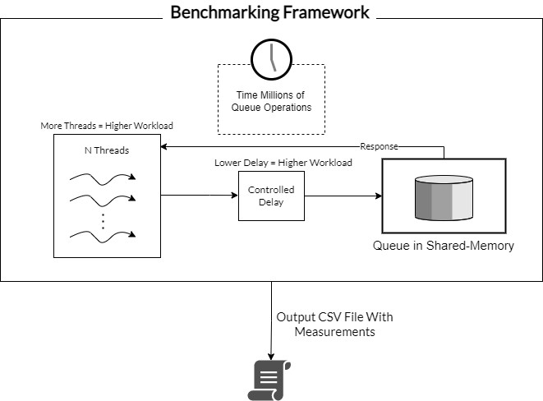
B.Sc. (Hons.)
Computing Science
A Comparative Study of Concurrent Queueing Algorithms & Their Performance
Luca Muscat
Supervisor: Dr Kevin Vella
INTRODUCTION
Queues are one of the most ubiquitous data structures in the field of Computing Science. With the advent of multiprocessor programming, concurrent queues are at the core of many concurrent and distributed algorithms. The act of writing and testing multiprocessor programs is often humorously referred to as an art [1], due to the sheer difficulty of ensuring the code’s correctness. Intimate knowledge of the CPU’s architecture and memory is a must, due to the plethora of ways one may unknowingly incur performance penalties.
ARCHITECTURE DESIGN
AIM
Several concurrent queuing algorithms, together with a benchmarking framework are implemented following methodologies based on prior art. In addition to the validation of results, all measurements taken are compared amongst each other and their original works.
METHODOLOGY
Mitigate operating system related sources of error.
Implement a variety of concurrent queueing algorithms, taking performance considerations into mind.
Take several readings for each queue, through which valid inferences can be made.
Create Benchmarks Resistant to Instrumentation Errors.
RESULTS
Using readings produced by the benchmarking framework, concurrent queues with the ‘Blocking’ algorithmic property were found to be competitive with concurrent queues possessing the ‘Non-Blocking’ Property at small numbers of threads, however, ‘Blocking’ queues were several magnitudes slower than their ‘Non-Blocking’ counterpart during intense artificial workloads, further demonstrating the superiority of ‘Non-Blocking’ queues and their resistance to delays attributed to busy systems.
CONCLUSIONS AND FUTURE WORK
A benchmarking framework for concurrent queues, together with several implementations of existing concurrent queueing algorithms are contributed. Some findings of researchers, such as the resilience to delay in ‘Non-Blocking’ queues [2] and claims of specific queues outperforming other queues are replicated [3, 4]. The contributions of this study can be further expanded by formally verifying the correctness of the queueing implementations, together with adding a more sophisticated monitoring and observability infrastructure to the benchmarking framework, allowing for a more fine-grained understanding of measurements with low observation costs.
REFERENCES
Herlihy, M., Shavit, N., Luchangco, V., and Spear, M. The Art of Multiprocessor Programming. Newnes, 2020. Valois, J. D. Implementing lock-free queues. In Proceedings of the seventh international conference on Parallel and Distributed Computing Systems, pages 64–69, 1994. Hoffman, M., Shalev, O., and Shavit, N. The baskets queue. In International Conference On Principles Of Distributed Systems, pages 401–414. Springer, 2007. Michael, M. M. and Scott, M. L. Simple, fast, and practical non-blocking and blocking concurrent queue algorithms. In Proceedings of the fifteenth annual ACM symposium on Principles of distributed computing, pages 267–275, 1996.

