Slide 1
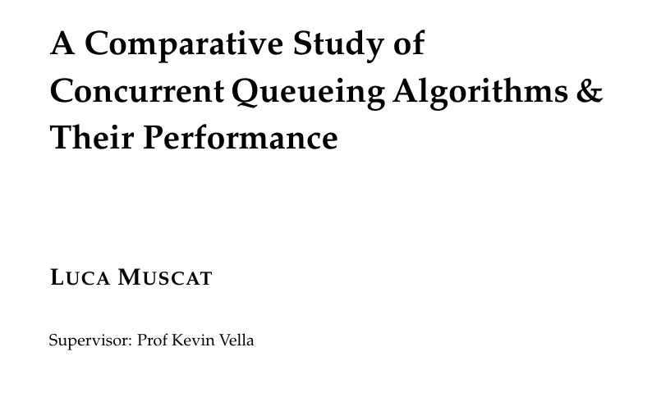
Notes:
Dear Examiners, my name is Luca Muscat, and I will be presenting my Final Year Project titled "A Comparative Study of Concurrent Queueing Algorithms & Their Performance", which is conducted under the supervision of Professor Kevin Vella

Slide 2
Motivation
Queues are one of the most ubiquitous data structures in the field of Computer Science, serving as the basis for many concurrent and distributed algorithms;
Concurrent data structures are difficult to get right, as creating multi-threaded programs requires intimate knowledge of the CPU;
We were able to identify few studies surveying and replicating concurrent queueing algorithms;
Notes:
Queues are one of the most ubiquitous data structures in the field of computer science;
Concurrent data structures are difficult to get right, as writing multi-threaded programs requires intimate knowledge of the CPU
We are able to identify few studies surveying and replicating concurrent queueing algorithms

Slide 3
Aims and Objectives
Implement a benchmarking framework for concurrent queueing algorithms capable of gathering measurements similar to prior works;
Reasonably validate the benchmarking framework through metrics and experiments;
Implement a variety of concurrent queueing algorithms, with the aim of replicating results from the original works;
Critically compare each concurrent queueing algorithm’s performance under a variety of synthetic benchmarks.
Notes:
Our aims and objectives are to implement a benchmarking framework for concurrent queueing algorithms, reasonably validate the implemented benchmarking framework, to implement a variety of concurrent queueing algorithms, and to critically compare each concurrent queue's performance.

Slide 4
Background Review
Concurrent queues may be characterized by their:
Capacity – Bounded or Unbounded
Multiplicity of Enqueuers/Dequeuers
An algorithm's progress condition describes how and when a number of threads can make forward progress;
Blocking - The system can reach a state where a thread is unable to make any forward progress until another thread takes action;
Non-blocking - Unable to reach a state where a thread cannot make forward progress;
Notes:
Concurrent Queues may be characterized by their capacity, and multiplicity of simulatenous enqueuers and dequeuers
An algorithm's progress condition describes how and when a number of threads can make forward progress

Slide 5
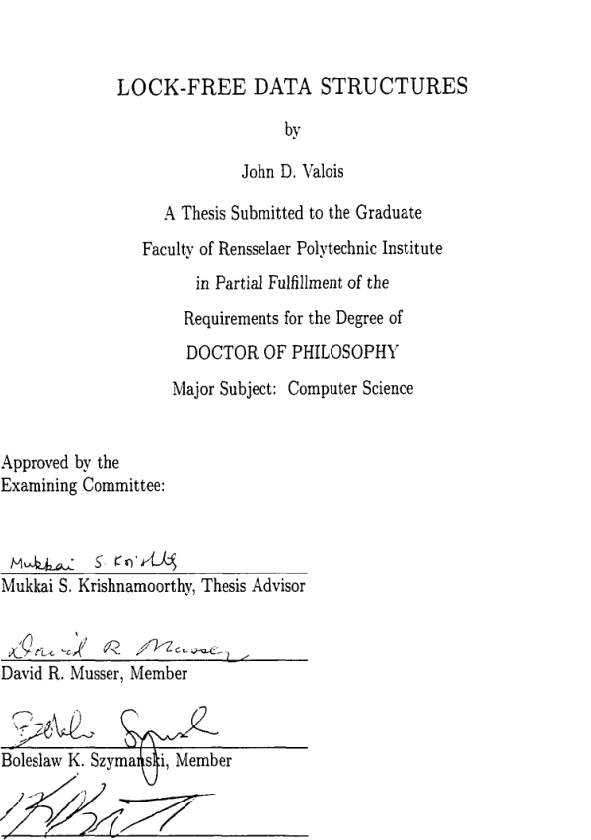
Literature Review
Valois’s Queue [1]
Notes:
In Valois's PHD Thesis 'Lock-Free Data Structures', Valois surveys several lock-free data structures and techniques. Valois also introduces an unbounded Multiple Producer Multiple Consumer queue, together with a novel memory reclamation scheme;

Slide 6
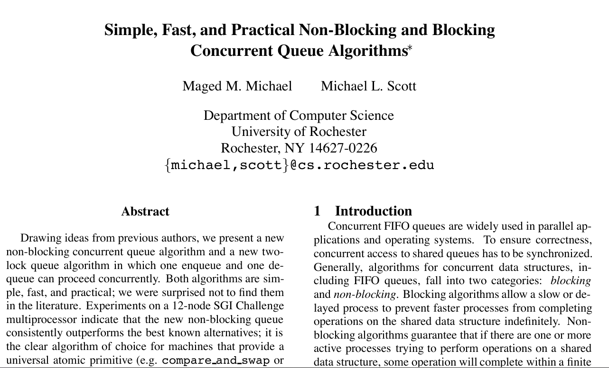
Literature Review
MS Queue and the Two-Lock Concurrent Queue [2]
Notes:
In 'Simple, Fast, and Practical Non-Blocking and Blocking Concurrent Queue Algorithms', Michael And Scott introduce two unbounded queues, the blocking two-lock queue and the lock-free MS Queue. The MS Queue is considered to be one of the field's classical algorithms, and is used in Java’s Concurrent Library;

Slide 7
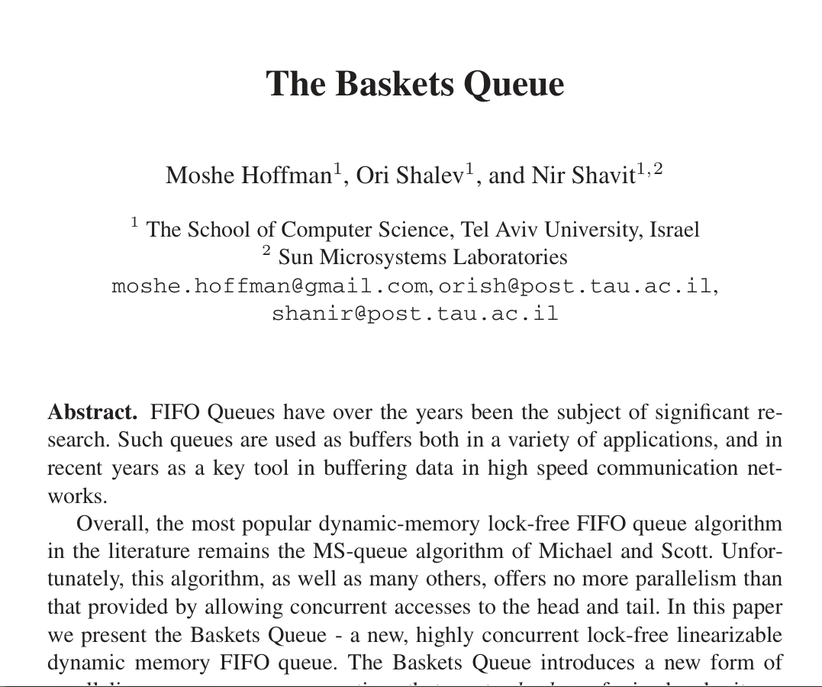
Literature Review
Hoffman et.al’s Baskets Queue [3]
Notes:
The Baskets Queue is a variation of the MS Queue, which exploits the fact that overlapping, linearizable operations take effect in a non-deterministic order;

Slide 8
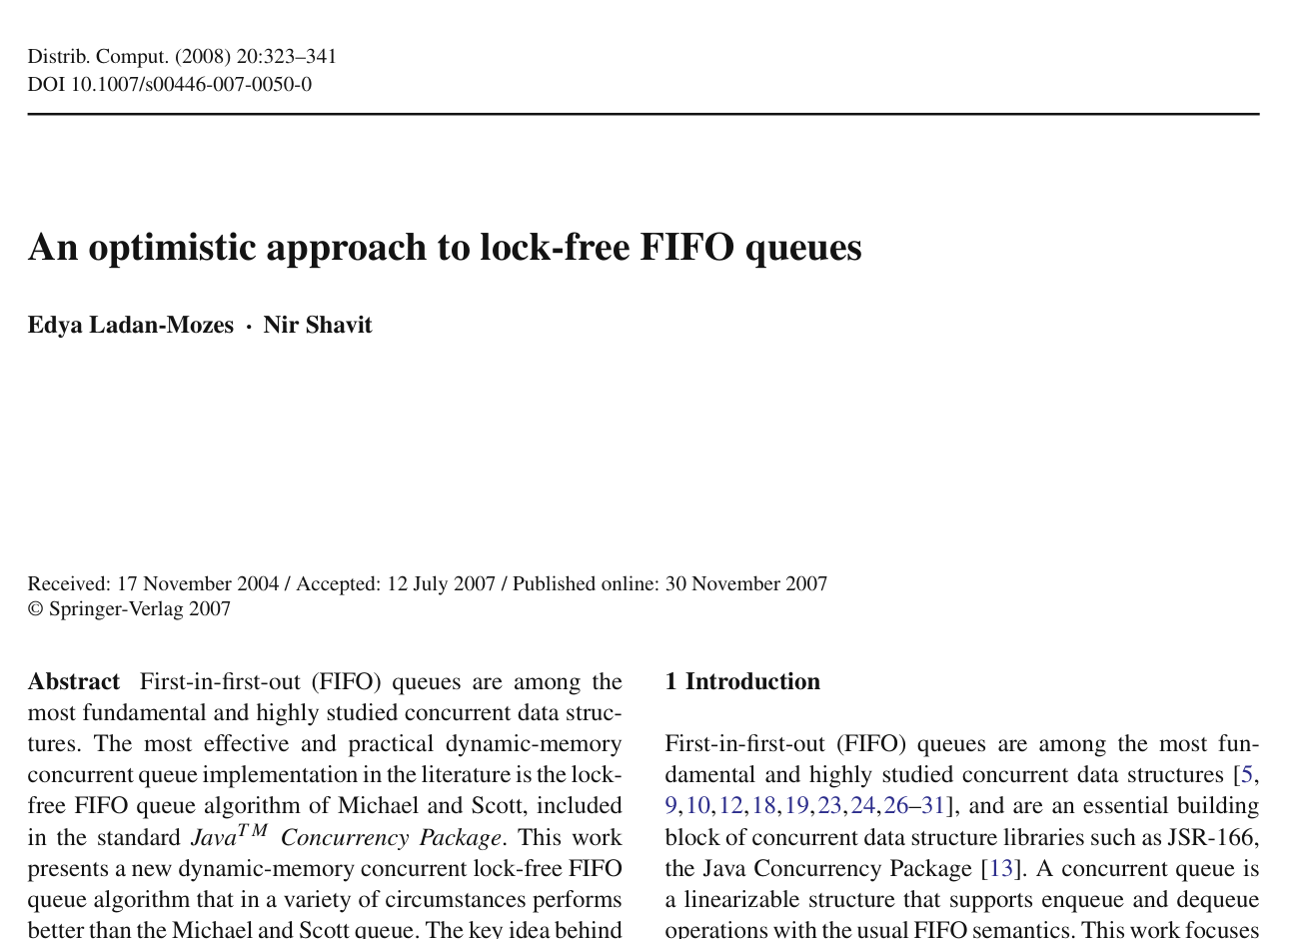
Literature Review
Optimistic Queue [4]
Notes:
The optimistic queue is a variation of the MS Queue which makes use of a doubly-linked list to enqueue a node in a single compare and swap.

Slide 9
Design and Implementation
The queues and benchmarks are implemented in C
Compiled using the Clang version 10.0.0-4ubuntu1 compiler
Optimization flags –O3 are used
Intel Core i7 6700HQ (Skylake), with four cores and a base frequency of 2.60GHz
16GB of RAM (8x2)
Notes:
Queues and benchmarks are implemented in C, and are compiled using Clang with O3 optimization flags.
The algorithms are benchmarked on a four core CPU with a clock speed of 2.6 GHz and 16 GBs of RAM;

Slide 10
Design and Implementation
We implement the following queues:
MS Queue [2]
Two-Lock Queue, using the Test-And-Test-And-Set Spinlock [2]
Valois’s Queue [1]
Baskets Queue [3]
Notes:
The following concurrent queueing algorithms have been implemented

Slide 11
Design and Implementation Methodology
Pairwise Benchmark – A thread enqueues a node, waits for an artificial delay, dequeues a node, and waits for another artificial delay;
50% Enqueue Benchmark – A thread gets a 50% chance to either enqueue or dequeue a node, followed by an artificial delay;
Enqueue
Artificial Delay
Dequeue
Artificial Delay
Enqueue
50%
Artificial Delay
50%
Dequeue
Notes:
Two benchmarks are used in the evaluation phase:
In the pairwise benchmark, an iteration consists of an enqueue-dequeue pair, padded by artificial delays;
In the ‘50% enqueue’ benchmark, an iteration consists of a thread either executing an enqueue or a dequeue, followed by an artificial delay.
Each benchmark executes ten million iterations across N threads for ten times, where the average of the average net runtime per thread is recorded. Each benchmark is executed for three times in order to determine the variance of the results;

Slide 12
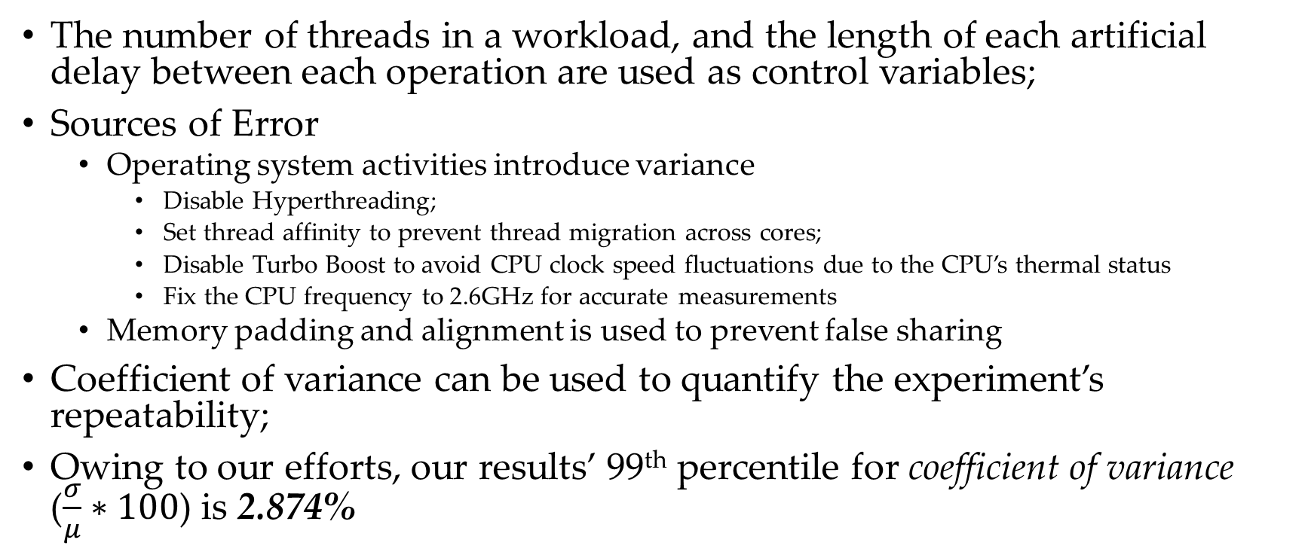
Design and Implementation Methodology
The number of threads in a workload, and the length of each artificial delay between each operation are used as control variables;
Sources of Error
Operating system activities introduce variance
Disable Hyperthreading;
Set thread affinity to prevent thread migration across cores;
Disable Turbo Boost to avoid CPU clock speed fluctuations due to the CPU’s thermal status
Fix the CPU frequency to 2.6GHz for accurate measurements
Memory padding and alignment is used to prevent false sharing
Coefficient of variance can be used to quantify the experiment’s repeatability;
Owing to our efforts, our results’ 99th percentile for coefficient of variance ($\frac{σ}{μ}∗100$) is 2.874%
Notes:
Our control variables are the number of threads in a workload, and the length of the artificial delay;
As this is an experimental study, it is crucial to identify and mitigate sources of error which threaten our results' validity. Operating system activities introduce variance, requiring the benchmarking machine to be fine-tuned.
Owing to our efforts in mitigating variance, our results’ 99th percentile for coefficient of variance is 2.874%

Slide 13
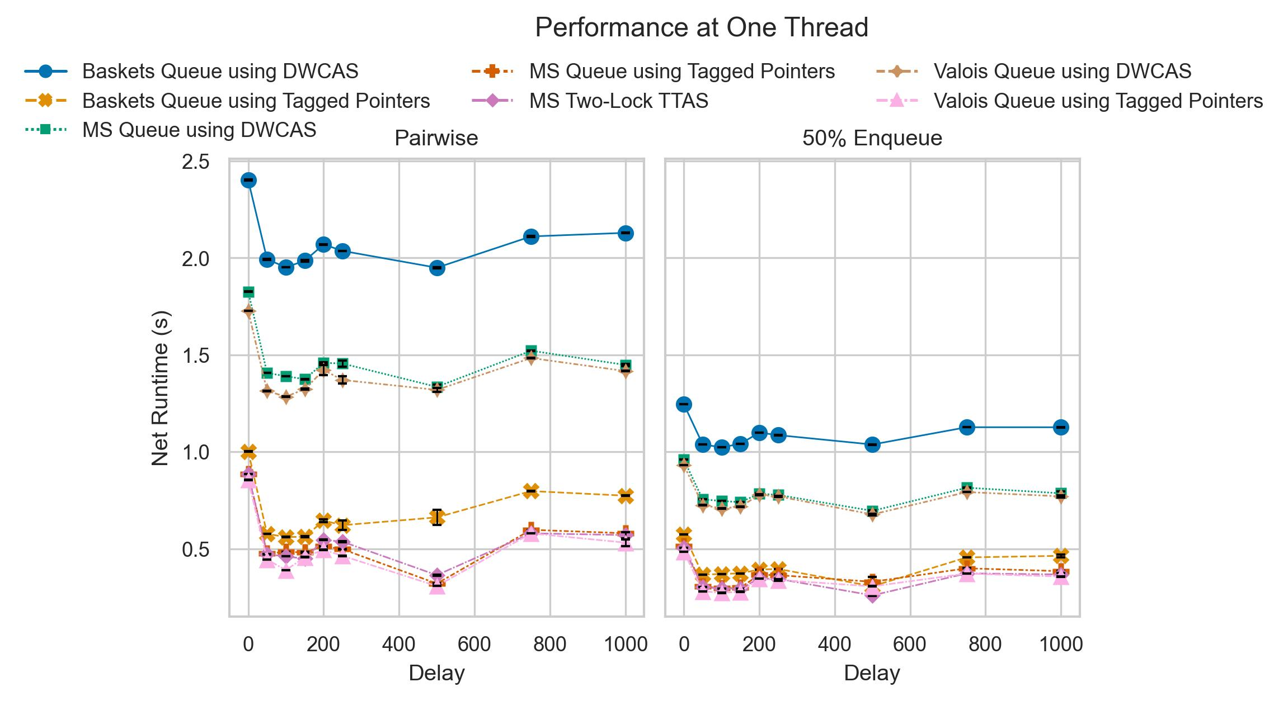
Evaluation Workload under One Thread
The MS Queue and Baskets Queue using tagged pointers (single width CAS) are at most 3.168 and 2.593 times faster than their DWCAS (double width CAS) counterparts
Baskets Queue using Tagged Pointers is consistently outperformed by the MS Queue and the Two-Lock Queue
The Two-Lock Queue consistently outperforms the MS-Queue by at most 27%
Notes:
Non-blocking queues using Single-Width Compare-And-Swap (also known as CAS) are significantly faster than their Double-Width counterparts (also known as DWCAS)
The two-lock queue consistently outperforms the MS-Queue and the Baskets Queue by at most 27%

Slide 14
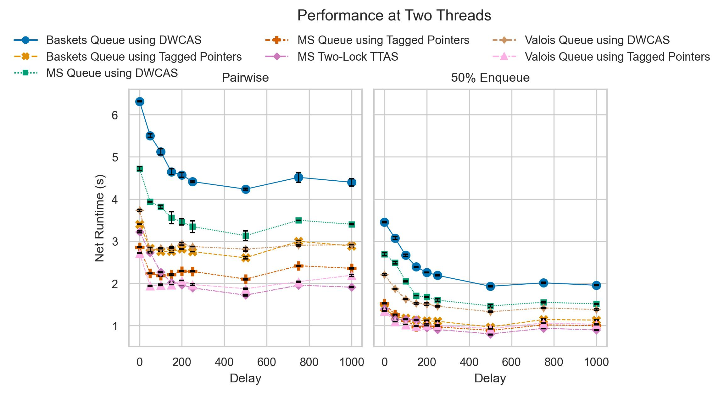
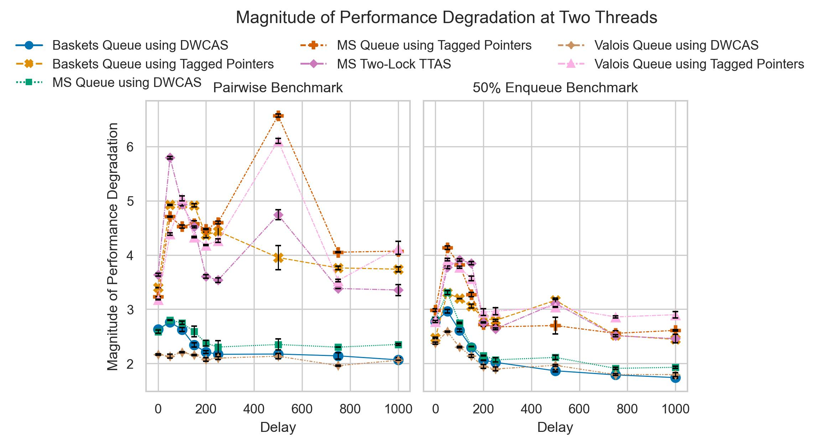

Evaluation Workload under Two Threads
Magnitude of performance degradation is calculated as the net runtime ratio of threads $t_{n}$ and $t_{n−1}$
Michael and Scott attribute the significantly degraded performance to the fact that the head and tail of each queue are shared between two threads, increasing the cache miss rate.
Non-blocking queues using CAS suffered from a harsher degradation in performance, as they were more likely to reattempt a queueing operation
Notes:
Under workloads of two threads, each queue experiences a significant degradation in performance.
Non-blocking queues using CAS experience a harsher degradation in performance than their double width counterparts. Michael and Scott attribute the degradation in performance to the head and tail of each queue being shared across two threads, increasing the cache miss rate;

Slide 15
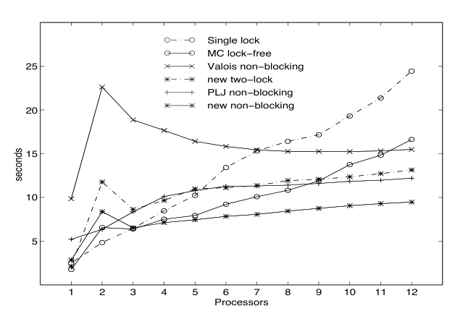
Evaluation Workload under Two Threads
Our Results
Michael & Scott’s Results
Notes:
Our implementation of Valois’s queue does not include a memory reclamation scheme, consequently, we were unable to reproduce Michael & Scott’s results for Valois’s queue.
Upon further investigation of their published source code, we observe that their choice of memory reclamation schemes introduces a bias that works in their favour.

Slide 16
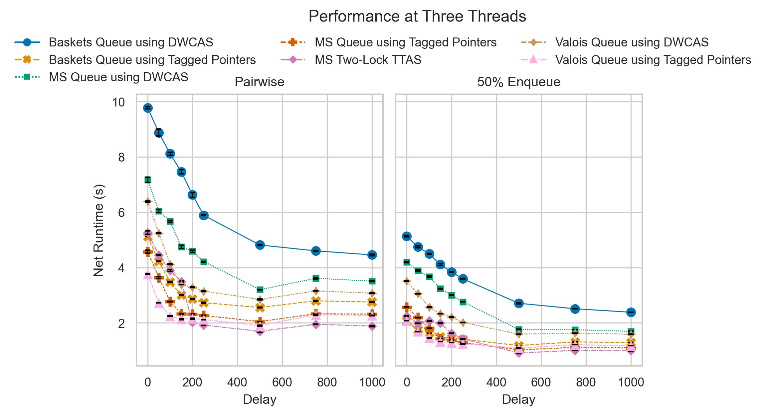
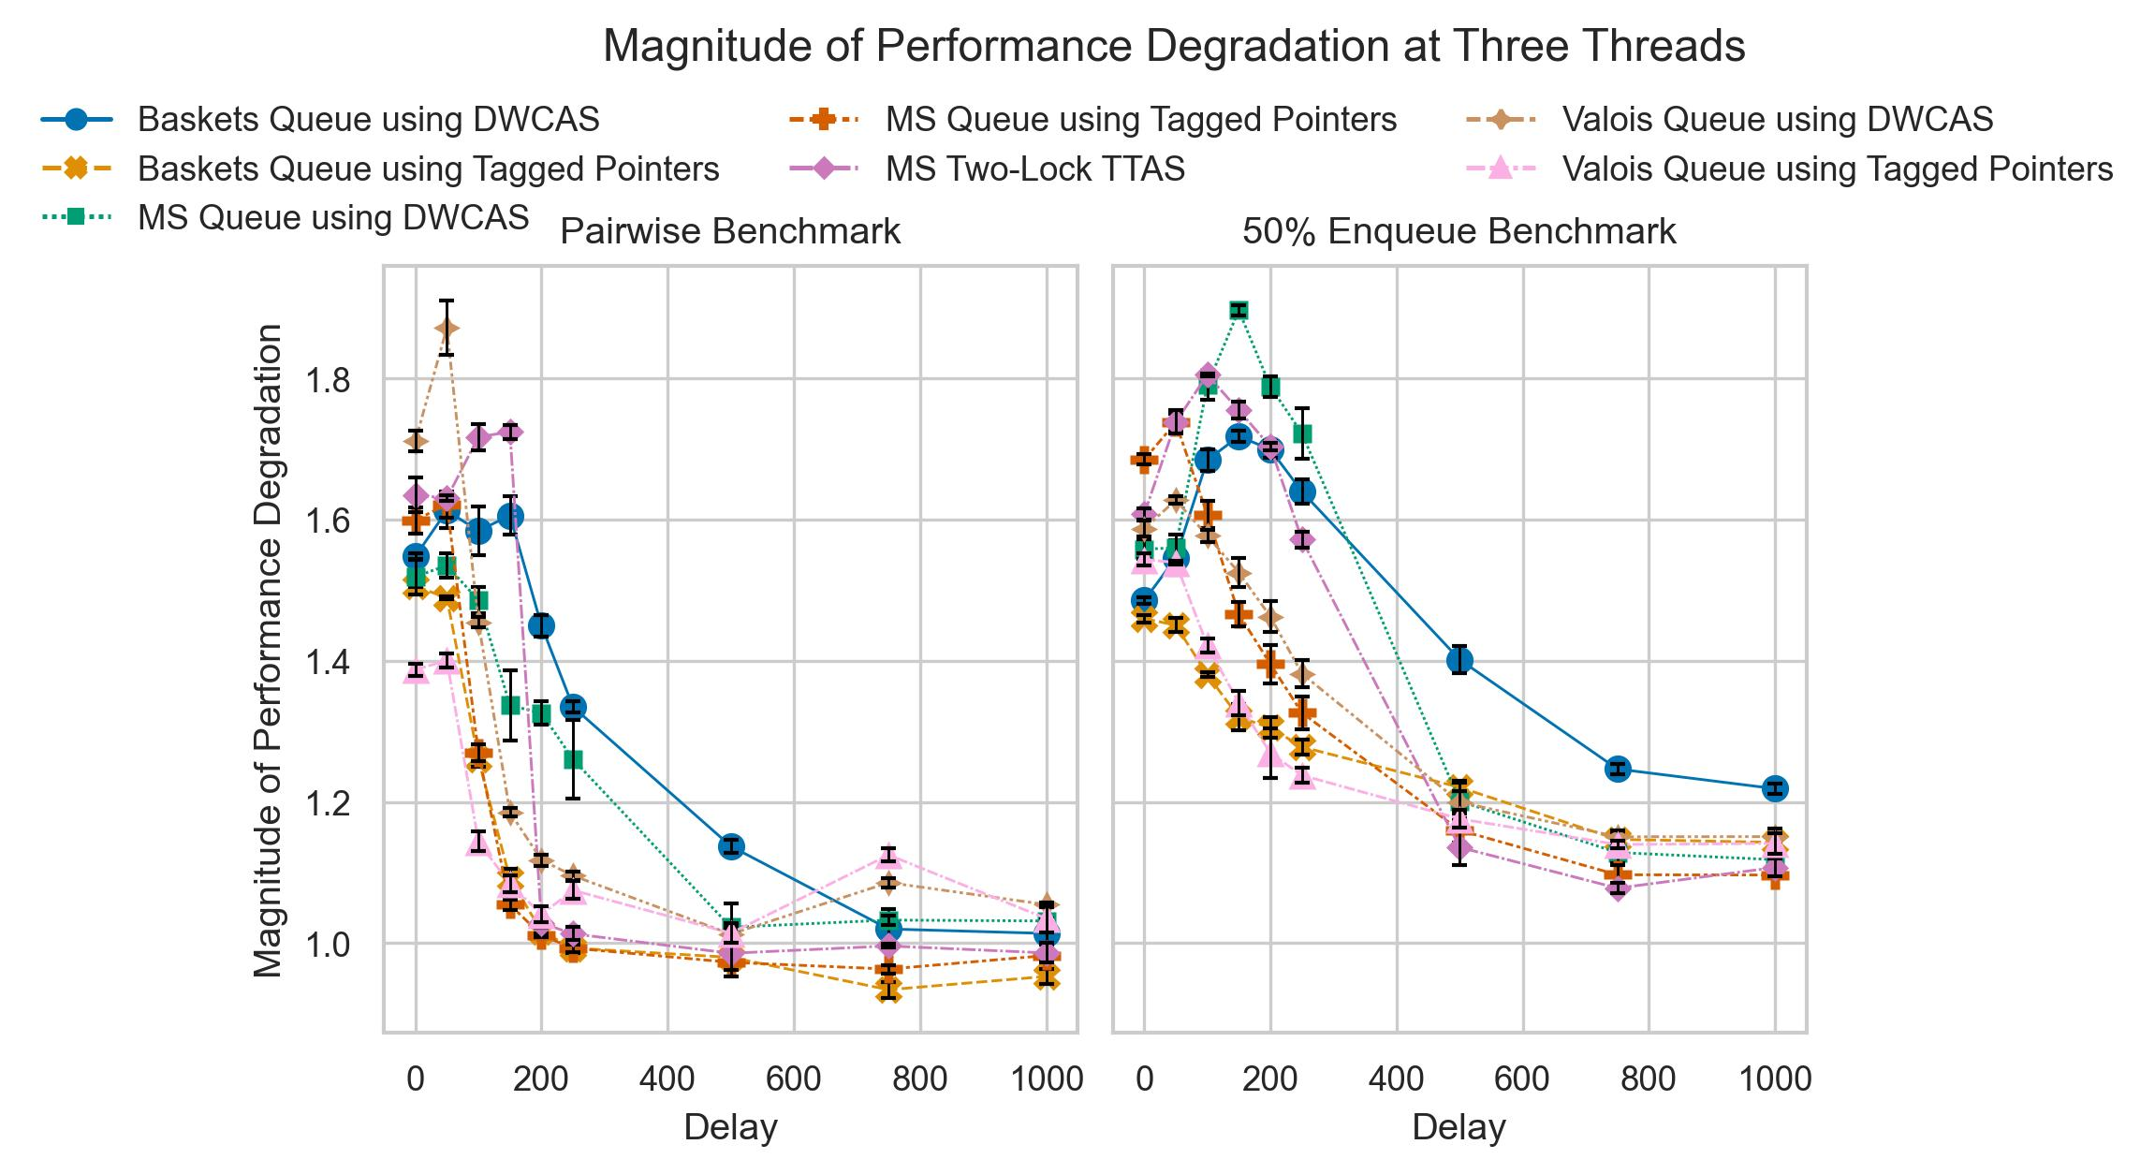
Evaluation Workload under Three Threads
Under the pairwise benchmark, speedups of up to 6.591% can be observed;
Michael and Scott boast of a more significant speedup (a factor less than 1/3), however, our results and the results of other researchers [3, 4] are more modest;
Up to delays of 150 nanoseconds, every non-blocking queue using tagged pointers outperforms the two-lock queue;
Two-Lock Queue has favourable performance at delays greater than 150 nanoseconds;
Notes:
Under workloads of three threads, Michael and Scott boast a speedup of a factor less than one third in their MS Queue, however, our results and the results of prior works shows more modest speedups (in our case, we observe a speedup of at most 6.591%).

Slide 17
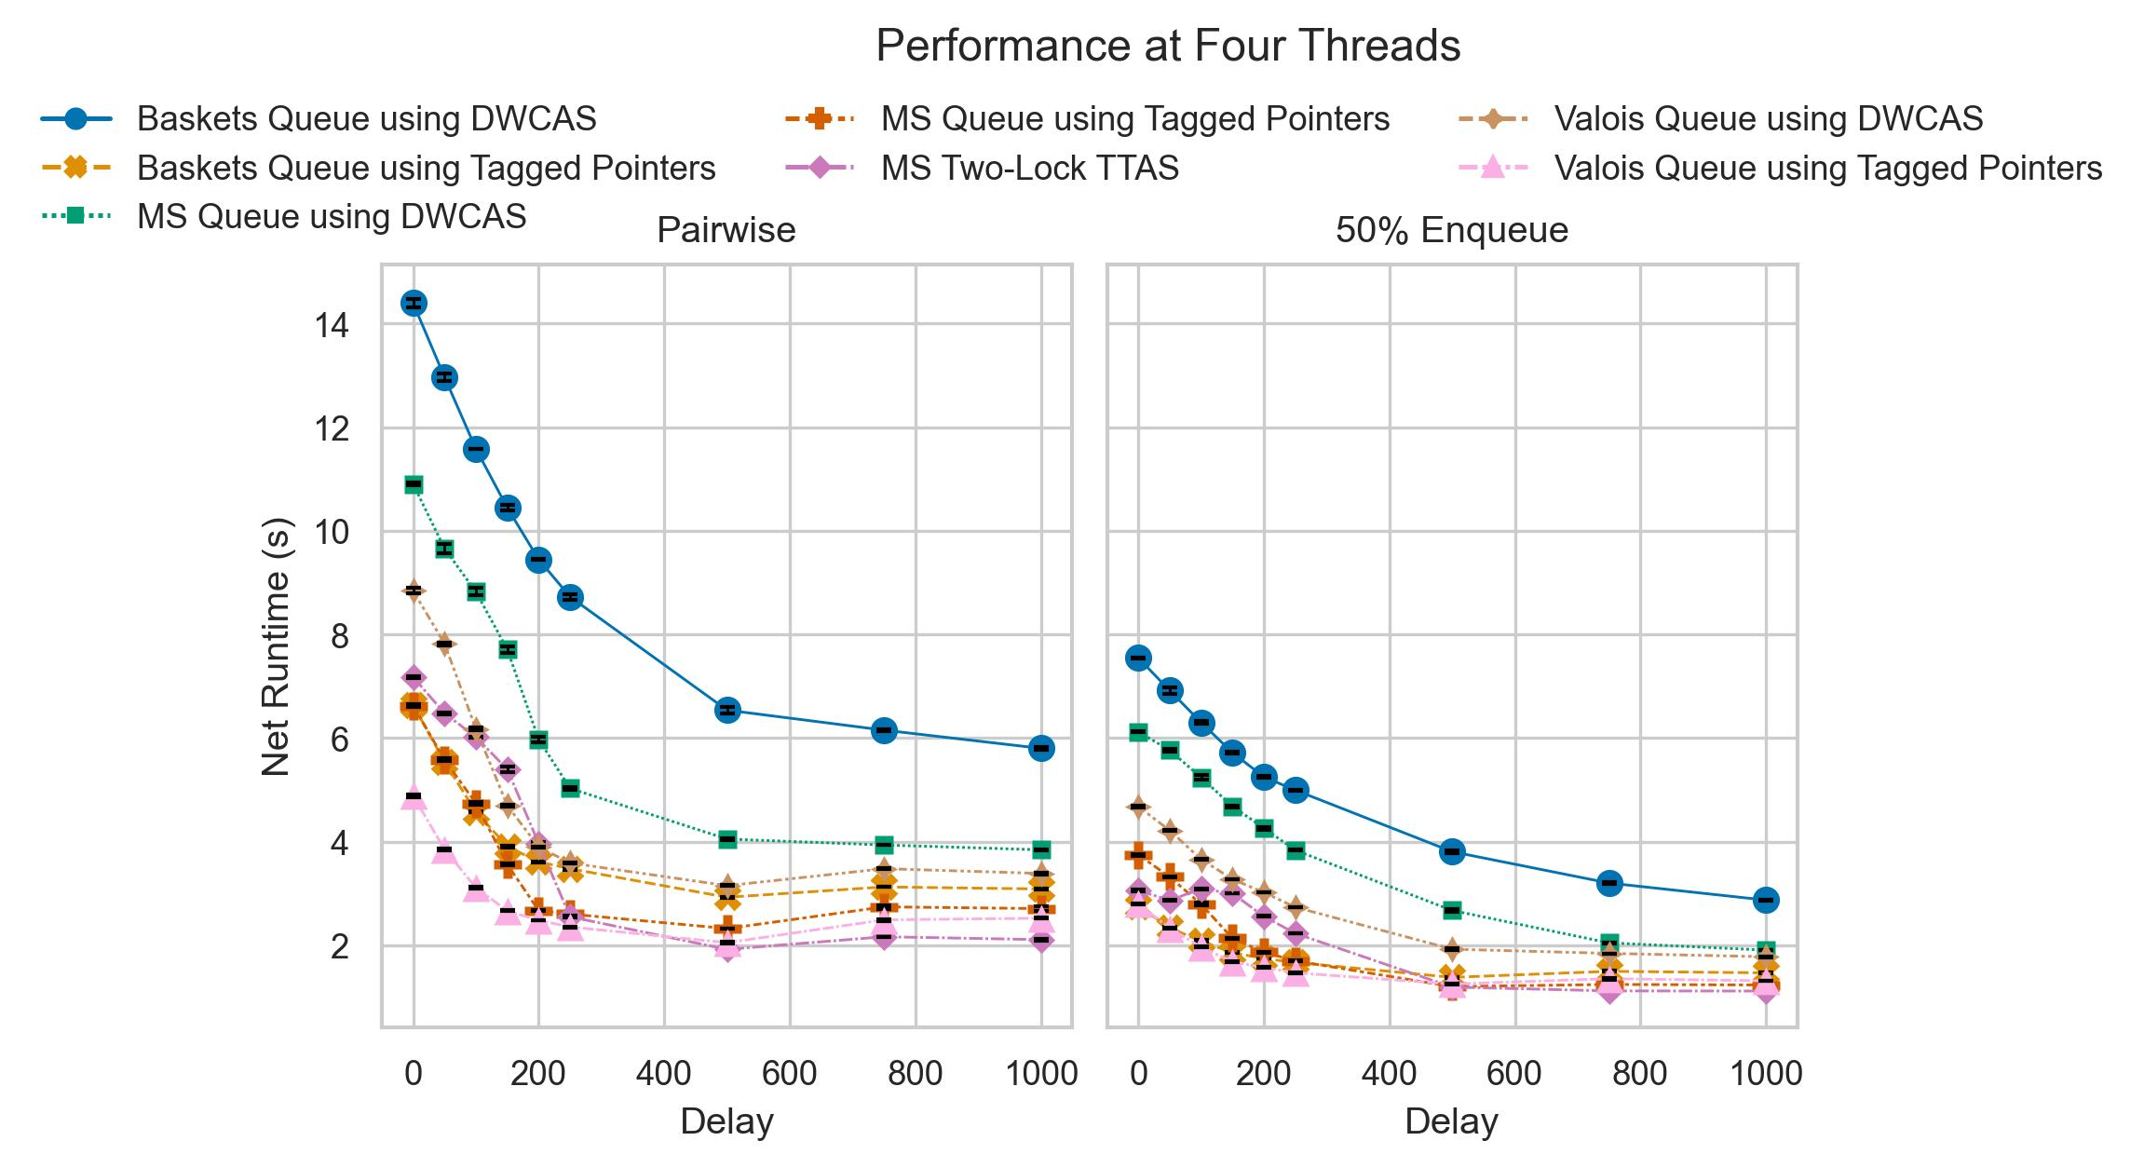
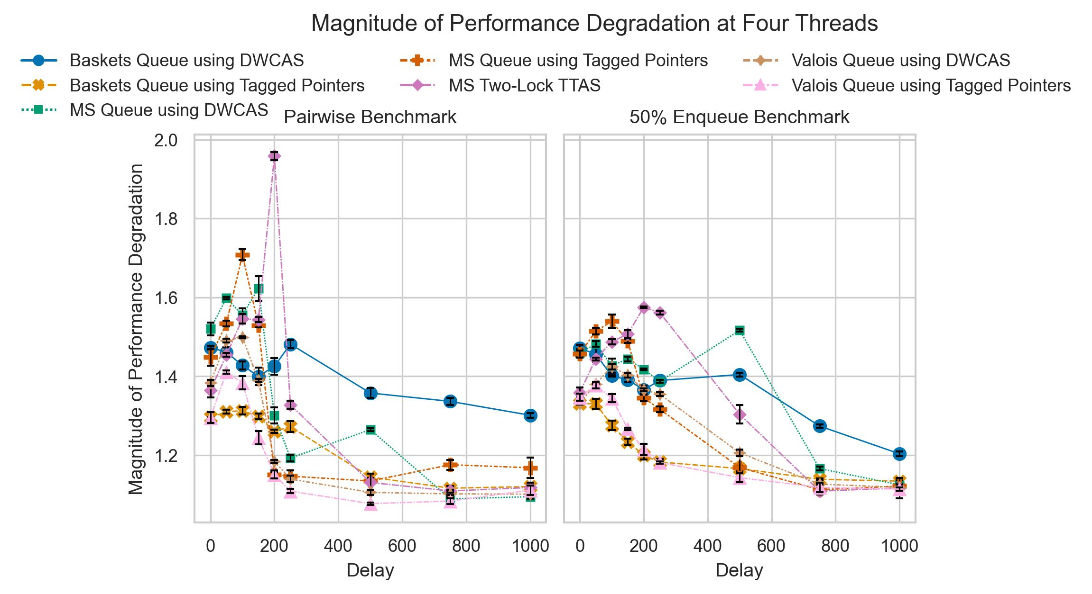
Evaluation Workload under Four Threads
Like [2, 3, 4], we observe a slight dip in performance for both the MS-Queue and the Two-Lock Queue;
Unlike [3], we do not observe a speedup in the Baskets Queue’s performance;
The Baskets Queue’s performance (w.r.t the rest of the queues) in the 50% enqueue benchmark is significantly better than in the Pairwise benchmark;
The Baskets Queue used the ‘baskets’ mechanism inside the 50% enqueue benchmark up to 110.694 times more than in the pairwise benchmark;
Notes:
Similar to prior work, we observe a slight dip in performance in the MS-Queue and the Two-Lock Queue under workloads of four threads.
The Baskets Queue performs better in the 50% Enqueue Benchmark as the baskets mechanism is used up to 111 times more than in the Pairwise benchmark.

Slide 18
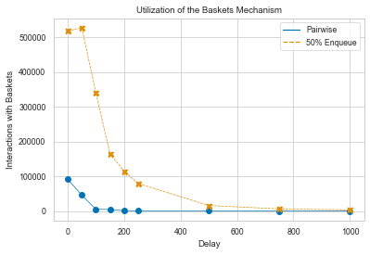
Evaluation Workload under Four Threads

Slide 19
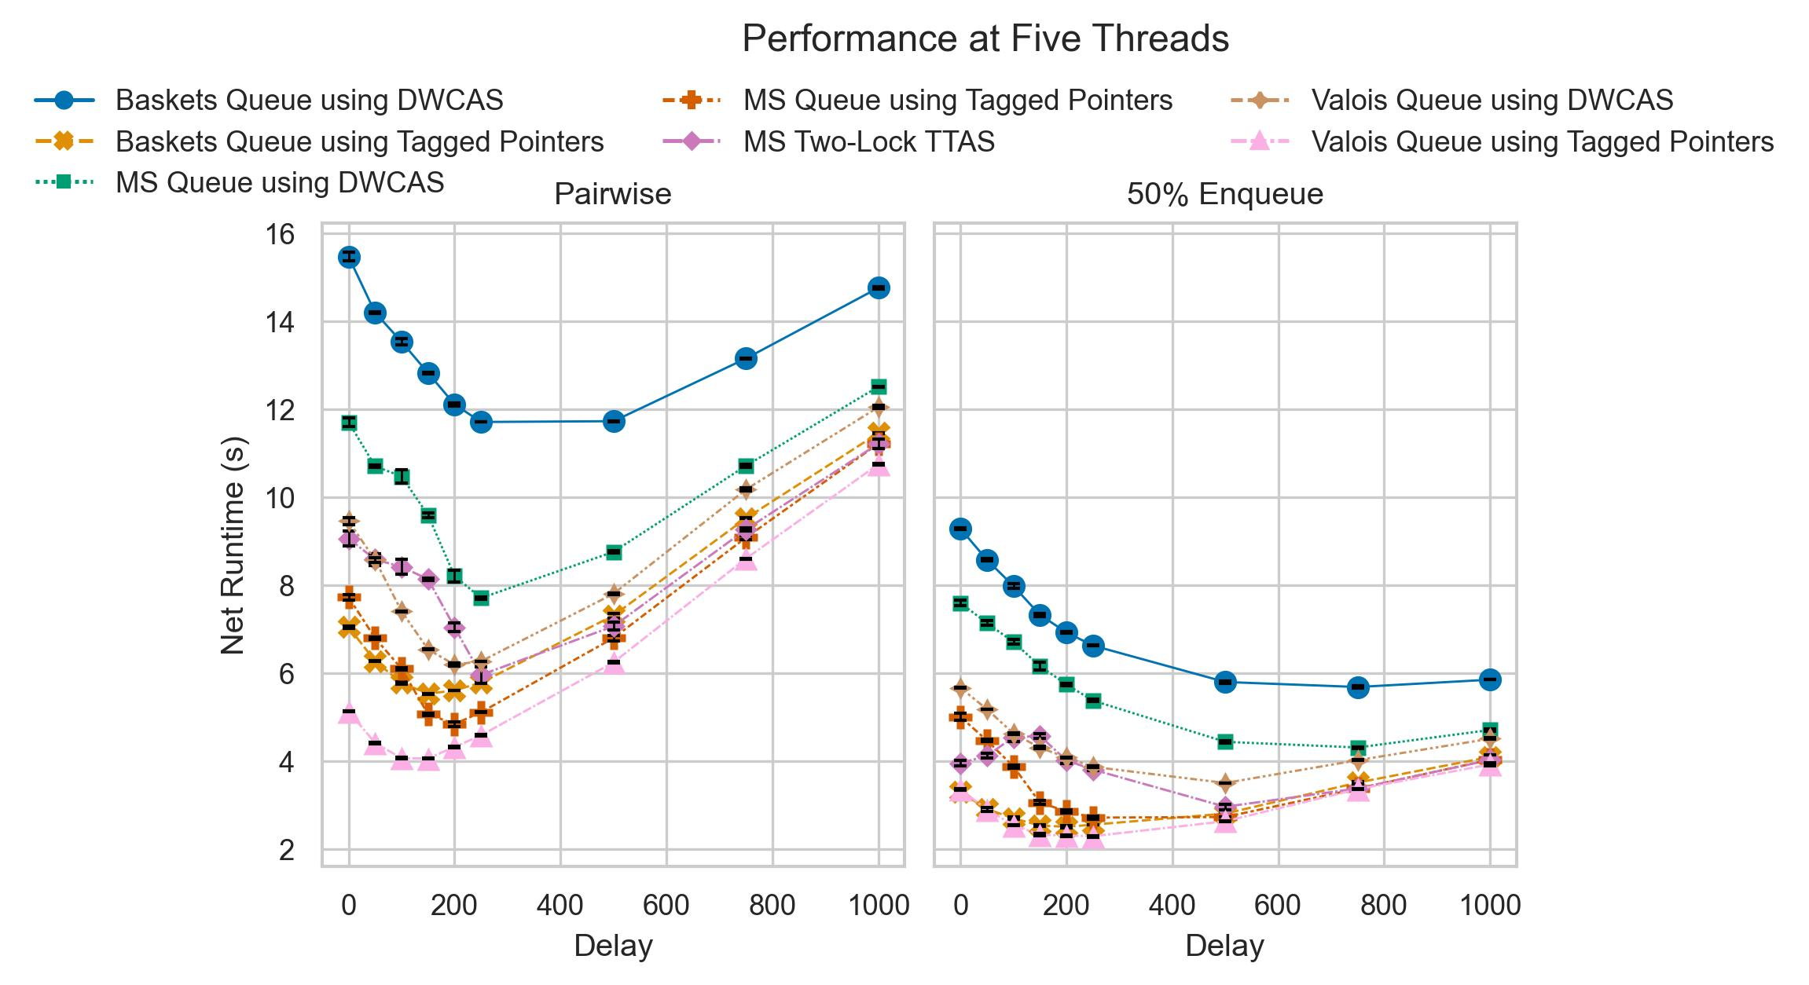
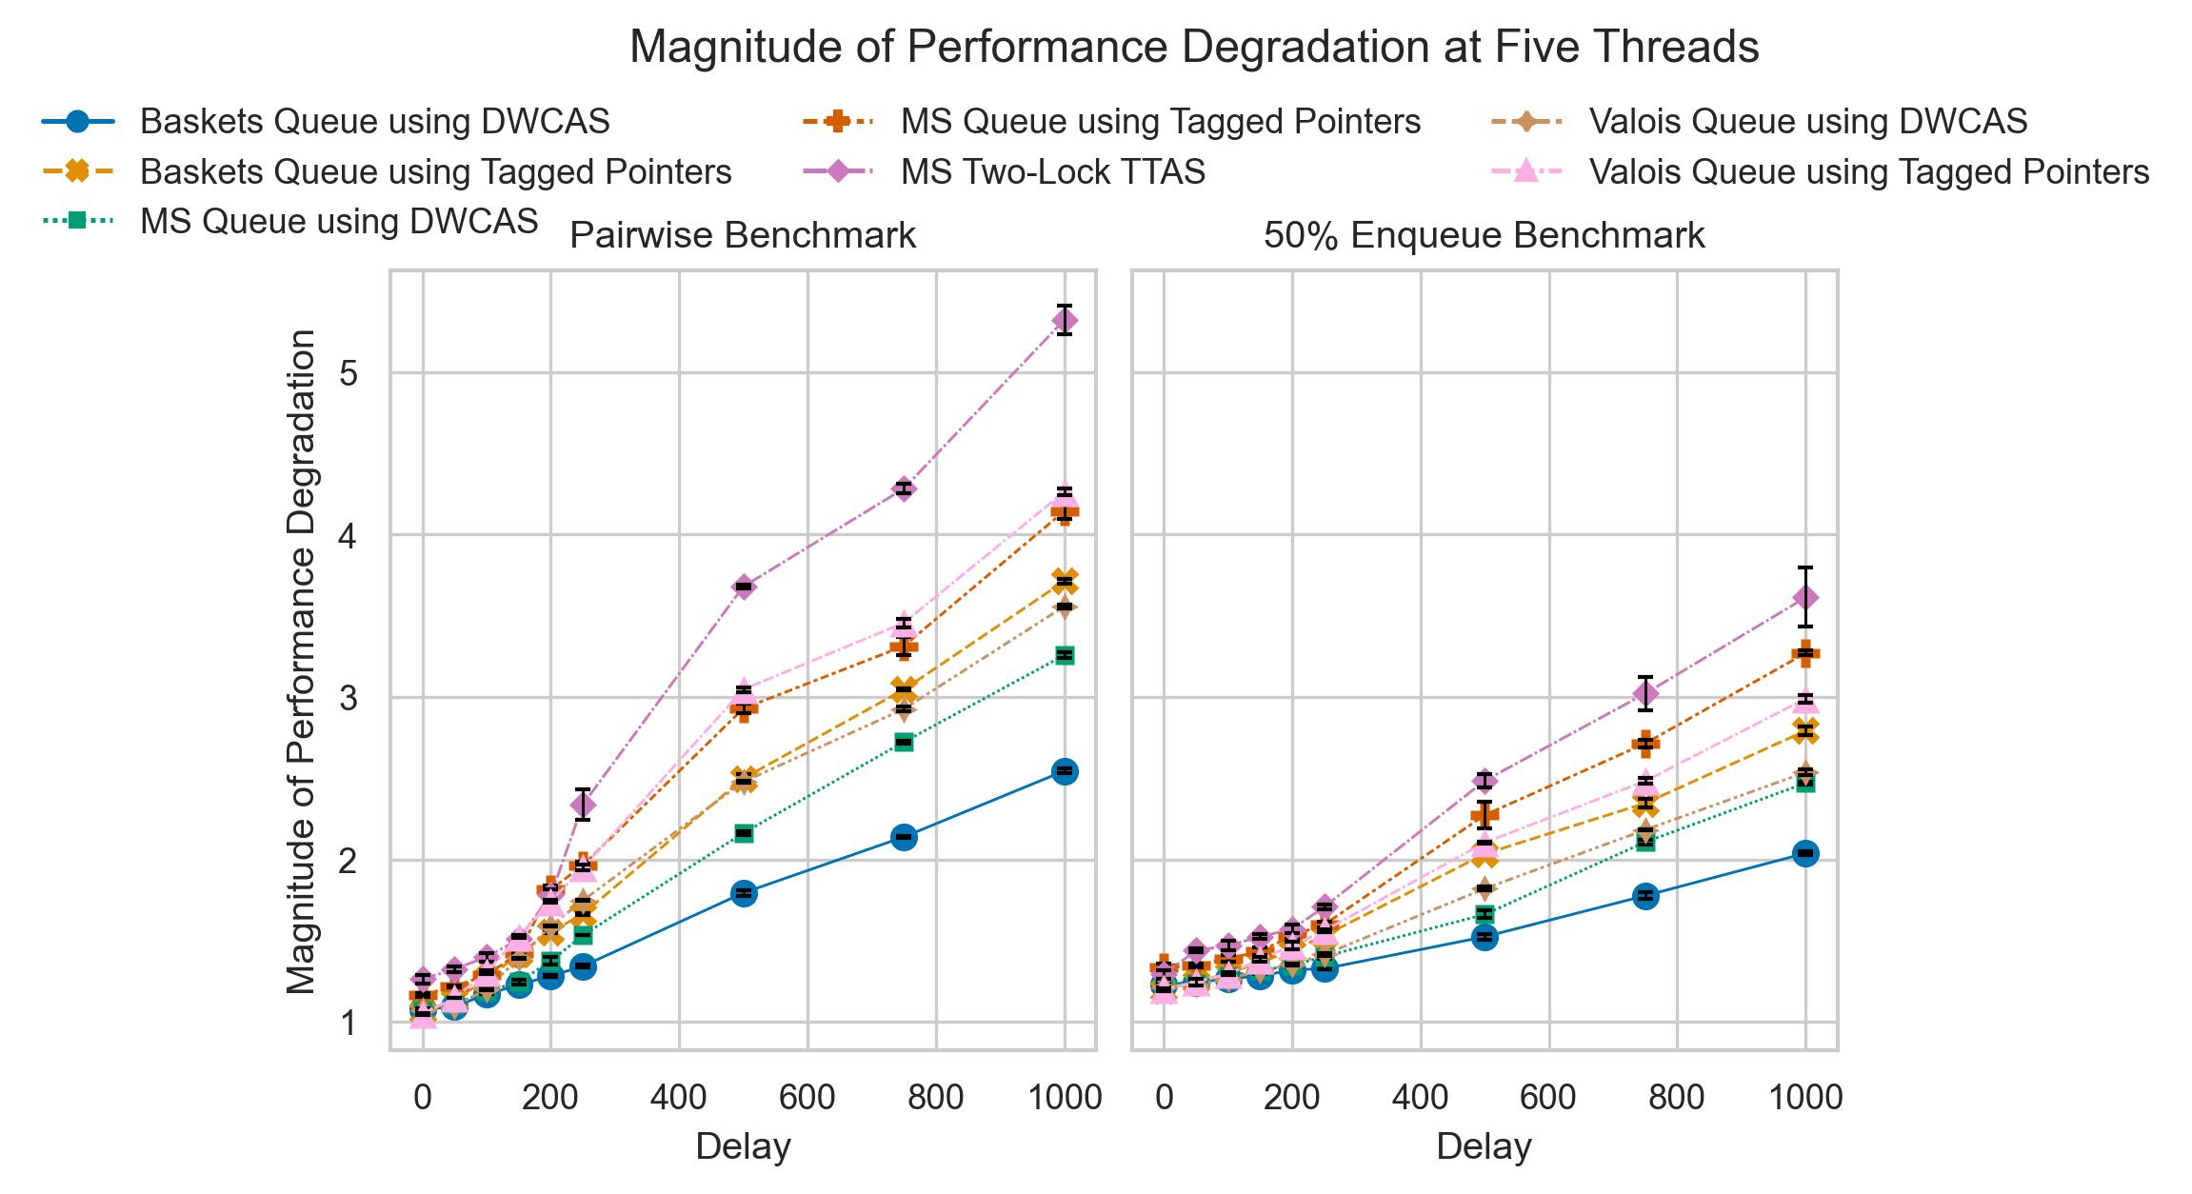
Evaluation Workload under Five Threads (oversubscription)
As we are restricted to four cores, we need to pin more than a single thread on several cores;
Between delays of zero and 250 nanoseconds, the Baskets Queue and the MS Queue are at most 47.045% and 60.604% faster than the Two-Lock Queue.
At delays greater than 150 nanoseconds, the magnitude of performance degradation increases significantly as context switches happen more often, and the larger delays take a larger share of the already dwindling CPU time.
Notes:
As we’re restricted to a four core CPU, we need to pin more than a single thread to several cores;
Up to delays of 250 nanoseconds, the Baskets Queue and the MS Queue are at most 47.045% and 60.604% faster than the two-lock queue;
At delays greater than 150 nanoseconds, each queue’s performance is significantly degraded, as context switches occur more often

Slide 20
Conclusion
Queues using DWCAS are significantly slower than their Single-Width counterparts;
Blocking queues are preferable to non-blocking queues under low contention;
Non-blocking queues are superior in environments with random delay (high contention and oversubscription);
We uncover biases in Michael & Scott’s study, which to the best of our knowledge, were not discussed in any previous publications;
We provide evidence that the Baskets Queue’s performance is heavily dependent on the utilization of its baskets mechanism, which is not discussed in the queue’s seminal paper.
Notes:
In conclusion, queues using DWCAS are significantly slower than their Single-Width counterparts, blocking queues are preferable to non-blocking queues under low contention, non-blocking queues are superior in environments with random delay
We uncover biases in Michael & Scott’s study, which to the best of our knowledge, were not discussed in any previous publications while the Baskets Queue’s performance is dependent on its use of the baskets mechanism.

