Slide 1
Explorer I Roll Control
SOFTWARE UPGRADE Rtos

Slide 2
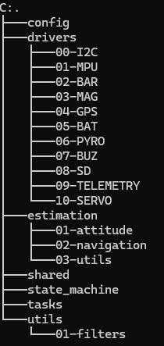
Software Architecture
CONFIG: system definition; contains: pin mapping, physical constants, sensor configuration, control system GAINS, flight parameters constants
DRIVERS: hardware interface layer; contains: all sensors and hardware + telemetry; read/write hardware, convert raw I/O to basic units
ESTIMATION: turn raw sensor data into physical state; contains: attitude estimation, navigation (velocity and position), filters, quaternion math, IMU processing fusion; Outputs: roll, pitch, yaw, positions, velocities.
SHARED: global runtime state (single source of truth); contains: system state, shared sensor values, commands, flags.
STATE MACHINE: mission logic brain; contains: operative mode states (0-6), transition conditions, safety logic, event interpretation.
TASKS: runtime execution scheduler (RTOS); contains: task. ; Manage timing (dt), ensure system runs deterministically, call modules in correct order
UTILS: reusable pure functions; contains: math utilities, filters, quaternion math helpers, timing helpers, unit conversion if complex.

Slide 3
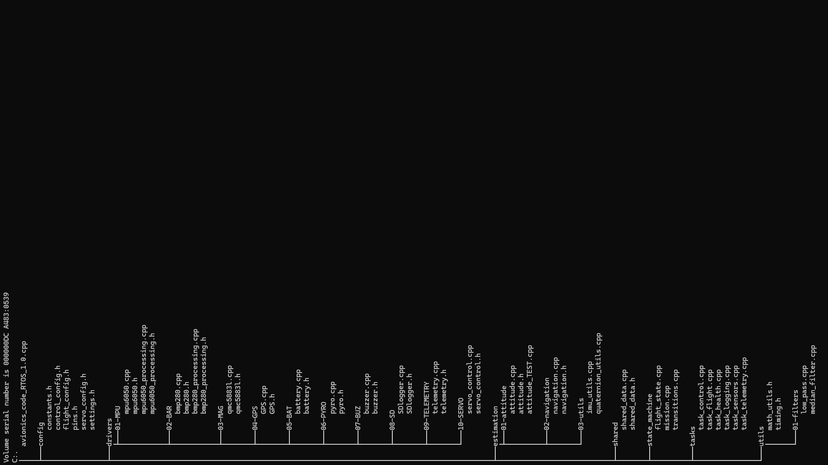

Slide 4
Block Diagram
DRIVERS (raw)
↓
PROCESSING (physics clean data)
↓
ESTIMATION (EKF)
↓
FLIGHT STATE (decisions)
↓
ACTUATORS (execution)

Slide 5
Estimation – Attitude (v1.0)
Pitch
Yaw
Roll
Heading

Slide 6
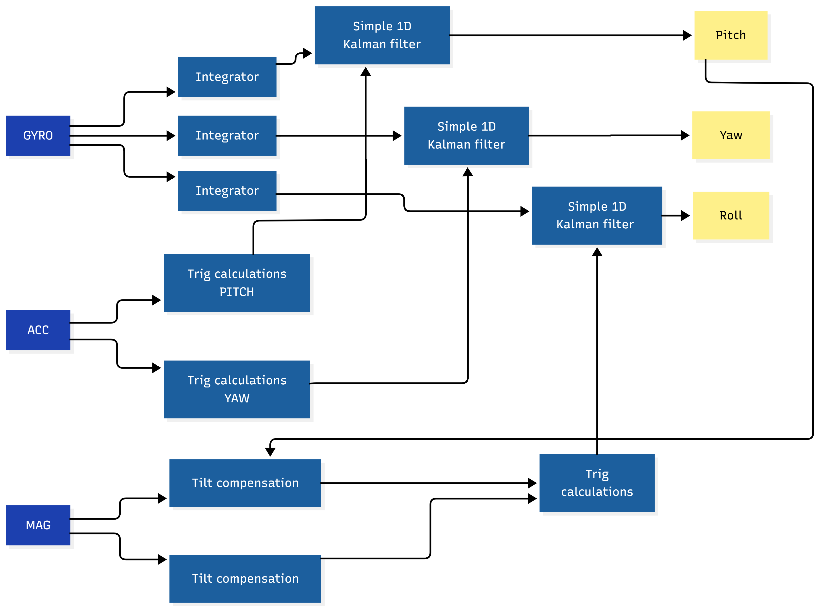
Estimation – Attitude (v1.0)
Pitch , Yaw , Roll

Slide 7
NAVIGATION STATE
Lat
Lng
X
Y
al
Vx
Vy
Vz

Slide 8
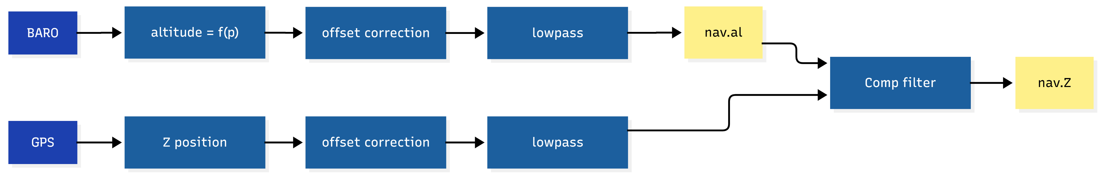
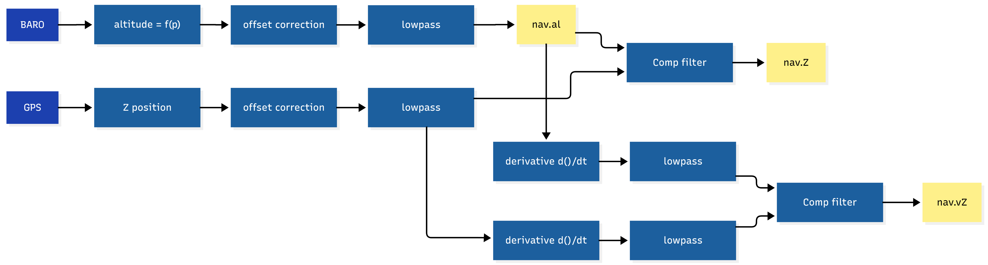
Estimation –Navigation (v1.0)
Z Position - estimation
Z Velocity - estimation

Slide 9
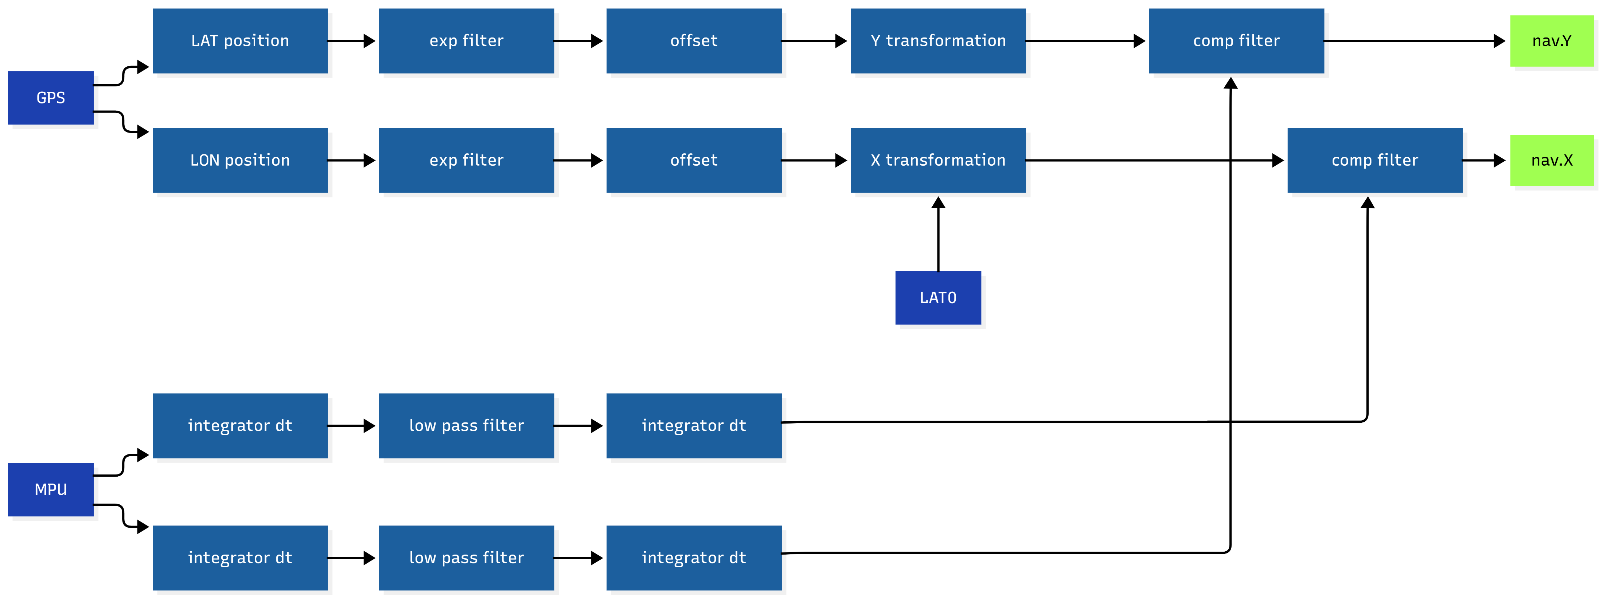
Estimation –Navigation (v1.0)
X,Y Position - estimation

Slide 10
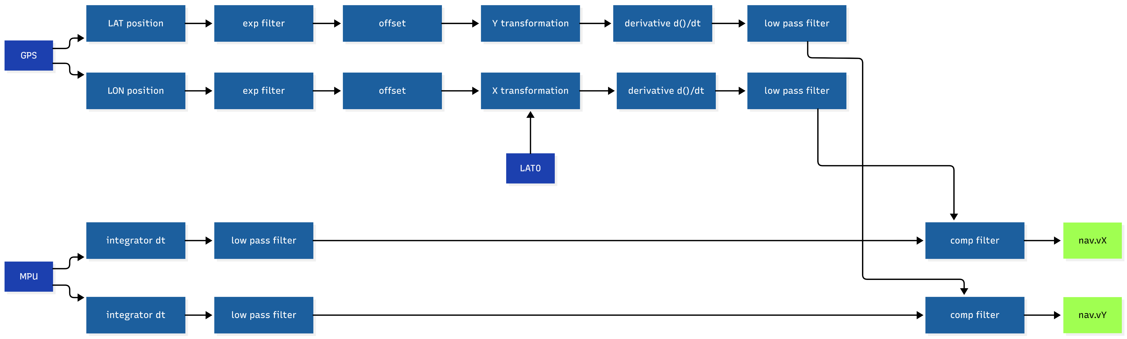
Estimation –Navigation (v1.0)
X,Y Velocity- estimation

Slide 11
OTHER INFO
Tmp
V_bat

Slide 12
ACTIVE ROLL COTROL
PID based
Servo output (4x max)

Slide 13
STATE VECTOR

