Slide 1
ROLL CONTROL ROCKET
Overview of the project

Slide 2
1-Introduction
Design, Implementation and Validation of an active attitude stabilization control system for sounding rockets

Slide 3
1-a Concept & Motivations
Use aerodynamic control tabs to control the roll attitude of a model rocket demonstrating active stability for a smooth ascent / gyro stabilization.
1- Why? There are some interesting applications:
  Avoid spin along the main axis (always present if there is not an active control system to compensate because of manufacturing errors) → better footage, better measurements (no coriolis acceleration on IMU), microgravity for space shots, solid motor perfomance closer to theoretical one
  Gyroscopic stiffness → if you spin the rocket up in the higher atmosphere you gain more stability (fins stability decrease)
2-How? You can use different systems but:
  Reaction wheels → X poor control authority at larger scale
  Cold gas thrusters → X heavy, draggy, complex
  Canards → X very good on paper, bad dynamics coupling and aerodynamics effect (adverse roll for tip vortices)
  Tabs → Good overall performance, small size and weight, easier control

Slide 4
1-a Concept & Motivations
2-How? Type of controllers: PID → OK, Since both the disturbance torque (from misalignment/asymmetry) and the control torque (from tabs) scale with dynamic pressure (q ∝ v²):
  Disturbance Torque: τ_dist = C_dist * q * A * L
  Control Torque: τ_ctrl = C_ctrl * q * A * L * δ
Since both scale the same way, their ratio remains constant across flight speeds:
τ_ctrl / τ_dist = (C_ctrl * δ) / C_dist = constant
This means the control authority relative to the disturbance doesn't change with speed - making the system surprisingly linear
Sizing → Simulation →Tuning → Validation => Implementation
The simplest way to simulate this is with a 2DOF Simulation

Slide 5
1-b Goals
1) Stabilize the roll within 5° ideally
2) Complete a roll program ex: «0-90-0»

Slide 6
2-Dynamics
2DOF System → Z translation and wZ angular velocity (roll-rate)
Assumptions:
  Vertical trajectory
  Spin only on Z axis
  No wind
  Only control during ascent

Slide 7
2-a Reference System

Slide 8
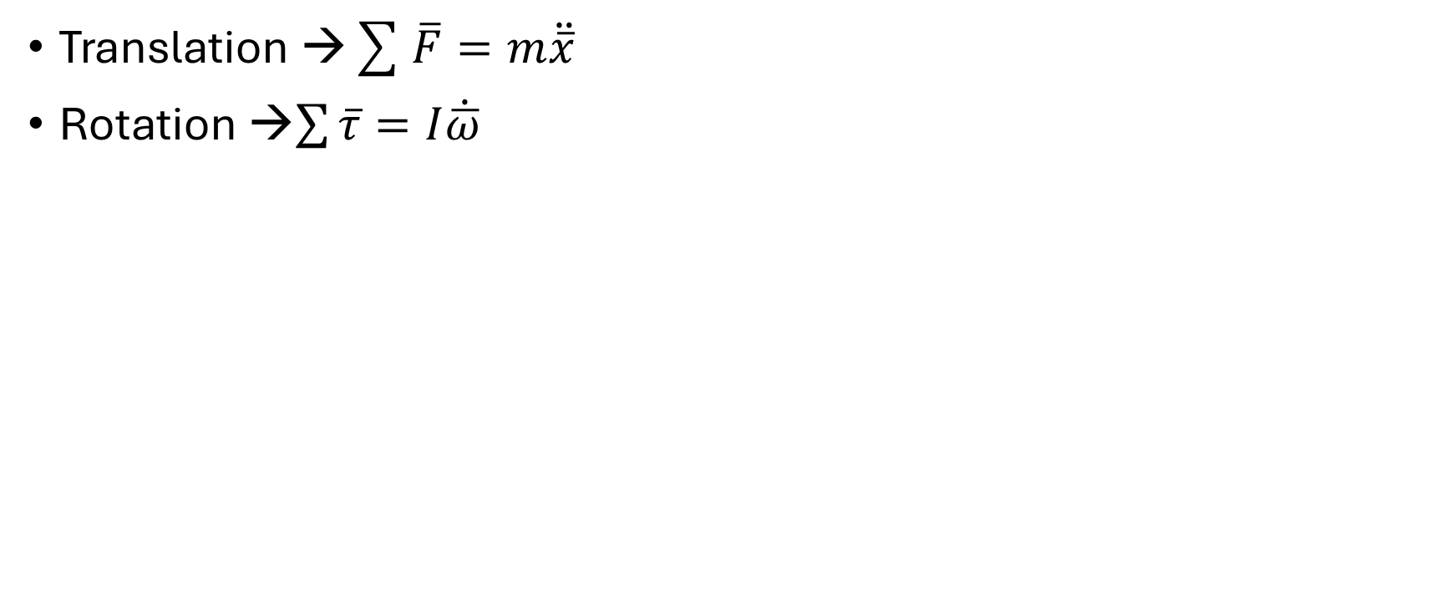
2-b Equations
Translation →$\sum{\overline{F}}=m\ddot{\overline{x}}$
Rotation →$\sum{\overline{τ}}=I\dot{\overline{ω}}$

Slide 9
2-c Aerodynamic Modeling

Slide 10
2-d Disturbances

Slide 11
3- Modeling and Simulation

Slide 12
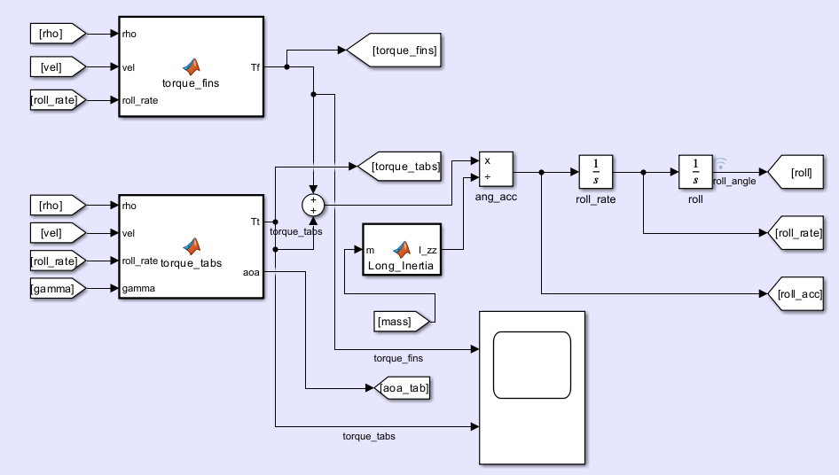
3-a Implementation on Simulink

Slide 13
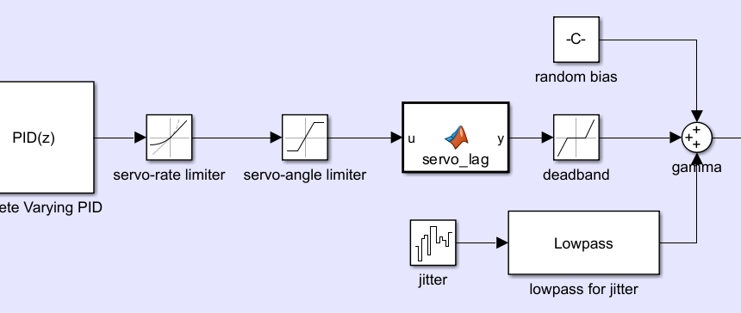
3-b Actuator Dynamics

Slide 14
3-c Sensor Modeling

Slide 15
4-Control System Design

Slide 16
4-a Controller structure

Slide 17
4-b Control surfaces sizing

Slide 18
4-c Tuning

Slide 19
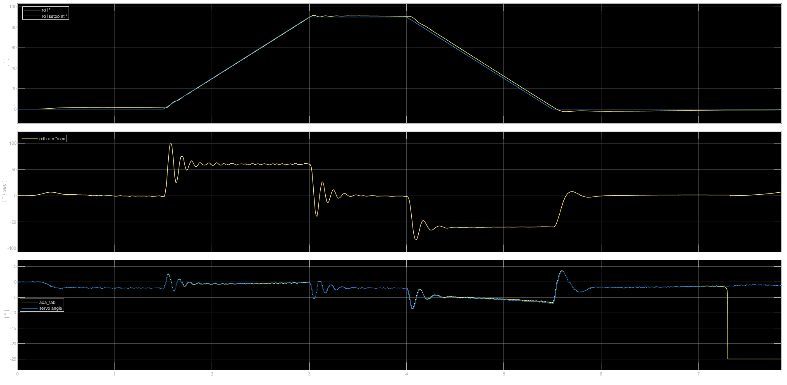
4-d Stability and Performance

Slide 20
5-Embedded Systems Implementation

Slide 21
5-a Hardware architecture

Slide 22
5-b Software architecture

Slide 23
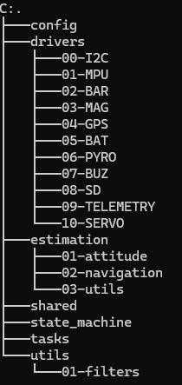
5-b Software architecture
CONFIG: system definition; contains: pin mapping, physical constants, sensor configuration, control system GAINS, flight parameters constants
DRIVERS: hardware interface layer; contains: all sensors and hardware + telemetry; read/write hardware, convert raw I/O to basic units
ESTIMATION: turn raw sensor data into physical state; contains: attitude estimation, navigation (velocity and position), filters, quaternion math, IMU processing fusion; Outputs: roll, pitch, yaw, positions, velocities.
SHARED: global runtime state (single source of truth); contains: system state, shared sensor values, commands, flags.
STATE MACHINE: mission logic brain; contains: operative mode states (0-6), transition conditions, safety logic, event interpretation.
TASKS: runtime execution scheduler (RTOS); contains: task. ; Manage timing (dt), ensure system runs deterministically, call modules in correct order
UTILS: reusable pure functions; contains: math utilities, filters, quaternion math helpers, timing helpers, unit conversion if complex.

Slide 24
Estimation – Attitude (v1.0)
Pitch
Yaw
Roll
Heading

Slide 25
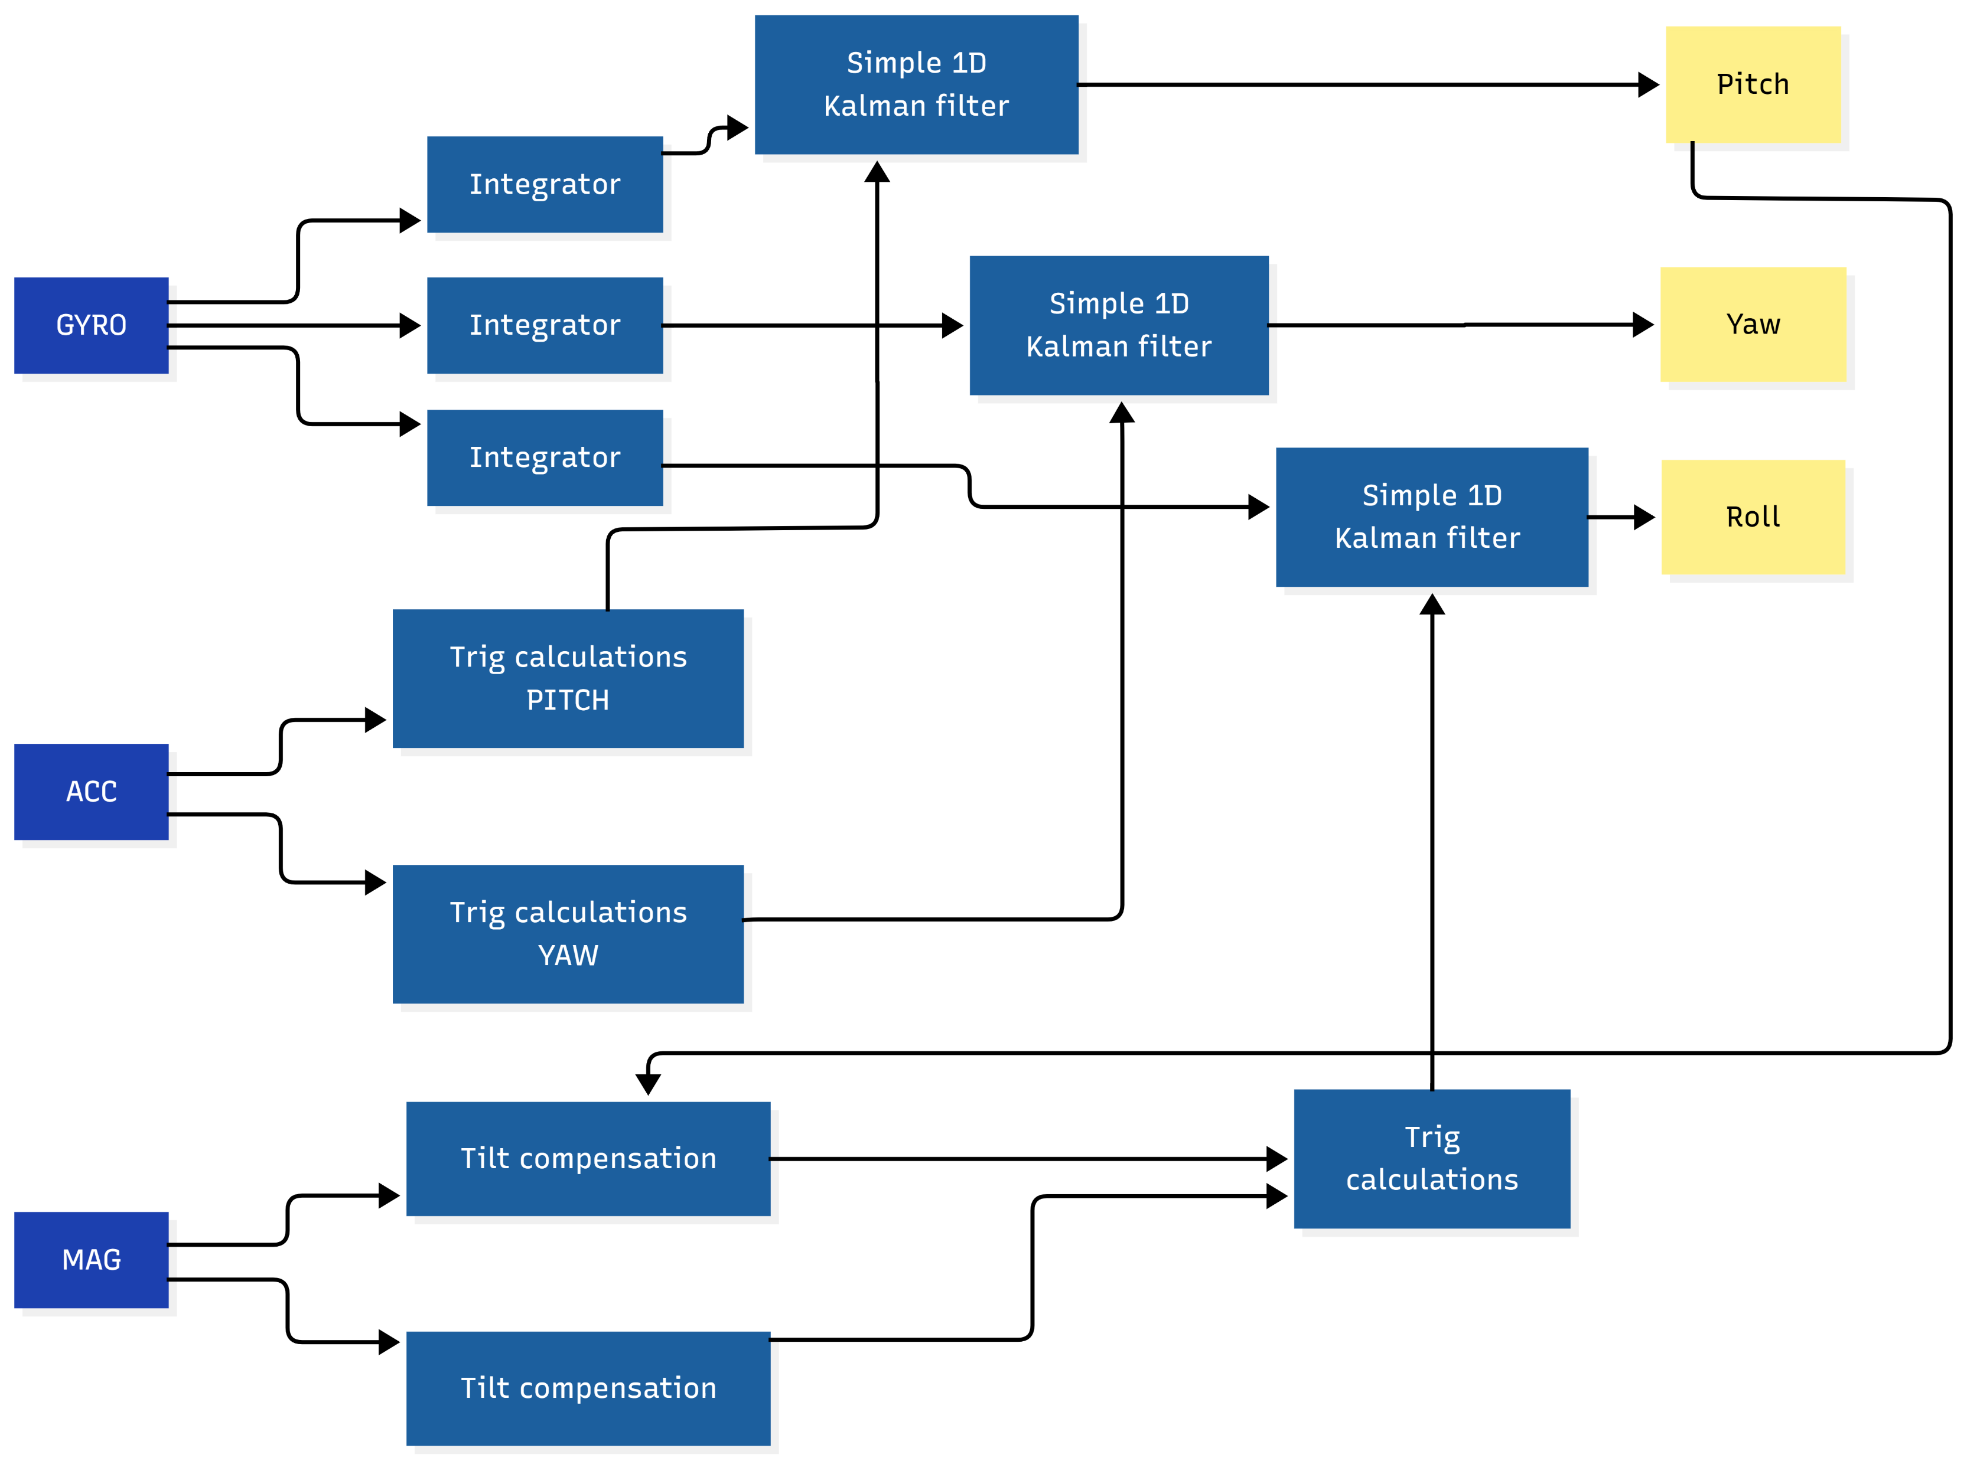
Estimation – Attitude (v1.0)
Pitch , Yaw , Roll

Slide 26
NAVIGATION STATE
Lat
Lng
X
Y
al
Vx
Vy
Vz

Slide 27
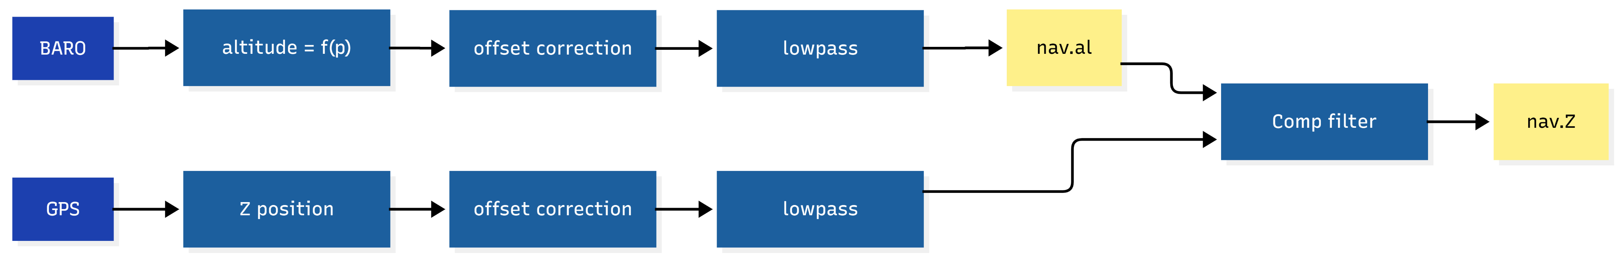
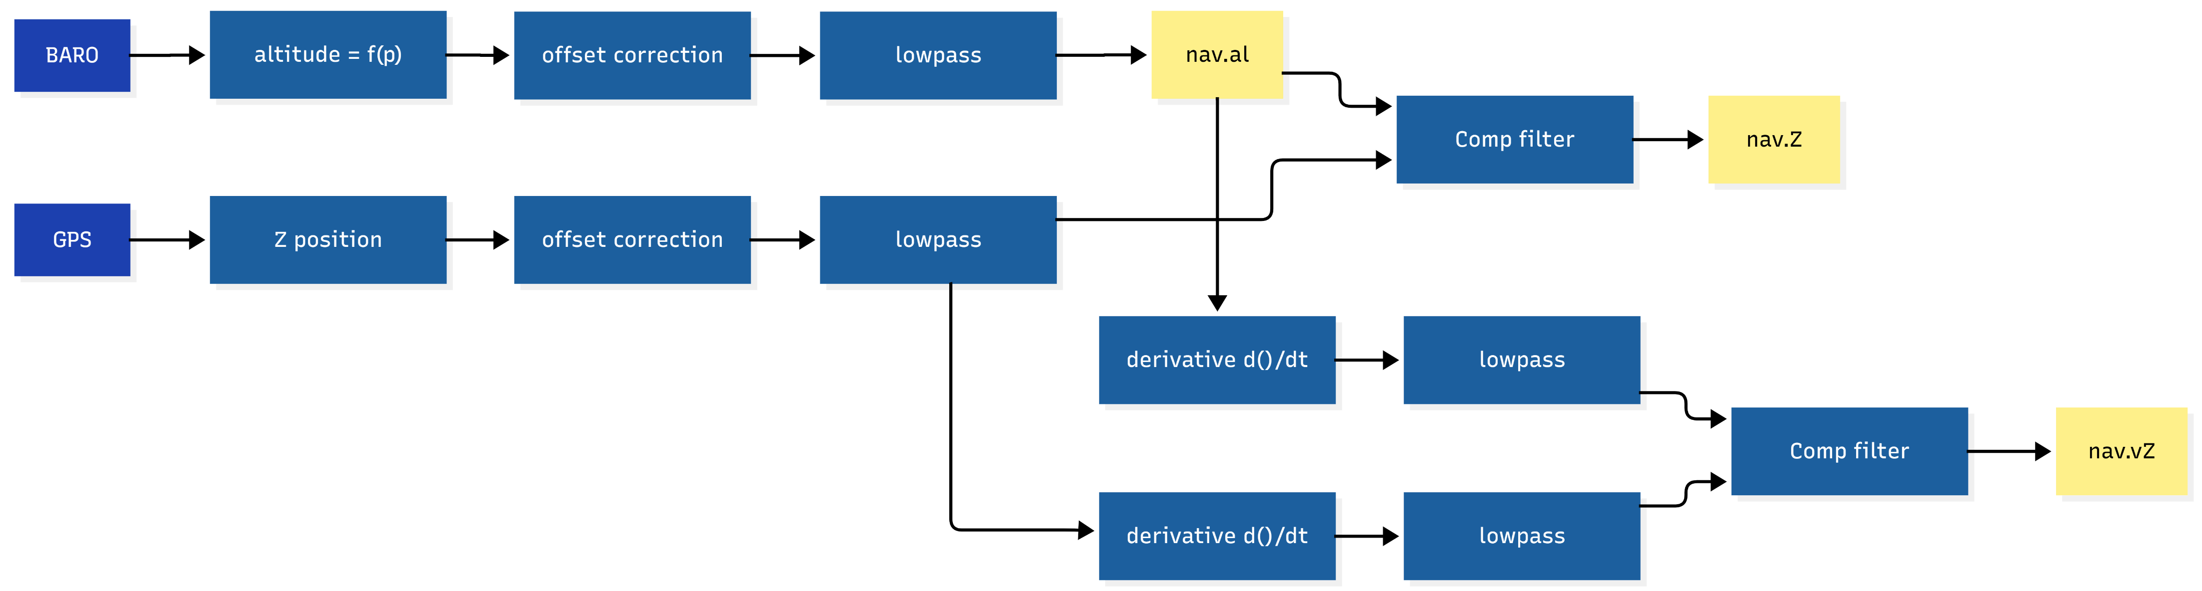
Estimation –Navigation (v1.0)
Z Position - estimation
Z Velocity - estimation

Slide 28
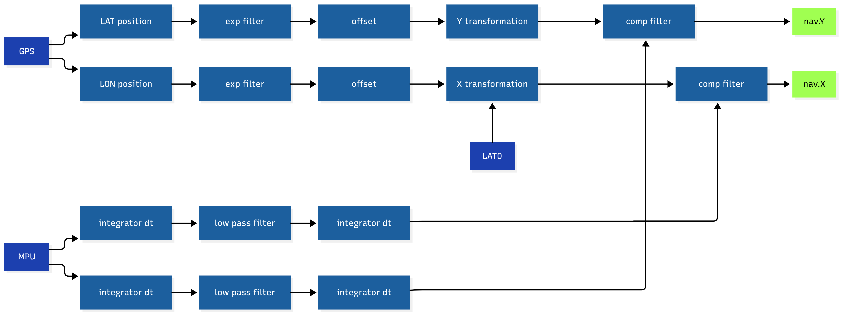
Estimation –Navigation (v1.0)
X,Y Position - estimation

Slide 29
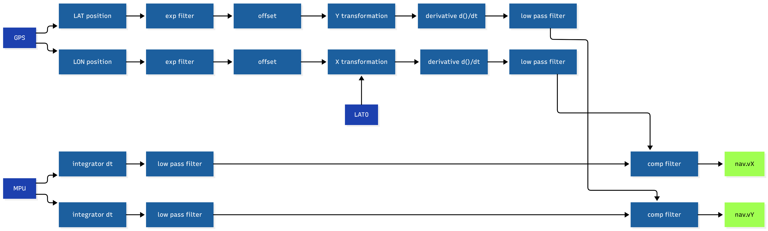
Estimation –Navigation (v1.0)
X,Y Velocity- estimation

Slide 30
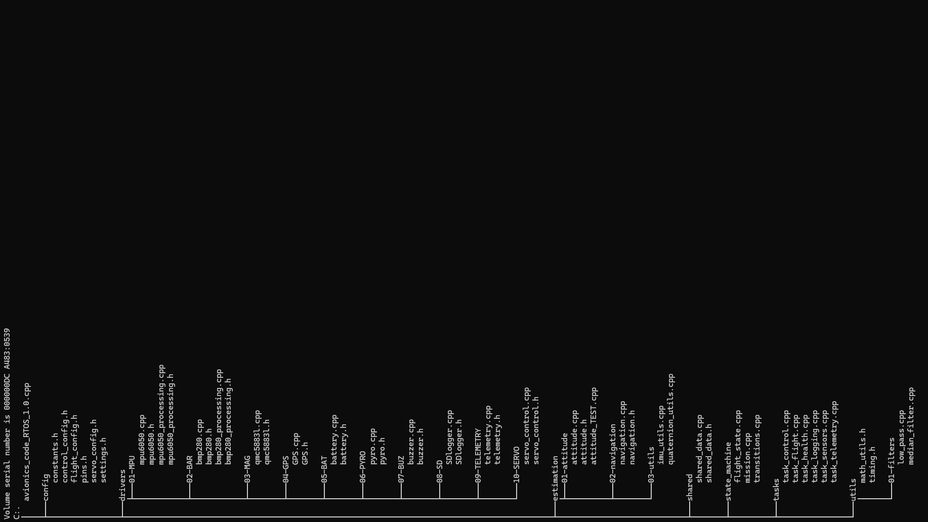
DRIVERS (raw)
↓
PROCESSING (physics clean data)
↓
ESTIMATION (EKF)
↓
FLIGHT STATE (decisions)
↓
ACTUATORS (execution)

Slide 31
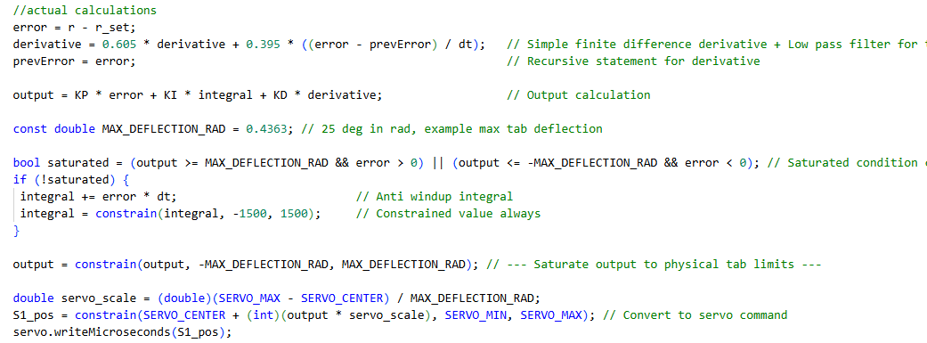
5-c C++ code
Export the gains and N to vscode and build a PID controller (finite difference and forward forward euler integration) use a exponential filter for the derivative calculations → N = ln(alpha)/dt

Slide 32
5-d Interface Sensors-Actuators

Slide 33
6-Experimental Validation

Slide 34
6-a Setup

Slide 35
6-b Test Results

Slide 36
7-Conclusions

Slide 37
7-a Results

Slide 38
7-b Limitations

Slide 39
7-c Further work

Slide 40
Rocket Sizing
Full rocket with high power motor would be better → Too powerful and needs more speed for same control authority → Because MoI is higher.
We scale down the rocket → less MoI → less speed needed for same control authority → less powerful motor → safer and compliant with safety rules + less cost per flight and per rocket (faster iterative time)
Everything needs to be optimized for weight → CM considerations and total mass considerations → We work around a known single use rocket motor F class
Avionics and Recovery is too heavy now → Pyro recovery still needed for reliability → less room to lose weight there (steel hardware needed) → more weight and size to shed on Avionics → PCB custom plug and play components needed → less hassle than perf board more reliability.
We need to learn how to design a simple custom PCB 2 sides that works (simple trace needed)

Slide 41
Rocket Sizing
Before doing a new PCB 2 things are needed tho → 1) A functional launch (crude) ; 2) A FreeRTOS program tested to optimize the code and see the full capabilities of the MCU
5V power is needed for PYRO, MCU power and servo power → total power is less than 3 A so only one buck is needed
Next up fins 3D printed with control actuators mounts → servo testing → avionics mount → recovery mount → final integration

Slide 42
Goals v2
Keep the roll angle fixed to 0°

Slide 43
The Active Control System
Since both the disturbance torque (from misalignment/asymmetry) and the control torque (from tabs) scale with dynamic pressure (q ∝ v²):
Disturbance Torque: τ_dist = C_dist * q * A * L
Control Torque: τ_ctrl = C_ctrl * q * A * L * δ
Since both scale the same way, their ratio remains constant across flight speeds:
τ_ctrl / τ_dist = (C_ctrl * δ) / C_dist = constant
This means the control authority relative to the disturbance doesn't change with speed - making the system surprisingly linear → a simple PID controller with derivative filter + integral antiwindup + output directional saturation is good
Fixed gains work well because the ratio remains constant across speeds and densities (altitudes)
The actuator (tab) is fixed to the servo so δ_servo = δ_tab and also the Lift is proportional to the angle of attack (in first approximation below 25°) → the actuator control has a linear output of torque (fixed arm length, fixed area of the tab) with respect to the angle of deflection
Both the actuator and the physics are linear for deflection angle

Slide 44
The Active Control System
It’s better to control roll angle and not roll rate → derivative term is simply the angular velocity → directly from the gyro (less noise than a finite difference derivative if it was roll rate) + naturally dampened system
The gains for the system are taken first from Simulink, then tweaked after flight performance evaluation

Slide 45
Model
2DOF h and roll simulation , 1 ms timestep
Real servo behaviour modeled: PID exact frequency 100Hz, servo lag (response time), servo positional accuracy, servo jitter (noise), servo angle limiter (linear Cl relationship with alpha), servo rate limiter (max speed), servo deadband
PID gain scheduler for manouvers at different speeds (control authorities)
Manual PID tuning based on overshoot, response delay, oscillations, combined for best accuracy near end of manouver

Slide 46
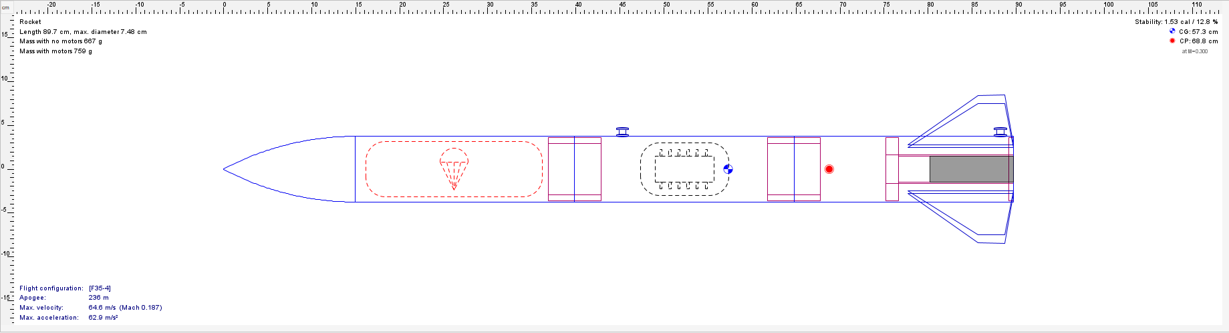
Procedure
Based on availability of body tubes and avionics current state select rocket caliber.
Roughly body length/D = 10
Select Nosecone length as 2D
Place the components after checking real life mass of them
Make a preliminary fin design: f_span = D ; f_root = 1.5*f_span ; f_tip = D/2 ; enough sweep to maximize stability

Slide 47
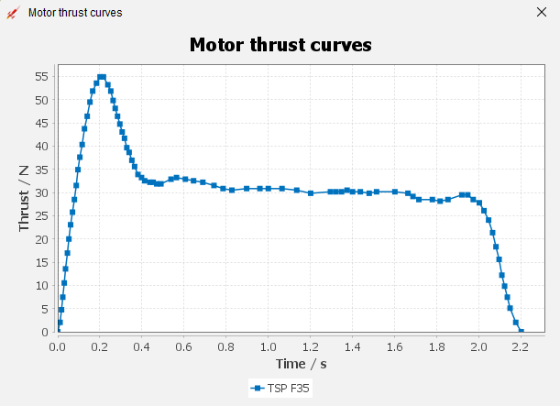
Procedure
Select a suitable motor for the mass budget. Target apogee 200-300m

Slide 48
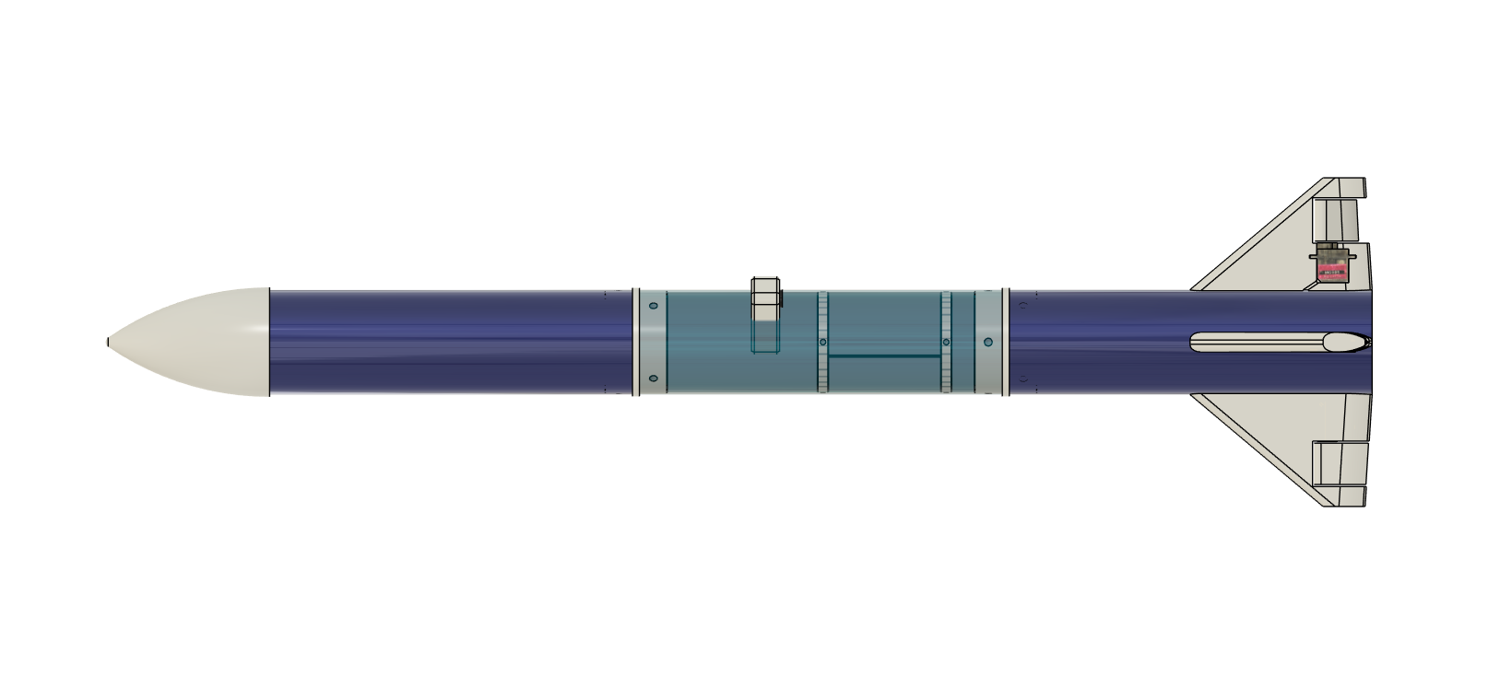
Procedure
Make a CAD model with the real life component masses and dimensions
Get a better estimate of Izz for the 2DOF simulation

Slide 49
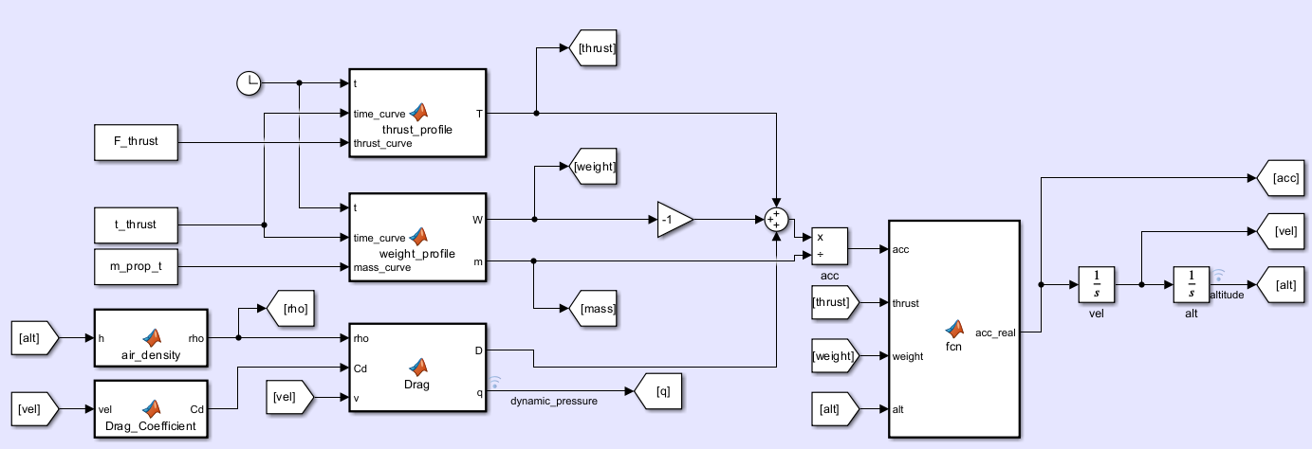
Procedure
Make a 2DOF simulation in Simulink modeling thrust, drag, gravity for z translations and fin misalignment torque (forcing and restoring with real aoa correction and no small angle approximation) , fin tab torque (with real aoa correction)
Implement a PID based control system with constant Kp Ki Kd and N values (convert exponential filter alpha to N). The problem is linear time independent so the controller can be tuned pretty well
Make the PID controller discrete and same Hz as Avionics. Add servo realistic behaviour

