Slide 1
Getting started with LiSA
Luca Negrini
Ca’ Foscari University of Venice
luca.negrini@unive.it

Slide 2

A Library for Static Analysis
[SOAP21, CSV23]
LiSA is a Java library for building static analyzers based on the Abstract Interpretation theory
for different analyses
LiSA provides a unique and generic fixpoint algorithm operating on an extensible intermediate representation
for different languages

Slide 3



A bit of history…
Back in 2020, where it all began:
Just started a PhD at Ca’ Foscari
Working at JuliaSoft on Julia
Background: taint analysis, Java/C#
Assistant Professor at Ca’ Foscari
Worked on Julia, Sample, Checkmate, …
Background: Java-like languages
Research Fellow at Ca’ Foscari
Developer of μJS in Verona
Background: string analysis, JavaScript

Slide 4
… and some motivations
When we met, we did not have an analyzer to work with
Research requirements
different properties
different languages
easy to build upon
Teaching requirements
with short pickup time
implementations close to their formal definition
Generic analysis engine
Pluggable analysis implementations
No fixed input representation
No semantic assumptions
Modular infrastructure
Reusable analysis components
Single responsibility of analysis components

Slide 5



LiSA is…
not a full analyzer
configuration parameters
components selection
plug-in new components
source
code
warnings
and outputs
generic analysis engine
pre-developed components

Slide 6
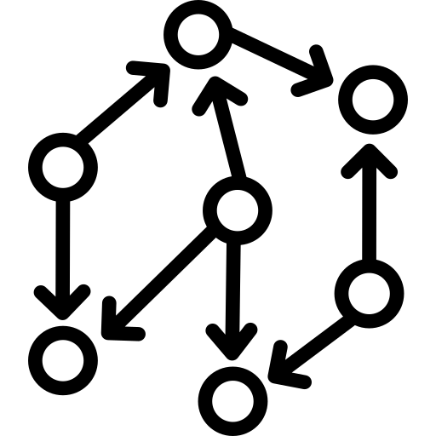

LiSA is… a library
Full analyzer
configuration parameters
components selection
plug-in new components
source
code
inputs
warnings
and outputs
generic analysis engine
pre-developed components

Slide 7





LiSA today
plus students hopping in for theses and projects
Languages: Go [SOAP22, ECOOP23, IEEE24], Python (wip) [SOAP23], Michelson [BRAIN23, DLTRP24], EVM (wip), Rust (wip), LLVM (wip)
Topics: Blockchain [SOAP22, BRAIN23, ECOOP23, DLTRP24, IEEE24], Data Science (wip) [SOAP23], Strings [VMCAI21, JSEP24], Modular interactions (wip), Dynamic languages (wip), Numeric trends (wip)

Slide 8
Today’s plan
Understanding the high-level architecture of LiSA
Call resolution and evaluation
Statement rewriting
Memory abstraction
Value abstraction
A first value analysis: the domain of Signs
Information flow: the Taint analysis
A simple relational analysis: the domain of Upper bounds
Products and relational analyses: the domain of Pentagons
Ask questions at any time!

Slide 9
Today’s plan
Understanding the high-level architecture of LiSA
Call resolution and evaluation
Statement rewriting
Memory abstraction
Value abstraction
A first value analysis: the domain of Signs
Information flow: the Taint analysis
A simple relational analysis: the domain of Upper bounds
Products and relational analyses: the domain of Pentagons

Slide 10
LiSA’s structure
P_{i}
Compilation to LiSA program
Definition of the language execution model
Definition of instruction semantics
Frontend_{i}
Embedded control flow
Standard fixpoints
CFGs
▢ language-dependent

Slide 11
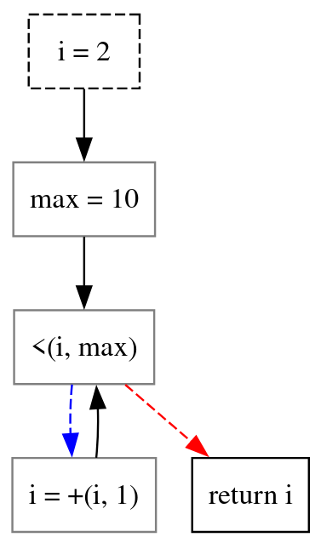
CFGs
int i = 2;
int max = 10;
while (i < max)
i = i + 1;
return i;
Nodes are Statement instances
Edges are Edge instances
LiSA does not fix a semantics for any Statement/Edge, but lets users define them (more details later)

Slide 12
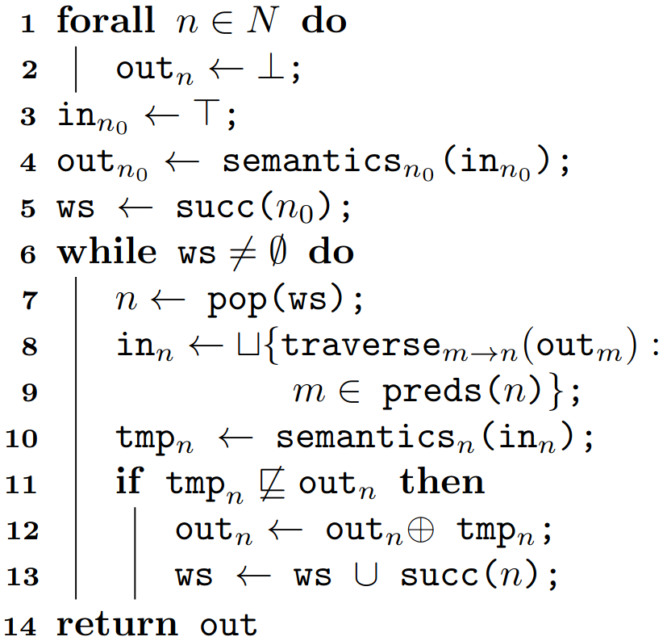
Computing fixpoints over CFGs
LiSA implements the classical worklist-based fixpoint
Delegating to Statement.semantics()
Using Edge.traverse()
Applying lub or widening

Slide 13
LiSA’s structure
configuration,
components
P_{i}
LiSA
?
?
Program-wide
fixpoint
?
?
Call resolution
and evaluation
Frontend_{i}
Statement
semantics
?
Value
Abstraction
?
Memory
Abstraction
?
CFGs
Modular infrastructure
Reusable analysis components
Single responsibility of analysis components
CFG fixpoint
▢ language-dependent

Slide 14
Today’s plan
Understanding the high-level architecture of LiSA
Call resolution and evaluation
Statement rewriting
Memory abstraction
Value abstraction
A first value analysis: the domain of Signs
Information flow: the Taint analysis
A simple relational analysis: the domain of Upper bounds
Products and relational analyses: the domain of Pentagons

Slide 15
The program-wide fixpoint
This happens inside the CFG fixpoint! We do not want this logic to flow over there
select the CFGs to start the analysis from
run a fixpoint over them
are calls
in the CFG?
yes
access another CFG’s result
no
find other CFGs to analyze
access the result from a previous fixpoint

Slide 16
The Interprocedural Analysis
fixpoint logic
semantics()
Interprocedural
Analysis
CFG fixpoint
Non-calling statement
abstract state
getTargetsOf(c)
getResultOf(this)
semantics()
possible targets
abstract state
abstract state
Logic can be:
Start from main and follow calls
Consider CFGs in isolation
…
Call Graph can use:
Runtime types of parameters
Types compatible with the signature
…
Statement semantics does not need to know how the global fixpoint is computed!
The whole process is independent on what analysis we are running!
And the remaining part of the analysis can ignore calls!
Call Graph
Calling statement
▢ configurable

Slide 17
LiSA’s structure
configuration,
components
P_{i}
LiSA
Frontend_{i}
CFG fixpoint
?
Value
Abstraction
Interprocedural
Analysis
CFGs
?
?
Memory
Abstraction
Call Graph
?
Statement semantics
▢ language-dependent
▢ configurable
?

Slide 18
Today’s plan
Understanding the high-level architecture of LiSA
Call resolution and evaluation
Statement rewriting
Memory abstraction
Value abstraction
A first value analysis: the domain of Signs
Information flow: the Taint analysis
A simple relational analysis: the domain of Upper bounds
Products and relational analyses: the domain of Pentagons

Slide 19
Syntax vs Semantics
We want to specify semantics generically
It should apply to all analyses
Analyses should not give meaning to the syntax
Java’s a + b can be a sum or a concatenation
Python’s [f(x) for x in dict.values()] expands to a loop
CFG fixpoint
Statement semantics
IA
Classic solution: rewrite to an IR
But we might want to exploit semantic information!

Slide 20
Symbolic Expressions
Our solution: break Statements into SymbolicExpressions
CFG fixpoint
The rewriting happens dynamically, and can exploit the analysis
Types, possible values, …
Statement semantics
SymbolicExpressions are extensible
We provide some, but users can define more
IA
expr₁
expr₂
…
expr_{n}
Analyses only have to model these expressions, ignoring the syntax behind them!

Slide 21
Examples (pseudocode)
Plus.semantics(): // left + right
if type(left) is string or type(right) is string:
return domain.eval(new BinaryExpression(“cat”, left, right))
else:
return domain.eval(new BinaryExpression(“+”, left, right))
Conditional.semantics(): // condition ? ifTrue : ifFalse
sat = domain.isSatisfied(condition)
tt = ifTrue.semantics()
ff = ifFalse.semantics()
return sat.isTrue() ? tt : (sat.isFalse() ? ff : tt ⊔ ff)
PreIncrement.semantics(): // ++var
add = new BinaryExpression(“+”, var, new Const(1))
d1 = domain.assign(var, add)
return d1.eval(var)

Slide 22
LiSA’s structure
configuration,
components
P_{i}
LiSA
Frontend_{i}
CFG fixpoint
?
Value
Abstraction
Interprocedural
Analysis
CFGs
?
?
Memory
Abstraction
Call Graph
Statement semantics
▢ language-dependent
▢ configurable

Slide 23
Today’s plan
Understanding the high-level architecture of LiSA
Call resolution and evaluation
Statement rewriting
Memory abstraction
Value abstraction
A first value analysis: the domain of Signs
Information flow: the Taint analysis
A simple relational analysis: the domain of Upper bounds
Products and relational analyses: the domain of Pentagons

Slide 24
Combining values and memory
While calls are “easy” to abstract away, dynamic memory (stack or heap) and computed values are strongly coupled
Values are moved from variables to dynamic memory continuously
Despite this, we still want to keep management of the two separate
For reusability
To reduce the complexity of the implementations
To allow newcomers to write only the analyses they need

Slide 25
What happens concretely?
Every memory-dealing instruction “refers” to an address in memory
0x11011…
x = new Foo();
x.f = 5;
x.g = 7;
0x10010…
class Foo {
int f, g;
Foo() {
f = 1;
g = 2;
}
}
f
A₂
A₁
g
x
A₃
x = &A₁;
A₂ = 5;
A₃ = 7;
0x01010…
What if we treat addresses as variables?

Slide 26
The Abstract State
[TCS16]
The Heap Domain tracks the structure of the dynamic memory
new allocations
pointer aliasing
…
Abstract State
Heap Domain
expr
rewrite
The Heap Domain rewrites memory-related expressions to their symbolic variables
Value Domain
The Value Domain only “sees” expressions with variables and constants!
▢ configurable

Slide 27
The Abstract State
[TCS16]
Heap Domain:
x ↦ L₁
Abstract State
L₁↦ {5}
L₁↦ {5, 7}
L_{1.1}↦ {5}
Value Domain:
L_{1.1}↦ {5}, L_{1.2}↦ {7}
Heap Domain
 |  |  | precision
expression | variable | low | medium | high
new Foo() | A₁ | L | L₁ | L₁
x.f | A₂ | L | L₁ | L_{1.1}
x.g | A₃ | L | L₁ | L_{1.2}
x.f = 5
x.g = 7
rewrite
L₁ = 7
L_{1.1} = 5
L_{1.2} = 7
L₁ = 5
Value Domain
L_{1.1} and L_{1.2} are assigned once each, so we are more precise without changing the Value Domain!
▢ configurable
L₁ is assigned twice, so we lost precision!
Can we do better?

Slide 28
LiSA’s structure
configuration,
components
warnings,
analysis dumps
P_{i}
LiSA
Checks
Frontend_{i}
CFG fixpoint
Abstract state
Interprocedural
Analysis
CFGs
Heap
Domain
Call Graph
Value
Domain
Statement semantics
▢ language-dependent
▢ configurable

Slide 29

Did we meet our requirements?
Generic analysis engine
Pluggable analysis implementations
The engine is unique, components are reusable plug-ins
No fixed input representation
No semantic assumptions
The engine uses information passed by frontends (e.g., semantics)
Modular infrastructure
Reusable analysis components
Single responsibility of analysis components
Components are defined through interfaces and can be combined together to create new analyses

Slide 30
Questions?

Slide 31
Today’s plan
Understanding the high-level architecture of LiSA
Call resolution and evaluation
Statement rewriting
Memory abstraction
Value abstraction
A first value analysis: the domain of Signs
Information flow: the Taint analysis
A simple relational analysis: the domain of Upper bounds
Products and relational analyses: the domain of Pentagons

Slide 32
But what are states, really?
Abstract states must be built, merged, and compared during the fixpoint
Lattice operators are required
Avenues for processing expressions are required
Lattice: L
+ lessOrEqual(other: L): boolean
+ lub(other: L): L
+ widening(other: L): L
+ top(): L
+ bottom(): L
SemanticDomain: D
+ assign(id: ID, expression: SymbExpr): D
+ smallStepSemantics(expression: SymbExpr): D
+ satisfies(expression: SymbExpr): Satisfiability
+ assume(expression: SymbExpr): D
Abstract State, Value Domain, and Heap Domain all implement both!

Slide 33
Examples (with less pseudocode)
Plus.semantics(): // left + right
if type(left) is string or type(right) is string:
return domain.smallStepSemantics(new BinaryExpression(“cat”, left, right))
else:
return domain.smallStepSemantics(new BinaryExpression(“+”, left, right))
Conditional.semantics(): // condition ? ifTrue : ifFalse
sat = domain.satisfies(condition)
tt = domain.assume(condition).smallStepSemantics(ifTrue)
ff = domain.assume(condition.negate()).smallStepSemantics(ifFalse)
return sat.isTrue() ? tt : (sat.isFalse() ? ff : tt.lub(ff))
PreIncrement.semantics(): // ++var
add = new BinaryExpression(“+”, var, new Const(1))
d1 = domain.assign(var, add)
return d1.smallStepSemantics(var)

Slide 34
Main classes for value analyses
Lattice
SemanticDomain
ValueDomain
A Value Domain is a lattice element
Its state carries the abstract information
Lattice operators compare/combine that information
A Value Domain can be used as a pre-state
Semantic Domain operators can transform it into a post-state
Can we further modularize?

Slide 35
Relational vs Non-Relational
Relational analyses have specific structures
Hard to factor out general implementation patterns
Non-relational analyses instead share a common structure:
Track values of single variables through a function (i.e., a map)
The mapping changes only with assignments (usually)
Evaluation logic is analysis-specific
There is space for modularization!
Abstract common logic (map and assignment)
Build instances of atomic information with domain-specific logic

Slide 36
Main classes for value analyses
values of variables
lattice structure
eval logic
Lattice
SemanticDomain
ValueDomain
NonRelationalElement: T, F
+ satisfies(expr: SymbExpr, env: F): Satisfiability
+ assume(expr: SymbExpr, env: F): F
FunctionalLattice: F, K, V
+ getState(key: K): V
+ putState(key: K, value: V): F
NonRelationalDomain: T, F
+ eval(expr: SymbExpr, env: F): T
Environment: M, T
+ eval(expr: SymbExpr): T
NonRelationalValueDomain: T
variable mapping
one instance per state
delegate to NRVD for eval logic
ValueEnvironment: T

Slide 37
Coding demo:
The Sign domain
T
-
0
+
丄

Slide 38
Today’s plan
Understanding the high-level architecture of LiSA
Call resolution and evaluation
Statement rewriting
Memory abstraction
Value abstraction
A first value analysis: the domain of Signs
Information flow: the Taint analysis
A simple relational analysis: the domain of Upper bounds
Products and relational analyses: the domain of Pentagons

Slide 39
Taint analysis
Information Flow analyses aim at understanding how data flows from a location to another during the execution
It does not care about values, but how they are computed
Taint analysis is one instance of Information Flow that only considers explicit flows
We mark relevant values as tainted
We mark variables as tainted when they are assigned a tainted value
After the analysis, we check where that taintedness reached

Slide 40
A practical example: SQL Injections
protected void doPost(HttpServletRequest request,
HttpServletResponse response)
throws ServletException, IOException {
boolean success = false;
String username = request.getParameter("username");
String password = request.getParameter("password");
String query = "SELECT * FROM users WHERE username='" + username
+ "' and password='" + password + "'";
Statement stmt = null;
Connection conn = DriverManager.getConnection("jdbc:mysql://" + DB_URL,
DB_USER, DB_PWD);
Statement stmt = conn.createStatement();
ResultSet rs = stmt.executeQuery(query);
// ...
}
User input: this is dangerous!
Security hotspot: input must not be given by user!

Slide 41
Implementing Taint analysis
Taint analysis can be implemented in different ways (e.g., boolean formulas)
We implement it as a non-relational domain:
One bit of taintedness per variable
We will use annotations for detecting sources
After the analysis, we will run a semantic check to find dangerous sinks

Slide 42
Coding demo:
Taint analysis
tainted
clean
丄

Slide 43
Today’s plan
Understanding the high-level architecture of LiSA
Call resolution and evaluation
Statement rewriting
Memory abstraction
Value abstraction
A first value analysis: the domain of Signs
Information flow: the Taint analysis
A simple relational analysis: the domain of Upper bounds
Products and relational analyses: the domain of Pentagons

Slide 44
The Upper Bounds domain
[SCP10]
The domain of Upper Bounds keep tracks of relations of the form x < y
Despite this, it has a convenient non-relational-like representation (if we ignore some operations):
x ↦ {y, z}
z ↦ {w}
x < y, x < z
z < w
The expressions to look at are in conditionals!
We have to use assume() instead of eval()

Slide 45
Coding demo:
the Upper
Bounds domain
∅
…
{x}
…
…
{x,y}
…
丄

Slide 46
Today’s plan
Understanding the high-level architecture of LiSA
Call resolution and evaluation
Statement rewriting
Memory abstraction
Value abstraction
A first value analysis: the domain of Signs
Information flow: the Taint analysis
A simple relational analysis: the domain of Upper bounds
Products and relational analyses: the domain of Pentagons

Slide 47
Products in LiSA
A product is a combination of two or more analyses
That run independently
That might exchange information
Regardless of the formalism, products in LiSA are just “nested” analyses
You define the individual analyses beforehand
You define the product as a new analysis that contains the client ones in its state
This maintains modularity!

Slide 48
The Pentagons domain
[SCP10]
The Pentagons abstract domain is a numerical analysis that:
Is relational
Is built as a reduced product
➡ we cannot implement it as a NRVD!
➡ we can implement it modularly!
y
Intervals:
x ↦ [3, 10]
y ↦ [6, 15]
Upper bounds:
x ↦ {y}
x

Slide 49
Coding demo:
the Pentagons domain

Slide 50
Thanks!
LiSA’s website - LiSA on GitHub - SSV research group
Today’s code
If you are interested for teaching and/or research, get in touch with us!
luca.negrini@unive.it

Slide 51
References I
[SOAP21] Ferrara P., Negrini L., Arceri V., Cortesi A. Static analysis for dummies: experiencing LiSA. In Proceedings of the 10th ACM SIGPLAN International Workshop on the State Of the Art in Program Analysis (SOAP 2021). https://doi.org/10.1145/3460946.3464316
[VMCAI21] Negrini L., Arceri V., Ferrara P., Cortesi A. Twinning Automata and Regular Expressions for String Static Analysis. In: Verification, Model Checking, and Abstract Interpretation (VMCAI 2021). https://doi.org/10.1007/978-3-030-67067-2_13
[SOAP22] Olivieri L., Tagliaferro F., Arceri V., Ruaro M., Negrini L., Cortesi A., Ferrara P., Spoto F., Talin E. Ensuring determinism in blockchain software with GoLiSA: an industrial experience report. In Proceedings of the 11th ACM SIGPLAN International Workshop on the State Of the Art in Program Analysis (SOAP 2022). https://doi.org/10.1145/3520313.3534658
[BRAIN23] L. Olivieri, T. Jensen, L. Negrini and F. Spoto. MichelsonLiSA: A Static Analyzer for Tezos. 2023 IEEE International Conference on Pervasive Computing and Communications Workshops and other Affiliated Events (PerCom Workshops). https://doi.org/10.1109/PerComWorkshops56833.2023.10150247
[SOAP23] Negrini L., Shabadi G., Urban C. Static Analysis of Data Transformations in Jupyter Notebooks. In Proceedings of the 12th ACM SIGPLAN International Workshop on the State Of the Art in Program Analysis (SOAP 2023). https://doi.org/10.1145/3589250.3596145

Slide 52
References II
[ECOOP23] Olivieri L., Negrini L., Arceri V., Tagliaferro F., Ferrara P., Cortesi A., Spoto F. Information Flow Analysis for Detecting Non-Determinism in Blockchain. In 37th European Conference on Object-Oriented Programming (ECOOP 2023). https://doi.org/10.4230/LIPIcs.ECOOP.2023.23
[CSV23] Negrini L., Ferrara P., Arceri V., Cortesi A. LiSA: A Generic Framework for Multilanguage Static Analysis. In: Challenges of Software Verification. Intelligent Systems Reference Library. https://doi.org/10.1007/978-981-19-9601-6_2
[DLTRP24] Olivieri L., Negrini L., Arceri V., Jensen T., Spoto F. Design and Implementation of Static Analyses for Tezos Smart Contracts. Distrib. Ledger Technol. https://doi.org/10.1145/3643567
[JSEP24] Negrini L., Arceri V., Cortesi A., Ferrara P. Tarsis: An effective automata-based abstract domain for string analysis. J Softw Evol Proc. https://doi.org/10.1002/smr.2647
[IEEE24] Olivieri L., Negrini L., Arceri V., Chachar B., Ferrara P., Cortesi A. Detection of Phantom Reads in Hyperledger Fabric. In: IEEE Access. https://doi.org/10.1109/ACCESS.2024.3410019
[TCS16] Ferrara P. A generic framework for heap and value analyses of object-oriented programming languages. Theoretical Computer Science. https://doi.org/10.1016/j.tcs.2016.04.001

Slide 53
References III
[SCP10] Logozzo F., Fähndrich M. Pentagons: A weakly relational abstract domain for the efficient validation of array accesses. Science of Computer Programming. https://doi.org/10.1016/j.scico.2009.04.004

