Slide 1
Modular Multi-Language Analysis in LiSA
Luca Negrini
January 19th, 2022

Slide 2

Abstract Interpretation
Framework for reasoning about program semantics
abstraction
P, I
P#, I#
semantics
abstract semantics
not computable
must over-approximate concrete semantics
R
R#
$⊆$ R'
concretization

Slide 3
What if the program is not atomic?
The same statement might have different effects:
array[-1]
→ Java: ArrayIndexOutOfBoundsException
→ Python: array[len(array) – 1]
→ C: undefined behavior
→ semantics is not well defined!

Slide 4
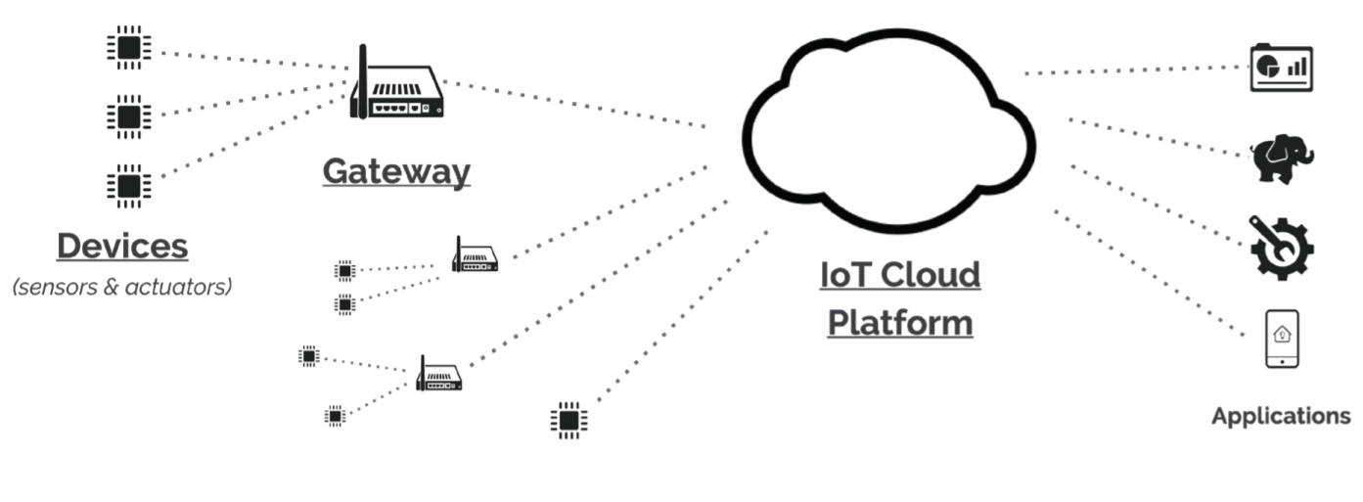
What if the program is not atomic?
From “Cross-Programming Language Taint Analysis for the IoT Ecosystem”
P. Ferrara, A. K. Mandal, A. Cortesi, F. Spoto @ InterAVT 2019

Slide 5

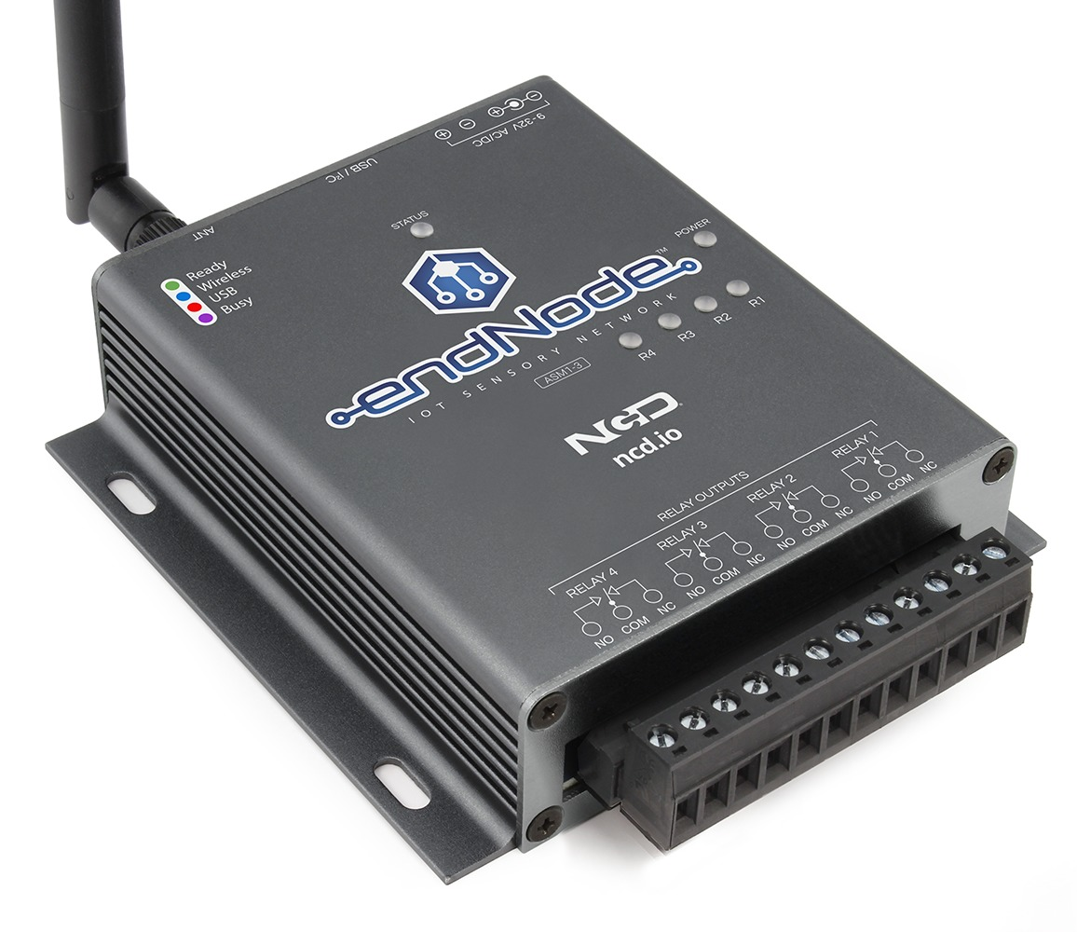

The scenario: robotic IoT car
Car (C++)
Controller (Java)
Joystick (C++)
initialize()
initialize()
readUpDown()
runMotor(sensor value)
sensor value
readLeftRight()
turnRight()
sensor value
Tainted?
readLeftRight()
turnLeft()
sensor value
isButtonPressed()
turnAtAngle(0)
true/false

Slide 6


Simple approach
Analyze each subprogram in isolation
As fast as we can: “single” analysis
Global reasoning within single languages
Cross-language interactions ignored
Syntactic properties
Semantic properties (language-local)
Semantic properties (global)

Slide 7
Can we do better?
Make analyses exchange information, and perform a fixpoint over the exchanged information
Slower: need to repeat the analysis of each subprogram
Cross-language interactions considered
Syntactic properties
Semantic properties (language-local)
Semantic properties (global)

Slide 8

Coordinated semantic analyses
CSONAR:
sensor value -> source actuator -> sink
JNI methods -> sinks
Analysis 1: CSONAR
Sensor -> JNI
Produce Julia annotation
Analysis 3 : CSONAR
Annotation -> Actuator
Warning!
Analysis 2: Julia
Annotation -> JNI
Produce CSONAR annotation
Julia:
JNI calls -> sinks
Car (C++)
Controller (Java)
Joystick (C++)
initialize()
initialize()
readUpDown()
runMotor(sensor value)
sensor value
readLeftRight()
turnRight()
sensor value
readLeftRight()
turnLeft()
sensor value
isButtonPressed()
turnAtAngle(0)
true/false

Slide 9
Can we do better?
Make analyses exchange information, and perform a fixpoint over the exchanged information
Slower: need to repeat the analysis of each subprogram
Cross-language interactions considered
But…
3 analyses on small example
Tool communication is hard
Complex information?
Syntactic properties
Semantic properties (language-local)
Semantic properties (global)

Slide 10
Multi-language analysis
Goal: single analysis of a whole program
Requirements:
Different semantics for the same construct
No assumptions on the execution model
Nice to have:
Modular structure: no need to reimplement from scratch when changing context
Easy to use and extend: for research and teaching

Slide 11
LiSA, a Library for Static Analysis
Library written in Java
Based on an extensible CFG representation
Received as inputs: no knowledge of source languages
Get rid of the syntax for control flow
Extensible: node instances are not fixed
Statements (CFG nodes) are language specific!
Each node over-approximates the semantics of its language

Slide 12
Well defined semantics
JavaArrayAccess.semantics() {
if index < 0 or index > len(receiver) then return bottom
return entry state but with accessed element on stack
}
PythonArrayAccess.semantics() {
if index < 0 then index = len(receiver) - index
if index < 0 or index > len(receiver) then return bottom
return entry state but with accessed element on stack
}
Language-specific semantic function
Different instances for each language

Slide 13
Symbolic expressions
With extensible statements there is no predefined set of operations
Analyses need to know how the state evolves with each statement
Solution: the SymbolicExpressions language
Analyses work on an internal extensible language of SymbolicExpressions
Each symbolic expression is an “atomic” semantic operation
Heap allocation, numeric sum, pointer dereference, …
malloc (C) and new int[] (Java) are modeled with the same symbolic expression HeapAllocation
Analyses use Statement.semantics() to rewrite each Statement to SymbolicExpression(s) and feed them to the analysis

Slide 14
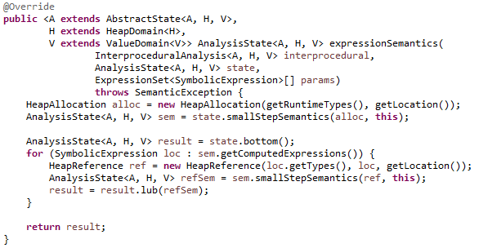
Example: creating a new array
Simulate the allocation of a new heap region
Let the analysis process the allocation
Simulate the creation of a reference to the new region
Let the analysis process the reference

Slide 15
Example: creating a new array
More operations can fit here!
Domain agnostic!

Slide 16
Recap: what does LiSA analyze?
LiSA program is made up of CFGs (+ extra information)
CFGs encode flow control in their structure
CFG nodes are language-specific
CFG nodes rewrite into symbolic expressions
Syntax
Semantics

Slide 17
Analysis modularity
Analysis components must be agnostic to how others are implemented:
Separation of responsibility: each component is responsible only for its duties
Modularity: analysis can be composed freely without changing the code, tuning precision and performances
Simple implementation: no need to worry about concepts external to the component being implemented

Slide 18

Achieving modularity
Value abstraction
Memory abstraction
Call resolution
Analysis orchestration
Value Domain
Intervals, octagons, …
Heap Domain
Program points, shape, …
How do memory and value abstraction modularly exchange information?

Slide 19
The Abstract State
int x = w + 3;
A a = new A();
a.f = x;
a.g = a.f * 2;
Abstract State
Heap Domain
expr
What if we want better precision?
x = w + 3
rewritten
expr
substitution
a = new A()
a.f = x
a.g = a.f * 2
Intervals + Program Point (field insensitive)
Intervals + Program Point (field sensitive)
x = w + 3
a = l
l = x
l.f = x
l = l * 2
l.g = l.f * 2
{}
Heap: []
Value: [w -> [5, 10]]
Heap: []
Value: [w -> [5, 10], x -> [8, 13]]
Heap: [a -> l]
Value: [w -> [5, 10], x -> [8, 13]]
Heap: [a -> l]
Value: [w -> [5, 10], x -> [8, 13], l -> [8, 13]]
Heap: [a -> l]
Value: [w -> [5, 10], x -> [8, 13], l.f -> [8, 13]]
Heap: [a -> l]
Value: [w -> [5, 10], x -> [8, 13]]
Heap: [a -> l]
Value: [w -> [5, 10], x -> [8, 13], l -> [8, 26]]
Heap: [a -> l]
Value: [w -> [5, 10], x -> [8, 13], l.f -> [8, 13], l.g -> [16, 26]]
Value Domain
Pietro Ferrara, A generic framework for heap and value analyses of object-oriented programming languages, Theoretical Computer Science, Volume 631, 2016, Pages 43-72

Slide 20
Achieving modularity
Value abstraction
Memory abstraction
Call resolution
Analysis orchestration
Analysis State
Abstract State
Value Domain
Intervals, octagons, …
Heap Domain
Program points, shape, …
Expr Stack
How do we modularly:
compute the result of calls?
run a fixpoint over the program?
Call Graph
RTA, CHA, …

Slide 21
The Interprocedural Analysis
Interprocedural
Analysis
fixpoint logic
CFG Fixpoint
Non-calling stmt
ia.getResultOf(this)
stmt.semantics()
abstract result
target(s) of the call
cg.resolve(call)
abstract result
The analysis state is not involved!
Call Graph
Calling stmt

Slide 22
Recap: what does LiSA analyze?
LiSA program is made up of CFGs (+ extra information)
CFGs encode flow control in their structure
CFG nodes are language-specific
CFG nodes rewrite into symbolic expressions
Calls + orchestration handled by Interprocedural Analysis + Call Graph
Memory is modeled by the Heap Domain
Values are modeled by the Value Domain
All components are independent from one another
Syntax
Semantics
Analysis

Slide 23
Who creates the CFGs?
Frontends are compilers from the original language to LiSA programs
They can also add logic to the analysis!
Library models
Each language has its own frontend
With language-specific statements!
Long-term objective: plug into compilers/interpreters
LiSA program P_{L}
Program P
L^{i} front-end
CFGs
P^{i}
Analysis logic

Slide 24
Analysis overview
Interprocedural Analysis
Call Graph
Heap Domain
Value Domain
P^{i}
Analysis Dump
Warnings
L^{i} front-end
LiSA
Analysis State
Abstract State
Interprocedural
Analysis
CFG fixpoint
CFGs
Heap Domain
Call Graph
Statement semantics
Value Domain
Language-based
Calling statement
Non-calling statement
Expr Stack

Slide 25
LiSA semantic analysis
LiSA:
sensor value -> source, actuator -> sink
Analysis 1: LiSA
sensor -> actuator
Warning!
Car (C++)
Controller (Java)
Joystick (C++)
initialize()
initialize()
readUpDown()
runMotor(sensor value)
sensor value
readLeftRight()
turnRight()
sensor value
readLeftRight()
turnLeft()
sensor value
isButtonPressed()
turnAtAngle(0)
true/false
https://github.com/UniVE-SSV/lisa-joycar-example

Slide 26
Current state
Development started in late 2020
Available on Maven and GitHub under MIT license
Able to model some features of languages (e.g. classes, global variables, inheritance, dynamic call resolution) while other are still missing (e.g. exceptions and error handling)
Frontend for IMP, early developments for Go, Java, Java Bytecode and Python

Slide 27
Ongoing works
Go: smart contracts
Overflows through numeric domains
Non-determinism through taint analysis
Python: jupyter notebooks
Dataframes operations modeling through custom domains
Java bytecode:
Verification and enforcement of AWS policies
TBD:
String properties with non-relational and relational domains

Slide 28
Teaching experience
LiSA has been adopted in:
ACADIA PhD course:
Online lectures
Final projects: abstract domains implementation
Software Correctness, Security and Reliability Master course:
Lab lectures
Weekly tasks: dataflow, simple abstract domains
Final projects: abstract domains implementation
Paper: “Static analysis for dummies: experiencing LiSA” @ SOAP 2021

Slide 29
Thanks!
Luca Negrini, PhD student
luca.negrini@unive.it
https://github.com/UniVE-SSV/lisa
https://unive-ssv.github.io/lisa/

