Slide 1
Static Analysis of Data Transformations in Jupyter Notebooks
Luca Negrini¹, Guruprerana Shabadi², Caterina Urban³
¹Corvallis srl, Verona, Italy, and Ca’ Foscari University of Venice, Venice, Italy
²École Polytechnique, Institut Polytechnique de Paris, Paris, France
³Inria & ENS — PSL, Paris, France
luca.negrini@unive.it
SOAP ‘23 – June 17th, 2023

Slide 2




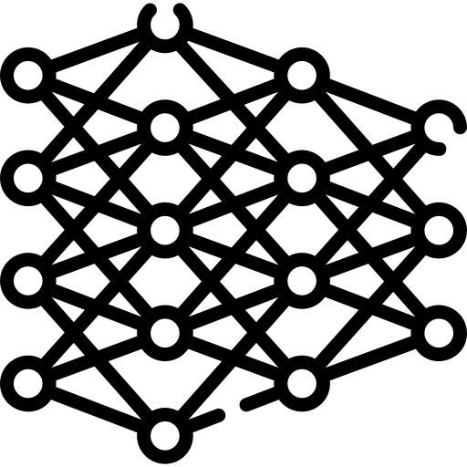
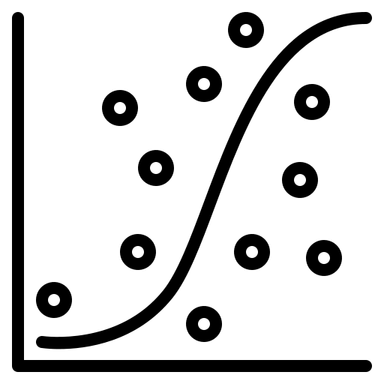
Data-centric programs
Raw data from different sources
Data-centric program
(likely Python script using pandas)
Business models, ML training, ...

Slide 3
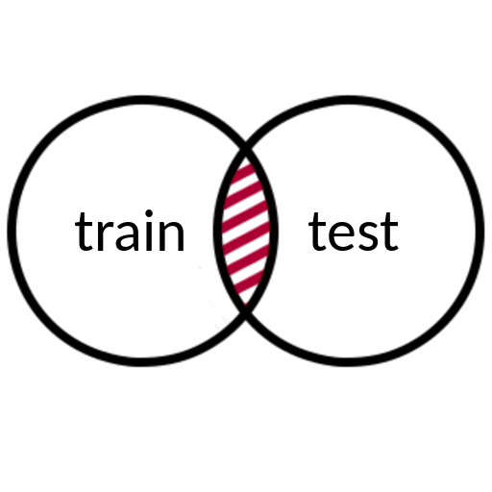


Properties to prove: old and new
Input data usage
Data provenance
ML data leak
> table[‘name’]
Traceback (most recent call last):
...
KeyError: ‘name’
Runtime errors

Slide 4







Data-centric programs
Different paradigm!

Slide 5
The paradigm change
Data and queries through object-oriented constructs
Tables become objects
Column accesses become properties access
Row selection becomes a complex operation
SELECT name
FROM people
WHERE age > 30
people
.loc[ , 'name']
people['age']
> 30

Slide 6
Verification of data-centric programs
Queries are “hidden” inside the program
  Need to model semantics of huge libraries
  We target pandas, but more exist
  Need to factor in Python semantics as well
Ideally, we don’t want to handle all the scaffolding in every analysis
Solution: abstract away the code!

Slide 7
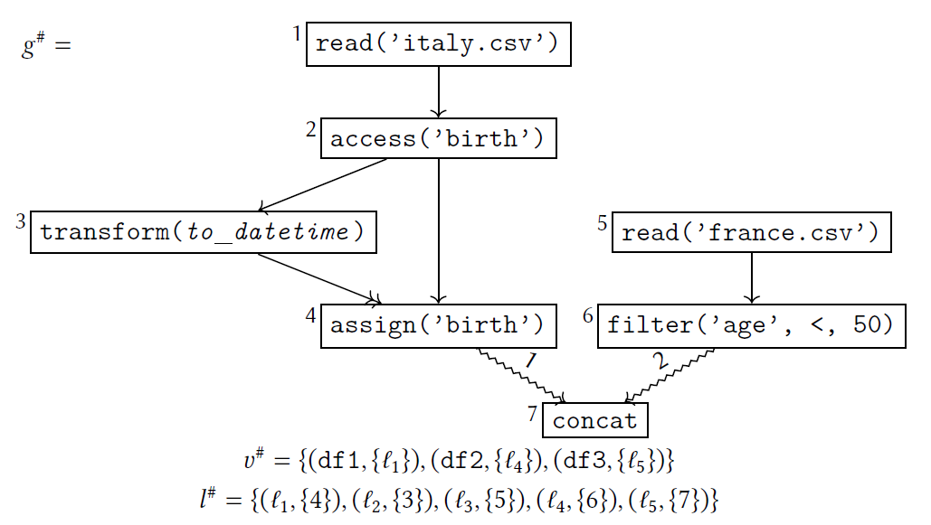
Removing Python from the picture
Use abstract domain to extract data transformations from the code:
df1 = pd.read_csv(’italy.csv’)
df1[’birth’] =
pd.to_datetime(df1[’birth’])
df2 = pd.read_csv(’france.csv’)
df2 = df2.loc[df2[’age’] < 50,:]
df3 = pd.concat([df1, df2])

Slide 8
The domain of abstract dataframes
Forest of graphs
  Nodes are transformations over data
  Edges encode sequentiality
  Special edges for multi-operands transformations

Slide 9
The domain of abstract dataframes
Forest of graphs
Deferred evaluation of transformations by functions
  Effect of a transformation might depend on the property to prove
  A given property might not require full evaluation

Slide 10
The domain of abstract dataframes
Forest of graphs
Deferred evaluation of transformations by functions
Two-level points-to mapping from variables to nodes
  Easy aliasing
  Can move labels around freely

Slide 11
The domain of abstract dataframes
Forest of graphs
Deferred evaluation of transformations by functions
Two-level points-to mapping from variables to nodes
Parametric to an auxiliary domain computing “native” values
  Mostly constants, so we use constant propagation

Slide 12
Cuts of the graph: variables

Slide 13
Cuts of the graph: sources

Slide 14
Inferring necessary columns
First client analysis built as abstract interpretation over the forest
  What are the columns that must exist for the program not to crash?
Run a fixpoint on the forest instead of the original program
Node semantics:
  Determine the sources (can be ≥ 1 with concatenation) of each node
  Store columns accessed or defined (assigned) by each node

Slide 15
Inferring necessary columns
{italy.csv}:
- accesses: birth
- defines: ∅
{italy.csv}:
- accesses: birth
- defines: birth
{france.csv}:
- accesses: age
- defines: ∅
{italy.csv, france.csv}:
- accesses: ∅
- defines: ∅

Slide 16
PyLiSA and LiSA
PyLiSA
LiSA analyzes CFGs whose nodes have parametric semantics
  PyLiSA compiles python code to CFGs
Node semantics is defined through symbolic expressions
  PyLiSA provides node semantics + language features
Call resolution, memory management and value tracking interact modularly
LiSA
Interprocedural
Analysis
Heap Domain
Value Domain
Checks

Slide 17
Abstract dataframes in PyLiSA
PyLiSA
pandas semantics in LiSA’s native CFGs
  Rewritten into symbolic expressions
Abstract dataframes domain as value domain
  No handling of calls or memory accesses
  Use pandas symbolic expressions to build the forest
Column inference in post-analysis check
LiSA
Interprocedural
Analysis
Pandas semantics
Heap Domain
Value Domain
Abstract Dataframes
Checks
Column names inference

Slide 18
Where we are
Open source implementation on GitHub
  https://github.com/lisa-analyzer/pylisa
Notebooks are analyzed according to a sequence of cell executions
Partial support for pandas
Proof-of-concept experiment identifying required column names
  Abstract dataframes: ~4k LOC (including pandas semantics)
  Column inference: ~250 LOC
  Too small as an overall evaluation

Slide 19
Next steps
Complete the support for pandas
Extensive evaluation
  Likely not with the column inference domain
Design a widening operator for the abstract dataframes
  Labels/variables are finite, but the forest can grow indefinitely
  We just used lub up to now
    Most programs don’t contain loops, or contain ones that stabilize in few iterations

Slide 20
Thanks!
Static Analysis of Data Transformations in Jupyter Notebooks
Luca Negrini, Guruprerana Shabadi, Caterina Urban
luca.negrini@unive.it
SOAP ‘23 – June 17th, 2023

Slide 21

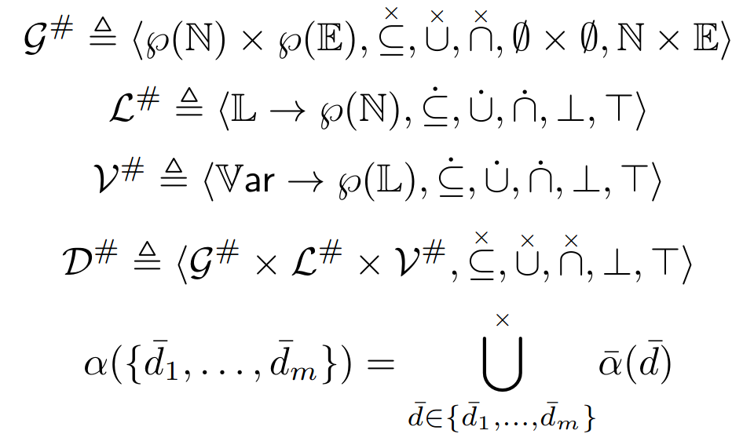
Domain definition

