Slide 1
Modular Multi-Language Analysis in LiSA
Luca Negrini
June 30th, 2021

Slide 2
Static Analysis
Aims at computing properties of programs without executing them
P, I
semantics
not computable
R

Slide 3

Abstract Interpretation
Framework for reasoning about program semantics
abstraction
P, I
P#, I#
semantics
abstract semantics
not computable
must be well defined
R
R#
$⊆$ R'
concretization

Slide 4
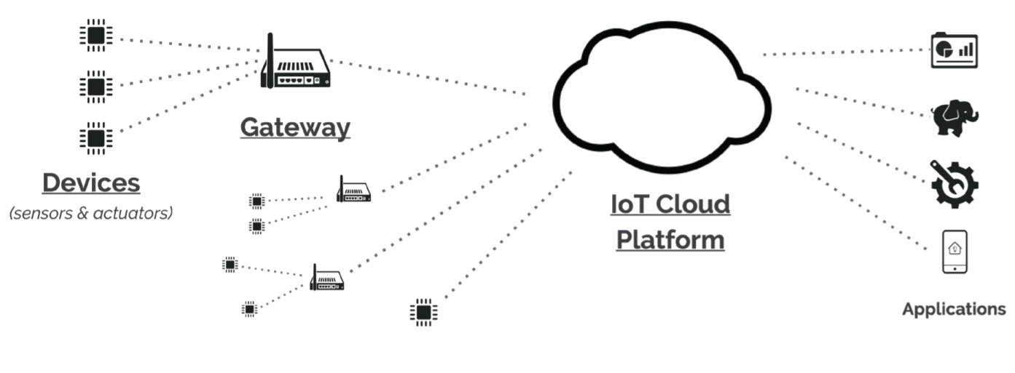
What if the program is not atomic?
From “Cross-Programming Language Taint Analysis for the IoT Ecosystem”
P. Ferrara, A. K. Mandal, A. Cortesi, F. Spoto @ InterAVT 2019

Slide 5
What if the program is not atomic?
The same statement might have different effects:
array[-1]
→ Java: ArrayIndexOutOfBoundsException
→ Python: array[len(array) – 1]
→ C: undefined behavior
→ semantics is not well defined!

Slide 6
What if the program is not atomic?
Using separate tools (analyses), one can:
Analyze each subprogram in isolation
Fast: “single” analysis, ok for syntactic properties
Not ok for semantic properties
Make analyses exchange information, and perform a fixpoint over the exchanged information
Slow: need to repeat the analysis of each subprogram

Slide 7
Multi-language analysis
Goal: single analysis of a whole program
Requirement:
Different semantics for the same construct
Nice to have:
Modular structure
Easy to use and extend

Slide 8
LiSA, a Library for Static Analysis
Based on an extensible CFG representation
Statements from different languages are different node instances
JavaArrayAccess, PythonArrayAccess, …
Each node defines its own semantics
JavaArrayAccess.semantics() and PythonArrayAccess.semantics() behave differently
→ Semantics is well defined again!

Slide 9
Well defined semantics
JavaArrayAccess.semantics() {
if index < 0 or index > len(receiver) then return bottom
return entry state but with accessed element on stack
}
PythonArrayAccess.semantics() {
if index < 0 then index = len(receiver) - index
if index > len(receiver) then return bottom
return entry state but with accessed element on stack
}

Slide 10
Symbolic expressions
With extensible statements there is no predefined set of operations
Analyses need to know how the state evolves with each statement
Solution: the SymbolicExpressions language
Analyses work on an internal language of SymbolicExpressions
Each symbolic expression is an “atomic” semantic operation
Heap allocation, numeric sum, pointer dereference, …
Analyses use Statement.semantics() to rewrite each Statement to SymbolicExpression(s) and feed them to the analysis
malloc (C) and new int[] (Java) are modeled with the same symbolic expression HeapAllocation

Slide 11
LiSA overview
Interprocedural Analysis
Call Graph
Heap Domain
Value Domain
P^{i}
Analysis Dump
Warnings
L^{i} front-end
LiSA
Analysis State
Abstract State
Interprocedural
Analysis
CFG fixpoint
CFGs
Heap Domain
Call Graph
Statement semantics
Value Domain
Language-based
Calling statement
Non-calling statement
Computed Expr.

Slide 12
Achieving modularity
Analysis components must be agnostic to how others are implemented:
Separation of responsibility: each component is responsible only for its duties
Modularity: analysis can be composed freely without changing the code, tuning precision and performances
Simple implementation: no need to worry about concepts external to the component being implemented

Slide 13

Achieving modularity
Call resolution
Analysis orchestration
Memory abstraction
Value abstraction
Interprocedural
Analysis
Call Graph
Abstract State
How do memory and value abstraction modularly exchange information?
Heap Domain
Value Domain

Slide 14
The Abstract State
int x = w + 3;
A a = new A();
a.f = x;
a.g = a.f * 2;
Abstract State
Heap Domain
expr
What if we want better precision?
x = w + 3
rewritten
expr
substitution
a = new A()
a.f = x
a.g = a.f * 2
Intervals + Program Point (field insensitive)
Intervals + Program Point (field sensitive)
x = w + 3
a = l
l = x
l.f = x
l = l * 2
l.g = l.f * 2
{}
Heap: []
Value: [w -> [5, 10]]
Heap: []
Value: [w -> [5, 10], x -> [8, 13]]
Heap: [a -> l]
Value: [w -> [5, 10], x -> [8, 13]]
Heap: [a -> l]
Value: [w -> [5, 10], x -> [8, 13], l -> [8, 13]]
Heap: [a -> l]
Value: [w -> [5, 10], x -> [8, 13], l.f -> [8, 13]]
Heap: [a -> l]
Value: [w -> [5, 10], x -> [8, 13]]
Heap: [a -> l]
Value: [w -> [5, 10], x -> [8, 13], l -> [16, 26]]
Heap: [a -> l]
Value: [w -> [5, 10], x -> [8, 13], l.f -> [8, 13], l.g -> [16, 26]]
Value Domain
Pietro Ferrara, A generic framework for heap and value analyses of object-oriented programming languages, Theoretical Computer Science, Volume 631, 2016, Pages 43-72

Slide 15
Current state
Development started in late 2020
Available on Maven and GitHub under MIT license
Frontend for IMP, early developments for Go, Java and Python
Able to model some features of languages (e.g. classes, global variables, inheritance, dynamic call resolution) while other are still missing (e.g. exceptions and error handling)
First application: on-chain verification of smart contracts (in dev)

Slide 16
Teaching experience
LiSA has been adopted in:
ACADIA PhD course:
Online lectures
Final projects: abstract domains implementation
Software Correctness, Security and Reliability Master course:
Lab lectures
Weekly tasks: dataflow, simple abstract domains
Final projects: abstract domains implementation

Slide 17
Thanks!
Luca Negrini, PhD student
luca.negrini@unive.it
https://github.com/UniVE-SSV/lisa
https://unive-ssv.github.io/lisa/

