Slide 1
Multi-Language Analysis in LiSA
Luca Negrini
June 15th, 2022

Slide 2

Abstract Interpretation
Framework for reasoning about program semantics
abstraction
P, I
P#, I#
semantics
abstract semantics
not computable
must over-approximate concrete semantics
R
R#
$⊆$ R'
concretization

Slide 3
The problem: multiple languages
What is the execution model?
x.foo(); // is the static initializer of the type of x invoked?
What is the memory model?
x = array[-1]; // does this raise an error?
What is the semantics of an instruction?
x = y + 1; // can this overflow?
→ semantics is not well defined!

Slide 4

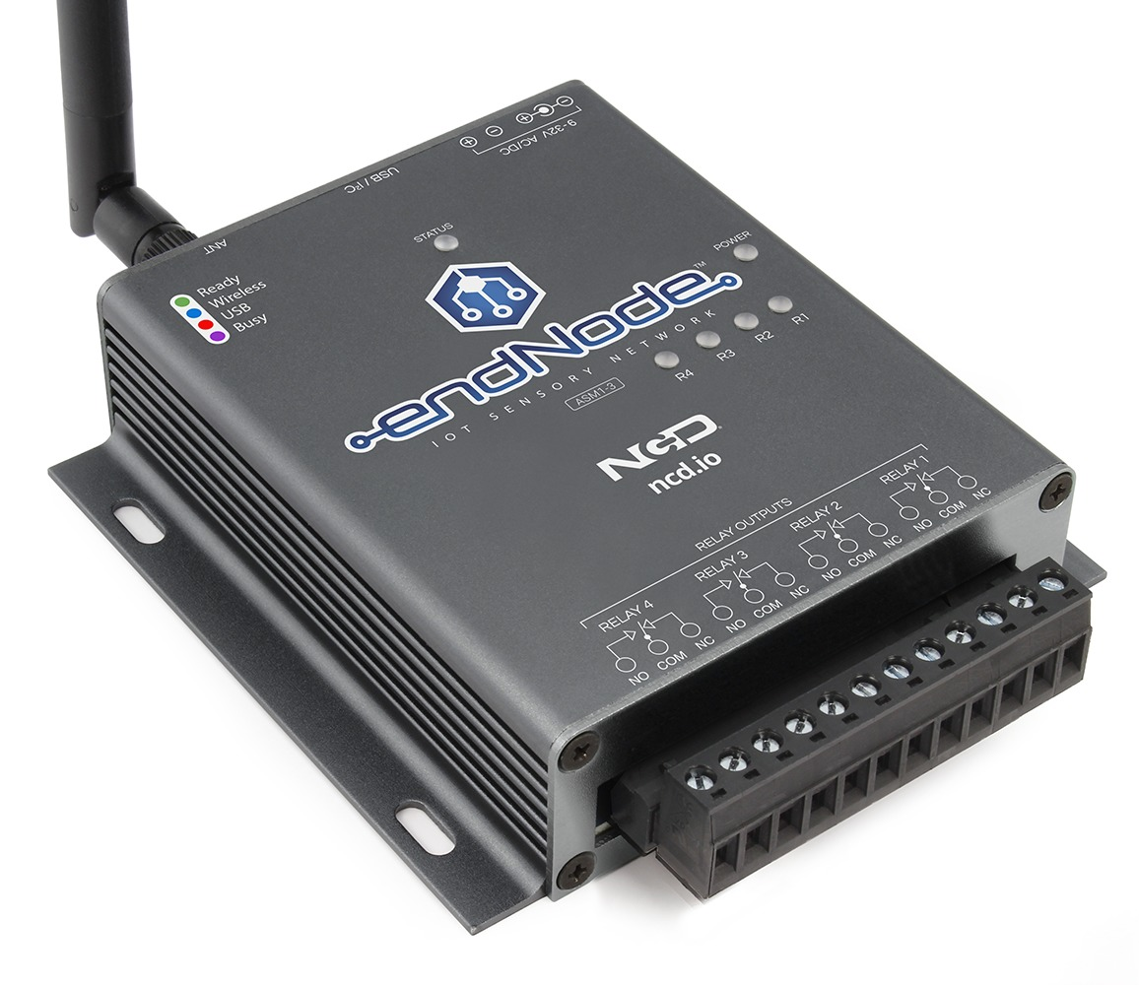

The scenario: robotic IoT car
Car (C++)
Controller (Java)
Joystick (C++)
initialize()
initialize()
readUpDown()
runMotor(sensor value)
sensor value
Tainted?
readLeftRight()
turnRight()
sensor value
readLeftRight()
turnLeft()
sensor value
isButtonPressed()
turnAtAngle(0)
true/false
“Cross-Programming Language Taint Analysis for the IoT Ecosystem” - Ferrara et al. @ InterAVT 2019

Slide 5
Can we use existing analyses?
Make analyses exchange information, and perform a fixpoint over the exchanged information
Slower: need to repeat the analysis of each subprogram
Cross-language interactions considered
Authors solution: Julia + CodeSonar configurable taint analysis

Slide 6

Coordinated semantic analyses
CSONAR:
sensor value -> source actuator -> sink
JNI methods -> sinks
Analysis 1: CSONAR
Sensor -> JNI
Produce Julia annotation
Analysis 3 : CSONAR
Annotation -> Actuator
Warning!
Analysis 2: Julia
Annotation -> JNI
Produce CSONAR annotation
Julia:
JNI calls -> sinks
Car (C++)
Controller (Java)
Joystick (C++)
initialize()
initialize()
readUpDown()
runMotor(sensor value)
sensor value
readLeftRight()
turnRight()
sensor value
readLeftRight()
turnLeft()
sensor value
isButtonPressed()
turnAtAngle(0)
true/false
“Cross-Programming Language Taint Analysis for the IoT Ecosystem” - Ferrara et al. @ InterAVT 2019

Slide 7
Can we use existing analyses?
Make analyses exchange information, and perform a fixpoint over the exchanged information
Slower: need to repeat the analysis of each subprogram
Cross-language interactions considered
But…
3 analyses on small example
Tool communication is hard
Complex information?

Slide 8
Multi-language analysis
Goal: single analysis of a whole program
Requirements:
Different semantics for the same construct
No assumptions on the execution/memory model
Modular structure: single responsibility of each component
Easy to use and extend: for research and teaching

Slide 9
LiSA, a Library for Static Analysis
Library written in Java
Based on Abstract Interpretation
Based on an extensible CFG representation
Received as inputs: no knowledge of source languages
Get rid of the syntax for control flow
Extensible: node instances are not fixed
Statements (CFG nodes) are language specific!
Each node over-approximates the semantics of its language

Slide 10
Well defined semantics
JavaArrayAccess.semantics() {
if index < 0 or index > len(receiver) then return bottom
return entry state but with accessed element on stack
}
PythonArrayAccess.semantics() {
if index < 0 then index = len(receiver) - index
if index < 0 or index > len(receiver) then return bottom
return entry state but with accessed element on stack
}
Language-specific semantic function
Different instances for each language

Slide 11
Achieving modularity
Calls | Memory structure | Values
Finding targets of calls Computing the result of calls Indirect requirement: orchestrating the analysis | Handle allocations Handle accesses | Concrete values (or their properties) stored in variables and memory

Slide 12
Calls and orchestration
Interprocedural
Analysis
fixpoint logic
CFG Fixpoint
Non-calling stmt
ia.getResultOf(this)
stmt.semantics()
abstract result
target(s) of the call
cg.resolve(call)
abstract result
Independent from the values computed by the program!
Call Graph
Calling stmt

Slide 13

Achieving modularity
Calls | Memory structure | Values
Finding targets of calls Computing the result of calls Indirect requirement: orchestrating the analysis | Handle allocations Handle accesses | Concrete values (or their properties) stored in variables and memory
Interprocedural
Analysis
These only see call-less programs!
Call Graph

Slide 14
Handling dynamic memory
Intuition: we can consider each memory location as a “fake” variable
class A { int f, g; }
x = new A();
Abstract State
Heap Domain
Expression | Memory location | Low precision | Medium precision | High precision
x | L₁ | L | L₁ | L₁
x.f | L_{1.1} | L | L₁ | L_{1.1}
x.g | L_{1.2} | L | L₁ | L_{1.2}
expr
x.g = 7
rewrite
x.f = 5
L₁ = 7
L_{1.1} = 5
L_{1.2} = 7
L₁ = 5
Rest of the analysis
All memory is the same variable
One variable per allocation
One variable per location

Slide 15
Achieving modularity
Calls | Memory structure | Values
Finding targets of calls Computing the result of calls Indirect requirement: orchestrating the analysis | Handle allocations Handle accesses | Concrete values (or their properties) stored in variables and memory
These only see variables, constants and operators!
Interprocedural
Analysis
Abstract State
Heap Domain
Value Domain
Call Graph

Slide 16
Who creates the CFGs?
Frontends are compilers from the original language to LiSA programs
They can also add logic to the analysis!
Library models
Each language has its own frontend
With language-specific statements!
Long-term objective: plug into compilers/interpreters
LiSA program P_{L}
Program P
L^{i} front-end
CFGs
P^{i}
Analysis logic

Slide 17
Analysis overview
P^{i}
Interprocedural Analysis
Call Graph
Heap Domain
Value Domain
L^{i} front-end
Analysis Dump
Warnings
LiSA
LiSA program P_{L}
Abstract State
Interprocedural
Analysis
CFG fixpoint
CFGs
Heap Domain
Call Graph
Value Domain
Analysis logic
Statement semantics
Language-based
Calling statement
Non-calling statement

Slide 18
LiSA semantic analysis
LiSA:
sensor value -> source, actuator -> sink
Analysis 1: LiSA
sensor -> actuator
Warning!
Car (C++)
Controller (Java)
Joystick (C++)
initialize()
initialize()
readUpDown()
runMotor(sensor value)
sensor value
readLeftRight()
turnRight()
sensor value
readLeftRight()
turnLeft()
sensor value
isButtonPressed()
turnAtAngle(0)
true/false
https://github.com/UniVE-SSV/lisa-joycar-example

Slide 19
Thanks!
Luca Negrini, PhD student
luca.negrini@unive.it
https://github.com/UniVE-SSV/lisa
https://unive-ssv.github.io/lisa/
https://github.com/UniVE-SSV/lisa-joycar-example

Slide 20
Handling dynamic memory
Intuition: we can consider each memory location as a “fake” variable
Handling dynamic memory access means understanding to which location an expression refers to
Expression | Memory location
x | L₁
x.f | L_{1.1}
x.g | L_{1.2}
y | L₂
y.f | L_{2.1}
y.g | L_{2.2}
class A {
int f, g;
}
x = new A();
y = new A();
L₁
L₂
A
A
f
g
f
g
L_{1.1}
L_{1.2}
L_{2.1}
L_{2.2}

Slide 21
Abstract State and Heap Domain
How much precision do we want?
Can we do better?
Expression | Memory location | Low precision | Medium precision | High precision
x | L₁ | L | L₁ | L₁
x.f | L_{1.1} | L | L₁ | L_{1.1}
x.g | L_{1.2} | L | L₁ | L_{1.2}
y | L₂ | L | L₂ | L₂
y.f | L_{2.1} | L | L₂ | L_{2.1}
y.g | L_{2.2} | L | L₂ | L_{2.2}
Abstract State
Heap Domain
expr
x.g = 7
rewrite
x.f = 5
L₁ = 7
L_{1.1} = 5
L_{1.2} = 7
L₁ = 5
Rest of the analysis
All memory is the same variable
One variable per allocation
One variable per location

Slide 22
Symbolic expressions
With extensible statements there is no predefined set of operations
Analyses need to know how the state evolves with each statement
Solution: the SymbolicExpressions language
Each symbolic expression is an “atomic” semantic operation
Heap allocation, numeric sum, pointer dereference, …
malloc (C) and new int[] (Java) are modeled with the same symbolic expression HeapAllocation
Analyses use Statement.semantics() to rewrite each Statement to SymbolicExpression(s) and feed them to the analysis

Slide 23
The Abstract State
int x = w + 3;
A a = new A();
a.f = x;
a.g = a.f * 2;
Abstract State
Heap Domain
expr
What if we want better precision?
x = w + 3
rewritten
expr
substitution
a = new A()
a.f = x
a.g = a.f * 2
Intervals + Program Point (field insensitive)
Intervals + Program Point (field sensitive)
x = w + 3
a = l
l = x
l.f = x
l = l * 2
l.g = l.f * 2
{}
Heap: []
Value: [w -> [5, 10]]
Heap: []
Value: [w -> [5, 10], x -> [8, 13]]
Heap: [a -> l]
Value: [w -> [5, 10], x -> [8, 13]]
Heap: [a -> l]
Value: [w -> [5, 10], x -> [8, 13], l -> [8, 13]]
Heap: [a -> l]
Value: [w -> [5, 10], x -> [8, 13], l.f -> [8, 13]]
Heap: [a -> l]
Value: [w -> [5, 10], x -> [8, 13]]
Heap: [a -> l]
Value: [w -> [5, 10], x -> [8, 13], l -> [8, 26]]
Heap: [a -> l]
Value: [w -> [5, 10], x -> [8, 13], l.f -> [8, 13], l.g -> [16, 26]]
Value Domain
Pietro Ferrara, A generic framework for heap and value analyses of object-oriented programming languages, Theoretical Computer Science, Volume 631, 2016, Pages 43-72

Slide 24
Analysis modularity
Analysis components must be agnostic to how others are implemented:
Separation of responsibility: each component is responsible only for its duties
Modularity: analysis can be composed freely without changing the code, tuning precision and performances
Simple implementation: no need to worry about concepts external to the component being implemented

Slide 25
Current state
Development started in late 2020
Available on Maven and GitHub under MIT license
Able to model some features of languages (e.g. classes, global variables, inheritance, dynamic call resolution) while other are still missing (e.g. exceptions and error handling)
Frontend for IMP, early developments for Go, Java, Java Bytecode and Python

Slide 26
Ongoing works
Go: smart contracts
Overflows through numeric domains
Non-determinism through taint analysis
Python: jupyter notebooks
Dataframes operations modeling through custom domains
Java bytecode:
Verification and enforcement of AWS policies
TBD:
String properties with non-relational and relational domains

Slide 27


Simple approach
Analyze each subprogram in isolation
As fast as we can: “single” analysis
Global reasoning within single languages
Cross-language interactions ignored
Syntactic properties
Semantic properties (language-local)
Semantic properties (global)

