Slide 1
Twinning Automata and Regular Expressions for String Static Analysis
Luca Negrini^{1,2}, Vincenzo Arceri¹,
Pietro Ferrara¹, Agostino Cortesi¹
¹Ca’ Foscari University of Venice, Venice, Italy
²Corvallis SpA, Padua, Italy
VMCAI 2021
January 18th, 2021

Slide 2
String analysis
Strings (and their transformation) are interesting!
String to code execution
Data protection policies
Reflection
Precision-efficiency tradeoff is extremely important
Simple and fast domains (e.g. prefix, suffix)
Automata-based abstractions

Slide 3
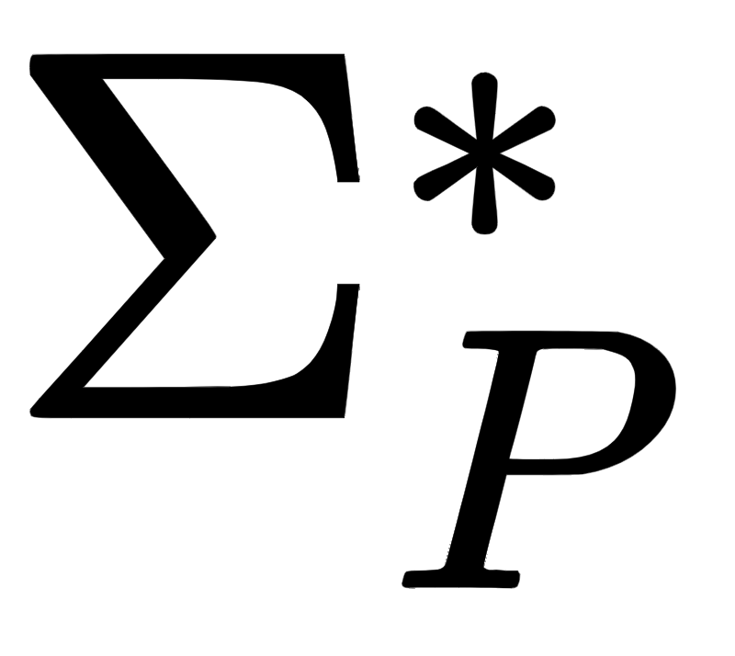

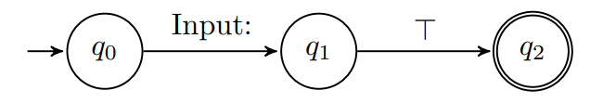

TARSIS automata
Given a program P, automata are defined over a special alphabet:
contains all the constant strings of P
is a special token for representing unknown strings

Slide 4
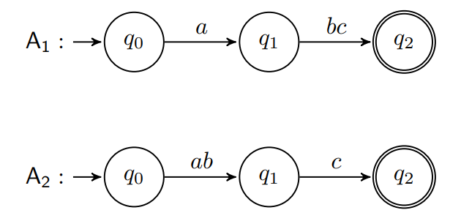

Lattice structure
Lattice defined over equivalence classes of minimum automata:
Classes contain automata equivalent w.r.t. language equality (i.e. they concretize to the same strings):

Slide 5


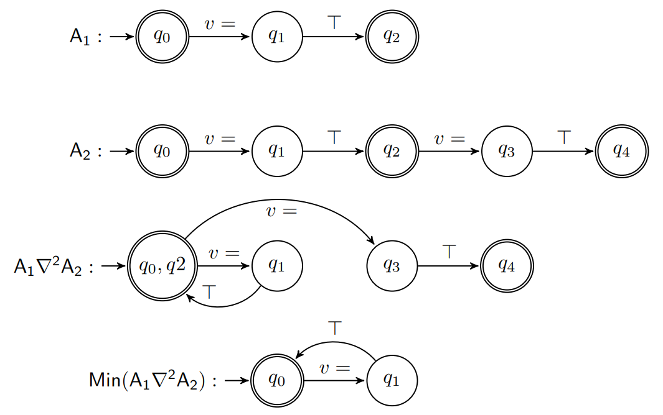
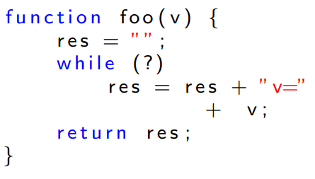
Widening
Infinite height, not ACC: widening merging states recognizing the same -language in the lub:
Apply widening
Second loop iteration
Minimize
First loop iteration

Slide 6
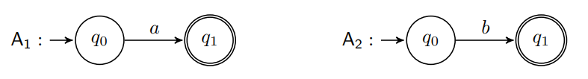

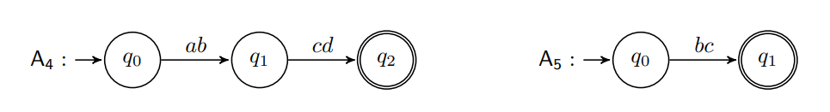

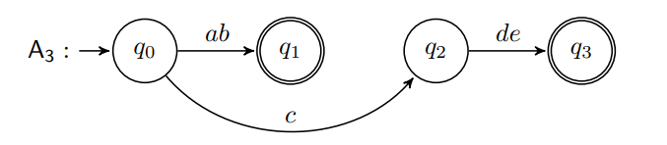

Sound abstract semantic operators
concat: automata concatenation
contains: intersection with factors automaton
length: min- and max-path length

Slide 7
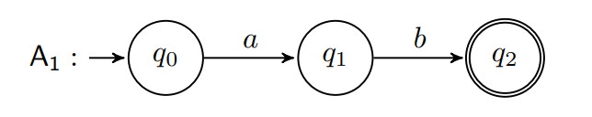
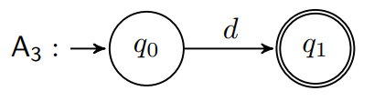
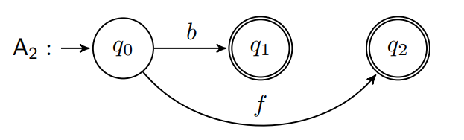
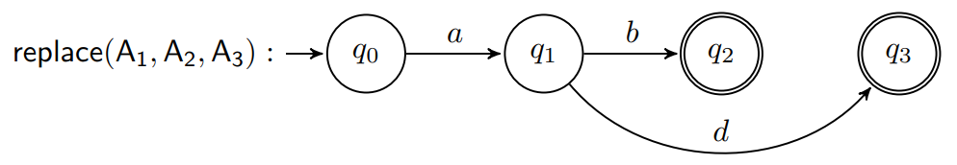
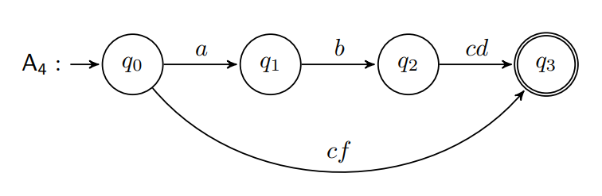
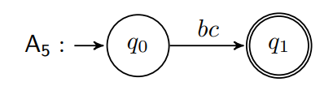

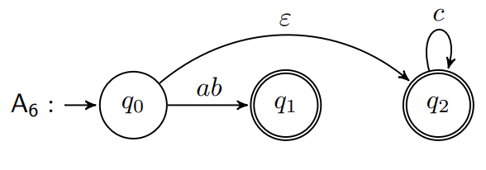


Sound abstract semantic operators
replace: must- or may-replace over all paths
indexOf: search over all paths
substring: induction on the structure of the regex

Slide 8
Experiments
Precision assessment on sample code against simpler domains¹ (SUBS and LOOP)
Early scalability assessments on more complex code against FA² (TOSTRING and COUNT)
¹Costantini, G., Ferrara, P., Cortesi, A.: A suite of abstract domains for static analysis of string values. Softw. Pract. Exp. 45(2): 245-287 (2015)
²Arceri, V., Mastroeni, I., Xu, S.: Static analysis for ECMAScript string manipulation programs. Appl. Sci. 10, 3525 (2020)
 | SUBS | LOOP | TOSTRING | COUNT
Basic domains avg. | 10 ms | 3 ms | 100 ms | 30 ms
FA | 10 ms | 52013 ms | 226769 ms | 4235 ms
TARSIS | 34 ms | 38 ms | 299 ms | 39 ms

Slide 9
Summing up
TARSIS is:
As precise as the FA domain, but with lower resource consumption
More precise than basic domains, with comparable execution times
Next steps:
Apply TARSIS to real world code with LiSA¹
Investigation on the completeness of the abstract operators
¹https://github.com/UniVE-SSV/lisa

Slide 10
Thanks! Any question?
luca.negrini@unive.it
vincenzo.arceri@unive.it
pietro.ferrara@unive.it
cortesi@unive.it
https://github.com/UniVE-SSV/tarsis

Slide 11
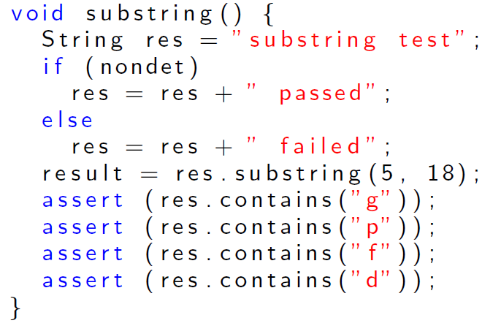
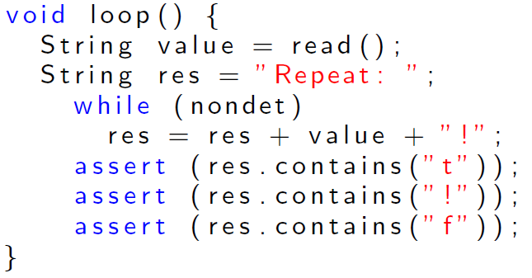
Simpler test cases
Execution times:
Other domains: | ~10 ms
TARSIS: | 34 ms
FA: | 10 ms
Execution times:
Other domains: | ~3 ms
TARSIS: | 38 ms
FA: | 52013 ms

Slide 12
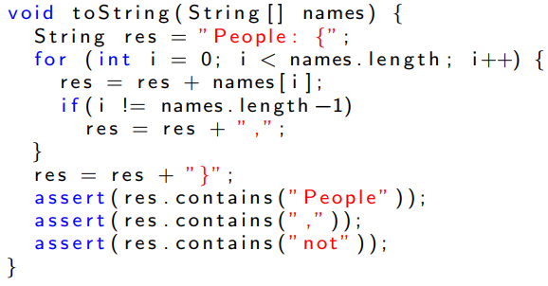
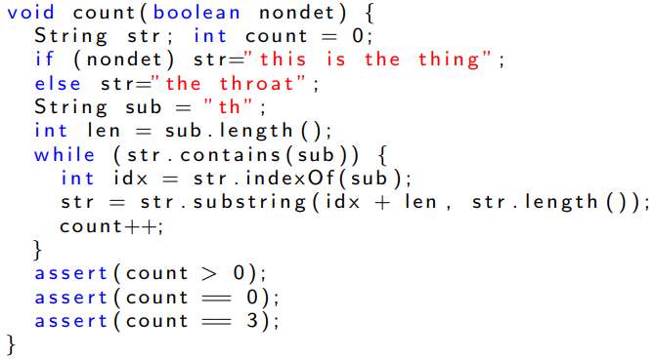
Scalability experiments
Execution times:
Other domains: | ~100 ms
TARSIS: | 299 ms
FA: | 226769 ms
Execution times:
Other domains: | ~30 ms
TARSIS: | 39 ms
FA: | 4235 ms

