Slide 1


SARL OO Framework specification for static analysis
Pietro Ferrara¹, Luca Negrini^{1,2}
¹Università Ca’ Foscari Venezia, ²JuliaSoft S.R.L.
July 20th, 2020

Slide 2
Software frameworks
Provide highly tested common functionalities
Simplify the application structure
Allow focusing on functionalities rather than architecture
Some examples:
Web application: Java Servlet API, ASP.NET, …
UI building: JavaFx, WindowsForms, …
DB interaction: Hibernate, NHibernate, …

Slide 3
ASP.NET
Http Request to MyPage
First App Access
Button click
Supertype for application objects:
class Global : HttpApplication {
void Application_Start(object sender, EventArgs e)
}
Supertype for web pages:
class MyPage : Page {
void Page_Load(object sender, EventArgs e)
void ButtonLogOn_Click(object sender, EventArgs e)
}
ASP.NET Runtime
Global
Application_Start
MyPage
Page_Load
ButtonLogOn_Click

Slide 4
THE problem with static analysis
Frameworks may:
Modify the execution model
Provide methods introducing security concerns
Automatically handle objects lifecycle
Lots of frameworks, each with lots of versions!
Cannot hardcode everything into the analyzer
Need to quickly add support for new frameworks
Which part of each framework is supported? How?

Slide 5
SARL: The idea
Each analysis component is parametric to annotations
Annotations are natively supported by OO languages
Annotations are part of the analysis input
Generate application-specific annotations
Apply a model to the input program!
The model of the framework contains all the knowledge needed during the analysis
All in one place: easy to maintain
External to the analyzer: easy to add new models
Self-describing: free documentation!

Slide 6
SARL
Designed for modeling frameworks of object oriented programs
Language for defining the frameworks models, called framework specifications
Loosely coupled with the analyzer code
Can make existing analyses framework-aware
No need to change the analyzer for new frameworks/new versions
The analyzer just needs to know how to handle the generated annotations

Slide 7
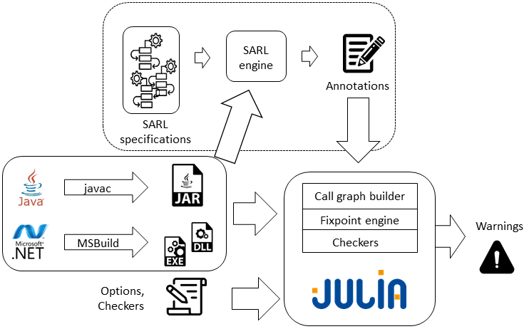
SARL
Exploits syntactic structure of the program
Applied in the early stages of the analysis
Annotations are serialized to an xml file that becomes an input of the analysis
Has been interfaced with the Julia static analyzer
Most of Julia’s analysis components use annotations to identify program members

Slide 8
ASP.NET: Introduce new entry points with sarl
rule: rte ".net"
rule: superclass "HttpApplication"
predicate: isWebPage = cls -> subtypeOf:: "Page"
predicate: isWebApplication = cls -> subtypeOf:: "HttpApplication"
predicate: isEventHandler =
and(mtd -> basicReturnType:: "void",
and(mtd -> numberOfParameters:: 2,
and(mtd -> hasParameter and(par -> index:: 0, par -> type:: "Object"),
mtd -> hasParameter and(par -> index:: 1, par -> type.subtypeOf:: "EventArgs")))))
specification: annotate mtd with EntryPoint if and(satisfies isEventHandler,
mtd -> definingClass or(satisfies isWebPage, satisfies isWebApplication))

Slide 9
LANGUAGE CONSTRUCTS
Rules defining when a framework specification should be applied
On the analysis: rule: rte ".net"
On the contents of the program:
rule: superclass "HttpApplication"
rule: annotation "SpringBootApplication"
rule: uses type "SessionFactory"
Implications defining relations between annotations
implication: "GetMapping" implies "EntryPoint"
Predicates assigning a name to a condition
predicate: isWebPage = cls -> subtypeOf:: "Page"

Slide 10
LANGUAGE CONSTRUCTS
Specifications identifying members to annotate through a condition:
specification: annotate mtd with EntryPoint if
and(mtd -> definingClass satisfies isControl, satisfies isEventHandler)
Library specifications identifying members to annotate by directly accessing them:
library: annotate mtd with ResourceThatDoesNotNeedToBeClosed if
cls "Brushes"
mtd matches "get_.∗()Brush;"

Slide 11
experiments
Top 3 ASP.NET web applications from GitHub
Top 3 WindowsForms desktop applications from GitHub
No knowledge of either frameworks in Julia
First analysis without SARL
Iterative analyses building SARL specifications to improve results
No relevant execution time difference (1% avg. overhead)

Slide 12
ASP.NET EXPERIMENTS
11 lines SARL specification, adding event handlers as entry points and marking fields storing graphical objects as externally reachable
Application | LOC | # Warnings | # Warnings removed with SARL | % Warnings removed | Time | Time with SARL | % Time diff.
SignalR | ~49K | 681 | 23 | 3.4% | 4’36’’ | 4’24’’ | -4%
AspNetBoilerplate | ~87K | 552 | 8 | 1.4% | 6’08’’ | 6’15’’ | 2%
Umbraco | ~130K | 1729 | 71 | 4.1% | 11’03’’ | 11’09’’ | 1%

Slide 13
WINDOWSforms EXPERIMENTS
12 lines SARL specification, marking fields storing graphical objects as externally reachable and disposable objects reachable from a Form as runtime-managed
Application | LOC | # Warnings | # Warnings removed with SARL | % Warnings removed | Time | Time with SARL | % Time diff.
ShadowSocks | ~12K | 730 | 257 | 35.2% | 2’14’’ | 2’23’’ | 7%
ShareX | ~99K | 5471 | 4074 | 74.5% | 5’24’’ | 5’24’’ | 0%
CefSharp | ~17K | 465 | 224 | 48.2% | 1’59’’ | 2’01’’ | 2%

Slide 14
Summing up and next steps
SARL can be used to build readable, concise and self-explanatory framework specifications
No need to modify the analyzer
Easy to add support for additional frameworks
Easy to generate documentation starting from a specification: https://static.juliasoft.com/docs/latest/Frameworks.html
Impact of SARL depends on how much the program relies on the framework
SARL requires a negligible amount of resources
We want to extend SARL to model other properties (i.e. objects lifecycle)

Slide 15
Thanks!
Any questions?
luca.negrini@juliasoft.com
pietro.ferrara@unive.it

