Slide 1


A generic framework for multilanguage analysis
Design of an abstract interpretation-based static analyzer
Luca Negrini
Ph.D. Defence
January 27th, 2023

Slide 2











From programs to systems
Programs
Programs
Cloud
Blockchain
Serverless
Microservices
IoT
Native Libraries
Different requirements, different languages!

Slide 3
Analysis of multiple languages
Different languages have different behaviors
What does array[-1] evaluate to?
How is the target of x.foo(y) chosen?
Can x+1 overflow?
Different languages execute in different environments
Each with their own APIs and libraries
Each providing different frameworks

Slide 4


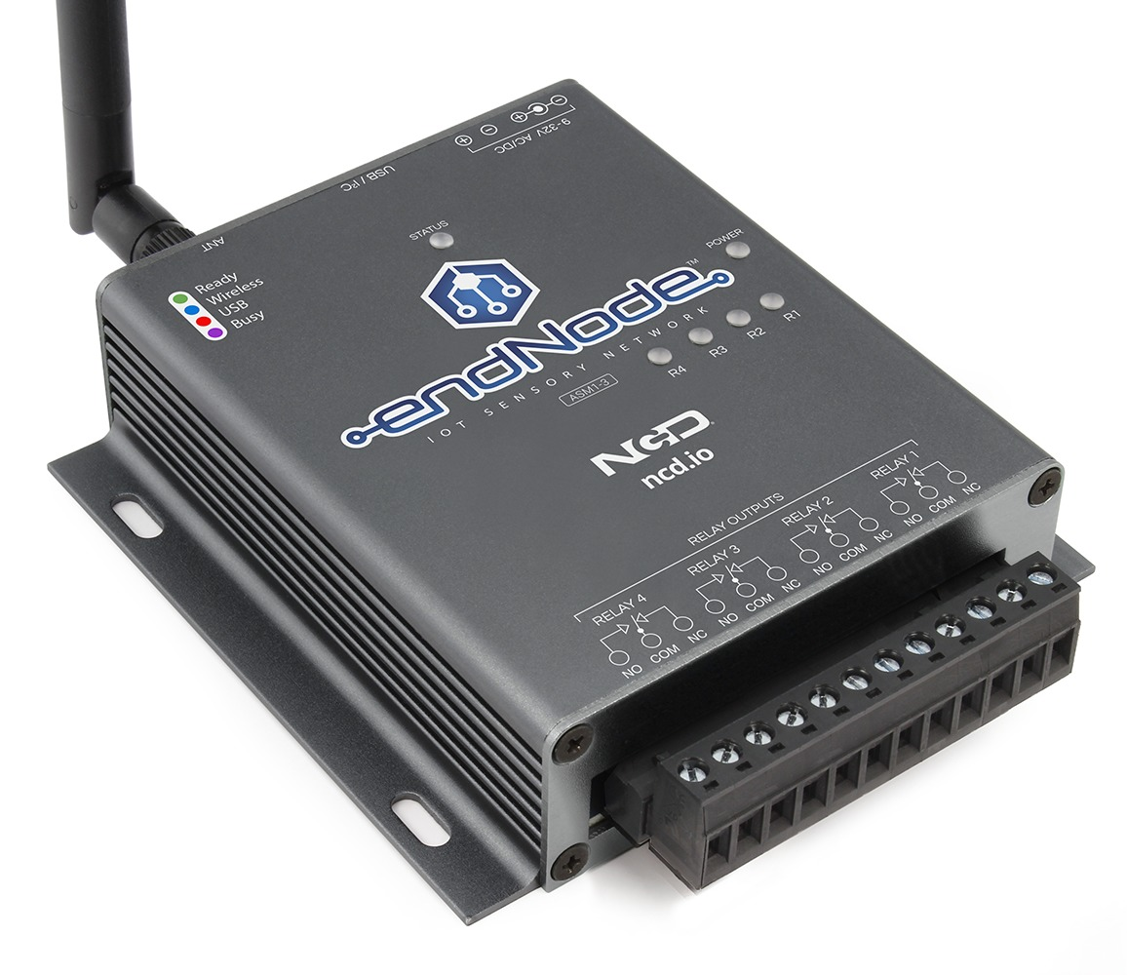

A minimal example: IoT car
CodeSonar for C++, Julia for Java
CodeSonar source: sensor value
CodeSonar sink: actuator
Track cross-language interactions
Controller (Java)
Joystick (C++)
Car (C++)
initialize()
Analysis 1: CodeSonar
sensor -> read()
initialize()
read()
Analysis 2: Julia
read() -> runMotor(sv)
sv
runMotor(sv)
Analysis 3 : CodeSonar
sv -> actuator
Tainted?
“Cross-Programming Language Taint Analysis for the IoT Ecosystem”, Ferrara et al., InterAVT 2019

Slide 5
Analysis techniques
Compose different tools
Iterative, need to serialize complex information
Translate languages towards a common IR
Inherently limited by the expressiveness of the chose IR
Summarize guest programs for the analysis of a host program
Not suited for systems with back-and-forth communication, some properties need context sensitivity
Multilanguage analysis with language-parametric reasoning

Slide 6
Contributions and outline
Introduction
LiSA, a modular framework for multilanguage analysis
Non-determinism detection in Go smart contracts
Dataframe modeling in Python notebooks for data science
SARL, a DSL for modeling of libraries and frameworks
Tarsis, an automata-based abstract domain for string values

Slide 7

A Library for Static Analysis
Published @ SOAP 2021
Accepted @ CSV 2022
LiSA is a library written in Java
Based on an extensible CFG representation
Get rid of the syntax for control flow
Extensible: node instances are not fixed
Statements (CFG nodes) are language specific!
Each node over-approximates the semantics of its language
Semantics rewrite statements into atomic semantic operations
https://github.com/lisa-analyzer/lisa

Slide 8
Example: array creation semantics
// new int[5]
class JavaNewArray : Statement {
def semantics(var entry) {
var pre = size.semantics(entry);
var alloc = new Allocation(type, pre.stack());
var all = pre.smallStepSemantics(alloc, this);
var ref = new Reference(all.stack());
return all.smallStepSemantics(ref, this);
}
}
Decompose into atomic operations with precise semantics
Operation processing is domain agnostic
Can query statement for language-specific logic
Extensible language!
How do symbolic expressions get evaluated?

Slide 9
Evaluating symbolic expressions
Abstract State
expr
Heap Domain
rewrite
Value Domain
w = 7 + loc
x = 5 * y
x = 5 * y
w = 7 + arr[2]
Heap Domain:
Tracks structure of dynamic memory
Handles operations manipulating memory
Value Domain:
Tracks properties of variables
Handles operations between variables and constants
Abstract State:
Coordinates communication modularly
Only requires Heap Domain to rewrite memory-dealing expressions with abstract locations (i.e., variables)
“A generic framework for heap and value analyses of object-oriented programming languages”, Ferrara, Theoretical Computer Science, 2016

Slide 10
Handling calls
class Call : Expression {
def semantics(var entry, var interproc) {
// recursive evaluation of parameters
return interproc.getResultOf(this, state);
}
}
Interprocedural
Analysis
Call Graph
Rely on interprocedural analysis for modular reasoning!
Interprocedural analysis can:
analyze CFGs in isolation
start from “main” and follow calls
…
To find targets, a call graph can use:
runtime types of receiver
all instances of static type of receiver
…

Slide 11
Analysis overview
P^{i}
Component implementations +
options (e.g., widening threshold)
Analysis Dump
Warnings
L^{i} front-end
Configuration
LiSA
Checks
LiSA program P_{L}
Interprocedural
Analysis
CFG fixpoint
Abstract State
CFGs
Heap Domain
Call Graph
Statement semantics
Analysis logic
Value Domain
Language-based
Calling statement
Non-calling statement

Slide 12
Can LiSA analyze the IoT car?
One frontend for each language
Parse the code independently
Instrument native Java methods
Call C++ targets following JNI specification
Rely on C++ execution model
JNI calls are now explicit and can be resolved!
Implement Taint analysis on symbolic expressions
https://github.com/lisa-analyzer/lisa-joycar-example
initialize()
initialize()
read ()
sv
runMotor(sv)

Slide 13
Outline
Introduction
LiSA, a modular framework for multilanguage analysis
Non-determinism detection in Go smart contracts
Dataframe modeling in Python notebooks for data science
SARL, a DSL for modeling of libraries and frameworks
Tarsis, an automata-based abstract domain for string values

Slide 14



Proof-of-Stake consensus
In PoS blockchains, transactions are accepted when consensus is reached
Necessary condition: peers must agree on the result
Not reaching consensus will fail the transaction!

Slide 15
Blockchain non-determinism
Non-deterministic constructs are troublesome for consensus
These include any machine-dependent operation!
var id string = ...
var obj MyObject
obj.ID = id
obj.Date = time.Now()
value, _ := json.Marshal(obj)
store.Set(id, value)
1 ms difference

Slide 16
Detecting non-determinism
Published @ SOAP 2022
In review @ ECOOP 2023
Non-determinism is only problematic if it affects the shared state
Blacklisting is too restrictive
Similar to detecting injection attacks: information flow!
Taint and Non Interference implemented in GoLiSA as Value Domains
Benchmark of ~600 smart contracts for Hyperledger Framework (Go)
Analyzer | # Warn | # TP | # FP | % FP | # FN
GoLiSA – Taint | 155 | 114 | 35 | 24.52% | 7
GoLiSA – Non Interference | 175 | 124 | 51 | 29.14% | 0
Chaincode Analyzer | 203 | 68 | 135 | 66.50% | 53
Revive^CC | 351 | 79 | 272 | 77.49% | 1

Slide 17
Outline
Introduction
LiSA, a modular framework for multilanguage analysis
Non-determinism detection in Go smart contracts
Dataframe modeling in Python notebooks for data science
SARL, a DSL for modeling of libraries and frameworks
Tarsis, an automata-based abstract domain for string values

Slide 18
Processing and visualizing data
JuPyter notebooks are widely used in DS/ML for polishing and visualizing raw data before employing them
Being at the beginning of the DS/ML pipeline, errors here propagate all the way!
import pandas as pd
df1 = pd.read_csv(’italy.csv’)
df1[’birth’] = pd.to_datetime(df1[’birth’])
df2 = pd.read_csv(’france.csv’)
df2 = df2[’age’ < 50]
df3 = pd.concat([df1, df2])
# …
Does this column exist?
Python is challenging, and there are lots of complex library calls to analyze
Bias?

Slide 19
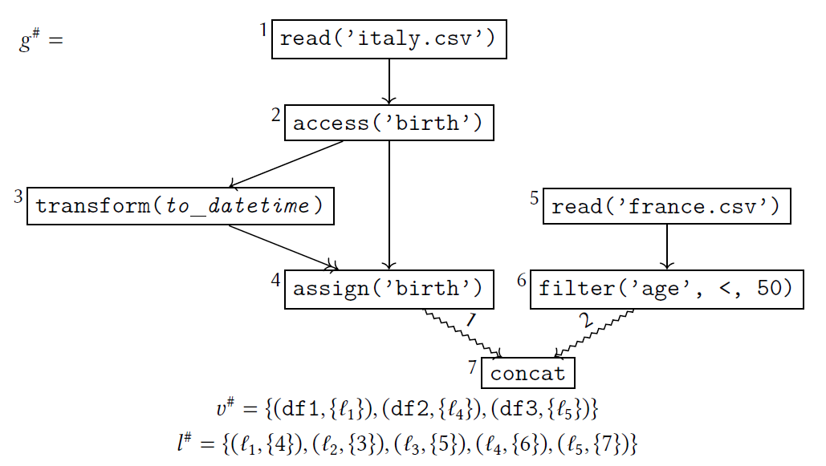
The dataframe graph domain
df1 = pd.read_csv(’italy.csv’)
df1[’birth’] =
pd.to_datetime(df1[’birth’])
df2 = pd.read_csv(’france.csv’)
df2 = df2[’age’ < 50]
df3 = pd.concat([df1, df2])

Slide 20
Experiment: data shape inference
Resulting graph used to infer required shape of input
PoC implementation in PyLiSA as Value Domain
Analysis of one notebook from Kaggle that aggregates data from different sources
[File: daily_reports/08-23-2022.csv] Columns accessed before being assigned: Confirmed, Province_State, Country_Region, Incident_Rate, Deaths
[File: daily_reports_us/08-23-2022.csv] Columns accessed before being assigned: Province_State, Testing_Rate, Total_Test_Results

Slide 21
Outline
Introduction
LiSA, a modular framework for multilanguage analysis
Non-determinism detection in Go smart contracts
Dataframe modeling in Python notebooks for data science
SARL, a DSL for modeling of libraries and frameworks
Tarsis, an automata-based abstract domain for string values

Slide 22
Analyzing external code
Requirement: Feasible modeling of runtimes, APIs, and frameworks
Languages come with vast APIs and runtimes that must be considered!
“Classic” solution: hardcoded semantic models
Rely on external models!
Each analysis component is parametric to annotations
Create framework models with rules on when to generate annotations
Models are written using SARL

Slide 23
Example SARL model
Published @ VSTTE 2020
class MyPage : Page {
void Page_Load(object sender, EventArgs e)
void ButtonLogOn_Click(object sender, EventArgs e)
}
predicate: isWebPage = cls -> subtypeOf:: "Page"
predicate: isEventHandler =
and(mtd -> basicReturnType:: "void",
and(mtd -> numberOfParameters:: 2,
and(mtd -> hasParameter and(par -> index:: 0, par -> type:: "Object"),
mtd -> hasParameter and(par -> index:: 1, par -> type.subtypeOf:: "EventArgs")))))
specification: annotate mtd with @EntryPoint if and(satisfies isEventHandler,
mtd -> definingClass satisfies isWebPage)

Slide 24
Experiments
Analysis of six applications using Windows Forms and ASP.NET with Julia
No relevant execution overhead
Improvement depends on how much the app relies on the framework, peaking at 74%
Application | LoC | # Warn | # Warn removed | % Warn removed | Time | Time w. SARL | % Time diff.
SignalR | ~49K | 681 | 23 | 3.4% | 4’36’’ | 4’24’’ | -4%
ABP | ~87K | 552 | 8 | 1.4% | 6’08’’ | 6’15’’ | 2%
Umbraco | ~130K | 1729 | 71 | 4.1% | 11’03’’ | 11’09’’ | 1%
ShadowSocks | ~12K | 730 | 257 | 35.2% | 2’14’’ | 2’23’’ | 7%
ShareX | ~99K | 5471 | 4074 | 74.5% | 5’24’’ | 5’24’’ | 0%
CefSharp | ~17K | 465 | 224 | 48.2% | 1’59’’ | 2’01’’ | 2%

Slide 25
Outline
Introduction
LiSA, a modular framework for multilanguage analysis
Non-determinism detection in Go smart contracts
Dataframe modeling in Python notebooks for data science
SARL, a DSL for modeling of libraries and frameworks
Tarsis, an automata-based abstract domain for string values

Slide 26
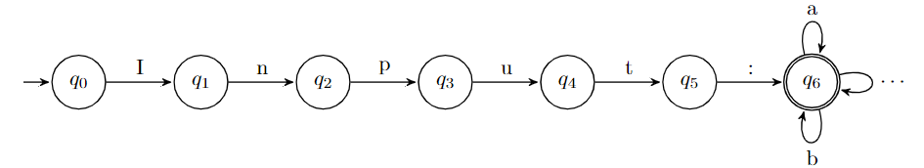
String analysis
Requirement: Model strings for inter-language communication
Precision-efficiency tradeoff is extremely important
Simple and fast domains (e.g., prefix, suffix)
Complex abstractions
Automata precisely abstract regular languages, but are costly:
foo = “Input:” + read()

Slide 27
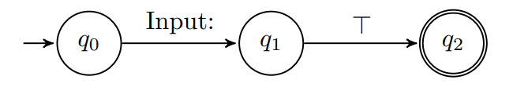
Tarsis
Published @ VMCAI 2021
Idea: compact the automata by changing alphabet:
foo = “Input:” + read()
Reuse lattice operators and widenings of standard automata:

Slide 28
Tarsis
Abstract transformers defined using
Automata operators: concat, contains
Algorithms over all paths: length, replace, indexOf
Structural induction over equivalent regex: substring
Experiments highlight relevant performance boost:
 | P1 | P2 | P3 | P4
Basic domains avg. | 10 ms | 3 ms | 100 ms | 30 ms
Reference FA domain | 10 ms | 52013 ms | 226769 ms | 4235 ms
Tarsis | 34 ms | 38 ms | 299 ms | 39 ms
“Static Analysis for ECMAScript String Manipulation Programs”, Arceri et al., Appl. Sci., 2020

Slide 29
Conclusions
LiSA, a framework for modular multilanguage analysis
SARL, a DSL for modeling semantic properties of frameworks
Tarsis, an automata-based string abstraction
Non-determinism detection through information flow
Implemented in GoLiSA, a static analyzer for Go based on LiSA
Extraction of dataframe transformations
Implemented in PyLiSA, a static analyzer for Python based on LiSA
Open source implementations on GitHub
SARL algorithms fully defined in the paper

Slide 30
Limits of the framework
Primarily designed for imperative and object-oriented languages
Applicability to other languages to investigate
Forward analyses only
Extension to backward analyses trivial
Can we modularly combine forward and backward?
Environment/system issues not considered
Modularity and generality might affect precision
Tradeoff w.r.t. other tools not assessed yet

Slide 31
Future works
LiSA
Frontends for more languages!
Further applications to multilanguage systems
Smart contracts analysis
Framework for on-chain analysis taking part in the consensus
Notebook analysis
Expand to domains beyond shape inference
Tarsis
Track relations among unknown strings

Slide 32
Thanks!
Publications:
“SARL: OO Framework Specification for Static Analysis”. Software verification. Springer, Cham, 2020. PP. 3-20 (VSTTE 2020).
“Twinning Automata and Regular Expressions for String Static Analysis”. Proceedings of the 22nd International Conference on Verification, Model Checking, and Abstract Interpretation (VMCAI 2021).
“Static analysis for dummies: experiencing LiSA”. Proceedings of the 10th ACM SIGPLAN International Workshop on the State Of the Art in Program Analysis (SOAP 2021).
“Ensuring Determinism in Blockchain Software with GoLiSA: An Industrial Experience Report”. Proceedings of the 11th ACM SIGPLAN International Workshop on the State Of the Art in Program Analysis (SOAP 2022).
“LiSA: A Generic Framework for Multilanguage Static Analysis”. To appear in Challenges of Software Verification (CSV 2022).

Slide 33
Requirements
Flexible program representation
Semantic reasoning depends on language-specific features
Feasible modeling of runtimes, APIs, and frameworks
Ability to model string properties for inter-language communication
Modular and easy to use

Slide 34
Recap: what does LiSA analyze?
LiSA program is made up of CFGs (+ extra information)
CFGs encode flow control in their structure
CFG nodes are language-specific
CFG nodes rewrite into symbolic expressions
Calls + orchestration handled by Interprocedural Analysis + Call Graph
Memory is modeled by the Heap Domain
Values are modeled by the Value Domain
All components are independent from one another
Syntax
Semantics
Analysis

Slide 35
Symbolic expressions
With extensible statements there is no predefined set of operations
Analyses need to know how the state evolves with each statement
Solution: the SymbolicExpressions language
Analyses work on an internal extensible language of SymbolicExpressions
Each symbolic expression is an “atomic” semantic operation
Heap allocation, numeric sum, pointer dereference, …
malloc (C) and new int[] (Java) are modeled with the same symbolic expression HeapAllocation
Analyses use Statement.semantics() to rewrite each Statement to SymbolicExpression(s) and feed them to the analysis

Slide 36
Well defined semantics
JavaArrayAccess.semantics() {
if index < 0 or index > len(receiver) then return bottom
return entry state but with accessed element on stack
}
PythonArrayAccess.semantics() {
if index < 0 then index = len(receiver) - index
if index < 0 or index > len(receiver) then return bottom
return entry state but with accessed element on stack
}
Language-specific semantic function
Different instances for each language

Slide 37
Who creates the CFGs?
Frontends are compilers from the original language to LiSA programs
They can also add logic to the analysis!
Library models
Each language has its own frontend
With language-specific statements!
Long-term objective: plug into compilers/interpreters
LiSA program P_{L}
Program P
L^{i} front-end
CFGs
P^{i}
Analysis logic

Slide 38
Handling calls
Interprocedural
Analysis
fixpoint logic
CFG Fixpoint
Non-calling stmt
ia.getResultOf(this)
stmt.semantics()
abstract result
target(s) of the call
cg.resolve(call)
abstract result
Domain agnostic!
Call Graph
Calling stmt
To find targets, call graph can use:
runtime types of receiver
all instances of static type of receiver
…
Interprocedural analysis can:
analyze CFGs in isolation
start from “main” and follow calls
…

Slide 39
Handling dynamic memory
We want domains to be independent on how we handle memory
Intuition: we can consider each memory location as a “fake” variable
Handling dynamic memory access means understanding to which location an expression refers to
Expression | Concrete location
x | L₁
x.f | L_{1.1}
x.g | L_{1.2}
y | L₂
y.f | L_{2.1}
y.g | L_{2.2}
class A {
int f, g;
}
x = new A();
y = new A();
L₁
L₂
A
A
f
g
f
g
L_{1.1}
L_{1.2}
L_{2.1}
L_{2.2}

Slide 40
The Abstract State
How much precision do we want?
Can we do better?
Expression | Concrete location | Low precision | Medium precision | High precision
x | L₁ | L | L₁ | L₁
x.f | L_{1.1} | L | L₁ | L_{1.1}
x.g | L_{1.2} | L | L₁ | L_{1.2}
y | L₂ | L | L₂ | L₂
y.f | L_{2.1} | L | L₂ | L_{2.1}
y.g | L_{2.2} | L | L₂ | L_{2.2}
Abstract State
Heap Domain
expr
x.g = 7
rewrite
x.f = 5
L₁ = 7
L_{1.1} = 5
L_{1.2} = 7
L₁ = 5
Value Domain

Slide 41
LiSA semantic analysis
LiSA
Source: sensor value
Sink: actuator
Track cross-language interactions
Controller (Java)
Joystick (C++)
Car (C++)
initialize()
initialize()
read ()
Analysis 1:
sensor -> actuator
Warning!
sv
runMotor(sv)

Slide 42
Detecting critical non-determinism
Non-determinism is only problematic if it affects the shared state
Blacklisting is too restrictive
Similar to detecting injection attacks: information flow!
Taint analysis
Non Interference
var id string = ...
var obj MyObject
obj.ID = id
obj.Date = time.Now()
value, _ := json.Marshal(obj)
store.Set(id, value)
var id string = ...
if rand.Int() % 2 == 0 {
store.Set(id, 0)
} else { store.Set(id, 1) }
Source
Source
Sink
Sink
Sink

Slide 43


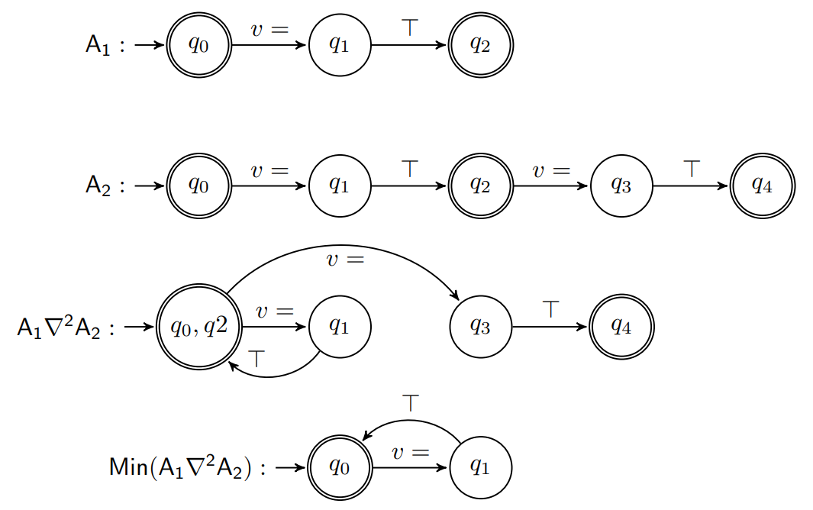
Tarsis
Lattice defined over equivalence classes of minimum automata:
Widening : subset construction w.r.t. languages of length :

Slide 44
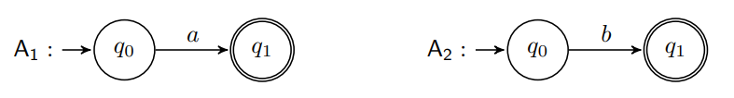

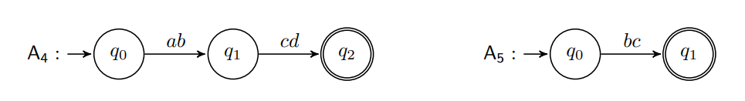

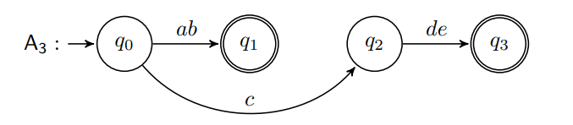

Tarsis abstract transformers
concat: automata concatenation
contains: intersection with factors automaton
length: min- and max-path length

Slide 45
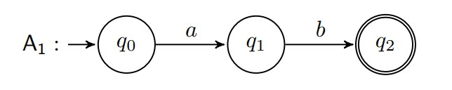
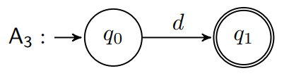
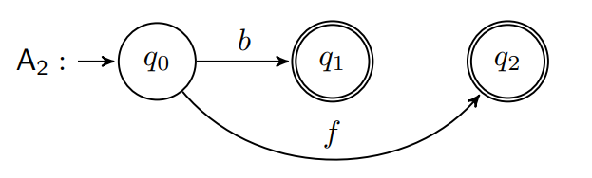
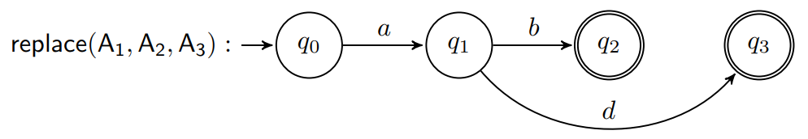
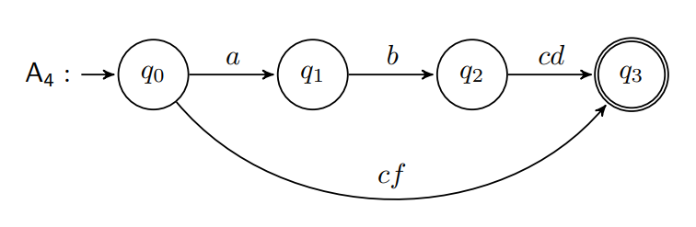
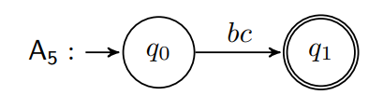

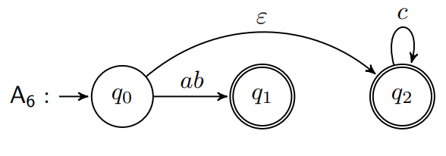


Tarsis abstract transformers
replace: must- or may-replace over all paths
indexOf: search over all paths
substring: induction on the structure of the regex

Slide 46
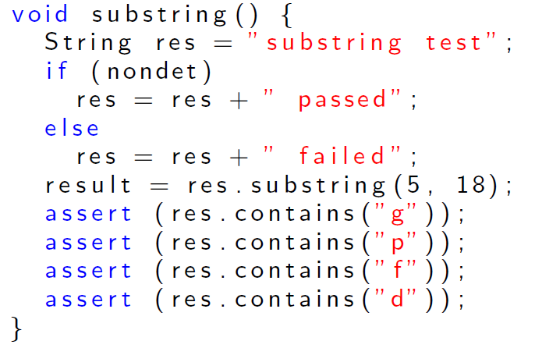
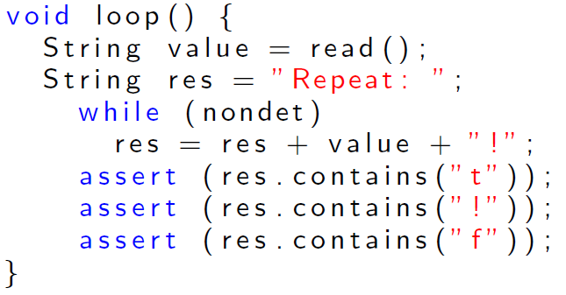
Tarsis experiments
P1 Execution times:
Other domains: | ~10 ms
TARSIS: | 34 ms
FA: | 10 ms
P2 Execution times:
Other domains: | ~3 ms
TARSIS: | 38 ms
FA: | 52013 ms

Slide 47
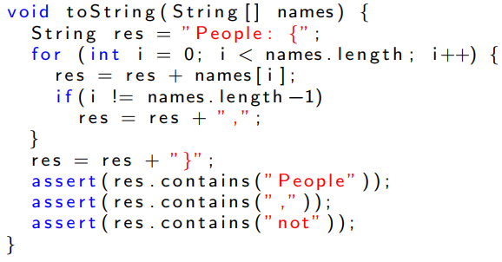
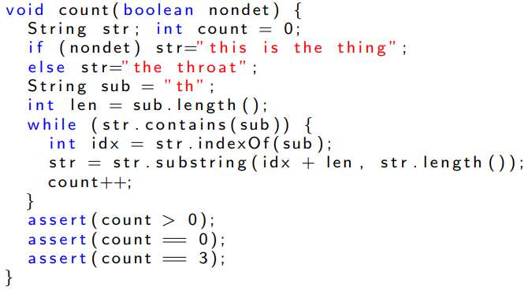
Tarsis experiments
P3 Execution times:
Other domains: | ~100 ms
TARSIS: | 299 ms
FA: | 226769 ms
P4 Execution times:
Other domains: | ~30 ms
TARSIS: | 39 ms
FA: | 4235 ms

