Slide 1

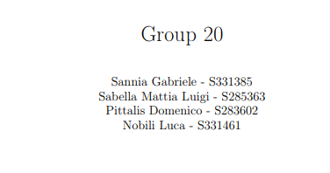


Slide 2

FreeRTOS - Introduction
Real-Time Operating System for microcontrollers
Robustness, scalability
Includes a kernel and a set of libraries
Minimal ROM, RAM and processing overhead

Slide 3
Tasks
Real-time applications in FreeRTOS consist of independent tasks
The Real-Time Scheduler decides which task runs based on priority
Lower is the value, lower is the priority
Tasks have no knowledge of the scheduler activity
-> Correct Context Switch is only under the responsibility of scheduler
Time-Sliced Round-Robin Scheduling may be used for tasks with identical priorities
We created two simple demos for both schedulers.

Slide 4
Semaphores
Binary Semaphores - synchronization tasks.
Mutexes – simple mutual exclusion tasks.
Only difference: priority inheritance mechanism.
Counting Semaphores are like queues with lengths greater than one.
They are used for:
Event counting.
Resource management.

Slide 5
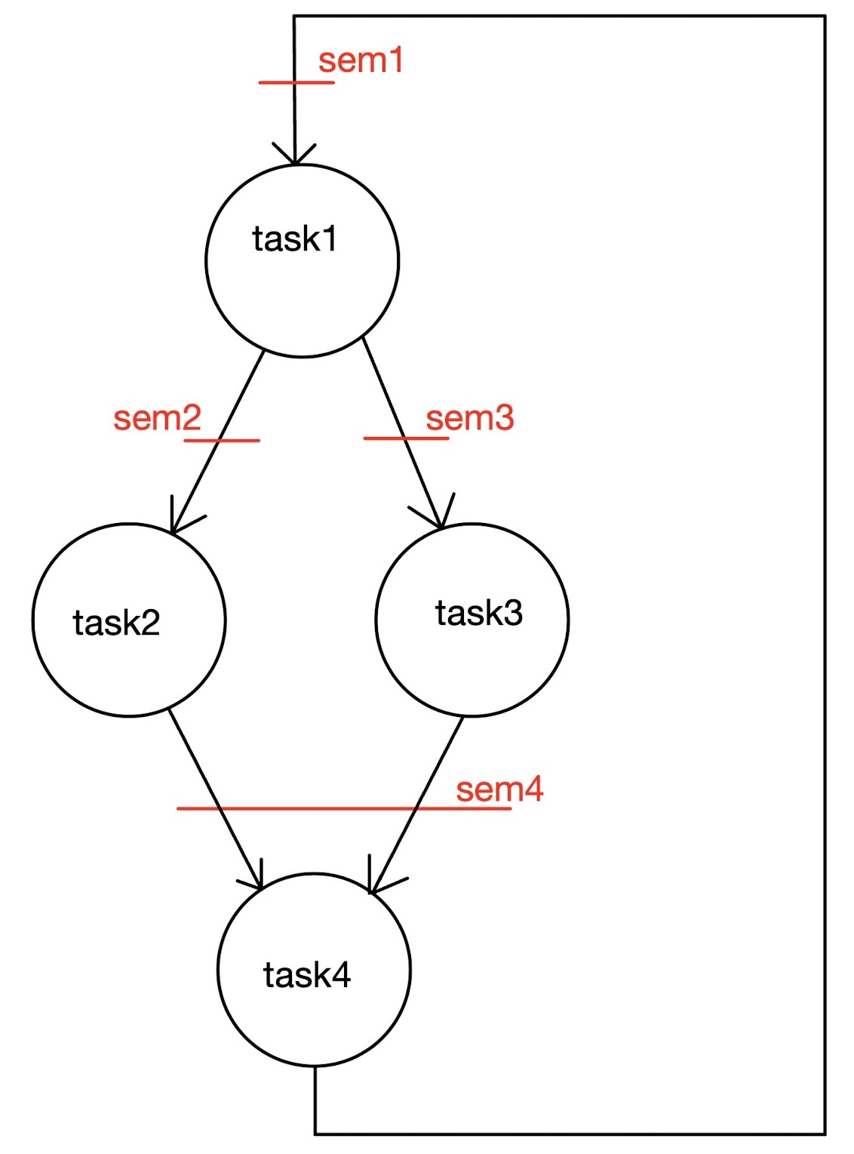
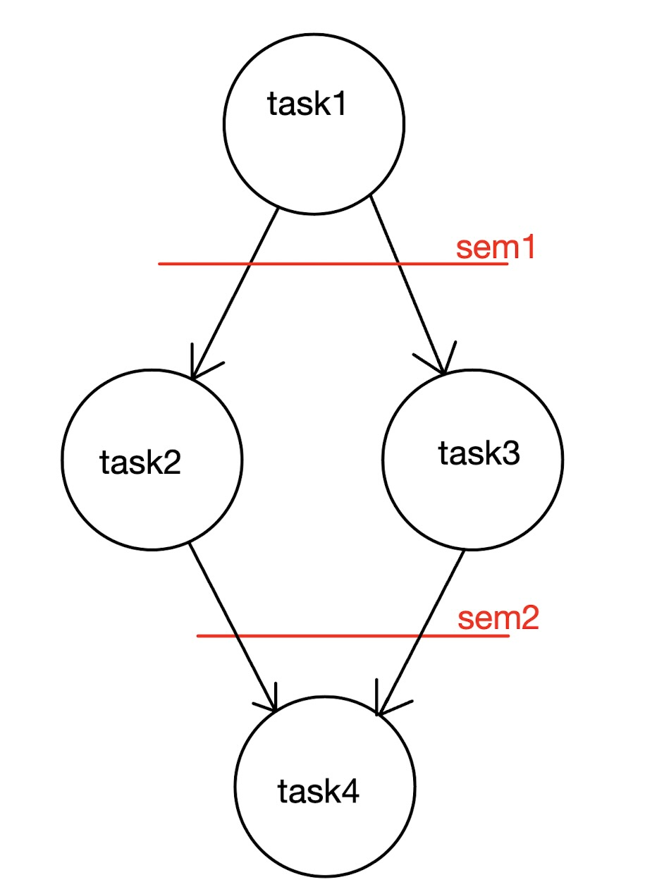
Semaphores Examples
Basic tasks
"semaphoresAcyclic.c"
Extended tasks
"semaphoresCyclic.c"

Slide 6
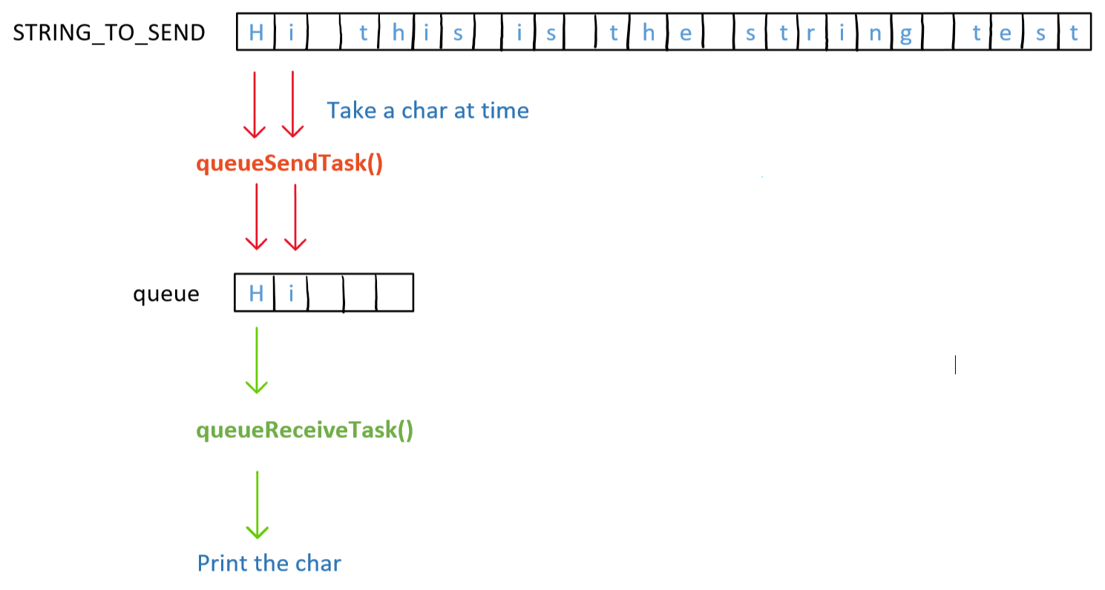
Queues
Queues are essential for task communication in a multitasking system.
They serve as channels through which tasks exchange messages, facilitating coordination and data sharing.
Queues operate on a FIFO basis, where the data sent earlier is received first.
Queues can block tasks when they are full or empty, ensuring efficient resource utilization.

Slide 7
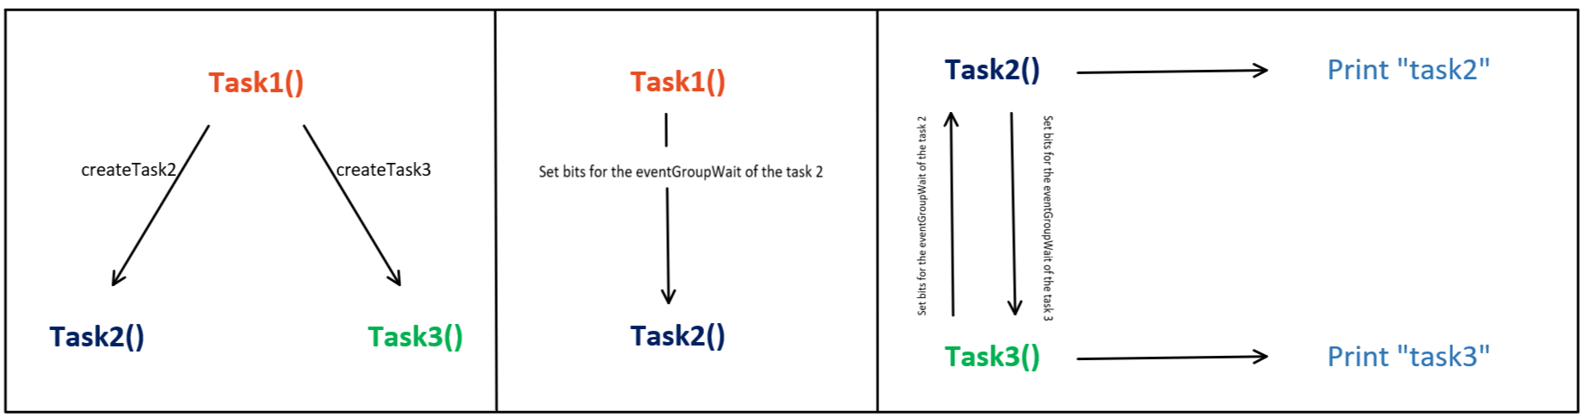
EventGroup
EventBits are individual bits used to represent different event states, such as message reception or task readiness.
Event groups are collections of these event bits grouped together for easier management and task synchronization.
Used for synchronization between tasks and managing multiple event states.

Slide 8
Earliest Deadline First with Background Scheduling

Slide 9
Earliest Deadline First Scheduling
Dynamic priority scheduler
Preemptive
At each instant, the task with earliest deadline will receive highest priority
handles periodic tasks
Backgroung Scheduling
Handles aperiodic tasks
Aperiodic tasks are scheduled in background, when no periodic instance is ready

Slide 10
How to implement?
Task Control Block modification
New task create function
New ready list
Deadline & Priority updates
Preemption management
Context Switching management
IDLE task management
Aperiodic Task Management

Slide 11
Task Control Block modification
A variable to store the deadline si added to the TCB.
TickType_t xTaskDeadline
New task create function
A new task creation function, xTaskCreateEDF , has been introduced to accommodate the deadline parameter
xTaskCreateEDF( TaskFunction_t pxTaskCode,…,
TickType_t deadline1)
Inside it, the value passed to the function is added to the TCB.
pxNewTCB->xTaskDeadline = deadline1;

Slide 12


New Ready List
0
1
Sorted in ascending order of deadlines
2
3
4
pxReadyTasksLists
xReadyTasksListsEDF

Slide 13
How to use the EDF ready list
….
xReadyTasksListsEDF
xTaskDeadline
TCB
…
List used internally by FreeRTOS to
manage task state information. Contains an item, that is used as deadline in our scheduler.
xStateListItem
….

Slide 14
Deadline & Priority updates
The prvAddTaskToReadyList function is modified to update task deadlines before the insertion into the ready list.
The deadline is recalculated as the sum of the previous deadline and the declared deadline value in the TCB.
( pxTCB )->xStateListItem.xItemValue += ( pxTCB )->xTaskDeadline;

Slide 15
Preemption management
Within the `xTaskIncrementTick` function, a new preemption policy is introduced.
When a task scheduled for insertion into the ready list has an earlier deadline than the currently running task, preemptive action is taken.
To reduce context switching overhead, if both tasks share the same deadline, preemptive action is not executed.
Context Switching management
The task to be executed is positioned at the head of this list.
The function listGET_OWNER_OF_HEAD_ENTRY is used to obtain the task in the head of the list.

Slide 16
IDLE task management
xReadyTasksListsEDF
IDLE task is initialized with vTaskCreateEDF
It simulates lowest priority by assigning farthest deadline, e.g., 10000.
Task 1 -- 30
Task 2 -- 80
IDLE -- 10000

Slide 17
Aperiodic task management
xReadyTasksListsEDF
Instead of creating a new ready list, we utilize the xReadyTasksListsEDF.
Aperiodic tasks are positioned just below the IDLE task's deadline.
We've devised a dedicated vTaskCreateEDFAperiodic.
Their deadlines are determined based on their arrival order.
Task 1 -- 30
Task 2 -- 80
Aperiodic tasks
IDLE -- 10000

Slide 18
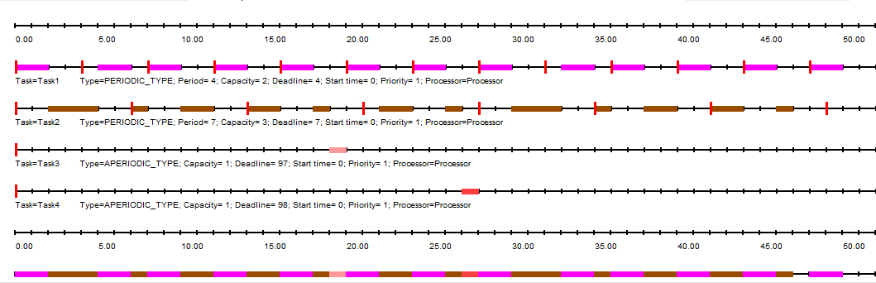
Demo

Slide 19
MultiLevel Queue Scheduler
Ready List
0
1
Priority-based preemptive
2
3
4
Round-robin

Slide 20
How to implement?
Task Control Block modification
xTaskPrioritySet
Priority upgrade
Highest Priority List Round Robin

Slide 21
Task control block modification
Addition of uxOldPriority Variable.
Inclusion of cc Variable:
- Reserved for internal purpose.
int cc
UBaseType_t uxOldPriority
Those values are then setted in the vTaskCreate function.

Slide 22
xTaskPrioritySet
A smaller version version of the vTaskPrioritySet is added to properly modify the priority of a task.
Priority upgrade
When system’s ticks reach a multiple of the “update rate”, a priority boost is applied.
This boost affects all tasks in the ready list except the one currently running.
To modify the priority, the `xTaskPrioritySet` is used.

Slide 23
Highest priority list Round-Robin
The `xTaskIncrementTick` function containes the code for our Round-Robin scheduling.
Activated if there are at least two tasks present in the highest priority list.
This mechanism ensures fair execution among tasks sharing the same highest priority level.
UBaseType_t c = (configMAX_PRIORITIES - 1U);
if( listCURRENT_LIST_LENGTH( &( pxReadyTasksLists[ c ] )) > 1)
{
xSwitchRequired = pdTRUE;
}

Slide 24
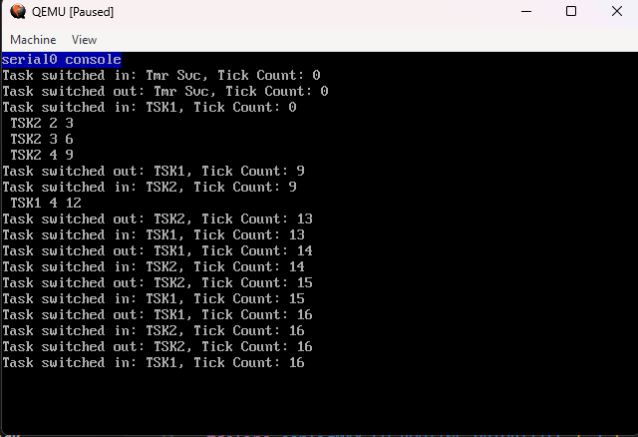

Demo

