Slide 1
ALLOY 6 CHALLENGE
Authors:
Luca Padalino
Francesca Pia Panaccione
Francesco Santambrogio

Slide 2
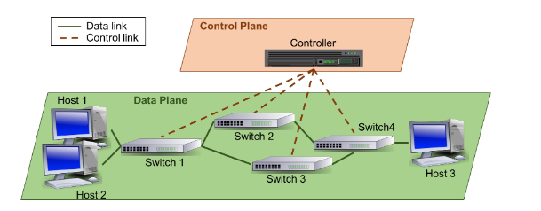
Software Defined Network
1
Definition
Software-Defined Network (SDN): A is a modern networking paradigm that explicitly separates the data and control planes to include intelligence in the network.

Slide 3
Software Defined Network
2
Controller and Switches
It is composed by these elements:
Controller: core entity of the SDN control plane. The network intelligence is logically centralized in the controller, which is able to dynamically configure the forwarding devices of the data plane in order to achieve a specific goal;
Switches: data plane components in charge of forwarding the data packets from its source to the destination. In SDNs, each switch has a routing table that contains a set of rules defining how the different incoming packets must be processed (forwarded, discarded, etc.). Each switch has also always a specific link (and thus a port) that connects it with the controller. This connection is mainly used to configure the switches. The data transmitted between nodes are called packets.

Slide 4
Software Defined Network
3
Packets
Packets that can be of two types:
control packets include control plane information, such as new rules that must be installed in an specific switch, or a request to know how to process a data packet;
data packets encapsulate information that must be transmitted from one host to another. In this case, the relevant information are the source and destination hosts, the type of data packets, and the current position in the network.

Slide 5
Software Defined Network
4
Switch
Switches contain tables with rules that specify how to route data packets. Simplifying, a rule is a structure with a field denoting the type of data packet (e.g. HTTP or FTP) and the input and output ports. The meaning of the rule is as follows:
If a data packet of a particular type arrives at port PortI, it must be forwarded through port PortO;
It is also possible to define rules that discard incoming data packets;
When a switch has no rule to deal with a data packet, it sends a request to the controller in order to know how to process the packet;
Finally, the controller can also send new rules to switches to update the routing tables.
packetType | action | iPort | oPort
... | ... | ... | ...
... | ... | ... | ...

Slide 6
Software Defined Network
5
Hosts
Hosts are the endpoints of the network, they are the source and destination of the data plane traffic. Although hosts are not specific elements of the SDN architecture, in our case study they are part of the model.

Slide 7
Software Defined Network
6
Static Model
Identify the main signatures of the system
Design some static facts defining:
how connections between nodes (switches, hosts, controllers) should be defined
how nodes should behave according to their type
how many packets should be accommodated in their port at the same time
what should travel within the various links (pay attention to the type of link and thus the type of packet)

Slide 8
Software Defined Network
7
Dynamic Model
Design some dynamic facts defining:
how packet position changes to reach the destination host
(A received packet must be handled by the node by applying the rules it contains, which may vary over time)
Then:
define predicates related to sending and receiving requests, then packets.
define predicates that handle forwarding, accepting, rejecting, and sending packets and simulate some scenarios by preparing an initial topology and observing how it changes over time.
define two assertions: one that proves that the controller does not receive requests, the other that a packet arrives at a node.

Slide 9

Software Defined Network
8
Info about the Challenge
Based on the directions in the slides above, construct your .als file and submit it by dd/mm/yyyy to this form. Your model will be corrected and if it is correct you will be given N additional point on the exam.
https://forms.office.com/e/WyxBQTYwCd

