Slide 1
ALLOY 6-Syntactic overview TEMPORAL CONNECTIVES
Authors:
Luca Padalino
Francesca Pia Panaccione
Francesco Santambrogio
Notes:
In this video, as mentioned in the first theoretical lecture, I am going to present all of the new temporal connectives introduced in Alloy 6…

Slide 2
LINEAR TEMPORAL LOGIC (LTL)
1
Definition
LINEAR TEMPORAL LOGIC (LTL): «an infinite sequence of states where each point in time has a unique successor, based on a linear-time perspective»
[1]
i-N
i-2
i-1
i
i+1
i+2
i+N
Past states
Current state
Future states
[1] Ashari, R., & Habib, S. (n.d.). LINEAR TEMPORAL LOGIC (LTL).
Notes:
…Getting back into the discussion about the new temporal logic of Alloy 6, such logic is defined by professors Ashari and Habib from the University of Colorado as an infinite sequence of states where each point in time has a unique successor, based on a linear-time perspective. Like most specification languages, Alloy divides time into a series of discrete steps, where i is denoted as the current state, i+ the future states and i- the past states…

Slide 3
INTRODUCTION
2
Signatures
sig Person {
var liveness: Liveness
}
SIGNATURES
enum Liveness {Alive, Dead}
Notes:
…Let’s introduce the signatures we are going to use in this video to show some examples of the new temporal connectives: we have a signature Person having a variable field called liveness, which is a relation with one atom of the Liveness signature, in particular, an enumeration signature that tells the two possible “states”, let me say, of a human being: alive and dead…

Slide 4
INTRODUCTION
3
Signatures
pred Die [p: Person] {
p.liveness = Alive
p.liveness' = Dead }
PREDICATES
Notes:
…Then, we have also a predicate Die that takes as input a Person and says that at the current state, the person is alive and then at the next state is dead: note that in order to refer to the value of the liveness relation in next state, we use the symbol prime: we can use also the temporal connective after as we’ll se later…

Slide 5


TEMPORAL CONNECTIVES
4
Goal
To express constraints that hold at different instants of time
or for a certain amount of time
How can we express that a person is not immortal?
How can we express that a person cannot come back to life?
Notes:
…So the goal of this video is to express constraints that hold at different instants of time or for a certain amount of time. Thus, In Alloy 6, we can easily define also constraints dealing with time, like how to express that a person is not immortal, or that a person cannot come back to life and etcetera…

Slide 6
TEMPORAL CONNECTIVES
5
Goal
To express constraints that hold at different instants of time
or for a certain amount of time
How can we express that a person is not immortal?
How can we express that a person cannot come back to life?
TEMPORAL CONNECTIVES
Notes:
…the answers to all of these questions lie in the temporal connectives!...

Slide 7
TEMPORAL CONNECTIVES
6
Always
Sintax: Exp::= un0p expr| expr bin0p expr
Un0p::= always| after| eventually
Bin0p::= until| releases| ;
F IS TRUE
ALWAYS F = true in i iff F = true in k>=i
for each state k
ALWAYS F
i
i+1
i+2
i+N
Notes:
…First of all: as you can see at the top-left of the slide, the syntax of these expressions changes whether it is a unary or a binary operator. Let’s start with the unary operators, in particular with the future ones, as highlighted in yellow. Firstly, we have the “always” expression: as you can see from the formal definition here, always F is true in state i iff F is true in every state after i including the current state as well.

Slide 8
TEMPORAL CONNECTIVES
7
Eventually
fact NoResurrection {
always (all p:Person| p.liveness = Dead implies always p.liveness = Dead)}
ALWAYS
Notes:
…let’s try to add a constraint for our model through the always temporal connective: for example, we want to say that in our model the resurrection is not possible. We can say that it is always true that if a person is dead, he will be always dead. Note that the functions of the two “always” present in the fact is different: the first one is needed to say that this fact must be respected in all future states starting from the initial one. If not added, we say that this fact must be true only in the first state, while then, starting from the second state, it can be respected or not. The second always instead is important to say that if the liveness value of the person is dead at the analyzed state, then the person is dead at the future states (and at the current one as well obviously)…

Slide 9
TEMPORAL CONNECTIVES
8
After
Sintax: Exp::= un0p expr| expr bin0p expr
Un0p::= always| after| eventually
Bin0p::= until| releases| ;
F IS TRUE
AFTER F = true in i iff F = true in i+1
AFTER F
AFTER S = S’
i
i+1
i+2
i+N
Notes:
…The second unary future operator presented is after: The expression after F is true in state i iff F is true in state i + 1, the next one. As I said before, instead of using after before a signature in an expression, we can use the prime symbol to represent the signature at the next state…

Slide 10
TEMPORAL CONNECTIVES
9
Eventually
assert NoResurrection {
always (all p:Person| p.liveness = Dead implies after p.liveness = Dead)}
AFTER
Notes:
…here there is an example with after, namely an assertion to check the NoResurrection property we have previously expressed only with always. Here we again say that it is always true that for each person if he is dead at the currently analyzed step of the trace, then he is dead also in the next step. Note that since we say that this fact must be always respected since the initial state, this is equivalent to using always instead of after here. For this reason, if we check this assertion, Alloy does not find any counterexample…

Slide 11
TEMPORAL CONNECTIVES
10
Eventually
Sintax: Exp::= un0p expr| expr bin0p expr
Un0p::= always| after| eventually
Bin0p::= until| releases| ;
F IS TRUE
EVENTUALLY F = true in i iff F = true in k>=i
for some state k
EVENTUALLY F
LIVENESS PROPERTY
i
i+1
i+2
i+N
Notes:
…The last unary future operator is eventually: the expression eventually F is true in state i iff F is true in some state after i, including the current state
Eventually is also used to express liveness properties, the ones that we could not define with Alloy 5, if you remember. This is where Alloy’s model-finder comes in handy: we can find example traces where something eventually happens, even if it’s not a guaranteed liveness property…

Slide 12
TEMPORAL CONNECTIVES
11
Eventually
fact noImmortality {
always (all p:Person | p.liveness = Alive implies after (eventually p.liveness = Dead))}
}
EVENTUALLY
Notes:
…here there is an example of eventually: a new fact saying that immortality must not be present in our model, therefore we say that it is always true that for each person p, if that person p is alive at the current state, then at some point in the future he will die. Here we can add the connective after before eventually to remove the current state as a possible state where the predicate after “eventually” is true: basically we narrow down the possible states where p.liveness = Dead by excluding the current state…

Slide 13
TEMPORAL CONNECTIVES
12
Combined expression
+
ALWAYS
EVENTUALLY
<
ALWAYS EVENTUALLY
EVENTUALLY ALWAYS
Some N always is true at some point in the future
Some N becomes permanently true
Notes:
…At this point, let me make a remark: temporal logic can become tricky to reason through if we combine the expressions we’ve just seen in order to create complex expressions. For example, we can combine always and eventually: the first predicate says that some N always is true at some point in the future, while the second predicate says that some N becomes permanently true. If we exploit Alloy to check which implies whom, we’ll find out that the second predicate is strictly more powerful…

Slide 14
TEMPORAL CONNECTIVES
13
Eventually
pred Mortality1 {
all p:Person |
always eventually p.liveness = Dead
}
ALWAYS
+
EVENTUALLY
pred Mortality2 {
all p:Person |
eventually always p.liveness = Dead
}
Notes:
…here there is an example of eventually: a new fact saying that immortality must not be present in our model, therefore we say that it is always true that for each person p, if that person p is alive at the current state, then at some point in the future he will die. Here we can add the connective after before eventually to remove the current state as a possible state where the predicate after “eventually” is true: basically we narrow down the possible states where p.liveness = Dead by excluding the current state…

Slide 15
TEMPORAL CONNECTIVES
14
Historically
Sintax: Exp::= un0p expr| expr bin0p expr
Un0p::= historically| once| before
Bin0p::= since| triggered|
F IS TRUE
HISTORICALLY F = true in i iff F = true in k<=i
for each state k
HISTORICALLY F
i-N
i-2
i-1
i
Notes:
…Now we move to the past unary expressions. The first one we see is historically: historically F is true in state i iff F is true in every state before i, including i itself, so it is the dual of always…

Slide 16
TEMPORAL CONNECTIVES
15
Historically
fact NoDeadThenAlive {
always (all p:Person | p.liveness = Alive implies historically p.liveness = Alive)}
HISTORICALLY
Notes:
…we can use historically with this fact to constrain that in our model it is always true that if a person is alive, this means that he has always been alive from the beginning of the trace: with this example we can appreciate that historically is the dual of always and therefore they constrain diametrically opposed facts…

Slide 17
TEMPORAL CONNECTIVES
16
Once
Sintax: Exp::= un0p expr| expr bin0p expr
Un0p::= historically| once| before
Bin0p::= since| triggered|
F IS TRUE
ONCE F = true in i iff F = true in k<=i
for some state k
ONCE F
i-N
i-2
i-1
i
Notes:
…The second past unary operator is once: the expression once F is true in state i iff F is true in at least one state before i including i. As you can see, it is the dual of eventually…

Slide 18
TEMPORAL CONNECTIVES
17
Before and Once
fact DeadSinceDeath {
always (all p:Person | p.liveness = Dead implies once Die [p])}
ONCE
Notes:
…We can use once to express another fact for our model that says that it is always true that if a person p is dead, this means that once he died, that is, he died in at least one past state. Then, since we constrained that if a person is dead, he remains dead forever, the die predicate can be true only one single time for each person.

Slide 19
TEMPORAL CONNECTIVES
18
Before
Sintax: Exp::= un0p expr| expr bin0p expr
Un0p::= historically| once| before
Bin0p::= since| triggered|
F IS TRUE
BEFORE F = true in i iff F = true in i-1
for i>0
BEFORE F
FALSE IN STATE 0
i-N
i-2
i-1
i
Notes:
…The last past unary operator is before: The expression before F is true in state i > 0 iff F is true in state i - 1. By convention, before F is false in state 0. Before instead is the dual of after…

Slide 20
TEMPORAL CONNECTIVES
19
Before and Once
assert IfAliveBeforeAlive {
after
(always (all p:Person | p.liveness = Alive implies before p.liveness = Alive) )}
BEFORE
Notes:
…Here there is an example with before. In particular, it is an assertion to check if it is true that, starting from the second state, it is always true that if a person is alive, then before has always been alive. Note that we have to add after before the assertion since before is false in state 0 by default. Obviously this property is guaranteed by the fact with historically, therefore Alloy does not found any counterexample if we check it…

Slide 21
TEMPORAL CONNECTIVES
20
Until
Sintax: Exp::= un0p expr| expr bin0p expr
Un0p::= always| after| eventually
Bin0p::= until| releases| ;
F IS TRUE
G IS TRUE
F UNTIL G = true in i iff G = true in j>=i && F = true in k: i<=k<j
for some state j, for each state k
F UNTIL G
i
i+1
i+2
i+N
Notes:
…Let’s now move to binary operators, starting from the future ones. The expression F until G is true in state i iff G is true in some state j after i and F is true in every state k such that k is in between i and j…

Slide 22
TEMPORAL CONNECTIVES
21
Until
fact AliveUntilDeath {
always (all p:Person | p.liveness = Alive implies (p.liveness=Alive until p.liveness = Dead))}
UNTIL
Notes:
…for instance, we can have a fact named LifeCycle, where it is said that for each person p it is always true that if p is alive, he remains alive until he is dead. Note that p.liveness = Alive is true until and excluding the state where p.liveness = dead is true …

Slide 23
TEMPORAL CONNECTIVES
22
Releases
Sintax: Exp::= un0p expr| expr bin0p expr
Un0p::= always| after| eventually
Bin0p::= until| releases| ;
F IS TRUE
G IS TRUE
F RELEASES G = true in i iff F = true in k && G = true in j: i<=j<=k
for some state k, for each state j
OR
no such k && G = true in j>=i for each j
F RELEASES G
i
i+1
i+2
i+N
i+
Notes:
…The expression F releases G is true in state i iff G is true in every state after and including i up to and including a state k in which F is true, OR there is no such k in which case G holds in any state >= I, so there are two options where releases can be true…

Slide 24
TEMPORAL CONNECTIVES
23
Releases
assert AliveUntilDeath2 {
always (all p:Person | p.liveness = Alive implies (Die[p] releases p.liveness = Alive))}
RELEASES
Notes:
…In this case, we use releases to create an assertion in order to check whether it is always true that if a person is alive, then the fact that he will die at some point in the future, releases the fact that he is alive, meaning that the person dies before the fact that he is alive becomes false and this is true since the predicate Die is defined as the current liveness is alive and the next one is dead. Releases is true even if Die never occurs and p.liveness = Alive is always true, which makes sense in this example because if the person does not die, he will live forever. This second option is not possible in our model, while the first one is always true, therefore Alloy does not show any counterexample…

Slide 25
TEMPORAL CONNECTIVES
24
Triggered
Sintax: Exp::= un0p expr| expr bin0p expr
Un0p::= historically| once| before
Bin0p::= since| triggered
F IS TRUE
G IS TRUE
F TRIGGERED G = true in i iff F = true in j<=i && G = true in k: j<k<=i
for some state j, for each state k
OR
F = false in j<=i && G = true in k<=j
for each j, for each k
F TRIGGERED G
i-N
i-2
i-1
i
Notes:
…For what concerns the binary past operators, The expression F triggered G is true in state i iff F is true in some state j before i and G is true in every state k in between j excluded and I included, or iff F is false in every state before i in which case G is true in every state before i: it is the dual of releases…

Slide 26
TEMPORAL CONNECTIVES
25
Triggered
assert DeadSinceDeath2 {
always (all p: Person | p.liveness = Dead implies (Die[p] triggered p.liveness = Dead))}
TRIGGERED
Notes:
…let’s make an example through an assertion. We want to check whether it is always true the fact that a person is dead implies that his death triggered the fact that he is dead: it is equal to say that he is dead since his death at least until now. Since it is equivalent to an already expressed fact, Alloy does not show any counterexample for this assertion…

Slide 27
TEMPORAL CONNECTIVES
26
Since
Sintax: Exp::= un0p expr| expr bin0p expr
Un0p::= historically| once| before
Bin0p::= since| triggered
F IS TRUE
G IS TRUE
F ONCE G = true in i iff G = true in j<=i && F = true in k: j<k<=i
for some state j, for each state k
F SINCE G
i-N
i-2
i-1
i
Notes:
…The last past binary operator says that F since G is true in state i iff G is true in some state j before and including i and F is true in every state k such that k is in between j and i: it is basically the dual of until…

Slide 28
TEMPORAL CONNECTIVES
27
Since
assert DeadSinceDeath2 {
always (all p: Person | p.liveness = Dead implies (p.liveness=Dead since Die[p]))}
SINCE
Notes:
…an example of the use of since can be this one: it is always true that for each person p, the fact that he is dead, implies that he is so since death. It is equivalent to the property expressed before, therefore Alloy does not find counterexample again…

Slide 29
TEMPORAL CONNECTIVES
28
;
Sintax: Exp::= un0p expr| expr bin0p expr
Un0p::= always| after| eventually
Bin0p::= until| releases| ;
F IS TRUE
G IS TRUE
F ; G = true in i iff F true in i && G = true in i+1
; = AND AFTER
F ; G
i
i+1
i+2
i+N
Notes:
…Eventually, the semicolon operator. The expression F ; G is true in state i iff F is true in state i and G is true in state i + 1. It is equivalent to saying AND AFTER
The (right-associative) ; operator is useful to describe sequences of operations, to describe a scenario passed to a run command for instance. …

Slide 30
TEMPORAL CONNECTIVES
29
;
run{#Person = 4 and some p: Person | (p.liveness = Alive ; p.liveness = Alive ; p.liveness = Dead)} for 5
;
Notes:
…as a matter of fact, we use here the semicolon operator within the run expression to explain the behaviour of our system in single future states: in this case, we say that in our world there must be at least one person who is alive at the first state, alive again at the next one then he dies and is dead in the final state…

Slide 31
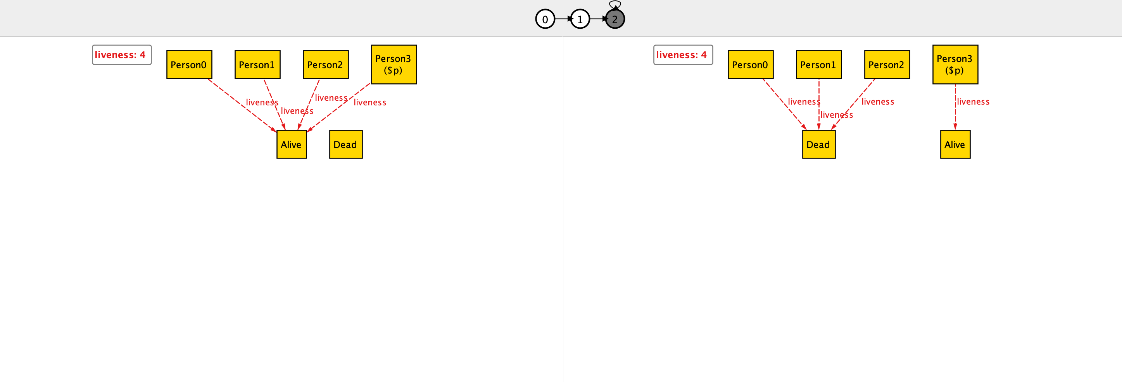
TEMPORAL CONNECTIVES
30
;
Notes:
…as you can see, the new visualizer of Alloy 6 creates a finite lasso of three states which loops back to the second state and therefore simulates the infinite sequence of states of a trace. In the beginning, the visualizer shows the first two states (0 and 1) which are enlightened, while the third state that is not shown is in grey. As written in the run expression, there must be a person who is alive in both the first and second state and this person is marked with the dollar symbol (Person 3). All the other people can behave as they wish respecting the constraints imposed by the facts…

Slide 32
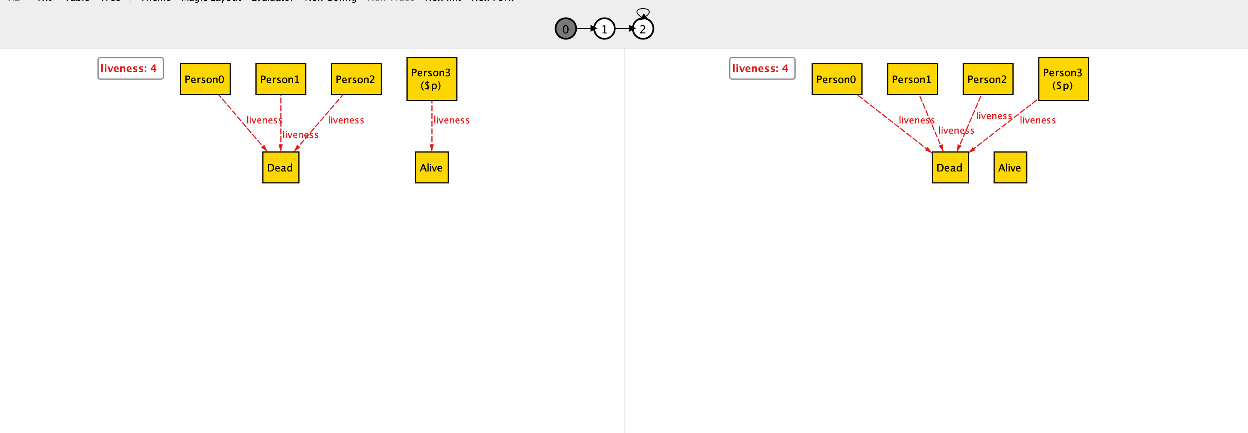
TEMPORAL CONNECTIVES
31
;
Notes:
…If we go on in the lasso trace, the visualizer shows the second pair of states: state 1 and state 2. As you can see, as expressed in the run, the marked person dies and in the third state is dead.

