Slide 1
ALLOY 6 A MATTER OF TIME
Authors:
Luca Padalino
Francesca Pia Panaccione
Francesco Santambrogio
Notes:
Good morning/evening, we are Francesco Santambrogio, Francesca Pia Panaccione, and Luca Padalino, and we are here to present Alloy 6 and the new features introduced into such a formal specification language. This new major version was released two years ago, in 2021, especially to incorporate the important notion of time within the language, for this reason, the subtitle we gave to this lecture is “a matter of time”….

Slide 2

ALLOY 6
1
Lesson objectives
To understand how Alloy 5 deals with dynamic modeling
To understand which are the limitations of the dynamic modeling in Alloy 5 and why Alloy needed a new version
To understand which are the new features introduced in Alloy 6
Notes:
…First of all, we sum up here the goals of this lesson: firstly, we are going to understand how Alloy 5 deals with dynamic modeling, then we’ll understand which are the limitations of such dynamic modeling in Alloy 5 and therefore why we needed a new version of Alloy. Eventually, we’ll se the new features brought by Alloy 6…

Slide 3
ALLOY MODELING
2
Static vs Dynamic models
STATIC
VS
DYNAMIC
Notes:
…In Alloy, as you may have already seen, we can make two types of models: a static and a dynamic one: according to you, what is the difference between the two? The first one deals with something that does not change over time, the second one deals with something that does change over time…

Slide 4
STATIC MODELS
3
The family example
STATIC
abstract sig Person {
father: lone Man,
mother: lone Woman
}
sig Man extends Person {
wife: lone Woman
}
sig Woman extends Person {
husband: lone Man
}
Represents something that does not change over time
Allows to describe a legal state of a dynamic system
Notes:
…so as i’ve already said the static model represents something that does not change over time, remains constant, and therefore it allows us to describe a legal state of a dynamic system. Taking the family example already shown in this course, we can use static modeling to set fixed signatures and their fields. For example, here, we are saying that a person has at most one father and at most one mother, a man has at most one wife and a woman at most one husband, and these relations do not change…

Slide 5
STATIC MODELS
4
Instances
STATIC
STATIC MODEL INSTANCES
Person = {John, Sarah}
Man = {John}
Woman = {Sarah}
Married = {}
Represents something that does not change over time
Allows to describe a legal state of a dynamic system
Person = {John, Sarah}
Man = {John}
Woman = {Sarah}
Married = {John, Sarah}
Notes:
…here are shown two instances of the static model as an example. In one instance we have John and Sarah as two people but they are not married, in another one John and Sarah are married, but these two instances are not linked in any way, not even from a temporal point of view because thew are separated static instances..

Slide 6
DYNAMIC MODELS
5
State transitions
DYNAMIC
Person = {John, Sarah}
Man = {John}
Woman = {Sarah}
Married = {}
Represents something changing over time
Allows to describe possible transitions between states of the system
DYNAMIC TRANSITION
Person = {John, Sarah}
Man = {John}
Woman = {Sarah}
Married = {John, Sarah}
Notes:
…what we want to represent here, though, is a transition from the first instance to the second one and for this reason, we need a dynamic model that represents something changing over time and therefore allows us to describe possible transitions between two states of the system, like in this example…

Slide 7
DYNAMIC MODELS
6
Until Alloy 6
Until Alloy 6: no predefined notion of time and of state transition
two ways to model dynamic aspects of a system:
BUT
1
By placing an ordering on some signatures
2
By introducing a Time signature expressing time
Notes:
…Unfortunately, until Alloy 6 there is no predefined notion of time and of state transition but there are several ways to model dynamic aspects of a system: the first one is by placing an ordering on some signatures, the second one is by introducing a time signature expressing time, but first things first…

Slide 8
DYNAMIC MODELS
7
Ordering
By placing an ordering on some signatures
open util/ordering[S]
sig S{}
Creates a single linear ordering over signature S
There are multiple “S” atoms representing the same physical element but at different points in time
It is like creating a finite state machine on atoms of “S”
next
next
next
The package provides some functions to move between states
S1
S2
S3
S4
last
first
prev
prev
prev
Notes:
…to place an «ordering» we need to import this package specifying also the signature on which we want to apply the ordering, for example here the generic signature S. By doing so, we create a single linear ordering over signature S: this means that there could be multiple S atoms representing the same physical element but at different points in time, if we consider the ordering as a temporal ordering. This is like creating a finite state machine on atoms of S where we start from an initial node, move through the nodes, which are the atoms of S, by exploiting some functions provided by the imported package, and eventually a final node representing the last atom…

Slide 9
DYNAMIC MODELS
8
Traces
TRACE (Alloy 5): a fact that describes how the system will evolve by constraining “valid models” to ones where the system evolves properly
open util/ordering[S] as ord
…
fact traces {
ord/first=S1
all s: ord-­ord/last |
let s' = s.next |
// general operations
op1[s, s'] or … or opN[s, s']
}
next
next
next
S1
S2
S3
S4
last
first
prev
prev
prev
Notes:
…but how can we build such a state machine and therefore define the ordering model? We have to create a fact that represents the trace and describes how the system will evolve by constraining valid models to ones where the system evolves properly. But let’s see what does that mean: if we still consider the ordering signature S, we have to specify the initial node (S1), and specify that we move from a node which is not the last to another node via some operations not specified here…

Slide 10


DYNAMIC MODELS
9
Ordering limitations
The ordering method is really hard to use when we have multiple signatures that are changing or multiple properties that can change:
We should place the order on each signature that can change over time
→ the code is not optimized
…WE CAN DO BETTER!
Notes:
…the problem with the ordering method is that it is really hard to use when we have to deal with multiple things that are changing or multiple properties that can change: in these cases we should place the order on each signature that can change over time and the code would not be optimized, we can do better…

Slide 11
DYNAMIC MODELS
10
Until Alloy 6
Until Alloy 6: no predefined notion of time and of state transition
two ways to model dynamic aspects of a system:
BUT
1
By placing an ordering on some signatures
2
By introducing a Time signature expressing time
Notes:
…as mentioned earlier, we can introduce a time signature expressing time itself…

Slide 12
DYNAMIC MODELS
11
Time signature
by introducing a Time signature expressing time
open util/ordering[Time]
sig Time {}
Creates a Time signature that internally uses the ordering module
The linear ordering is placed on Time
Time is an ordered set
T0
T1
T2
T3
We have to add a time component to each
relation that changes over time
Notes:
…again, we need to import the ordering package but this time, instead of placing the ordering on the target signature that changes over time, we place it to a single signature called Time: therefore, the time signature internally uses the ordering module. In this case, the signature fields that change over time are not ordered and should be related to the time signature which is ordered instead. Thus, we have to add a time component to each relation that changes over time…

Slide 13
DYNAMIC MODELS
12
The family example
DYNAMIC
sig Time {}
abstract sig Person {
father: Man
mother: Woman
alive: set Time
}
sig Man extends Person {
wife: Woman lone -> Time
}
sig Woman extends Person {
husband: Man lone -> Time
}
Represents something changing over time
Allows to describe possible transitions between states of the system
Notes:
…As you can see here, the time signature is added (and the import of the ordering module omitted) and two types of relations with time: the first one is between a field and directly a set of the time signature (alive), while the second one is between a field of Man and Woman, at most an atom of Woman/Man and the signature Time, so the relation is ternary…

Slide 14
DYNAMIC MODELS
13
The family example
If the relation that changes over time is BOOLEAN:
Person0
sig Person {
alive: set Time
}
TIME
t0
t1
t2
t3
t4
Is alive
Is alive
Is alive
Is not alive
Is not alive
times where the field is true
Notes:
…the difference is that if the relation that changes over time is boolean, we relate it to a set of times indicating where the boolean is true, so in this case there is a set of times where the person is alive, and a set of time where he is not (either because he is unborn or because he is dead)…

Slide 15
DYNAMIC MODELS
14
The family example
If the relation that changes over time is ARBITRARY:
Man0
sig Man extends Person {
wife: Woman lone -> Time
}
TIME
t0
t1
t2
t3
t4
Woman0
Woman0
Woman1
Woman1
Multirelation with time:
for every Man and Time,
there is at most one Woman
Notes:
…if the relation that changes over time is arbitrary, meaning not boolean, in general, there is a multi relation with time, in this case, ternary relation: for every man and time, there is at most one woman. This means that for example Man0 is married to woman0 at time 0, but then at time 1 he can be married to another woman (woman 1) and then at another time he can be single or widower…

Slide 16
DYNAMIC MODELS
15
Limitations
There are some limitations to what we can model in a dynamic system:
Import a package and try to emulate time without dealing with a real notion of time
Alloy cannot test that some property is guaranteed to happen in infinite time (liveness)
…WE CAN DO BETTER!
Notes:
…unfortunately, the time signature has some limitations as well, and in general to make dynamic models until Alloy 6 we have to import the package util/ordering and try to emulate the time without dealing with a real notion of time. Moreover, Alloy cannot test that some property is guaranteed to happen in infinite time, aka liveness, that instead can be expressed in Alloy 6 as we’ll see. So, again, we can do better…

Slide 17

ALLOY 6
18
Introduction
ALLOY 6!
ALLOY 6
https://github.com/AlloyTools/org.alloytools.alloy/releases
Notes:
…Alloy 6 comes into play here thanks to its new features…

Slide 18
ALLOY 6
19
Introduction
Alloy 6: there is an implicit, built-in notion of (discrete) time
1
Linear temporal logic
4
Time horizon
2
Mutable signatures and fields
5
New visualizer
3
Temporal operators
6
Concurrency
Notes:
…As a matter of fact, unlike the previous versions, Alloy 6 has an implicit, built-in notion of discrete time and this is possible especially because Alloy 6 introduced a new logic: the linear temporal logic, on which all the new features of Alloy 6 are based…

Slide 19
LINEAR TEMPORAL LOGIC (LTL)
20
Definition
LINEAR TEMPORAL LOGIC (LTL): «an infinite sequence of states where each point in time has a unique successor, based on a linear-time perspective»
i-3
i-2
i-1
i
i+1
i+2
i+3
…
…
Past states
Current state
Future states
Notes:
…Until Alloy 6, there was only the relational logic on which Alloy is based ( in Alloy everything is a relation). In addition to the relational one, in Alloy 6 there is the linear-time temporal logic, defined by the University of Colorado as an infinite sequence of states where each point in time has a unique successor, based on a linear-time perspective. Like most specification languages, Alloy divides time into a series of discrete steps, where i is denoted as the current state, i+ the future state and i- the past states…

Slide 20
LINEAR TEMPORAL LOGIC (LTL)
21
Trace
0
1
2
3
4
5
6
7
8
9
…
Instance = TRACE: infinite sequence of states
Notes:
…In Alloy 6 the instances are traces, namely an infinite sequence of states and the are not a fact anymore but they are implicit within a mutable model…

Slide 21
LINEAR TEMPORAL LOGIC (LTL)
22
State
0
1
2
3
4
5
6
7
8
9
…
0
1
2
3
4
5
6
7
8
9
Instance = TRACE: infinite sequence of states
STATE: a valuation for signatures and fields explore
Notes:
…a state is in turn a valuation for signatures and fields, a snapshot let’s say: for example i-2 is a state, the one which is two steps before the current one...

Slide 22
LINEAR TEMPORAL LOGIC (LTL)
23
Lasso
0
1
2
3
4
5
6
7
8
9
…
0
1
2
3
4
5
6
7
8
9
0
1
2
3
4
5
6
Instance = TRACE: infinite sequence of states
STATE: a valuation for signatures and fields explore
LASSO: a sequence of a finite number of states that loops back to a former state
Notes:
…obviously, we cannot consider an infinite sequence of states due to finite memory, therefore the considered traces are represented as lasso traces: that is, a sequence of a finite number of states that loops back to a former state. Because the last state can be looped back to itself, this is completely general…

Slide 23
LINEAR TEMPORAL LOGIC (LTL)
24
Trace, States, Lasso
LASSO
0
1
2
3
4
5
6
i-3
i-2
i-1
i
i+1
i+2
i+3
…
…
Past states
Current state
Future states
Notes:
…here we can see how to consider the lasso and all the temporal steps when we are in a certain step, starting from the initial one. Since the state 0 is the very first state of our lasso trace, there are no previous states and they are marked in grey, while the future states are all the other states of the lasso trace…

Slide 24
LINEAR TEMPORAL LOGIC (LTL)
25
Traces, States, Lassos
LASSO
0
1
2
3
4
5
6
i-3
i-2
i-1
i
i+1
i+2
i+3
…
…
Past states
Current state
Future states
Notes:
…by proceeding along the lasso, the current state changes and therefore also the next and previous ones: this is important to understand when we will make our model in Alloy 6 using temporal connectives….

Slide 25
LINEAR TEMPORAL LOGIC (LTL)
26
Traces, States, Lassos
LASSO
0
1
2
3
4
5
6
i-3
i-2
i-1
i
i+1
i+2
i+3
…
…
Past states
Current state
Future states

Slide 26
LINEAR TEMPORAL LOGIC (LTL)
27
Traces, States, Lassos
LASSO
0
1
2
3
4
5
6
i-3
i-2
i-1
i
i+1
i+2
i+3
…
…
Past states
Current state
Future states

Slide 27
LINEAR TEMPORAL LOGIC (LTL)
28
Traces, States, Lassos
LASSO
0
1
2
3
4
5
6
i-3
i-2
i-1
i
i+1
i+2
…
i+3
…
…
Past states
Current state
Future states
Notes:
…as i said before, since the computer has a finite memory, it is not possible to represent traces, that is, infinite sequence of states, except through loops: in this way, the number of states is finite and the sequence can go on infinitely but the future states do not really change from the sixth one onwards. We will se with the new visualizer a way to create new different states after the sixth one while weeping the same trace…

Slide 28
ALLOY 6
29
Introduction
Alloy 6: an implicit, built-in notion of (discrete) time
1
Linear temporal logic
4
Time horizon
2
Mutable signatures and fields
5
New visualizer
3
Temporal operators
6
Concurrency
Notes:
…thanks to this new temporal logic, we can now make signatures and fields mutable…

Slide 29
MUATBLE SIGNATURES AND FIELDS
30
Var keyword
VAR
enum Liveness {Alive, Dead, Unborn}
abstract sig Person {
father: lone Man
mother: lone Woman
var liveness: Liveness
}
sig Man extends Person {
var wife: lone Woman
}
sig Woman extends Person {
var husband: lone Man
}
A signature or field proceeded by var is said to be mutable
A signature or field not proceeded by var is said to be static and assumed to be constant over time
Notes:
…While before we had to import a package and make changing signatures ordered, here it is sufficient to add the var keyword: a signature or field preceded by vat is said to be mutable; a signature or field not proceeded by vat is said to be static and assumed to be constant over time. The valuation of a mutable signature or field is likely to vary from state to state in a given trace, while static (that is, immutable) ones remain unchanged in a given trace. As you can see here, the fields that change over time, like liveness, wife, and husband are now proceeded by var, the others remain the same as before and are static, like mother or father. Notice also that there is no more a difference between Boolean or arbitrary properties because there is no more a separated signature Time, the only discriminant here is whether the field is mutable or not…

Slide 30
ALLOY 6
33
Introduction
Alloy 6: an implicit, built-in notion of (discrete) time
1
Linear temporal logic
4
Time horizon
2
Mutable signatures and fields
5
New visualizer
3
Temporal operators
6
Concurrency
Notes:
…Now we can briefly overview the new temporal operators included in Alloy 6 that enrich the Alloy lexicon…

Slide 31
TEMPORAL OPERATORS
34
Future and Past operators
FUTURE | PAST
ALWAYS | HISTORICALLY
EVENTUALLY | ONCE
AFTER | BEFORE
UNTIL | SINCE
RELEASES | TRIGGERERD
; | (NO DUAL)
…FOR MORE INFO: (link)
Notes:
….the operators are divided into future and past operators: as you can see in this table, there is a 1:1 correspondence between most of them except for the binary past operator “;” which is equivalent to “and after”. There are both unary and binary operators but for more information, we leave you with the link to a video where we explain these operators in more detail…

Slide 32
Flipped Classroom
35
Video on Temporal Operators
Link Video
10 min.

Slide 33

Quiz 1
16
Dynamic modeling in Alloy 5
https://forms.office.com/e/9bjmhZTQ0j
5 min.

Slide 34
DYNAMIC MODELS
17
Quiz solutions
What is a dynamic model?
A model that represents something static.
A model that represents something changing over time.
A model that has a first-class notion of time.
How is time emulated in Alloy 5?
By using utility macros.
By placing an ordering on some signature.
By encoding it in the signature fields.
What is a trace in Alloy 5?
A fact that describes how the system will evolve.
A module that helps to model time.
A predicate that relates each state to the next state in the sequence.
What is the purpose of a time signature?
To represent complex specifications with multiple changing entities or properties.
To represent simple boolean properties that change over time.
To encode arbitrary properties with multirelations.

Slide 35

Quiz 2
31
LTL and Mutable Signatures and Fields
https://forms.office.com/e/G3MzQugLb5
5 min.

Slide 36
LTL & MUTABLE SIGNATURES AND FIELDS
32
Quiz solutions
What does the 'var' keyword do in Alloy 6?
Specifies that a signature or field is constant over time
Specifies that a signature or field is mutable
Specifies that a signature or field is a trace
Specifies that a signature or field is a lasso trace
What is a static signature or field in Alloy 6?
A signature or field that is constant over time
A signature or field that is a trace
A signature or field that is a lasso trace
A signature or field that is mutable
What is linear-time temporal logic used for in Alloy 6?
Reasoning about future and past states along a trace
Reasoning about constant values
Reasoning about mutable values
Reasoning about lasso traces

Slide 37

Quiz 3
36
Temporal Operators
https://forms.office.com/e/d5Himvahqs
10 min.

Slide 38
TEMPORAL OPERATORS
37
Quiz solutions
What is the condition for the expression "F until G" to be true in state i?
G is true in some state j ≥ i and F is true in every state k such that i ≤ k < j
G is true in every state ≥ i up to and including a state k in which F is true
F is true in state i and G is true in state i + 1
What is the condition for the expression "F ; G" to be true in state i?
G is true in some state j ≥ i and F is true in every state k such that i ≤ k < j
G is true in every state ≥ i up to and including a state k in which F is true
F is true in state i and G is true in state i + 1
What is the condition for the expression "always F" to be true in state i?
F is true in some state ≥ i
F is true in every state ≥ i
F is true in state i + 1
What is the condition for the expression "eventually F" to be true in state i?
F is true in some state ≥ i
F is true in every state ≥ i
F is true in state i + 1

Slide 39
TEMPORAL OPERATORS
38
Quiz solutions
What is the condition for the expression "after F" to be true in state i?
F is true in some state ≤ i
F is true in every state ≤ i
F is true in state i + 1
What is the condition for the expression "before F" to be true in state i?
F is true in some state ≤ i
F is true in every state ≤ i
F is true in state i – 1
What is the condition for the expression "historically F" to be true in state i?
F is true in some state ≥ i
F is true in every state ≤ i
F is true in state i + 1
What is the condition for the expression "once F" to be true in state i?
F is true in some state ≤ i
F is true in every state ≤ i
F is true in state i + 1

Slide 40
ALLOY 6
39
Introduction
Alloy 6: an implicit, built-in notion of (discrete) time
1
Linear temporal logic
4
Time horizon
2
Mutable signatures and fields
5
New visualizer
3
Temporal operators
6
Concurrency
Notes:
…After having made some signatures or fields mutable with the var keyword and having used the temporal operators within predicates, functions, and facts, we can also specify the time horizon where we want to check our model…

Slide 41
TIME HORIZON
40
Number of steps
TIME HORIZON: the possible number of transitions of lasso traces to explore
default
#steps = 10
for 10 steps
1 <= #steps <= N
for N steps
N
M <= #steps <= N
for M .. N steps
M .. N
1 <= #steps
for 1 .. steps
1..
Notes:
…the time horizon is the possible number of transitions of lasso traces to explore (recall that traces are infinite but periodic, which allows to represent them as finite lasso traces). To do so, Alloy features a reserved steps keyword to be used like type signature names in plain scopes (steps cannot be used anywhere else):
If no time horizon is given, this is implicitly equivalent to for 10 steps.
If the time horizon takes the form for N steps, this is equivalent to for 1 .. N steps
If the time horizon takes the form for M .. N steps, only lasso traces with at least M transitions and at most N ones (including the looping transition starting in the last state) will be explored (this is called bounded model checking).
If the time horizon takes the form for 1.. Steps, the number of steps is greater or equal to 1…

Slide 42
TIME HORIZON
41
Model-checking
TIME HORIZON: the possible number of transitions of lasso traces to explore
default
#steps = 10
1 <= #steps <= N
BOUNDED MODEL-CHECKING
N
M <= #steps <= N
M .. N
1 <= #steps
COMPLETE MODEL-CHECKING
1..
Notes:
…This means that while the first three are examples of bounded model checking, due to the upper bound given to the number of steps, the time horizon in the last example is unbounded (in that case, the selected solver must support complete model checking). Complete model-checking allows checking over all possible traces, without bounding them upfront. This is possible because the state space is finite thanks to scopes on signatures.
Such model-checking is theoretically guaranteed to terminate but may fail due to a lack of memory or may run for too long. Currently, NuSMV and nuXmv are supported (notice that they can also be used for bounded model checking): they must be installed by the user though. Such an option should therefore preferably be executed to check assertions on small models and only when checking with a bounded time horizon does not find counterexamples anymore…

Slide 43

Quiz 4
42
Time Horizon
https://forms.office.com/e/SXfQ5ByiNJ
5 min.

Slide 44
TIME HOIZON
43
Quiz solutions
What is the time horizon in Alloy used for?
To specify the upper bound on the number of transitions in a lasso trace
To specify the lower bound on the number of transitions in a lasso trace
To specify the exact number of transitions in a lasso trace
To specify the type signature names in plain scopes
What is a lasso trace?
An infinite and non-repeating sequence of transitions
A finite and non-repeating sequence of transitions
An infinite and periodic sequence of transitions
A finite and periodic sequence of transitions
What is the purpose of the steps keyword in Alloy?
To specify the upper bound on the number of transitions in a lasso trace
To specify the lower bound on the number of transitions in a lasso trace
To specify the exact number of transitions in a lasso trace
To specify the type signature names in plain scopes
What is the difference between complete model-checking and bounded model checking?
Complete model-checking checks over all possible traces without bounding them upfront, while bounded model checking only checks a subset of possible traces with an upper bound on the number of transitions.
Complete model-checking checks only a subset of possible traces with an upper bound on the number of transitions, while bounded model checking checks over all possible traces without bounding them upfront.
Complete model-checking checks only the first and last states in a lasso trace, while bounded model checking checks all states in a lasso trace.
Complete model-checking and bounded model checking are the same thing.

Slide 45
ALLOY 6
44
Introduction
Alloy 6: an implicit, built-in notion of (discrete) time
1
Linear temporal logic
4
Time horizon
2
Mutable signatures and fields
5
New visualizer
3
Temporal operators
6
Concurrency
Notes:
…Eventually let’s see what happens now in Alloy 6 when we open the visualizer to see the graphs of our model…

Slide 46
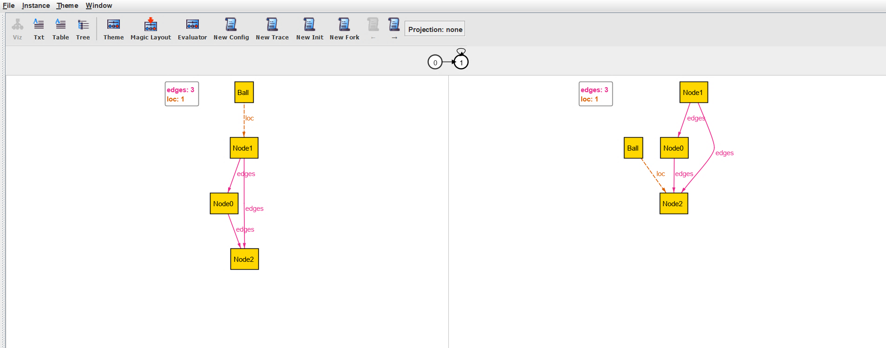
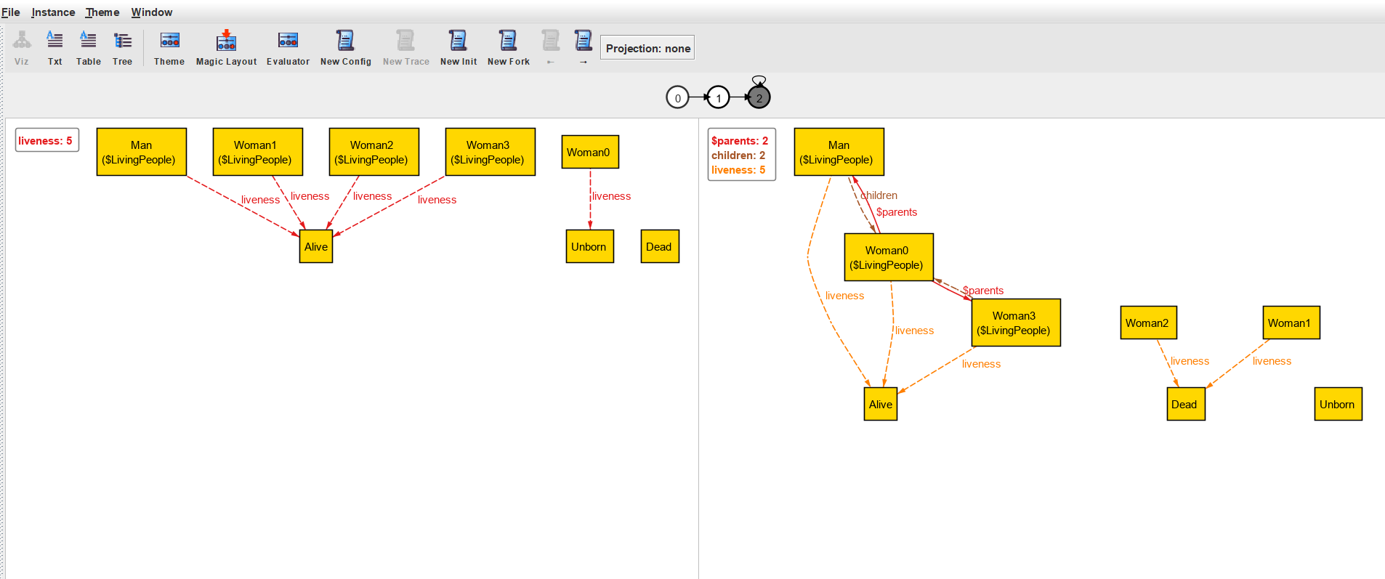
NEW VISUALIZER
1..
45
Introduction
NEW VISUALIZER
C
A
B
Notes:
…if we open the visualizer in Alloy 6, we see this: Do you see anything different from Alloy 5?...The main differences are highlighted by the letters A, B, C, let’s check them out…

Slide 47

NEW VISUALIZER
46
Trace, states, lasso
To visualize the next pair of states in the trace (in this case 1-2)
A
Current state
Next state
TRACE
0
1
2
…
The state after the next state: it is in gray because not currently displayed
STATES
0
1
2
LASSO
0
1
2
Notes:
…First of all, above the graphs, there is a bar with some balls representing states. Remember that the trace is the infinite sequence of states that continues after the third state here represented, the states are 0, 1, 2, while the lasso is the one represented by the visualizer here as it can be seen by the loop at the third state. In particular, the white states are the ones represented below in the visualizer and, from left to right, they represent respectively the current and the next state. Then there are the remaining states of the same trace which are not currently displayed and therefore depicted in grey. Eventually, we can move to the next pair of states of the same trace (in this case, we move from 0-1 to 1-2) by clicking on the page icon above..

Slide 48
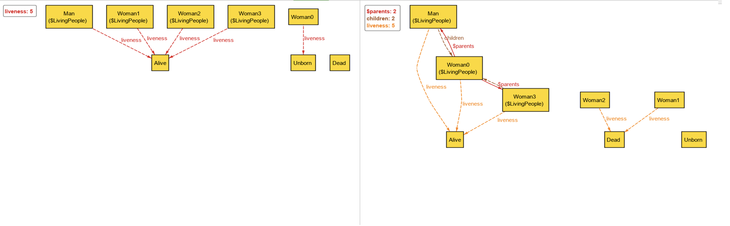
NEW VISUALIZER
47
Step-pair
The visualizer shows a step-pair
B
Current state
Next state
Notes:
…Therefore, the graphs below represent, as I said before, a step-pair of the trace: on the left, we have the current state, and on the right, the next one. Notice that all the instances and fields that we stated as static remain the same in the two time-instances, while the ones that are mutable, change and are distinguished by the dashed lines …

Slide 49
NEW VISUALIZER
48
New generating options
C
yields a new trace that is similar to the current one until the currently-displayed state but differs afterwards
yields a trace where the configuration changed
yields a trace with a different initial state, under the same configuration
yields a new trace under the same configuration
Notes:
…Eventually, while in Alloy 5 we could just generate new instances, here we have new options:
New config: it changes the immutable parts of the model (static signatures and fields), and finds a new behavior trace)
New trace: it finds a new behavior trace from the existing configuration and initial state
New init: it finds a different initial state given the same configuration
New fork: can only be used in the middle of a trace. It fixes the present state (and states before) and finds a new next state

Slide 50

Quiz 5
49
New Visualizer
https://forms.office.com/e/TWVpieWMCF
5 min.

Slide 51
NEW VISUALIZER
50
Quiz solutions
What does the visualizer show?
All possible states of the system
The current state and the next state
All past states of the system.
The entire behavior of the system.
What is lasso in the visualizer?
A sequence of states that terminates.
A sequence of states that loops back to a previous state.
A sequence of states that terminates or loops back to a previous state.
A sequence of states that cannot be represented in the visualizer.
What does the "New Fork" option do?
Finds a new behavior trace from the existing configuration and initial state.
Finds a new initial state and behavior trace.
Fixes the present state and states before and finds a new next state.
Changes the immutable parts of the model and finds a new behavior trace.

Slide 52
NEW VISUALIZER
51
Quiz solutions
What is the purpose of the "New Init" option?
To find a new behavior trace from the existing configuration and initial state.
To change the immutable parts of the model and find a new behavior trace.
To fix the immutable relations and find a new initial state and behavior trace.
To fix the present state and states before and find a new next state.
What happens when you select the "New Config" option?
The visualizer finds a new initial state and behavior trace.
The visualizer shows a popup message.
The visualizer changes the immutable parts of the model and finds a new behavior trace.
When does the visualizer show the old layout with a "New Instance" button?
When the model is entirely dynamic.
When the model is entirely static.
When there are too many forks in the visualizer.
When the model has too many states to fit in memory.

Slide 53
ALLOY 6
52
Introduction
Alloy 6: an implicit, built-in notion of (discrete) time
1
Linear temporal logic
4
Time horizon
2
Mutable signatures and fields
5
New visualizer
3
Temporal operators
6
Concurrency
Notes:
…Eventually, we can appreciate the power of Alloy 6 that allows us to model systems that were not feasible before, like concurrency systems…

Slide 54
CONCURRENCY
53
An Alloy 6 application
CONCURRENCY: a property of a system in which multiple processes or threads can run simultaneously or appear to be running simultaneously.
Scenarios that deal with CONCURRENCY:
distributed systems
multi-threading/multi-tasking applications
data migrations…
…EXAMPLE ON EXERCISE LECTURE
Notes:
…Concurrency is a property of a system in which multiple processes or threads can run simultaneously or appear to be running simultaneously. With the new features introduced in Alloy 6 it is much easier to model dynamic systems without resorting to external packages. Thanks to LTL, new temporal connectives, and the new visualizer, it is possible to model and check scenarios that deal with concurrency:
distributed systems
multi-threading/multi-tasking applications
data migrations
An example of a concurrency model is shown in the next exercise lecture, together with the application of the concepts we’ve seen today….

Slide 55

ALLOY 6
54
Lesson summary
Two ways to deal with dynamic modeling in Alloy 5:
Odering module
Time signature
To understand how Alloy 5 deals with dynamic modeling
Limitations of dynamic modeling in Alloy 5:
Cannot tell deadlocks
No liveness property
No built-in notion of time
To understand which are the limitations of the dynamic modeling in Alloy 5 and why Alloy needed a new version
New features introduced in Alloy 6:
Linear temporal logic
Mutable signatures and fields
Temporal operators
Time horizon
New visualizer
Concurrency
To understand which are the new features introduced in Alloy 6
Notes:
…And now let sum up what we have seen in this lecture. As you can see, we have achieved our goals to understand how Alloy 5 deals with dynamic modeling, namely in two ways: ordering module, and the time signature. We’ve understood which are the limitations of the dynamic modeling in Alloy 5, that is, it cannot tell deadlocks, it cannot express liveness property and in general there is not a built-in notion of time. Eventually, we have seen the new features brought by Alloy 6, which are the linear temporal logic, the mutable signatures and fields, the temporal operatorsm the time horizon, the new visualizer and a possible application of Alloy 6, namely the modeling of concurrent systems.

