Slide 1
SMOTE
Synthetic Minority Over-sampling Technique

Slide 2
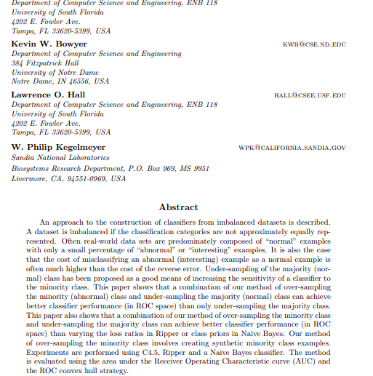
SMOTE: Synthetic Minority Over-sampling Technique
https://arxiv.org/pdf/1106.1813.pdf
Chawla, Bowyer, Hall & Kegelmeyer

Slide 3
Imbalanced dataset
"The cost of misclassifying an abnormal (interesting) example as a normal example is often much higher than the cost of the reverse error."
Class 1
Class 2

Slide 4
Under - sampling
Loss of information
Class 1
Class 2

Slide 5
Over - sampling
Overfitting (with replacement)
Class 1
Class 2

Slide 6
DECISION REGION AFTER BUILDING A DECISION TREE
Before
Over-sampling with replacement
FEATURE 2
MAJORITY CLASS DECISION REGION
Contains 2 false negatives
FEATURE 1

Slide 7
DECISION REGION AFTER BUILDING A DECISION TREE
After
Over-sampling with replacement
FEATURE 2
NEW MINORITY CLASS DECISION REGIONS
FEATURE 1

Slide 8
SOLUTION: ADD PERTURBATION
"If we replicate the minority class, the decision region for the minority class becomes very specific and will cause new splits in the decision tree. This will lead to more terminal nodes (leaves) as the learning algorithm tries to learn more and more specific regions of the minority class; in essence, overfitting."

Slide 9
Generate synthetic data

Slide 10
Generate synthetic data

Slide 11
Algorithm SMOTE(T,N,k)
Input: Number of minority class samples T;
Amount of SMOTE N%;
Number of nearest neighbors K.
Output: (N/100) • T synthetic minority class samples

Slide 12
Algorithm SMOTE(T,N,k)
#If N is less than 100%, randomize the minority class samples as only a random percent of them will be SMOTEd.
if N<100
Randomize the T minority class samples
T = (N/100)*T
N = 100
N = int(N/100) #The amount of SMOTE is assumed to be in integral multiplies of 100

Slide 13
Algorithm SMOTE(T,N,k)
7. k = Number of nearest neighbors
8. numattrs = Number of attributes
9. sample[][]: array for original minority class samples
10. newindex: keeps a count of number of synthetic samples generated, initialized to 0
11. #Compute k nearest neighbors for each minority class sample only
12. for i <- to T
13. Compute k nearest neighbors for i, and save the indices in the nnarray
14. Populate(N,i,nnarray)

Slide 14
Algorithm SMOTE(T,N,k) - Populate(N,i,nnarray)
15. #Function to generate the synthetic samples
16. while N != 0
17. Choose a random number between 1 and k, call it nn. This step chooses
one of the k nearest neighbors of i.
18. for attr <- 1 to numattrs
19. Compute: dif = Sample[nnarray[nn]][attr] − Sample[i][attr]
20. Compute: gap = random number between 0 and 1
21. Synthetic[newindex][attr] = Sample[i][attr] + gap ∗ dif
22. newindex++
23. N = N – 1
24. Return

Slide 15

TEST CREDIT CARD FRAUD DETECTION
link colab

Slide 16
DATASET
284315 NOT FRAUD
492 FRAUD
30 FEATURES
NOT FRAUD
FRAUD

Slide 17
MODEL TRAINING
NEURAL NETWORK
200000 SAMPLES TRAINING SET
20 EPOCHS
0.000001 LEARNING RATE
RELU
RELU
OUT
30
128
128

Slide 18
TRAIN DATASET
NOT FRAUD 199615
FRAUD 385

Slide 19
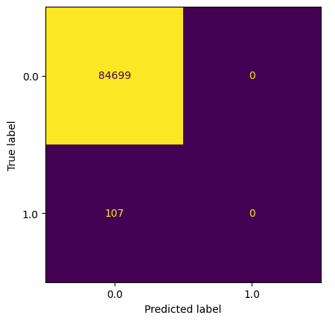
RESULTS TEST SET

Slide 20
SMOTE OVERSAMPLING (OF TRAIN DATASET ONLY)
K = 5
NOT FRAUD 199615
FRAUD 199615 ( 199230 SYNTHETIC )

Slide 21

RESULTS SMOTE TEST SET

Slide 22
NO SMOTE
SMOTE

Slide 23
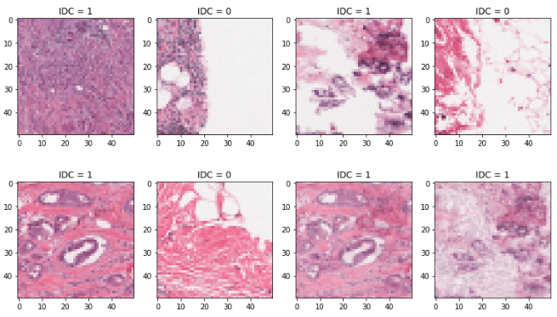
OTHER APPLICATIONS
Imbalanced Histopathological Breast Cancer Image Classification with Convolutional Neural Network

Slide 24
WHEN SMOTE DOESN'T WORK
HIGH-DIMENSIONAL DATA
https://bmcbioinformatics.biomedcentral.com/articles/10.1186/1471-2105-14-106

Slide 25
THEORETICAL PROPERTIES OF SMOTE FOT HIGH-DIMENSIONAL DATA
SMOTE does not change the expected value of the (SMOTE-augmented) minority class and it decreases it's variability

Slide 26
THEORETICAL PROPERTIES OF SMOTE FOT HIGH-DIMENSIONAL DATA
SMOTE introduces correlation between some samples, but not between variables

Slide 27
THEORETICAL PROPERTIES OF SMOTE FOT HIGH-DIMENSIONAL DATA
SMOTE modifies the Euclidean distance between test samples and the (SMOTE-augmented) minority class

Slide 28
SMOTE has hardly any effect on most classifiers trained on high-dimensional data;
Undersampling or, for some classifiers, cut-off adjustment are preferable to SMOTE for high-dimensional class-prediction tasks.

Slide 29
SOME SMOTE VARIANTS

Slide 30
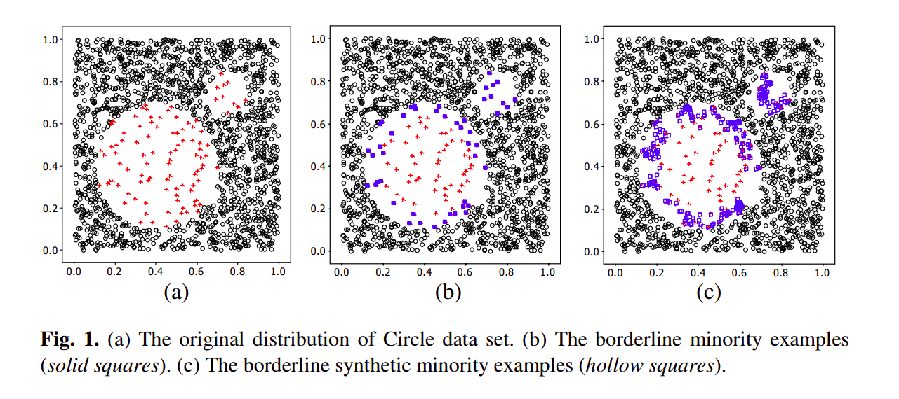
BORDERLINE-SMOTE
https://sci2s.ugr.es/keel/keel-dataset/pdfs/2005-Han-LNCS.pdf

Slide 31
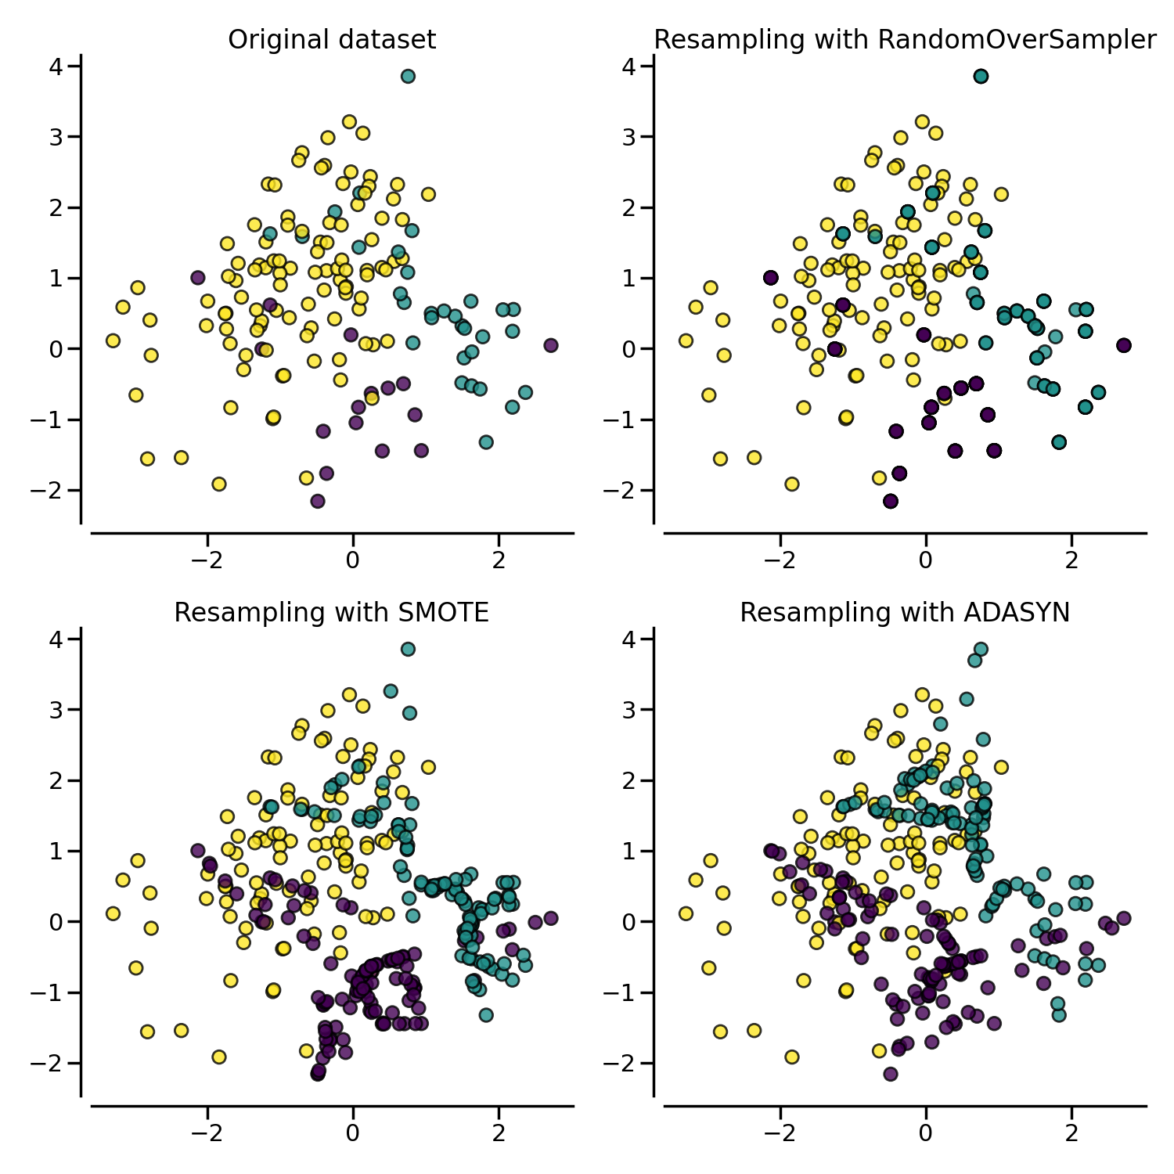
ADASYN
https://imbalanced-learn.org/stable/auto_examples/over-sampling/plot_comparison_over_sampling.html#sphx-glr-auto-examples-over-sampling-plot-comparison-over-sampling-py

Slide 32
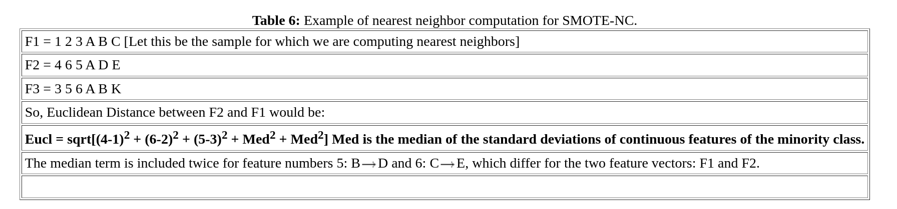
SMOTE-NC
https://www.cs.cmu.edu/afs/cs/project/jair/pub/volume16/chawla02a-html/node15.html

