Slide 1


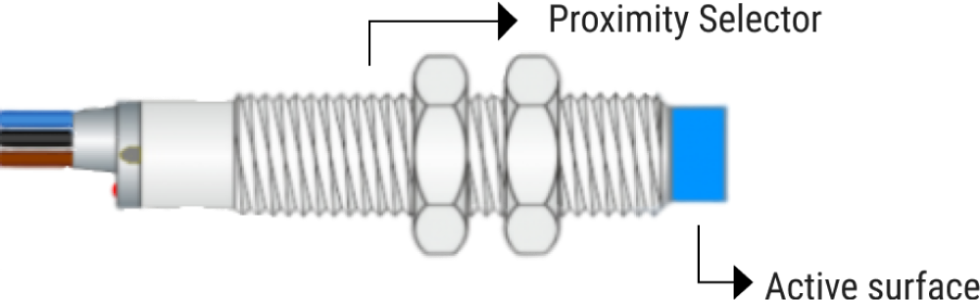
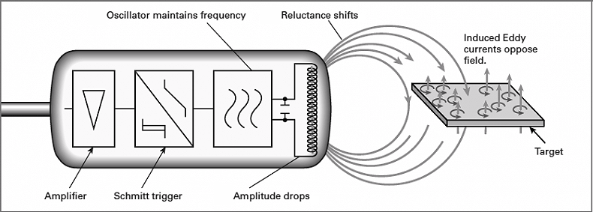
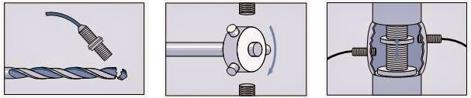
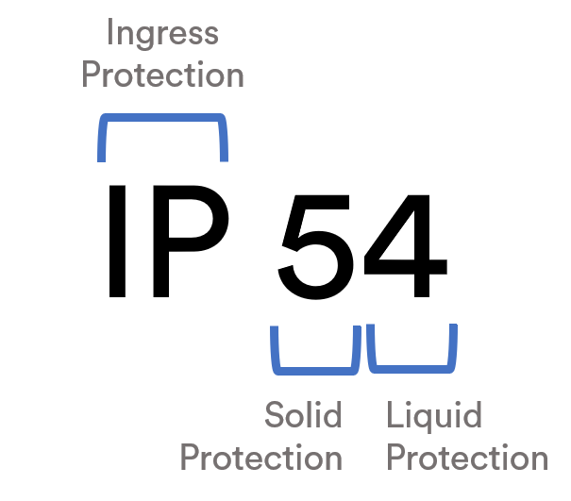



Inductive Sensor
What is an Inductive sensor?
An Inductive sensor is to measure position. They use a contactless principle which gives them longer life and makes them highly reliable because they don’t get worned out.
Working Principle
Inductive sensors use currents induced by magnetic fields to detect nearby metal objects. The inductive sensor uses a coil to generate a high frequency magnetic field. If there is a metal object near the changing magnetic field, current will flow in the object.
Applications
These sensors have industries, military, robotics, rail, aerospace applications:
- Position Detection on a Mechanical Moving Part;
- Gear Tooth Detection for Motion Monitoring;
- Valve Position Control during Processing.
This sensors are also used in the most hostile places do to it's durable and hard metallic construction.
Protection Class
In Inductive sensors have all types of protection classes, from IP50 to IP69K.
Dust-tight, water and water jets are the main protection this sensors have.
The Inductive Family
There are 3 main branches of inductive sensors:
- High frequency oscilation type (electro magnectic induction);
- Magnetic type (magnet);
- Capacitance type (change in capacitance).

