Slide 1



BASTA 2024-WORKSHOP

Slide 2
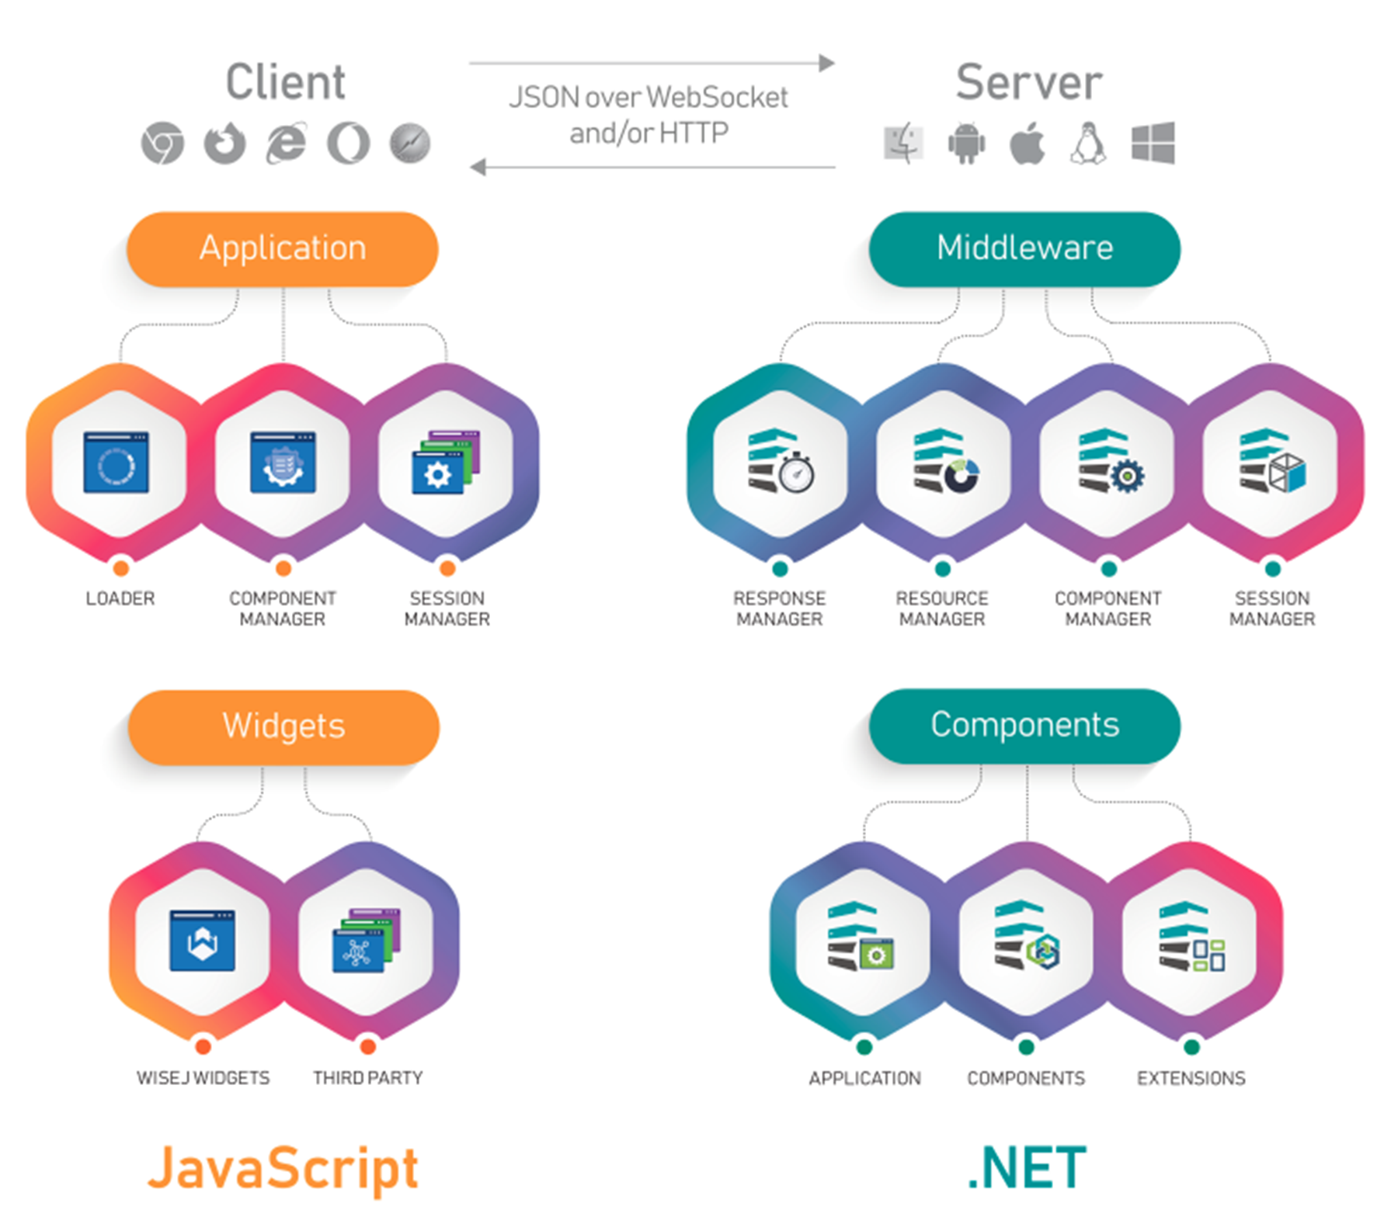

Architecture
WWW.ICETEAGROUP.COM

Slide 3
control Set
Containers
Content
Actions
Data
Extensions

Slide 4
DESIGNER TOUR
Use the Toolbar
Tame the Toolbox
Snaplines, Anchors
Auto layouts
Document Outline
Design Mode trap

Slide 5
WEBSOCKET ANALYSIS
Messages
Compression
Pushing
Polling Fallback

Slide 6
SIMPLE DATA BINDING vs BLAZOR

Slide 7
DEBUGGER and HOT RELOAD

Slide 8
WINFORMS MIGRATION
Reuse WinForms UI
Reuse Data Sources
Reuse Code-Behind
Remove WinForms
Convert Statics to Session
Better UI, Same Binding

Slide 9
WPF MIGRATION
Replace XAML UI
Reuse ViewModel
Reuse Commands
Remove PresentationCore
Convert Statics to Session
Better UI, Simpler Binding

Slide 10
ADVANCED TOPICS
Background Tasks
Dynamic Controls
File System Integration
Reports PDF Generation
Third Party Controls
Theming

