Slide 1
First hitting time on circulant graphs
Luca Previdi

Slide 2
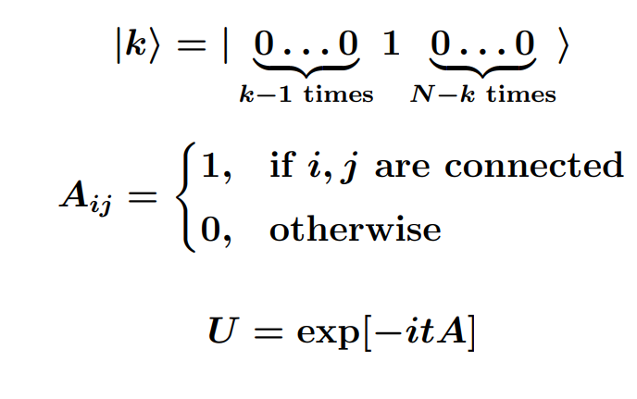
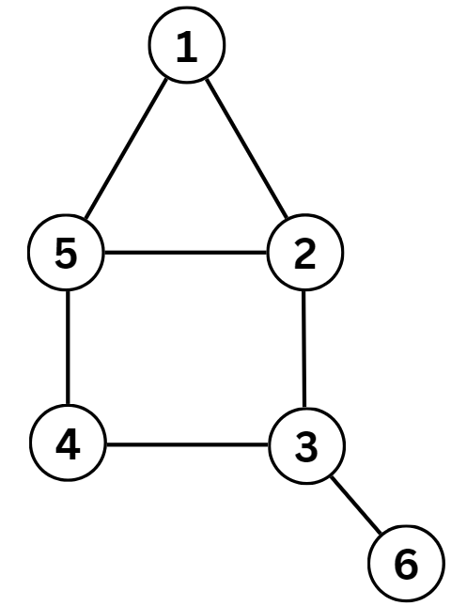
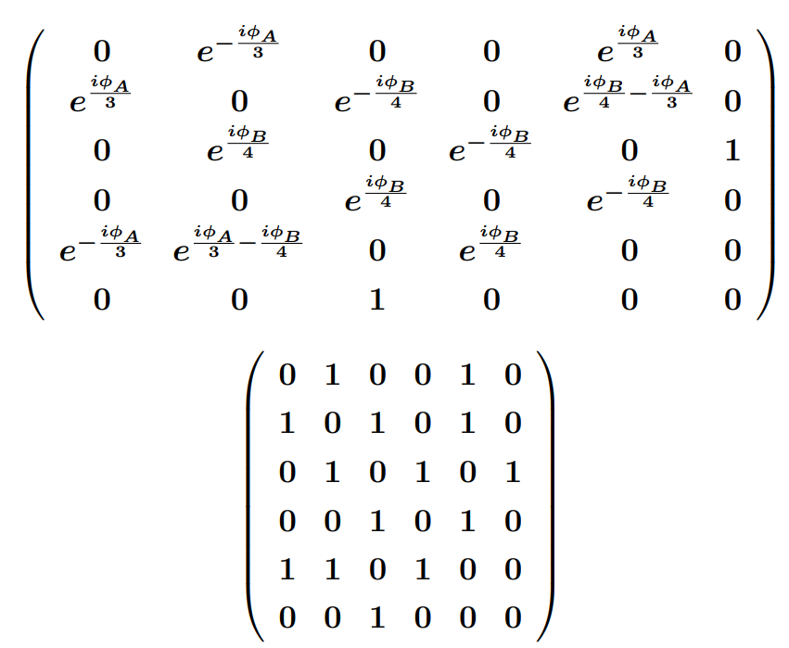
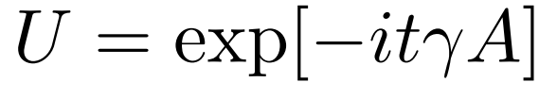
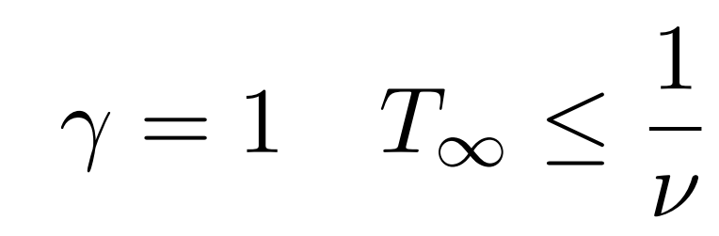
Continuous Time Quantum Walks[1]
The dynamics of a walker is governed by the adjacency matrix
In principle one should consider:
But in this work:
[1] Mülken, O., & Blumen, A. (2011). Continuous-time quantum walks: Models for coherent transport on complex networks. Physics Reports, 502(2-3), 37-87.

Slide 3
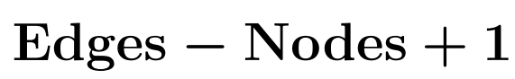
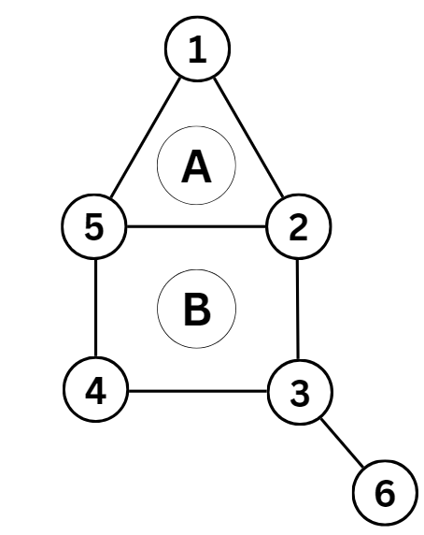
Chirality[2]
The adjacency matrix is not the more general hamiltonian!
Complex Hamiltonians
Gauge symmetry
Only physical phases
Equivalent to Ahronov-Bohm phase!
[2] Frigerio, M. (2022). Perspectives and applications of chiral quantum walks. IL NUOVO CIMENTO, 100(72), 45.

Slide 4
First Hitting Time Classical vs Quantum
Classical first hitting time
First time a walker reaches a given node
Random variable if the process is stochastic
Quantum first hitting time
How do we keep track of where a quantum walker has been????
Hitting time is ill defined

Slide 5
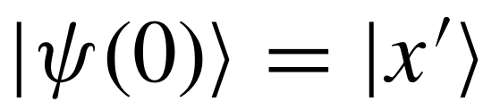
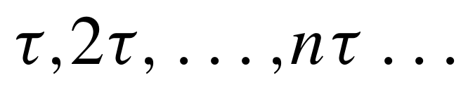
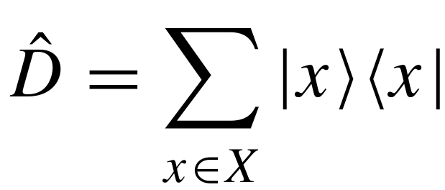
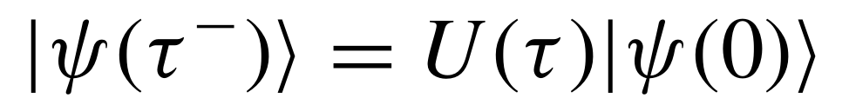
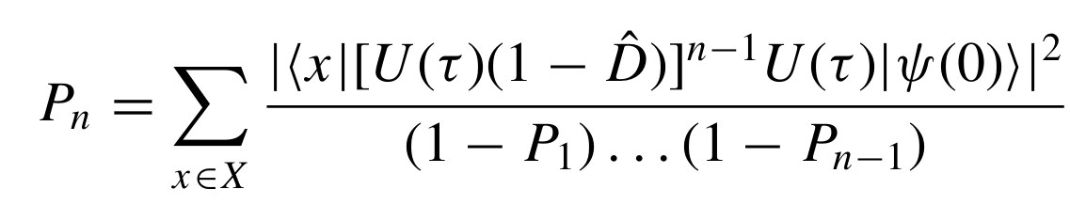
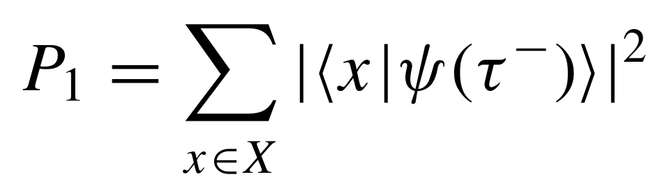
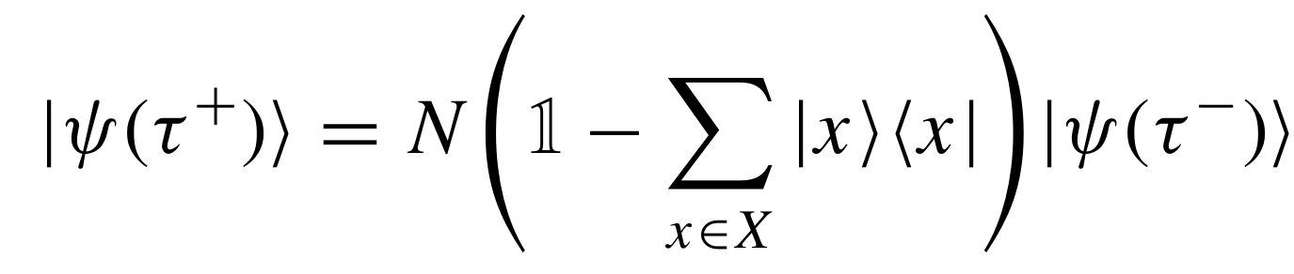
First Hitting Time Protocol[3]
Starting with a localized walker:
Measure stroboscopically on a set of sites with a fixed frequency
Probability of detecting the walker at step n given that it has not been detected previously
[3] Friedman, H., Kessler, D. A., & Barkai, E. (2017). Quantum walks: The first detected passage time problem. Physical Review E, 95(3), 032141.

Slide 6
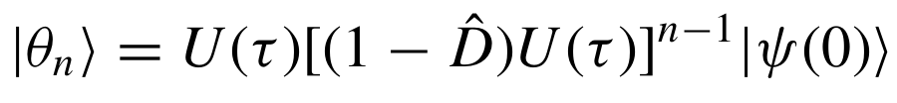
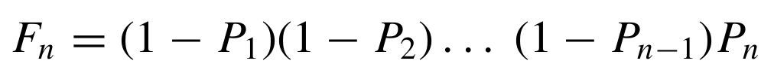
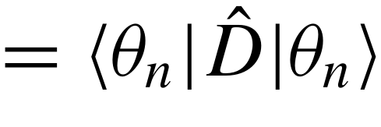
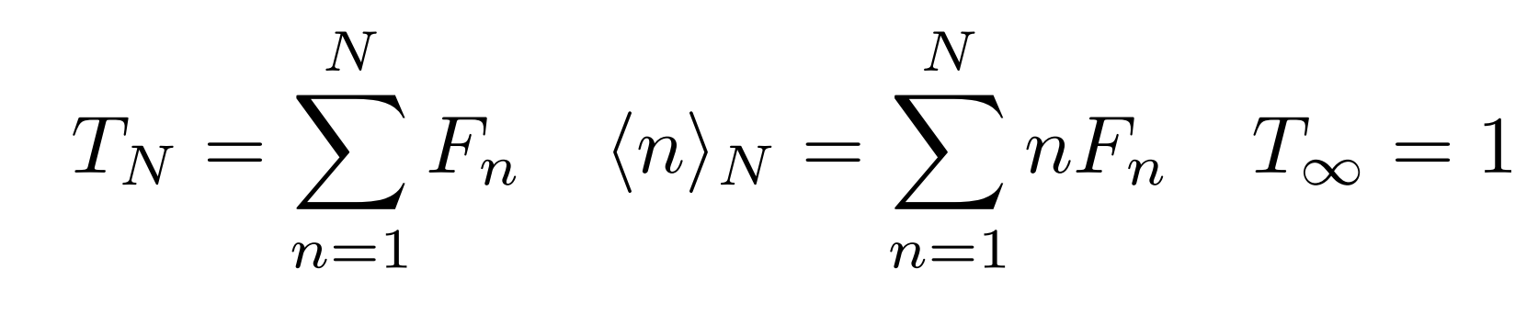
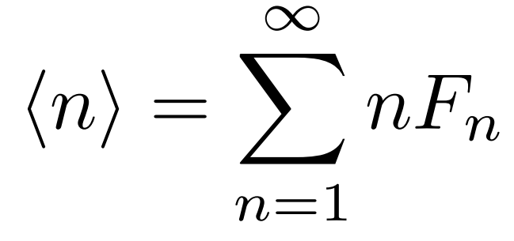
Observables
First detection probability
Total detection probability
if
Mean first hitting time

Slide 7
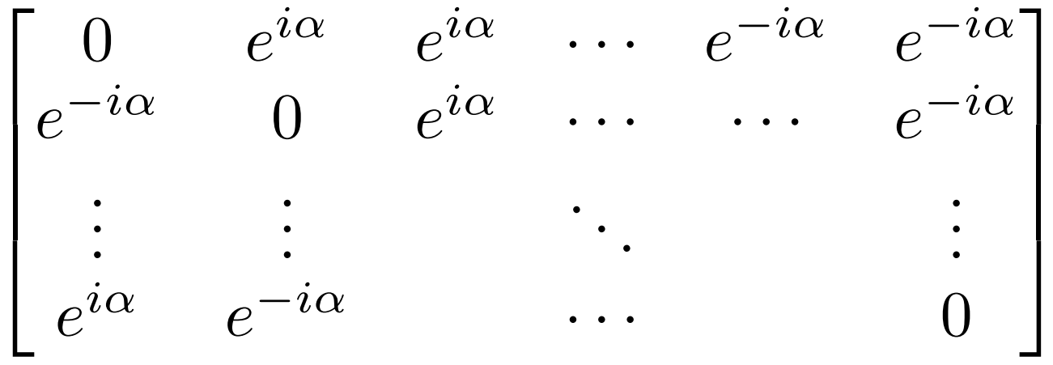
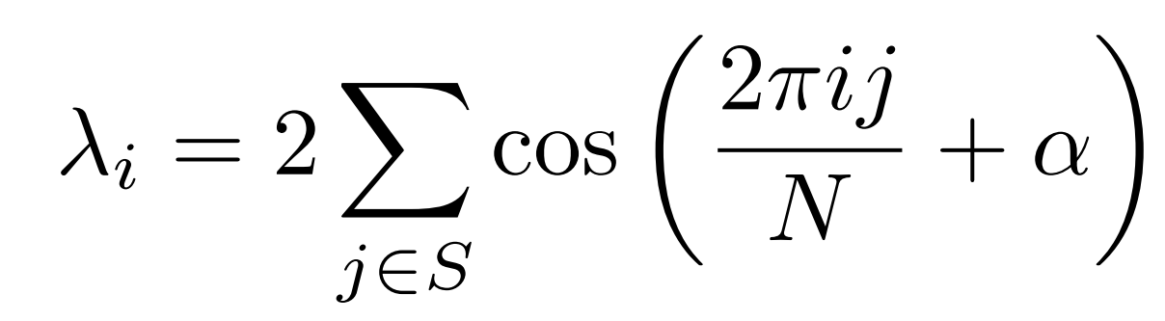
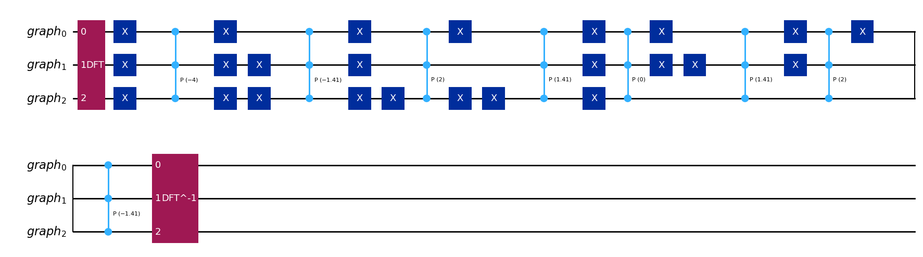
Efficient Implementation of Circulant Graphs[4]
Circulant matrices are diagonalized by DFT [5]
We can efficiently simulate diagonal hamiltonians! [6]
[4] Qiang, Xiaogang, et al. "Efficient quantum walk on a quantum processor." Nature communications 7.1 (2016): 11511.
[5] Bamieh, B. (2018). Discovering transforms: A tutorial on circulant matrices, circular convolution, and the discrete Fourier transform. arXiv preprint arXiv:1805.05533.
[6] Childs, A. M. (2004). Quantum information processing in continuous time (Doctoral dissertation, MIT).

Slide 8
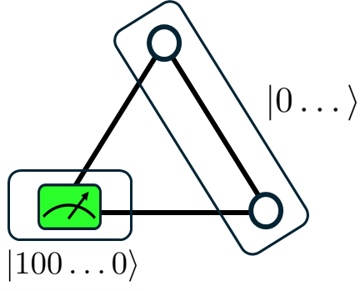
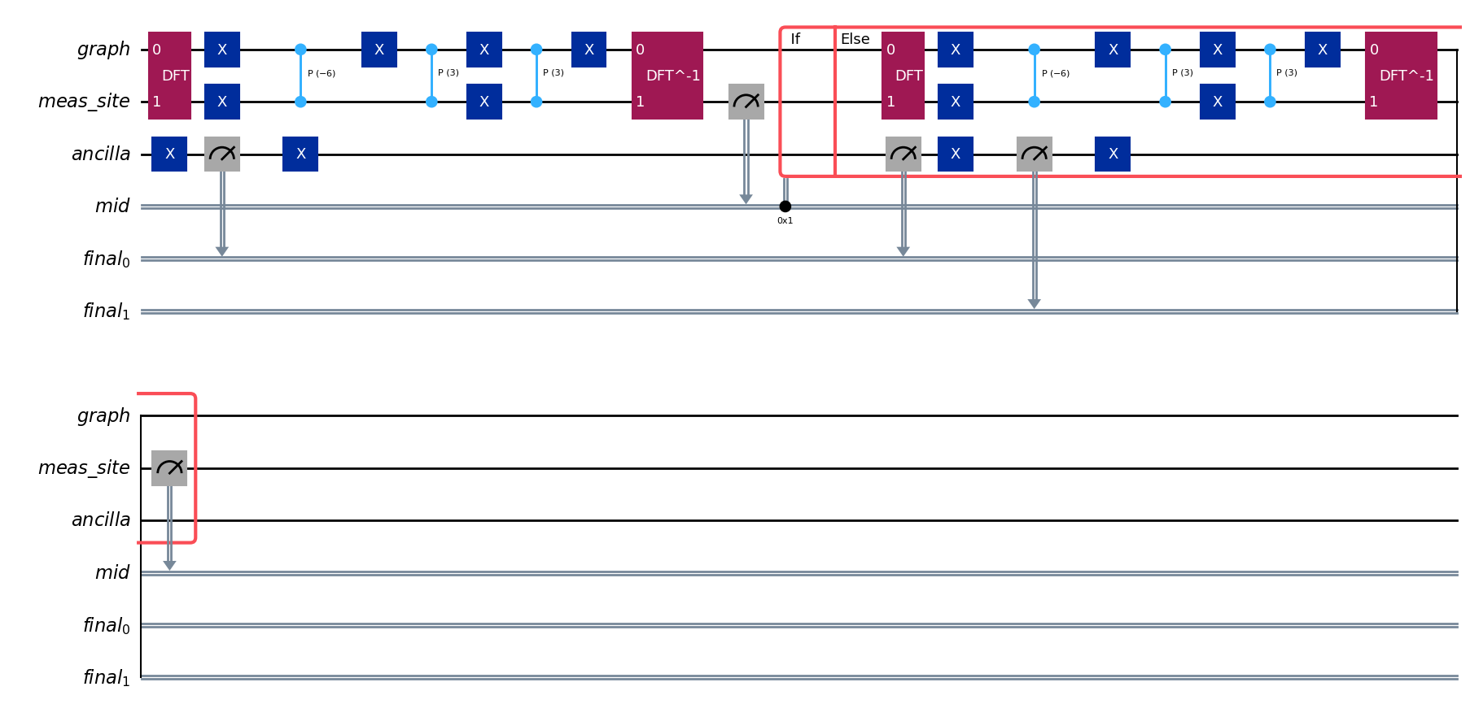
Conditional Quantum Circuits
Split the Hilbert space in 2 in order to measure a site without disturbing the rest
Write on a classical register the number of runs
Check if the walker has been detected

Slide 9
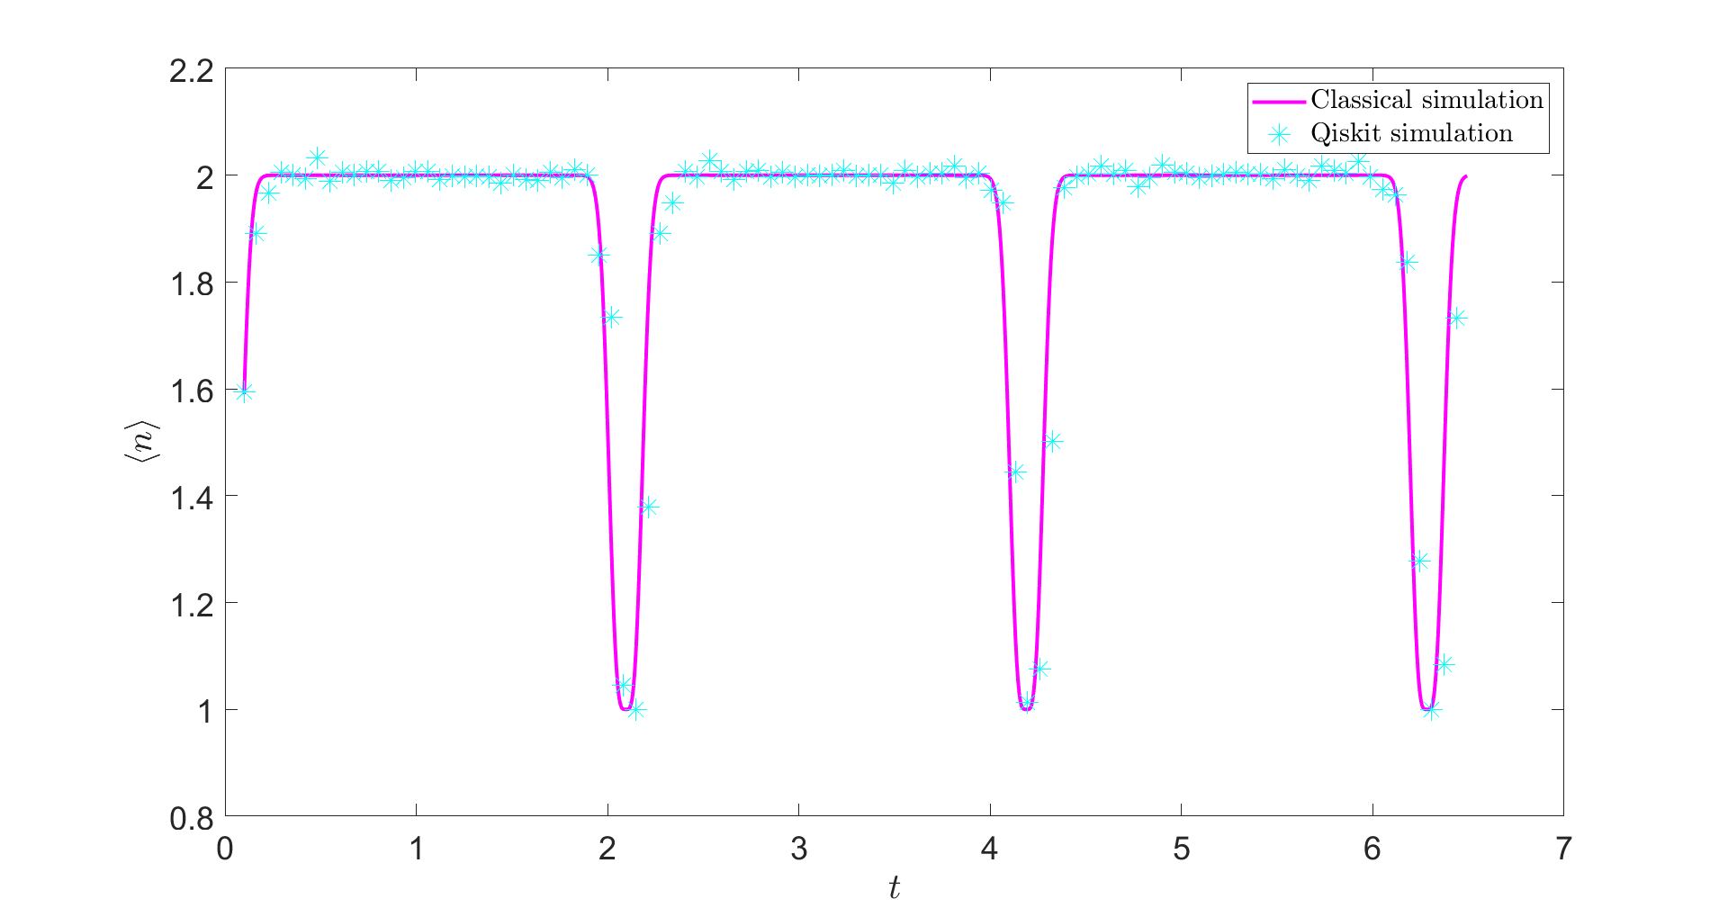
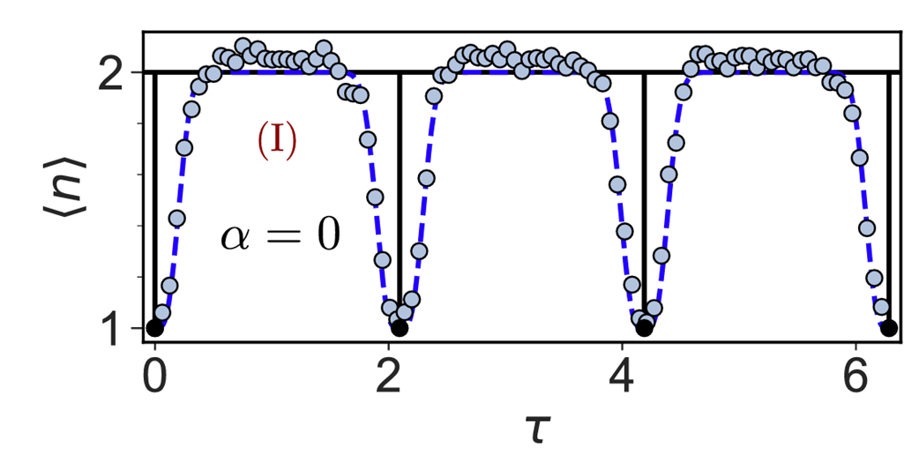
Return Time
Detection site equal to initial site
Sanity check
Resonant frequencies
[7] Wang, Qingyuan, et al. "First Hitting Times on a Quantum Computer: Topological Effects and Dark States." arXiv preprint arXiv:2402.15843 (2024).

Slide 10
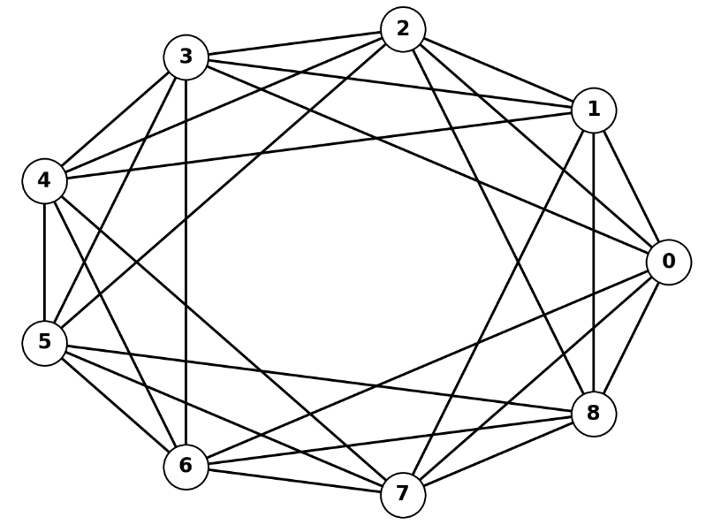
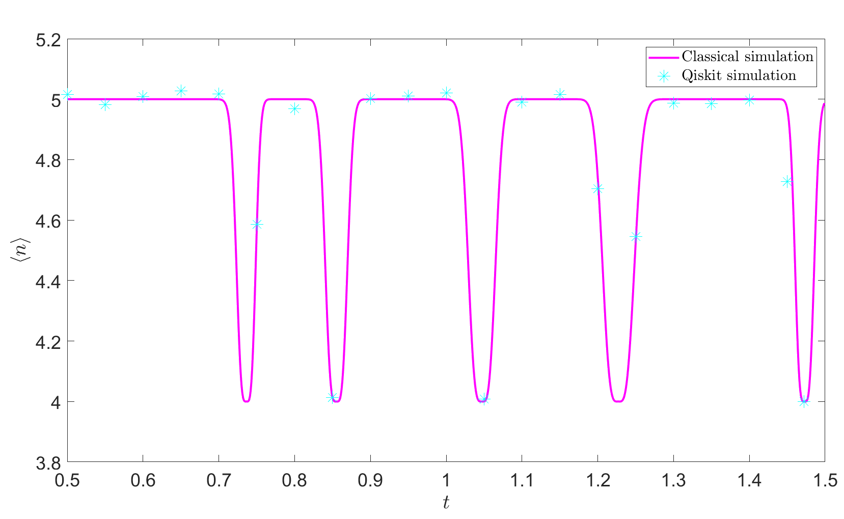
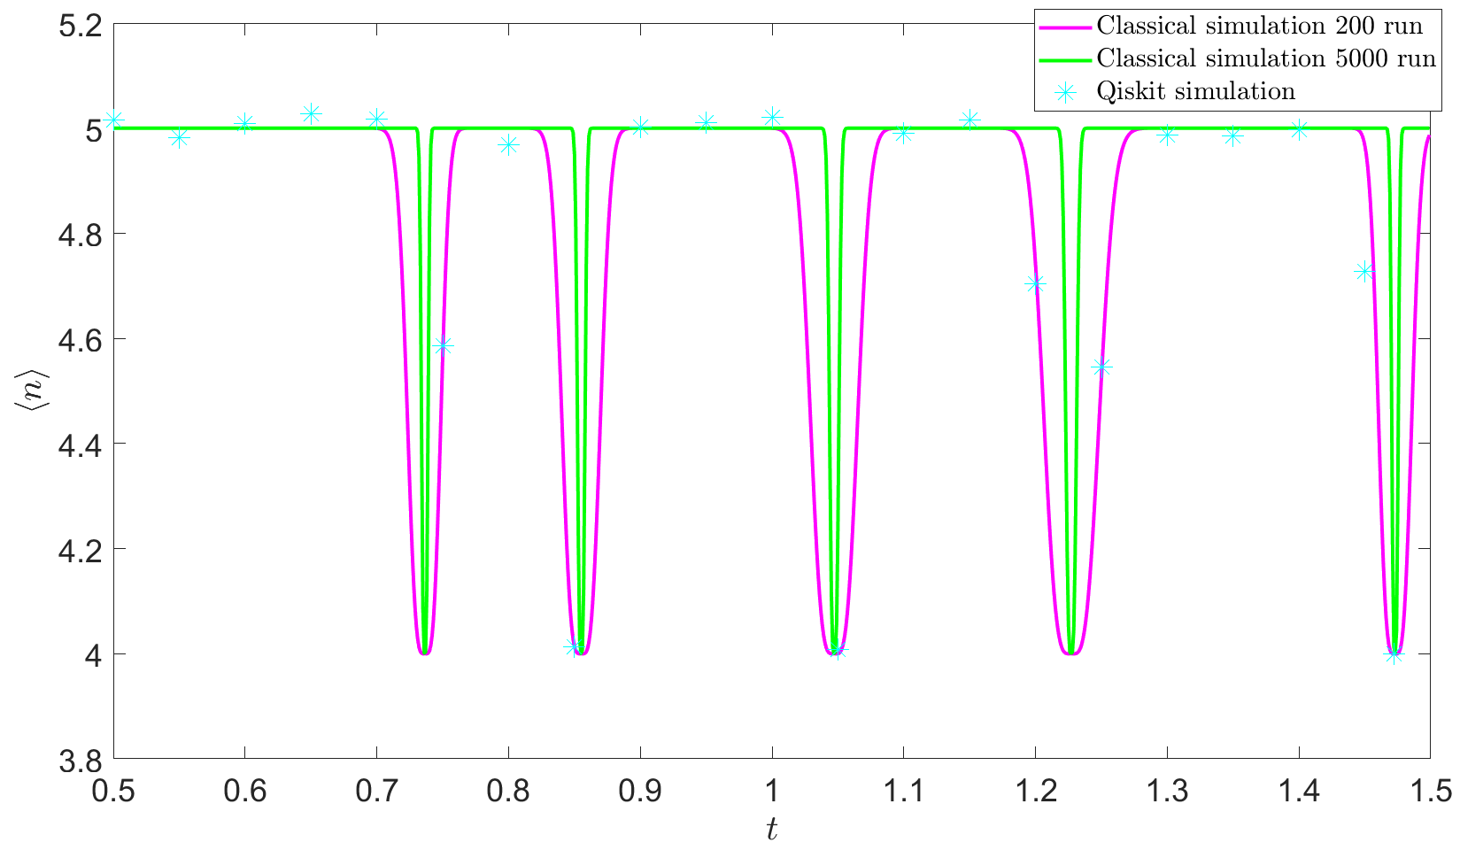

Return Time
0

Slide 11
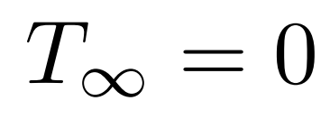
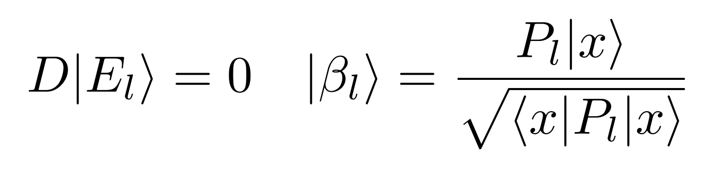
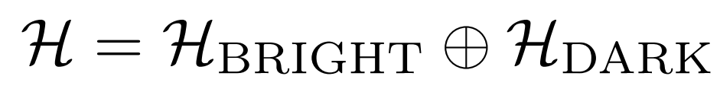
Dark States[8]
Dark State
States which cannot be detected
Invariant under both unitary evolution and detection protocol
Completely dark energy levels
Degenerate energy levels
Each state orthogonal in the eigenspace will be dark
Bright State
[8] Thiel, Felix, et al. "Dark states of quantum search cause imperfect detection." Physical Review Research 2.4 (2020): 043107.

Slide 12
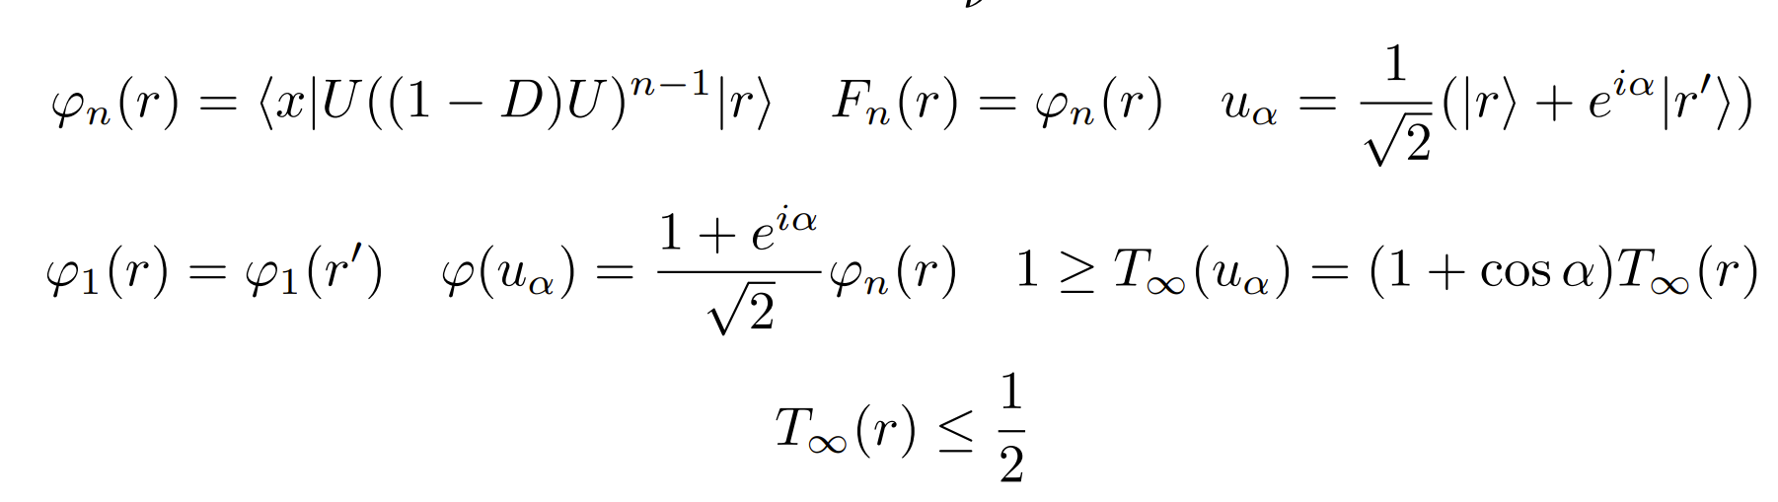
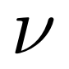
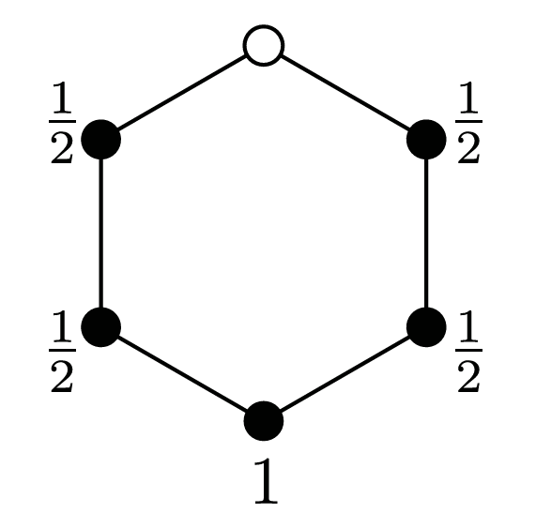
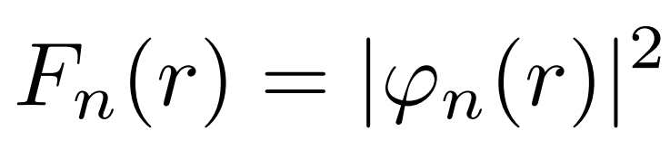
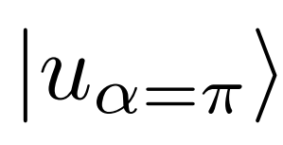
Simmetry Bound
Initial state localized on a node
Number of nodes equivalent to the initial one (wrt the measurement site)
First detection amplitude
is a dark state

Slide 13
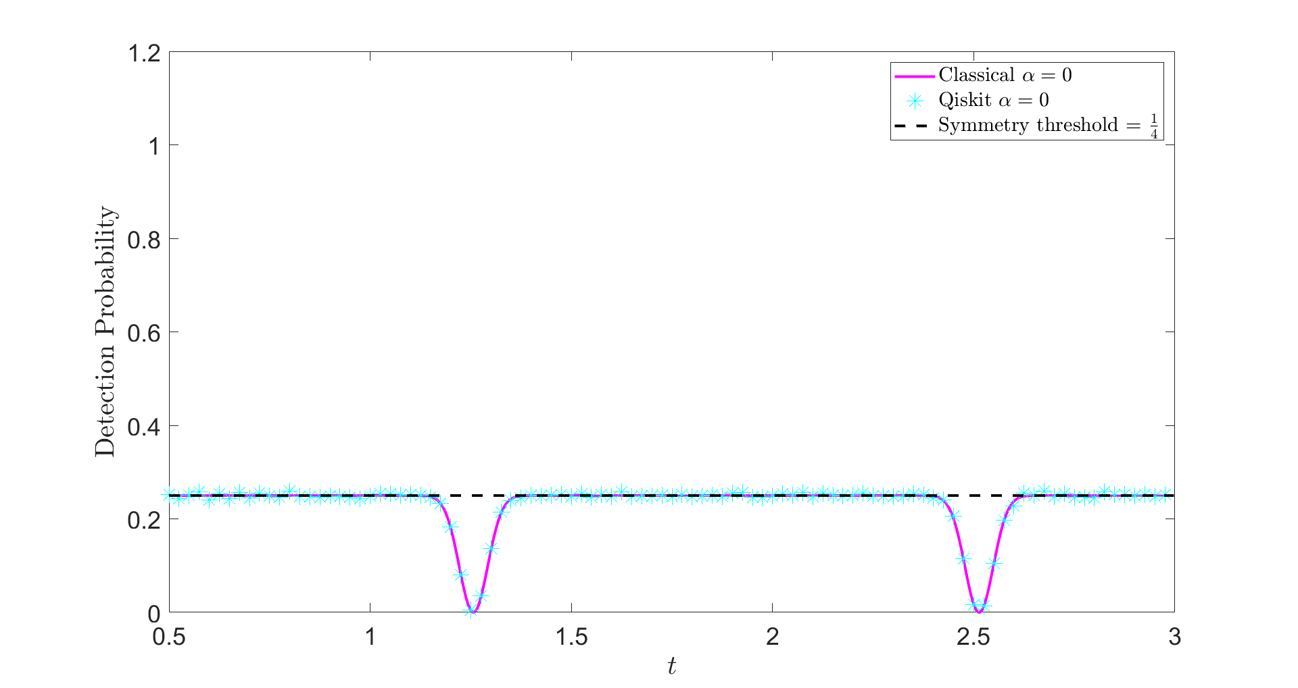
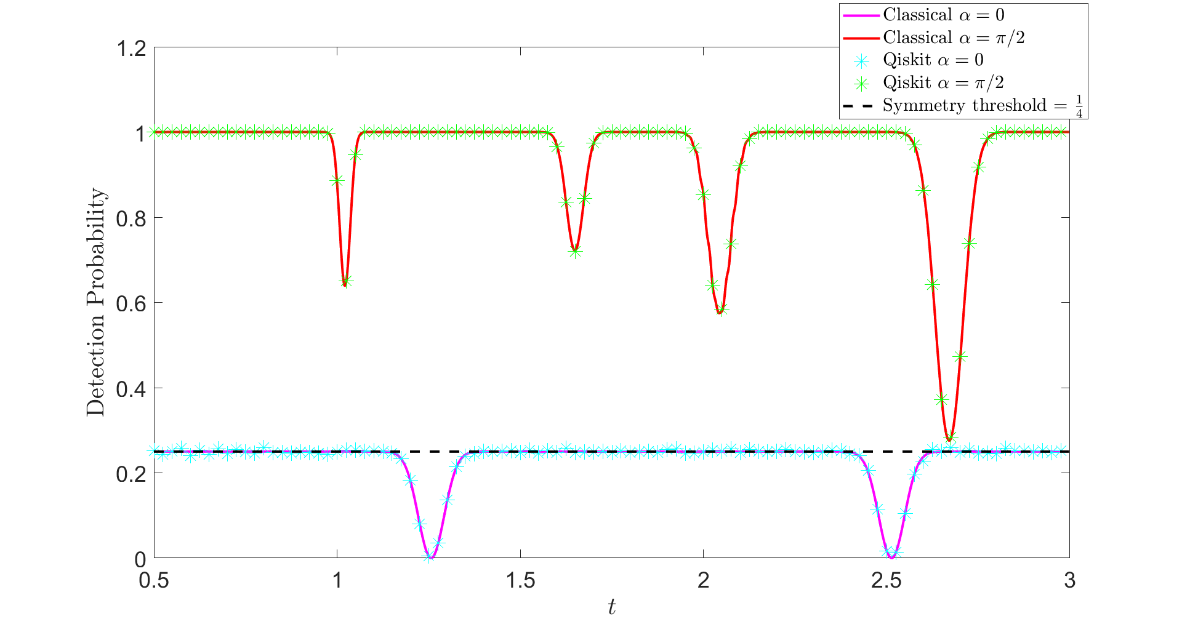
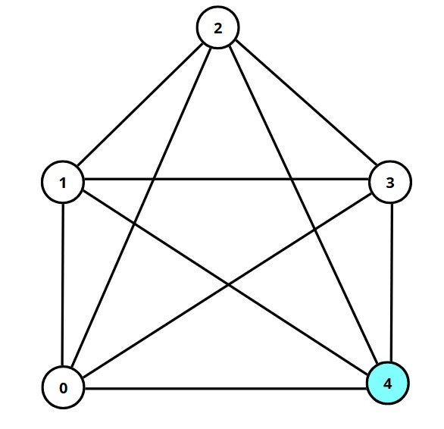
Dark States with a Magnetic Field
Chiral phase removes the degeneracy

Slide 14
Parrondo’s paradox
Game A: you lose 1€ every time you play
Game B: depending on your capital: if it is an even number you win 3€, otherwise you lose 5€
If you start with 100€
Game A
Game B
Losing Game
Losing Game
But, if we mix the 2 strategies:
BABABABA...
ABABABAB...
Winning Game
Losing Game

Slide 15
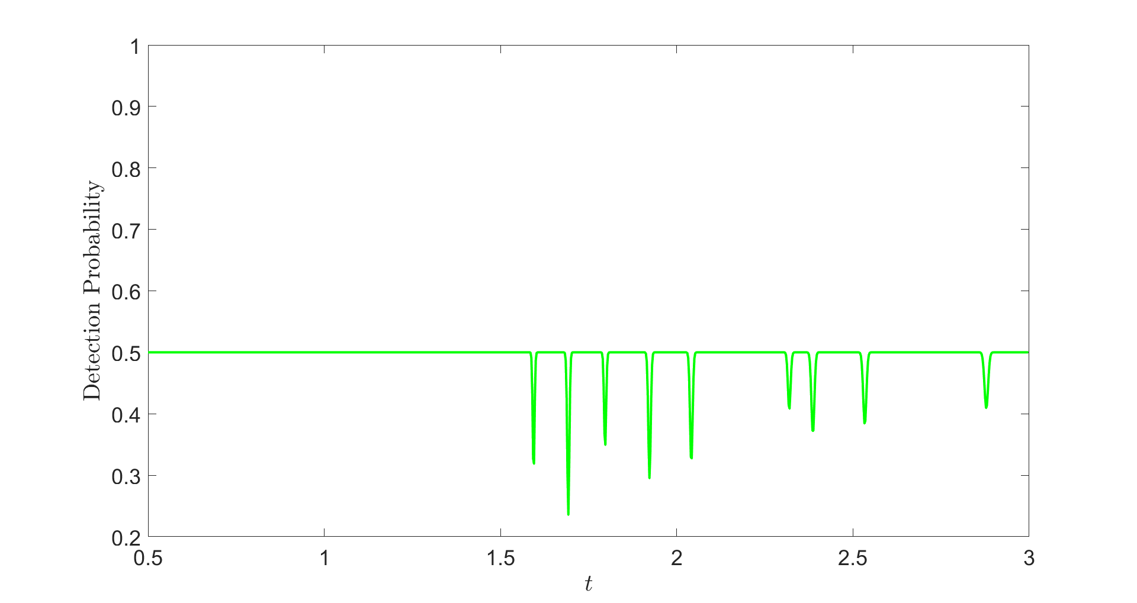
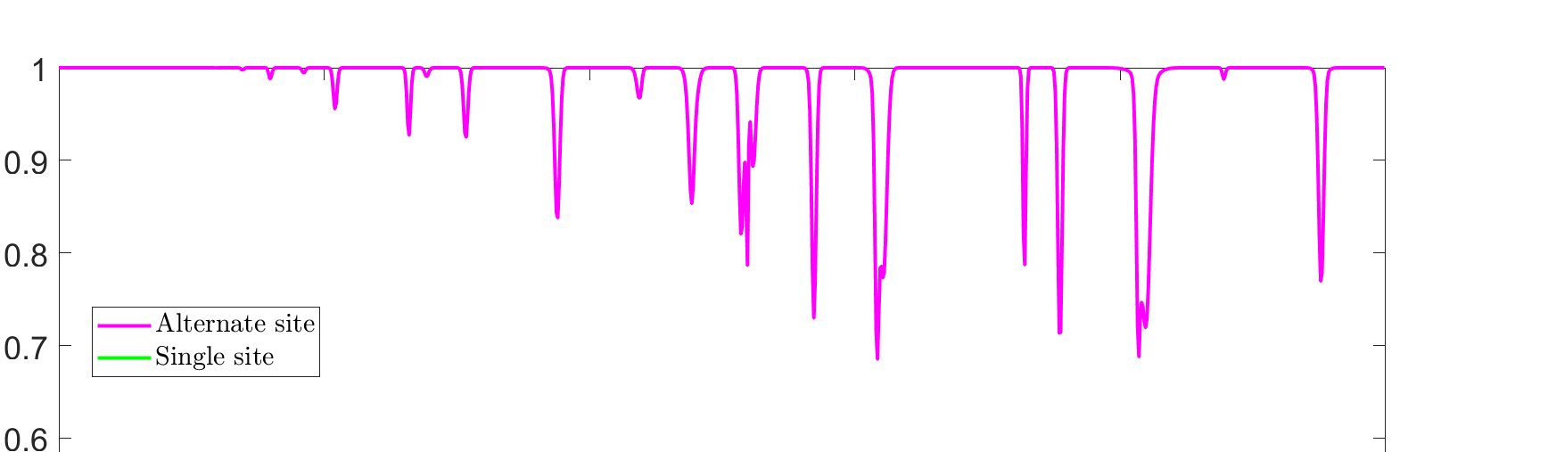
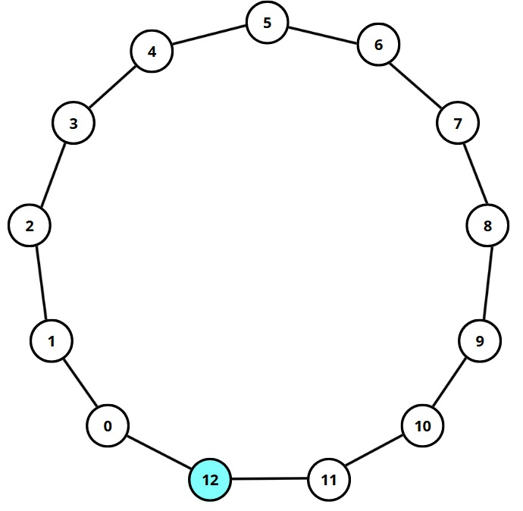
Mixed Local Strategies
Alternate sequence of measurements: 01010101010…..
No more bounded by the symmetry!

Slide 16
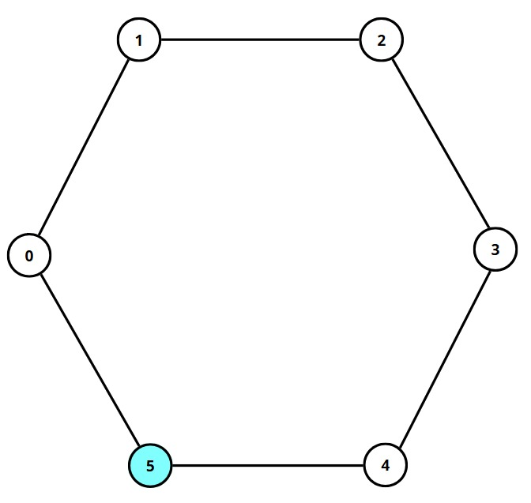
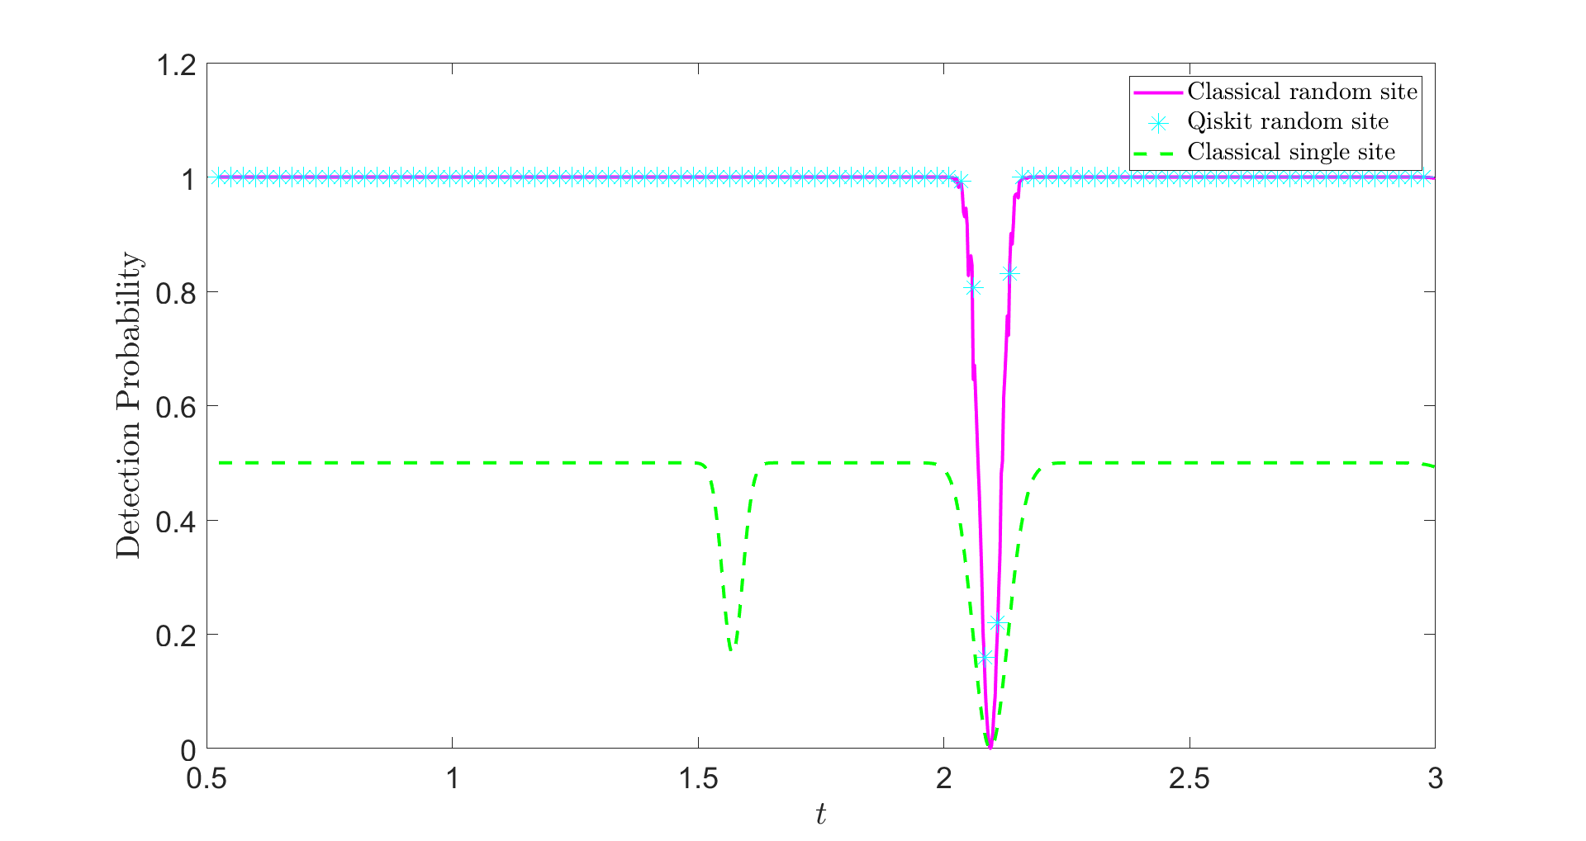
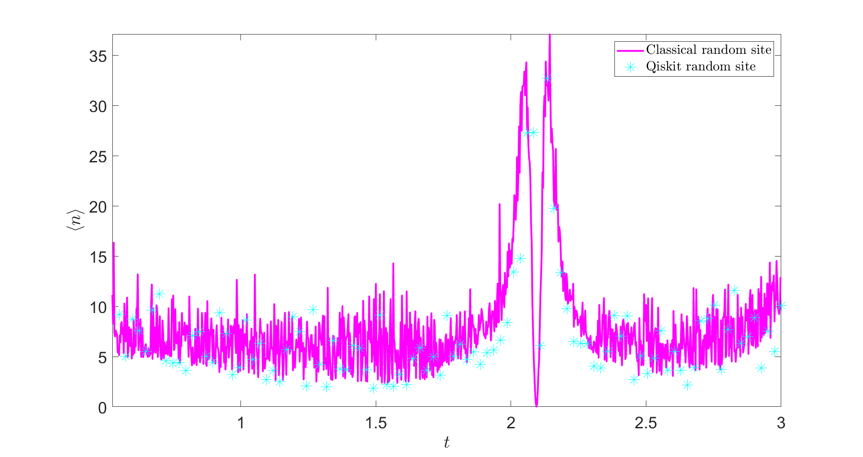
Mixed Local Strategies
Choose randomly the detection site between 0 and 1 each with probability 1/2

Slide 17
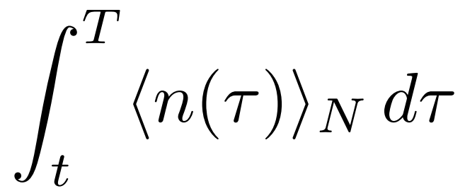
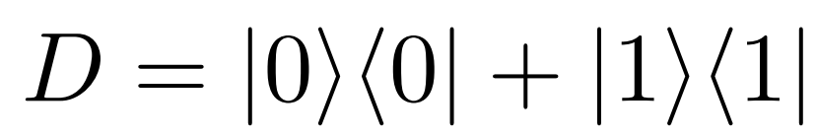
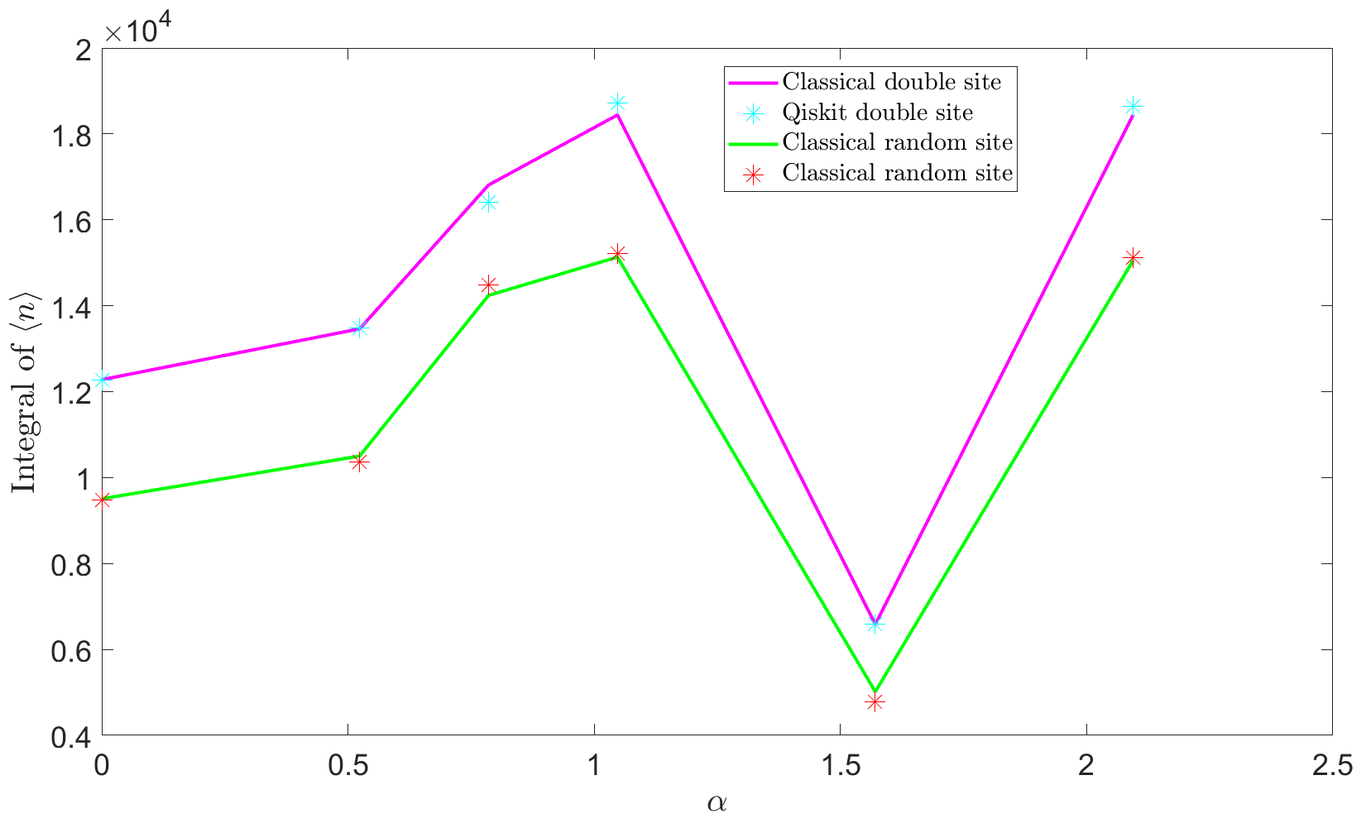
Local vs non-local
Compare with a non-local strategy which measure on 0 and 1 at the same time
Figure of merit
Local is better!
Indeed after a failed attempt in the non-local strategy the state collapses in the subspace orthogonal to the detection operator

Slide 18
Conclusions
We introduced a way to efficiently implement and simulate on a quantum computer a protocol for the first hitting time on circulant graphs
We showed that mixed local strategies can break limits imposed by the symmetries of the system
Parrondo’s Paradox
We proved that mixing local strategies can be better than using a non local one in terms of hitting time
Thanks for listening

Slide 19
Main References
[1] Mülken, O., & Blumen, A. (2011). Continuous-time quantum walks: Models for coherent transport on complex networks. Physics Reports, 502(2-3), 37-87.
[2] Frigerio, M. (2022). Perspectives and applications of chiral quantum walks. IL NUOVO CIMENTO, 100(72), 45.
[3] Friedman, H., Kessler, D. A., & Barkai, E. (2017). Quantum walks: The first detected passage time problem. Physical Review E, 95(3), 032141.
[4] Qiang, Xiaogang, et al. "Efficient quantum walk on a quantum processor." Nature communications 7.1 (2016): 11511.
[5] Bamieh, B. (2018). Discovering transforms: A tutorial on circulant matrices, circular convolution, and the discrete Fourier transform. arXiv preprint arXiv:1805.05533.
[6] Childs, A. M. (2004). Quantum information processing in continuous time (Doctoral dissertation, MIT).
[7] Wang, Qingyuan, et al. "First Hitting Times on a Quantum Computer: Topological Effects and Dark States." arXiv preprint arXiv:2402.15843 (2024).
[8] Thiel, Felix, et al. "Dark states of quantum search cause imperfect detection." Physical Review Research 2.4 (2020): 043107.

