Slide 1
Quantum Natural Gradient Descent
Luca Previdi

Slide 2
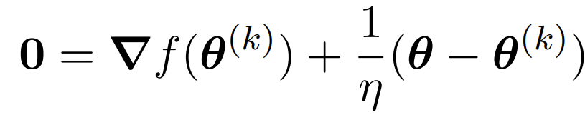
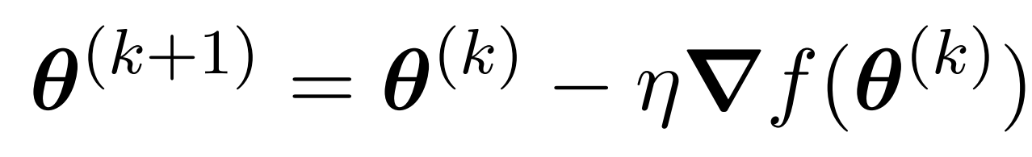
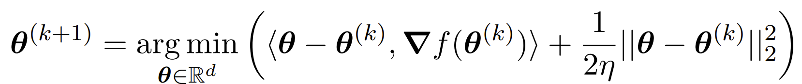
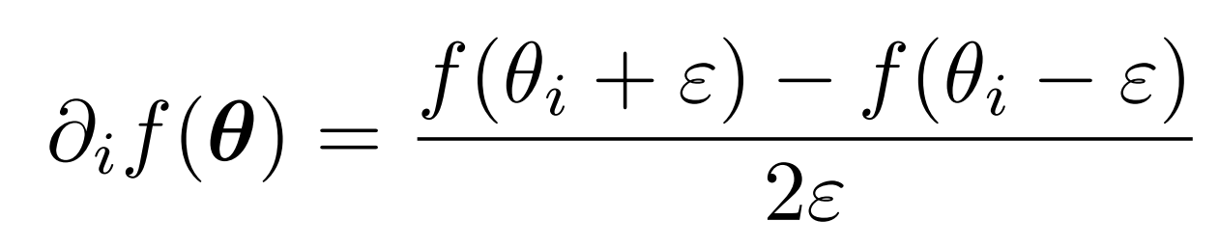
Vanilla GD[1]
GOAL
Minimize a function over a set of parameters
VGD step
Perform derivatives
Assume to have a quantum circuit which evaluates
Evaluate the gradient through the shift rule
[1] Kerenidis, Iordanis, and Anupam Prakash. "Quantum gradient descent for linear systems and least squares." Physical Review A 101.2 (2020): 022316.

Slide 3
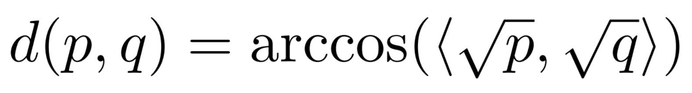
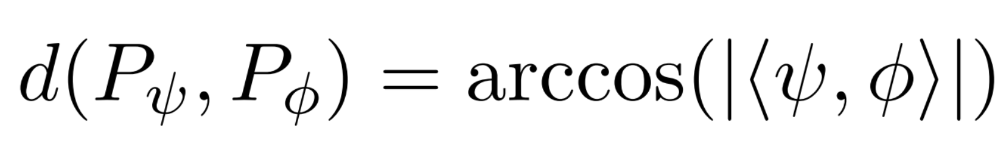
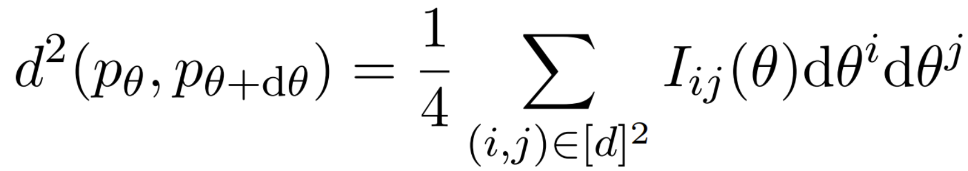
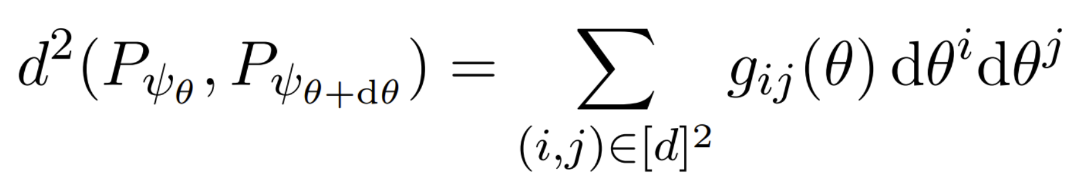
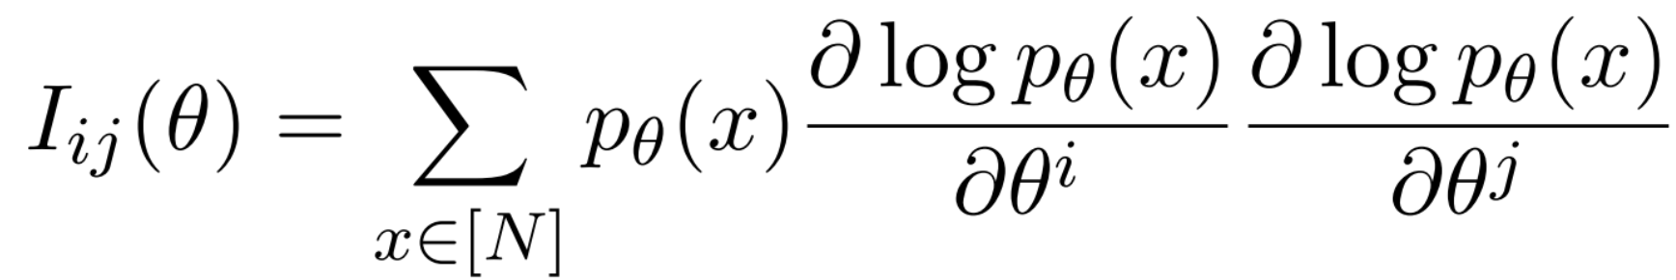
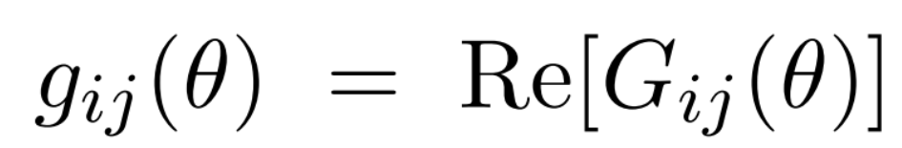
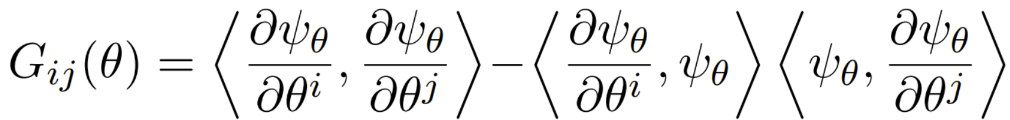
Quantum Information Geometry[2]
Distance between probabilities
Distance between pure states
Fisher Information Matrix
Quantum Geometric Tensor
[2] Helstrom, Carl W. "Minimum mean-squared error of estimates in quantum statistics." Physics letters A 25.2 (1967): 101-102.

Slide 4
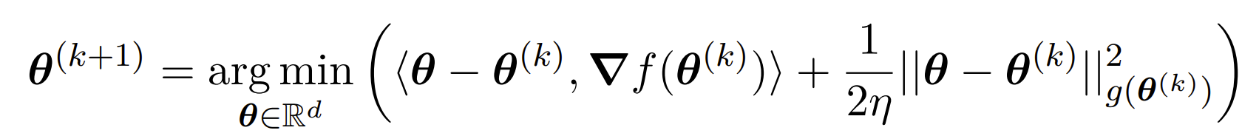
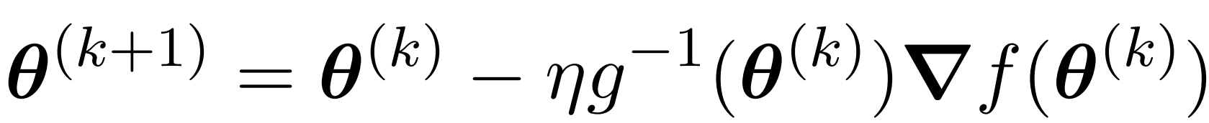
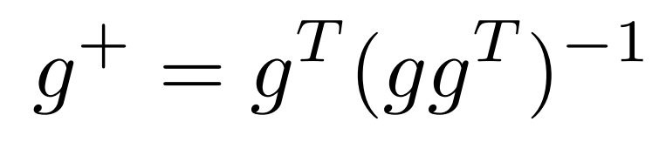
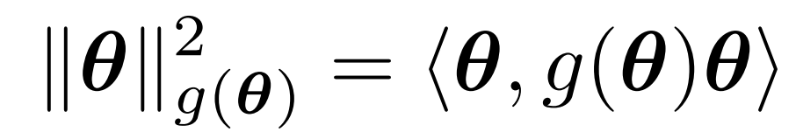
Quantum Natural Gradient[3]
QNG step
Natural norm
Pseudoinverse
[3] Stokes, James, et al. "Quantum natural gradient." Quantum 4 (2020): 269.

Slide 5


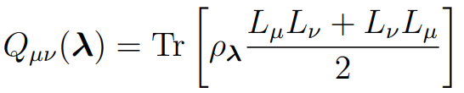
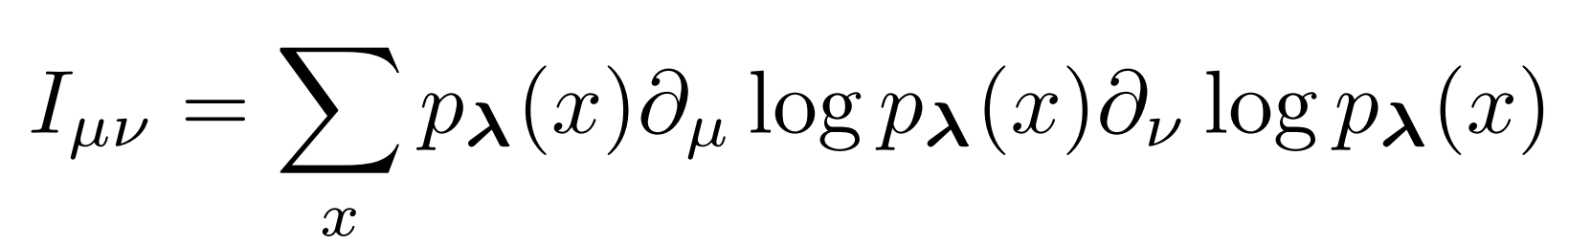
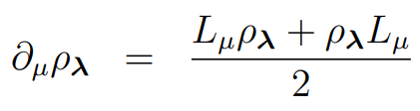
Quantum Fisher Information Matrix[4]
Set of quantum states labelled by continuos parameters
Born rule
Quantum Fisher Information Matrix
Fisher Information Matrix
Quantum Cramer-Rao Bound
[4] Albarelli, Francesco, et al. "A perspective on multiparameter quantum metrology: From theoretical tools to applications in quantum imaging." Physics Letters A 384.12 (2020): 126311.

Slide 6

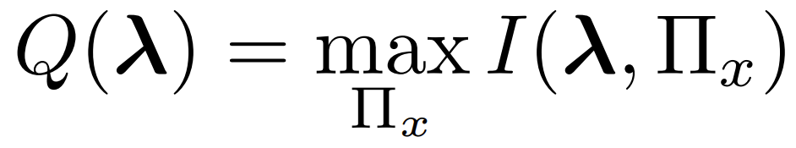
Quantum Fisher Information Matrix
? ? ?
BUT
iff

Slide 7
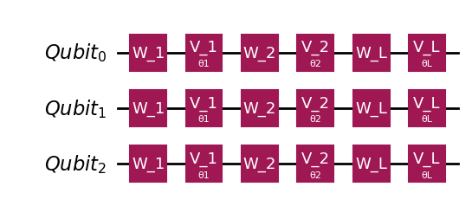
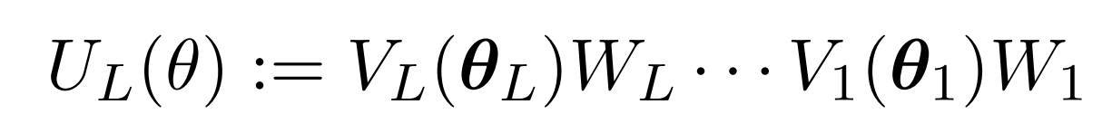
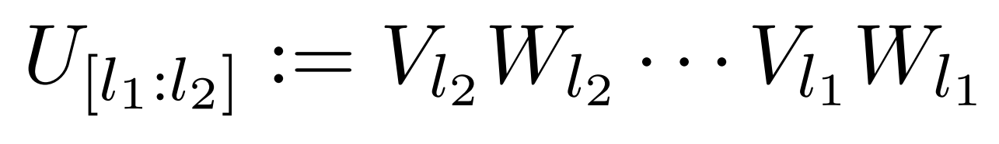
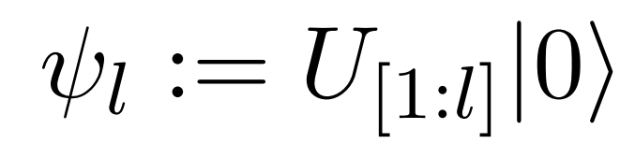
Approximate QFIM Evaluation
Parametric gate
Non-parametric gate
Total evolution
Layers evolution
State after the l-th layer

Slide 8
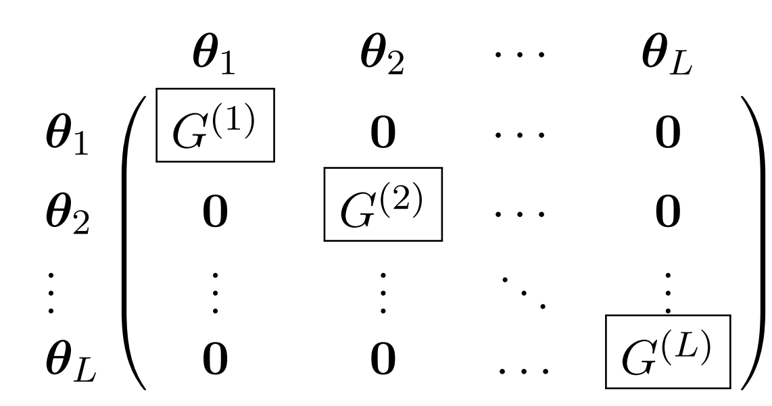
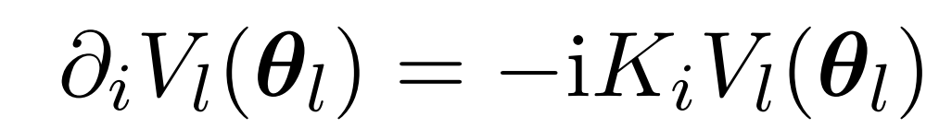
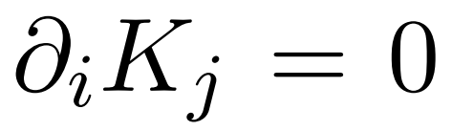
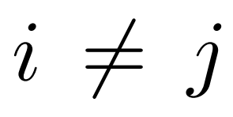
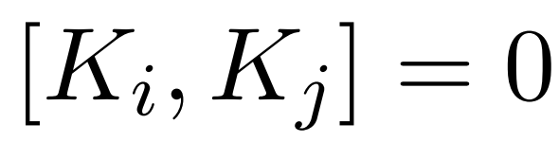
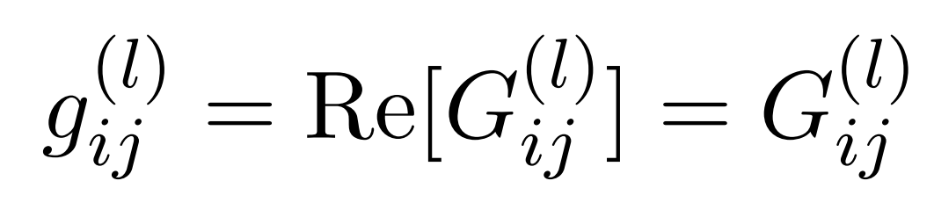
Approximate QFIM Evaluation
Block diagonal approximation
Ignore correlations between different layers
Generators
Commuting generators

Slide 9
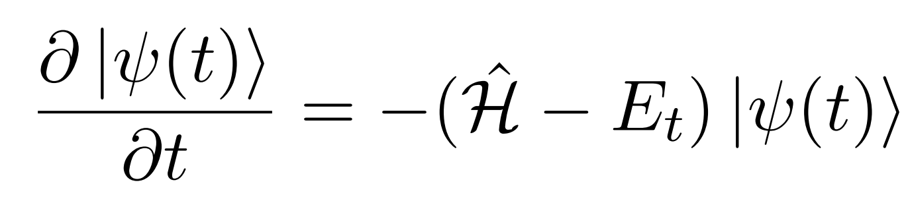
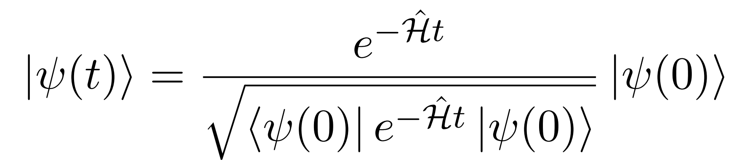
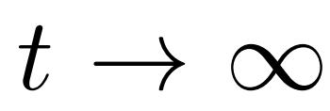
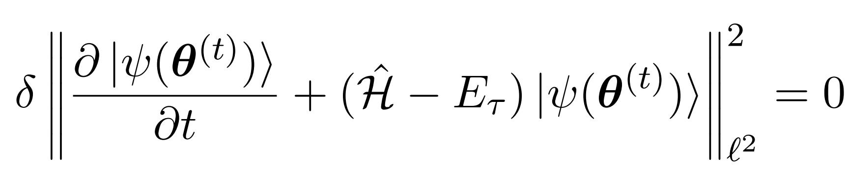
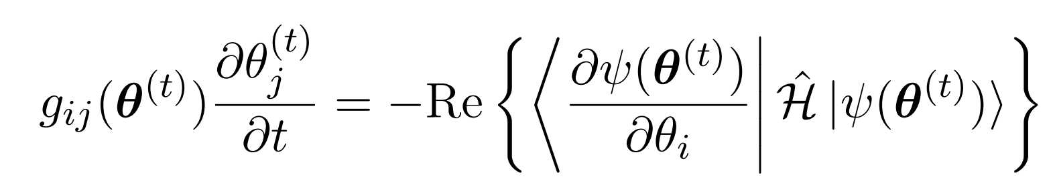
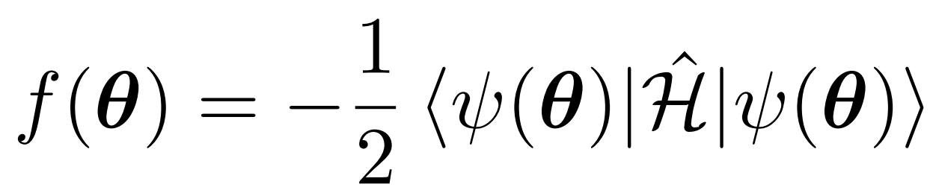
Quantum Imaginary Time Evolution[5]
Wick rotated Schrödinger equation
is the ground state
McLachlan’s variational principle[6]
Derivatives
Same as QNG!
With:
[5] McArdle, Sam, et al. "Variational ansatz-based quantum simulation of imaginary time evolution." Quantum Information (2019): 75.
[6] McLachlan, Andrew D. "A variational solution of the time-dependent Schrodinger equation." Molecular Physics (1964): 39-44.

Slide 10








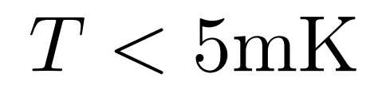
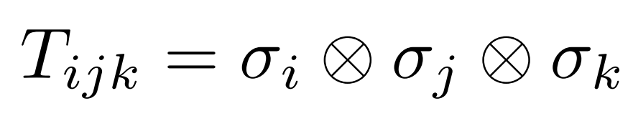
OH Molecule
Lara’s basis
total angular momentum
projection on x-axis
projection on internuclear axis
symmetry
or
with:
[7] Lara, Manuel, Benjamin L. Lev, and John L. Bohn. "Loss of molecules in magneto-electrostatic traps due to nonadiabatic transitions." Physical Review A—Atomic, Molecular, and Optical Physics 78.3 (2008): 033433.

Slide 11
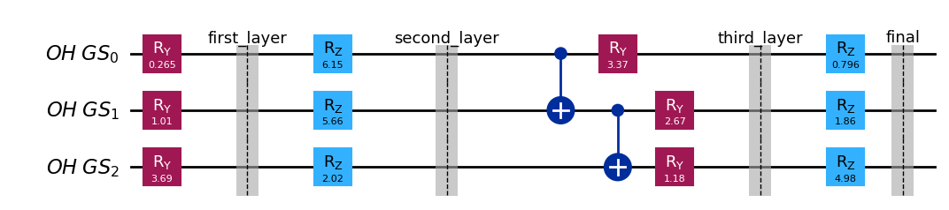
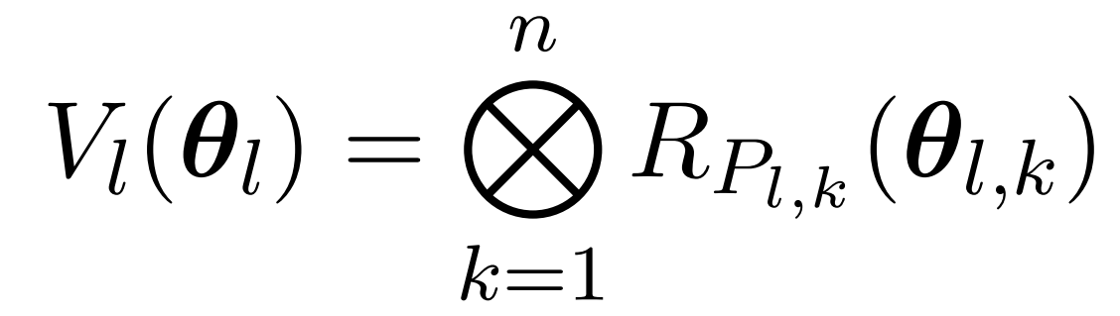
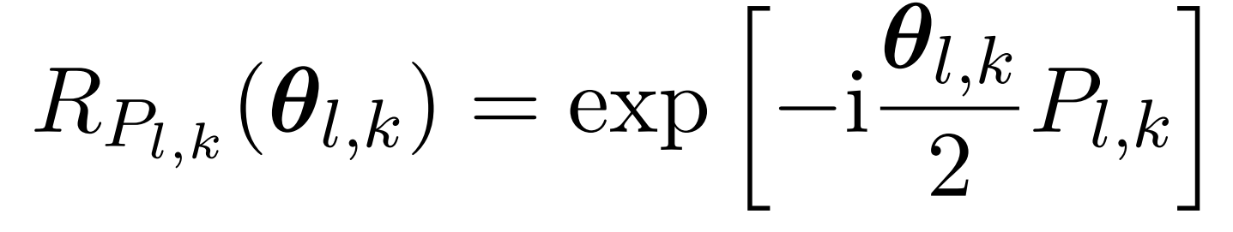
Encoding
Parametric gates are Pauli Rotations
with

Slide 12
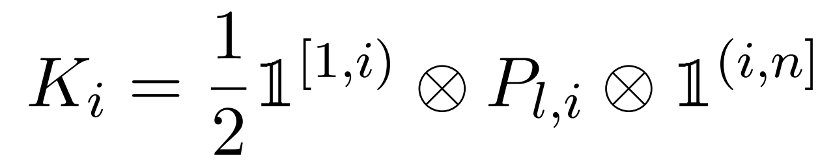
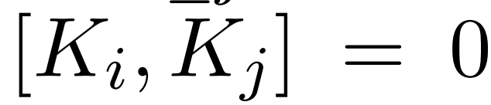
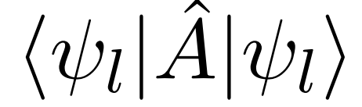
Encoding
Generators are Pauli matrices
Need to evaluate
in
All the operators in commute
Just need 1 measurement

Slide 13
Qiskit Implementation
Random initial values of the parameters
Parameters encoding
QFIM evaluation
Gradient evaluation
Update values

Slide 14
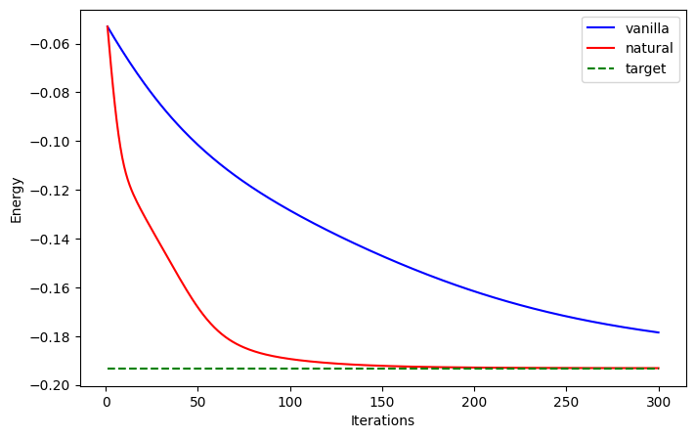
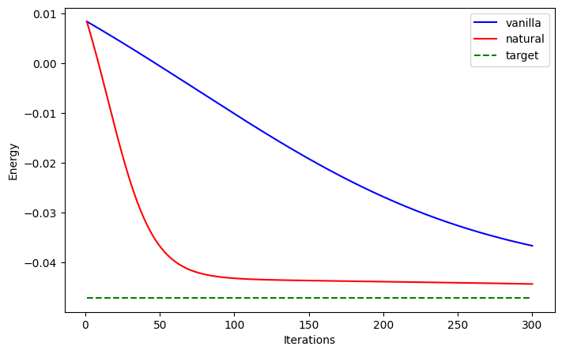
Results
B = 0.1 E = 5e5 θ = π/4
B = 0.01 E = 1e5 θ = 2π/3

Slide 15
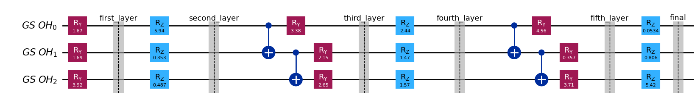
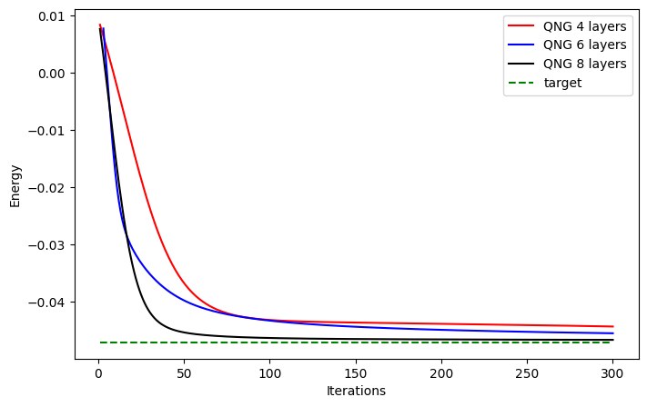
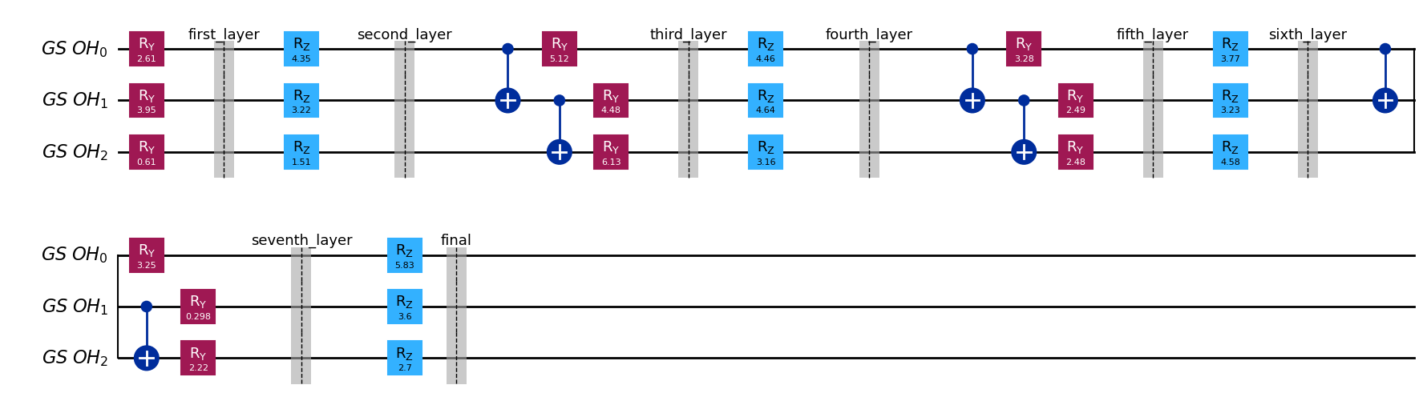
Results

Slide 16
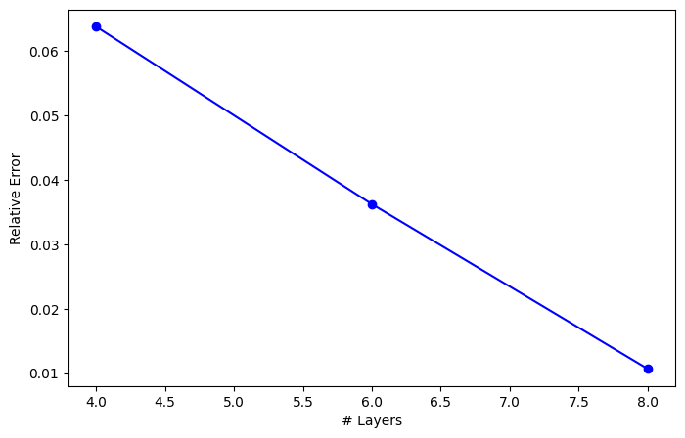
Results
Relative error seems to scale linearly with the number of layers
But requires furher investigations…

Slide 17
Conclusions
We introduced the Quantum Gemetric Tensor and related it to the Covariance Matrix
We showed that the Quantum Natural Gradient performs better than the standard Vanilla Gradient
We showed that the convergence can be ensured through adding more layers
We pointed out a particular behavior of the relative error wrt the number of layers (in a particular regime)
Thanks for listening

Slide 18
References
[1] Kerenidis, Iordanis, and Anupam Prakash. "Quantum gradient descent for linear systems and least squares." Physical Review A 101.2 (2020): 022316.
[2] Helstrom, Carl W. "Minimum mean-squared error of estimates in quantum statistics." Physics letters A 25.2 (1967): 101-102.
[3] Stokes, James, et al. "Quantum natural gradient." Quantum 4 (2020): 269.
[4] Albarelli, Francesco, et al. "A perspective on multiparameter quantum metrology: From theoretical tools to applications in quantum imaging." Physics Letters A 384.12 (2020): 126311.
[5] McArdle, Sam, et al. "Variational ansatz-based quantum simulation of imaginary time evolution." Quantum Information (2019): 75.
[6] McLachlan, Andrew D. "A variational solution of the time-dependent Schrodinger equation." Molecular Physics (1964): 39-44.
[7] Lara, Manuel, Benjamin L. Lev, and John L. Bohn. "Loss of molecules in magneto-electrostatic traps due to nonadiabatic transitions." Physical Review A—Atomic, Molecular, and Optical Physics 78.3 (2008): 033433.

