Slide 1



Consistency, Acyclicity, and Positive Semirings
Albert Atserias
UPC Barcelona
Phokion G. Kolaitis
UC Santa Cruz & IBM Research

Slide 2
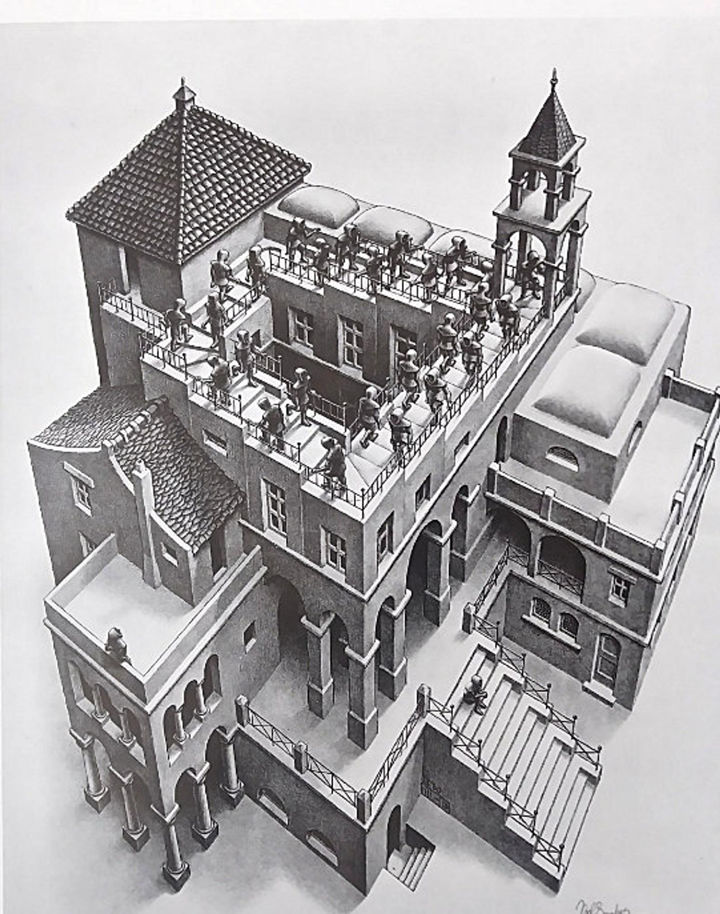

Local Consistency vs. Global Consistency

Slide 3
Local Consistency vs. Global Consistency
Locally Consistent
Globally Inconsistent
MC Escher

Slide 4
Local Consistency vs. Global Consistency
Locally Consistent Locally Consistent
Globally Inconsistent Globally Consistent
MC Escher Santorini, Greece

Slide 5
Local Consistency vs. Global Consistency
Fact:
In several different settings, the objects of study are
“locally consistent” but they may or may not be
“globally consistent”. Such settings include:
Quantum Mechanics, Probability Theory,
Constraint Satisfaction, Database Theory, …
Research Program:
Study the structural aspects of global consistency
Can we unveil the “intelligible structure” of global consistency?
When is local consistency equivalent to global consistency?

Slide 6
Local Consistency vs. Global Consistency
Earlier Work:
Vorob’ev – 1962
Characterized when a family of probability distributions defined on
overlapping sets of variables has a joint distribution.
Beeri, Fagin, Maier, Yannakakis – 1983
Characterized when a family of database relations with overlapping
sets of attributes has a universal relation.
Goal of this work:
A common generalization of the results of Vorob’ev and of Beeri et al.
A unifying framework for studying local vs. global consistency that uses K-relations, where K is a positive semiring.

Slide 7

Local vs. Global Consistency in Databases
Basic Concepts:
Attribute: a symbol A with an associated set dom(A) of values.
R(X): relation R with X as its set of attributes (names of columns)
R[Z] with Z $⊆$X: the projection of R on Z
Example:
R(A,B,C)
R[A,B]
A | B | C
1 | 2 | 3
1 | 2 | 5
2 | 4 | 6
A | B
1 | 2
2 | 4

Slide 8
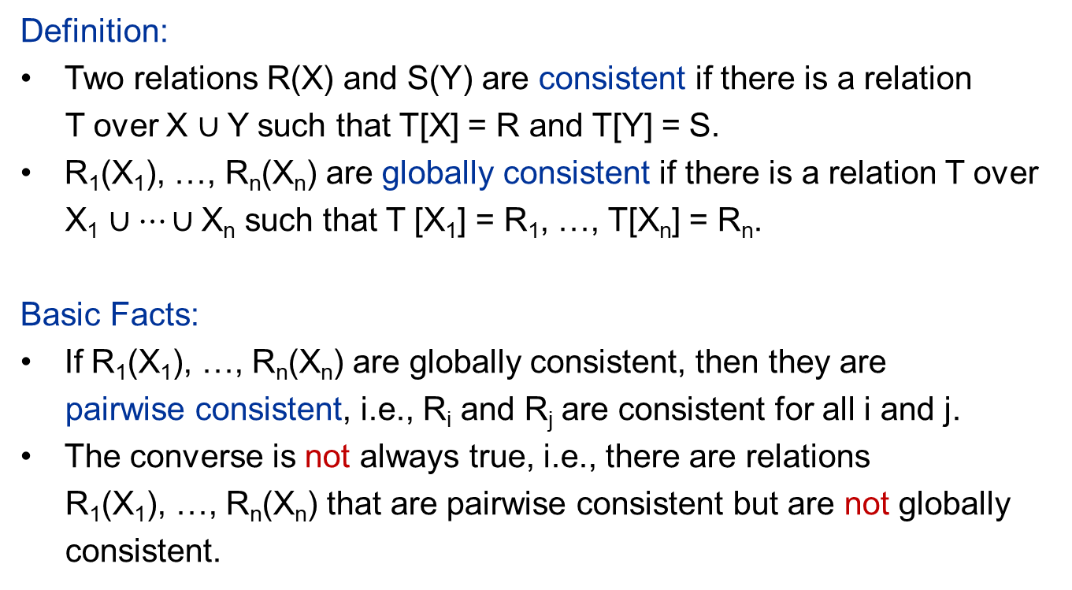
Local vs. Global Consistency in Databases
Definition:
Two relations R(X) and S(Y) are consistent if there is a relation
T over X $∪$Y such that T[X] = R and T[Y] = S.
R₁(X₁), …, R_{n}(X_{n}) are globally consistent if there is a relation T over
X₁ $∪⋯∪$X_{n} such that T [X₁] = R₁, …, T[X_{n}] = R_{n}.
Basic Facts:
If R₁(X₁), …, R_{n}(X_{n}) are globally consistent, then they are
pairwise consistent, i.e., R_{i} and R_{j} are consistent for all i and j.
The converse is not always true, i.e., there are relations
R₁(X₁), …, R_{n}(X_{n}) that are pairwise consistent but are not globally
consistent.

Slide 9
Local-to-Global Consistency for Relations
Definition: Schema H = (X₁, …, X_{n}) of sets of attributes.
H has the local-to-global consistency property for relations if every
pairwise consistent collection R₁(X₁), …, R_{n}(X_{n}) of relations is globally consistent.
Example 1: The schema
H = ({A₁,A₂}, {A₂,A₃}, {A₃,A₄})
has the local-to-global consistency property for relations.
Example 2: The schema
H = ({A₁,A₂}, {A₂,A₃}, {A₃,A₄}, {A₄,A₁})
does not have the local-to-global consistency property for relations.

Slide 10
Local-to-Global Consistency for Relations
Definition: Schema H = (X₁, …, X_{n}) of sets of attributes.
H has the local-to-global consistency property for relations if every pairwise consistent collection R₁(X₁), …, R_{n}(X_{n}) of relations is globally consistent.
Theorem (Beeri, Fagin, Maier, Yannakakis – 1983):
The following are equivalent for a schema H = (X₁, …, X_{n})
H is an acyclic hypergraph.
H is a conformal and chordal hypergraph.
H has the running intersection property.
H has a join tree.
H has the local-to-global consistency property for relations.

Slide 11
Conformal and Chordal Hypergraphs
Definition: Let H be a hypergraph
The primal graph of H is the undirected graph whose edges are pairs of nodes that appear together in at least one hyperedge of H.
H is conformal if every clique of the primal graph of H is contained in some hyperedge of H.
H is chordal if its primal graph is chordal (i.e., every cycle of length at least four of has a chord).
Example 1: H = ({A₁,A₂}, {A₂,A₃}, {A₃,A₄}) is conformal and chordal.
Example 2: H = ({A₁,A₂}, {A₂,A₃}, {A₃,A₄}, {A₄,A₁}) is
conformal but not chordal.
Example 3: H = ({A₁,A₂}, {A₂,A₃}, {A₃,A₁}) is chordal but not conformal.

Slide 12
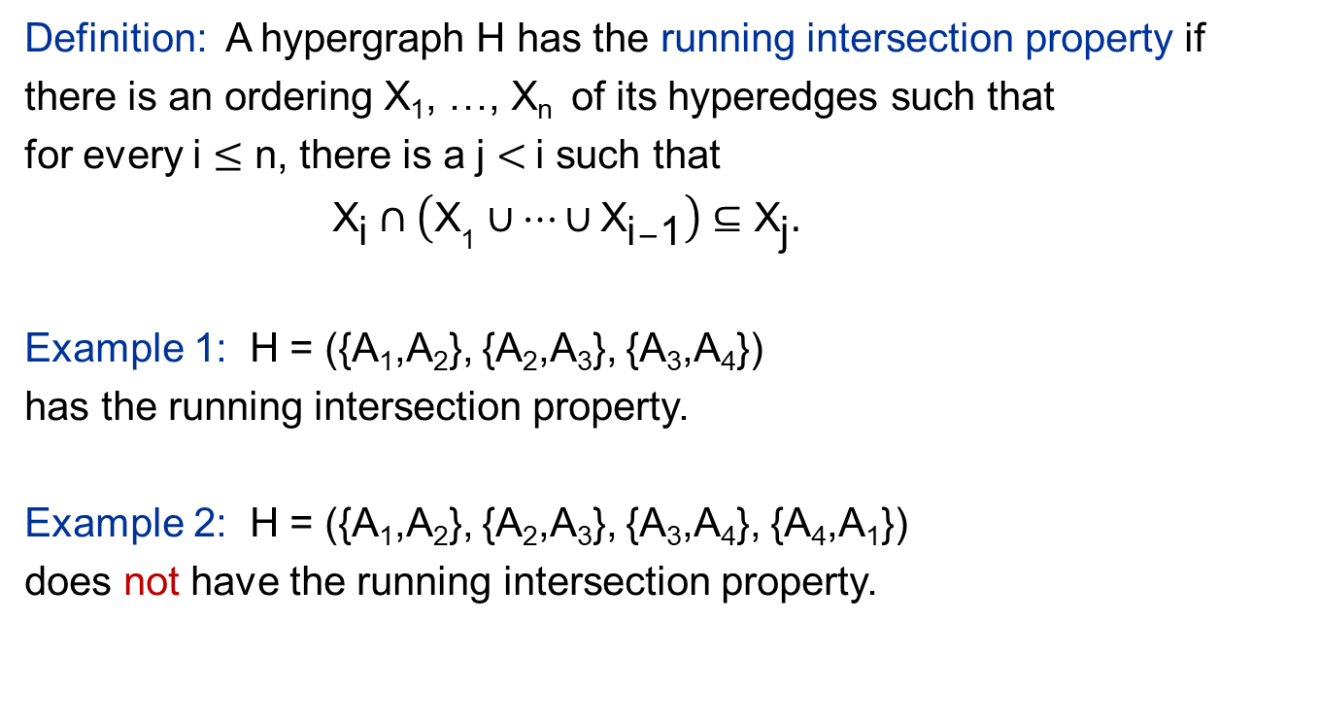
The Running Intersection Property
Definition: A hypergraph H has the running intersection property if
there is an ordering X₁, …, X_{n} of its hyperedges such that
for every i $≤\text{n}$, there is a j $<$ i such that
${ \text{X}}_{\text{i}} ∩\left({\text{X}}_{\text{1}}∪⋯∪{\text{X}}_{\text{i}−\text{1}}\right)⊆{\text{X}}_{\text{j}}.$
Example 1: H = ({A₁,A₂}, {A₂,A₃}, {A₃,A₄})
has the running intersection property.
Example 2: H = ({A₁,A₂}, {A₂,A₃}, {A₃,A₄}, {A₄,A₁})
does not have the running intersection property.

Slide 13
Join Tree of a Hypergraph
H = ({x,y,z}, {y,v},{y,z,v},{z,u,v},{u,v,w})
{z,u,v}
{y,z,v}
{u,v,w}
Join Tree for H
{x,y,z}
{y,v}

Slide 14
Local-to-Global Consistency for Relations
Definition: Schema H = (X₁, …, X_{n}) of sets of attributes.
H has the local-to-global consistency property for relations if every pairwise consistent collection R₁(X₁), …, R_{n}(X_{n}) of relations is globally consistent.
Theorem (Beeri, Fagin, Maier, Yannakakis – 1983):
The following are equivalent for a schema H = (X₁, …, X_{n})
H is an acyclic hypergraph.
H is a conformal and chordal hypergraph.
H has the running intersection property.
H has a join tree.
H has the local-to-global consistency property for relations.
Structural Notions
Semantic Notion

Slide 15
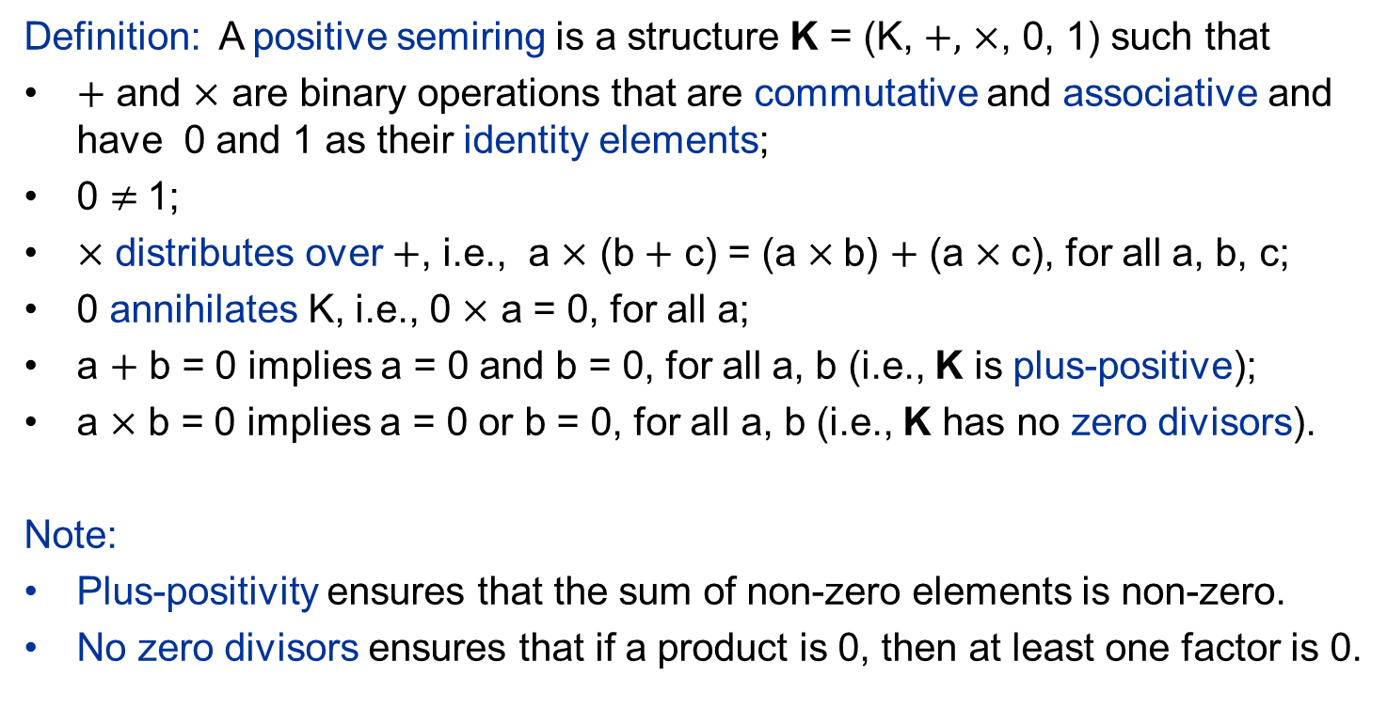
Positive Semirings
Definition: A positive semiring is a structure K = (K, $+,$ $×$, 0, 1) such that
$+$ and $×$ are binary operations that are commutative and associative and have 0 and 1 as their identity elements;
0 $≠$1;
$×$ distributes over $+$, i.e., a $×$ (b $+$ c) = (a $×$b) $+$ (a $×$c), for all a, b, c;
0 annihilates K, i.e., 0 $×$ a = 0, for all a;
a $+$ b = 0 implies a = 0 and b = 0, for all a, b (i.e., K is plus-positive);
a $×$ b = 0 implies a = 0 or b = 0, for all a, b (i.e., K has no zero divisors).
Note:
Plus-positivity ensures that the sum of non-zero elements is non-zero.
No zero divisors ensures that if a product is 0, then at least one factor is 0.

Slide 16
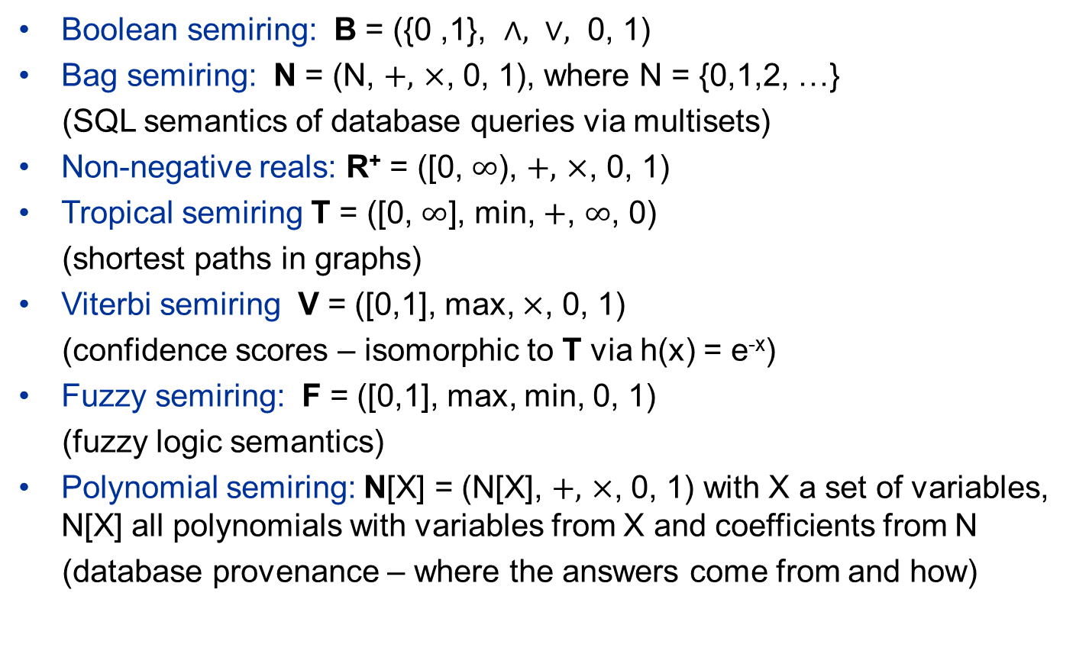
Positive Semirings Are Everywhere
Boolean semiring: B = ({0 ,1}, $∧, ∨,$ 0, 1)
Bag semiring: N = (N, $+,$ $×$, 0, 1), where N = {0,1,2, …}
(SQL semantics of database queries via multisets)
Non-negative reals: R⁺ = ([0, $∞$), $+,$ $×$, 0, 1)
Tropical semiring T = ([0, $∞\text{]}$, min, $+$, $∞$, 0)
(shortest paths in graphs)
Viterbi semiring V = ([0,1], max, $×$, 0, 1)
(confidence scores – isomorphic to T via h(x) = e^{-x})
Fuzzy semiring: F = ([0,1], max, min, 0, 1)
(fuzzy logic semantics)
Polynomial semiring: N[X] = (N[X], $+,$ $×$, 0, 1) with X a set of variables, N[X] all polynomials with variables from X and coefficients from N
(database provenance – where the answers come from and how)

Slide 17
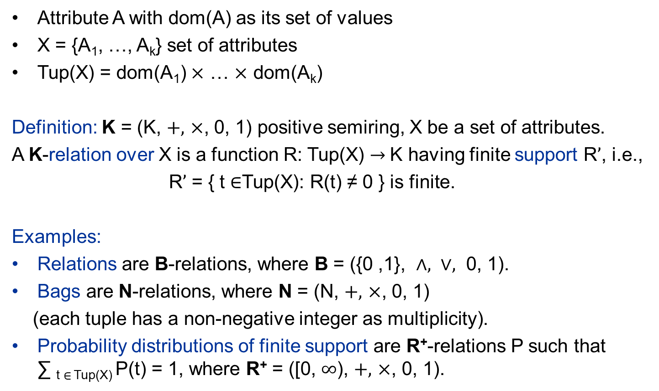
K-Relations
Attribute A with dom(A) as its set of values
X = {A₁, …, A_{k}} set of attributes
Tup(X) = dom(A₁) $×$ … $×$ dom(A_{k})
Definition: K = (K, $+,$ $×$, 0, 1) positive semiring, X be a set of attributes.
A K-relation over X is a function R: Tup(X) $→$K having finite support R$’$, i.e.,
R$’$ = { t $∈$Tup(X): R(t) ≠ 0 } is finite.
Examples:
Relations are B-relations, where B = ({0 ,1}, $∧, ∨,$ 0, 1).
Bags are N-relations, where N = (N, $+,$ $×$, 0, 1)
(each tuple has a non-negative integer as multiplicity).
Probability distributions of finite support are R⁺-relations P such that ∑ _{t} $∈$_{Tup(X)} P(t) = 1, where R⁺ = ([0, $∞$), $+,$ $×$, 0, 1).

Slide 18
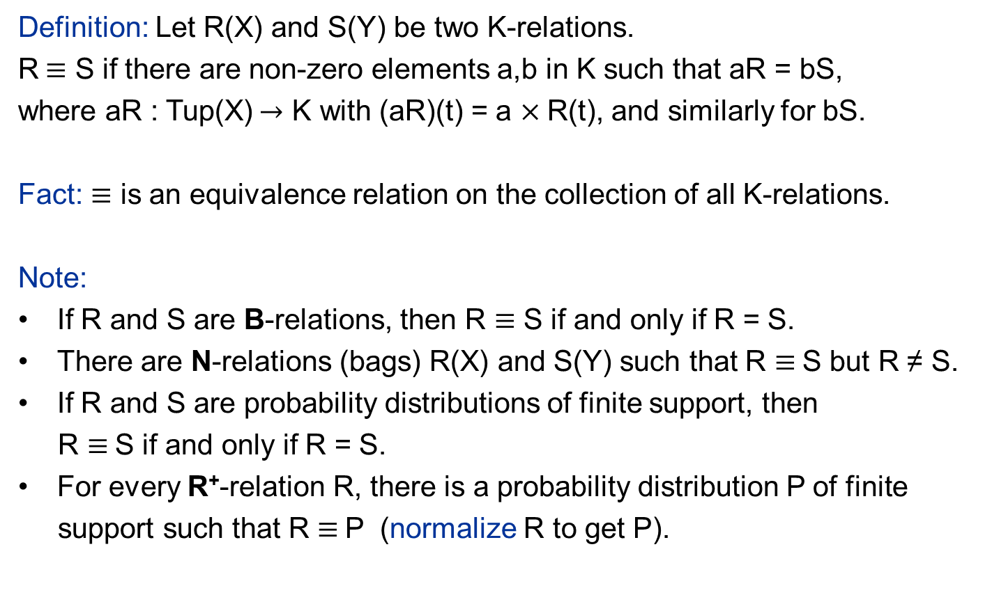
Equivalence of K-relations
Definition: Let R(X) and S(Y) be two K-relations.
R$≡$ S if there are non-zero elements a,b in K such that aR = bS,
where aR : Tup(X)$→$ K with (aR)(t) = a $×$R(t), and similarly for bS.
Fact: $≡$ is an equivalence relation on the collection of all K-relations.
Note:
If R and S are B-relations, then R $≡$ S if and only if R = S.
There are N-relations (bags) R(X) and S(Y) such that R $≡$S but R ≠ S.
If R and S are probability distributions of finite support, then
R $≡$S if and only if R = S.
For every R⁺-relation R, there is a probability distribution P of finite
support such that R $≡$P (normalize R to get P).

Slide 19
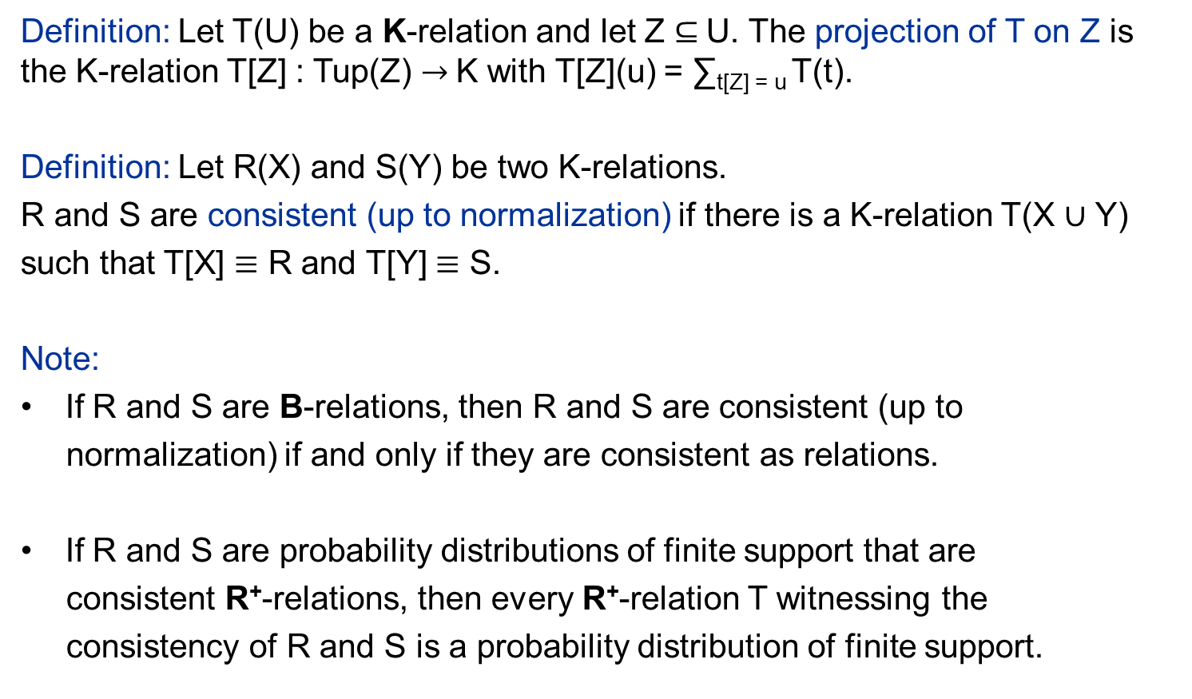
Consistency of K-relations
Definition: Let T(U) be a K-relation and let Z $⊆$U. The projection of T on Z is the K-relation T[Z] : Tup(Z) $→$K with T[Z](u) = ∑_{t[Z] = u} T(t).
Definition: Let R(X) and S(Y) be two K-relations.
R and S are consistent (up to normalization) if there is a K-relation T(X $∪$ Y)
such that T[X] $≡$ R and T[Y] $≡$ S.
Note:
If R and S are B-relations, then R and S are consistent (up to
normalization) if and only if they are consistent as relations.
If R and S are probability distributions of finite support that are
consistent R⁺-relations, then every R⁺-relation T witnessing the
consistency of R and S is a probability distribution of finite support.

Slide 20
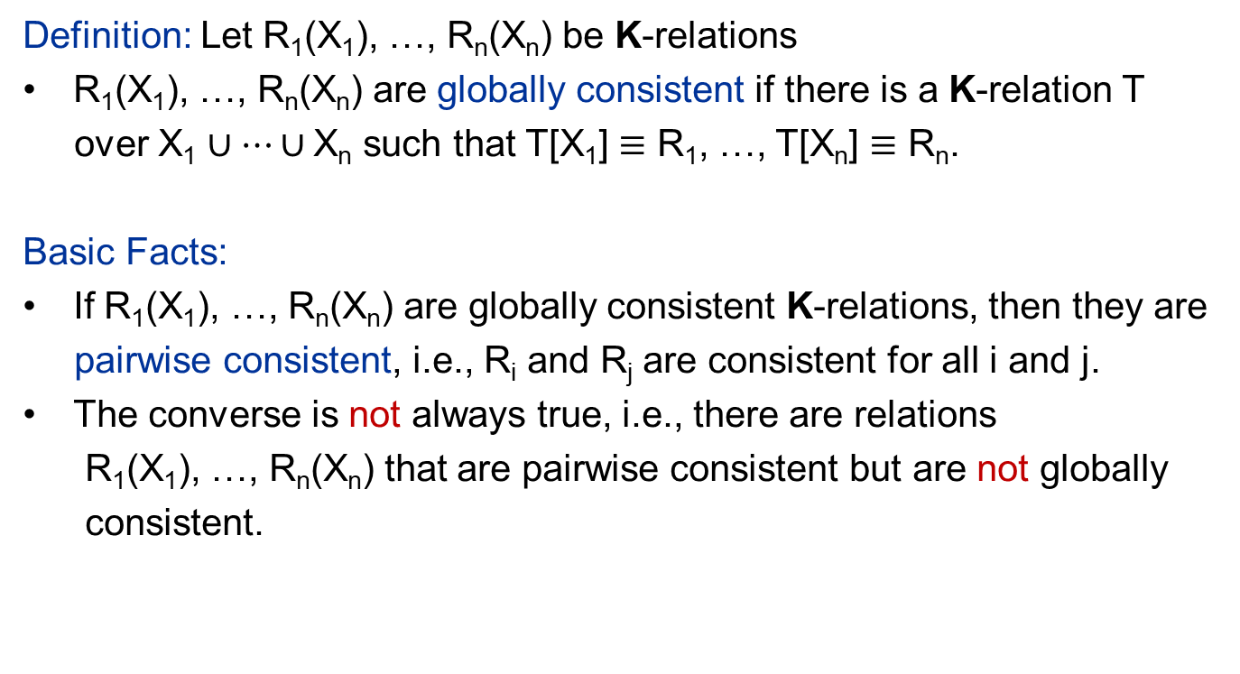
Local vs. Global Consistency for K-Relations
Definition: Let R₁(X₁), …, R_{n}(X_{n}) be K-relations
R₁(X₁), …, R_{n}(X_{n}) are globally consistent if there is a K-relation T
over X₁ $∪⋯∪$X_{n} such that T[X₁] $≡$ R₁, …, T[X_{n}] $≡$ R_{n}.
Basic Facts:
If R₁(X₁), …, R_{n}(X_{n}) are globally consistent K-relations, then they are
pairwise consistent, i.e., R_{i} and R_{j} are consistent for all i and j.
The converse is not always true, i.e., there are relations
R₁(X₁), …, R_{n}(X_{n}) that are pairwise consistent but are not globally
consistent.

Slide 21
Local-to-Global Consistency for K-relations
Definition: K positive semiring, Schema H = (X₁, …, X_{n}) of sets of attributes.
H has the local-to-global consistency property for K-relations if every
pairwise consistent collection R₁(X₁), …, R_{n}(X_{n}) of K-relations is globally consistent.
Main Theorem: Let K be a positive semiring.
The following are equivalent for a schema H = (X₁, …, X_{n})
H is an acyclic hypergraph.
H is a conformal and chordal hypergraph.
H has the running intersection property.
H has a join tree.
H has the local-to-global consistency property for K-relations.
Structural Notions
Semantic Notion

Slide 22
Local-to-Global Consistency for K-relations
Main Theorem: Let K be a positive semiring.
The following are equivalent for a schema H = (X₁, …, X_{n})
H is an acyclic hypergraph.
H has the local-to-global consistency property for K-relations.
Proof Hint: Different proof architecture than the BFMY Theorem.
Step 1: If H has the running intersection property, then H has
the local-to-global consistency property for K-relations.
Step 2: If H is not conformal or H is not chordal, then H does not have the local-to-global consistency property for K-relations.

Slide 23
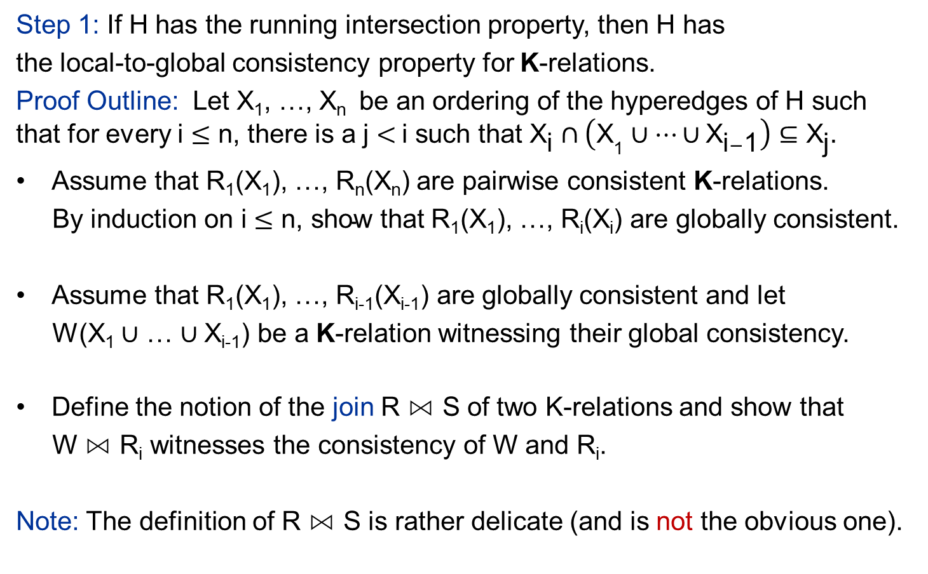
Local-to-Global Consistency for K-relations
Step 1: If H has the running intersection property, then H has
the local-to-global consistency property for K-relations.
Proof Outline: Let X₁, …, X_{n} be an ordering of the hyperedges of H such that for every i $≤\text{n}$, there is a j $<$i such that ${\text{X}}_{\text{i}}∩\left({\text{X}}_{\text{1}}∪⋯∪{\text{X}}_{\text{i}−\text{1}}\right)⊆{\text{X}}_{\text{j}}.$
Assume that R₁(X₁), …, R_{n}(X_{n}) are pairwise consistent K-relations.
By induction on i $≤\text{n}\text{, }\text{show} \text{that}$ R₁(X₁), …, R_{i}(X_{i}) are globally consistent.
Assume that R₁(X₁), …, R_{i-1}(X_{i-1}) are globally consistent and let
W(X₁ $∪$ … $∪$X_{i-1}) be a K-relation witnessing their global consistency.
Define the notion of the join R ⋈ S of two K-relations and show that
W ⋈ R_{i} witnesses the consistency of W and R_{i}.
Note: The definition of R ⋈ S is rather delicate (and is not the obvious one).

Slide 24
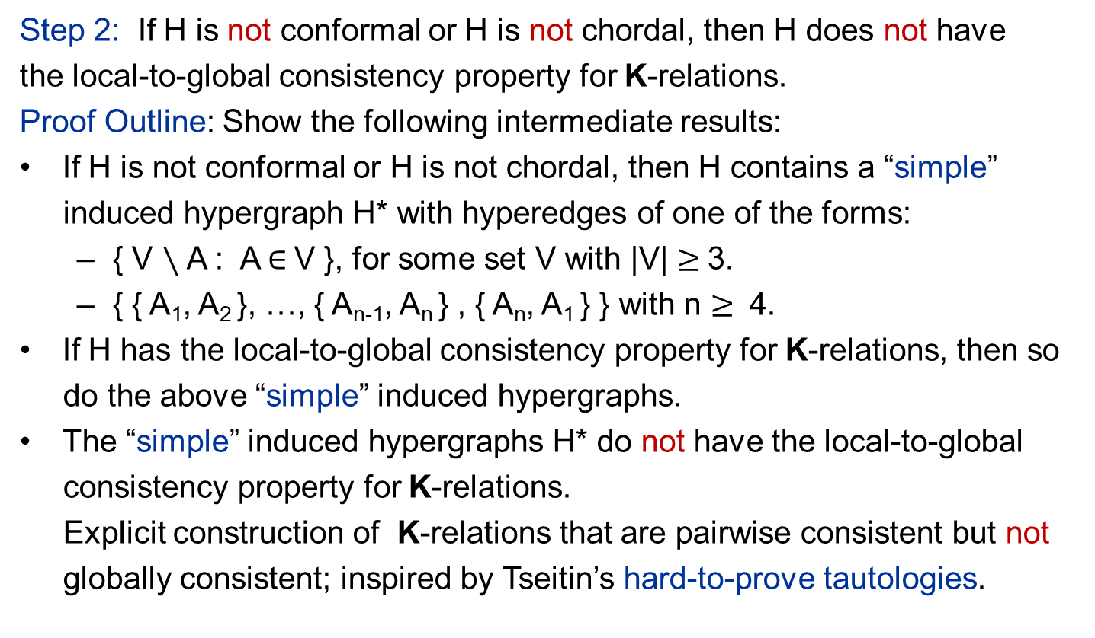
Local-to-Global Consistency for K-relations
Step 2: If H is not conformal or H is not chordal, then H does not have
the local-to-global consistency property for K-relations.
Proof Outline: Show the following intermediate results:
If H is not conformal or H is not chordal, then H contains a “simple”
induced hypergraph H* with hyperedges of one of the forms:
{ V $∖$ A : A $∈$V }, for some set V with |V| $≥$3.
{ { A₁, A₂ }, …, { A_{n-1}, A_{n} } , { A_{n}, A₁ } } with n $≥$ 4.
If H has the local-to-global consistency property for K-relations, then so
do the above “simple” induced hypergraphs.
The “simple” induced hypergraphs H* do not have the local-to-global
consistency property for K-relations.
Explicit construction of K-relations that are pairwise consistent but not
globally consistent; inspired by Tseitin’s hard-to-prove tautologies.

Slide 25
Local-to-Global Consistency
Main Theorem: Let K be a positive semiring.
The following are equivalent for a schema H = (X₁, …, X_{n})
H is an acyclic hypergraph.
H has the local-to-global consistency property for K-relations.
Corollary: The following are equivalent for a schema H = (X₁, …, X_{n})
H is an acyclic hypergraph.
H has the local-to-global consistency property for relations.
H has the local-to-global consistency property for probability
distributions of finite support.
Note:
The equivalence between 1. and 2. is the BFMY result.
How is the equivalence between 1. and 3. related to Vorob’ev’s work?

Slide 26
Vorob’ev’s Theorem and Related Work
Vorob’ev’s Theorem - 1962:
The following are equivalent for a schema H = (X₁, …, X_{n})
The hypergraph H = (X₁, …, X_{n}) is regular.
H has the local-to-global consistency property for probability distributions of finite support.
Note: In the paper, we give a direct proof that H is regular iff H is acyclic.
Related Work:
Barbosa (2015) explored local vs. global consistency in the sheaf-theoretic framework for contextuality and gave a sufficient condition for acyclicity to imply the local-to-global consistency property in that framework.

Slide 27
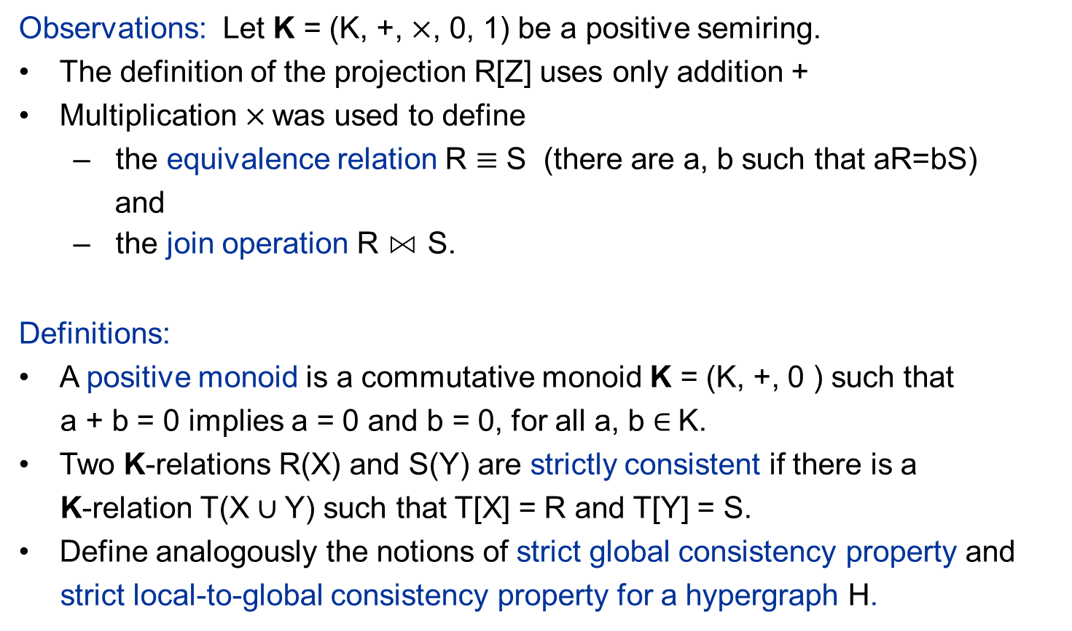
Consistency over Positive Monoids
Observations: Let K = (K, +, $×$, 0, 1) be a positive semiring.
The definition of the projection R[Z] uses only addition +
Multiplication$×$ was used to define
the equivalence relation R $≡$ S (there are a, b such that aR=bS)
and
the join operation R ⋈ S.
Definitions:
A positive monoid is a commutative monoid K = (K, +, 0 ) such that
a + b = 0 implies a = 0 and b = 0, for all a, b $∈$K.
Two K-relations R(X) and S(Y) are strictly consistent if there is a
K-relation T(X $∪$Y) such that T[X] = R and T[Y] = S.
Define analogously the notions of strict global consistency property and
strict local-to-global consistency property for a hypergraph H.

Slide 28
Consistency over Positive Monoids
Results (work in progress):
Let K = (K, +, 0) be a positive monoid and let H be a hypergraph.
If H has the strict local-to-global consistency property for K-relations,
then H is acyclic.
There are positive monoids K and acyclic hypergraphs H such that H
does not have the strict local-to-global consistency property
for K-relations.
There are “many” positive monoids K for which every acyclic hypergraph
H has the strict local-to-global consistency property for K-relations.
A new framework for local vs. global consistency

Slide 29
Thank you for your attention!

Slide 30
Backup Slides

Slide 31
Hardy’s Construction
R(A,B)
S(A,B’)
A | B
0 | 0
0 | 1
1 | 0
1 | 1
A | B’
0 | 1
1 | 0
1 | 1
T(A’,B)
U(A’,B’)
A’ | B
0 | 1
1 | 0
1 | 1
A’ | B’
0 | 0
0 | 1
1 | 0

Slide 32

The Join of two K-relations
If R(X) and S(Y) are K-relations, then the join of R and S is the
K-relation R ⋈ S over X $∪$Y such that for every (X $∪$Y)-tuple t, we have
(R ⋈ S)(t) = R(t[X]) $×$ S(t[Y]) $×$ ∏_{u ≠ t[ X} $∩$_{Y]} S[X $∩$Y](u)

