Slide 1

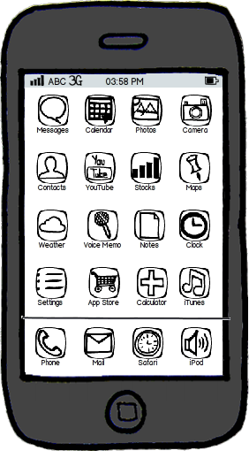



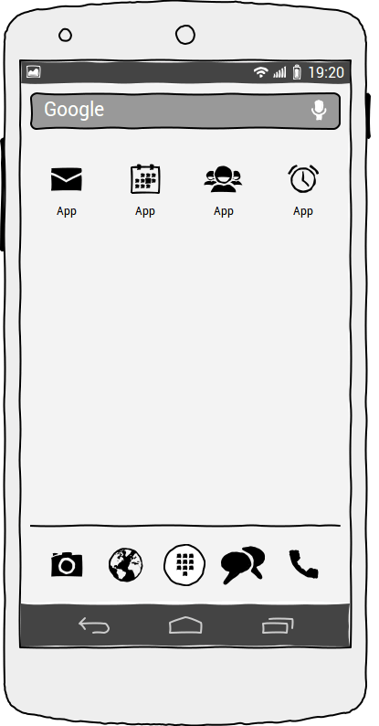
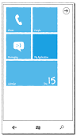
GUI
Application
Data
PC with Browser
Data Base
Network
iPhone
Application Server
DATA Server
Android Phone
Windows Phone

Slide 2
Subscribe
Publish
Request
Subscriber
Client
Server
Publisher
Response
HOST B
HOST A

