Slide 1
MPI parallelization of conjugate gradient
Luca Righetti
20/11/2025

Slide 2

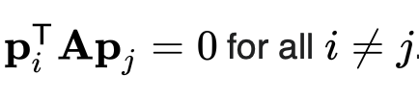
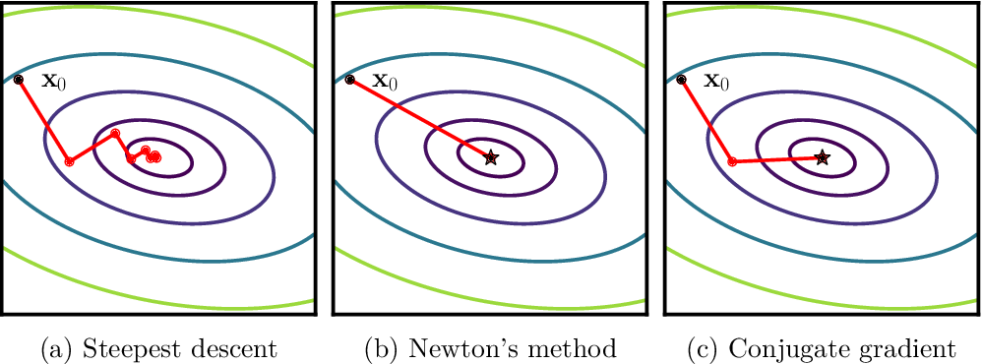
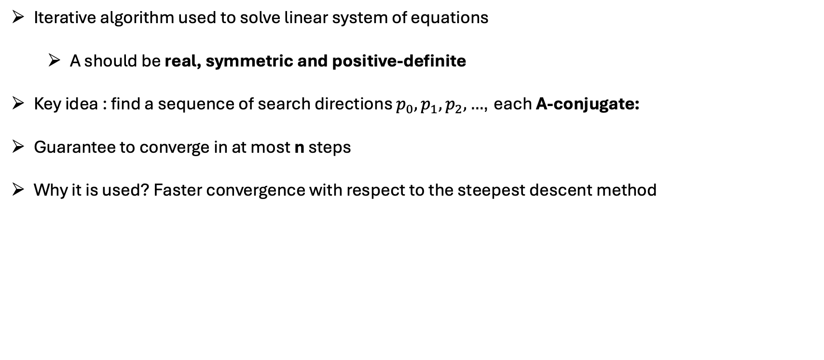
The conjugate gradient method
Iterative algorithm used to solve linear system of equations
  A should be real, symmetric and positive-definite
Key idea : find a sequence of search directions $p_{0},p_{1},p_{2},…$, each A-conjugate:
Guarantee to converge in at most n steps
Why it is used? Faster convergence with respect to the steepest descent method
Steepest descent
Conjugate gradient

Slide 3
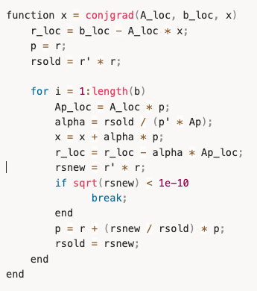
Serial algorithm
Compute residual r from initial condition
Enter the iterative loop (of length at most n)
Compute matrix-vector product Ap
Compute scalar alpha (step size)
Compute the new vectors x_{k+1} and r_{k+1}
Check if the new residual r (which is proportional to the gradient) is small enough, in case exit the loop

Slide 4
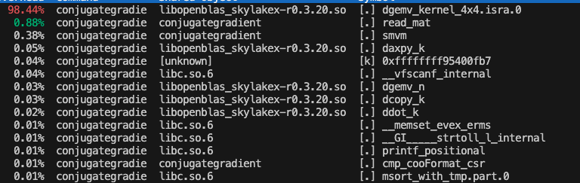
Profiling of the serial code
Amdahl’s law : the speedup is limited by the serial part if assuming fixe problem size
Non parallelizable part in our code:
  reading the matrix
  summation of the vector elements in the iterative loop to compute scalar part
Profiling the code with perf indicates 98.44% of the time is spent into matrix-vector multiplication, which is the parallelizable part

Slide 5
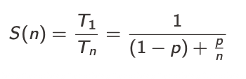

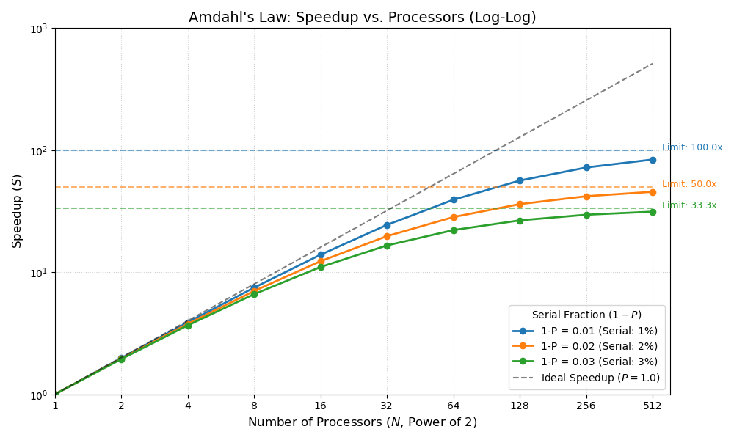
Amdahl’s law ideal scaling
In the limit of infinite resources the limiting factor is the serial part
Assuming the serial part is mainly reading the matrix (and small computation in the iterative loop) : (1-p) is in the range of 1-2 %

Slide 6
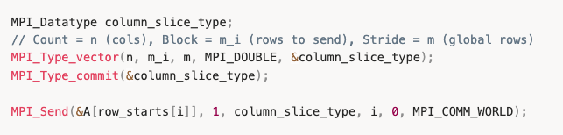
Implemented parallelization strategy
Parallelization of the dense solver
Strategy : divide the input matrix by row to perform locally matrix-vector product
Sending m rows of a matrix stored in column-major order (for BLAS performance)
Pack m rows into a new MPI_Datatype
Calculate the index of each local block of rows for sending to each rank from rank 0
Possible improvements: use MPI_Scatterv to better handling sending, or non-blocking

Slide 7
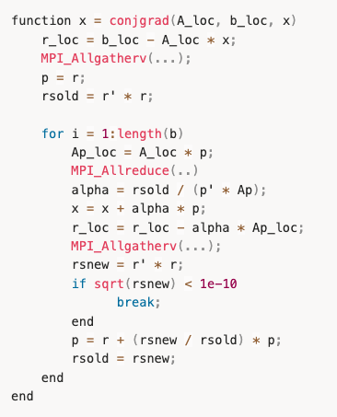
Parallelization of the solver after sending local pieces
cgsolver_mpi :
Receive local block of matrix A , full vector x
Strategy: Keep all the matrix-vector product local
r = b – A * x computed locally
MPI_Allgatherv used to gather r and compute p = r
Compute locally Ap = A * p (main speedup)
MPI_Allreduce to compute alpha
MPI_Allgatherv to gather r

Slide 8
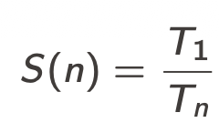
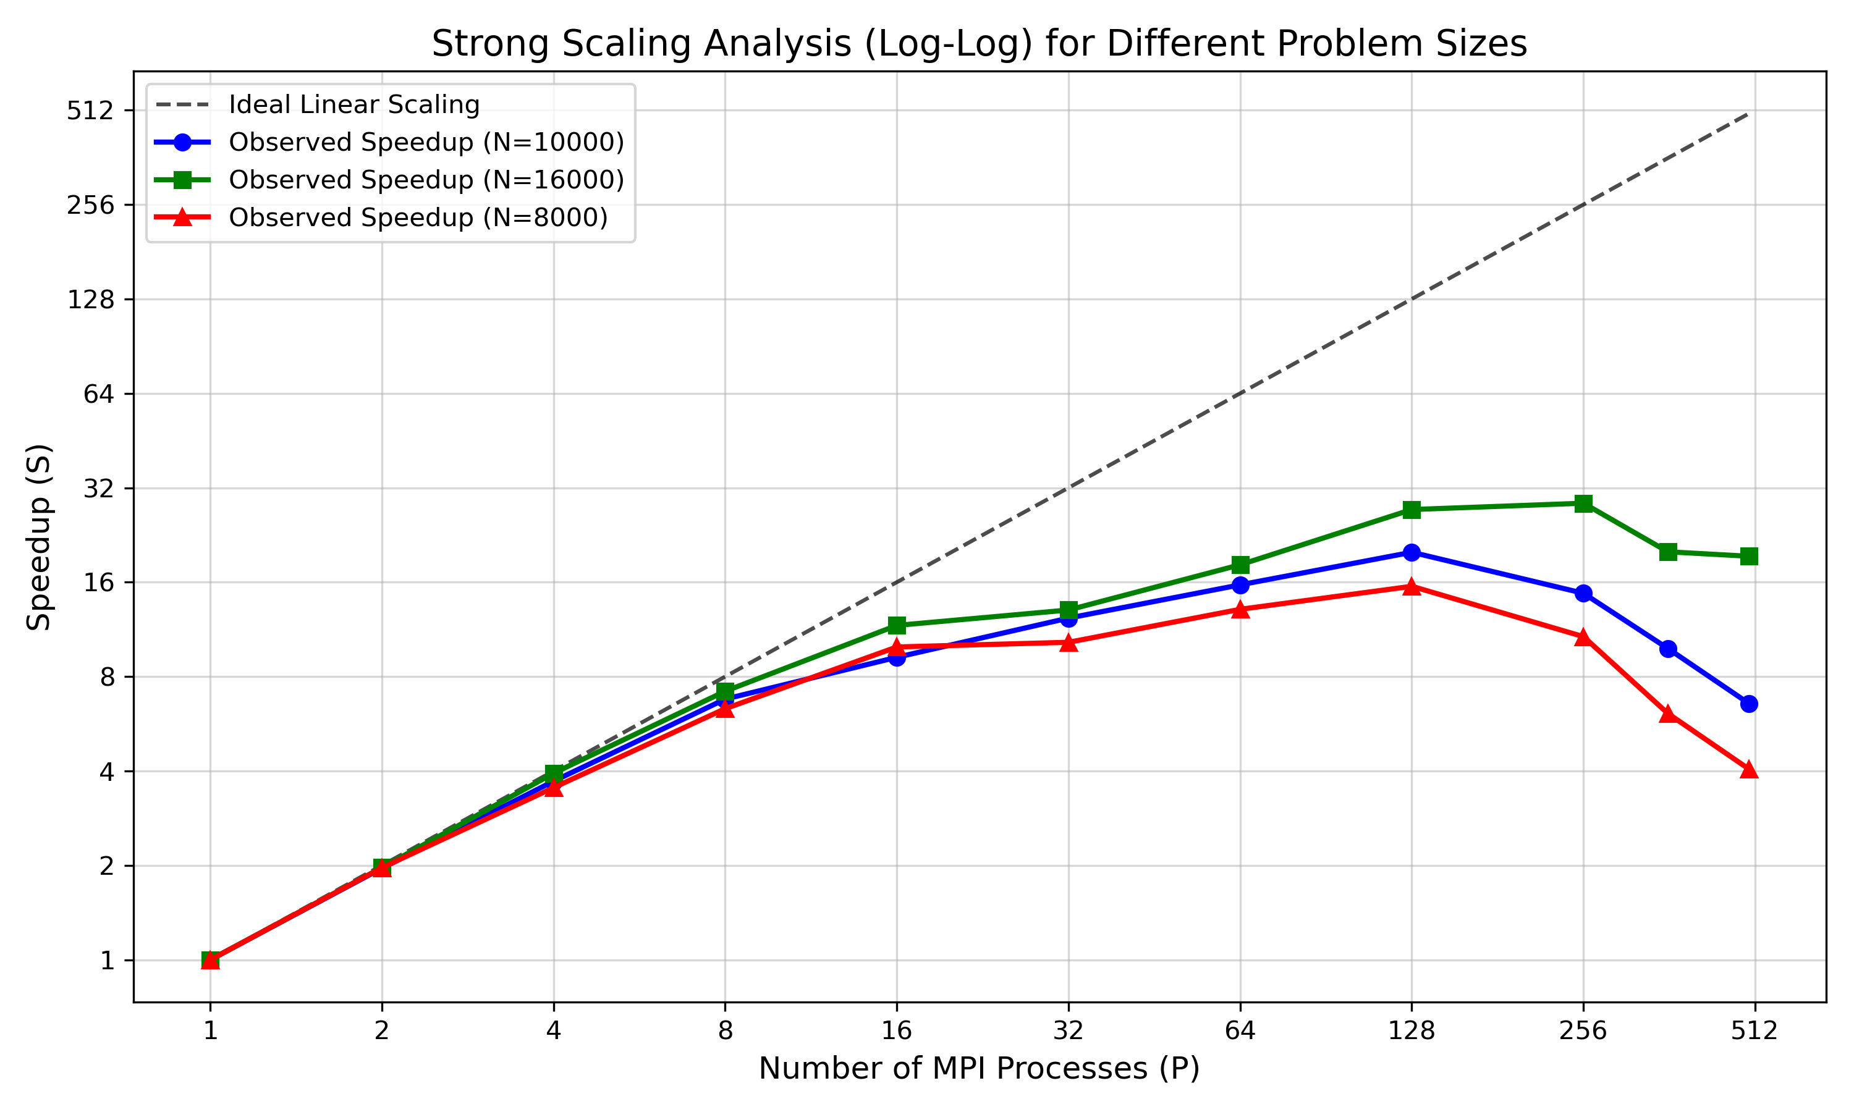
Performance measurement (strong scaling)
Plot of the speedup
Ideal scaling does not take into account latency and bandwidth of communication between processes
Performance drop after adding more processes due to the MPI communication part. The time of communication is constant or increasing with increasing processors
At nproc=512, the time of the cgsolver_mpi is ~ 0.35 s while the MPI communication time is ~ 4 s !

Slide 9

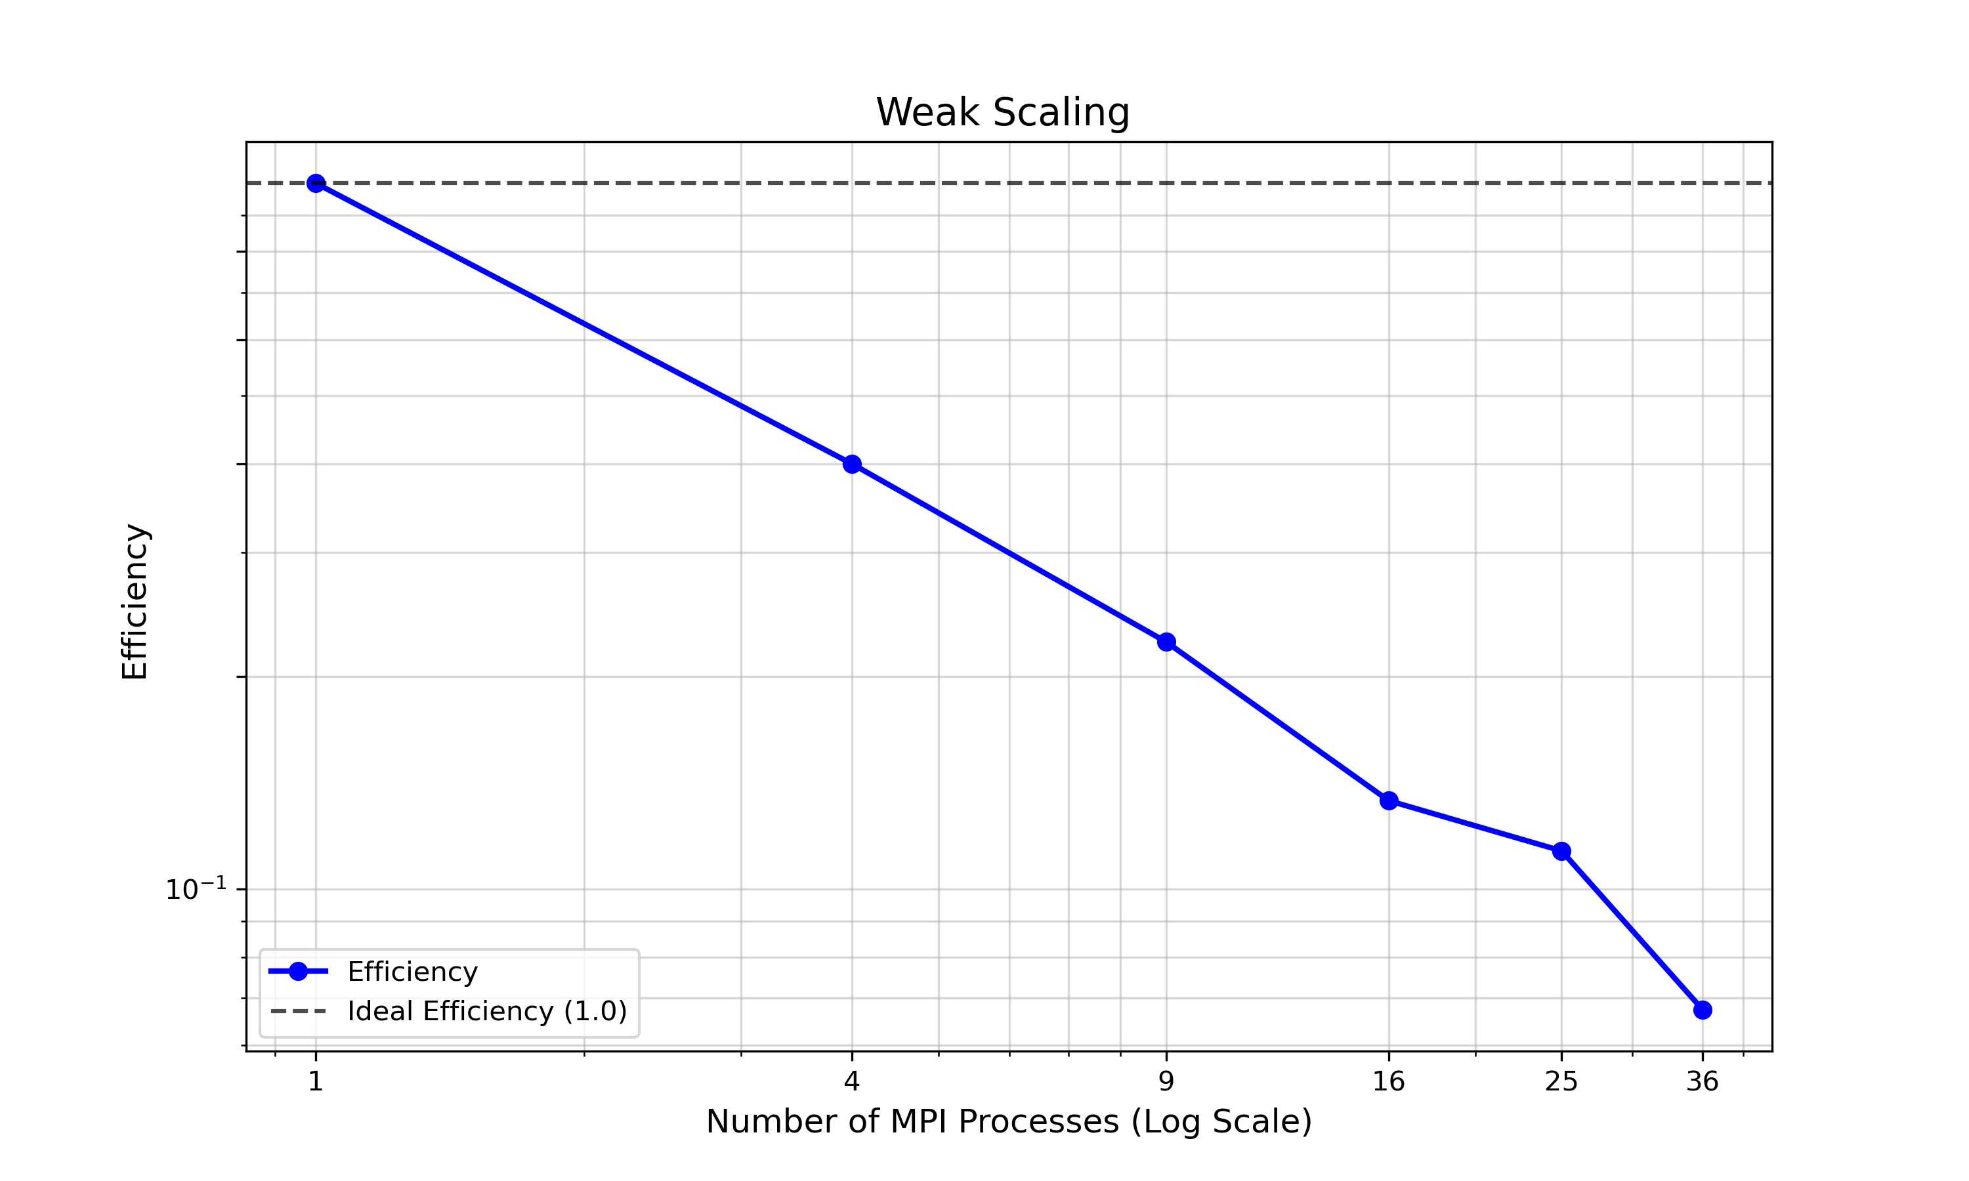
Performance measurement (weak scaling)
Plot of the efficiency
Starting matrix size is 1000, then I multiply by sqrt(nproc)
Keeping constant the amount of work per processor reveals that efficiency is fine in this implementation

Slide 10
Conclusion
I was able to obtain a speedup with MPI as evidenced by the strong scaling analysis
Main bottleneck : initial communication/sending to each processes !
Total time is 4.5 s for total MPI, while the cgsolver_mpi only takes 0.35 s on 500 processes.
Possible improvements :
The initial sending could be done more efficiently with MPI_Scatterv
the main bottleneck is reading the matrix on one processes and then send it to other ranks
For the algorithm: dividing the matrix in square block instead of just dividing rows could bring improvements

