Slide 1


Slide 2
FaaS: Cloud Run Functions VS Lambda
Functions
By Luca Roganti

Slide 3
Workflow
Function wriiting
script K6 creation
Run script and analyze report
Function creation and configuration

Slide 4
Creation and Configuration phase
AWS
Fast creation, then :
- create Python layer
- add layer
set handler =file_name.function_name
- generate URL
GOOGLE
Easy process in one screen

Slide 5
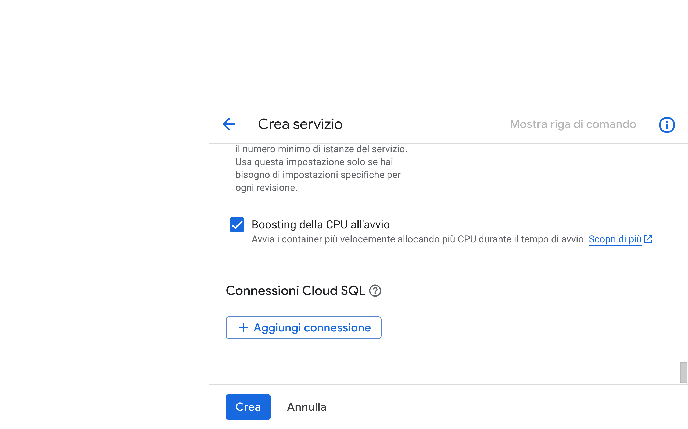
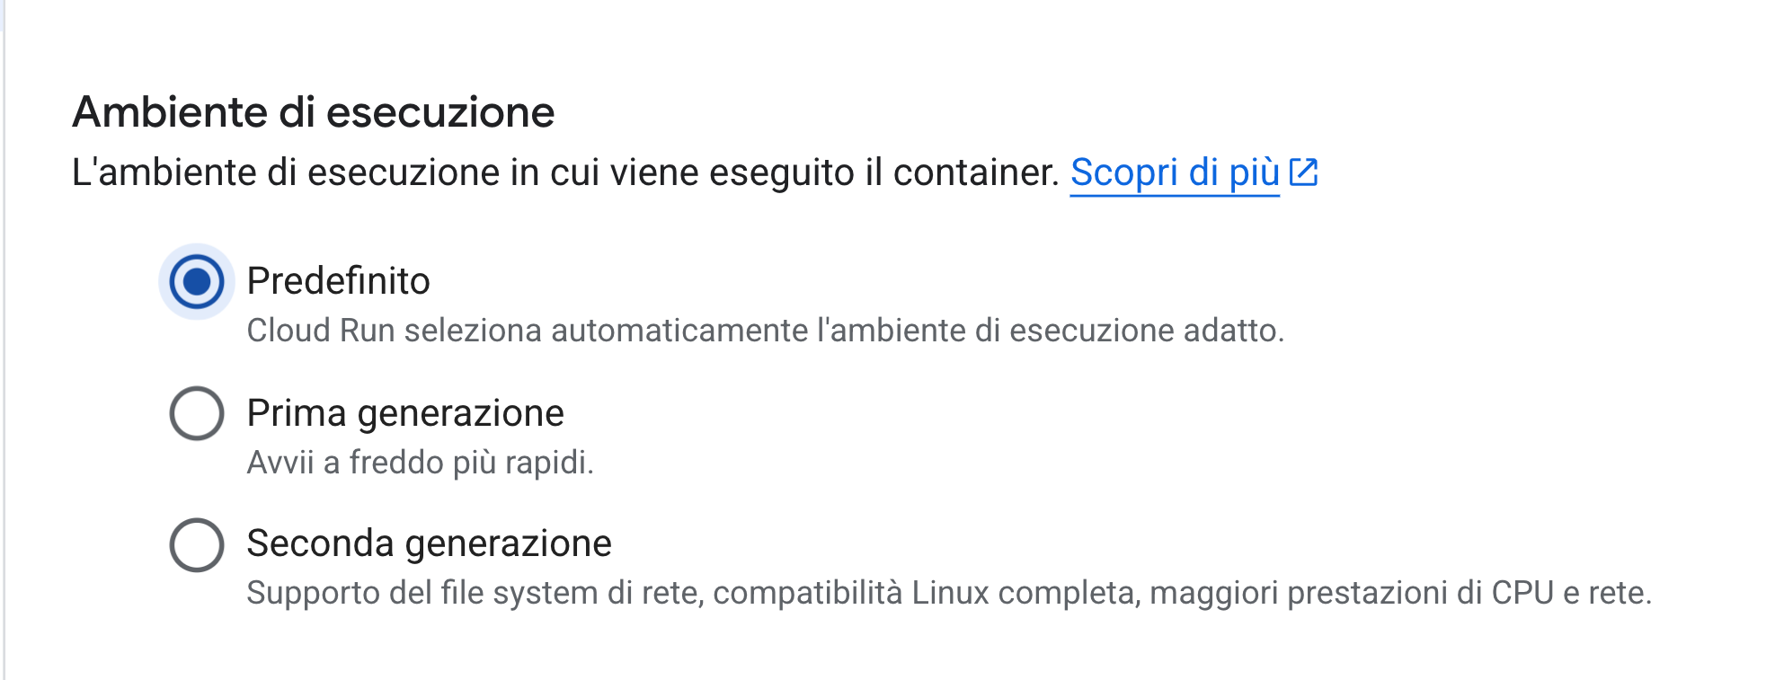

Slide 6
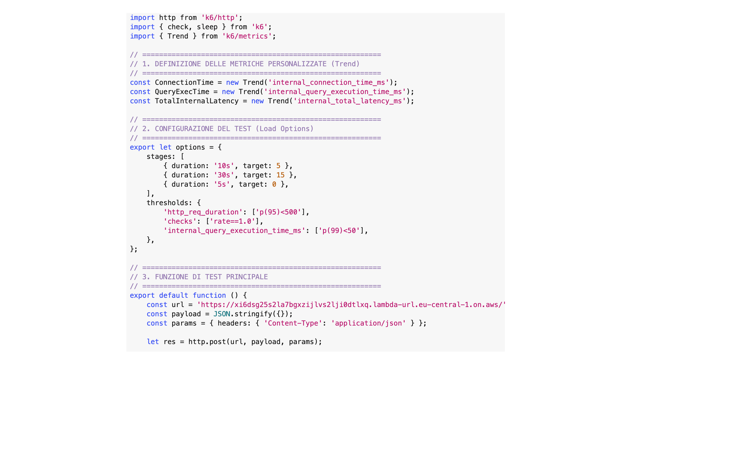
Script k6’s Creation

Slide 7
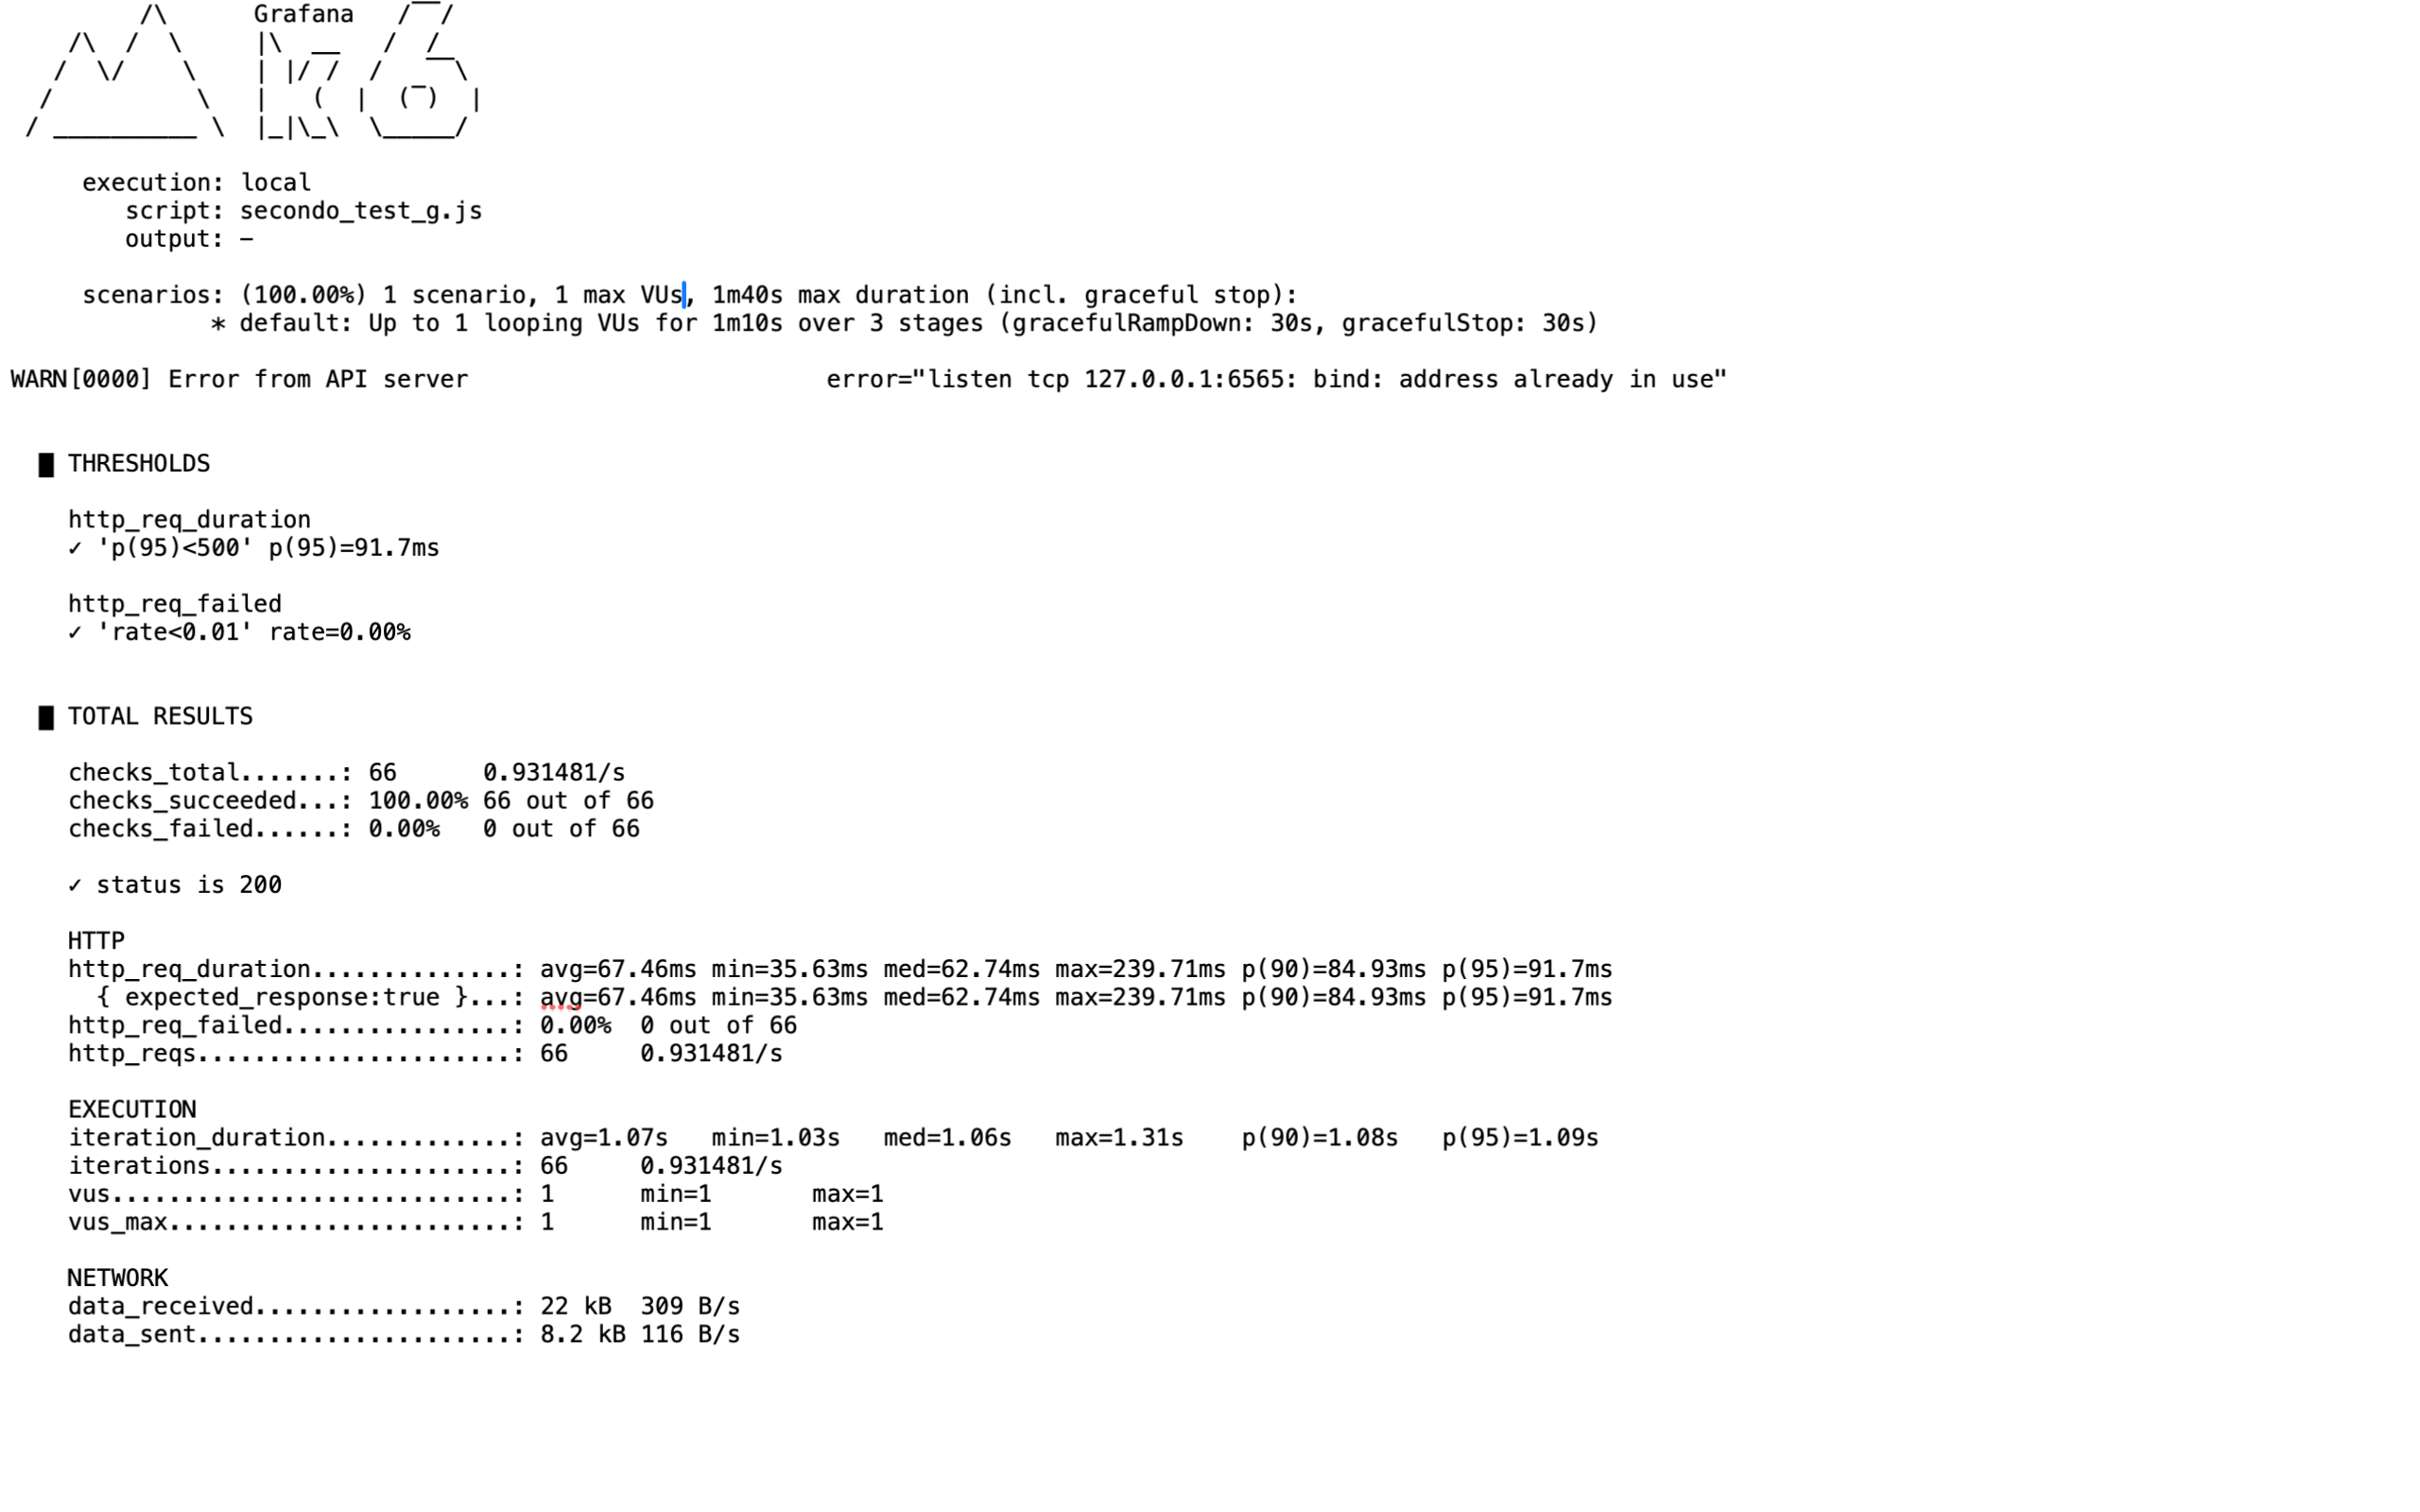
Report Analysis

Slide 8
Report Analysis
Time between sending the client request (Vus) and receiving the last byte of the response → http_req_duration
Network time when the k6 request reaches the Cloud provider and vice versa → data_sent/data_received
Overhead of request routing to the function by Cloud Provider + Instance initialization time + Actual function execution time → TotalInternalLatency = ConnectionTime+QueryExecTime

Slide 9
Lambda vs Cloud Run
Fibonacci(n)
Faas + DB
Cost Analysis
Comparison of Testing Tools

Slide 10
1.Fibonacci(n)

Slide 11
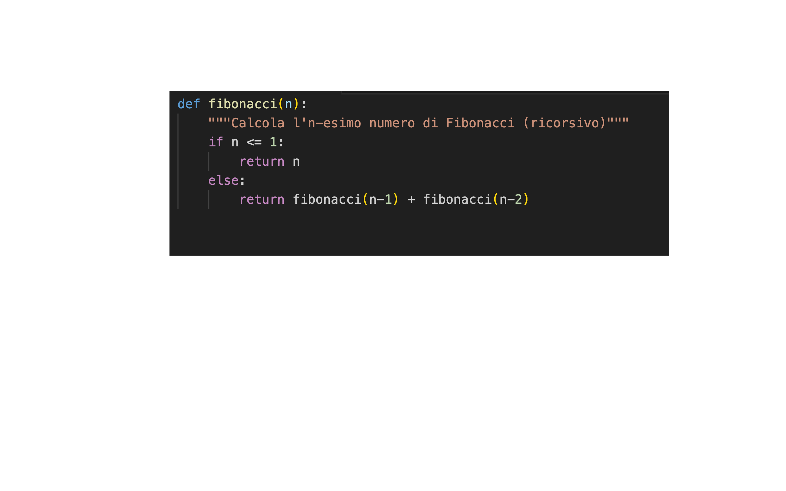
Simple test
Fibonacci(20)
10 VUs → 30s
10 VUs → 1m
0 VUs → 10s

Slide 12
Simple test
AWS
http_req_duration
Avg= 41.94ms
P(95)= 51.77ms
GOOGLE
http_req_duration
Avg=50.91ms
P(95)=150.12ms

Slide 13
Cold test
Cold Start → Instance terminated, need to start environment, load image, initialize runtime
Warm Start → Instance already active
Soft Start → Instance active, but process terminated to save CPU, the Cloud Provider must reactivate the application process

Slide 14
Cold test
Fibonacci(5), 1VUs for 30 iterations, functions just created
AWS
http_req_avg = 170 ms
http_req_max = 597 ms
GOOGLE
http_req_avg= 58 ms
http_req_max= 72 ms

Slide 15
Cold test
Fibonacci(5), 1VUs for 30 iterations, 5 hours after the previous slide test
AWS
http_req_avg = 122 ms
http_req_max = 822 ms
GOOGLE
http_req_avg= 70 ms
http_req_max= 831 ms

Slide 16
IDLE TIME
ms

Slide 17
IDLE TIME
Google has stated that the maximum time before deallocation is 15 minutes and drops to 10 for instances that use GPUs (“About instance autoscaling in Cloud Run Services“).
AWS has never explicitly stated this, but the developer community agrees on a value between 5 and 15 minutes.
In reality, it can even take 45/60 minutes, depending on: allocated memory, allocated function CPU, datacenter load, area load.
With the paid Provisioned Concurrency feature in AWS you can avoid deallocation.
In Google you could do the same by setting the number of minimum instances to 1

Slide 18
STRESS TEST
1st test
Req/s completed
2nd test
Execution Time
Warm Start Latency
Autoscaling reactivity
What will we manage ?
What will we evaluate ?
In K6 we no longer use the ‘stages’ executor, but ‘constant-arrival-rate’ which allows us to set a number of requests to launch per unit of time.

Slide 19
Stress test 1st test
Fibonacci(15), 5,50,500 req/s

Slide 20


Stress test 2nd test
Fibonacci(15), 5,50,500 req/s
475 req/s e 465 req/s → saturation

Slide 21
Stress test 2nd test
Fibonacci(30),5,20,40 req/s

Slide 22
Stress test 2nd test possible causes?
AWS
Firecracker
Combined compute model
GOOGLE
Docker Container
Separate compute model

Slide 23
2.Faas + Db

Slide 24
Faas + Db
Creation of an instance“db.t3.micro“ [2vCPU,1GB Ram,20GB SSD] and a “db_cloud_sql“ [2vCPU,8GB Ram,10GB SSD]
We used endpoint to link lambda function and db in AWS.While in Google Cloud we used Cloud Sql Proxy
Database ’’benchmark’’ with table:‘’bench_data’’ we have 3 columns : id(INT),value_a(VARCHAR),value_b(INT).

Slide 25
Simple test
Query: ‘SELECT value_a where id=1’ --WARM– [No Cloud Sql Proxy]
 | AWS | GOOGLE
Connection time (avg) | 9.7ms | 8ms
Query Execution (avg) | 1.9ms | 1.8ms
Internal Latency(avg) | 11.5ms | 10.5ms
http_req_AVG | 69.3ms | 61.11ms
http_req_MAX | 189ms | 197ms
http_req_P(95) | 93ms | 83.5ms
10s → 5 VUs 30s →15VUs 5s → 0VUs

Slide 26
Bigger query
Query: ‘SELECT * + UPDATE * value_b = id*20’
 | AWS | GOOGLE
Connection time (avg) | 9ms | 20ms
Query Execution (avg) | 112ms | 40ms
http_req_AVG | 157ms | 86.5ms
http_req_MAX | 293ms | 196ms
http_req_P(95) | 175ms | 122ms
Cloud Sql Proxy is now essential. Without it, since the update was blocking, the GCR instances would fail the test because they waited longer than the timeout.
The test results are dominated by query execution time, it would be interesting to test 2 completely identical db instances

Slide 27
Stress Test we look for the breaking point by increasing the VUs
 | AWS | GOOGLE
Connection Time (avg) | 12ms | 28ms
Query Execution (avg) | 127ms | 78ms
http_req_AVG | 175ms | 147ms
http_req_MAX | 716ms | 1.81s
http_req_P(95) | 223ms | 302ms
30s → 25 VUs 1m →50 VUs 15s →0 VUs

Slide 28
Stress Test trend reversal
 | AWS | GOOGLE
Connection Time (avg) | 12ms | 29ms
Query Execution (avg) | 133ms | 154ms
http_req_AVG | 180ms | 301ms
http_req_MAX | 986ms | 1.34s
http_req_P(95) | 225ms | 770ms
30s → 50 VUs 1m → 50 VUs 30s →100 Vus 15s →0 VUs
2 ramps to stress the services

Slide 29
Stress Test breaking-point
 | AWS | GOOGLE
Connection Time (avg) | 100ms | 25ms
Query Execution (avg) | 442ms | 408ms
http_req_AVG | 578ms | 1.52s
http_req_MAX | 4.27s | 3.19s
http_req_P(95) | 1.16s | 2.53s
CHECKS FAILED | 77% | 0%
Now instead of increasing the VUs, we remove the sleep() (pause between iterations of the same VUs), this will increase the requests per second.

Slide 30
Stress Test
The connection values ​​tell us that in AWS many requests had to wait so long for a free slot in the resource pool that they failed before getting it.
3 out of 4 AWS users will receive an error page, while Google users will wait longer for a response, but they will receive one.
Aws implements “fail fast“ logic
Google (with Cloud Sql Proxy) implements “queue&wait“ logic

Slide 31
Idle Test query: ‘select 1’ every 1/5/10/15/20 minutes (this time the cold start is container startup + connection to the db)

Slide 32
Idle Test
Deallocation happens sooner than the single function without db (about 7min and 12min).
In AWS historically there was an additional timeframe to consider in the start, the time to create and associate an Elastic Network Interface (ENI) to the new container.

Slide 33
3.Cost Analysis

Slide 34
Cost Analysis
 | AWS | GOOGLE
Free req/month | 1 million | 2 million
Free calculation per month | 400.00 gib-s | 400.00 vCPU-s 200.00 gib-s
Type of computing | combined | separate
DB free plan | 750 hours/month for 1 year | 300$
IPV4 cost per month | 3.65 $ | 2.92 $
Estimated Faas cost after the free plan | 17 $ | 13-15 $

Slide 35
4. Comparison of Testing Tools

Slide 36
IPERF
Measure the bandwidth between 2 points
We need to create a VM instance and calculate the bandwidth between the VM and us to understand if there is a bottleneck

Slide 37
Locust
It’s the real K6 competitor
We can write script with Python
There is a web interface
K6 is more efficient thanks to its engine written in Go

Slide 38
5. Extra

Slide 39
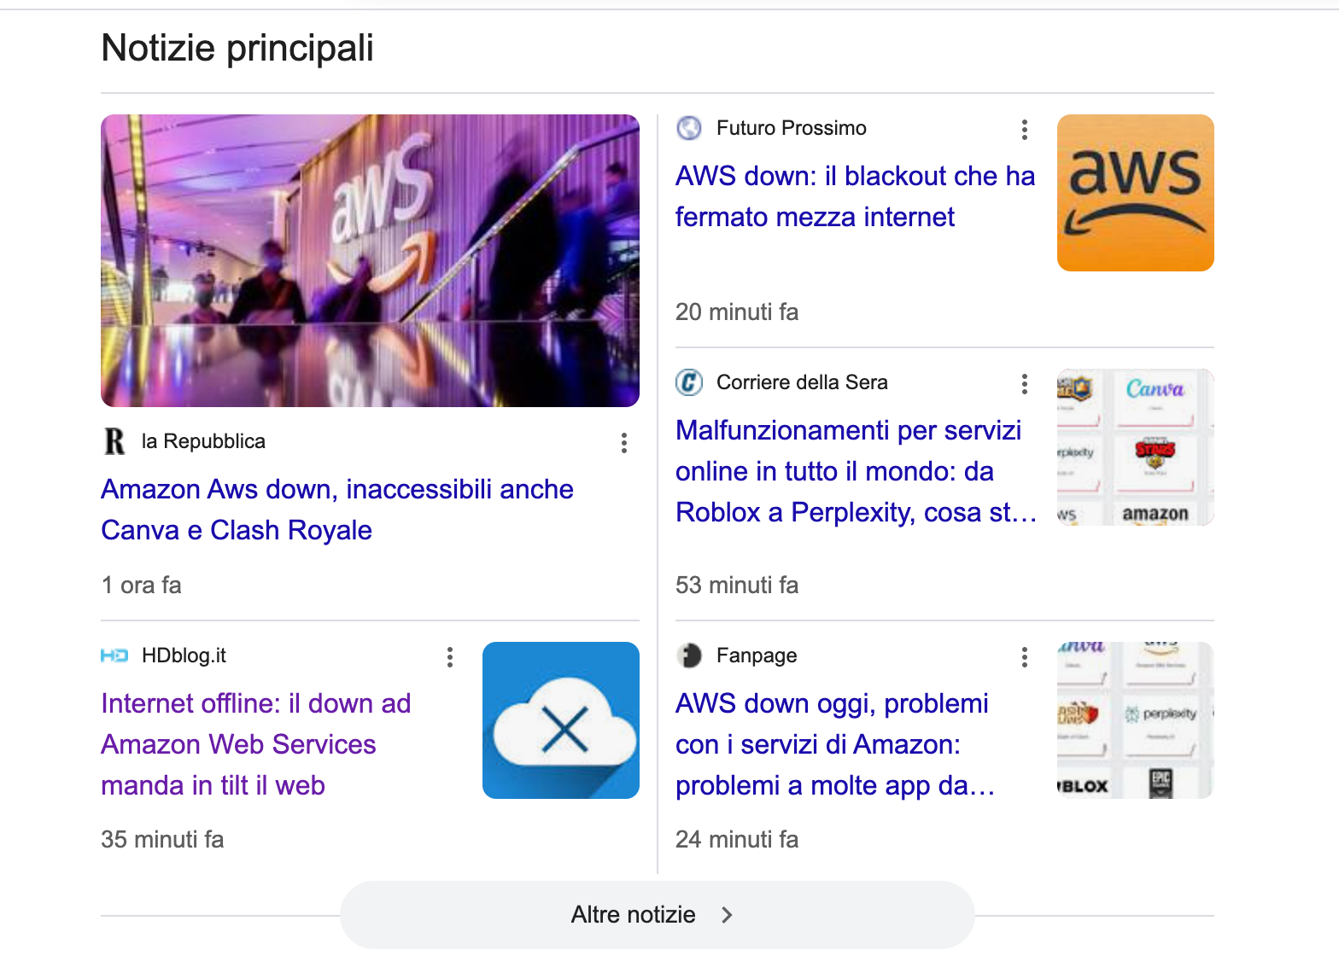
AWS DOWN 20/10/2025

Slide 40
Conclusion
Google Cloud Run, thanks to its cold start performance, seems to be the right choice for real-time apps and microservices
AWS has been shown to have much more efficient autoscaling
Google has a free plan that appears more comfortable
Regarding the deallocation time, AWS follows a policy (perhaps due to its architecture) that tends to restart the instances multiple times.
How the Faas service is connected to other services greatly influences the final results (it would have been interesting to try the RDS Proxy but it is paid)

