Slide 1
Using Quarto for everything
Lucas A. Meyer

Slide 2
Why Quarto

Slide 3
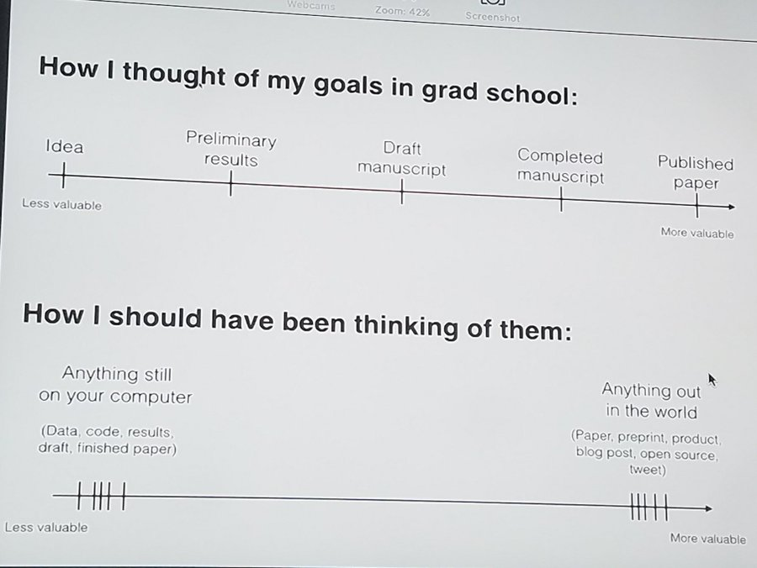
Quarto helps with the content value chain
Gets things out of my computer fast
Reproducible
Git-based collaboration
Write once, generate:
Code
Paper
PowerPoint
Site/documentation
The content value chain from David Robinson’s (@drrob) Tweet

Slide 4
Also… the population project
Goals and questions
Explore the consequences of the decline in population predicted to start at around 2100 for the world, but earlier in developed nations.
What are the economic impacts?
What should governments do?
Challenges
Unknown collaborators at the start
Need to go “wide” rather than “deep”
May need to pivot fast
May need to generate data on demand
Show graphs for country X, Y and Z
Generate code, paper, PowerPoint

Slide 5
In the last 20 years, I tried many tools…
LaTeX
Great for PDFs… Ok, Beamer!
Website generation is not great
I even know how to write code!
\usepackage{ifthen}
@for, @while
Word/PPT
Hard to collaborate before O365
Hard to reproduce / auto-generate
Jekyll
Great for sites
Not great for PPT, papers
RMarkdown
Great PDFs
Mostly good presentations
Hugo and blogdown work well
Need to learn R

Slide 6
Quarto
Quarto is pandoc on steroids, and solves a lot of problems.

Slide 7
LaTeX
Great for PDFs… Ok, Beamer!
Website generation is not great
I even know how to write code!
\usepackage{ifthen}
@for, @while
Word/PPT
Hard to collaborate before O365
Hard to reproduce / auto-generate
Jekyll
Great for sites
Not great for PPT, papers
RMarkdown
Great PDFs
Mostly good presentations
Hugo and blogdown work well
Need to learn R

Slide 8
Articles

Slide 9
Using Quarto to write articles
Blah bleh blih

Slide 10
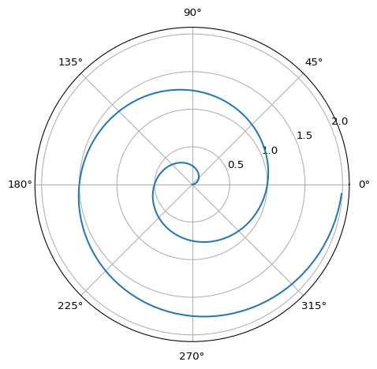
What if I want to add code?
import numpy as np import matplotlib.pyplot as plt r = np.arange(0, 2, 0.01) theta = 2 * np.pi * r fig, ax = plt.subplots(subplot_kw={'projection': 'polar'}) ax.plot(theta, r) ax.set_rticks([0.5, 1, 1.5, 2]) ax.grid(True) plt.show()

Slide 11
Presentations

Slide 12
Things that you can add to a template
Title Slide
Title and Content
Section Header
Two Content
Comparison
Content with Caption
Blank

Slide 13
Projects
You can use Quarto to generate the whole shebang!

Slide 14
Appendix

Slide 15
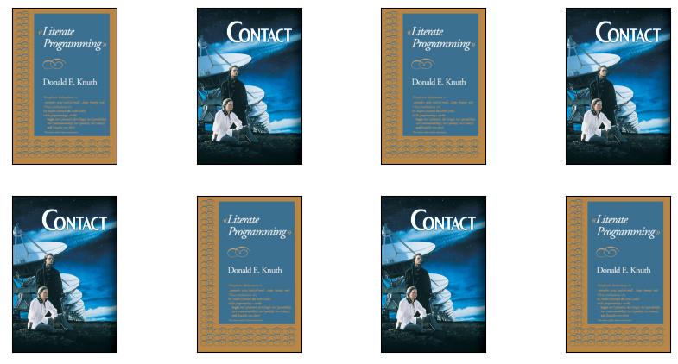
Test multiple images
This slide uses the “Caption plus stuff” template

