Slide 1
Using Quarto for reproducible article writing
Lucas A. Meyer

Slide 2
Quarto
Popular Science
In 1997…
I watched the movie “Contact”
I read “Literate Programming”
I started working on a science museum

Slide 3
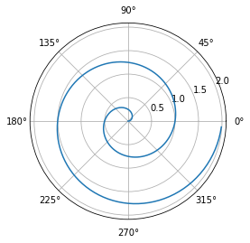
Articles
Using Quarto to write articles
What if I want to add code?
import numpy as np import matplotlib.pyplot as plt r = np.arange(0, 2, 0.01) theta = 2 * np.pi * r fig, ax = plt.subplots(subplot_kw={'projection': 'polar'}) ax.plot(theta, r) ax.set_rticks([0.5, 1, 1.5, 2]) ax.grid(True) plt.show()

Slide 4
Presentations
Things that you can add to a template
Title Slide
Title and Content
Section Header
Two Content
Comparison
Content with Caption
Blank

Slide 5
Projects
You can use Quarto to generate the whole shebang!

