Slide 1
Using Quarto for everything
Lucas A. Meyer

Slide 2
Why Quarto
Quarto helps with the content value chain

Slide 3
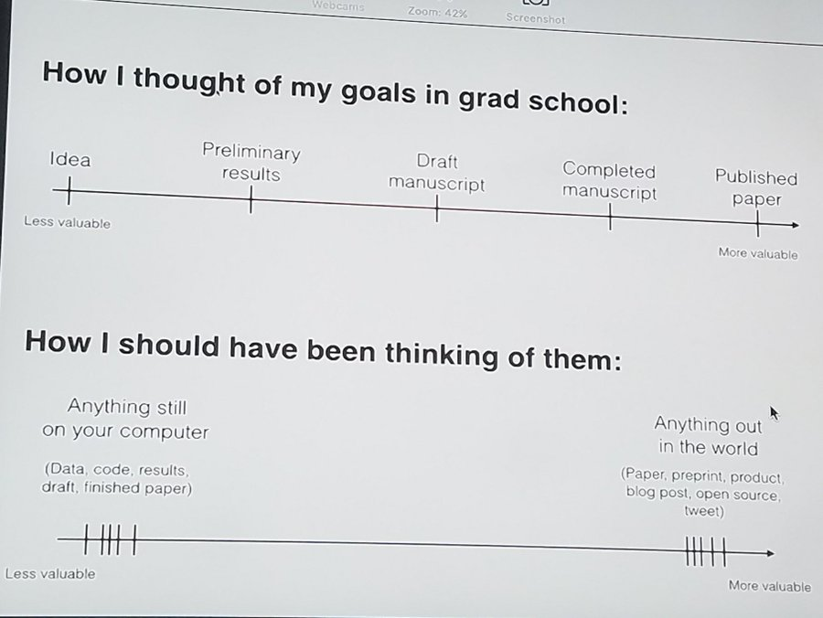
Move content out of my computer as fast as possible
Reproducible
Git-based collaboration
Write once, generate:
Code
Paper
PowerPoint
Site/documentation
The content value chain from David Robinson’s (@drrob) Tweet

Slide 4
In the last 20 years, I tried many tools…

Slide 5
LaTeX
Great for PDFs… Ok, Beamer!
Website generation is not great
I even know how to write code!
\usepackage{ifthen}
@for, @while
Word/PPT
Hard to collaborate before O365
Hard to reproduce / auto-generate
Jekyll
Great for sites
Not great for PPT, papers
RMarkdown
Great PDFs
Mostly good presentations
Hugo and blogdown work well
Need to learn R

Slide 6
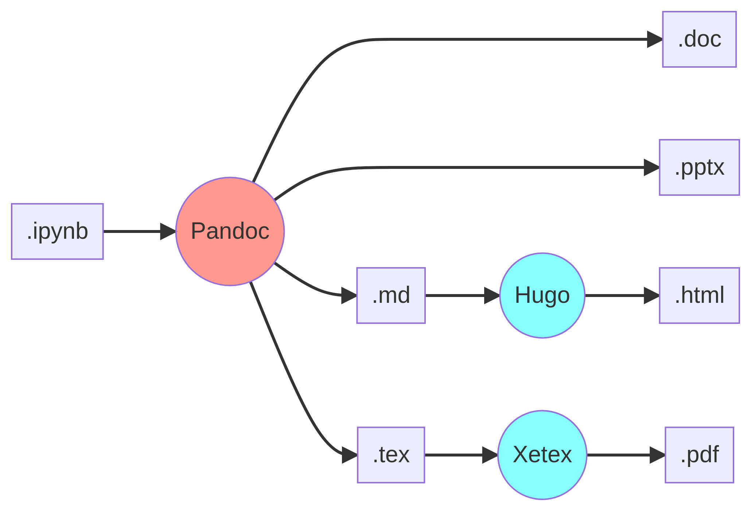
The content pipeline for .ipynb
About 75% of data scientists use Python through Jupyter notebooks, and one can use pandoc to generate papers and PowerPoint, but it can be complicated.

Slide 7
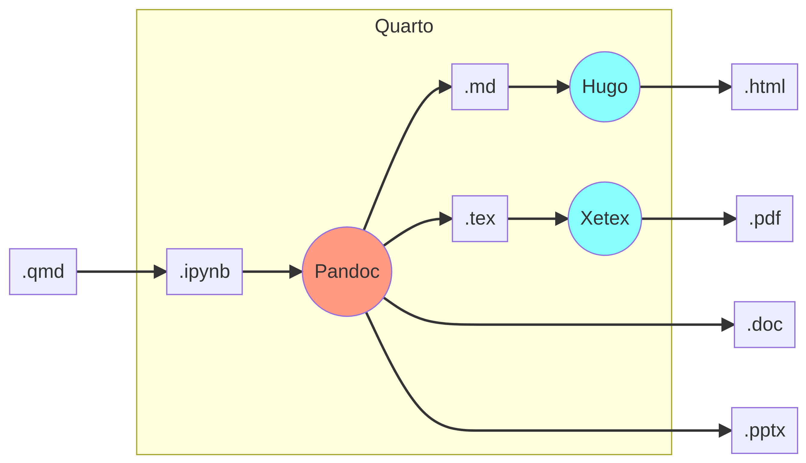
Quarto for Python, in a nutshell
In Quarto’s .qmd files, you write Markdown and code, just like .ipynb. Add some YAML configuration and Quarto does the intermediate steps. It integrates well with VSCode and Jupyter.

Slide 8
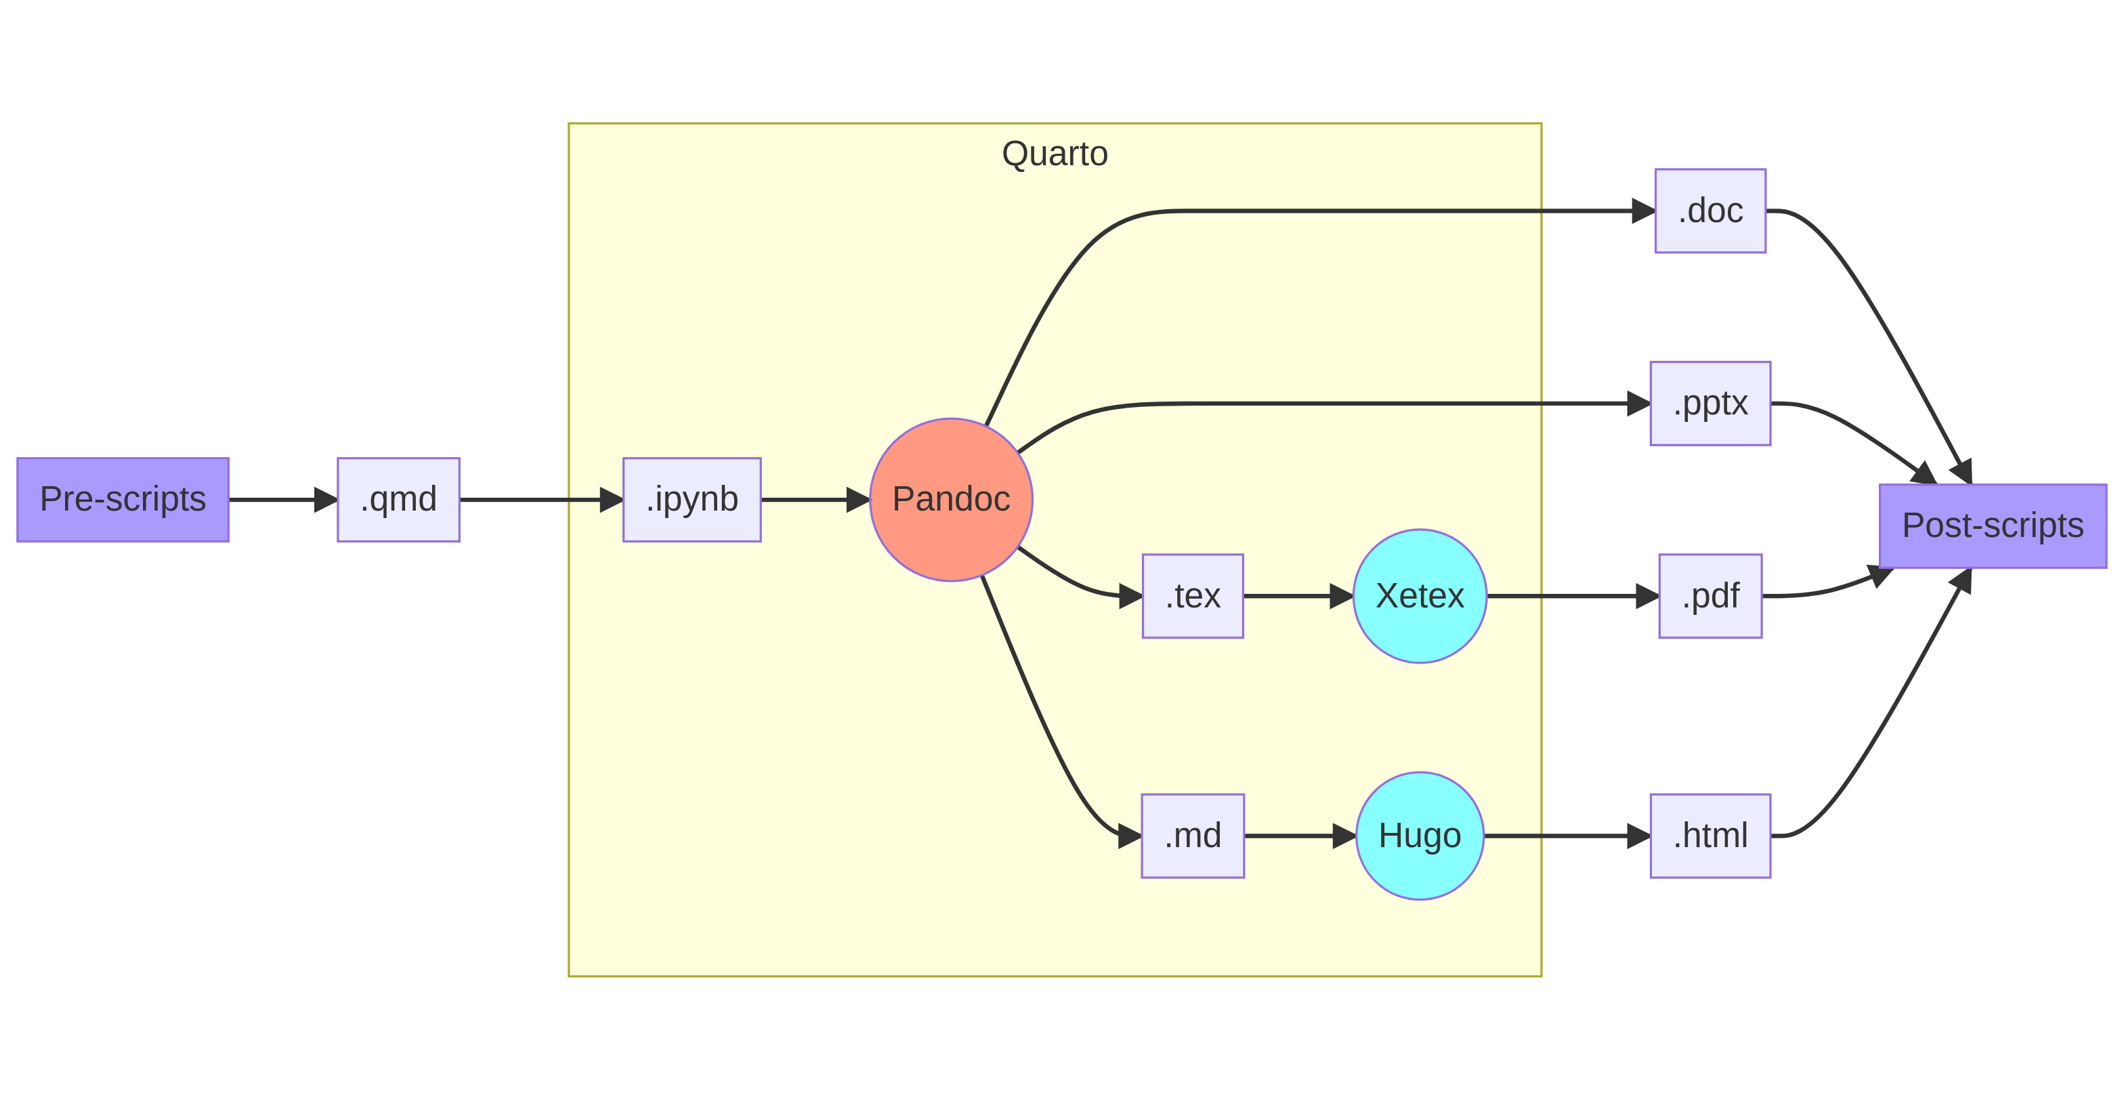
But wait, there’s more!
Quarto can easily run pre-scripts and post-scripts. I frequenly use this to pre-process data and to automatically publish output to git repositories.

Slide 9
Using Quarto
The basics

Slide 10
Whether you use Quarto from .qmd, .ipynb, or .Rmd files, you always start with a YAML front-matter file.
The YAML configuration determines what’s the output format of your document. A few popular output options are html, pptx, docx, and pdf.
You can use a single source file to generate multiple output types.
For example, the YAML on the right will generate a PowerPoint file and a Revealjs presentation.
--- title: "Using Quarto for everything" format: pptx: reference-doc: templates/template.pptx revealjs: incremental: false theme: sky author: Lucas A. Meyer date: 2022-07-14 ---

Slide 11
Main content

Slide 12
### Writing the main content Most writing in Quarto is done in [Markdown]. Quarto's Markdown supports everything I'm used to: figures, tables, bibliography, etc. It also supports lots of extra features, like diagrams with `mermaid` and `GraphViz` and even LaTeX equations: $$ E = mc^2 $$
Writing the main content
Most writing in Quarto is done in Markdown.
Quarto’s Markdown supports everything I’m used to: figures, tables, bibliography, etc.
It also supports lots of extra features, like diagrams with mermaid and GraphViz and even LaTeX equations:
$$E=mc^{2}$$

Slide 13
What if I want to add code?

Slide 14
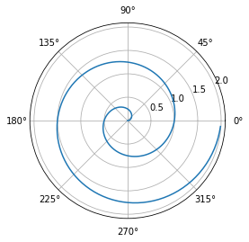
The best thing about Quarto is that you can use it to run any code that you would be able to run in a Python notebook.
import numpy as np import matplotlib.pyplot as plt r = np.arange(0, 2, 0.01) theta = 2 * np.pi * r fig, ax = plt.subplots(subplot_kw=\ {'projection': 'polar'}) ax.plot(theta, r) ax.set_rticks([0.5, 1, 1.5, 2]) ax.grid(True) plt.show()

Slide 15
Presentations in Quarto
Basic slide syntax

Slide 16
To create slides, you create sections with `#`, titles with `##`, and bullets with `-`. Quarto will render your content in slide form. ### Content types - You can add several types of content - code (use backticks) - images - diagrams - tables - etc.
To create slides, you create sections with #, titles with ##, and bullets with -.
Content types
You can add several types of content
code (use backticks)
images
diagrams
tables
etc.

Slide 17
Best feature: generate content dynamically
Let’s say you’re presenting a project about population dynamics but you don’t know which world leaders are coming to the conference.
On the presentation day, you learn that Belgium, China, Brazil, India, Japan and Nigeria are attending.
The next slides were generated using the code below:
df_dr = pd.read_csv("data/dr.csv.gz", compression="gzip") df_pop = pd.read_csv("data/pop_brackets.csv.gz", compression="gzip") years = [2000, 2025, 2050, 2075, 2100] regions = ["Belgium", "China", "Brazil", "India", "Japan", "Nigeria"] for name in regions: display(Markdown(f"## Age and Population Pyramids for {name}")) display(Markdown(f'<div class="columns">')) display(Markdown(f'<div class="column">')) plot_dependency_ratio(df_dr[df_dr.Location == name]) display(Markdown(f'</div>')) display(Markdown(f'<div class="column">')) plot_population_pyramid_series(df_pop[df_pop["Location"]==name], years) display(Markdown(f'</div>')) display(Markdown(f'</div>'))
Age and Population Pyramids for Belgium

Slide 18
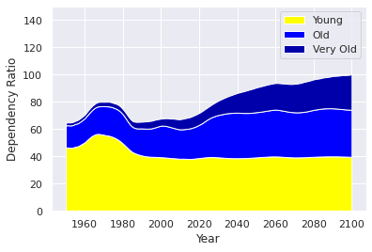
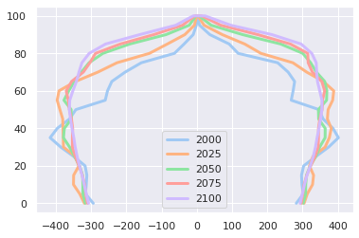

Slide 19
Age and Population Pyramids for China

Slide 20
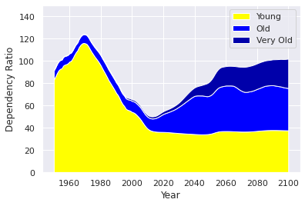
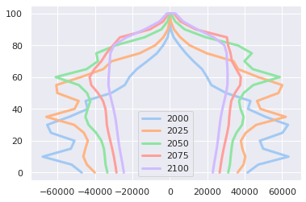

Slide 21
Age and Population Pyramids for Brazil

Slide 22
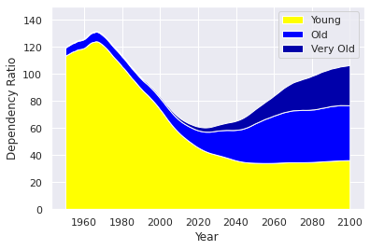
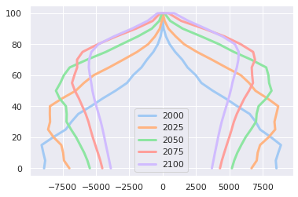

Slide 23
Age and Population Pyramids for India

Slide 24
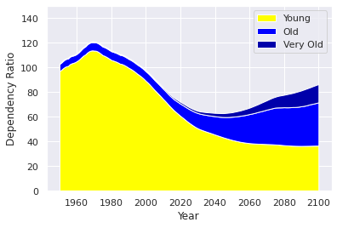
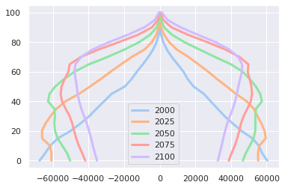

Slide 25
Age and Population Pyramids for Japan

Slide 26
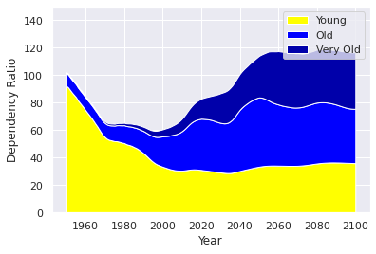
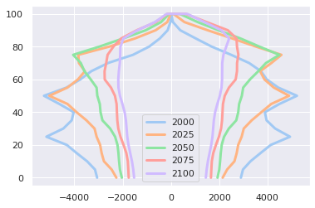

Slide 27
Age and Population Pyramids for Nigeria

Slide 28
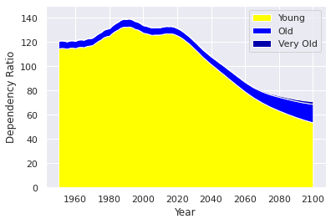
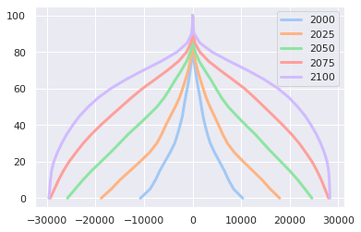

Slide 29
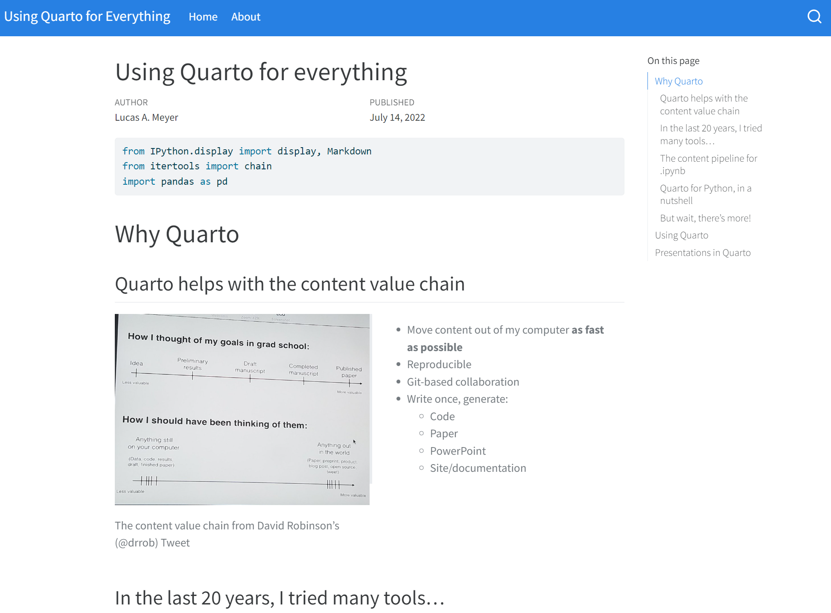
Websites
What I get by just changing the format in YAML
--- title: "Using Quarto for everything" format: html # revealjs: # incremental: false # theme: [simple, revealjs-customizations.scss] # title-slide-attributes: # data-background-image: images/data-viz-bg.jpg # data-background-size: contain # data-background-position: right author: Lucas A. Meyer date: 2022-07-14 ---
To avoid overwriting the slides, I’m generating a new file for the website.
You can see the result here, and a screenshot in the next slide.
Render presentation as a website

Slide 30
Articles

Slide 31
Projects
You can use Quarto to generate the whole shebang!

