Slide 1
Using Quarto for everything
Lucas A. Meyer

Slide 2
Why Quarto

Slide 3
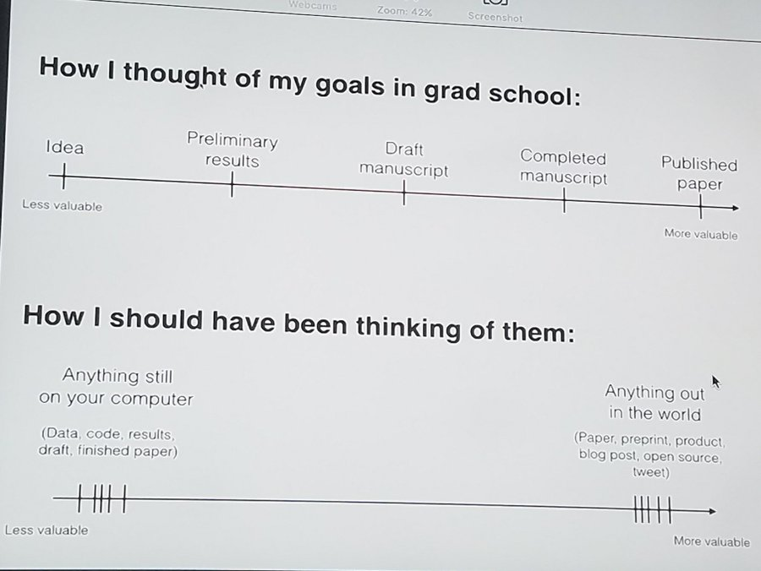
Quarto helps with the content value chain
Move content out of my computer as fast as possible
Reproducible
Git-based collaboration
Write once, generate:
Code
Paper
PowerPoint
Site/documentation
The content value chain from David Robinson’s (@drrob) Tweet

Slide 4
Also… the population project
Goals and questions
Explore the consequences of the decline in population predicted to start at around 2100 for the world, but earlier in developed nations.
What are the economic impacts?
What should governments do?
Population project challenges
Unknown collaborators at the start
Need to go “wide” rather than “deep”
May need to pivot fast
May need to generate data on demand
Show graphs for country X, Y and Z
Generate code, paper, PowerPoint

Slide 5
In the last 20 years, I tried many tools…
LaTeX
Great for PDFs… Ok, Beamer!
Website generation is not great
I even know how to write code!
\usepackage{ifthen}
@for, @while
Word/PPT
Hard to collaborate before O365
Hard to reproduce / auto-generate
Jekyll
Great for sites
Not great for PPT, papers
RMarkdown
Great PDFs
Mostly good presentations
Hugo and blogdown work well
Need to learn R

Slide 6
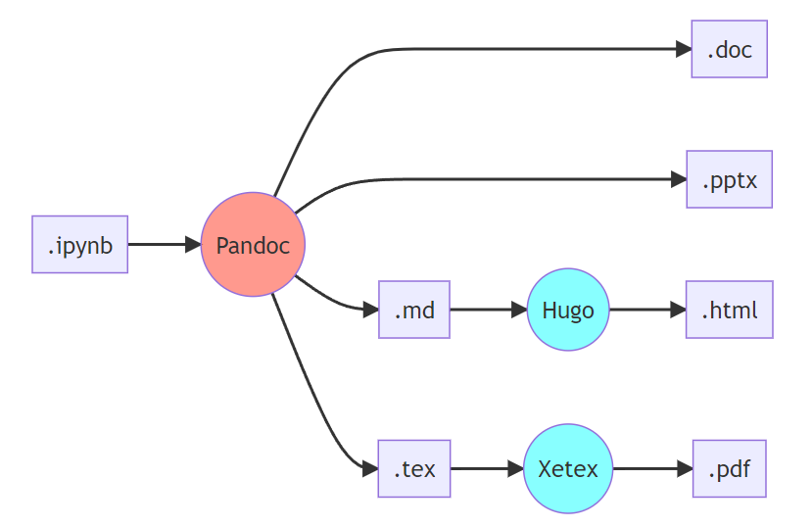
The content pipeline for .ipynb
About 75% of data scientists use Python through Jupyter notebooks, and one can use pandoc to generate papers and PowerPoint, but it can be complicated.
Processing ipynb

Slide 7
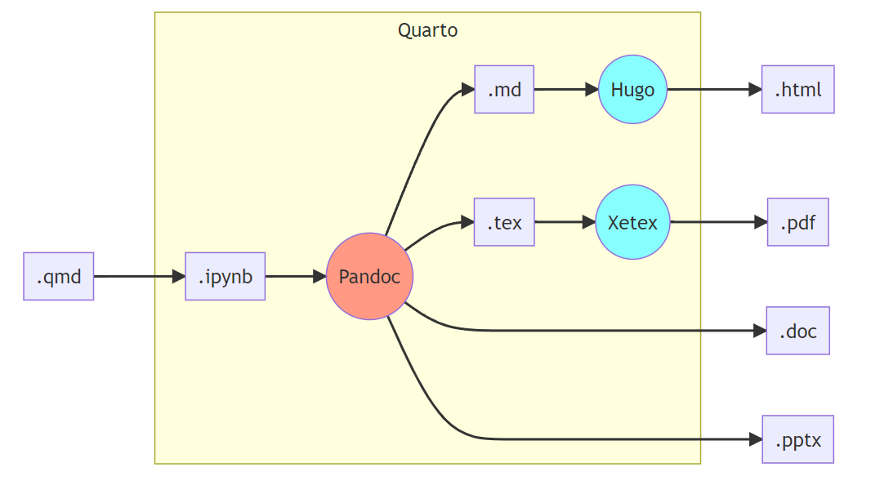
Quarto for Python, in a nutshell
In Quarto’s .qmd files, you write Markdown and code, just like .ipynb. Add some YAML configuration and Quarto does the intermediate steps. It integrates well with VSCode and Jupyter.
Quarto using Python

Slide 8
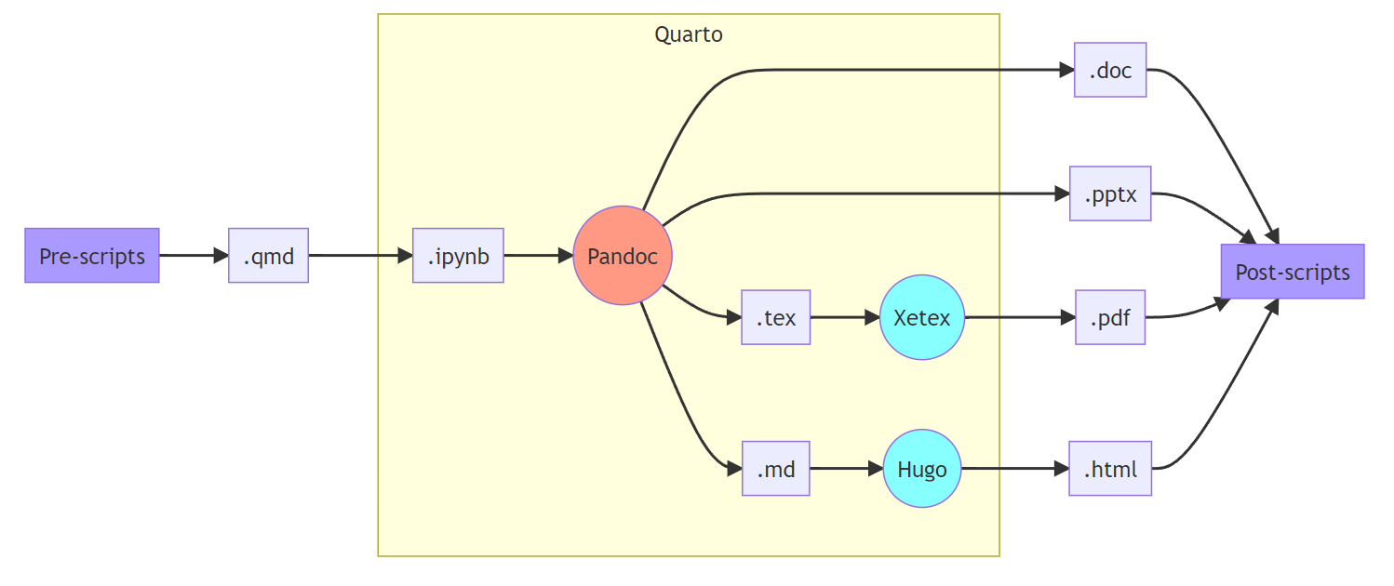
But wait, there’s more!
Quarto can easily run pre-scripts and post-scripts. I frequenly use this to pre-process data and to automatically publish output to git repositories.
Scripts

Slide 9
Using Quarto

Slide 10
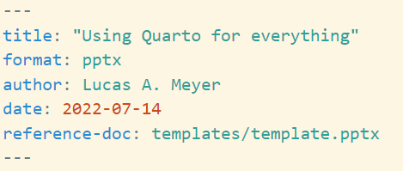
The basics
Whether you use Quarto from .qmd, .ipynb, or .Rmd files, you always start with a YAML front-matter file.
The YAML configuration determines what’s the output format of your document. A few popular output options are html, pptx, docx, and pdf.
You can use a single source file to generate multiple output types.
YAML

Slide 11
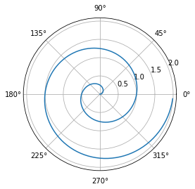
What if I want to add code?
import numpy as np import matplotlib.pyplot as plt r = np.arange(0, 2, 0.01) theta = 2 * np.pi * r fig, ax = plt.subplots(subplot_kw={'projection': 'polar'}) ax.plot(theta, r) ax.set_rticks([0.5, 1, 1.5, 2]) ax.grid(True) plt.show()

Slide 12
<<<<<<< HEAD # Presentations in PowerPoint

Slide 13
Things that you can add to a template

Slide 14
This is the part of Quarto I liked the least.
To generate a presentation from a .qmd file, add format: pptx to the YAML front-matter.
Quarto will use the pandoc PowerPoint rules to render the content from the .qmd into the .pptx.
::: ::: {.column} - Quarto can use a template with (only) these layouts: - Title Slide - Title and Content - Section Header - Two Content - Comparison - Content with Caption - Blank ::: :::: {.columns}

Slide 15
Dependency ratios around the world

Slide 16
Population pyramids around the world

Slide 17
Projects
You can use Quarto to generate the whole shebang!

Slide 18
Appendix

Slide 19
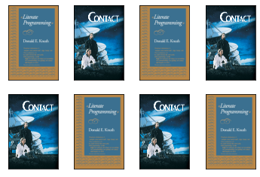
Test multiple images
This slide uses the “Caption plus stuff” template

Slide 20
Mermaid Diagram 1

Slide 21
Mermaid Diagram 2
Mermaid Diagram 3

