Slide 1
Using Quarto with Python
Lucas A. Meyer

Slide 2
Why Quarto

Slide 3
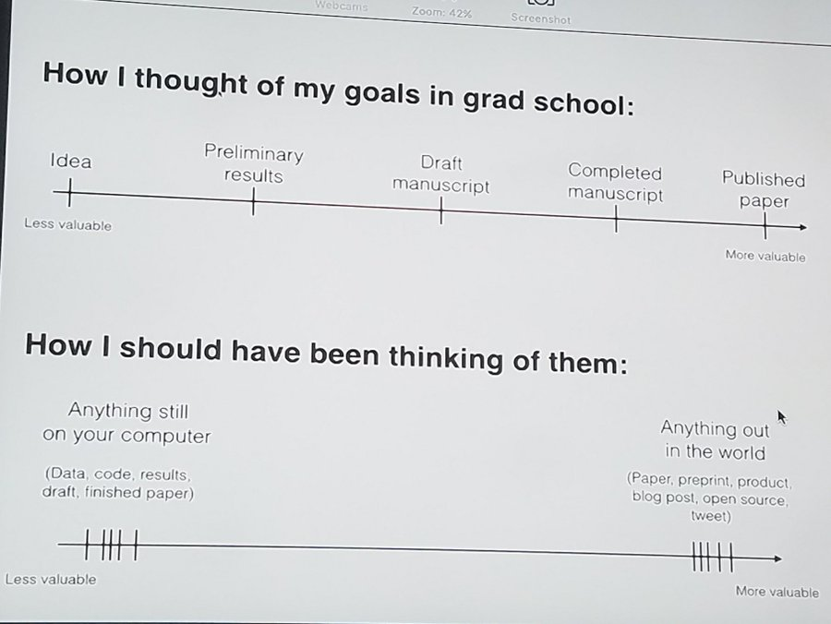
The content value chain
Content stuck in my computer is nearly worthless.
Goal
Move good content out of my computer as fast as possible
Reproducible
Git-based collaboration
Write once, generate:
Code
Paper
PowerPoint
Site/documentation
The content value chain by (@drrob) captured by Amelia McNamara

Slide 4
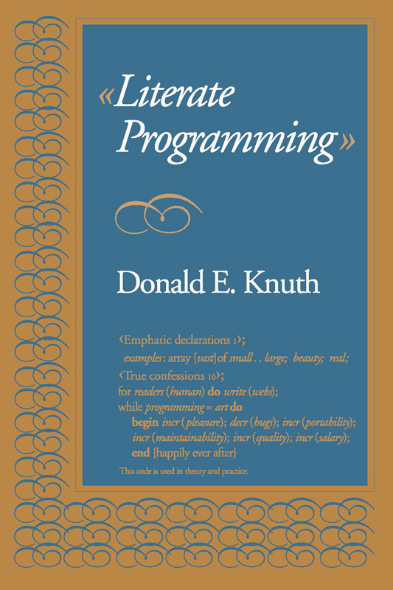
Literate Programming
Literate programming can help create high-quality reproducible, documented code.
Donald E. Knuth proposed literate programming in a 1984 article.
Jupyter implements the literate programming paradigm, but generating high-quality mass-consumable output (articles, websites) requires additional tools.
Donald Knuth’s Literate Programming book

Slide 5
I tried many tools for Literate Programming
LaTeX
Great for PDFs… Beamer for slides
Not great for websites
Dynamic content: coding Latex
\usepackage{ifthen}
@for, @while
Word/PPT
Hard to collaborate before O365
Hard to reproduce / auto-generate
Jekyll / Github Pages
Great for sites
Not great for slides, papers
Python notebooks
Great, with Pandoc
RMarkdown
Great for everything
Heavily dependent on R
New features in Quarto

Slide 6
Quarto
Quarto® is an open-source scientific and technical publishing system built on Pandoc.
The name “quarto” comes from the format of a book or pamphlet printed with eight pages of text, four to a side, then folded twice to produce four leaves.
The earliest known European printed book, the Sibyllenbuch (Gutemberg, c.1452), was done in the quarto format. Shakespeare’s plays, too!
With Quarto, you can:
Write Markdown and Python (or R, Julia, OJS)
Use equations, diagrams, citations, figures, etc.
Output articles, presentations, interactive websites…
Work with Jupyter Lab or VSCode
You can install Quarto on Linux, Windows and Mac.

Slide 7
Quarto workflow

Slide 8
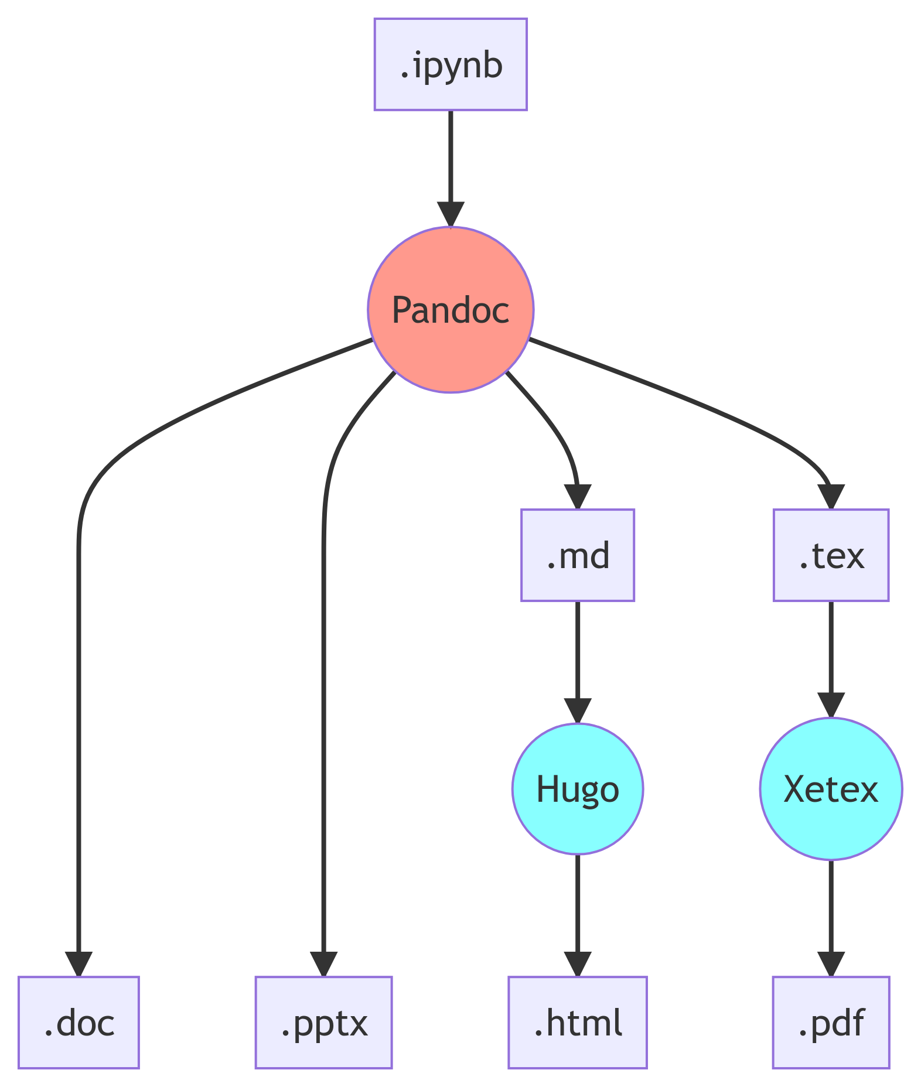
The content pipeline for .ipynb
About 75% of data scientists use Python through Jupyter notebooks.
With some scripting, you can use Pandoc on .ipynb files to generate papers, HTML, PowerPoint, etc.
You just need to learn Pandoc and shell scripting.

Slide 9
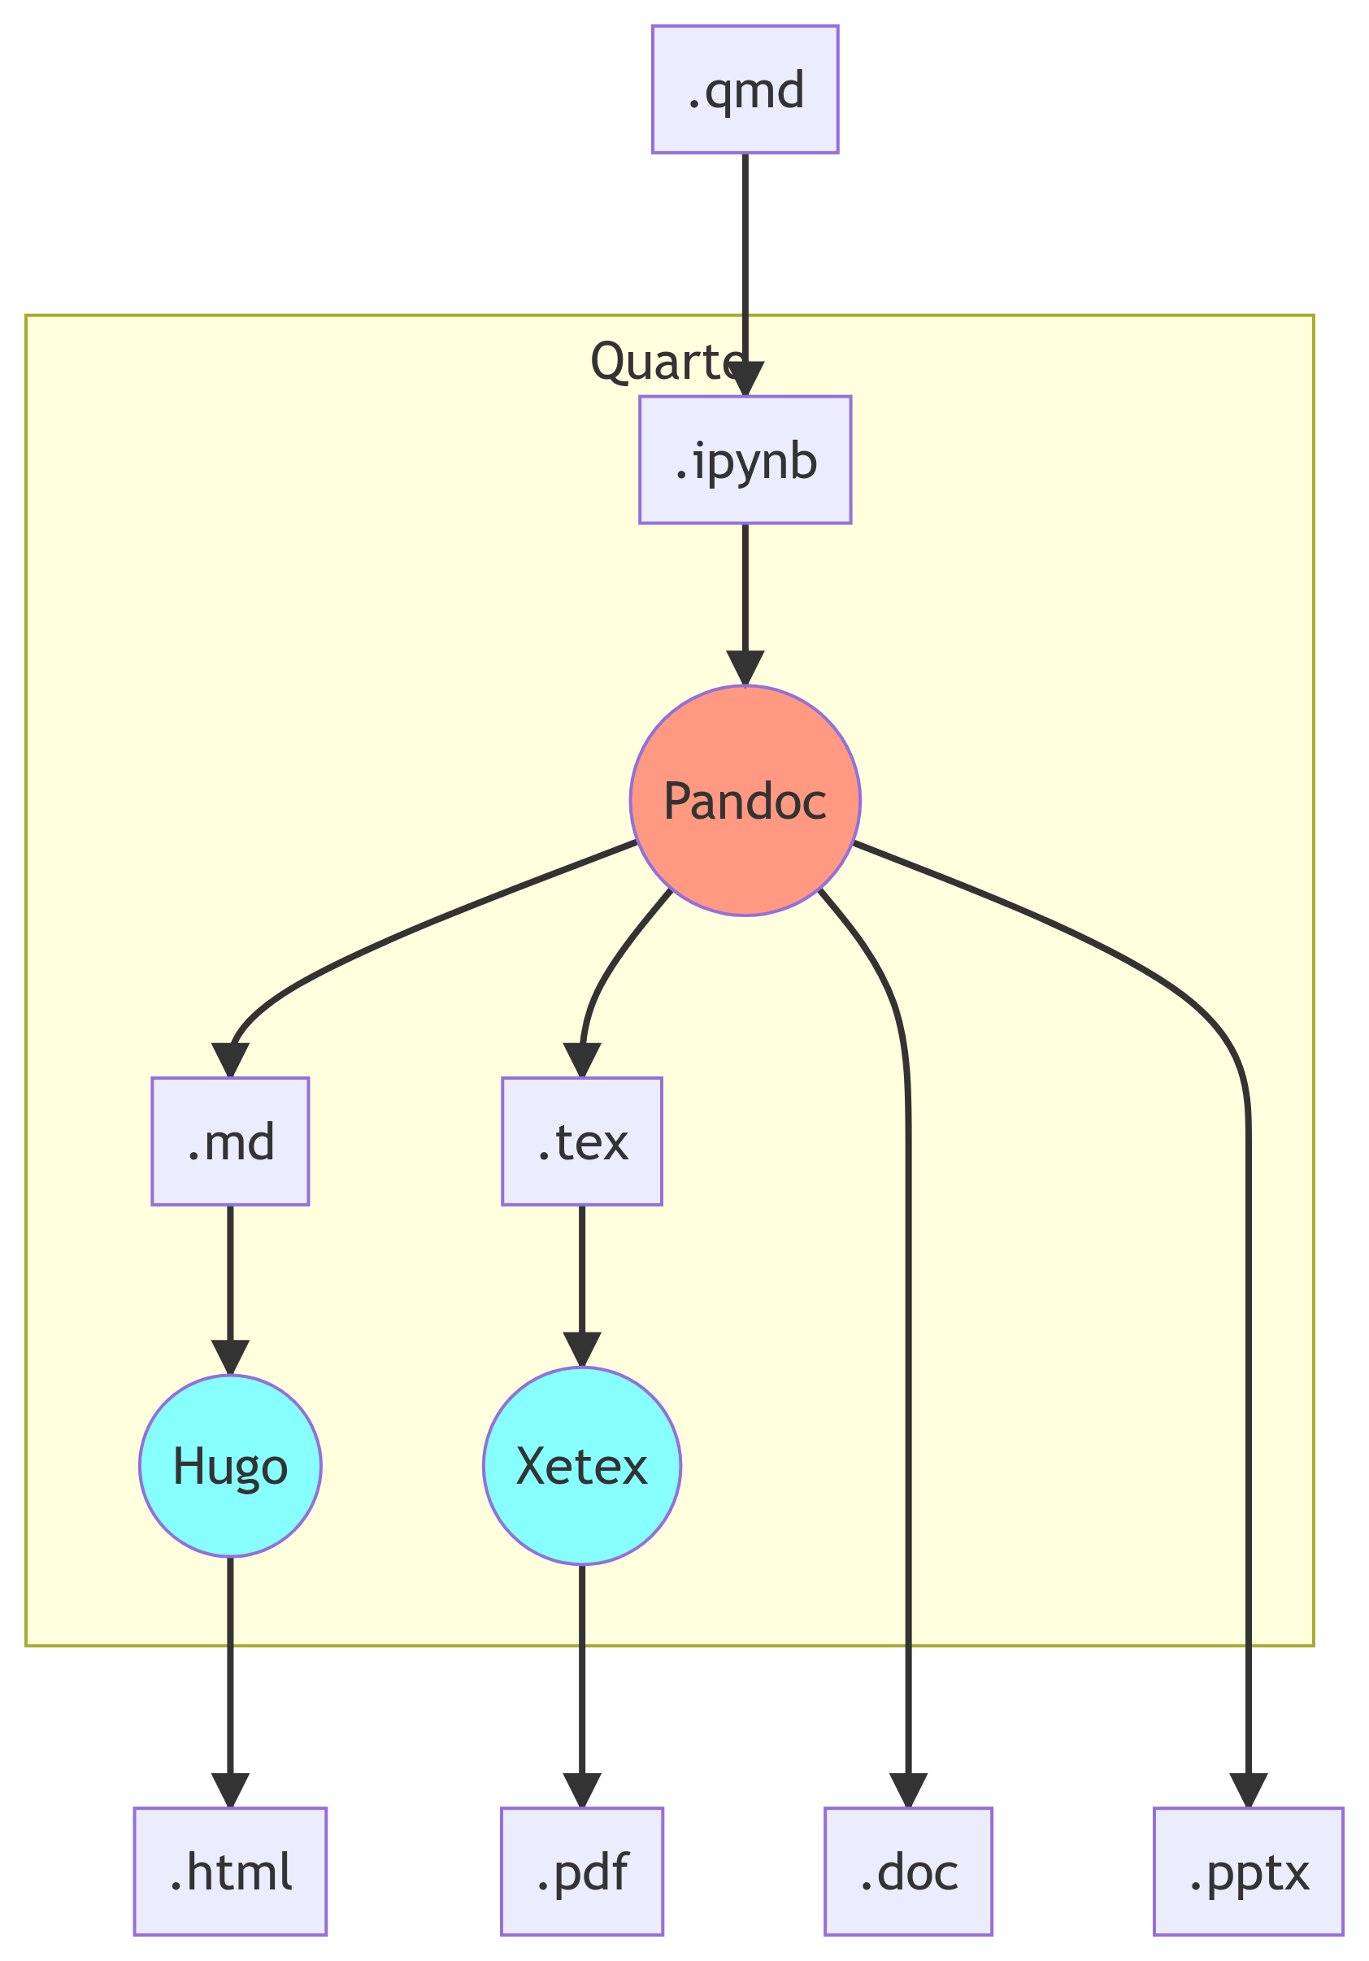
Quarto in Python, in a nutshell
All you need to use Quarto is to add some YAML (mostly simplified Pandoc configurations) to a .qmd file.
ipynb + YAML = .qmd.
This keeps the configuration and content in the same file. You can then render the outputs using quarto render <file.qmd> in the command line.

Slide 10
Using Quarto

Slide 11
The YAML front-matter
Quarto files always start with a YAML front-matter.
The YAML configuration determines what’s the output format of your document. A few popular output options are html, pptx, docx, and pdf.
You can use a single source file to generate multiple output types.
For example, the YAML on the right will generate a PowerPoint file and a Revealjs presentation.
--- title: "Quarto with Python" format: pptx: reference-doc: templates/template.pptx revealjs: incremental: false theme: pulse author: Lucas A. Meyer date: 2022-07-07 ---

Slide 12
Main content
Writing content
Write content in Markdown.
Quarto’s Markdown supports figures, tables, bibliography, etc.
It also supports lots of extra features, like diagrams with mermaid and GraphViz, and even LaTeX equations:
$$E=mc^{2}$$
### Writing content Write content in [Markdown]. Quarto's Markdown supports figures, tables, bibliography, etc. It also supports lots of extra features, like diagrams with `mermaid` and `GraphViz`, and even LaTeX equations: $$ E = mc^2 $$

Slide 13
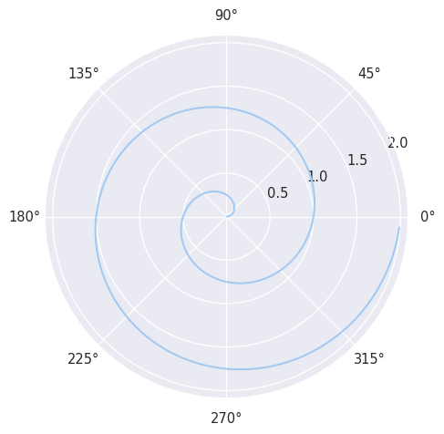
What if I want to add code?
The best thing about Quarto is that you can use it to run any code that you would be able to run in a Python notebook.
import numpy as np import matplotlib.pyplot as plt r = np.arange(0, 2, 0.01) theta = 2 * np.pi * r fig, ax = plt.subplots(subplot_kw=\ {'projection': 'polar'}) ax.plot(theta, r) ax.set_rticks([0.5, 1, 1.5, 2]) ax.grid(True) plt.show()

Slide 14
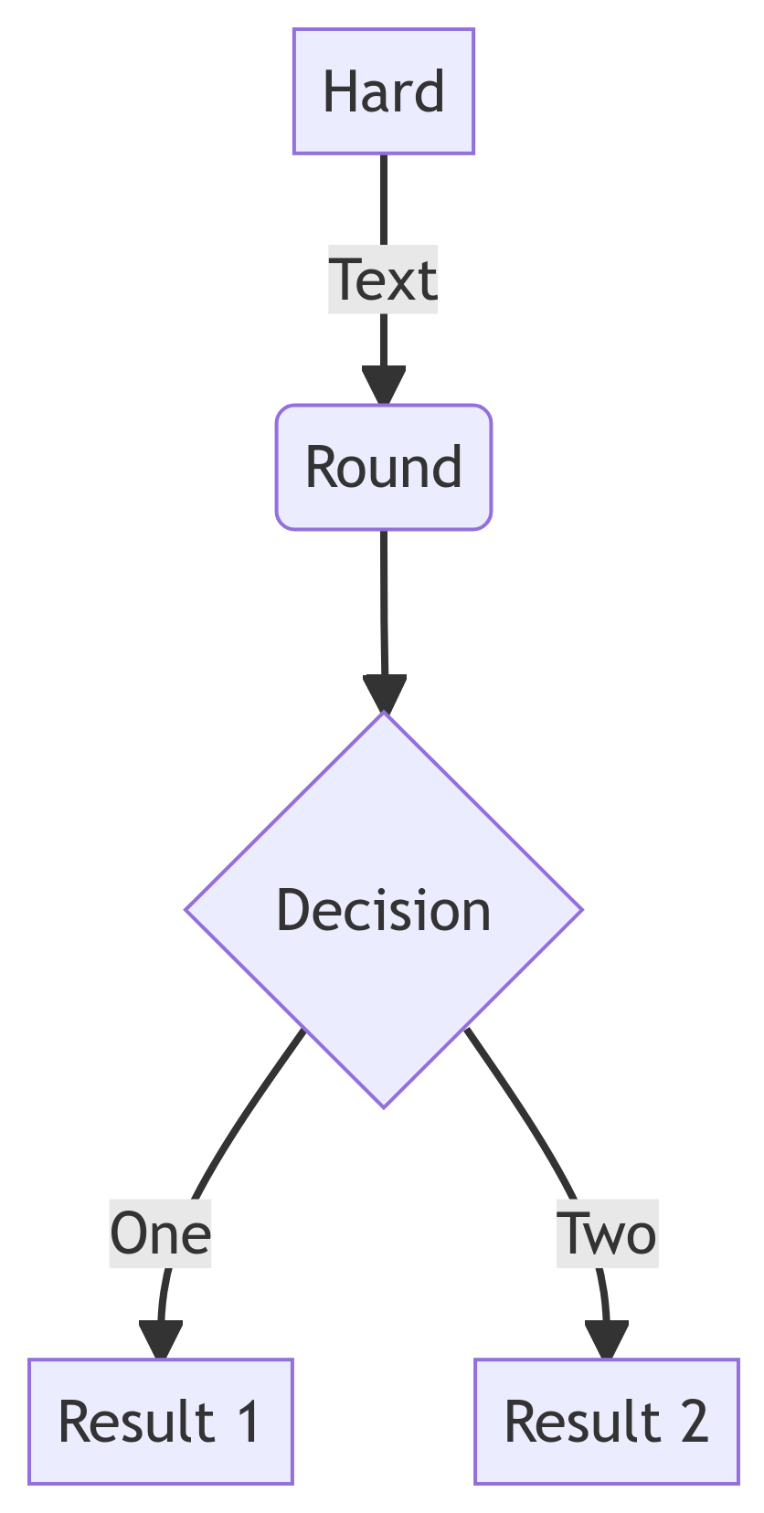
Diagrams
You can use mermaid to create diagrams.
The diagram in this and in previous sections were created with mermaid.
flowchart TD A[Hard] -->|Text| B(Round) B --> C{Decision} C -->|One| D[Result 1] C -->|Two| E[Result 2]

Slide 15
Regression and results
This code runs the first simple regression in Wooldridge’s Econometrics.
$$\text{wage}=α+β_{1}×\text{educ}+ϵ$$
# Load the data df_wage = pd.read_csv("data/wage1.csv") # Create an OLS model using # the R syntax - assumes an intercept mod = smf.ols(formula="wage ~ educ", data=df_wage) # Fit the model res = mod.fit() # Show the results display(Markdown(md(res.summary().tables[1].as_html())))
coef | s.e. | t | p-value
-0.9049 | 0.685 | -1.321 | 0.187
0.5414 | 0.053 | 10.167 | 0

Slide 16
Presentations in Quarto

Slide 17
Basic slide syntax
To create slides, you create sections with #, titles with ##, and bullets with -.
Content types
You can add several types of content
code (use backticks)
images
diagrams
tables
etc.
## Basic slide syntax To create slides, you create sections with `#`, titles with `##`, and bullets with `-`. ### Content types - You can add several types of content - code (use backticks) - images - diagrams - tables - etc.

Slide 18
Creating PowerPoint slides
To generate a presentation from a .qmd file, add format: pptx to the YAML front-matter.
Quarto will use the pandoc PowerPoint rules to render the content from the .qmd into .pptx.
The “pandoc rules” limit the flexibility to create PowerPoint presentations. Quarto has better presentation support for revealjs and beamer.
PowerPoint can use a template with only these layouts:
Title Slide
Title and Content
Section Header
Two Content
Comparison
Content with Caption
Blank

Slide 19
PowerPoint layout rules
The rules are available at: https://pandoc.org/MANUAL.html#powerpoint-layout-choice
Title Slide: created from metadata fields like title and author
Section Header: created from the top-level headings (#)
Two Content: used when .md source contains :::: {.columns} and only text content
Comparison: same as “Two Content”, but content of columns is not text
Content with Caption: used when slide has non-text content, but no columns
Title and Content: whatever doesn’t fit the rules above.

Slide 20
PowerPoint templates
By adding a reference-doc entry to your YAML, you can tell Quarto (and pandoc) to use a file as a template for the format of your presentation.
The “Slide Master” needs to contain layouts named as per the previous slide (e.g. “Comparison”).
This allows you a lot of flexibility in the design of your slide deck, even if it is for just the small number of layouts that were listed in the previous slide.
You can control fonts, add background images, page numbering, etc.
--- title: "Using Quarto for everything" format: pptx reference-doc: templates/template.pptx author: Lucas A. Meyer date: 2022-07-14 ---

Slide 21
Best feature: generate content dynamically
Let’s say you’re presenting a project about population dynamics but you don’t know which world leaders are coming to the conference.
On the presentation day, you learn that Belgium, China, Brazil, India, Japan and Nigeria are attending.
You can use Python or R to automatically generate slides.

Slide 22
Generating slides with Python
The next slides/sections were generated using the code below:
df_dr = pd.read_csv("data/dr.csv.gz", compression="gzip") df_pop = pd.read_csv("data/pop_brackets.csv.gz", compression="gzip") years = [2000, 2025, 2050, 2075, 2100] regions = ["Belgium", "China", "Brazil", "India", "Japan", "Nigeria"] for name in regions: display(Markdown(f"## Age and Population Pyramids for {name}")) display(Markdown(f'<div class="columns">')) display(Markdown(f'<div class="column">')) plot_dependency_ratio(df_dr[df_dr.Location == name]) display(Markdown(f'</div>')) display(Markdown(f'<div class="column">')) plot_population_pyramid_series(df_pop[df_pop["Location"]==name], years) display(Markdown(f'</div>')) display(Markdown(f'</div>'))

Slide 23
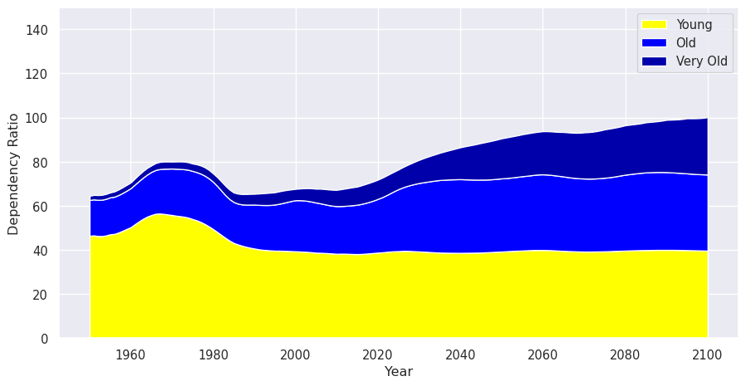
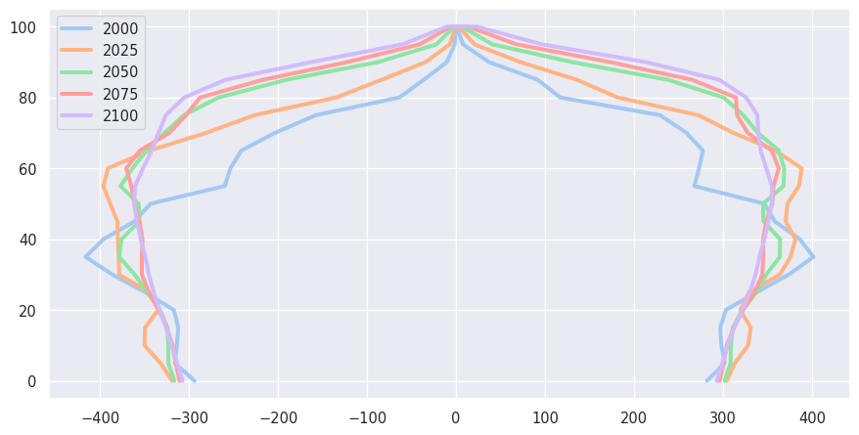
Age and Population Pyramids for Belgium

Slide 24
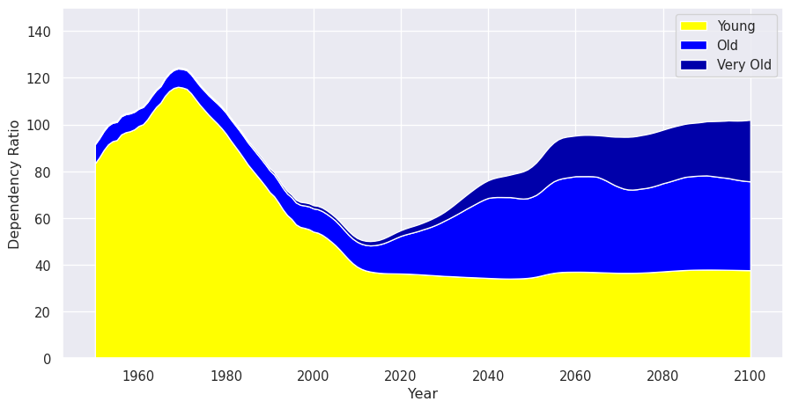
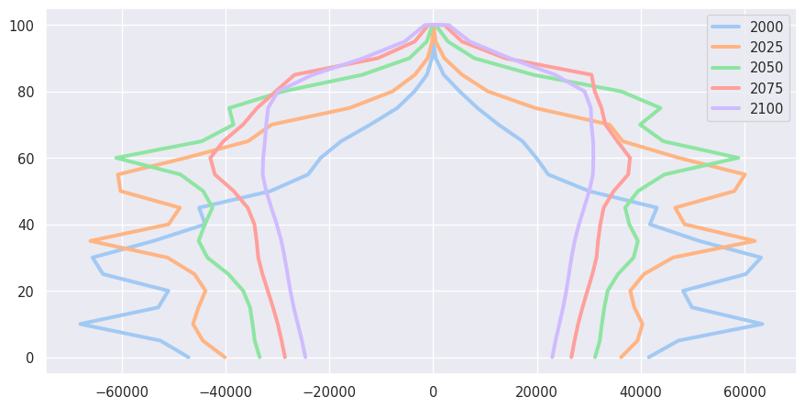
Age and Population Pyramids for China

Slide 25
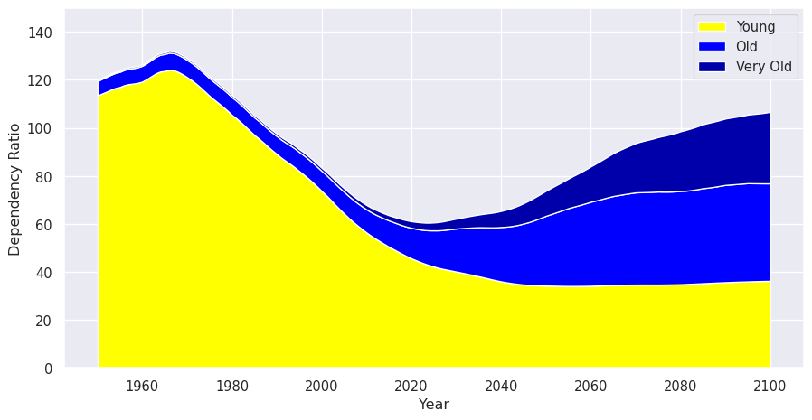
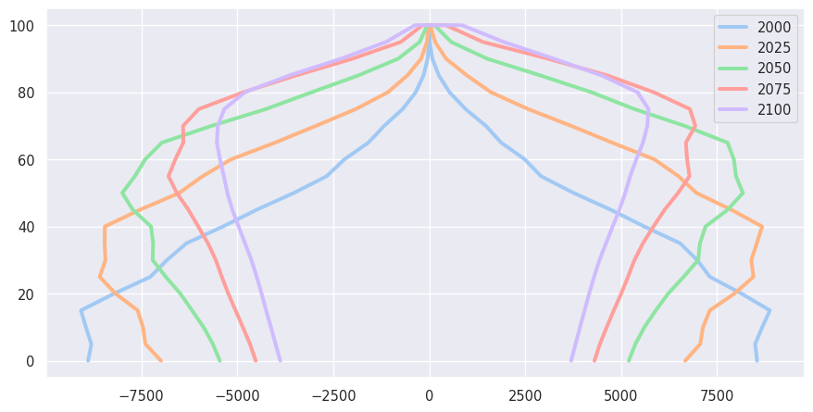
Age and Population Pyramids for Brazil

Slide 26
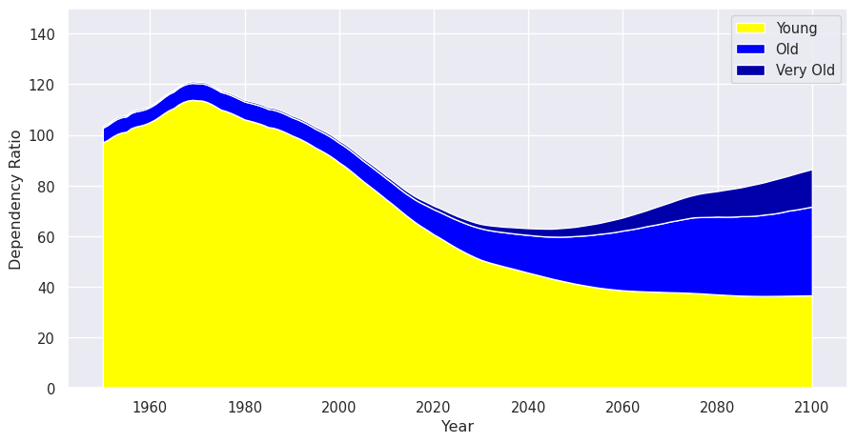
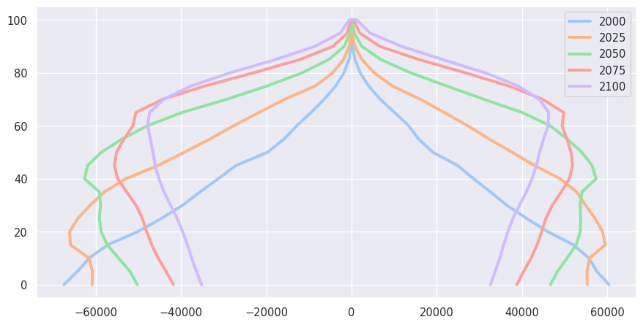
Age and Population Pyramids for India

Slide 27
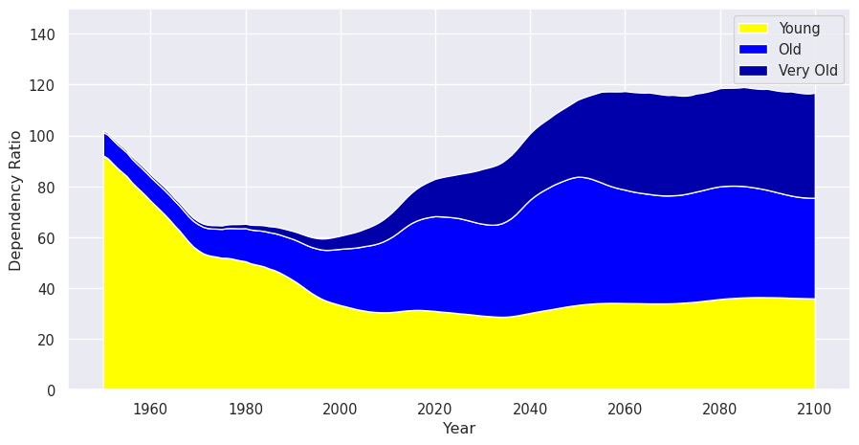
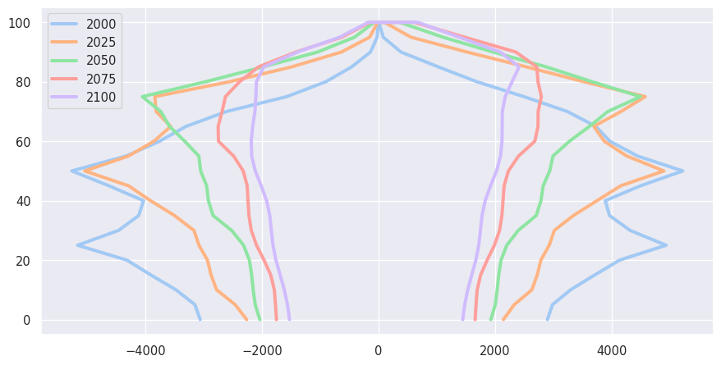
Age and Population Pyramids for Japan

Slide 28
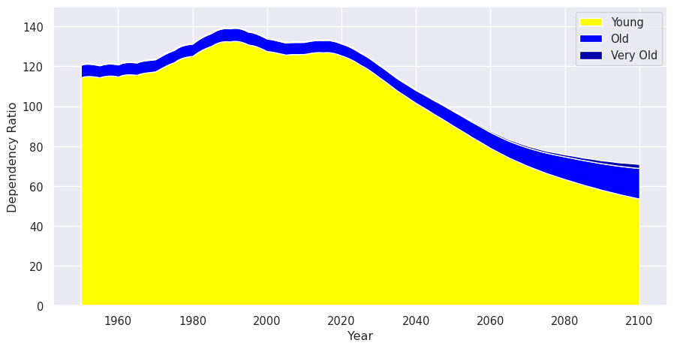
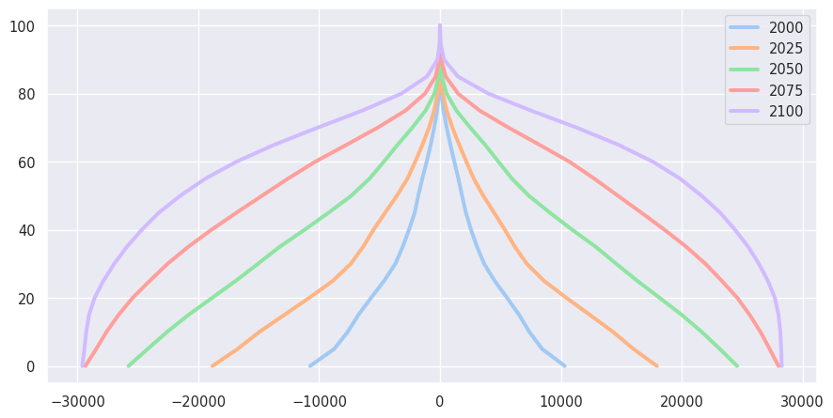
Age and Population Pyramids for Nigeria

Slide 29
Generating a website

Slide 30
One-liner creates a website
--- title: "Quarto with Python" format: html # revealjs: # incremental: false # theme: [simple, revealjs-customizations.scss] # title-slide-attributes: # data-background-image: images/data-viz-bg.jpg # data-background-size: contain # data-background-position: right author: Lucas A. Meyer date: 2022-07-14 ---
Adding or changing the format to html will create a website.

Slide 31
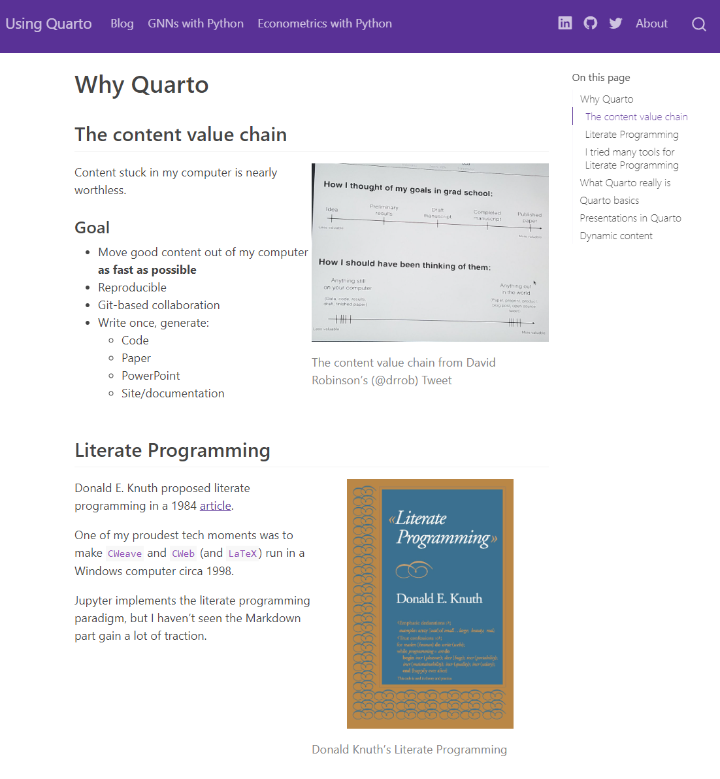
Screenshot of website

Slide 32
Scholarly articles

Slide 33
Writing scholarly articles
I reused some of the content of this presentation to create two scholarly-looking articles. The purpose of the articles is just to show how easy it is to generate them with Quarto, they don’t contain original research. Quarto add cross-reference, citations and bibliography support to Markdown.
The relevant files are:
Quarto source file
Microsoft Word output
LaTeX PDF output `

Slide 34
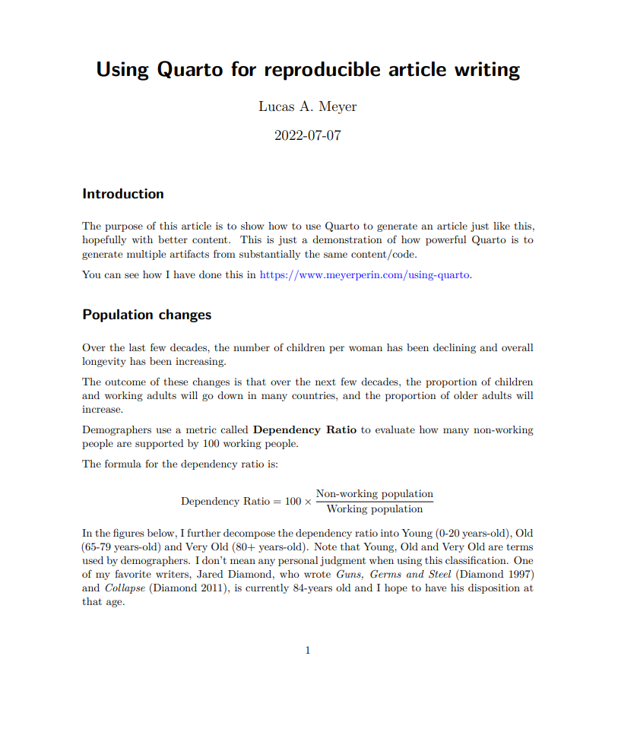
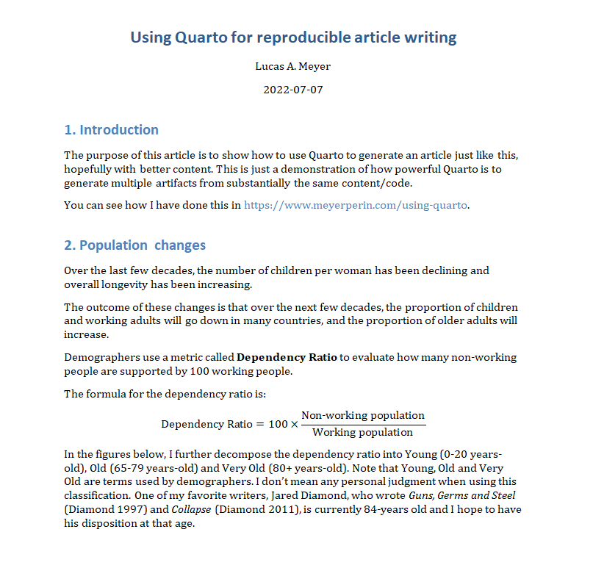
Scholarly article screenshots
PDF version of the article
Microsoft Word version of the article

Slide 35
Citations and Footnotes
Citations don’t work on presentations, but are easy to add to articles.
You need to reference a BibTex file in the YAML front-matter bibliography: references.bib. Quarto supports any of the 8000+ Citation Style Languages and will generate the “References” section automatically.
You can cite by using [@citation-name] in your text. Please check the article .qmd source and the PDF and DOCX outputs.
Generating footnotes is also easy. Using [^ref] links to a footnote, and [^ref: content of the footnote] generates its content¹.

Slide 36
Books in Quarto

Slide 37
Books in Quarto
You can also write books with quarto. From the same collection of .qmd files, Quarto can generate:
ePub
PDF
Online book
Two recent examples are:
Hands-on Programming in R, by Garrett Grolemund (source)
Python for Data Analysis, 3E, by Wes McKinney (source)

Slide 38
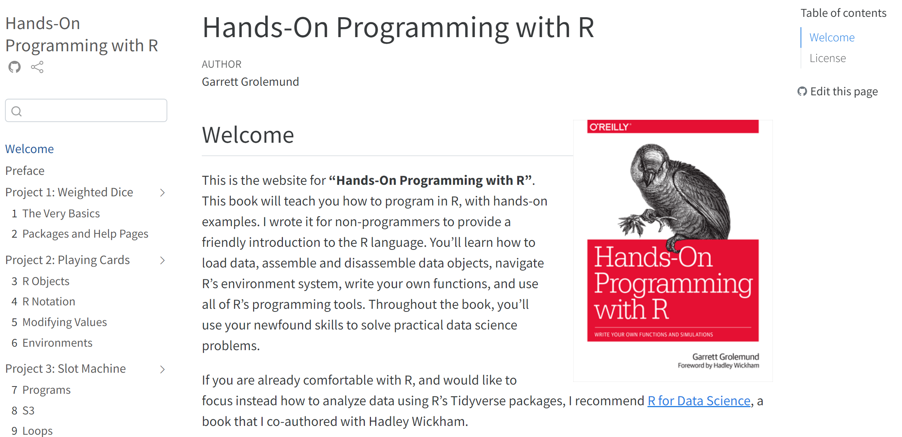
Hands-on Programming in R
This is a free book, and you can see the Quarto (source) that generated it.

Slide 39
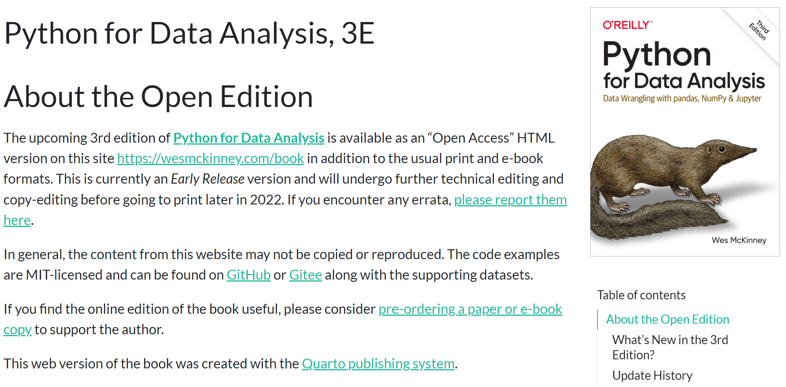
Python for Data Analysis, 3E
This is another free book, and you can see the Quarto (source) that generated it.

Slide 40
Should I use Quarto?

Slide 41
Where I think Quarto is good (July 2022)
Articles: maybe
I think Quarto is more helpful for a team that already uses Git with Python notebooks or LaTeX to write articles.
Microsoft Word collaboration through SharePoint and Teams is easier than Git and Quarto… but it’s not reproducible.
Python notebook: excellent
Quarto adds features to Python notebooks without detracting anything. You just need a few YAML lines.
Blog: excellent
Quarto allowed me to have a scriptable, Python-based blog. I wrote code to post new articles to Twitter and LinkedIn.
Presentations
Great for RevealJS. For PPT, render process => long edit cycle. Useful for:
a lot of dynamic content
Reproducibility needs
Collaborators used to Git/Beamer

Slide 42
Next steps

Slide 43
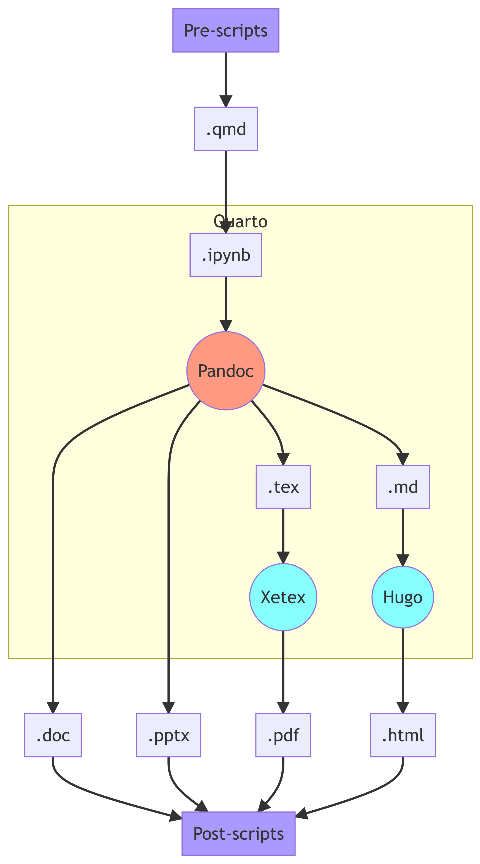
Next Steps
The Quarto website has great tutorials:
Jupyter
VSCode
If you have multiple input files (e.g., blog or book), you can create a project.
Projects can have pre- and post-render steps

Slide 44
THANK YOU

Slide 45
Notes
1. You can use footnotes in presentations and websites, too

