Slide 1
Street Light Demo FW
Presenter name

Slide 2
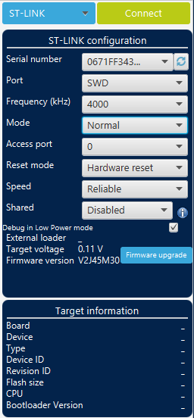
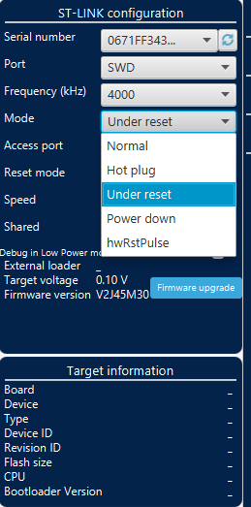
STM32CubeProgrammer – Pre-configuration
1
Click on Connect
2
Select Mode menu
3
Select "Under Reset" mode
After this, you can continue to flash the firmware normally

Slide 3
Protocol/Port configuration
(version > 8a)
P1
1
Pin 2 – Port selection ⁽¹⁾:
  1-2: jumper not fitted: port 1 – led D3 blinks 1 time
  1-2: jumper fitted : port 2 – led D3 blinks 2 times
Pin 4 – Protocol selection:
  3-4: jumper not fitted – UDP – led D2 blinks 1 time
  3-4: jumper fitted – TCP – led D2 blinks 2 times
2
3
4
5
(1) USA version has only 1 port available

Slide 4
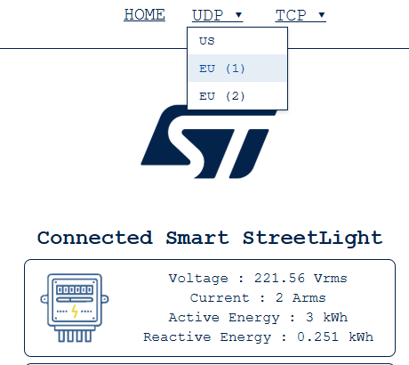
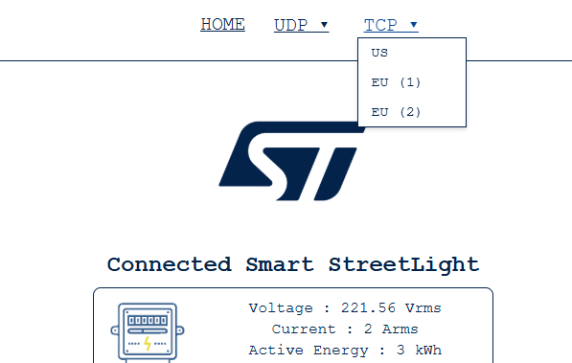
Webserver

Slide 5
Section title

Slide 6


You can personalize this
last page with a short link
(ex. www.st.com/shortlink)
You can find a complete list of
st.com short links on this page:
http://seo.st.com/toolbox/shortcuts/
Find out more at www.st.com

