Slide 1

Machine Learning Final Project
Titanic

Slide 2
Agenda
Purpose
Get the data
Process data
Select variables/ Feature Engineering
Train models
Select Best Model

Slide 3
Purpose
To accurately predict whether a person on the Titanic survived or not, based off feature data.

Slide 4
Summary of Data

Slide 5
Target Variable (Y) Shape → (891 x 1)
Survived
Yes = 1
No = 0

Slide 6
Feature Data (X) Shape → (891 x 11)
﻿PassengerId = Passenger Id
Pclass = Passenger Class
Name = Name of the passenger
Sex = Whether the passenger is male or female
Age = Age of the passenger
SibSp = Passenger’s number of siblings/ spouses
Parch = Passenger’s number parents/children
Ticket = Passenger Ticket number
Fare = Amount of the ticket the passenger paid
Cabin = Passenger cabin number
Embarked = Passengers point of Embarkment

Slide 7
Process Data

Slide 8
Glance at Feature Values
﻿ # Column Non-Null Count Dtype
--- ------ -------------- -----
0 PassengerId 891 non-null int64
1 Survived 891 non-null int64
2 Pclass 891 non-null int64
3 Name 891 non-null object
4 Sex 891 non-null object
5 Age 714 non-null float64
6 SibSp 891 non-null int64
7 Parch 891 non-null int64
8 Ticket 891 non-null object
9 Fare 891 non-null float64
10 Cabin 204 non-null object
11 Embarked 889 non-null object

Slide 9
Null Value Count
PassengerId 0
Pclass 0
Name 0
Sex 0
Age 177
SibSp 0
Parch 0
Ticket 0
Fare 0
Cabin 687
Embarked 2
Survived 0

Slide 10
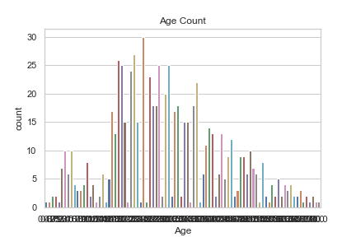
Age Null Values = 177
Fill in the Age with the mean value
train_mean_age = x_train["Age"].mean()
x_train["Age"].fillna(train_mean_age, inplace = True)

Slide 11
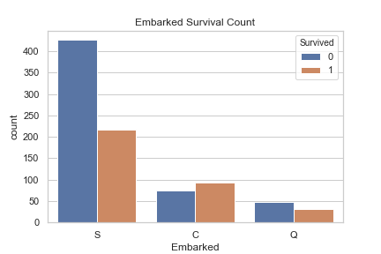
Embarked Null Values = 2
﻿x_train["Embarked"].fillna("Q", inplace = True)

Slide 12
Cabin Null Values = 687
I will not include feature ‘Cabin’ in the dataset.

Slide 13
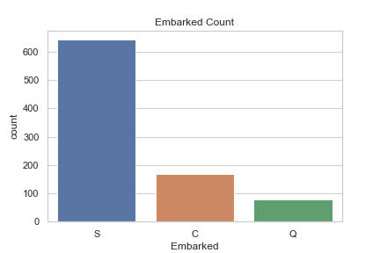
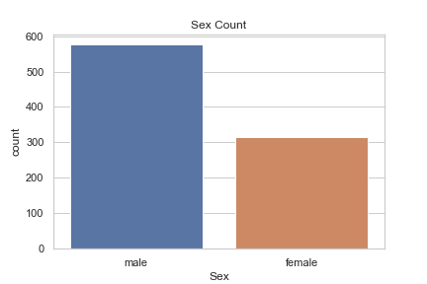
Non-Numerical Categorical Feature Data
Embarked
Passenger Class

Slide 14
Encode Categorical Features
﻿def encode_cat():
labelencoder_X = LabelEncoder()
x_train['Embarked'] = labelencoder_X.fit_transform(x_train['Embarked'])
x_train['Sex'] = labelencoder_X.fit_transform(x_train['Sex'])
test_data['Embarked'] = labelencoder_X.fit_transform(test_data['Embarked'])
test_data['Sex'] = labelencoder_X.fit_transform(test_data['Sex'])

Slide 15
Drop Other Features
﻿ global drop_feature
def drop_feature(feature):
print("Dropping feature ",feature)
x_train.drop(columns=[str(feature)], inplace = True)
test_data.drop(columns=[str(feature)], inplace = True)
﻿ drop_feature('Cabin')
drop_feature('Ticket')
drop_feature('Name')
drop_feature('PassengerId')

Slide 16
Variable Selection

Slide 17
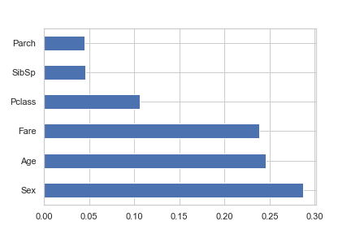
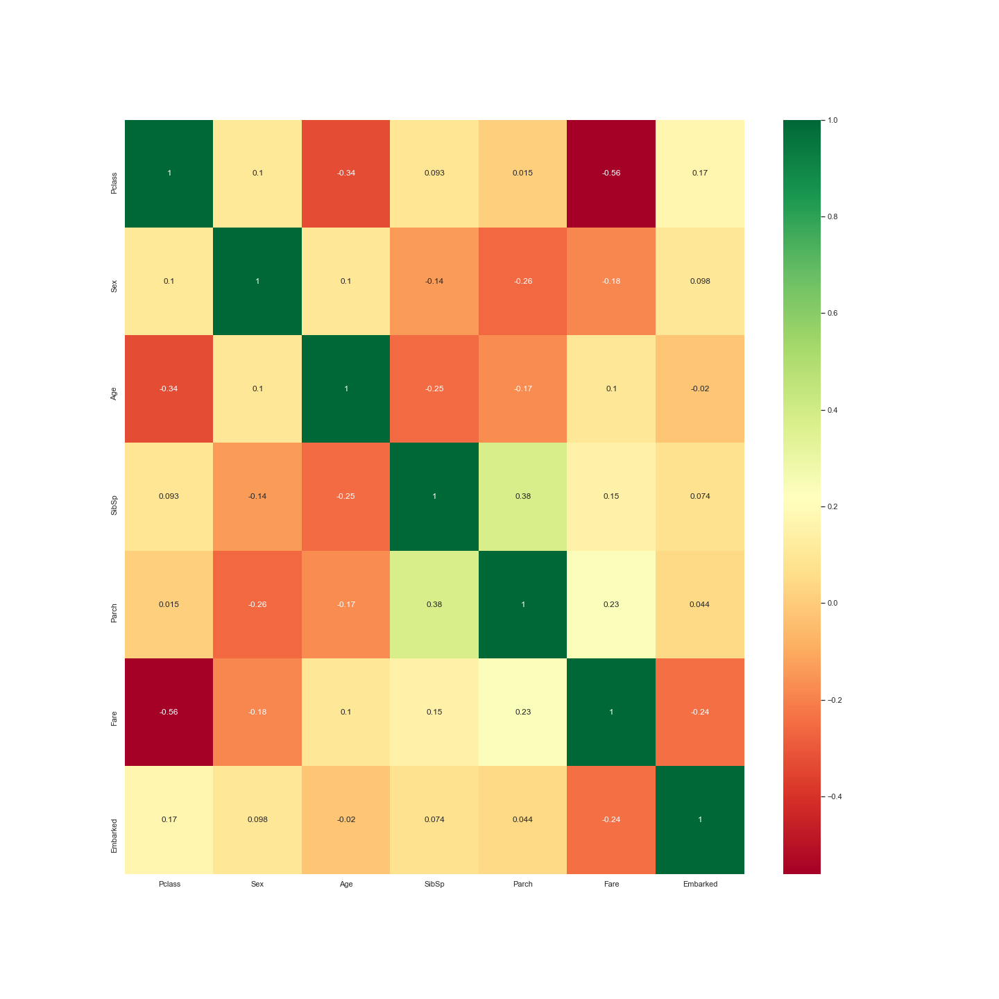
Feature Importance

Slide 18
Model Selection

Slide 19
Models Used
Logistic Regression
Support Vector Machine
Random Forest Classifier
Neural Network

Slide 20
Logistic Regression Report
﻿ precision recall f1-score support
0 0.86 0.87 0.87 111
1 0.79 0.76 0.78 68
accuracy 0.83 179
macro avg 0.82 0.82 0.82 179
weighted avg 0.83 0.83 0.83 179

Slide 21
Support Vector Machine
﻿
precision recall f1-score support
0 0.62 1.00 0.77 111
1 0.00 0.00 0.00 68
accuracy 0.62 179
macro avg 0.31 0.50 0.38 179
weighted avg 0.38 0.62 0.47 179

Slide 22
Random Forest
﻿ precision recall f1-score support
0 0.86 0.88 0.87 111
1 0.80 0.76 0.78 68
accuracy 0.84 179
macro avg 0.83 0.82 0.83 179
weighted avg 0.84 0.84 0.84 179

Slide 23
Neural Network with Keras
Two Hidden Layers
Accuracy of 81 percent, with 100 epochs

Slide 24
Conclusion – More Can Be Done
Can make model better by feature engineering
Combine Parch and SibSp for a new feature called FamilySize
Use the title from the name to add another categorical feature
Use Cabin to classify passengers based off the deck their room was.

