Slide 1
Regression Kriging to Improve Landsat-based Model Predictions of Forest Biomass
ERE 621 - FALL 2021
Lucas Johnson

Slide 2
Outline
Background and Data
Goal
First Order Effects
Variogram Fitting
Kriging Predictions and Comparison of Results
Conclusions

Slide 3
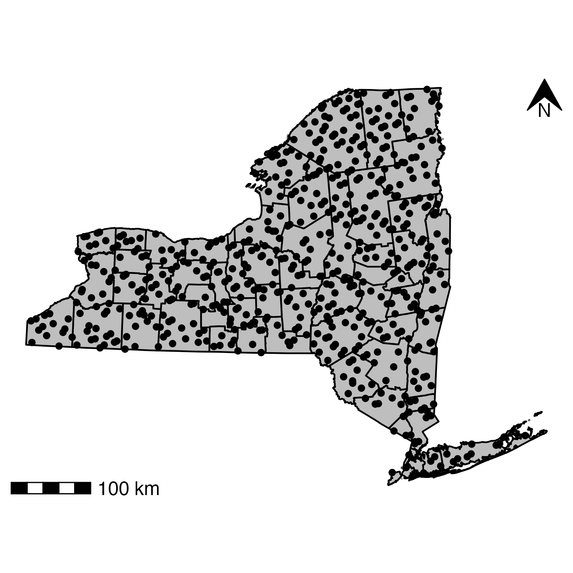
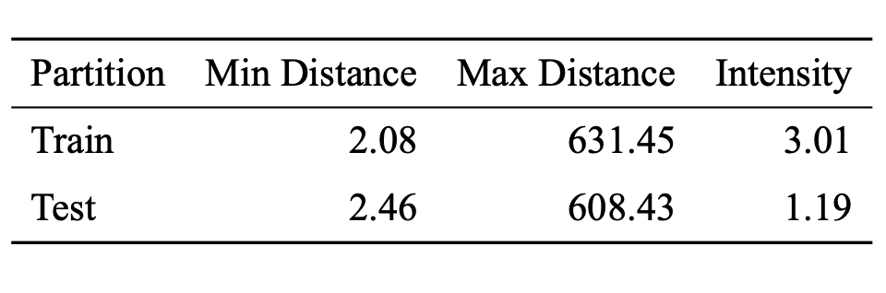
Field Inventory Data
Distances in km, Intensity in points per 1000 km²

Slide 4
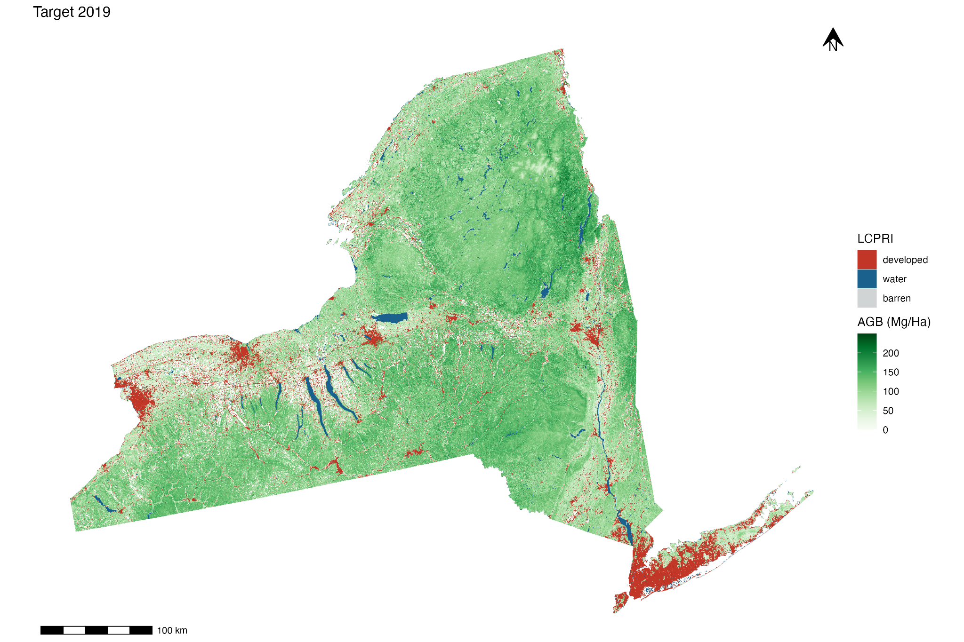
Model Predictions

Slide 5
Goal
Improve Model Predictions Through Kriging Residuals!

Slide 6
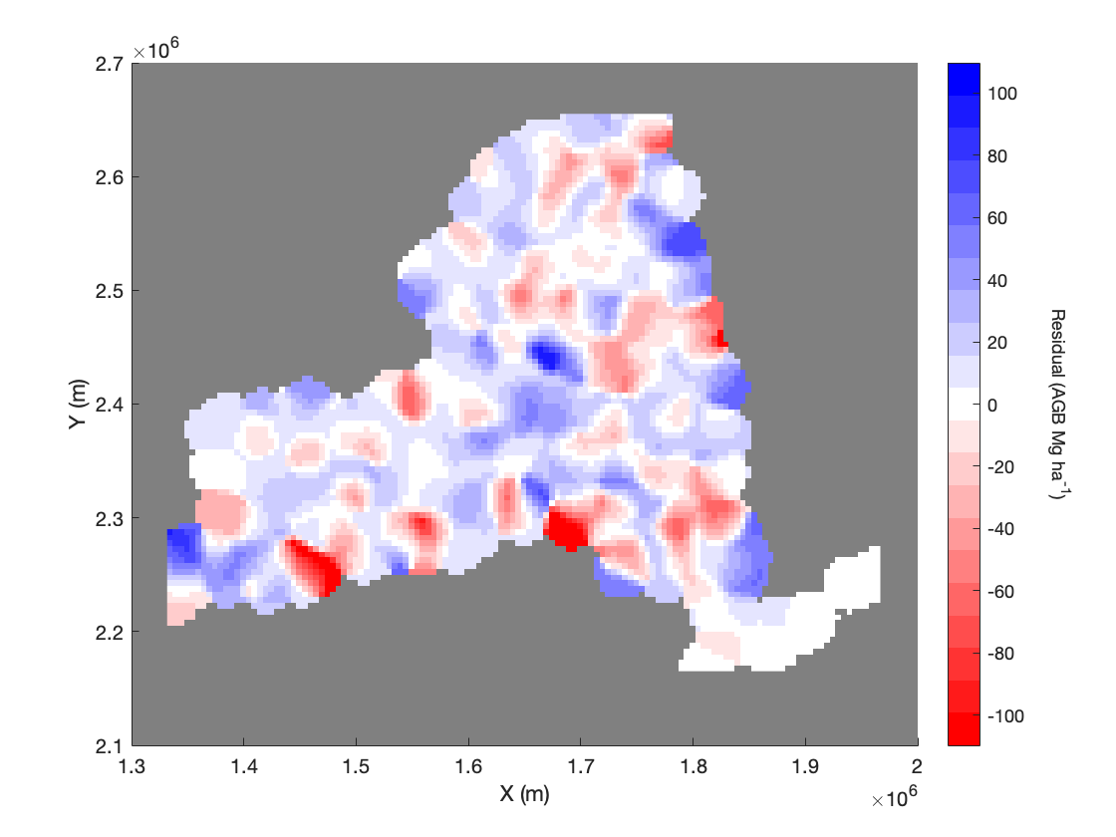
First Order Effects

Slide 7
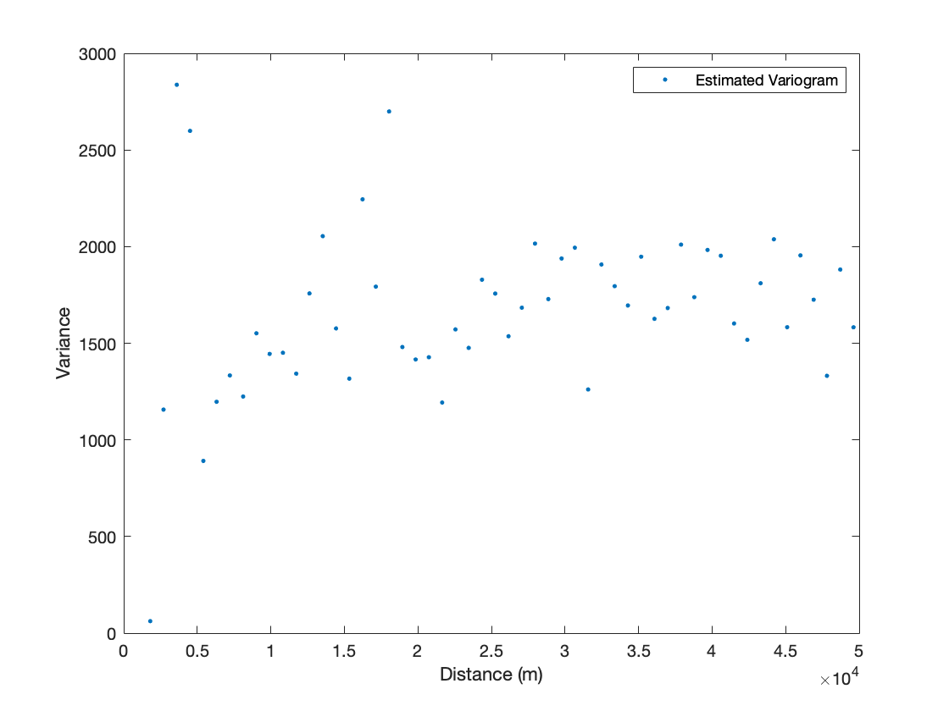
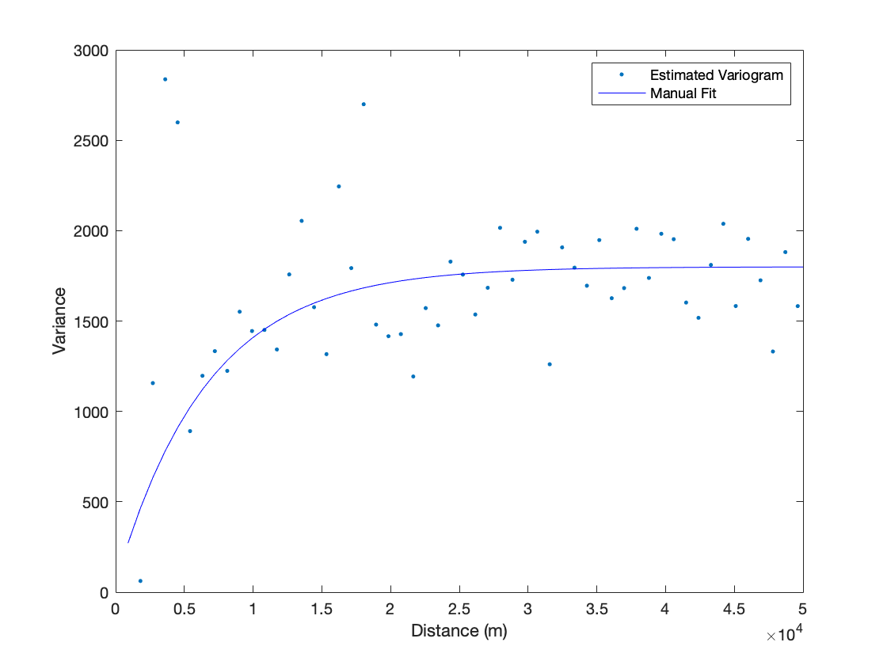
Variograms

Slide 8
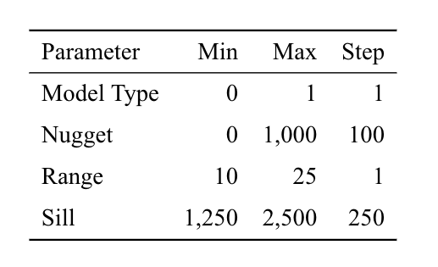
Grid Search for Variogram Fitting
Grid search
70% training data
10-fold cross-validation
RMSE comparison

Slide 9
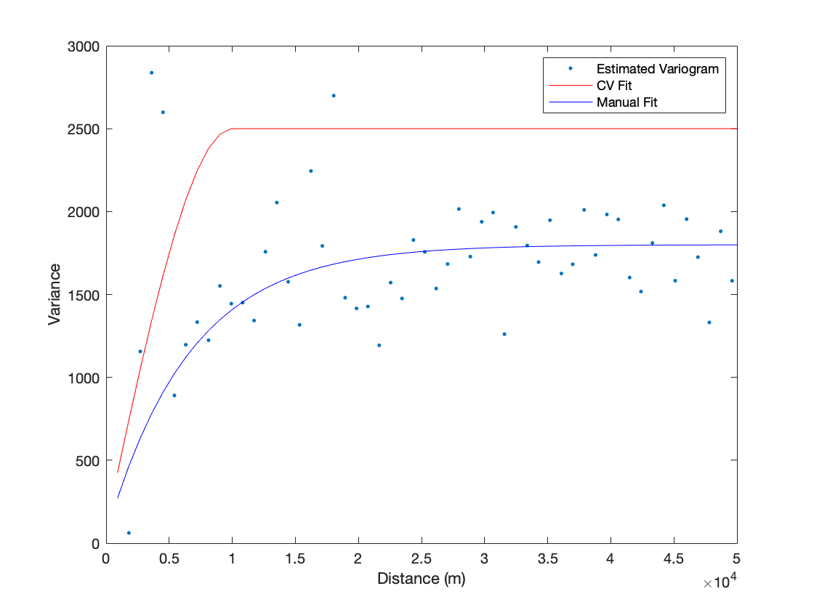
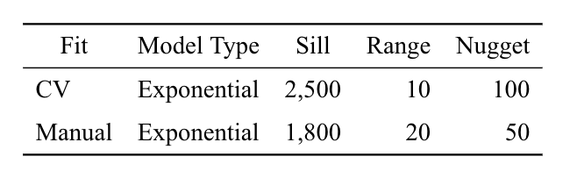
Variograms continued

Slide 10
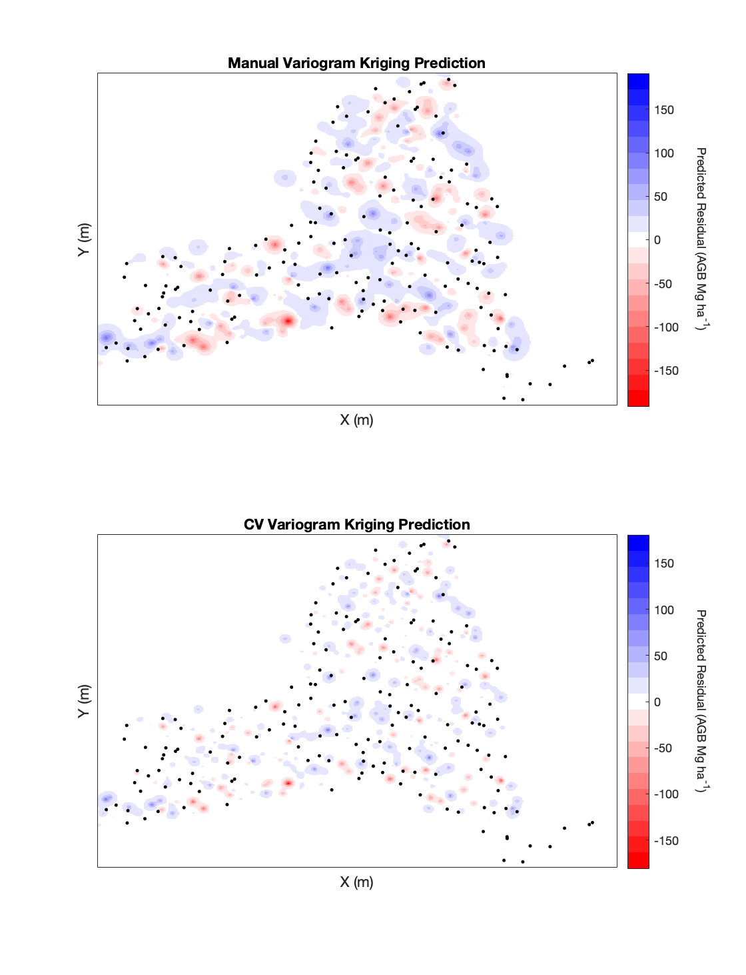
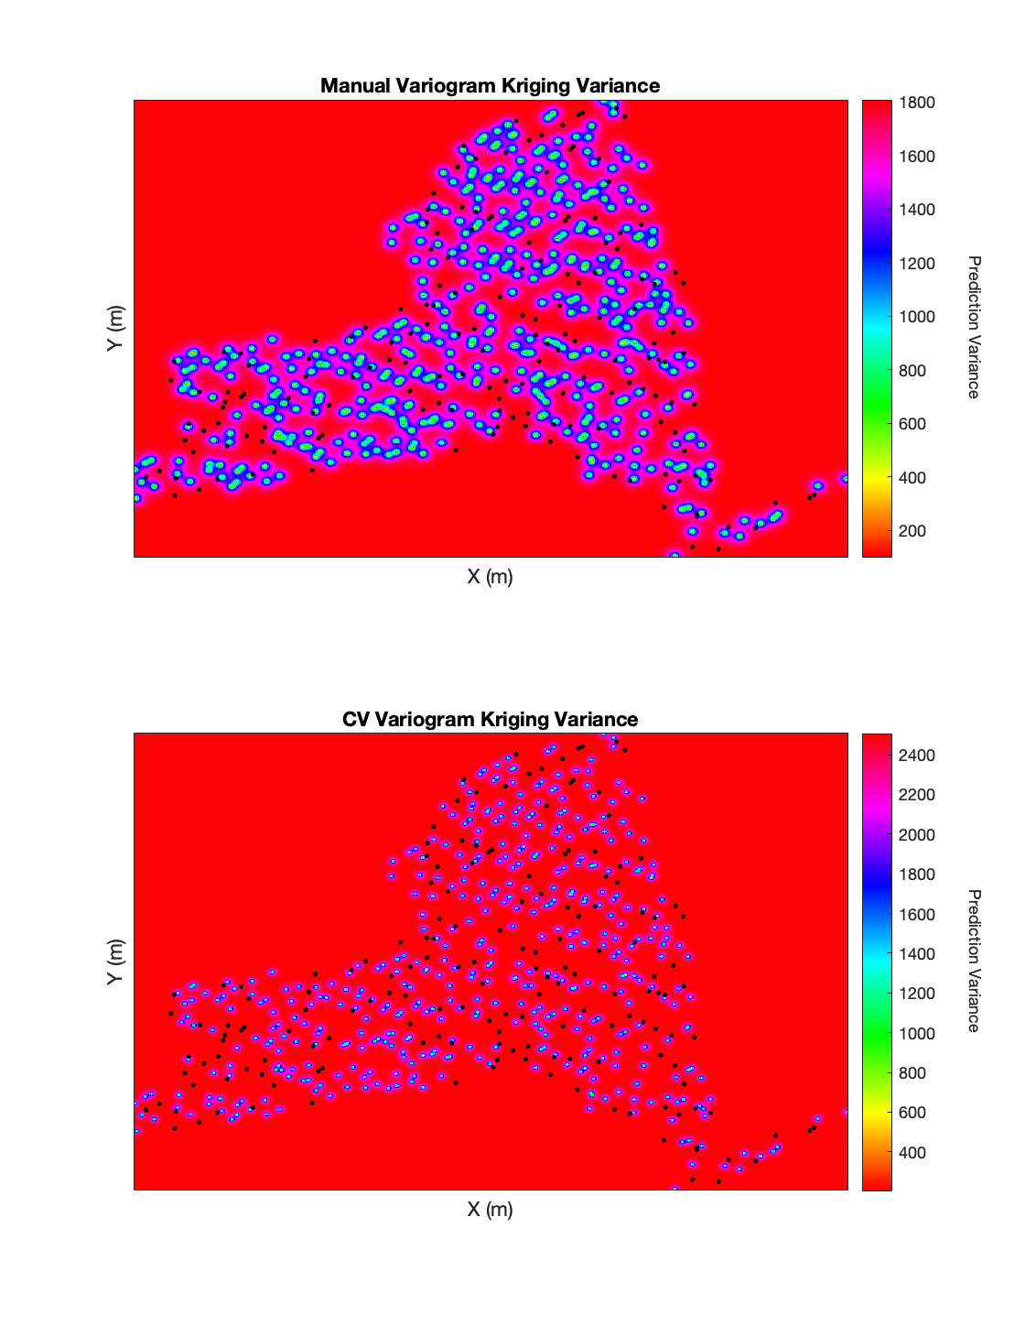
Kriging Surfaces

Slide 11
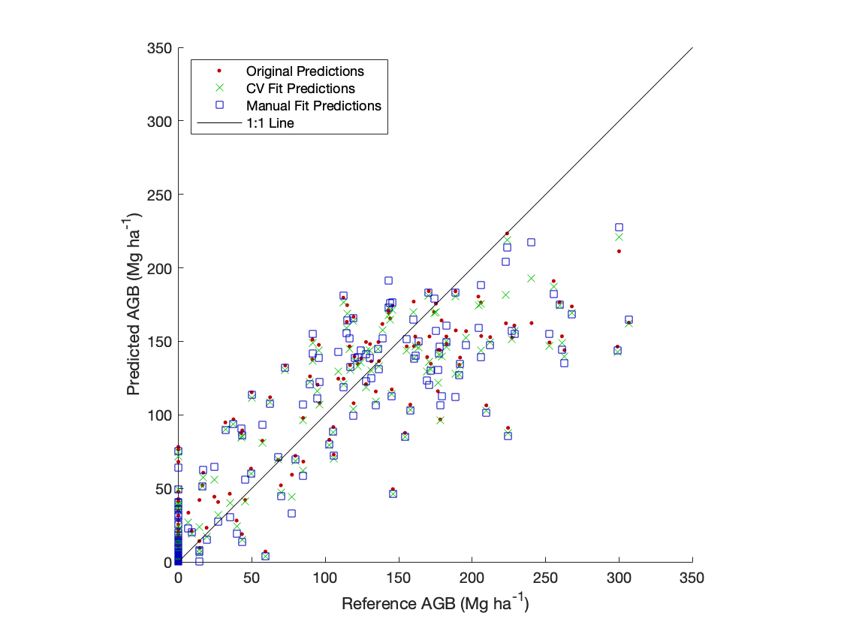
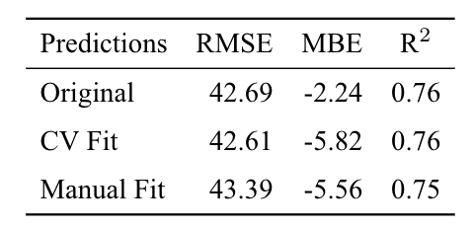
Results at Holdout Plots

Slide 12
Conclusions
Kriging residuals did little to improve model predictions
A grid-search with k-fold cross-validation can improve the selection of variogram parameters

