Slide 1
Numpy Linear Algebra
And its applications

Slide 2
Numpy: Uses
Code vectorization (speeds up lists by replacing them with arrays)
Linear Algebra
This is what we will cover in this slideshow
Note: Notation is generally the same as MATLAB, the MATrix LABoratory.

Slide 3
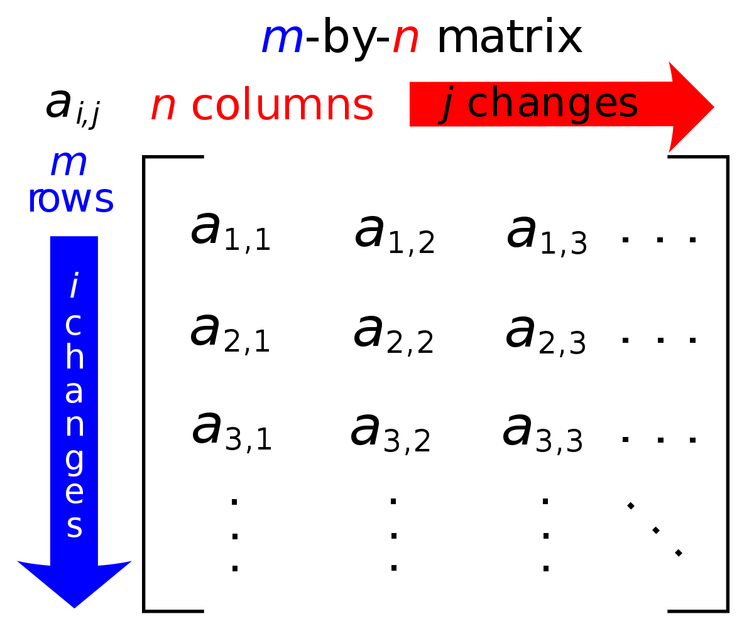
The Matrix
We have discussed the 1-d array in the previous lecture. In the next class, we will discuss the n-d array (n being any natural number).
What is a matrix?
A 2d Array!
What we discuss on n-d arrays will apply to matrices
But there are special things you can do with matrices

Slide 4
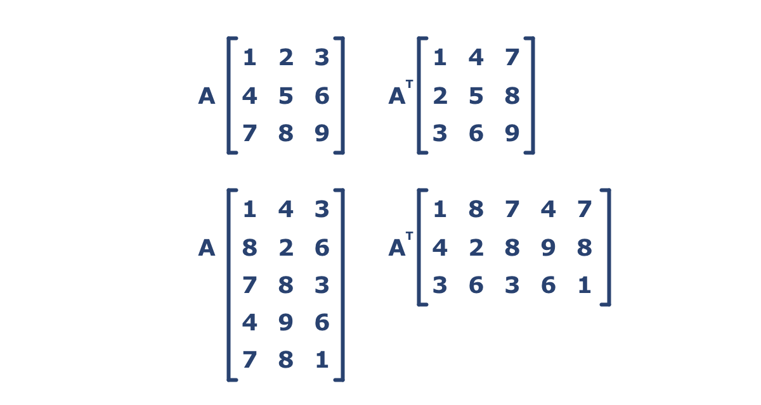
Review: Transposition
Let B = A.T (that’s how to take a transpose of a numpy matrix)
Then B[i,j] = A[j,i]
Thus, if A is n-by-m then B is m-by-n

Slide 5
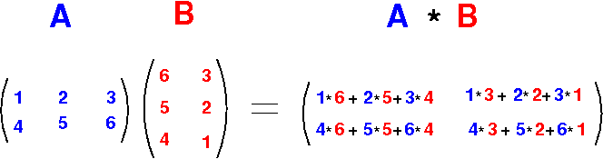
Review: Matrix Multiplication
A is k-by-n, B is n-by-m
AB is k-by-m
In numpy: A @ B

Slide 6
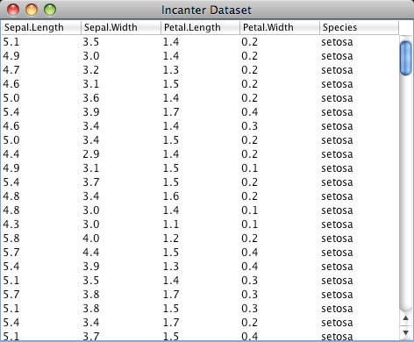
Why is the matrix important
Data generally comes in the 2-d array format
Experiment by Features
Patients by Signal (EHR data)
We generally use pandas for datasets of this nature
Shows up in second order models
Will discuss this a bit later
All linear maps can be represented by matrices
Many ML algorithms rely on linear maps
Such as the oft-discuss Neural Net
Linear Regression just assume we apply a linear map to our data
Many natural phenoma can be model as markov chains/processes
The underlying structure of a markov chain is a matrix
EN 553.426 – Stochastic Processes, covers the theory
EN 553.492 – Mathematical Biology, covers the “natural phenoma”

Slide 7
How to use Numpy for Linear Algebra?
The standard notation is import numpy.linalg as la
Then call la.<FUNC>
Documentation: https://docs.scipy.org/doc/numpy-1.15.1/reference/routines.linalg.html

Slide 8
Linear Independence (Summary Stats)
What is linear independence?
Why have the SAT Total column?
Name | SAT Math | SAT Reading | SAT Total
Andrew | 710 | 720 | 1510
Paul | 650 | 800 | 1290
Jim | 730 | 640 | 1500
Rachel | 800 | 770 | 1510
Marybeth | 690 | 710 | 690
Notes:
LI: Can one of the columns be written as a linear combo of the others
From an information perspective this asks: is there a point to having this feature
Say our task was to predict whether these students went to Johns Hopkins or Their Local state college? What is the point of having the SAT Total column?

Slide 9
Linear Independence (Summary Stats)
Lets check the rank of our matrix
Rank is number of linearly independent columns

Slide 10
Linear Regression
Our first “ML” model
What is regression?
What is classification?

Slide 11
Linear Regression Example
Could we have predicted the score of this other test?
Can we make a reasonable guess as to what kind of test this other test is?
Name | SAT Math | SAT Reading | SAT Total | Some Other test
Andrew | 710 | 720 | 1510 | 85
Paul | 650 | 800 | 1290 | 50
Jim | 730 | 640 | 1500 | 87
Rachel | 800 | 770 | 1510 | 100
Marybeth | 690 | 710 | 690 | 70

Slide 12
The Hypothesis
Every ML algorithm has a hypothesis. A more simple ML algorithm means a more simple hypothesis.
Paradoxically, a more simple hypothesis is equivalent to having more assumptions about the data. For example, linear regression assumes that there are no correlation between features in the dataset.
Linear Regression is a simple algorithm. It makes many assumptions about the underlying data not a good model in many cases.

Slide 13
All models are wrong, some are useful. - George Box (of the famous Box-Cox model)
Notes:
Linear Regression is useful because it simple and fast to solve, but bad results for many problems.
Example, nonlinear data (can easily draw this on board)

Slide 14
The Hypothesis
Let data matrix be called A and output be called y
In our example, A is the matrix of SAT Reading and Writing Scores and y is the output of this other exam
Model:
Ax = y
Where x is some vector that we do not know
What does this mean?
Notes:
Y is some linear combo

Slide 15
Linear Regression
Find x such that Ax=y
Not always possible, at least try to make Ax-y get as close as possible to 0
Same as minimizing (Ax-y)²
Turns out this is the same as finding x such that
A^{T}Ax = A^{T}y
If anyone is interested in this derivation let me know
Efficient methods have been created to solve this

Slide 16
Neural Network (Multiplication)
A very immediate application of matrix multiplication and vectorization
Extremely powerful, oft-misunderstood tool
Face recognition, speech recognition, etc.
Very cool application (uses architecture a bit more complicated than what I’ll show you next)
https://github.com/lengstrom/fast-style-transfer

Slide 17
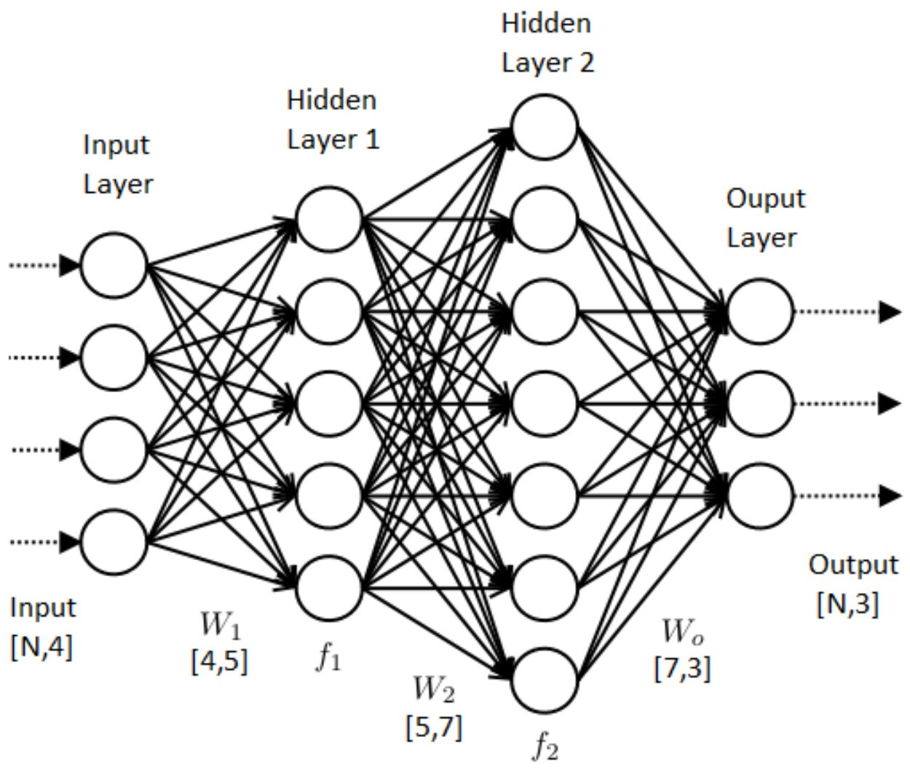
What is a Neural Network doing?

Slide 18
Input
Input data X is in this case an N-by-4 matrix.
What does this mean?
Example: Group of European Caucasian Females
N women
4 features: eye color, hair color, height, weight
This would make our input data N-by-4

Slide 19
Output
Output is an N-by-3 matrix
Go back to example from input
Say our task was to predict home country
We output probabilities for each home country for each woman
If we knew that these women were either: French, German, or British then our output data would be N-by-3

Slide 20
Idea of Neural Net
Put our input data through this network and output predictions of class
Network has some “weights”
Like linear regression
Our predictions start out really bad as the weights are random
No formula like linear regression to find “best weights”
At each iteration we will update our weights to make the process better until we are happy
Will discuss how to make weights “better” next class.

Slide 21
The Hypothesis
Complex Hypothesis
A neural network is a very complex algorithm. It makes few assumptions about the underlying data, hence why it is useful on such a wide variety of problems.
The hypothesis is: The probability distribution of the classes is the network in the image above
There is no reason that this hypothesis would be true. However:
The idea is: the network on the previous slide is a good model for the probability that some datapoint is of a given class

Slide 22
All models are wrong, some are useful. - George Box (of the famous Box-Cox model)
Addendum: The neural network is a very useful model. - Lucas Rosen (not famous for anything)
Notes:
Important. The neural network is useful because it is less wrong because it makes fewer assumptions.

Slide 23
How it Works (Using Matrices)

Slide 24
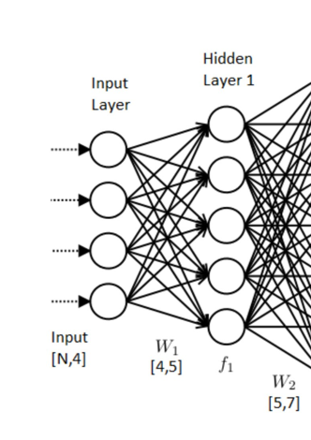
Getting from Layer 0 (Input) to Layer 1
At each iteration there is a matrix multiplication followed by a vectorized function application
Our hidden layer 1 has 5 nodes.
Note, we choose the amount of nodes in our hidden layer before training.
How to choose: outside the scope of this course.
H_1 = f(X*W[1])
Easy to do with Numpy

Slide 25
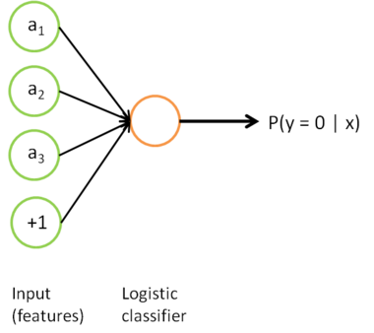
A Taste of What’s to Come
Your HW3 will have you implement logistic regression, the simplest classification algorithm.
Logistic Regression is simple yet powerful, and it also can be thought of in an interesting way.
A neural network with only 1 hidden layer and only 1 node!

Slide 26
Minimum Finding
Say you are working in finance and you have some complicated function that tells you about the risk in a trade
Want to find the amount of money we’d need to put in and at what time for the lowest risk
Finding a minimum
Finding all zeros of the derivative with pencil and paper is too hard
Basically the field of unconstrained optimization

Slide 27
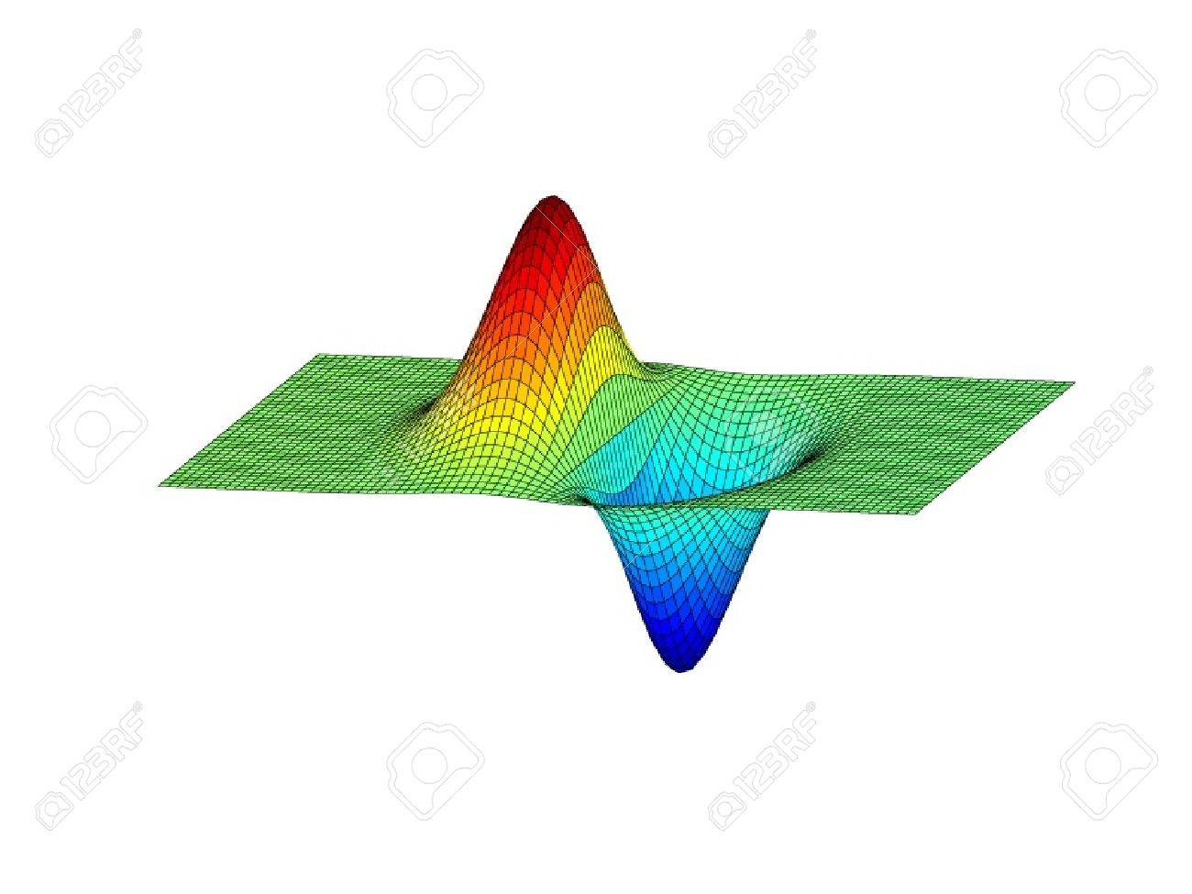
Risk as a function of money and time
Notes:
Want to get to the blue

Slide 28
What do we do?
Decrease a little bit each time
How?
Build a model that we can take the derivative of and solve that
Then move a bit in that direction and do again and again
… Complicated math
One of the most popular algorithms involves “convexification”
Notes:
Do a 1d example on blackboard

Slide 29
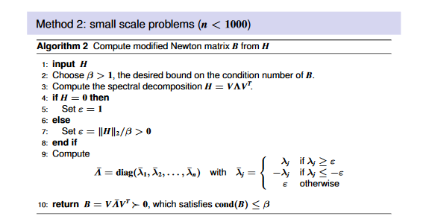
You can easily do all of this with numpy

Slide 30
This will a bonus problem on this homework
Hints on next slide
2 points or 0 points

Slide 31

Hints
Use beta = 100000
Spectral decomposition is la.eig(H)
L, V = la.eig(H)
If we then do L_mat = np.diag(L_bar) we would find the relation:
H = V@L_mat@V.T which is this in step 3
is la.norm(A), essentially just says how “large” is the matrix in terms of the number in it
DO NOT use a loop in step 9, you will receive no credit
In step 9 first use what we have shown in class to create L_bar from L. Then create L_bar_mat using np.diag(L_bar).
L_bar_mat is
Notes:
Note; L is only a 1-d array so we don’t have to worry about indexing on n-d arrays which can be tough

Slide 32
Last Hint
In step 4 it says to check if H = 0.
This means we want to check if All of the elements of H are 0.
Notice that I bolded “All”

Slide 33
Comment
If that last example interested you, consider taking (EN.553.761) – Nonlinear Optimization
It is graduate level but very manageable if you have taken Calc 3, Lin Alg, and Opti I.

