Slide 1
Introduction: What is Data Science?

Slide 2
The title of this course!
Python for Data Science Applications
Clearly Python is the tool (and a great, FREE one) and data science is the goal
What is data science?
Is it just a buzzword?
Is it CS?
Is it Statistics?

Slide 3
What do you think?
Why did you sign up for this course?
What do you think data science is?

Slide 4
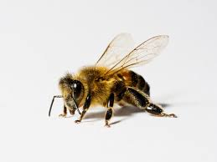
The Buzz

Slide 5
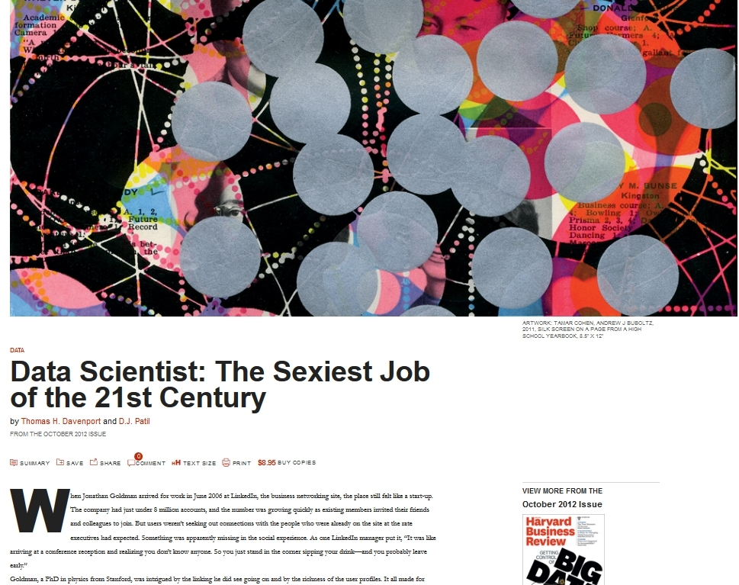
Source: https://hbr.org/2012/10/data-scientist-the-sexiest-job-of-the-21st-century

Slide 6
Extra Credit Opportunity
2 points if you read the article and send me a 1 page double spaced response on if you still think it holds true today 6 years later. I’m personally not sure.
As in Syllabus 0 points if your work is “embarrassing” and 1 point if you missed the point (it will be hard to miss the point in an opinion assignment)
Due Sunday 1/13 at Noon
Notes:
Do you still agree with the points? Is there still that buzz? Most of you are younger than me.

Slide 7
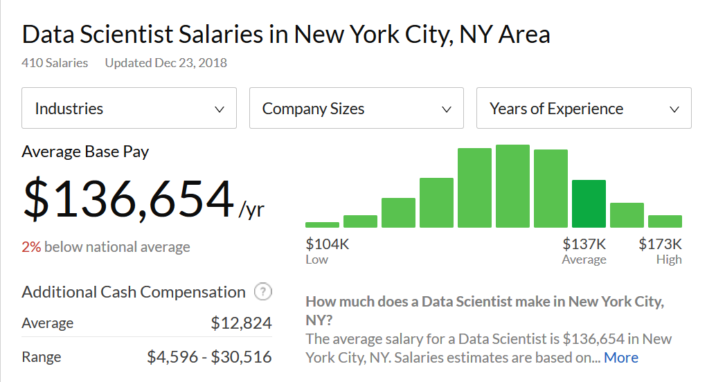
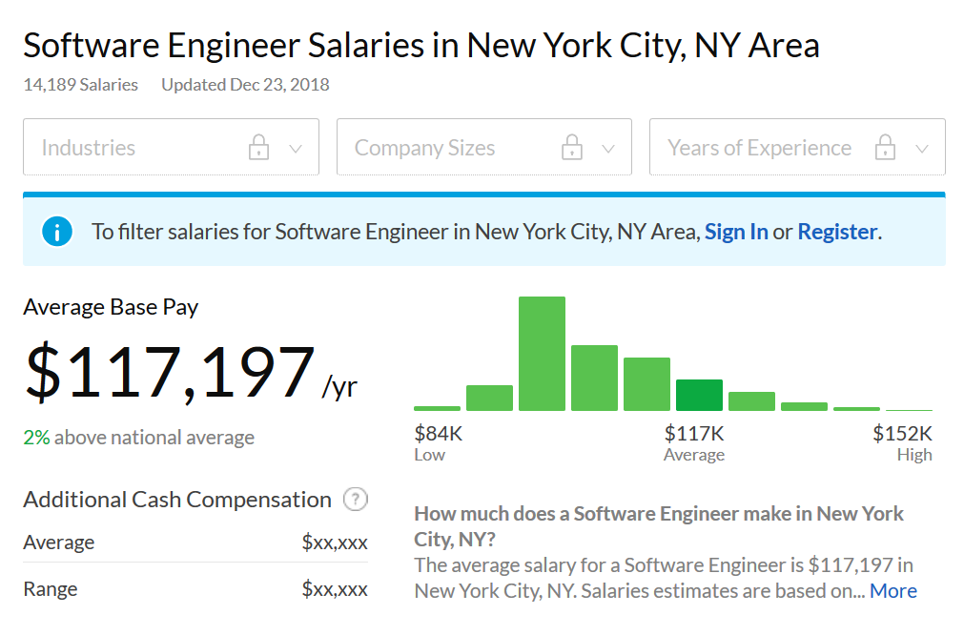
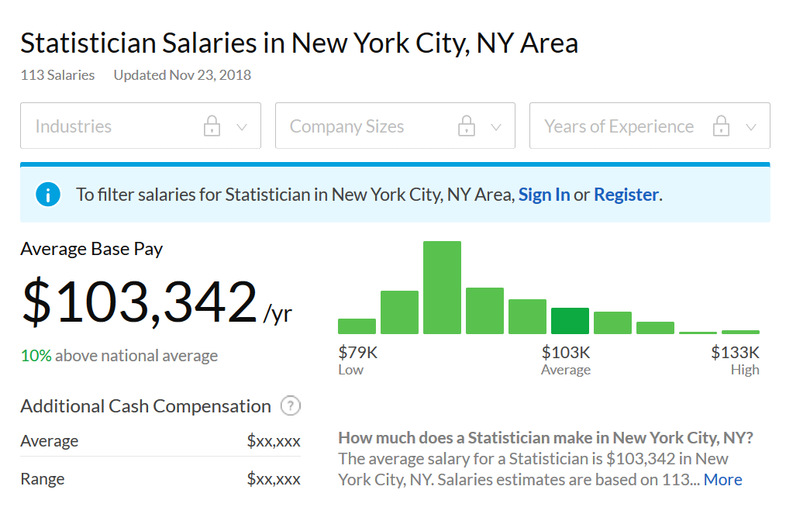
Source: Glassdoor

Slide 8
Note: These are not starting salaries (I wish they were)

Slide 9
What does a data scientist need?

Slide 10
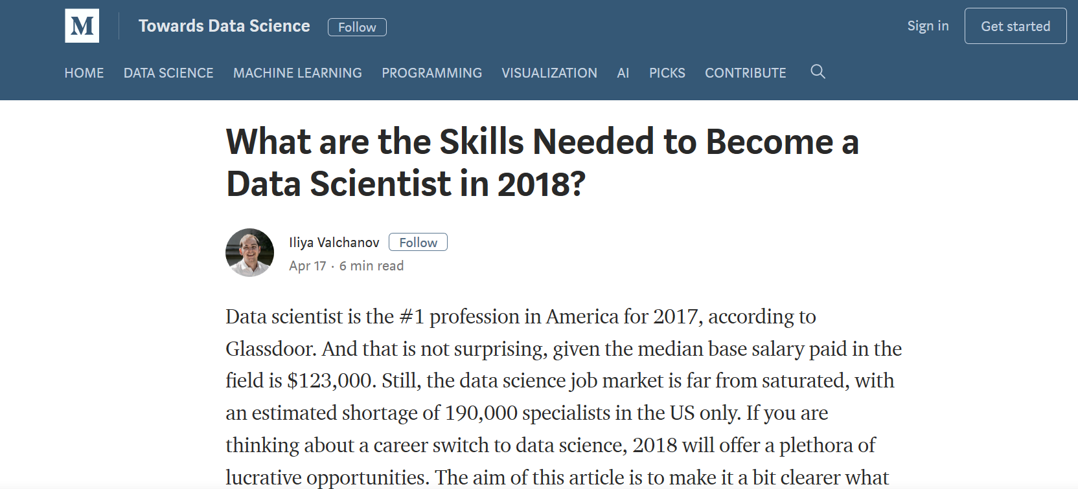
Source: https://towardsdatascience.com/what-are-the-skills-needed-to-become-a-data-scientist-in-2018-d037012f1db2

Slide 11
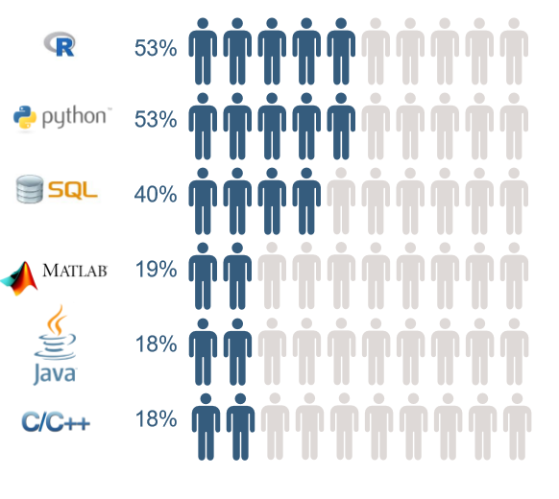
The article itself points out that python has been steadily outpacing R.
SQL can be learned in a week
Don’t bother with MATLAB, it is not used in industry to my experience. Also, after taking this class, going over to MATLAB will be incredibly easy.
I’m not sure why JAVA and C++ are even here.
My advice:
This class will get you started with Python.
Learn basic SQL. (Code academy)
Learn basic R either via Stat (553.430) or the free JHU Coursera Courses

Slide 12
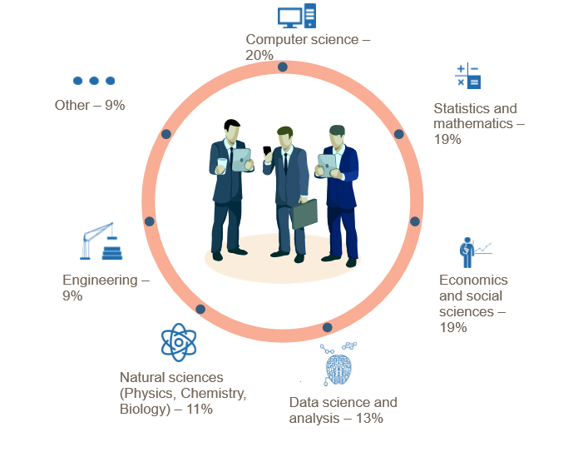
The point: Anyone with a background in problem solving can be a data scientist.
A good math background (probability, statistics, optimization, etc) and programming (data structures, algos, etc) background are necessary too

Slide 13
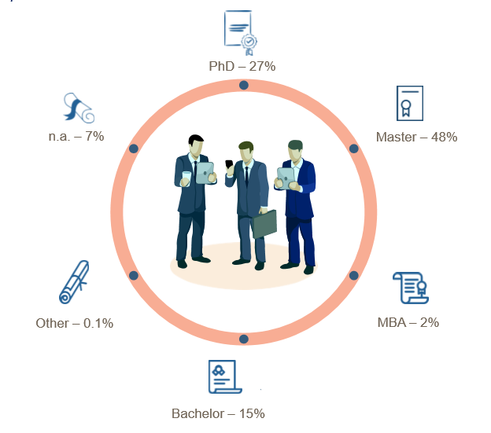
Anecdote: I’ve heard that the percentage of jobs requiring PhDs is dropping in favor of Masters and even Bachelor degrees, especially at big companies

Slide 14
What does a data scientist do?
https://tinyurl.com/y8rx7ps2
https://tinyurl.com/ya97pgak
If you think these are a bit vague and buzzwordy you’re not alone

Slide 15
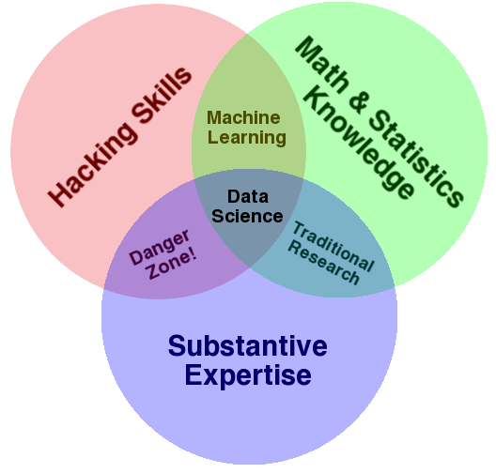
Finally, what is data science? Here’s what our textbook has to say:
Source: [Drew Conway](http://drewconway.com/zia/2013/3/26/the-data-science-venn-diagram
Notes:
Our book says this:
Data science is fundamentally interdisciplinary
Statistics – how to model and summarize datasets (and phenomena)
CS – how to design and use algorithms to efficiently store, process, and visualize this data
Domain Knowledge - "classical" training in a subject
The third is quite underrated in my opinon but can be learned on the job

Slide 16
What you will learn in this course
Cloud Computing with AWS (this will just be a brief taste, there is a lot more that can be done than what I will show you)
Jupyter – A data science specific environment that streamlines the entire process
Numpy – Efficient vectorized computations that allow us to work on large datasets
Pandas – Data manipulation at its easiest
Matplotlib – Data visualization
Sklearn – Basic Machine Learning Models (classification/regression)

Slide 17
Questions?
Notes:
Feel free to question my credentials

