Slide 1
Minimum Vertex Cover Algorithm For Complement Graphs
Lucas Geurtjens (s5132841)

Slide 2
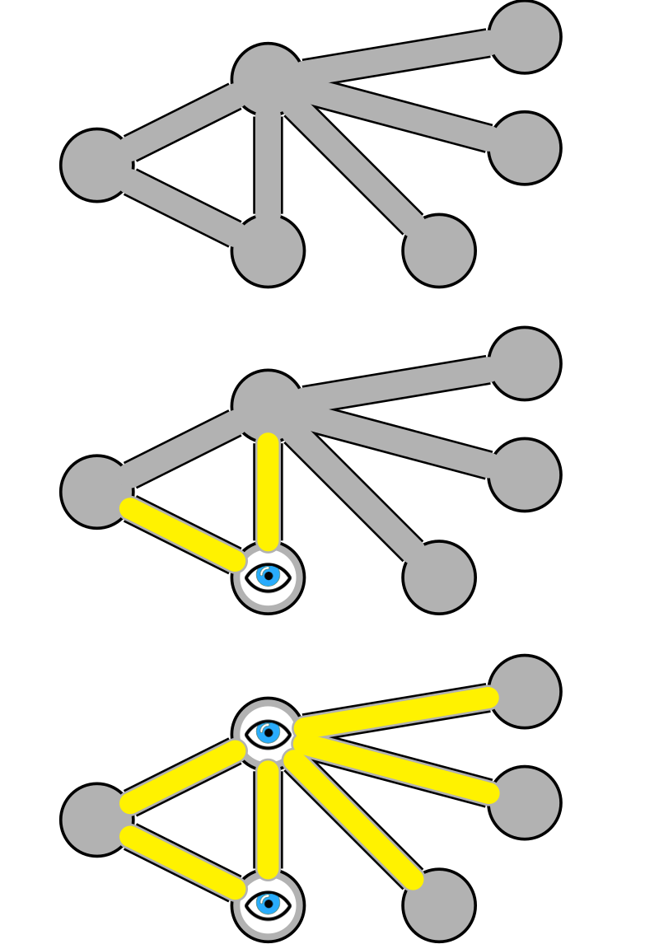
About the Problem
An algorithm was developed to solve the Minimum Vertex Cover problem.
It aims to select a set of nodes that have edges to every node in the graph.
It is an NP-hard problem.
Image credit: By Fschwarzentruber - Own work, CC BY-SA 4.0, https://commons.wikimedia.org/w/index.php?curid=48175909

Slide 3
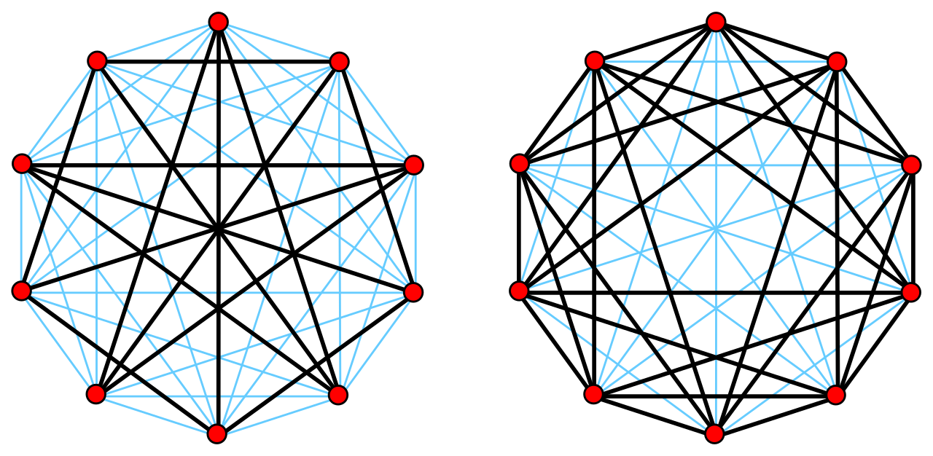
About the Problem
The graphs we’re looking at are Complement graphs.
These are graphs whereby all edges disconnect from the nodes they’re adjacent to, and connect to all nodes they were previously not adjacent to.
Image credit: Complement_graph_sample.gif: Claudio Rocchiniderivative work: David Eppstein, CC BY 2.5 <https://creativecommons.org/licenses/by/2.5>, via Wikimedia Commons

Slide 4
Known Algorithms
The following algorithms have been developed for finding the minimum vertex cover of a graph:
One solution was developed using Dijkstra’s algorithm, getting a vertex cover with a time complexity of O(n³) where n is the number of nodes in the graph [1].
Another current solution is to use an approximate algorithm instead of an exact algorithm. In this approach, we continue picking the nodes covering the greatest number of edges until all nodes have been covered.

Slide 5
Implementation
Description
Greedy search that selects vertices that result in the largest number of nodes being covered.
Does so by maintaining a priority queue (nodes with largest number of connected uncovered nodes are at its head).
We explore the priority queue, popping off the head, and adding the children to the priority queue until we’ve covered all nodes.

Slide 6
Implementation
Data Structure
The algorithm relies on a list of nodes for its operations. The node data structure is as follows:
ID: The Node’s ID
Connections: A list of nodes that are connected to the node by an edge.
Unseen Connections: The number of nodes connected to the node that have not yet been seen.
Visited: If a node has been visited (i.e., selected as a cover vertex).
Seen: If a node has been seen (i.e., we know is connected to a cover vertex).

Slide 7
Results
Graph | Minimum Vertex Cover
 | Known results | Obtained results
Brock800_1 | 777 | N/A
Brock800_2 | 776 | N/A
Brock800_3 | 775 | N/A
Brock800_4 | 774 | N/A
C2000.9 | 1922 | N/A
C4000.5 | 3982 | N/A
MANN_a45 | 691 | N/A
p_hat1500-1 | 1488 | N/A
Unfortunately, the algorithm was really slow and wouldn’t finish executing in a reasonable amount of time. As a result, I was unable to get any results to analyse and compare to the known results.

Slide 8
Performance Analysis
Graph | Average CPU Time
 | Known results | Obtained results
Brock800_1 | 84.54 | 1hr+
Brock800_2 | 74.90 | 1hr+
Brock800_3 | 45.30 | 1hr+
Brock800_4 | 26.75 | 1hr+
C2000.9 | 36.28 | 1hr+
C4000.5 | 142.02 | 1hr+
MANN_a45 | 88.76 | 1hr+
p_hat1500-1 | 1.39 | 1hr+
The algorithm performance was extremely poor and was not able to run in a reasonable amount of time.
The approach that was used has a few nested loop operations that indicate the algorithm has a worst-case time complexity of O(e² + n²) where n is the number of nodes, and e is the number of edges.

