Slide 1
Ball Picker Problem
‘
Created by Lucas Geurtjens

Slide 2
Overview
Background
Algorithm Descriptions
Pseudocode
Results
Time Complexity
Correctness
In-place?
Stable?

Slide 3
Background
The ball picker problem aims to optimally pick a ball from a given list.
This implementation utilises a heap to store valued balls in a priority queue.
It has two players who participate in the picking of these balls within a game.

Slide 4
Background
The two players pick balls differently:
Scott: Picks balls based on their value e.g. 123 = 123
Rusty: Picks balls based on the sum of the number integer values e.g. 123 = 1 + 2 + 3 = 6
After the balls have been picked, the sum of their true values are returned as a score.

Slide 5
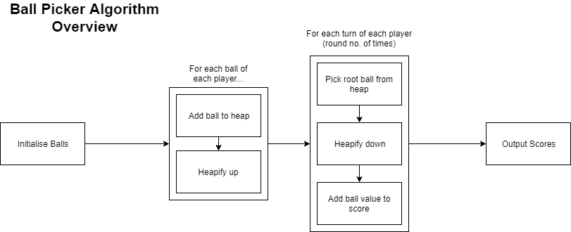
How does it work?
For each game, the following algorithm is executed to find the optimal solutions for each player.

Slide 6
The Heap
Firstly, the heap uses several helper functions to perform its actions.
It does this for parent, left and right child nodes:
Index Getters – Get index value
Value Getters – Get player value
Existence Checkers – Check if node exists

Slide 7
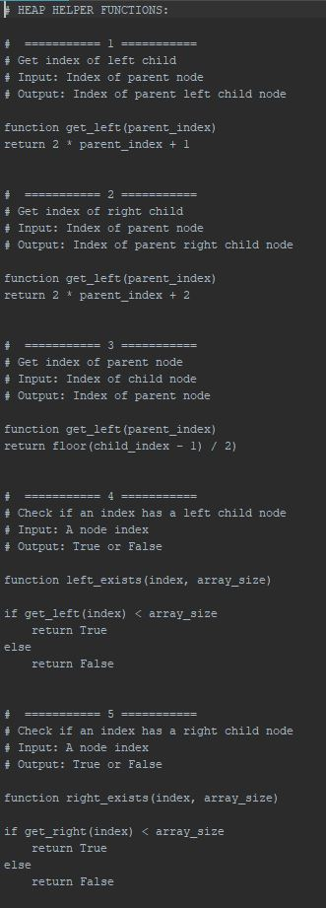
Helper Functions Pseudocode 1/2

Slide 8
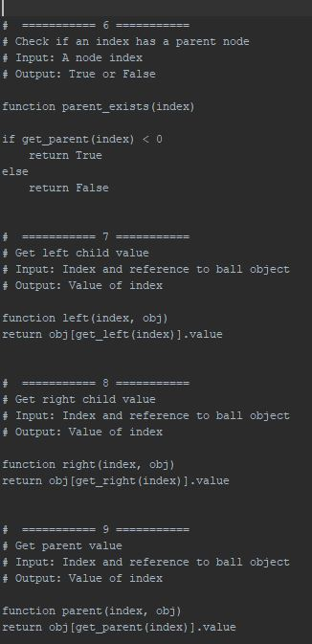
Helper Functions Pseudocode 2/2

Slide 9
The Heap
Next, the heap has the ability to perform a heapify up or heapify down for when a ball is enqueued or dequeued.
Heapify up takes a newly added leaf node and compares it with its parent, swapping until the parent is larger than it.
Heapify down takes a previously swapped root node and compares it with its children, swapping until the node is larger than it’s children

Slide 10
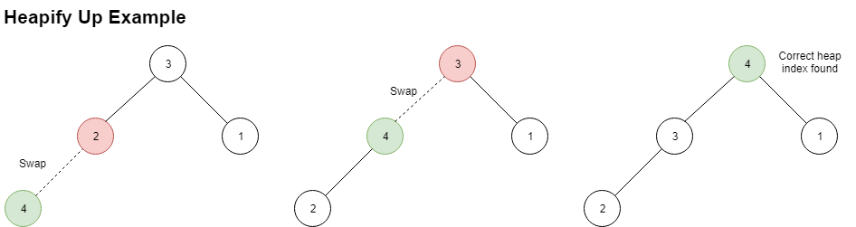
Heapify Up Example

Slide 11
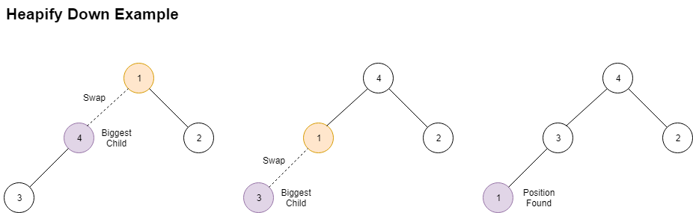
Heapify Down Example

Slide 12
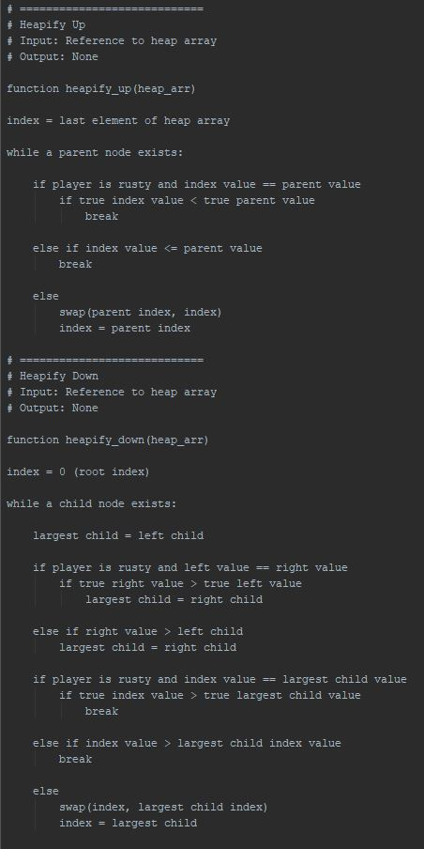
Heapify Up Pseudocode

Slide 13
Heapify Down Pseudocode

Slide 14
Add & Pop
Using the heapify up and down functions, the algorithm is able to push and pop elements to and from the queue.

Slide 15
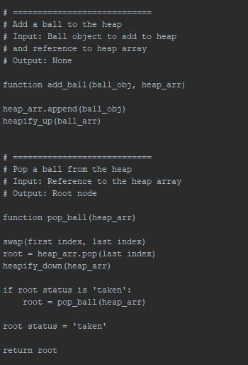
Add & Pop Pseudocode

Slide 16
Ball Initialisation
To create a shared set of balls, we create a list of ball objects.
Each ball has a status (taken or not) and value.
The value has two indexes:
[0] is the true/Scott’s value
[1] is Rusty’s value (picked though an integer sum function)
The input balls and run though a function that turns the balls into these objects.

Slide 17
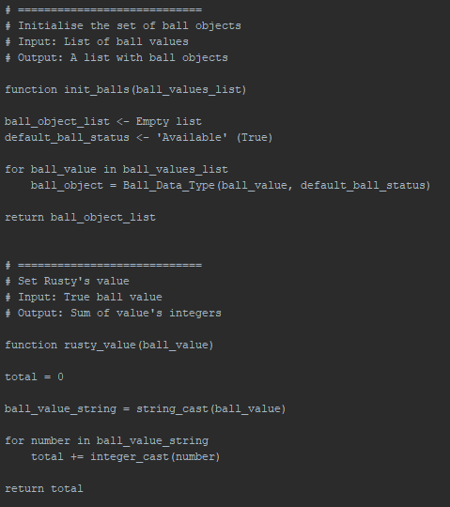
Ball Initialisation Pseudocode

Slide 18
Game
To establish a game where scores are calculated, a game function is used
We keep track of the current player.
Each of the player’s heaps are built with the same ball objects.
A coin toss decides which player goes first.
While there are still balls to pick, the current chosen player is able to pick balls from the queue a specified amount of times.

Slide 19
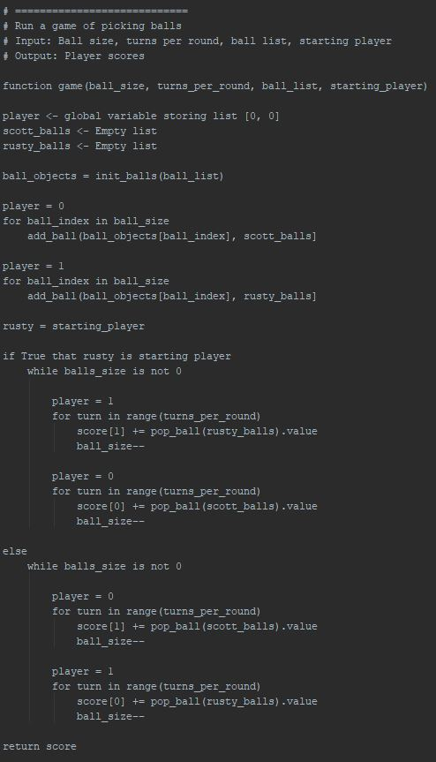
Game Pseudocode 1/2

Slide 20
Game Pseudocode 2/2

Slide 21
Results
Input # | Output (Scott | Rusty) | Time Taken (secs)
1 | 1000 197 | < 0.000009
2 | 240 150
3 | 2100000000 98888899
4 | 9538 2256
5 | 30031 17796
6 | 4726793900 3941702128
7 | 13793 12543
8 | 2173 1665
9 | 3923529875 3049188235
10 | 0 284401

Slide 22
Time Complexity
Had a time complexity of O(nlog₂n)
Proof:
T(n) = nlog₂n + nlog₂n + nlog₂n + 1
= 3nlog₂n + 1
≤ C ⋅ nlog₂n
∴O(nlog₂n)

Slide 23
Correctness
Yes, the algorithm behaves correctly.
Proof by contradiction:
Assume the same ball can be picked by two players. (Ball’ = Ball’’)
If Ball’ is taken, its status becomes False. When a ball is picked with a False status, it is discarded and the next ball is taken instead. Hence, it is impossible to pick Ball’’.
Hence, this is a contradiction and the same ball cannot be picked by two players.

Slide 24
In-Place?
In-Place? Yes
There was no additional memory used as manipulation of the list of balls only used a reference to the list when sorting it.

Slide 25
Stable?
Stable? No
Relative positions of equal valued elements were not maintained.
This is because the heapify down only stops when the value is greater than the child. If they are equal, it will keep going.

Slide 26
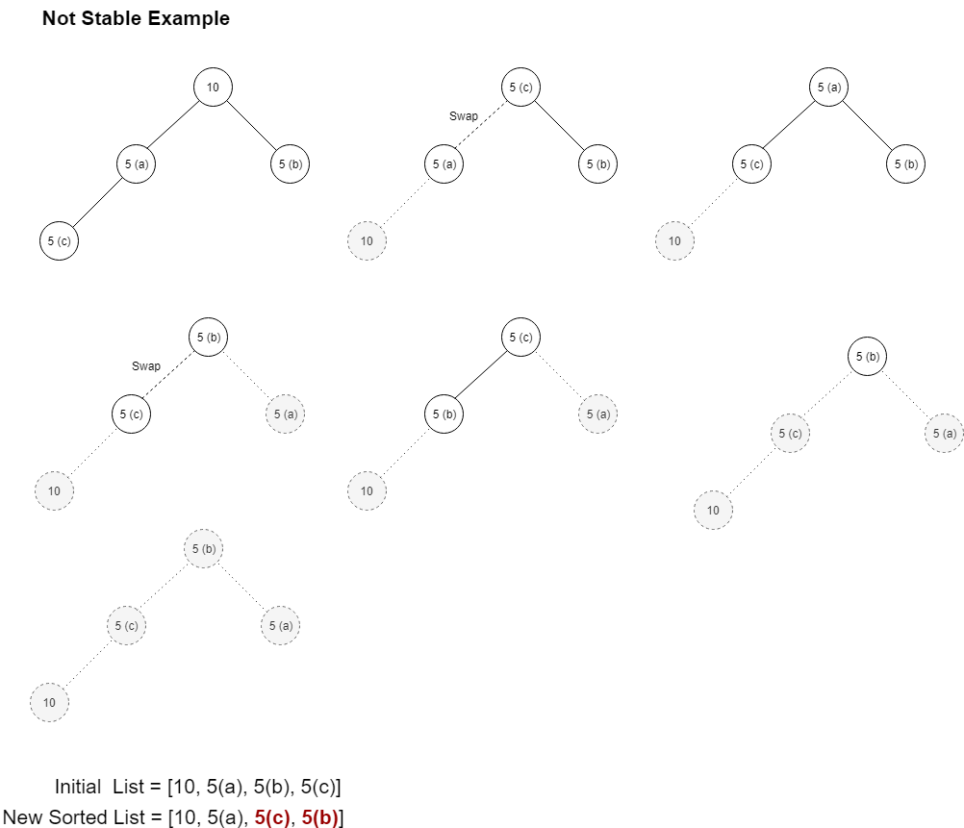
Not Stable Example

Slide 27
END
QUESTIONS? . . .

