Slide 1
Prime Coin Change Problem
¢
Created by Lucas Geurtjens

Slide 2
Overview
Background
Algorithm Overview
Pseudocode
Results
Time Complexity
Correctness
In-place and Stable?
P or NP?

Slide 3
Background
A coin change problem aims to find all ways to pay a certain amount given a set of coins.
This problem uses a set of infinite prime numbers, 1 and the amount itself as it’s coin set.
The following can be found:
All possible solutions.
Solutions for an exact amount of coins.
Solutions within a range of coins.

Slide 4
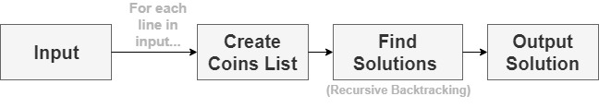
How does it work?
This is the general structure of the algorithm
It depends on 3 core methods.

Slide 5
Recursive Backtracking
Searches for all solutions for a given amount
Keep decreasing amount until ≤ 0 or coins used passes the limits.
Keeps track of current coin to skip duplicate permutations.
Needs to keep track of different parameters given.

Slide 6
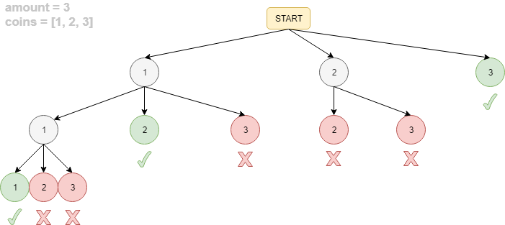
Backtracking Example

Slide 7
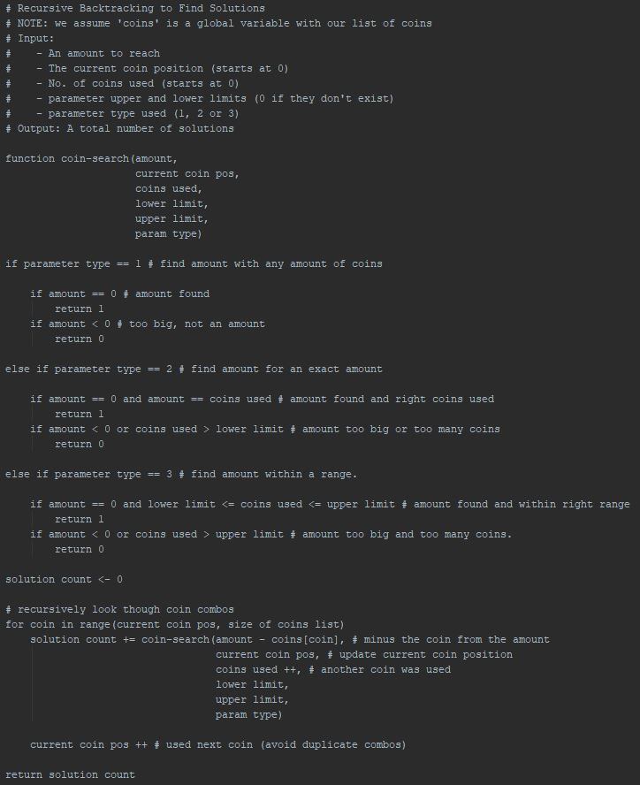
Pseudocode 1/2

Slide 8
Pseudocode 2/2

Slide 9
Prime Checker
Checks if a number is prime
Checks against factors within range 2 to sqrt(number) + 2
Using square root saves time for larger numbers as it prunes larger factors (e.g. we can know 100 with 10.)

Slide 10
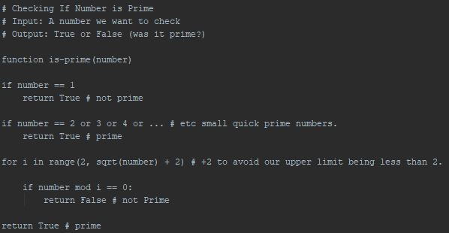
Pseudocode

Slide 11
Coin List Generator
Creates a list of coins our program can use.
It runs though numbers 1 -> amount and adds the numbers that are prime (using the prime checker).
It also adds a golden coin and 1 coin.
The coin list is declared globally afterwards.

Slide 12
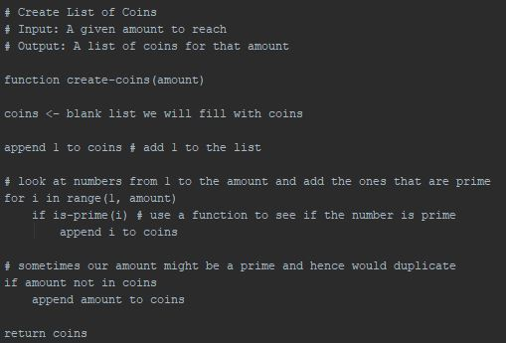
Pseudocode

Slide 13
Results
# | Input | Output | Speed (secs)
1 | 5 | 6 | 0.0000
2 | 6 2 5 | 7 | 0.0000
3 | 6 1 6 | 9 | 0.0000
4 | 8 3 | 2 | 0.0005
5 | 8 2 5 | 10 | 0.0005
6 | 20 10 15 | 57 | 0.0090
7 | 100 5 10 | 14839 | 7.6174
8 | 100 8 25 | 278083 | 76.0504
9 | 300 12 | 4307252 | 13470.9674
10 | 300 10 15 | N/A | 14400+

Slide 14
Observations
Performed well for most inputs
Struggled when it came to inputs over 100.
Was not able to find solutions for ‘300 10 15’ input in a reasonable amount of time.
Suggests an exponential time complexity.

Slide 15
Comparison to known input solution
Had same solutions
Slightly longer runtime for larger inputs.

Slide 16
Time Complexity
T(n) = C ⋅ T (n – 1) + 1
= C [ C ⋅ T(n – 2) + 1] + 1
= C² T(n – 2) + C¹ + C⁰
= C² [ C ⋅ T(n – 3) + 1] + C¹ + C⁰
= C³ T(n – 3) + C² + C¹ + C⁰
....
= C^{k} T(n – k) + C^{k-1} + C^{k-2} + ... + C¹ + C⁰
Here, n – k = 0, hence n = k
Now, using T(0) = 1
= C^{k} ⋅ T(0) + C^{k-1} + C^{k-2} + ... + C¹ + C⁰
= C^{k} + C^{k-1} + C^{k-2} + ... + C¹ + C⁰
= C^{k+1} – 1
= C ⋅ C^{k} – 1
≤ C ⋅ C^{k}
∴ O(C^{n})
Had an O(C^{n}) exponential time complexity where C is a constant.
This confirms what was observed in the results.

Slide 17
Correctness
1. Proposition
T(n) = C^{n} where n ≥ 0
2. Base Case
Since T(0) = 1,
T(0) = C⁰ = 1 where n = 0
∴ True for n = 0
3. Assumption
Assume True for n = k
T(k) = C^{k}
4. Inductive Step
T(k+1) = C^{k+1}
5. Conclusion
Thus, we can conclude that T(n) = C^{n}
Using proof by induction, we are able to prove the correctness of our algorithm.

Slide 18
Stable and In-place?
Stable? YES
Since the recursive backtracking algorithm does not require significant extra memory (such as lists), it is stable.
In-Place? YES
There was no swapping in the algorithm, thus it is in place.

Slide 19
P or NP?
Non-Polynomial (NP).
There wasn’t an easy polynomial method of calculating either:
Primes
Coin Combinations
But it was easy to confirm said solutions were true.

Slide 20
END
QUESTIONS? . . .

