Slide 1
Eyelib Fixation Test
Nathan Lucas

Slide 2
Calibration

Slide 3
Eye Tracker Calibration
Accuracy and error
tan(θ) = e/d
θ is angular accuracy
e is on-screen error
d is distance to screen
The Eye Tribe Tracker product documentation
Center user in front of the monitor at a distance of 45-75 cm (17.7-29.5 in)
Eye Tribe server reports calibrated system calculates eye gaze coordinates with an average accuracy of approximately 0.5 to 1°
Eye Tribe server reports average error of 0.5 to 1 cm (0.2 to 0.4 in) at 60 cm (23.6 in) from the screen/tracker

Slide 4
Calibration Point Results
Rating Scale and Accuracy
Components
dark green: great (≤ 0.5°)
binocular
right eye
left eye
light green: good (≤ 0.7°)
yellow: moderate (≤ 1.0°)
orange: poor (≤ 1.5°)
red: recalibrate (> 1.5°)
Example
gray: uncalibrated
good
moderate
great

Slide 5
Calibration Criteria
Each Calibration Point
Overall Results
light or dark
green
green or
yellow
dark
green
light or dark
green

Slide 6
Preliminary Fixation Study

Slide 7
Preliminary Fixation Study
Exploratory data analysis
Scatter plots
Fixation point accuracy
Determine appropriate parameters for dispersion threshold (DT) and velocity threshold (VT) fixation detection algorithms
Window size – number of contiguous points for which to compute dispersion
Maximum dispersion of fixation points
Maximum displacement between fixation points
Test metrics for fixations on object (target)
Count of fixations
Average duration
Interval between fixations

Slide 8
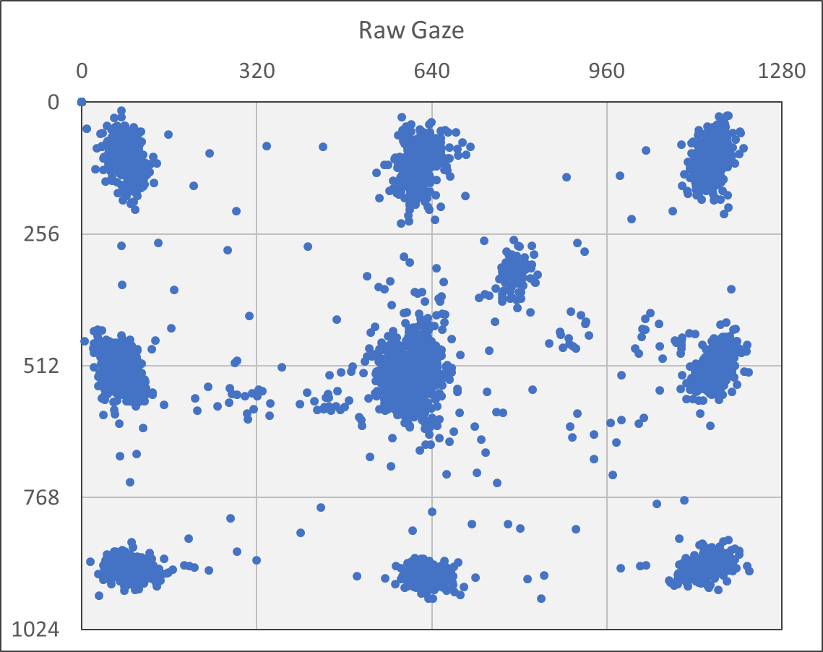
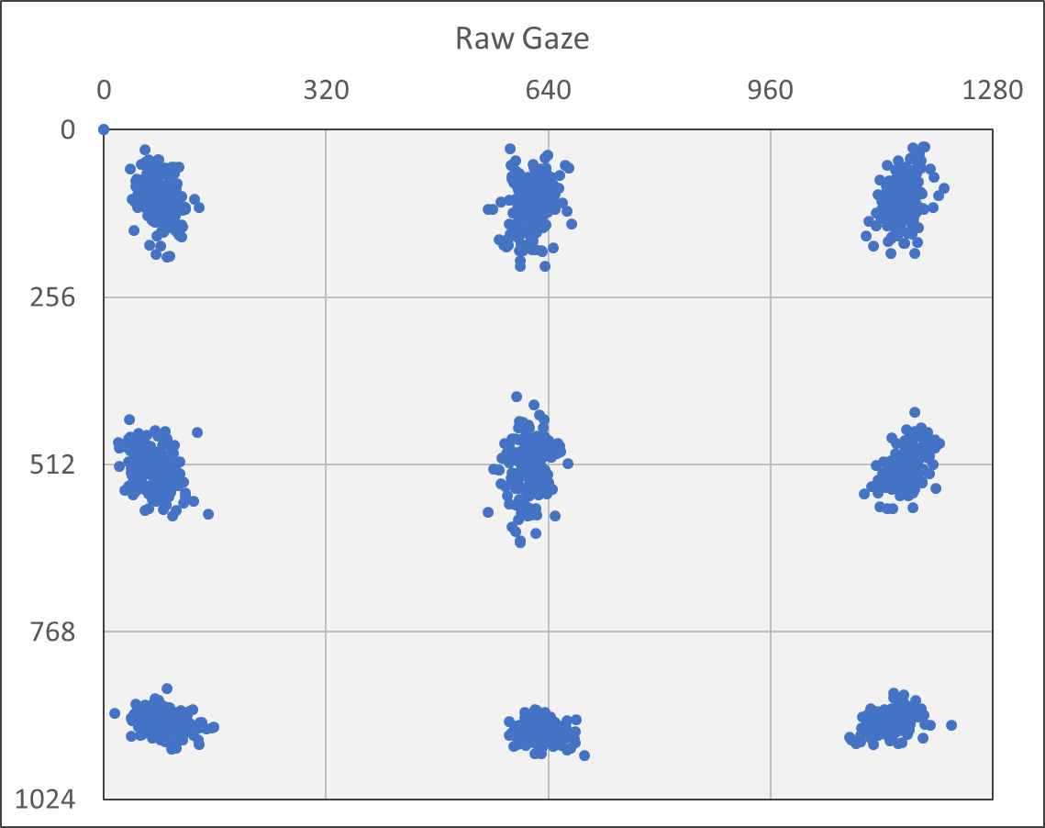
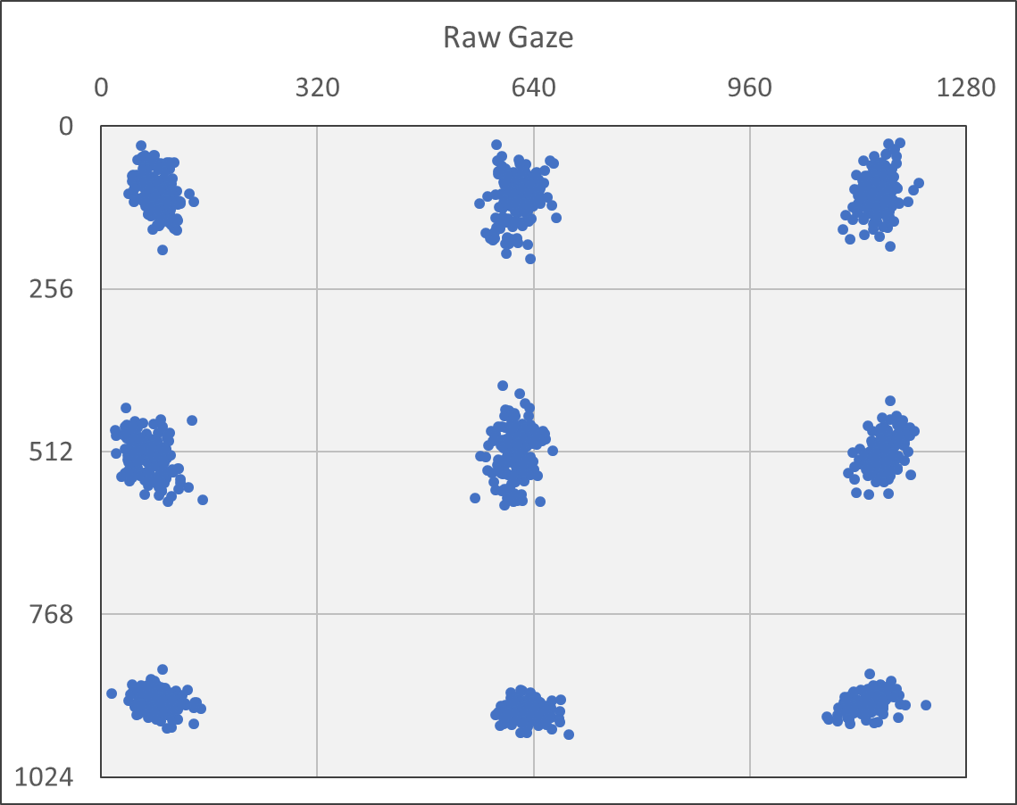
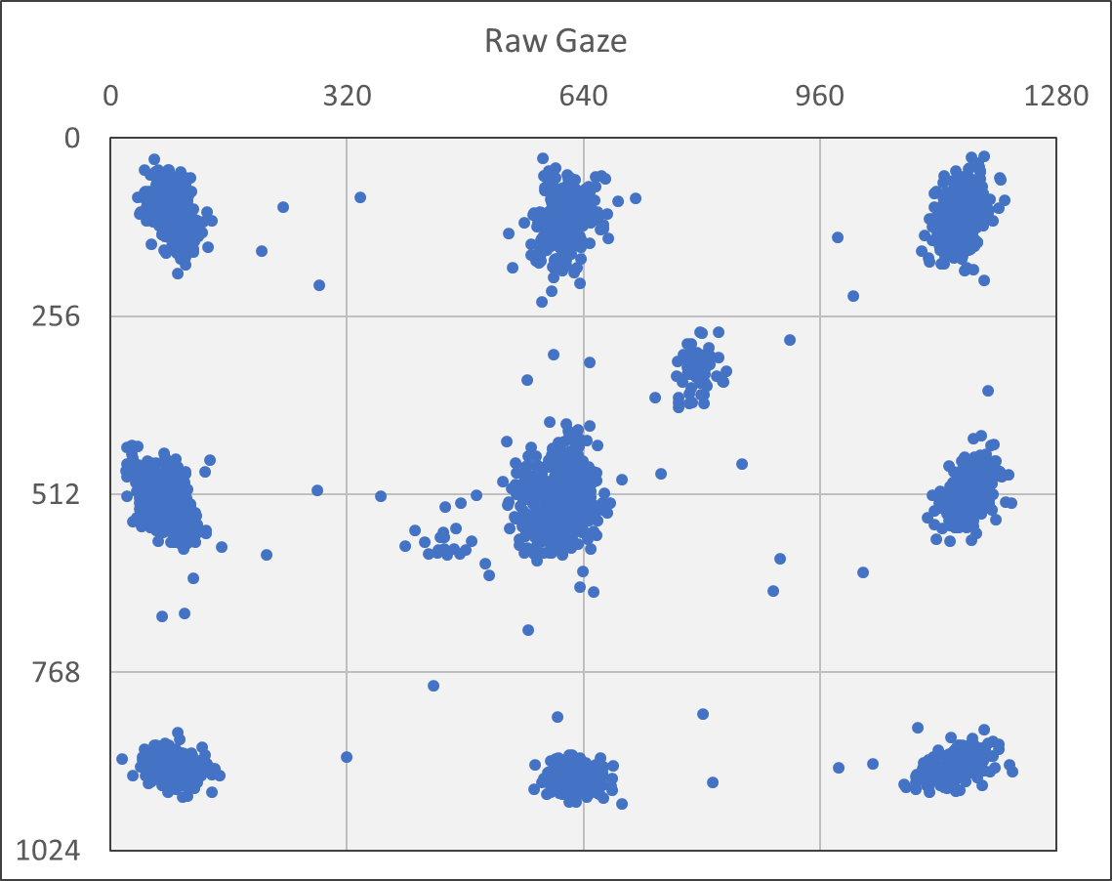
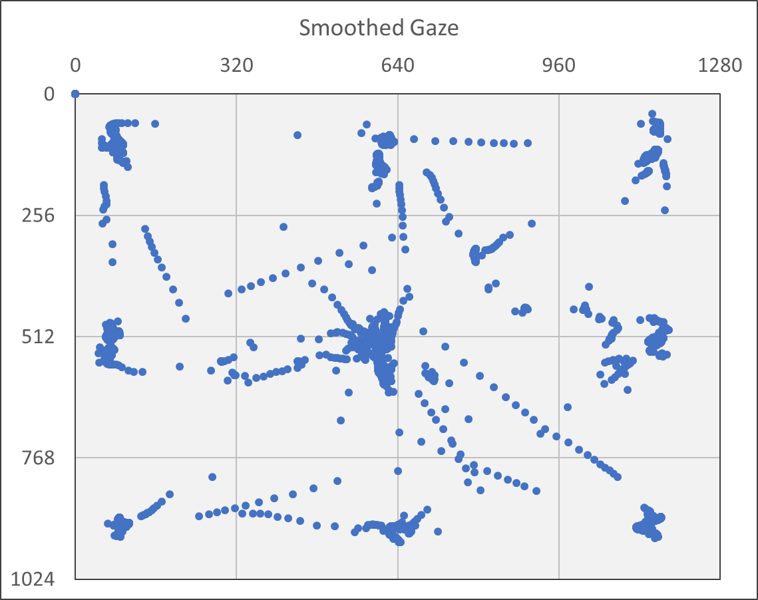
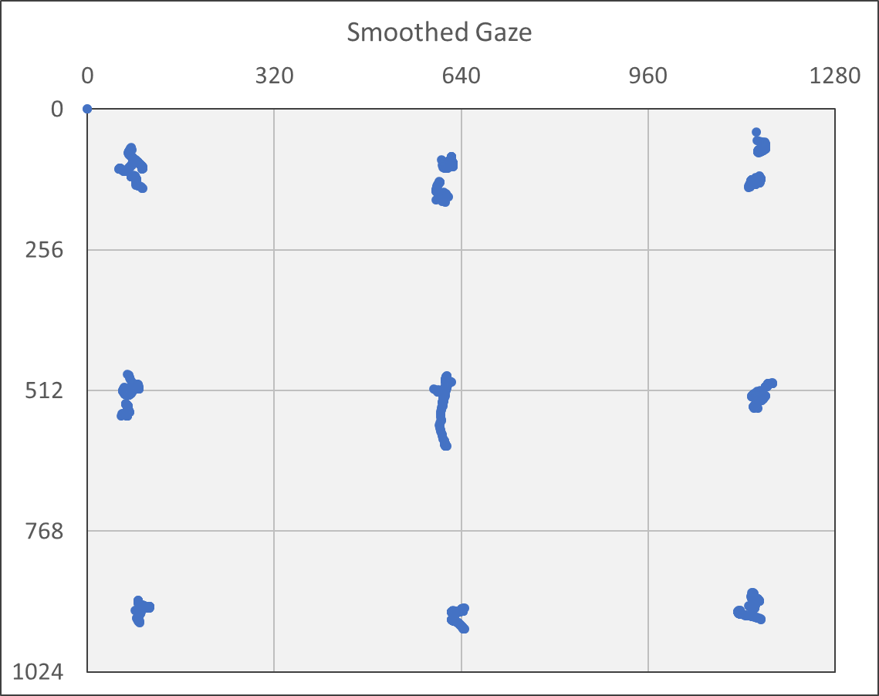
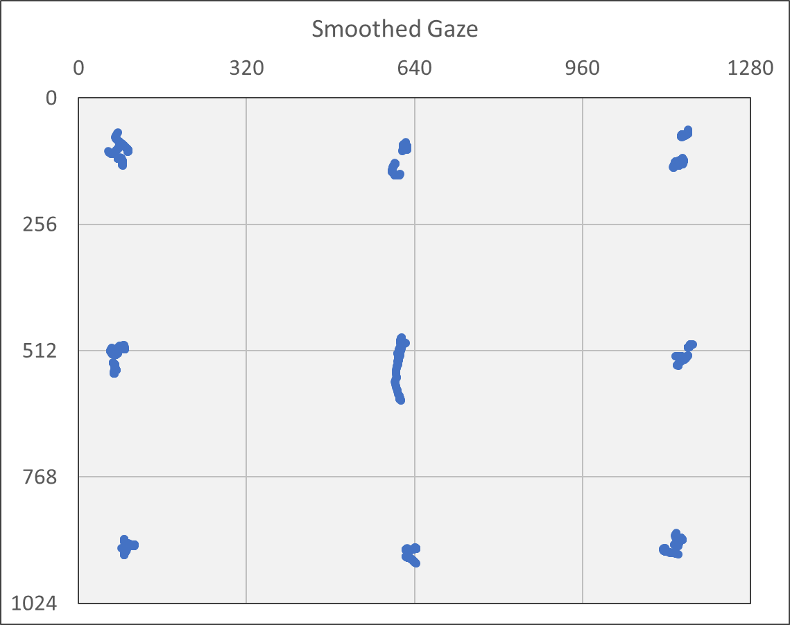
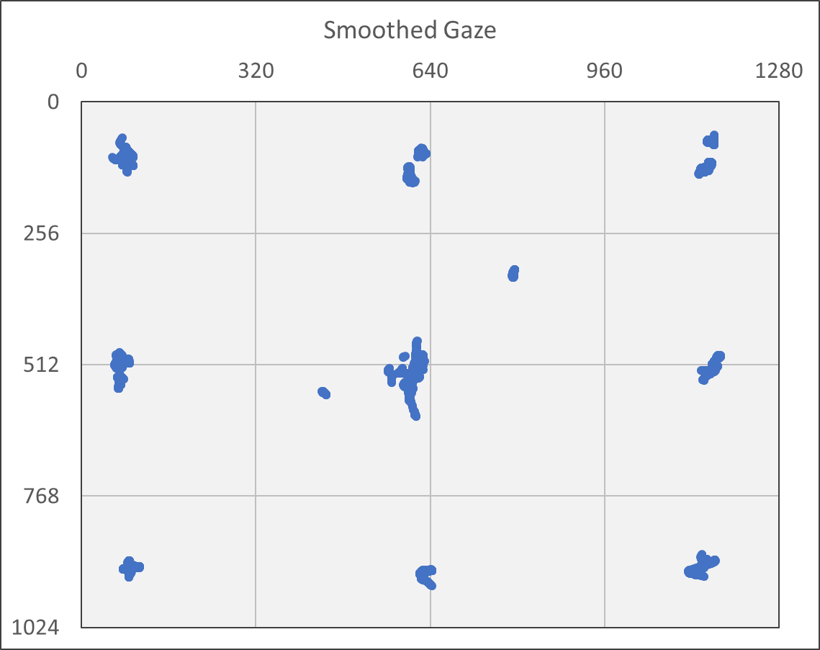
Exploratory Data Analysis
All gaze points
(fixations and saccades)
Gaze points during
active target
Gaze points during active
target and fixation
Gaze points
during fixation
Filter: none
Filter: active = TRUE
Filter: active = TRUE, ET = TRUE
Filter: ET = TRUE
Smoothed gaze points
reveal saccade paths
As expected, high density
of gaze points near targets
As expected, high density
of fixations near targets
Some fixations were not
on or during active target
Data set: 20170217T174030-fixation

Slide 9
Fixation Point Accuracy
Target |  |  | Count of points | Average raw gaze |  |  |  |  | Average smoothed gaze
 |  |  |  | Gaze point |  | Percent error |  | Pixel error | Gaze point |  | Percent error |  | Pixel error
ID | x | y |  | x | y | x | y |  | x | y | x | y
0 | 102 | 102 | 182 | 80.50 | 107.65 | 21.1% | 5.5% | 22.23 | 77.50 | 105.97 | 24.0% | 3.9% | 24.82
1 | 640 | 102 | 183 | 616.44 | 112.93 | 3.7% | 10.7% | 25.97 | 615.50 | 116.04 | 3.8% | 13.8% | 28.24
2 | 1178 | 102 | 182 | 1151.23 | 107.88 | 2.3% | 5.8% | 27.41 | 1147.84 | 111.52 | 2.6% | 9.3% | 31.63
3 | 102 | 512 | 182 | 71.11 | 517.19 | 30.0% | 1.0% | 31.32 | 71.98 | 519.14 | 29.4% | 1.4% | 30.86
4 | 640 | 512 | 182 | 613.30 | 516.38 | 4.2% | 0.9% | 27.05 | 611.00 | 532.62 | 4.5% | 4.0% | 35.58
5 | 1178 | 512 | 179 | 1156.58 | 516.63 | 1.8% | 0.9% | 21.92 | 1153.39 | 520.27 | 2.1% | 1.6% | 25.96
6 | 102 | 922 | 182 | 89.23 | 906.73 | 12.5% | 1.7% | 19.90 | 93.53 | 910.16 | 8.3% | 1.3% | 14.56
7 | 640 | 922 | 181 | 629.65 | 920.21 | 1.6% | 0.2% | 10.50 | 632.79 | 921.12 | 1.1% | 0.1% | 7.26
8 | 1178 | 922 | 181 | 1129.59 | 898.92 | 4.1% | 2.5% | 53.63 | 1129.42 | 899.33 | 4.1% | 2.5% | 53.61
Avg. | 640 | 512 | 1634 | 613.98 | 510.87 | 4.1% | 0.2% | 26.05 | 613.46 | 514.39 | 4.1% | 0.5% | 26.65
As expected, average raw and smoothed
gaze error values are very consistent
Data set: 20170217T174030-fixation

Slide 10
Fixation Point Accuracy
Screen pixels per inch (PPI)
Screen resolution:
1280 pixels / 14 ¹³/₁₆ in = 86 PPI
1024 pixels / 11 ⁷/₈ in = 86 PPI
Screen diagonal:
(1280² + 1024²)^{1/2} / 19 in = 86 PPI
On-screen measurement:
200 pixels / 2⁵/₁₆ in = 86 PPI
Accuracy
tan(θ) = e/d
θ is angular accuracy
e is on-screen error
d is distance to screen (24.5 in)
Raw gaze
e = 26 pixels / 86 PPI = 0.30 in
θ = tan⁻¹(0.30/24.5) = 0.70°
Smoothed gaze
e = 27 pixels / 86 PPI = 0.31 in
θ = tan⁻¹(0.31/24.5) = 0.72°
Data set: 20170217T174030-fixation

Slide 11
Dispersion and Displacement During Active Target
Target |  |  | Count of points | Average raw gaze |  | Average smoothed gaze
ID | x | y |  | Dispersion (pixels) | Displacement (pixels) | Dispersion (pixels) | Displacement (pixels)
0 | 102 | 102 | 182 | 90.88 | 40.91 | 14.17 | 0.98
1 | 640 | 102 | 183 | 101.40 | 44.60 | 17.33 | 1.34
2 | 1178 | 102 | 182 | 80.65 | 34.39 | 17.40 | 1.62
3 | 102 | 512 | 182 | 106.04 | 44.77 | 28.06 | 6.62
4 | 640 | 512 | 182 | 87.48 | 37.92 | 11.51 | 1.63
5 | 1178 | 512 | 179 | 80.51 | 32.77 | 12.99 | 0.93
6 | 102 | 922 | 182 | 80.06 | 29.35 | 27.54 | 0.87
7 | 640 | 922 | 181 | 57.59 | 26.31 | 11.00 | 0.61
8 | 1178 | 922 | 181 | 104.76 | 43.55 | 37.41 | 16.87
Avg. | 640 | 512 | 1634 | 87.74 | 37.19 | 19.72 | 3.49
Data set: 20170217T174030-fixation

Slide 12
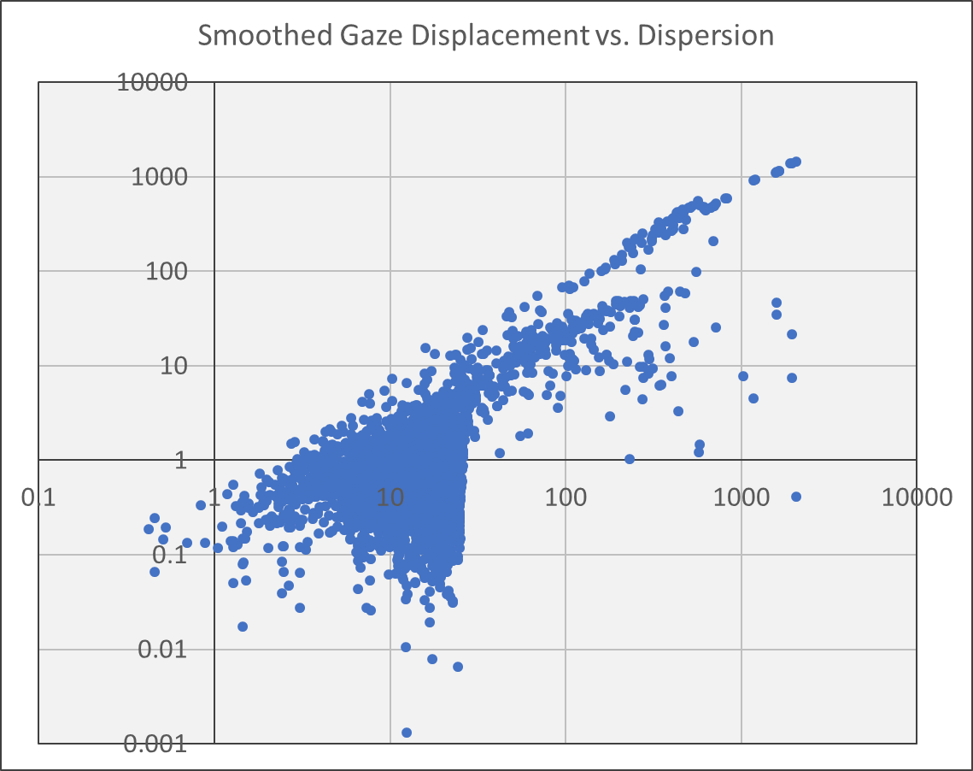
All Smoothed Gaze Points
The data suggest a
dispersion threshold
Displacement
Fixation?
Dispersion
Data set: 20170217T174030-fixation
Filter: none
Dispersion window: 4 points

Slide 13
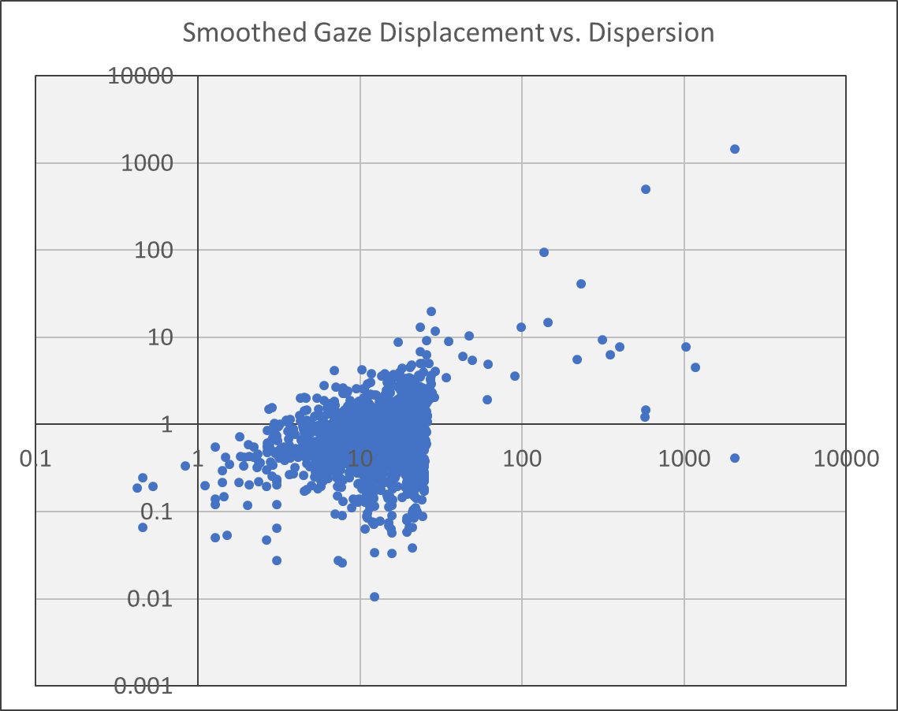
Smoothed Gaze Points During Active Target
Data filtered to show
only fixation points
while target is active
Displacement
Dispersion
Non-fixation points,
perhaps just before
fixation is detected?
Data set: 20170217T174030-fixation
Filter: active = TRUE
Dispersion window: 4 points

Slide 14
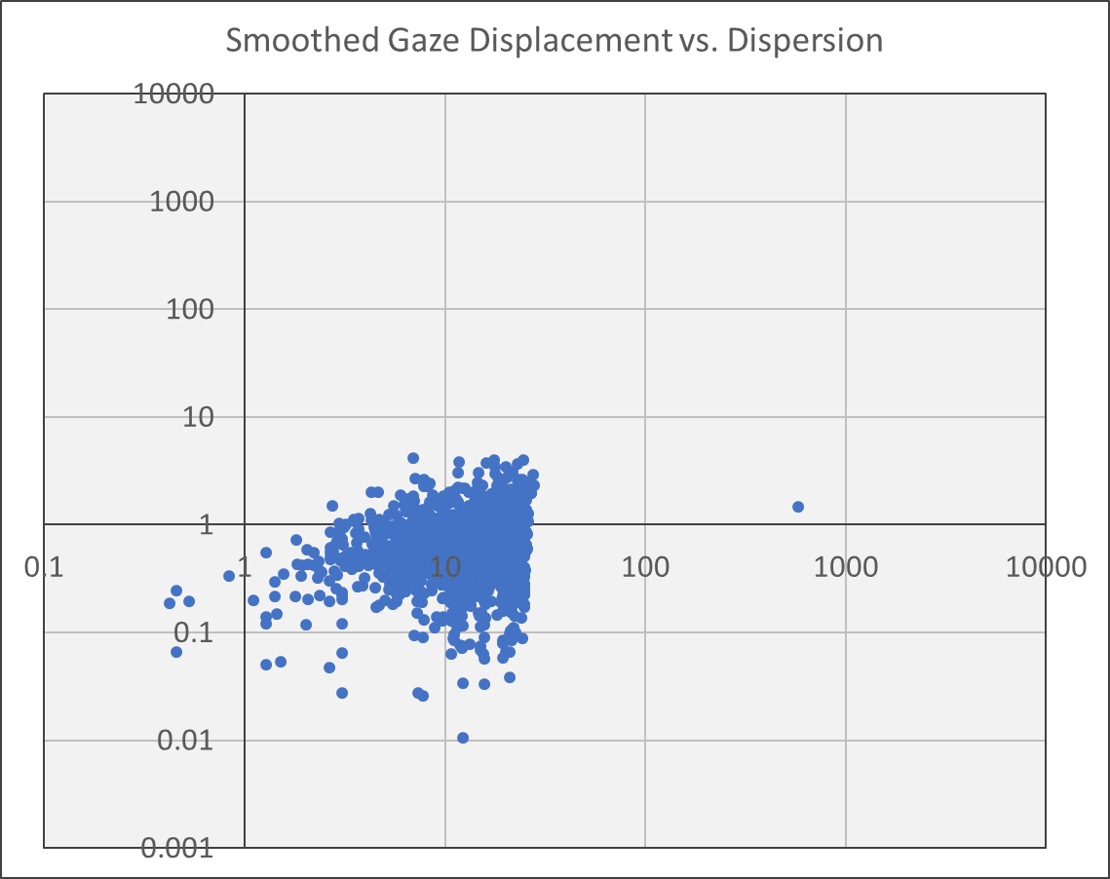
Smoothed Gaze Fixation Points During Active Target
Data filtered to show
only points while
target is active
28
Displacement
5
Dispersion
Data set: 20170217T174030-fixation
Filter: active = TRUE, ET = TRUE
Dispersion window: 4 points

Slide 15
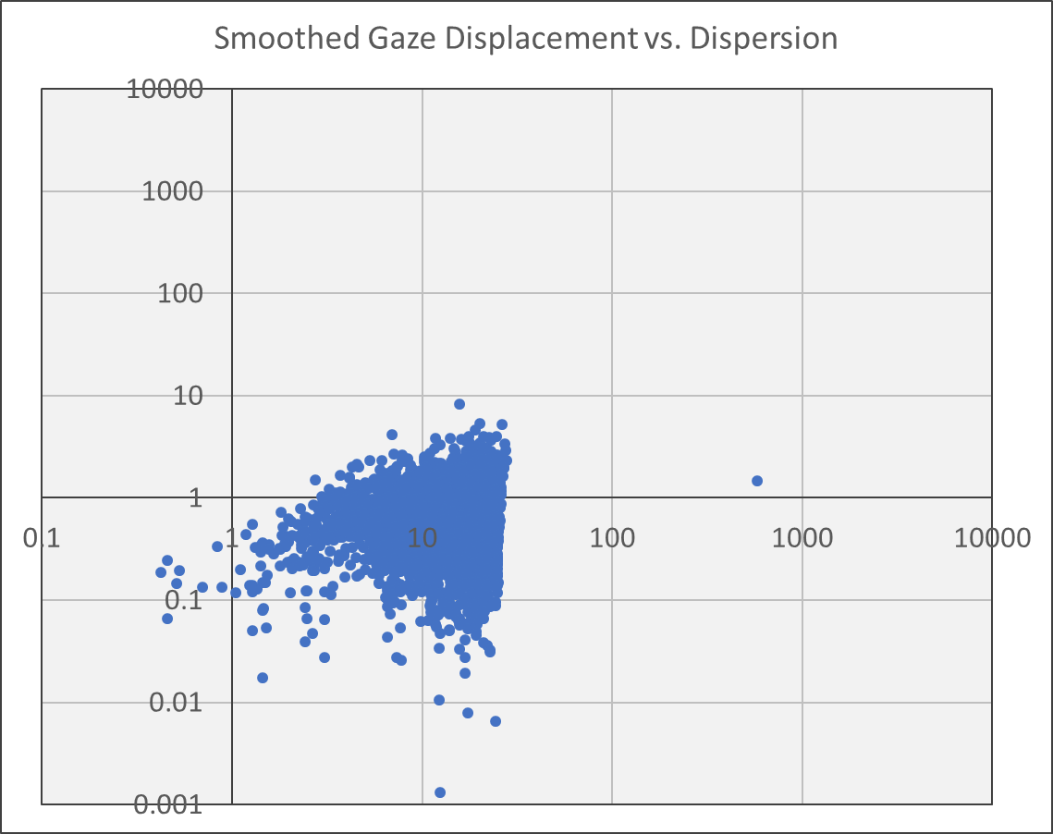
Smoothed Gaze All Fixation Points
Higher displacement
threshold would permit
additional fixation points
observed outside the
active target durations
28
Displacement
7
Dispersion
Data set: 20170217T174030-fixation
Filter: ET = TRUE
Dispersion window: 4 points

Slide 16
All Smoothed Gaze Points
28
Displacement
7
Dispersion
Data set: 20170217T174030-fixation
Filter: none
Dispersion window: 4 points

Slide 17
Smoothed Gaze Displacement and Dispersion
Fixation of
Active Target
All Fixation
Points
Observed
displacement
and dispersion
thresholds
Active Target
Points
All Gaze
Points
Data set: 20170217T174030-fixation
Dispersion window: 4 points

Slide 18
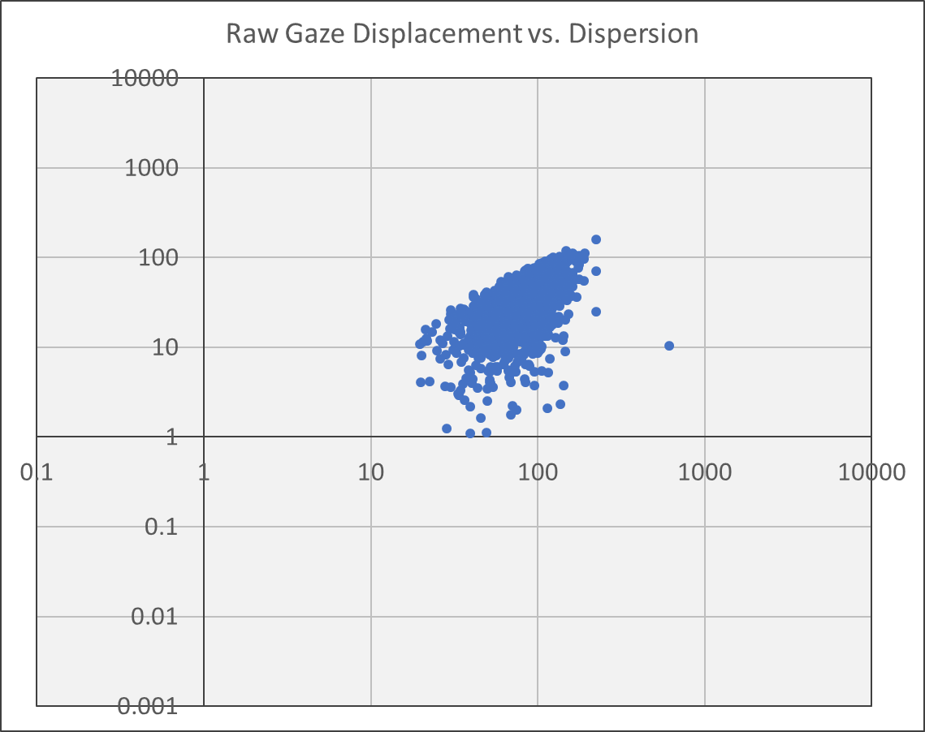
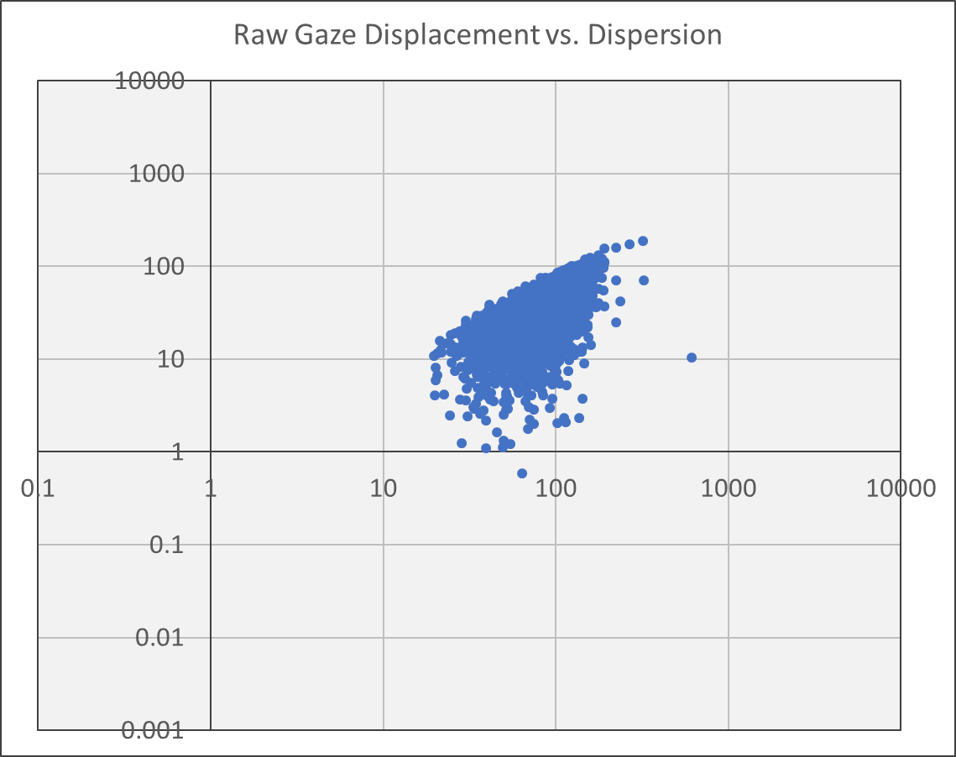

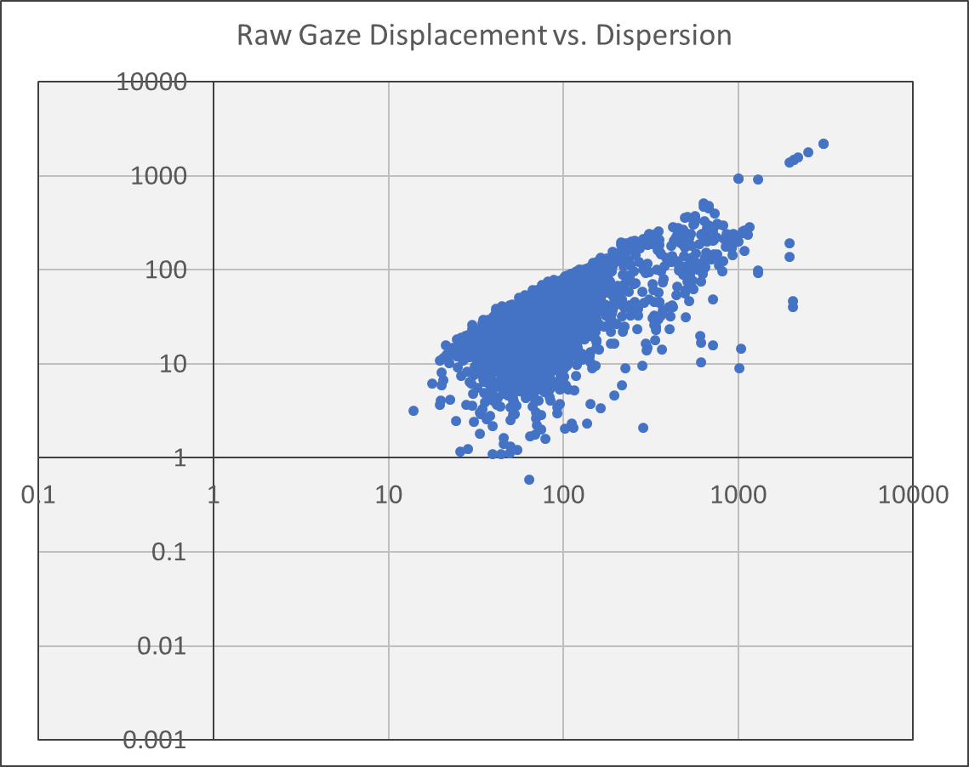
Raw Gaze Displacement and Dispersion
Fixation of
Active Target
All Fixation
Points
Displacement
and dispersion
thresholds are
less clear from
raw gaze points
Active Target
Points
All Gaze
Points
Data set: 20170217T174030-fixation
Dispersion window: 4 points

Slide 19
Dispersion Threshold
Typical maximum dispersion
0.5° to 1°
d · tan(θ) · p
d = 24.5 inches to screen
p = 86 pixels per inch (PPI)
24.5 in · tan(0.5°) · 86 PPI = 18 pixels
24.5 in · tan(1.0°) · 86 PPI = 37 pixels
Observed dispersion threshold
θ = tan⁻¹( (28 pixels / 86 PPI) / 24.5 in) = 0.76°
Data set: 20170217T174030-fixation

Slide 20
Dispersion and Displacement
Typical velocity threshold
Fixation: < 100°/second → 24.5 in · tan(100°/s / 60 fps) · 86 PPI = 61 pixels
Saccade: > 300°/second → 24.5 in · tan(300°/s / 60 fps) · 86 PPI = 184 pixels
Observed displacement threshold
θ = tan⁻¹( (7 pixels / 86 PPI) / 24.5 in) · 60 fps = 11°/s
Data set: 20170217T174030-fixation

Slide 21
Fixations on Targets
Target | x | y | Count of fixations on target | Average fixation duration (ms) | Interval between fixations (ms)
0 | 102 | 102 | 3 | 1,875 | 20,295
1 | 640 | 102 | 3 | 1,665 | 14,200
2 | 1178 | 102 | 3 | 2,420 | 32,449
3 | 102 | 512 | 3 | 2,153 | 16,316
4 | 640 | 512 | 3 | 1,686 | 16,217
5 | 1178 | 512 | 3 | 1,864 | 28,369
6 | 102 | 922 | 3 | 1,860 | 6,144
7 | 640 | 922 | 3 | 1,890 | 18,280
8 | 1178 | 922 | 3 | 1,876 | 10,222
Average |  |  | 3 | 1,921 | 18,055
Ideal count is 3, one for each
target sequence. Less than 3
represents failure to detect
fixation(s) on a target.
Greater than 3 represents
interrupted fixation(s).
Fixation durations
should be equal
to or greater than
the target active
time of 1,000
milliseconds.
An average interval of
18,000 milliseconds
would be consistent
with 9 targets and
2,000 milliseconds
per target.
Data set: 20170217T174030-fixation

Slide 22
Preliminary Fixation Study – Summary
Exploratory data analysis provides evidence of expected observations
Smoothed gaze points reveal saccade paths
High density of gaze points observed near targets
High density of fixations observed near targets
Some fixations appear not to be on or during an active target
Fixation point accuracy
Average error: 26-27 pixels (0.7° visual angle)
Parameters for fixation detection
DT window size: 4 points
Initial testing suggested 4 points would be sufficient
Data analysis provides evidence to support
Maximum dispersion of fixation points in DT window: 28
Evidence implemented DT algorithm may be suitable for fixation detection
Maximum displacement between fixation points: 7
However, there is evidence implemented VT algorithm may not be suitable for fixation detection
Test metrics for fixations on object (target)
Count of fixations for each target equals 3, one for each target sequence
Average fixation duration at each target is greater than the minimum of 1,000 ms
Interval between fixations is consistent with a sequence of 9 targets, repeated 3 times, with 2,000 ms per target

Slide 23
Fixation Test

Slide 24
Fixation Test Objectives
Fixation Test
Introduction
Test reliability and compare three (3) fixation detection methods
Eye tracker fixation flag (ET)
Dispersion threshold (DT)
Velocity threshold (VT)
Input smoothed gaze points to both DT and VT
Is eye tracker fixation detection sufficient?
Measure fixation point accuracy
Smoothed gaze point error during fixation, in pixels and degrees visual angle
Compare with reported accuracy of eye tracker
Model the relationship between fixation metrics and attention
May need to use a different test
This test might be limited to assessing reliability of measurements
Capture pictures of experiment for use during dissertation defense

Slide 25
Test Parameters
Fixation Test
Introduction
Category | Parameter | Value | Units
Fixation detection | DT sample window size | 4 | points
 | DT maximum dispersion | 30 | pixels
 | VT maximum displacement | 7 | pixels
Target duration | Before active | 750 | milliseconds
 | Active state | 750 | milliseconds
 | After active | 0 | milliseconds
Target sequence | Number of targets per cycle | 9 | targets
 | Number of target cycles | 3 | cycles
Fixations | Fixation object radius | 56 | pixels

Slide 26
Data Analysis
Fixation Test
Introduction
File type | File name | Description
Data log | 20170310T150350-fixation-A3.csv 20170310T152053-fixation-B1.csv 2017XXXXTXXXXXX-fixation-CX.csv | Gaze and fixation data CSV files File timestamp Timestamped eye tracker, target, fixation detection, and target object fixation Summary of target object fixation for each fixation detection method
 | 20170310T150350-fix-calib-A3.csv 20170310T152053-fix-calib-B1.csv 2017XXXXTXXXXXX-fix-calib-CX.csv | Calibration results CSV files File timestamp Overall calibration results Calibration point results
Report | 20170310T150350-fixation-A3-gaze.xlsx | Scatter plots of gaze points, including animated playback
 | 20170310T152053-fixation-B1-accuracy.xlsx | Bubble chart and table of eye tracker calibrated and observed accuracy
 | 20170310T152053-fixation-B1-calib.xlsx | Bubble chart and table of eye tracker calibration accuracy
 | 20170310T152053-fixation-B1-target.xlsx | Bar and bubble charts of fixation count, duration, and interval
Analysis | 20170310T150350-fixation-A3.xlsx 20170310T152053-fixation-B1.xlsx 2017XXXXTXXXXXX-fixation-CX.xlsx | File timestamps from CSV source data
 | fixation-test.xlsx | Aggregate data analysis workbook
TBD
TBD
TBD

Slide 27
Fixation Detection
Fixation Test
Objective 1
Total count of fixation points may varying by participant, depending on the frequency and duration of fixations between active targets.
However, during active target periods the percentage of points for which fixation is detected should approach 100% and the count of fixation points should be more consistent among individual targets and participants.

Slide 28
Fixation Detection
Fixation Test
Objective 1
Target | Participant | ET = true | DT = true | VT = true | ET = DT | ET = VT | DT = VT
active = true | A | 97.8% | 94.9% | 99.8% | 93.7% | 98.0% | 95.2%
 | B | 96.6% | 92.7% | 99.2% | 92.2% | 97.4% | 93.3%
 | C | % | % | % | % | % | %
active = false | A | 53.0% | 72.0% | 79.9% | 77.7% | 73.1% | 91.4%
 | B | 53.9% | 70.8% | 81.6% | 77.3% | 72.1% | 87.9%
 | C | % | % | % | % | % | %
All points | A | 71.4% | 81.4% | 88.0% | 84.3% | 83.4% | 93.0%
 | B | 71.7% | 79.9% | 89.0% | 83.5% | 82.7% | 90.2%
 | C | % | % | % | % | % | %
TBD
TBD
TBD
ET produces fewer
false positives (?)
Source: Analysis workbooks : fixation, compare

Slide 29
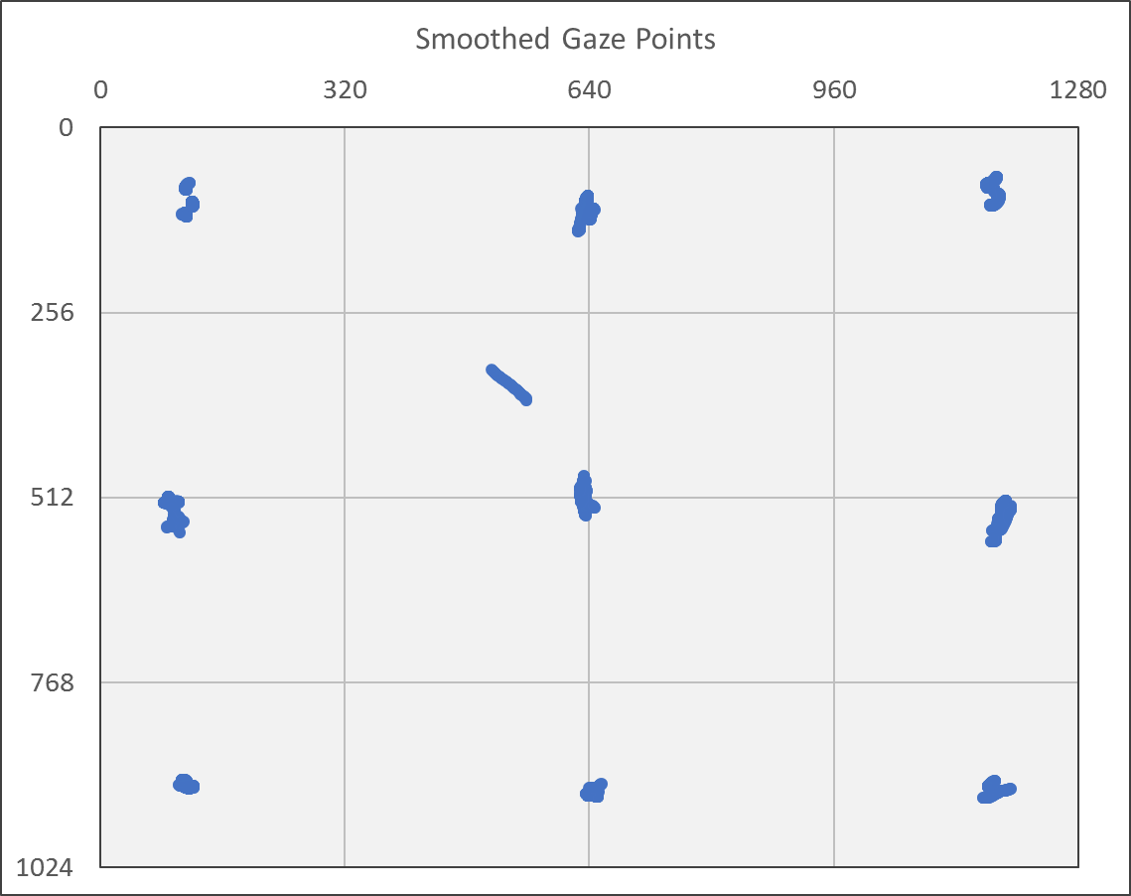
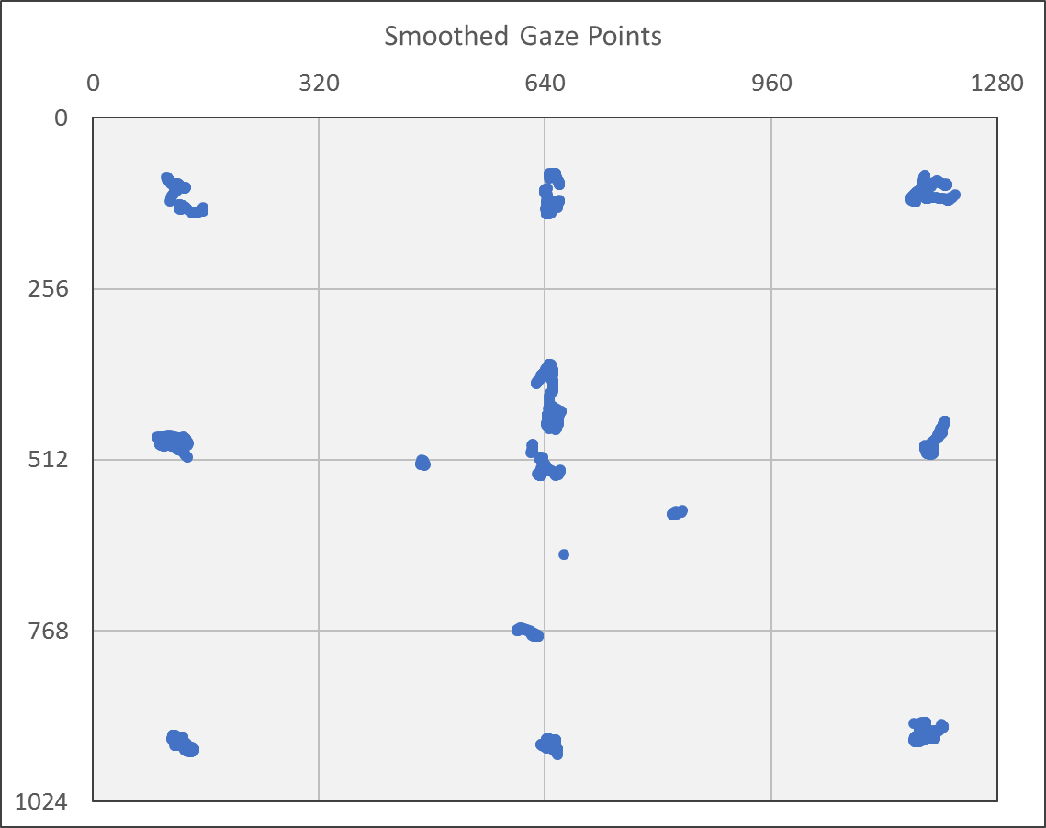
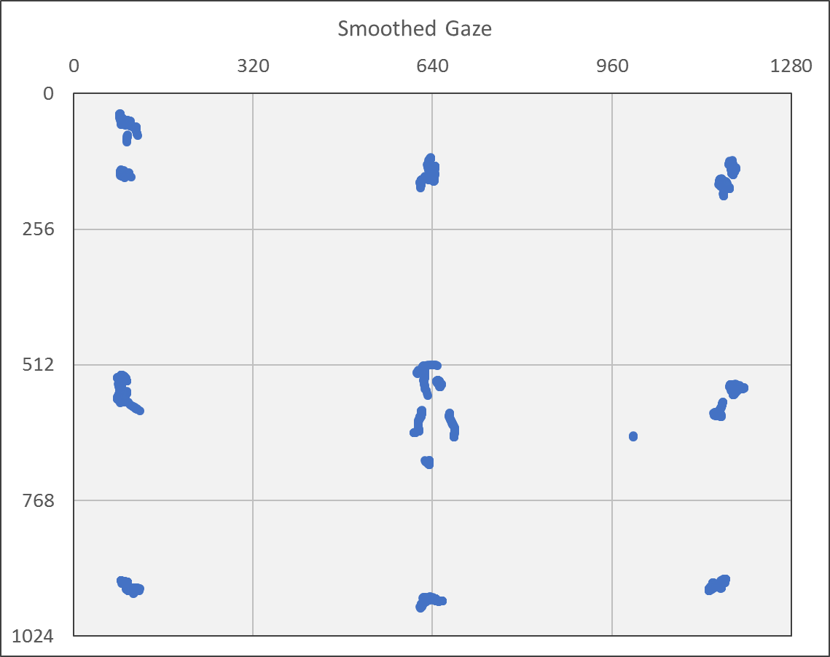
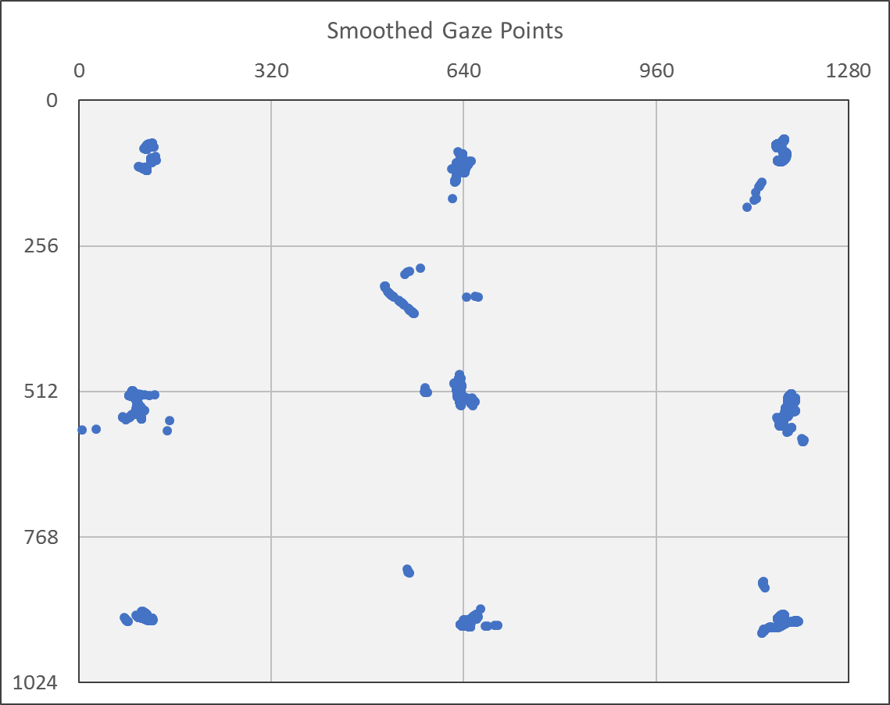
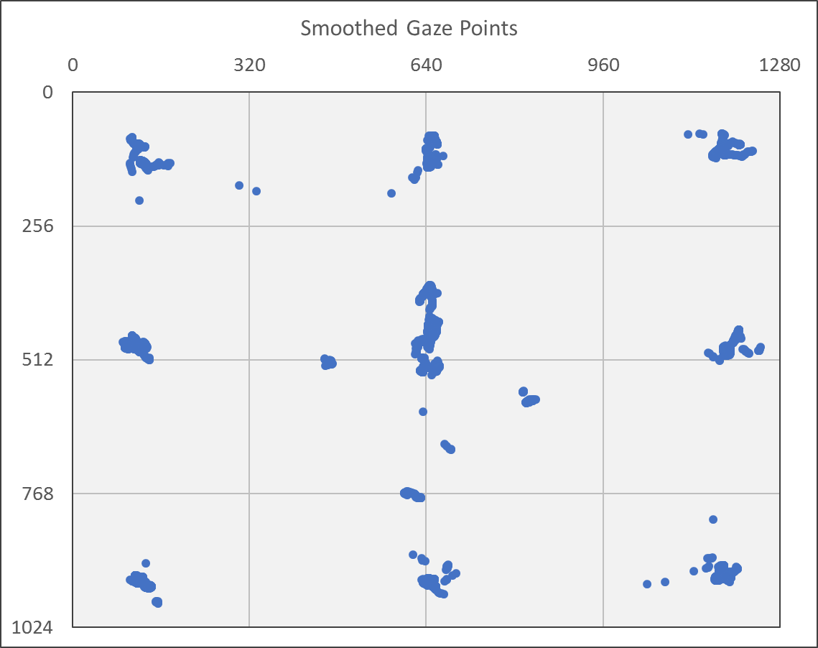
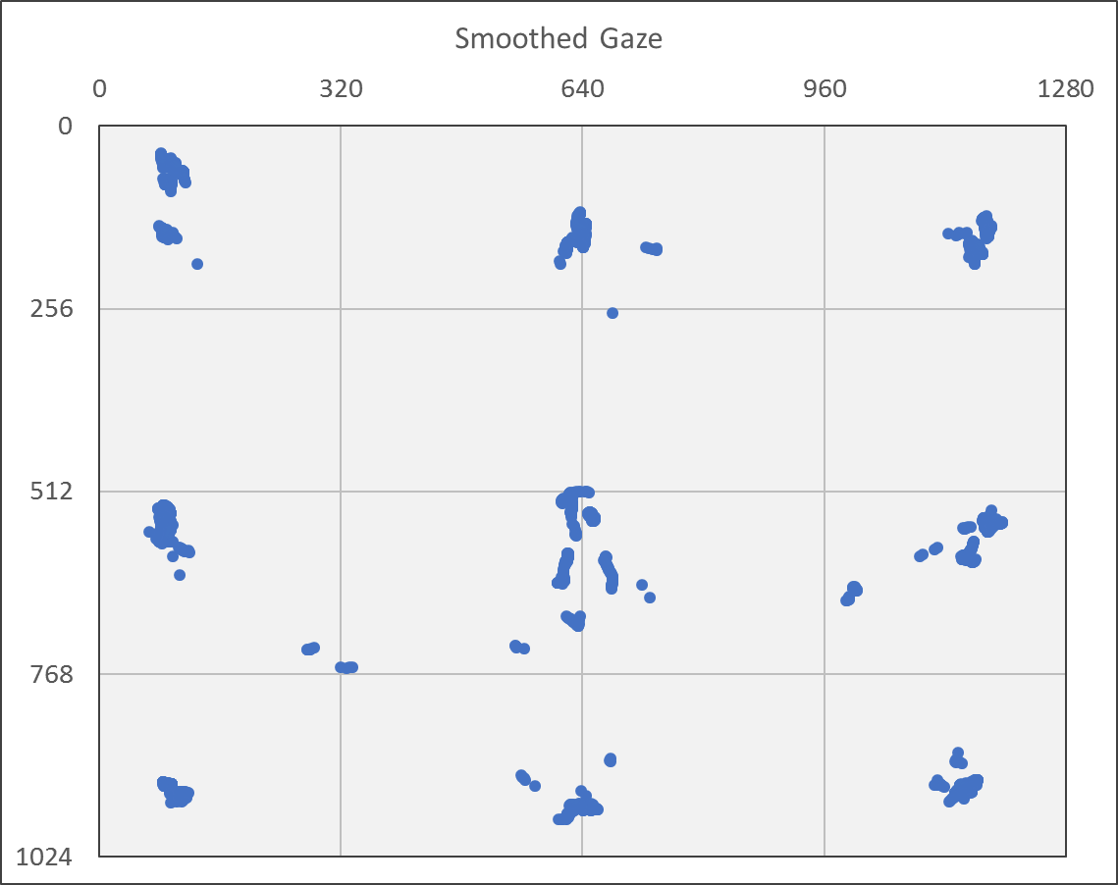
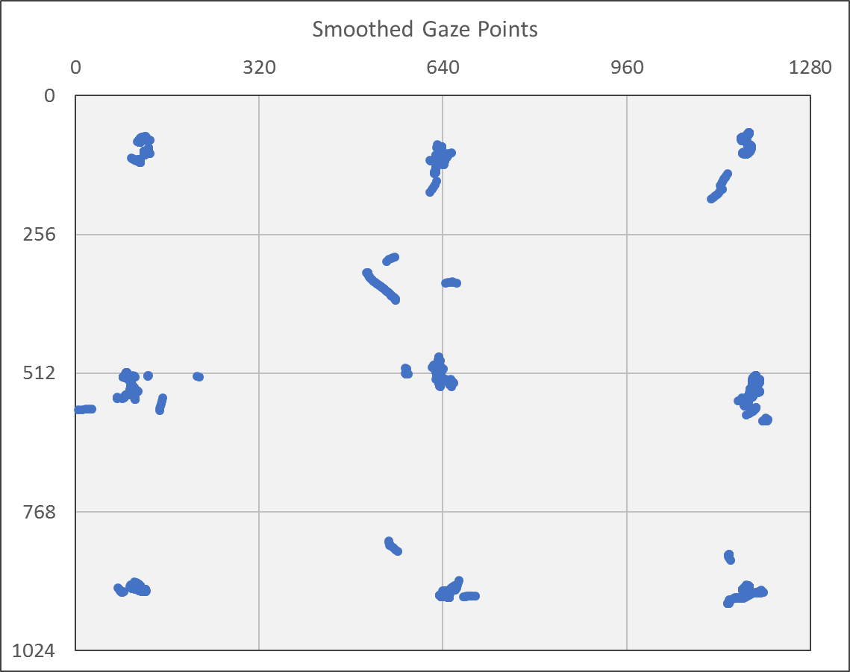
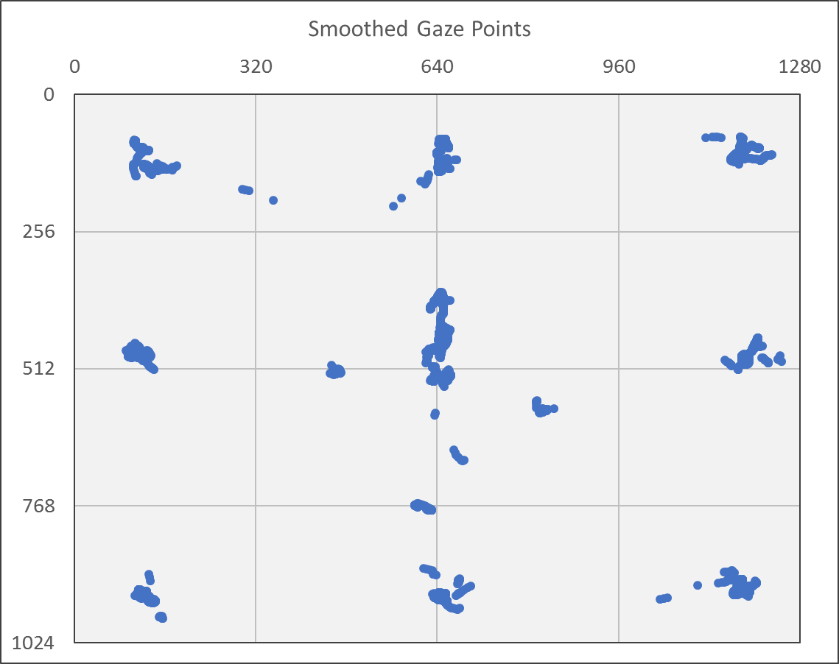
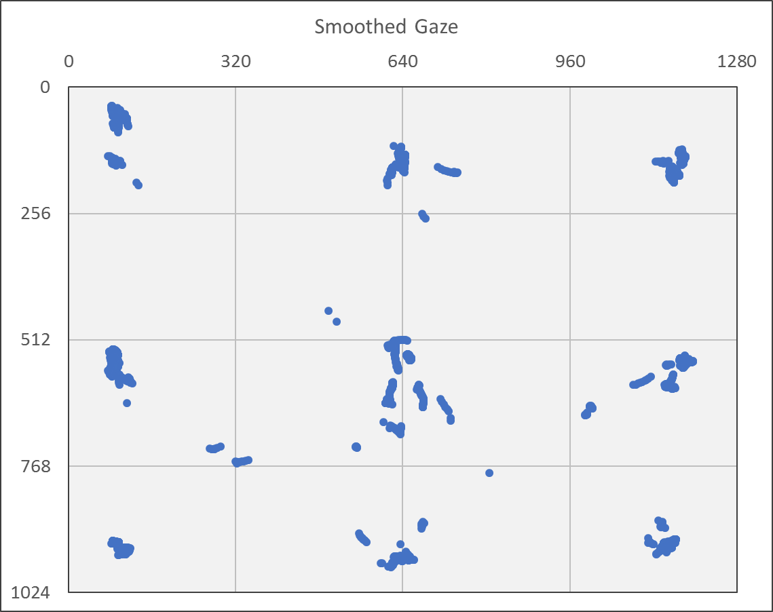
Smoothed Gaze Fixation Points
Fixation Test
Objective 1
Participant A
Participant B
Participant C
TBD
ET = true
DT = true
VT = true
Source: Analysis workbooks : smoothed

Slide 30
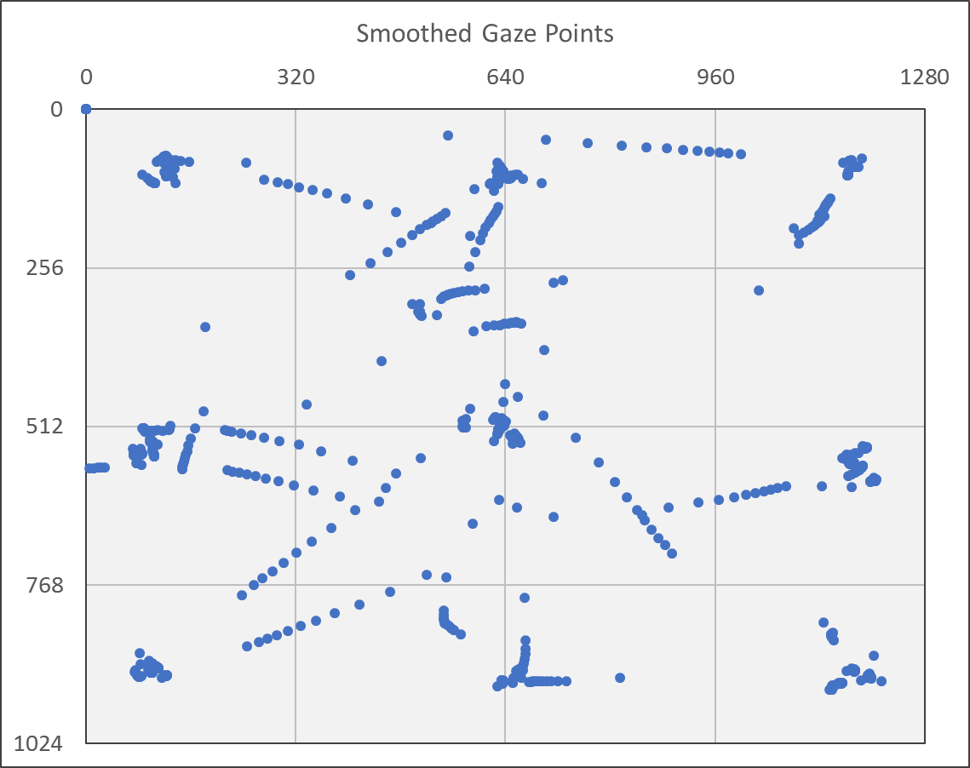
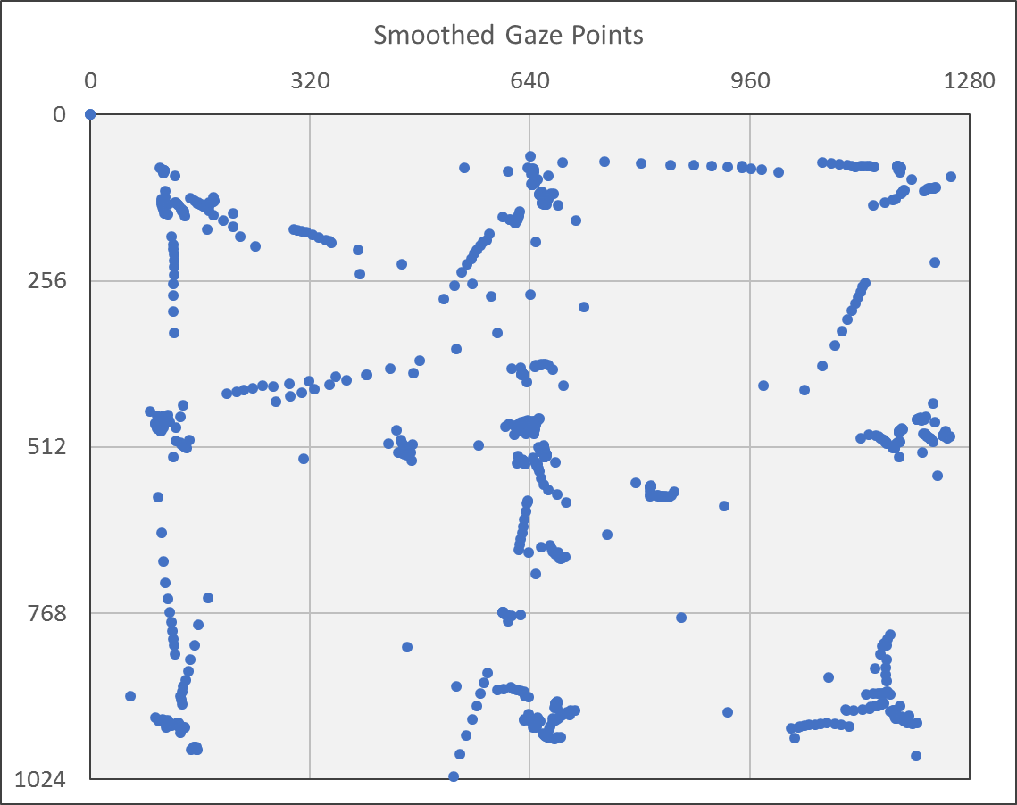
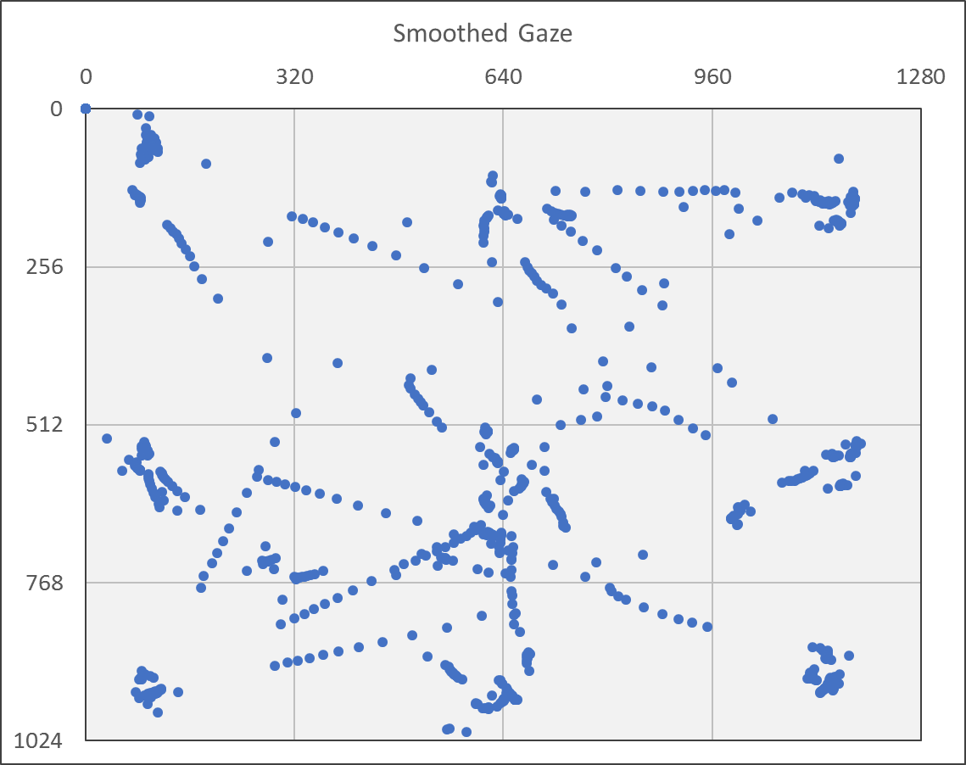
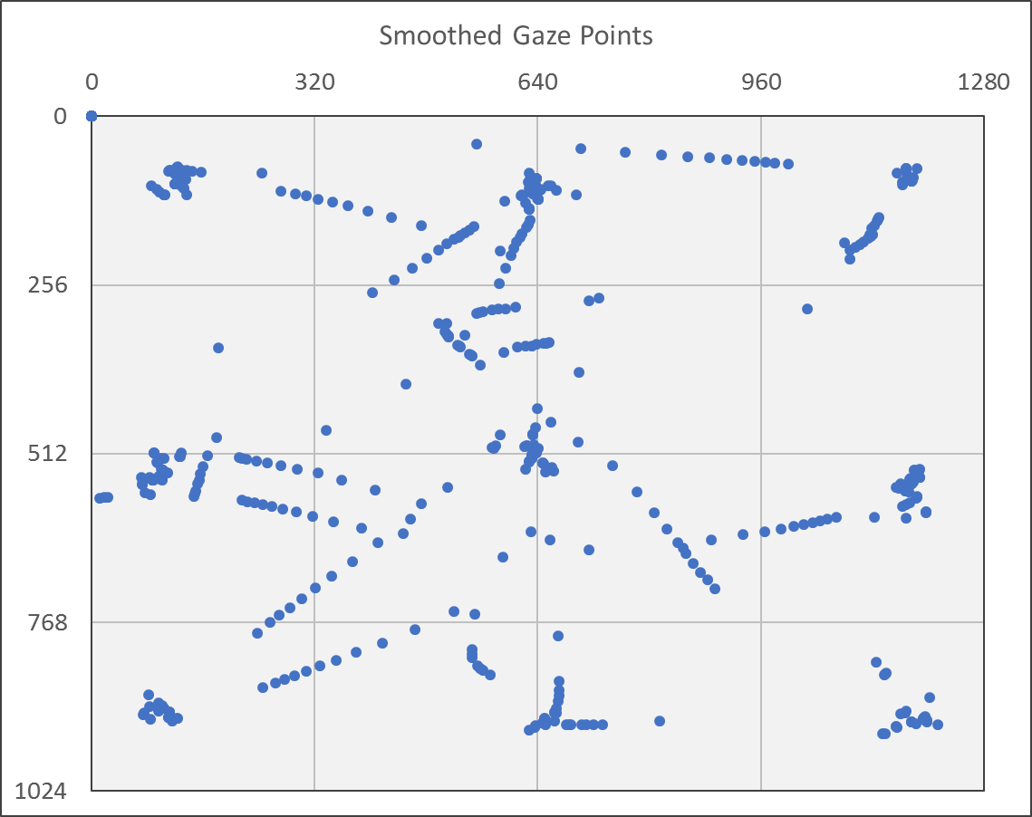
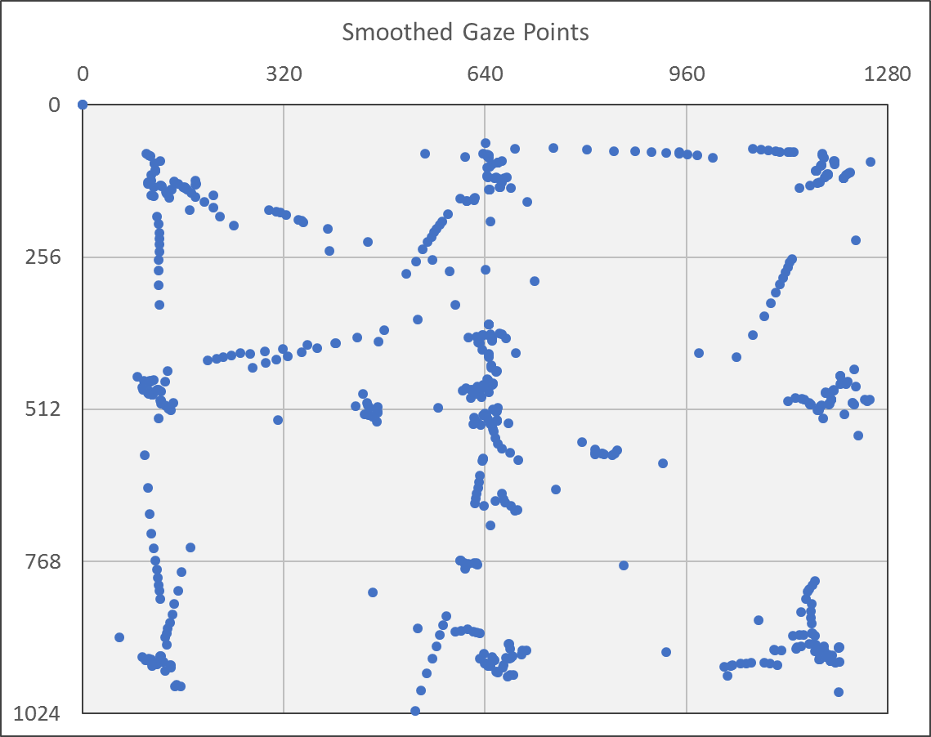
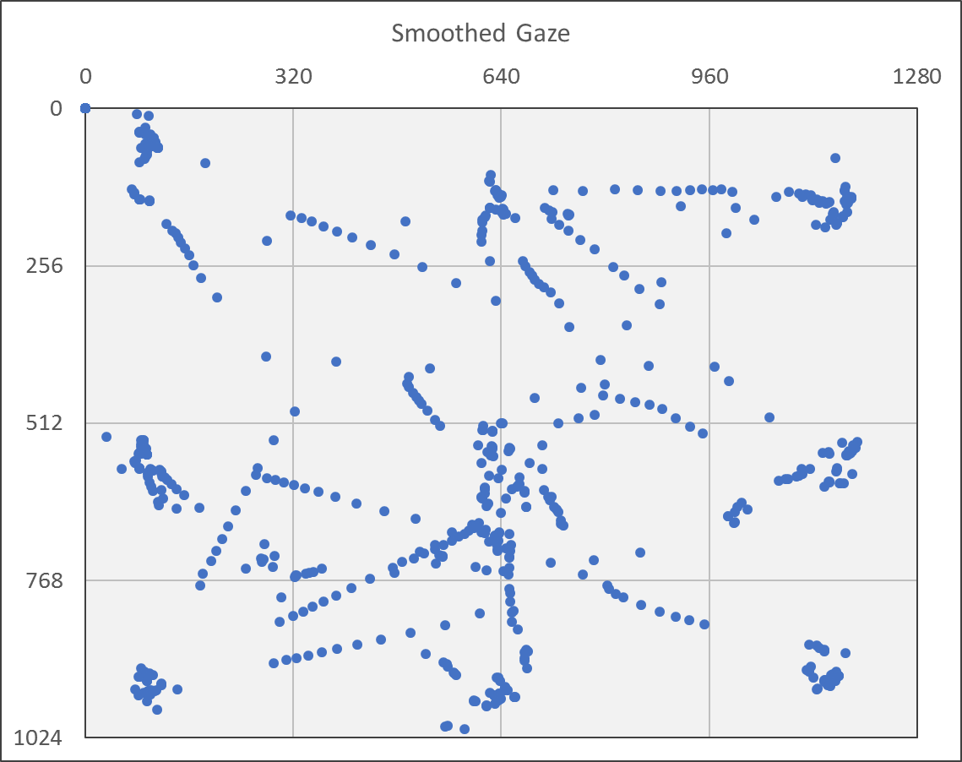
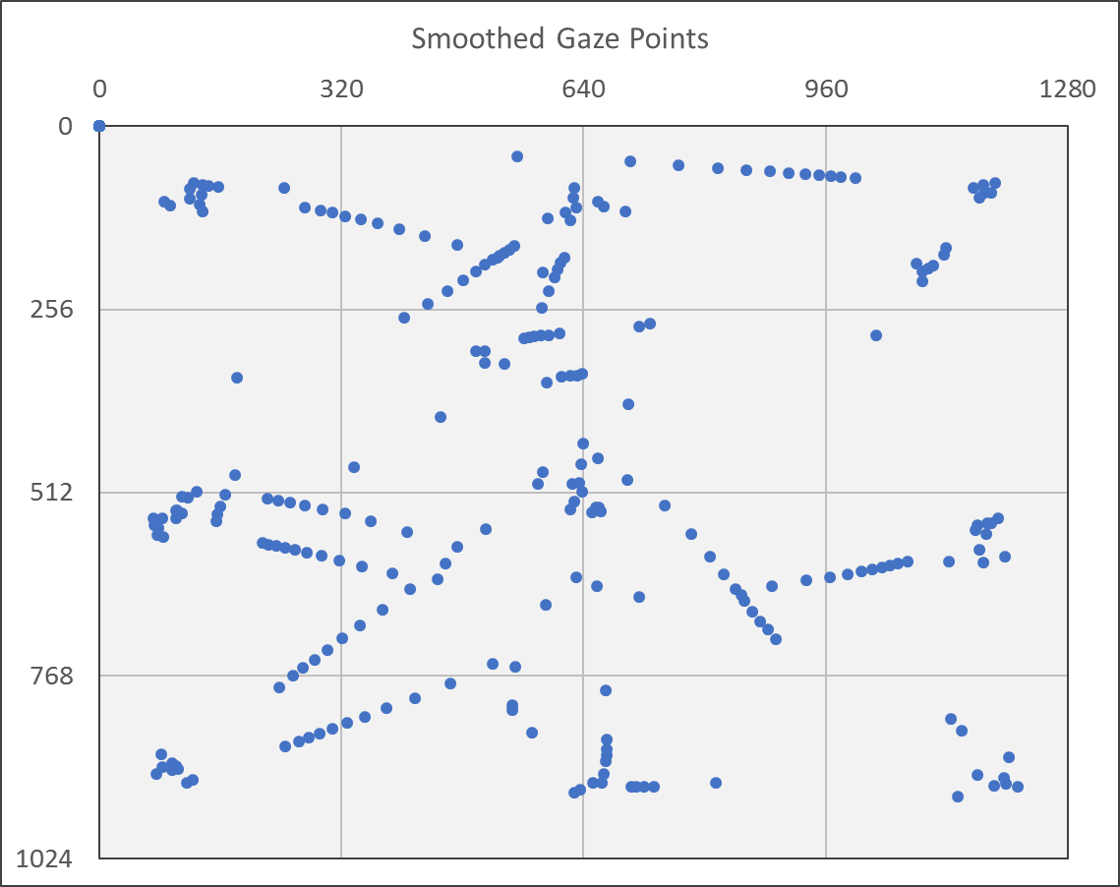
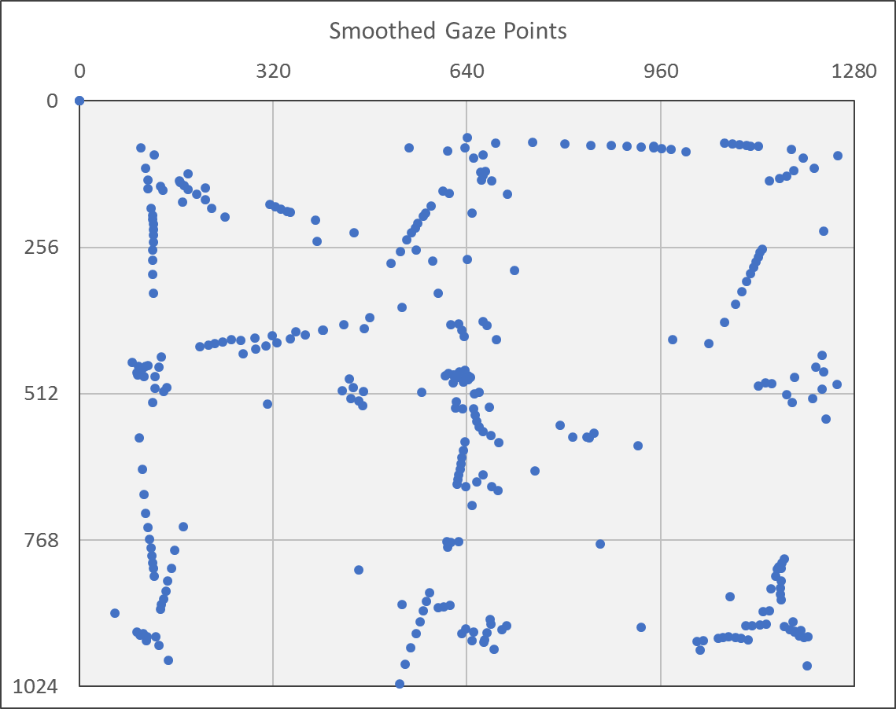
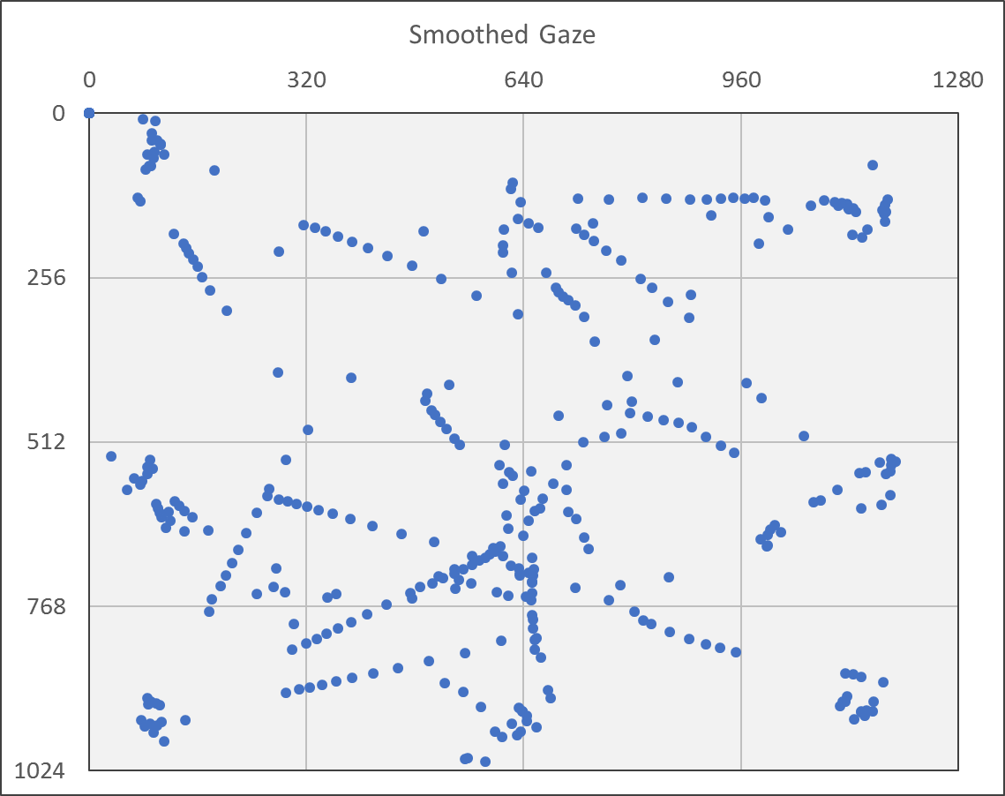
Smoothed Gaze Saccade Points
Fixation Test
Objective 1
Participant A
Participant B
Participant C
TBD
ET = false
DT = false
VT = false
Source: Analysis workbooks : smoothed

Slide 31
Fixation Point Accuracy
Fixation Test
Objective 2
 |  |  | Smoothed gaze point error during fixation
Target |  |  | Displacement on screen (pixels) |  |  | Visual angle (degrees)
 |  |  | Participant |  |  | Participant
ID | x | y | A | B | C | A | B | C
0 | 102 | 102 | 20.09 | 17.81 |  | 0.55 | 0.48
1 | 640 | 102 | 11.04 | 25.89 |  | 0.30 | 0.70
2 | 1178 | 102 | 21.89 | 12.11 |  | 0.60 | 0.33
3 | 102 | 512 | 15.25 | 28.35 |  | 0.41 | 0.77
4 | 640 | 512 | 13.29 | 8.75 |  | 0.36 | 0.24
5 | 1178 | 512 | 26.51 | 24.99 |  | 0.72 | 0.68
6 | 102 | 922 | 16.50 | 24.45 |  | 0.45 | 0.66
7 | 640 | 922 | 5.60 | 20.35 |  | 0.15 | 0.55
8 | 1178 | 922 | 11.47 | 10.99 |  | 0.31 | 0.30
Avg. | 640 | 512 | 15.75 | 19.25 |  | 0.43 | 0.52
TBD
TBD
TBD
TBD
Source: Analysis workbooks : accuracy

Slide 32
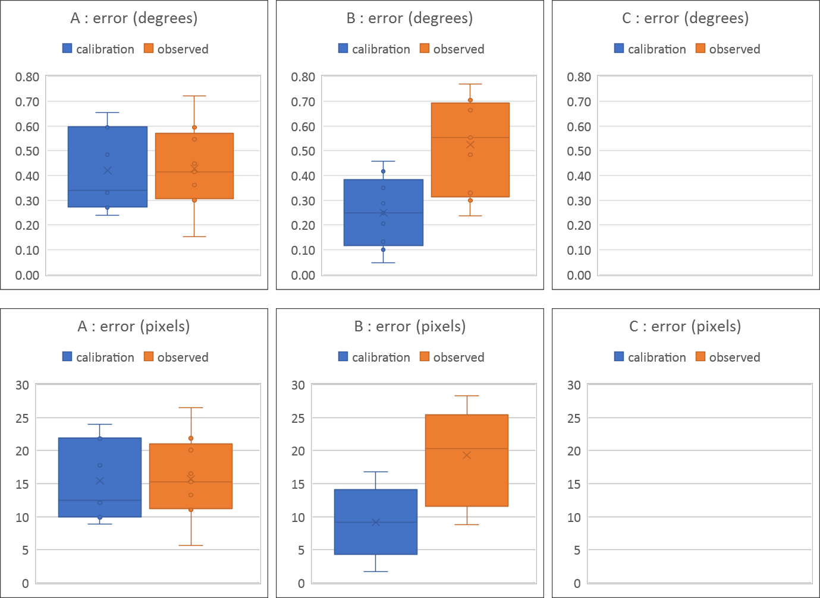
Fixation Point Accuracy
Fixation Test
Objective 2
TBD
Source: Analysis workbooks : accuracy

Slide 33
Fixation Point Accuracy
Fixation Test
Objective 2
Observed fixation point error vs. calibration accuracy reported by the eye tracker
Note: Locations of fixation test software (eyelib-test -f) gaze targets are within 1 pixel of the 3×3 array of calibration points used by EyeTribe UI (EyeTribe-UIWin)
 |  |  | Calibration accuracy |  |  | Observed error |  |  | Percent difference
ID | x | y | A | B | C | A | B | C | A | B | C
0 | 102 | 102 | 0.33° | 0.20° |  | 0.55° | 0.48° | ° | 49% | 81% | %
1 | 640 | 102 | 0.48° | 0.29° |  | 0.30° | 0.70° | ° | 47% | 84% | %
2 | 1178 | 102 | 0.34° | 0.46° |  | 0.60° | 0.33° | ° | 55% | 32% | %
3 | 102 | 512 | 0.59° | 0.25° |  | 0.41° | 0.77° | ° | 36% | 103% | %
4 | 640 | 512 | 0.65° | 0.42° |  | 0.36° | 0.24° | ° | 57% | 55% | %
5 | 1178 | 512 | 0.60° | 0.35° |  | 0.72° | 0.68° | ° | 19% | 64% | %
6 | 102 | 922 | 0.27° | 0.05° |  | 0.45° | 0.66° | ° | 48% | 174% | %
7 | 640 | 922 | 0.24° | 0.13° |  | 0.15° | 0.55° | ° | 45% | 123% | %
8 | 1178 | 922 | 0.27° | 0.10° |  | 0.31° | 0.30° | ° | 14% | 100% | %
Avg. | 640 | 512 | 0.42° | 0.25° |  | 0.43° | 0.52° | ° | 2% | 71% | %
 |  |  |  | ° |  |  | ° |  |  | %
TBD
TBD
TBD
TBD
TBD
TBD
Source: Analysis workbooks : accuracy

Slide 34
Object Fixations
Fixation Test
Objective 3
Fixation duration
The average fixation duration for each target should be equal to or greater than the target active duration of 750 ms. If the participant immediately fixated the target when it appeared until the moment it disappeared, the fixation duration would be the pre-active plus active target durations:
750 + 750 = 1,500 ms
Because the participant may fixate near a target location even when the target is not present, the fixation duration may even exceed 1,500 ms. However, the average per target and overall average should generally be in the range of 750-1,500 ms.
Fixation interval
Because the target order is randomized for each target cycle, the observed fixation interval is not expected to be the same for each target. Furthermore, the average of all target intervals may vary significantly between participants due to variability in the delay between the target cycles. However, the average of all target values for each participant may provide some confirmation that the fixation interval metric functions as anticipated. The theoretical average interval is a function of the number of targets and the duration of each target:
t_{int} = 9 targets · 1,500 ms = 13,500 ms

Slide 35
Object Fixations
Fixation Test
Objective 3
Model the relationship between fixation metrics and attention
Possible fixational measures of attention include the count of fixations of an object; the peak, average, or sum total fixation time duration; and response time until the first fixation of an object
Approach
Assess the consistency of fixation count and duration(?)
May need to use a different test...
ET and VT produce
more consistent and
accurate fixation
counts and durations
than DT (?)
...or...
Could just be DT
is more sensitive
than ET and VT (?)
 | Count of fixations on object |  |  | Average fixation duration (ms) |  |  | Average fixation interval (ms)
 | Participant |  |  | Participant |  |  | Participant
 | A | B | C | A | B | C | A | B | C
ET | 3.1 | 3.1 |  | 1,557 | 1,408 |  | 13,472 | 13,312
DT | 5.1 | 5.2 |  | 963 | 827 |  | 7,435 | 7,610
VT | 3.0 | 3.2 |  | 1,610 | 1,396 |  | 13,472 | 13,282
Average | 3.7 | 3.9 |  | 1,377 | 1,210 |  | 11,460 | 11,402
TBD
TBD
TBD
Source: Analysis workbooks : target

Slide 36
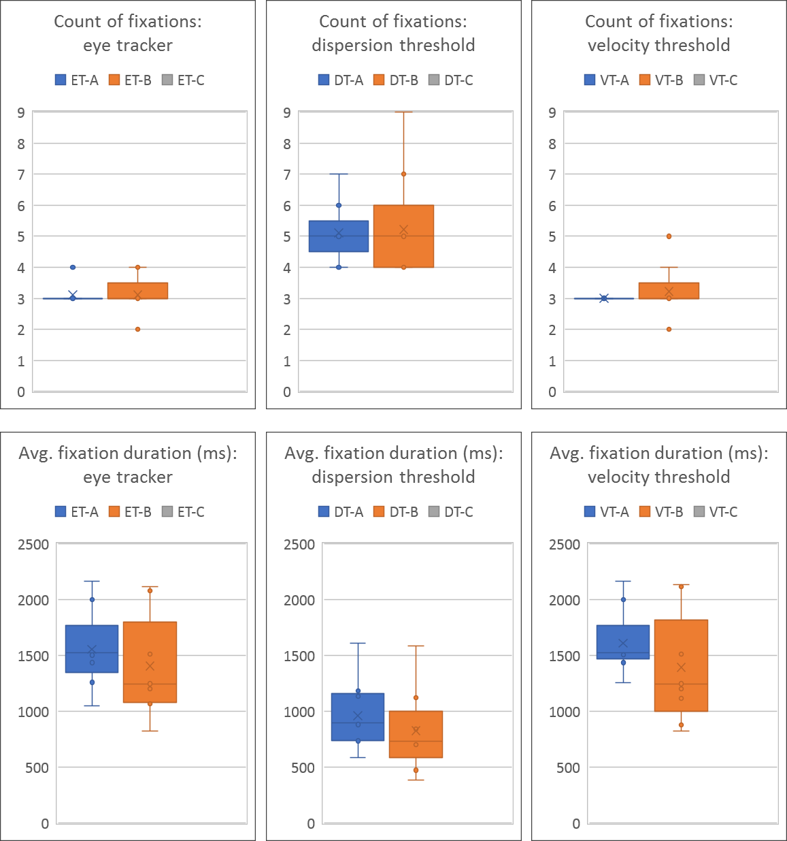
Object Fixations
Fixation Test
Objective 3
Compare fixation count and duration
results from ET, DT, and VT fixation detection
Source: Analysis workbooks : target

Slide 37
Test Bed Pictures
Fixation Test
Objective 4
TBD

Slide 38
Fixation Test Summary
Fixation Test
Conclusion
Fixation detection
Comparable performance?
Hypothesis: DT and VT work, but offer no apparent advantage over ET
Measure fixation point error
Average error: XX pixels (X.X° visual angle)
Model the relationship between fixation metrics and attention
Fixations on object (target)
Count of fixations for each target equals 3, one for each target sequence
Average fixation duration at each target is greater than the minimum of 1,000 ms
Interval between fixations is consistent with a sequence of 9 targets, repeated 3 times, with 2,000 ms per target
Capture pictures of experiment for use during dissertation defense

Slide 39
Attention and Workload Test

