Slide 1
Tracked Robot Design
Nathan Lucas
CARES Lab
Wayne State University

Slide 2
Outline
Hardware Design
Hardware Installation
Software
Software Build Guide
Backup

Slide 3
Hardware Design

Slide 4

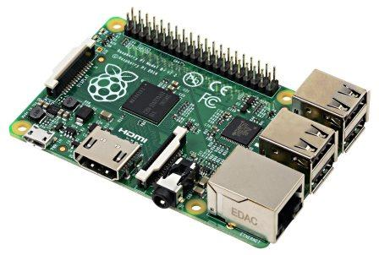
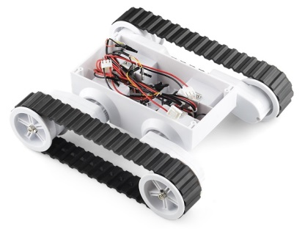

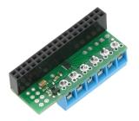


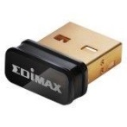
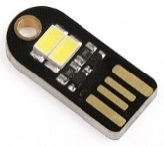

Components
Tracked Robot
Platform
Motor Driver
Power
Controller
Wireless
Dagu Rover 5
Tracked Chassis
DRV8835
Dual Motor
Driver Kit
6700 mAh
Li-ion
5200 mAh
Li-ion
Raspberry Pi 2 Model B
IEEE
802.11
Edimax
EW-7811Un
USB Wi-Fi
Module
16 GB
microSDHC
USB
100 mA
USB LED
Lamp
GPIO
5V power
3.3V power
PWM signals

Slide 5
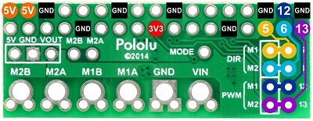
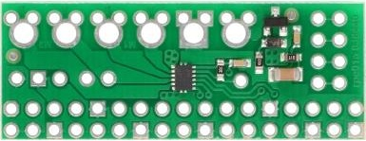
Motor Driver
Pololu DRV8835 Dual Motor Driver Kit for Raspberry Pi
DRV8835 dual H-bridge motor driver
FET for reverse battery protection
GPIO header
Optionally power Raspberry Pi through add-on regulator (not included)
https://www.pololu.com/product/2753
Python library
https://github.com/pololu/drv8835-motor-driver-rpi
Alternative
MC33926 motor driver board if higher current is needed
Parameter |  | Value
Supply voltage | Minimum | 1.5 | V
 | Maximum | 11 | V
Current (per channel) | Continuous | 1.2 | A
 | Max peak | 1.5 | A
PWM frequency | Maximum | 250 | kHz

Slide 6
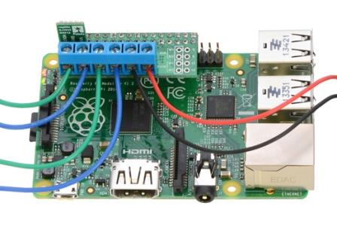
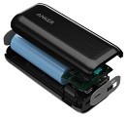
Power and Motor Control Concept
DRV8835 Dual
Motor Driver
Raspberry Pi 2B
Li-ion Battery (×2)
Motor 2
Motor 1

Slide 7
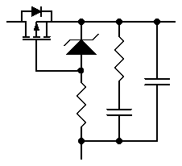
Power and Motor Control
DRV8835 Motor Driver Kit for Raspberry Pi
Voltage Regulator Interface
(Not Used)
3
5V
GPIO
5V
2
5V
2
GND
4
1
2.7-11.8V
Toggle
Switch
VOUT
Reverse Polarity
Protection
6
LED Lamp
2
~5V
9
VIN
14
+
–
1
20
GND
5.1 Ah
Li-ion
Battery
Pack
GND
25
30
34
DRV8835 Dual Low
Voltage H-Bridge IC
Motor 1
4
M1A
2
AOUT1
VM
1
3
M1B
3
AOUT2
12
VCC
17
3V3
Motor 2
2
M2A
4
BOUT1
10
1
5
M1DIR
29
GPIO5
M2B
BOUT2
M2DIR
8
31
GPIO6
6
M1PWM
9
32
GPIO12
13
GND
7
GND
M2PWM
33
GPIO13

Slide 8
Motor Driver Interface
Raspberry Pi
GPIO
J8
3V3
1
2
5V
5V
+5V
GPIO2
3
4
5V
Not Used
GPIO3
5
6
GND
GPIO4
7
8
GPIO14
GND
9
10
GPIO15
GPIO17
11
12
GPIO18
GPIO27
13
14
GND
GPIO22
15
16
GPIO23
+3V
VCC
3V3
17
18
GPIO24
GPIO10
19
20
GND
GPIO9
21
22
GPIO25
GPIO11
23
24
GPIO8
GND
25
26
GPIO7
GPIO0
27
28
GPIO1
Motor 1 Direction
M1DIR
GPIO5
29
30
GND
Motor 2 Direction
M2DIR
GPIO6
31
32
GPIO12
M1PWM
Motor 1 PWM
Motor 2 PWM
M2PWM
GPIO13
33
34
GND
GPIO19
35
36
GPIO16
GPIO26
37
38
GPIO20
GND
39
40
GPIO21

Slide 9
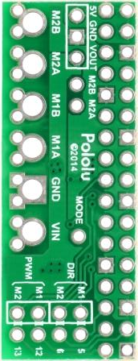
Motor Driver Interface
Housing
TE P/N
1744036-4
Header
TE P/N
1744048-4
5.08 mm (0.2 in) Pitch
2.54 mm (0.100 in) Pitch
1
Motor 2
(Right)
20 AWG
20 AWG
3×1 Socket Strip
Voltage Regulator
Interface (Not Used)
Motor 1
(Left)
20 AWG
20 AWG
1
Li-ion
Battery
–
26 AWG
+
26 AWG
Housing
TE P/N
1744036-2
Header
TE P/N
1744048-2
DRV8835 Motor
Driver Kit for
Raspberry Pi

Slide 10
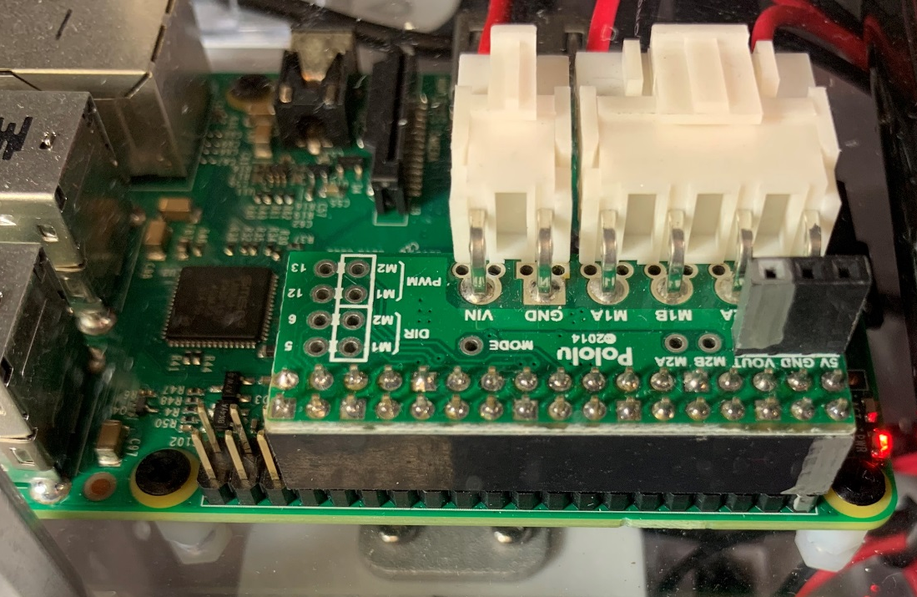
...
Battery Power
Motor Power
Motor Driver
GPIO Header
Hex Nut
Controller Standoff
Hex Nut

Slide 11
Hardware Installation

Slide 12
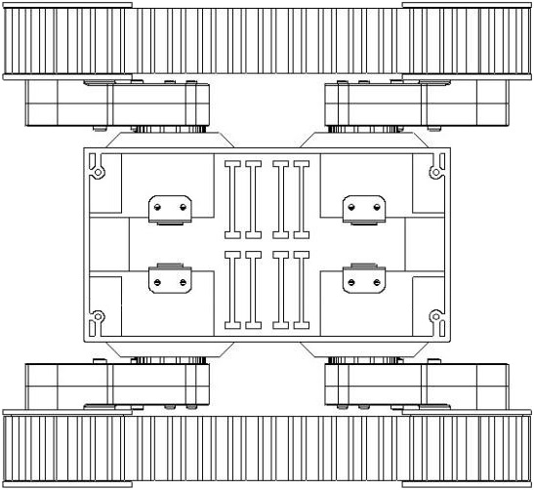
Wiring Connectors
Extract contacts
and reuse in motor
connector housing
Do NOT cut wires
Motor 2
FORWARD
Motor 1
TOP

Slide 13




Wiring Connectors
1
1
Note opposite
polarities
of motors
Motor 2
FORWARD
Motor 1
USB A
plug
5
4
USB cable
1
1
USB Micro-B
receptacle
Toggle
switch
USB A
receptacle

Slide 14
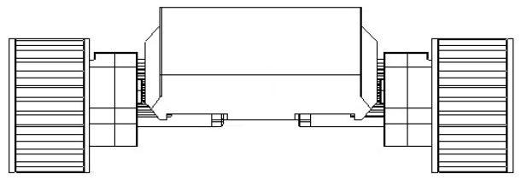
Mounting Holes
Motor 2
FORWARD
1
Tap #6-32 UNC (×4)
Motor 1
TOP
FRONT

Slide 15
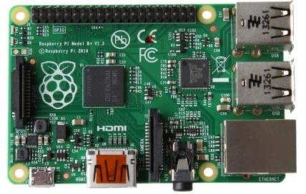
Controller Mount
Raspberry Pi 2B
58
49
56
85
TOP
FRONT

Slide 16
Controller Mount
Drill holes for
USB Micro-B
Breakout Board
Cut slot for
Motor Cable
Polycarbonate Sheet
203×254 mm (8×10 in)
(Makes 2 Mounting Plates)
USB
RPi 2B
Cut slot for
Toggle Switch
GPIO Header
Controller Mounting Plate
203×127 mm (8×5 in)
Drill holes to
Mount Controller
Drill holes
for attaching
Controller Mount
to Chassis
TOP
FRONT

Slide 17
Controller Mounting Plate
⌀ ?/? in (×2)
⌀ ?/? in (×5)
⌀ ?/? in (×4)
? in
Use USB Micro-B
breakout board
as a template for
marking holes
? in
5 in
? in
8 in
TOP

Slide 18
Controller Mounting Plate
Use Raspberry Pi board as
a template for marking holes
⌀ ?/? in
⌀ ?/? in (×4)
?
? in
? in
?
TOP

Slide 19
Controller Mount
Standoff, M2.5-0.45 × 6 mm, Nylon (×4)
under plate: Nut, M2.5-0.45, Nylon (×4)
RPi 2B
GPIO Header
Standoff, 6-32 × 1.5-in, Aluminum (×4)
TOP
FRONT

Slide 20
Controller Mount
Attach Controller with M2.5 Nylon Screws (×4)
TOP
FRONT

Slide 21


Motors and Power
USB cable
A plug
A plug
USB cable
Micro-B
plug
Micro-B
plug
Micro-B
receptacle
1
5
Motor 2
Toggle
switch
LED
lamp
Motor 1
USB A
receptacle

Slide 22


Motor Power Circuit
Screw
Solder
USB Micro-B
Receptacle
Nut
Controller
Mounting Plate
USB
Toggle Switch
Switch
Cutout
Controller
100 mA LED Lamp
USB A
Receptacle
Motor Power
Cable Slot
TOP
FRONT

Slide 23
Fiducial Mounting Plate
Polycarbonate Sheet
203×254 mm (8×10 in)
⌀ 9/64 in, and
Counter Sink (×4)
Screw, 6-32 × 3/8 in,
Flat Head, Zinc Plated (×4)
TOP
FRONT

Slide 24
Fiducial Mounting Plate
Polycarbonate Sheet
203×254 mm (8×10 in)
⌀ 9/64 in, and
Counter Sink (×4)
Screw, 6-32 × 3/8 in,
Flat Head, Zinc Plated (×4)
TOP

Slide 25
Software

Slide 26
Software Architecture
Motor Driver Interface
Python
Pololu_drv8835_rpi
socket
WiringPi2-Python
WiringPi
GPIO
USB
Motor Driver
Wi-Fi

Slide 27

Robot Control Network
Robot 1
192.168.2.101:64000
Robot 2
Robot Control
Server
Linksys
WRT54GL
192.168.2.102:64000
Robot 3
192.168.2.1
192.168.2.100
Robot 4
192.168.2.103:64000
192.168.2.104:64000

Slide 28
Communication
Control Server
Robot
Motor
Process
Accept Connection
Request Connection
Motor Command: 0,0
Motor Driver
Command: close
Terminate Process
Power
Process
Accept Connection
and Send Timestamp
Request Connection
Synchronize Timestamp
Query: batt
Not Implemented
Supply Voltage in mV
Response: 0000
Battery Voltage
Command: close
Terminate Process

Slide 29

Communication
Messages to Robot
Remote Access
PuTTY
Port 22 (0x16): Secure Shell (SSH)
Start processes (for testing only?)
Shutdown controller
Motor Command
Port 64000 (0xFA00)
Command: mL,mR
Set left and right motor speeds
Range: 0-1
Command: close
Terminate process
Battery Query
Port 64160 (0xFAA0)
Command: batt
Request battery voltage
Command: close
Terminate process
Messages from Robot
Battery Response
Port 64160 (0xFAA0)
Data: 0000
Battery voltage in mV
Not Implemented

Slide 30
Robot API
Messages to Robot
Remote Access
PuTTY
Port 22 (0x16): Secure Shell (SSH)
Start processes (for testing only?)
Shutdown controller
Port 64000 (0xFA00)
Motor speed
command: mL,mR
mL <int> left motor
mR <int> right motor
integer value range:
max 100 full speed forward
0 stopped
min -100 full speed reverse
example:
Close robot client
close
Battery query
Not Implemented
batt
Battery response
integer
battery voltage in mV
Not Implemented
100,100
0000

Slide 31
Motor Software Interface Options
Embed Python in C++ application
http://stackoverflow.com/questions/22497532
https://docs.python.org/2/extending/embedding.html
Use Python access to network services
https://docs.python.org/3/library/socket.html#module-socket
http://www.tutorialspoint.com/python/python_networking.htm
✗
✓

Slide 32
Motor Software
Control Server
Motor Driver Interface
Python application providing access via network socket
Python library for the Pololu DRV8835 Dual Motor Driver Kit for Raspberry Pi
Pololu_drv8835_rpi
GPIO
https://github.com/pololu/drv8835-motor-driver-rpi
WiringPi version 2 implements functions for managing IO expanders
WiringPi2-Python
GPIO access library for the BCM2835 used in the Raspberry Pi
[GNU LGPLv3]
WiringPi
https://github.com/Gadgetoid/WiringPi2-Python
http://wiringpi.com/
DRV8835 Dual
Motor Driver Kit
for Raspberry Pi

Slide 33
Software Build Guide

Slide 34
Hardware
Raspberry Pi (RPi) 2 Model B
https://www.raspberrypi.org/products/raspberry-pi-2-model-b/
Secure Digital (SD) memory card
4 GB or larger
Edimax EW-7811Un USB Wi-Fi module
Pololu DRV8835 Dual Motor Driver Kit for Raspberry Pi
https://www.pololu.com/product/2753
Peripherals (for software installation and configuration only)
Monitor
HDMI input or adapter (e.g., HDMI to DVI cable for monitor with DVI input
USB keyboard
USB mouse

Slide 35
Operating System
Format SD card as FAT
SD Formatter from SD Association
https://www.sdcard.org/downloads/formatter_4/
Raspberry Pi (RPi) New Out Of the Box Software (NOOBS)
https://www.raspberrypi.org/documentation/installation/noobs.md
Download NOOBS and extract files
https://www.raspberrypi.org/downloads/noobs/
Copy extracted files to SD card (~20 minutes)
Insert SD card into RPi
Connect screen (HDMI), Ethernet (RJ45), Wi-Fi module, keyboard, and mouse
Install Raspbian
Power on RPi
Select install options
OS Raspbian
Language English (US)
Keyboard us
Click Install (~10 minutes)

Slide 36
Configuration
Configuration:
~ $ sudo raspi-config
Password: Follow on-screen instructions
Boot Option: B1 Console
Internationalisation
Locale: en_US.UTF-8 UTF-8
Default: en_US.UTF-8 UTF-8
Timezone: US, Eastern
Advanced Options: ..
A2 Hostname: e.g., rpi-2b-01
A4 SSH: Enabled
Reboot:
~ $ sudo shutdown –r now
Reference:
https://www.raspberrypi.org/documentation/configuration/raspi-config.md

Slide 37
Update Software
Update system packages:
~ $ sudo aptitude update
Update installed packages:
~ $ sudo aptitude upgrade
Update firmware:
~ $ sudo rpi-update

Slide 38
Install Libraries
Download and install Python 3.
~ $ sudo aptitude install python3-dev python3-pip
Download and install WiringPi-Python.
~ $ sudo pip install wiringpi
Download and install Pololu_drv8835_rpi.
~ $ git clone https://github.com/pololu/drv8835-motor-driver-rpi.git
~ $ cd drv8835-motor-driver-rpi
~ $ sudo python setup.py install
Reference:
https://github.com/pololu/drv8835-motor-driver-rpi

Slide 39
Wireless Configuration
Update interfaces configuration file before updating router DHCP routing list:
~ $ sudo nano /etc/network/interfaces
auto lo
iface lo inet loopback
iface eth0 inet manual
allow-hotplug wlan0
iface wlan0 inet manual
wpa-conf /etc/wpa_supplicant/wpa_supplicant.conf
allow-hotplug wlan1
iface wlan0 inet manual
wpa-conf /etc/wpa_supplicant/wpa_supplicant.conf
Reference:
https://www.raspberrypi.org/forums/viewtopic.php?f=28&t=50312

Slide 40
Wireless Configuration
Update wpa_supplicant.conf configuration file:
~ $ sudo nano /etc/wpa_supplicant/wpa_supplicant.conf
ctrl_interface=DIR=/var/run/wpa_supplicant GROUP=netdev
update_config=1
country=GB
network={
ssid=“dd-wrt”
psk=“********”
proto=RSN
key_mgmt=WPA-PSK
pairwise=CCMP
group=CCMP
auth_alg=OPEN
}
network={
ssid=“WSU-ENG”
key_mgmt=NONE
}
Reboot:
~ $ sudo shutdown –r now

Slide 41
Wireless Configuration
Update router DHCP routing list
Status > LAN
Copy MAC Address
Services > Services
Under DHCP Server
Click Add
Populate MAC Address, Host Name, and IP Address fields
At the bottom of the page, click Apply Settings

Slide 42
Wireless Configuration
Edit interfaces configuration file after updating router DHCP routing list:
~ $ sudo nano /etc/network/interfaces
auto lo
iface lo inet loopback
iface eth0 inet manual
allow-hotplug wlan0
#iface wlan0 inet manual
iface wlan0 inet dhcp
wpa-conf /etc/wpa_supplicant/wpa_supplicant.conf
allow-hotplug wlan1
iface wlan0 inet manual
wpa-conf /etc/wpa_supplicant/wpa_supplicant.conf
Reboot:
~ $ sudo shutdown –r now

Slide 43
Software Installation
FileZilla
File > Site manager
Protocol SFTP
Host IP address
Port 22
Logon Type Normal
User pi
Password cares
Click Connect

Slide 44
Launch Script
Create a launch script:
~ $ sudo nano launch-robot-1.sh
#!/bin/sh
# launch-robot-1.sh
echo `date +"%Y-%m-%d %H:%M:%S"` `hostname`
#sleep 20
cd /
cd /home/pi
echo `date +"%Y-%m-%d %H:%M:%S"` robot-client-1.py
sudo python3 robot-client-1.py $1
sudo shutdown –h now
Make script executable:
~ $ chmod 755 launch-robot-1.sh

Slide 45
Schedule Script Task
Create log directory:
~ $ mkdir log
Schedule cron task:
~ $ sudo crontab -e
@reboot sh /home/pi/launch-robot-1.sh >/home/pi/log/cronlog 2>&1
Execute command every boot | @reboot cmd
Redirect standard output to overwrite log file | cmd > logfile
Redirect standard output to append log file | cmd >> logfile
Redirect standard output and standard error | cmd >> logfile 2>&1
Reboot:
~ $ sudo shutdown –r now
References:
https://help.ubuntu.com/community/CronHowto
http://www.instructables.com/id/Raspberry-Pi-Launch-Python-script-on-startup/
http://www.unixgeeks.org/security/newbie/unix/cron-1.html

Slide 46
Raspberry Pi Cheat Sheet
Environment | Command
Start graphical interface | startx
Reboot | sudo shutdown –r now -or- sudo reboot
Shutdown | sudo shutdown –h now -or- sudo halt
Hardware | Command
CPU information, including serial number | cat /proc/cpuinfo -also- lscpu
Memory | cat /proc/meminfo
Memory available | free –o -h
Disk partitions | cat /proc/partitions
Linux kernel version, distribution number, gcc version, etc. | cat /proc/version
List attached devices | lsusb
Processes | Command
Find process number | ps aux | grep /path/script.py
Stop process no. 1984 | sudo kill 1984
Stop Python script | Ctrl + Shift + \
Task | Command
Edit text file | nano ~/path/file sudo nano /path/file
Get IP address | hostname –I -or- ip addr
Update packages | sudo aptitude update sudo aptitude upgrade
Update firmware | sudo rpi-update

Slide 47
Robot Information
Robot | Brand | Model | Serial # | Hostname | IP Address | User | Password
1 | Raspberry Pi | 2B | 00000000ff954578 | rpi-2b-01 | 192.168.2.101 | pi | cares
2 | Raspberry Pi | 2B | 000000000344931c | rpi-2b-02 | 192.168.2.102 | pi | cares
3 | Raspberry Pi | 2B | 000000001e245a0a | rpi-2b-03 | 192.168.2.103 | pi | cares
4 | Raspberry Pi | 2B | 0000000052c2172e | rpi-2b-04 | 192.168.2.104 | pi | cares
test | Raspberry Pi | B+ | 00000000e92a74ee | rpi-bp-01 | 192.168.2.*** | pi | cares

Slide 48
Backup

Slide 49
References
Pololu DRV8835 Dual Motor Driver Kit for Raspberry Pi B+
https://www.pololu.com/product/2753
P-MOSFET Reverse Polarity Protection
http://myelectrons.com/mosfet-reversed-protection/
http://hackaday.com/2011/12/06/reverse-voltage-protection-with-a-p-fet/
Raspberry Pi B+ GPIO pinout
http://pi.gadgetoid.com/pinout

Slide 50
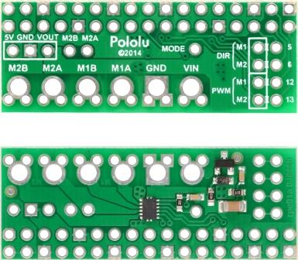
Motor Driver PCB
Pitch: 4.5-5.7 mm
2.54 mm
(0.1 in)
2.54 mm
(0.1 in)
5.08 mm
(0.2 in)
1.27 mm
(0.05 in)
5 mm
4.49 mm
5.67 mm
16.51 mm
(0.65 in)
43.18 mm
(1.7 in)
3:1 scale

Slide 51
Power and Motor Control
S7V7F5 switching 5V regulator with lab power supply at 7.2 V
Idle: 200-230 mA
Raspberry Pi B+, HDMI, keyboard, mouse, Wi-Fi, DRV8835 motor driver
Dagu Rover 5 platform with lab power supply at 7.2 V
No track resistance: 350 mA
With track resistance: 400 mA
Platform moving on level surface
1140 gram payload

Slide 52
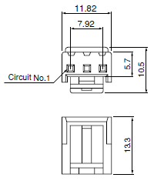
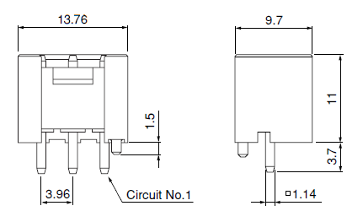
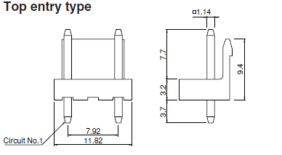
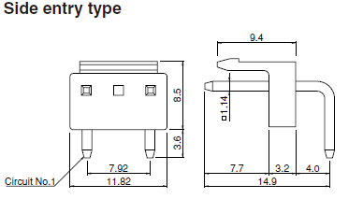
JST Connectors
VH Housing
VH Shrouded Header
VA Locking Header
Contact | Wire Size
SVH-21T-P1.1 | 18-22 AWG
SVH-41T-P1.1 | 16-20 AWG
Contact | Hole Size
1.14 mm Square Pin | 1.65 mm
Contact | Hole Size
1.14 mm Square Pin | 1.65 mm
VHR-3N
B3P-VH-FB-B
B2P3-VH
B2P3S-VH
VH Header
Circuits | Locking |  | Shrouded
 | Top Entry | Side Entry | Top Entry
3 | B3P-VH | B3PS-VH | B3P-VH-FB-B
6 | B6P-VH | B6PS-VH | B6P-VH-FB-B

Slide 53
JST Connectors
NV Housing
XA Housing
Contact | Wire Size
SVH-21T-P1.1 | 18-22 AWG
SVH-41T-P1.1 | 16-20 AWG
Contact | Wire Size
SXA-001T-P0.6 | 22-28 AWG
SXA-01T-P0.6 | 20-24 AWG
SXA-001T-P0.6L | 22-26 AWG

Slide 54
Robot
FRONT
1:2 SCALE
REAR

Slide 55
Drawings
USB A plug
USB Micro-B plug
5
1
4
3
2
1
5
4
3
2
1
USB A receptacle
USB Micro-B receptacle
1
5
1
2
3
4
1
2
3
4
5
USB Micro-B
receptacle
breakout board
LED lamp

Slide 56
References
Raspberry Pi Mounting Hole Positions and Template. http://www.raspberrypi-spy.co.uk/2012/11/raspberry-pi-mounting-hole-positions-and-template/

Slide 57
Wi-Fi Troubleshooting
https://www.raspberrypi.org/forums/viewtopic.php?f=28&t=44044
1) Check whether the WiFi stick is being picked up at all
~ $ sudo lsusb
Bus 001 Device 002: ID 0424:9512 Standard Microsystems Corp.
Bus 001 Device 001: ID 1d6b:0002 Linux Foundation 2.0 root hub
Bus 001 Device 003: ID 0424:ec00 Standard Microsystems Corp.
Bus 001 Device 004: ID 7392:7811 Edimax Technology Co., Ltd EW-7811Un 802.11n Wireless Adapter [Realtek RTL8188CUS]
2) Check whether the modules loaded
~ $ sudo lsmod
Module Size Used by
snd_bcm2835 21149 0
snd_pcm 90778 1 snd_bcm2835
snd_seq 61097 0
snd_seq_device 7209 1 snd_seq
snd_timer 23007 2 snd_pcm,snd_seq
snd 66325 5 snd_bcm2835,snd_timer,snd_pcm,snd_seq,snd_seq_device
joydev 9766 0
evdev 11000 6
8192cu 569561 0
Uio_pdrv_genirq 3666 0
uio 9897 1 uio_pdrv_genirq

Slide 58
Wi-Fi Troubleshooting
3) Check the WiFi NIC
~ $ ifconfig -a
wlan0 Link encap:Ethernet HWaddr 74:da:38:0a:21:22
UP BROADCAST MULTICAST MTU:1500 Metric:1
RX packets:0 errors:0 dropped:0 overruns:0 frame:0
TX packets:0 errors:0 dropped:0 overruns:0 carrier0
collisions:0 txqueuelen:1000
RX bytes:0 (0.0 B) TX bytes (0.0 B)
4) Check the WiFi configuration
~ $ cat /etc/network/interfaces
auto lo
iface lo inet loopback
eface eth0 inet dhcp
allow-hotplug wlan0
iface wlan0 inet manual
wpa-conf /etc/wpa_supplicant/wpa_supplicant.conf
iface default inet dhcp

