Slide 1
Hardware

Slide 2
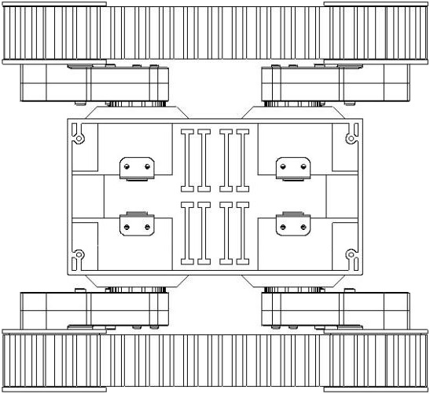
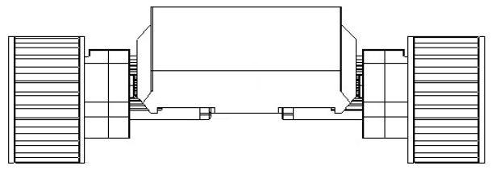
Camera Mount
Mount camera inside chassis?
24
?
TOP
FRONT

Slide 3
Camera Mount
REF: Chassis Wall ~2-3 mm Thick
REF: Camera PCB ~1 mm Thick
Screw, M2-0.4 × 6 mm, Nylon (×8)
Standoff, M2-0.4 × 6 mm, Brass (×4)
24
?
Pi NOIR Camera
Guard to protect camera?
Mount camera inside chassis?
TOP
FRONT

Slide 4
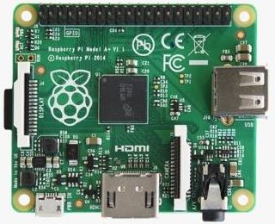
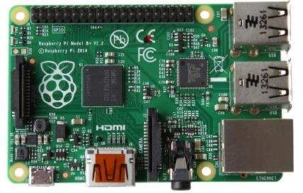
Controller Mount
Raspberry Pi A+
Raspberry Pi B+
58
58
49
56
49
56
65
85
TOP
FRONT

Slide 5
Controller Mount
Material?
Controller
Mounting Plate
170×90 mm
(6.7×3.5 in)
? Office Depot black plastic clipboard 6”×9” (1 ea. $3.99)
TOP
FRONT

Slide 6
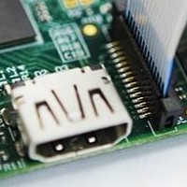
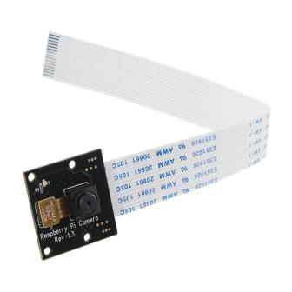
Camera Ribbon Cable
+
–
Insert ribbon cable with silver contacts toward HDMI connector

Slide 7
Controller and Camera
58
25
2
23.9
9.35
49
56
16.2
Pi NOIR Camera
85
4× M2 Mounting Holes
Raspberry Pi B+
PCB ~1 mm thick
4× M2.5 Mounting Holes
6 mm from face of camera to reverse side of the PCB

Slide 8
Robot
+
–
FRONT
1:2 SCALE
REAR

Slide 9
Software

Slide 10
Software Architecture
Application
Motor Driver Interface
Image Processing
Language
Python
Library
Pololu_drv8835_rpi
socket
OpenCV-Python
WiringPi2-Python
bcm2835-v4l2
MMAL
WiringPi
OpenMax
Interface
GPIO
USB
CSI
Hardware
Motor Driver
Wi-Fi
Pi NoIR Camera

Slide 11
Image Processing Options
Video Capture
Video4Linux (V4L2) driver bcm2835-v412
https://www.raspberrypi.org/forums/viewtopic.php?t=62364
http://www.ics.com/blog/raspberry-pi-camera-module
http://raspberrypi.stackexchange.com/questions/17068
http://raspberrypi.stackexchange.com/questions/28003
http://raspberrypi.stackexchange.com/questions/24262
https://github.com/raspberrypi/linux/blob/rpi-3.10.y/Documentation/video4linux/bcm2835-v4l2.txt
https://www.raspberrypi.org/forums/viewtopic.php?f=43&t=65026
RaspiCam
raspistill
raspivid
Picamera
Pure Python interface to RPi Camera
Image Processing
OpenCV
Python bindings / interface for OpenCV
Real time image capture
Image processing (brightness, contrast, thresholds, etc.)
Object recognition (faces, bodies, etc.)
Recognition of homogenous characteristics (blob)
SimpleCV
Python
Easy to use
Custom
C/C++ or Python
✓
✓
✗
✗
✗
✗

Slide 12
Camera Software
Control Server
Image Processing
Python application providing access via network socket
Fiducial marker detection and tracking coordinates
Library of OpenCV bindings
OpenCV-Python
bcm2835-v4l2
Video4Linux (V4L2) driver
CSI-2
Broadcom Multi-Media Abstraction Layer
MMAL
OpenMAX
Open Media Acceleration
Camera Serial Interface 2 Specification
Pi NoIR Camera
http://elinux.org/Rpi_Camera_Module

Slide 13
Video4Linux (V4L2)
Load module:
sudo modprobe bcm2835-v4l2
Enumerate controls the driver exposes:
v4l2-ctl --list-ctrls
Take a picture to test:
v4l2-ctl --set-fmt-video=width=2592,height=1944,pixelformat=3
v4l2-ctl --stream-mmap=3 --stream-count=1 --stream-to=test1.jpg
Load module on boot:
sudo nano /etc/modules
bcm2835-v4l2
Flip image:
V4l2-ctl –-set-ctrl=vertical_flip=1
V4l2-ctl –c vertical_flip=1

Slide 14
OpenCV-Python
Installation
Install Cmake
sudo apt-get update
sudo apt-get install cmake
Install OpenCV
sudo apt-get update
sudo apt-get install libopencv-dev
sudo apt-get install pyton-opencv
Tutorials
http://docs.opencv.org/master/d6/d00/tutorial_py_root.html
http://docs.opencv.org/master/dd/d43/tutorial_py_video_display.html
http://docs.opencv.org/master/d7/d4d/tutorial_py_thresholding.html
API documentation
http://docs.opencv.org/modules/highgui/doc/reading_and_writing_images_and_video.html
http://docs.opencv.org/modules/highgui/doc/user_interface.html

Slide 15
OpenCV-Python
Import modules
import sys
import time
import cv2
Initialize video capture
device_index = 0 # assume only one camera connected
capture = cv2.VideoCapture(device_index) # create video capture object
time.sleep(1) # wait for initialization
capture.set(3, 640) # frame width
capture.set(4, 480) # frame height
Capture and process frames
while True:
ret,frame = capture.read() # grab and decode next video frame
gray = cv.cvtColor(frame, cv2.COLOR_BGR2GRAY) # grayscale convert
ret,thresh = cv2.threshold(gray,127,255,cv2.THRESH_BINARY) # threshold image
cv2.imshow("frame", thresh) # display image
if cv2.waitKey(1) & 0xFF == 27: # check if user pressed 'Esc' key
break
Free resources at exit
capture.release() # close capturing device
cv.destroyAllWindows() # close window and de-allocate associated memory

Slide 16
Matrix Barcode Detection
Process a single image
~0.02 second (process image)
~0.03 second (process image, draw contours)
~0.05 second (process image, draw contours, print debug messages)
640×480 (VGA 4:3)
13 fps (no processing)
4 fps (CPU 43%)
5 fps (CPU 54%)
6 fps (CPU ~65%)
7 fps (CPU ~75%, total CPU 100%)
480×270 (HVGA 16:9)
7 fps (CPU 37%)
10 fps (CPU 55%)
15 fps (CPU 80%, total CPU 100%)
320×240 (QVGA 4:3)
10 fps (CPU 38%)
15 fps (CPU 58%)
20 fps (CPU ~75%)
ncurse

Slide 17
AprilTags
Install dependencies for AprilTags
sudo apt-get install subversion cmake libopencv-dev libeigen3-dev libv4l-dev
Check out AprilTags from the public svn repository
svn co https://svn.csail.mit.edu/apriltags
The AprilTags library uses the pods build system in connection with cmake
cd apriltags
make
After compiling, run the example program
./build/bin/apriltags_demo
References
Installation instructions: http://people.csail.mit.edu/kaess/apriltags/
Main website: http://april.eecs.umich.edu/wiki/index.php/AprilTags

Slide 18
Fiducial Marker Options
✓
AprilTags
apriltags_demo
Raspberry Pi B+, 640×480: ~0.7 fps
Raspberry Pi 2 B, 640×480, detecting 3 fiducials: ~2.5 fps (24% CPU)
Raspberry Pi 2 B, 320×240, detecting 3 fiducials: ~8.5 fps (24% CPU)
Matrix Barcode
Acceptable frame rate and detection reliability
✗

Slide 19
RaspiCam
Three command line driven applications comprise RaspiCam
raspistill and raspistillyuv capture images
raspivid captures video
RaspiCam takes advantage of Multi-Media Abstraction Layer (MMAL) API
Broadcom specific API used only for Videocore 4 systems
Runs over OpenMAX
Use up to four OpenMax (MMAL) components
camera – used by all 3 applications
encoder
raspistill uses Image Encode component
raspistillyuv does not use an encoder
raspivid uses Video Encode component
preview
optionally used full screen or directed to specific rectangular area of the display
null_sink
“absorbs” preview frames if preview is disable

Slide 20
Camera Software
RaspiCam
raspberrypi\userland\host_applications\linux\apps\raspicam
Broadcom Host
raspberrypi\userland\host_applications\linux\libs\bcm_host
Multi-Media Abstraction Layer (MMAL)
raspberrypi\userland\interface\mmal
VideoCore OS Abstraction Layer (VCOS)
raspberrypi\userland\interface\vcos

Slide 21
Camera Software
RaspiCam Dependencies
Standard libraries
<ctype>
<stdio>
<stdlib>
<string>
<memory>
BSD
<sysexits.h>
POSIX
<semaphore.h>
Broadcom
bcm_host.h
Multi-Media Abstraction Layer (MMAL)
interface/mmal/mmal.h
interface/mmal/mmal_logging.h
interface/mmal/mmal_buffer.h
interface/mmal/util/mmal_util.h
interface/mmal/util/mmal_util_params.h
interface/mmal/util/mmal_default_components.h
interface/mmal/util/mmal_connection.h
VideoCore OS Abstraction Layer
interface/vcos/vcos.h

