Slide 1

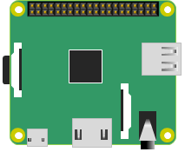
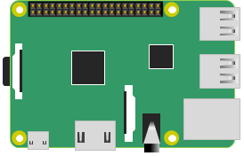
Illustrations

Slide 2
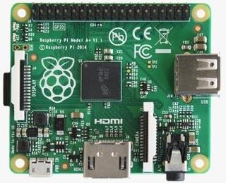
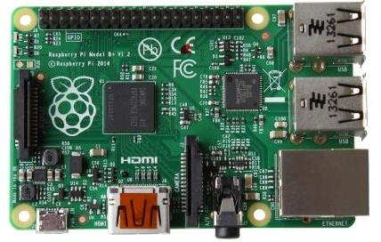
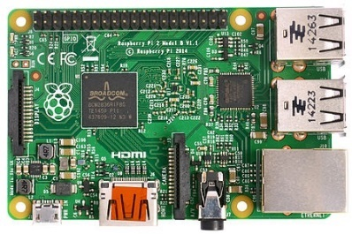
Comparison
Raspberry Pi A+
Raspberry Pi B+
Raspberry Pi 2
58
58
58
49
56
49
56
49
56
65
85
85
700 MHz single-core
ARM1176JZF-S CPU
VideoCore IV GPU
256 MB RAM
200 mA (1.0 W)
1 USB port
700 MHz single-core
ARM1176JZF-S CPU
VideoCore IV GPU
512 MB RAM
600 mA (3.0 W)
4 USB ports
Ethernet port
900 MHz quad-core
ARM Cortex-A7 CPU
VideoCore IV GPU
1 GB RAM
800 mA (4.0 W)
4 USB ports
Ethernet port

Slide 3
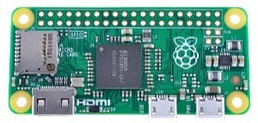
Comparison
Raspberry Pi A+
Raspberry Pi B+
Raspberry Pi 2
Raspberry Pi Zero
58
58
58
58
23
30
49
56
49
56
49
56
65
65
85
85
700 MHz single-core
ARM1176JZF-S CPU
VideoCore IV GPU
256 MB RAM
200 mA (1.0 W)
1 USB port
700 MHz single-core
ARM1176JZF-S CPU
VideoCore IV GPU
512 MB RAM
600 mA (3.0 W)
4 USB ports
Ethernet port
900 MHz quad-core
ARM Cortex-A7 CPU
VideoCore IV GPU
1 GB RAM
800 mA (4.0 W)
4 USB ports
Ethernet port
1 GHz single-core
ARM1176JZF-S CPU
VideoCore IV GPU
512 MB RAM
160 mA (0.8 W)
1 USB port

Slide 4
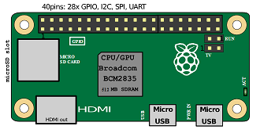
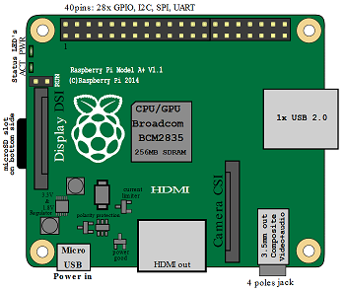
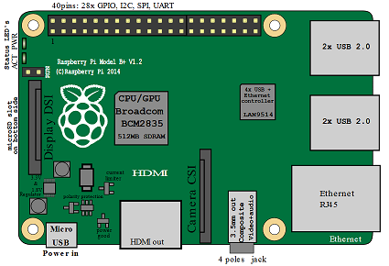
Comparison

Slide 5
Comparison

Slide 6
Raspberry Pi and Pi Camera
58
25
2
23.9
9.35
49
56
16.2
Pi NOIR Camera
85
4× M2 Mounting Holes
Raspberry Pi B+
PCB ~1 mm thick
4× M2.5 Mounting Holes
6 mm from face of camera to reverse side of the PCB

Slide 7
GPIO Header
RPi Zero
RPi
B+/
2B
RPi 1 A+

Slide 8
